Slide 1
Design of ultrasensitive sensors
BS Project Midterm Presentation
Nitanshu Bhagawat Kate
Roll: 17166, Email: nitanshu17@iiserb.ac.in
Electrical Engineering and Computer Science (EECS) Dept.
Indian Institute of Science Education and Research (IISER) Bhopal
Advisor: Dr. Kuntal Roy, Email: kuntal@iiserb.ac.in
Team:
Siddharth Sethi, UG Student
M Mohanlal Naik, PhD Student
Priyesh Kumar, PhD Student

Slide 2
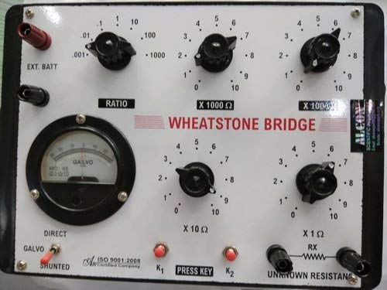
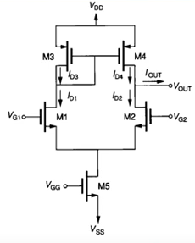
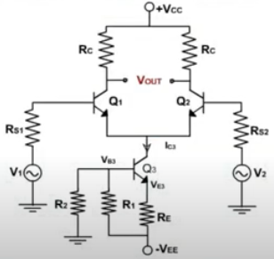
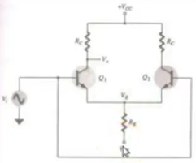
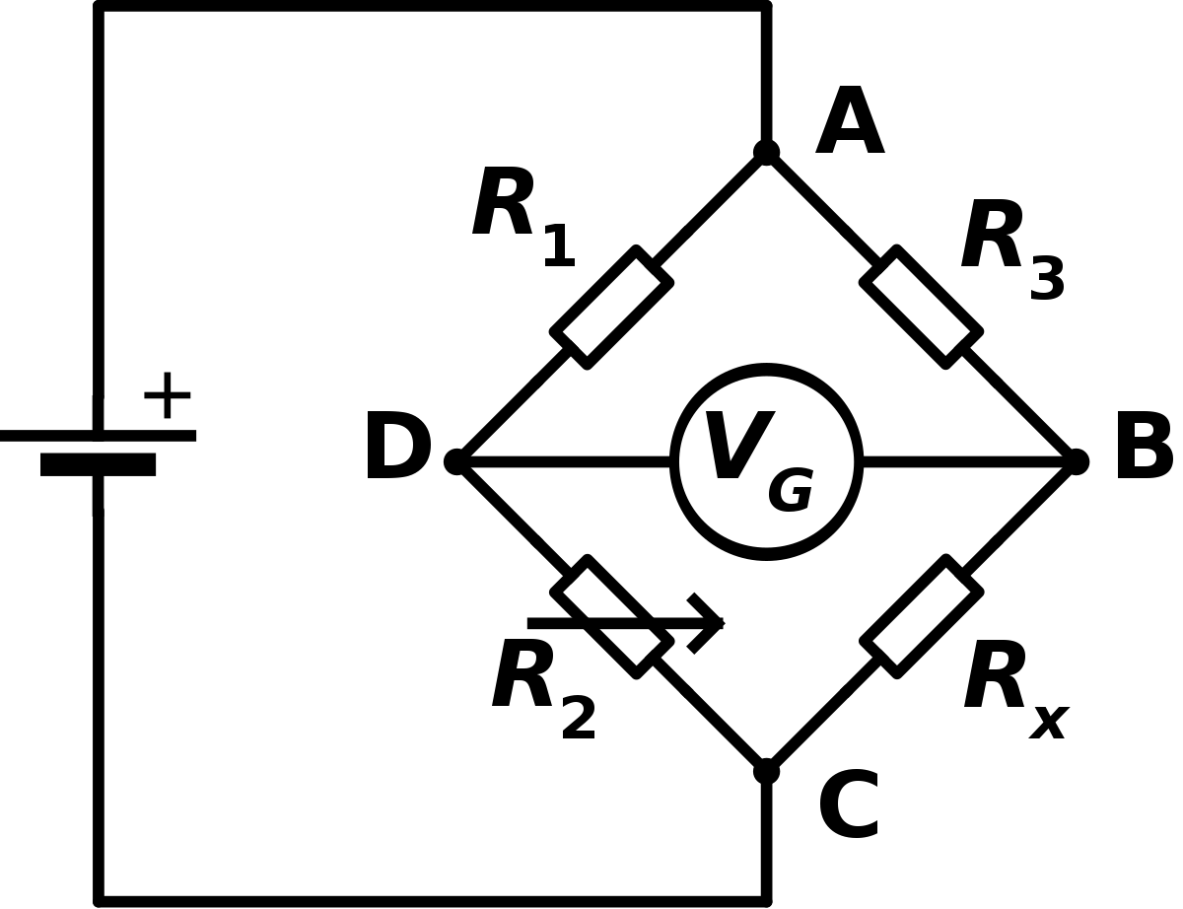
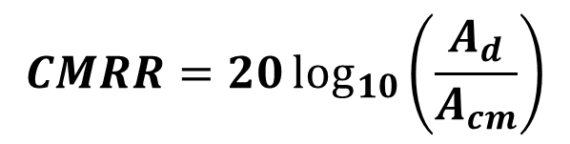
Differential/Operational amplifiers
Noise-cancellation
Differential amplifiers
Operational amplifiers
$$CMRR=20\log_{10}\left(\frac{A_{d}}{A_{cm}}\right)$$
Differential gain and common mode rejection ratio (CMRR)
Constant current source
Current mirror as load
Wheatstone Bridge (balanced)
to get the inputs

Slide 3
Summary and future works
Noise-cancellation techniques
Differential amplifiers
Operational amplifiers
Thank you
?

