Slide 1

Exploiting Asymmetric Systems with Flexible System Software
Research Plan
Kallia Chronaki
Thesis advisors: Rosa M. Badia and Eduard Ayguade
Barcelona, 12 July 2016

Slide 2


The HPC Challenge
High performance computers are very power hungry!
The main challenge nowadays is to design energy efficient supercomputers
The MontBlanc project:
Use of mobile processors to build a supercomputer!
Mobile processors are designed to operate on low power yet offer high performance
This thesis:
Focus on the use of asymmetric multi-core systems for HPC

Slide 3
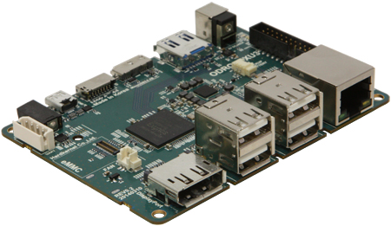
Asymmetric Multi-Core Systems
A new type of Heterogeneous multi-core system
Different types of cores that share the same instruction set architecture (Single-ISA)
Cores are designed with different performance or energy optimization points
One type of cores might target performance
Another type of cores might target energy efficiency
Our Platform for this thesis: ARM big.LITTLE
Four out-of-order (big) cores
Designed for performance
Four in-order (little) cores
Designed to operate on low power
Using such systems in HPC is not trivial

Slide 4
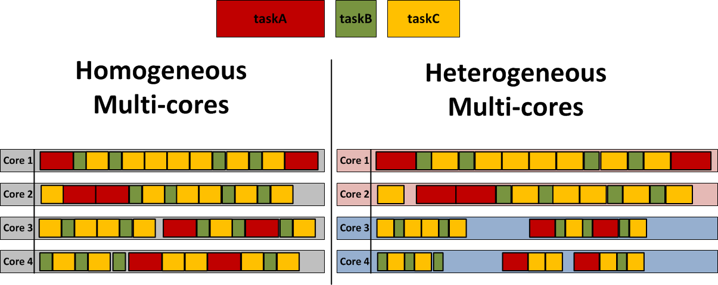
Moving from Symmetric to Asymmetric
time
time
Load imbalance! →
Need of new schedulers and runtime systems

Slide 5
Thesis Objectives
Analysis of Existing Approaches
Task Scheduling
Runtime Thread Migration
Asymmetry-Aware Runtime System

Slide 6
Phase 1: Analysis of Existing Approaches
Experimenting with existing approaches
Evaluation of real scientific applications (PARSEC) using different scheduling approaches:
Application-based scheduling
Static Threading – done by the programmer in the application code
System Aware OS (thread)-based scheduling
Global Task Scheduler (GTS) [1]
Threads move to the appropriate core depending on their workload
Task-based scheduling (runtime)
OmpSs programming model
Asymmetry-unaware
[1] H. Chung et.al, “Heterogeneous Multi-Processing Solution of Exynos 5 Octa with ARM big.LITTLE Technology,” Samsung Electronics Co., Ltd., Tech. Rep., 2013

Slide 7
Phase 1: Analysis of Existing Approaches - High-level results
The task-based approach provides the highest performance with decent energy consumption
Task-based approach minimizes EDP (energy-delay product)
Number of cores
Number of cores

Slide 8
Phase 2: Task Scheduling
We provide the knowledge of the platform to the runtime system
According to this the runtime schedules tasks to the appropriate cores (fast or slow)
Asymmetry-aware schedulers:
Critical tasks → Fast cores
Non-critical tasks → Slow cores
These schedulers are:
CATS [2]
CPATH
HYBRID
[2] K. Chronaki et.al Criticality-Aware Dynamic Task Scheduling for Heterogeneous Architectures in ICS’15

Slide 9
Phase 2: Task Scheduling – High-level results on 8 cores
SCHED | MIN | MAX | AVG
CATS | 6% | 38% | 19%
CPATH | -20% (HEAT) | 27%(HIST) | 6%
HYBRID | 7% | 34% | 18%
dHEFT | -10% (BODYTR) | 45%(CHOL8x8) | 14%

Slide 10
Phase 3: Runtime Thread Migration
A different approach to provide energy efficiency
Devote one thread for the runtime activity
Runtime activity is: Scheduling, dependence analysis
During runtime choose the appropriate type of core for this thread to migrate
Should the runtime execute on a fast or a slow core?
Either boosts or delays runtime
Implement different policies for this dynamic migration
Considering: number of tasks, dependencies, task size etc.

Slide 11
Phase 4: Asymmetry-Aware Runtime System
Scheduling policies
CATS
CPATH
HYBRID
Runtime Thread Migration Mechanisms (RTMM)
Combine the above to find the best match
Connect each combination with the application characteristics

Slide 12
Roadmap
PhD Enrolment
Current Month

Slide 13
Conclusions and Expectations
The results of Phase 1 showed that the task-based approach achieves the lowest EDP
The asymmetry-aware scheduling policies (Phase 2) showed their potential in performance (up to 38% improvement)
We expect that the Runtime Thread Migration (Phase 3) will increase energy efficiency
The Asymmetry-Aware runtime system (Phase 4) is expected to overcome all existing approaches in asymmetric systems
It is aimed to offer full utilization of the system keeping the energy consumption the lowest possible

Slide 14
Thank you!
For further information please contact
Kallia.chronaki@bsc.es

Slide 15
Conclusions
Our expected contributions per chapter
Task | Publication | Status
Analysis of Existing Approaches | 1 conference paper | Under review (est: 10/2016)
Task Scheduling | 1 conference paper | Accepted
 | 1 journal paper | Under review (est: 4/2017)
Runtime Thread Migration Mechanisms | 1 conference paper | TODO (est: 12/2017)
Asymmetry-Aware runtime system | 1 conference paper | TODO (est: 12/2018)

