Slide 1
נושאים להיום
Multithreading cont.
Java Gui

Slide 2
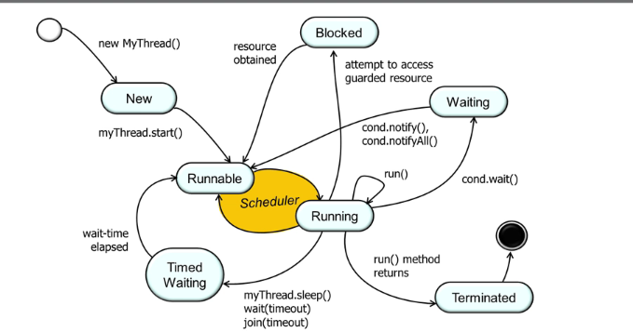
Java - Multithreading
Java is a multi-threaded programming language which means we can develop multi-threaded program using Java. A multi-threaded program contains two or more parts that can run concurrently and each part can handle a different task at the same time making optimal use of the available resources specially when your computer has multiple CPUs.
By definition, multitasking is when multiple processes share common processing resources such as a CPU. Multi-threading extends the idea of multitasking into applications where you can subdivide specific operations within a single application into individual threads. Each of the threads can run in parallel. The OS divides processing time not only among different applications, but also among each thread within an application.
Multi-threading enables you to write in a way where multiple activities can proceed concurrently in the same program.

Slide 3
Java Concurrency Utilities - java.util.concurrent
Java 5 added a new Java package to the Java platform, the java.util.concurrent package. This package contains a set of classes that makes it easier to develop concurrent (multithreaded) applications in Java. Before this package was added, you would have to program your utility classes yourself.
Java BlockingQueue
Java ArrayBlockingQueue
Java DelayQueue
Java LinkedBlockingQueue
Java PriorityBlockingQueue
Java SynchronousQueue
Java BlockingDeque
Java LinkedBlockingDeque
Java ConcurrentMap
Java ConcurrentNavigableMap
Java CountDownLatch
Java CyclicBarrier
Java Exchanger
Java Semaphore
Java ExecutorService
Java Callable
Java Future
Java ThreadPoolExecutor
Java ScheduledExecutorService
Java ForkJoinPool
Java Lock
Java ReadWriteLock
Java AtomicInteger
Java AtomicLong
Java AtomicReference
Java AtomicStampedReference
Java AtomicIntegerArray
Java AtomicLongArray
Java AtomicReferenceArray

Slide 4
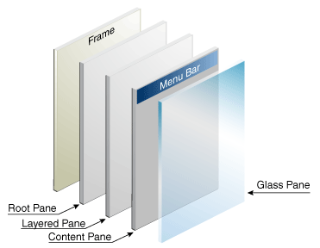

Slide 5
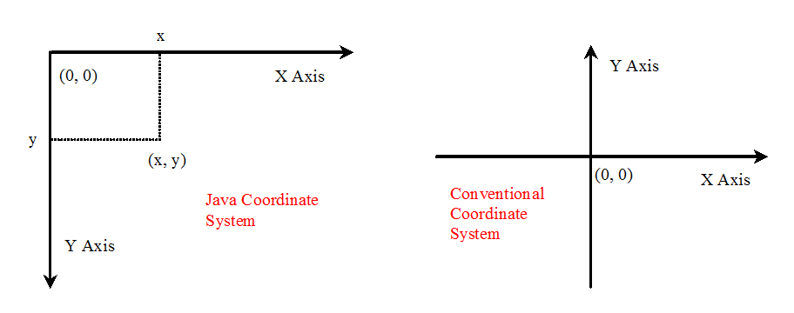
Java Coordinate System
To paint, you need to know where to paint.
the origin (0, 0) at the upper-left corner of the component

Slide 6
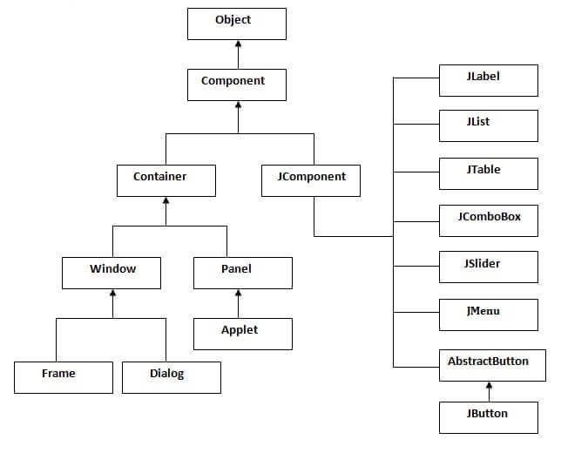
Hierarchy of Java Swing classes
The hierarchy of java swing API is given below.

Slide 7
JLabel
The object of JLabel class is a component for placing text in a container. It is used to display a single line of read only text. The text can be changed by an application but a user cannot edit it directly. It inherits JComponent class.
Constructor | Description
JLabel() | Creates a JLabel instance with no image and with an empty string for the title.
JLabel(String s) | Creates a JLabel instance with the specified text.
JLabel(Icon i) | Creates a JLabel instance with the specified image.
JLabel(String s, Icon i, int horizontalAlignment) | Creates a JLabel instance with the specified text, image, and horizontal alignment.
Methods | Description
String getText() | t returns the text string that a label displays.
void setText(String text) | It defines the single line of text this component will display.
void setHorizontalAlignment(int alignment) | It sets the alignment of the label's contents along the X axis.
Icon getIcon() | It returns the graphic image that the label displays.
int getHorizontalAlignment() | It returns the alignment of the label's contents along the X axis.

Slide 8
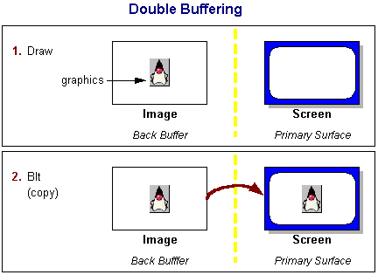
Double Buffering
Suppose you had to draw an entire picture on the screen, pixel by pixel or line by line. If you were to draw such a thing directly to the screen (using, say, Graphics.drawLine), you would probably notice with much disappointment that it takes a bit of time. You will probably even notice visible artifacts of how your picture is drawn. Rather than watching things being drawn in this fashion and at this pace, most programmers use a technique called double-buffering.
The traditional notion of double-buffering in Java applications is fairly straightforward: create an offscreen image, draw to that image using the image's graphics object, then, in one step, call drawImage using the target window's graphics object and the offscreen image. You may have already noticed that Swing uses this technique in many of its components, usually enabled by default, using the setDoubleBuffered method.

Slide 9
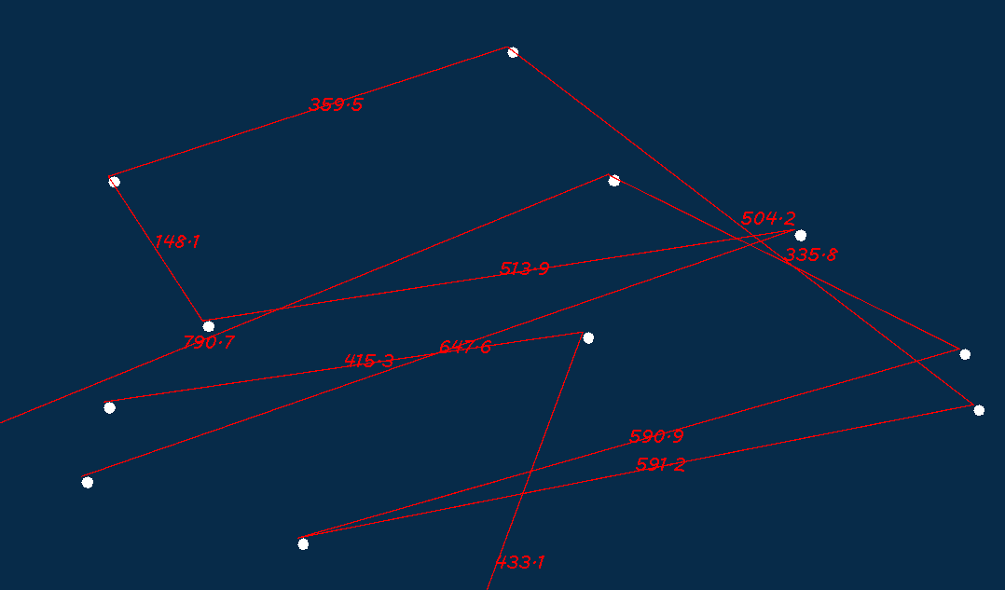
JPanel
The JPanel is a simplest container class. It provides space in which an application can attach any other component. It inherits the JComponents class.
It doesn't have title bar.
JPanel() | It is used to create a new JPanel with a double buffer and a flow layout.

Slide 10
Scale
* * @param data denote some data to be scaled * @param r_min the minimum of the range of your data * @param r_max the maximum of the range of your data * @param t_min the minimum of the range of your desired target scaling * @param t_max the maximum of the range of your desired target scaling * @return */ private double scale(double data, double r_min, double r_max, double t_min, double t_max) { double res = ((data - r_min) / (r_max-r_min)) * (t_max - t_min) + t_min; return res; }

Slide 11
Sources
https://www.geeksforgeeks.org/daemon-thread-java/?ref=lbp
http://tutorials.jenkov.com/java-util-concurrent/index.html

