Slide 1
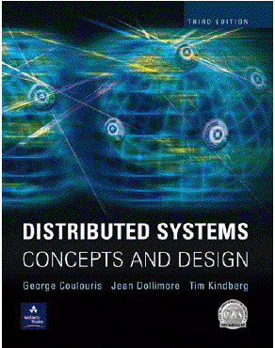
Distributed Objects and Remote Invocation: RMI & CORBA
Rajkumar Buyya, Xingchen Chu, Rodrigo Calheiros
Cloud Computing and Distributed Systems (CLOUDS) Laboratory
Department of Computing and Information Systems
The University of Melbourne, Australia
http://www.cloudbus.org/652
Most concepts are
drawn from Chapter 5
© Pearson Education
Programming examples
are provided by Sun Java
online tutorials
http://java.sun.com/docs/books/tutorial/rmi/

Slide 2
Outline
Introduction to Distributed Objects and RMI
RMI Architecture
RMI Programming and a Sample Example:
  Server-Side RMI programming
  Client-Side RMI programming
Advanced RMI Concepts
  Security Policies
  Exceptions
  Dynamic Loading
A more advanced RMI application
  File Server
Notes:
What are the steps involved in server-side and client-side RMI?
What advanced concepts can we use to make our program production ready? Security policies to restrict access and encrypt data flow?
What exceptions will we come across? Can we dynamically deploy our service?

Slide 3
Distributed Objects
A programming model based on Object-Oriented principles for distributed programming.
Enables reuse of well-known programming abstractions (Objects, Interfaces, methods…), familiar languages (Java, C#...), and design principles and tools (design patterns, UML…)
Each process contains a collection of objects, some of which can receive both and local invocations:
  Method invocations between objects in different processes are known as remote method invocation, regardless the processes run in the same or different machines.
Distributed objects may adopt a client-server architecture, but other architectural models can be applied as well.
Notes:
Available reliably from java “2” aka Java 1.2
Has been consistently improved since then for each new Java version.
Data must be Serializable (or Remote) so that RMI can marshall (flatten) and unmarshall (reconstruct) the data
Primatives (int/float/etc) are inherently serializable, as are many Objects

Slide 4
Java RMI
Java Remote Method Invocation (Java RMI) is an extension of the Java object model to support distributed objects
  methods of remote Java objects can be invoked from other Java virtual machines, possibly on different hosts
Single-language system with a proprietary transport protocol (JRMP)
  There is support for IIOP (from CORBA)
RMI uses object serialization to marshal and unmarshal
  Any serializable object can be used as parameter or method return
Releases of Java RMI
  Java RMI is available for Java Standard Edition (JSE) and Java Micro Edition (JME)
Notes:
Available reliably from java “2” aka Java 1.2
Has been consistently improved since then for each new Java version.
Data must be Serializable (or Remote) so that RMI can marshall (flatten) and unmarshall (reconstruct) the data
Primatives (int/float/etc) are inherently serializable, as are many Objects

Slide 5
RMI Architecture & Components
Remote reference module is responsible for providing addressing to the proxy (stub) object
Proxy is used to implement a stub and provide transparency to the client. It is invoked directly by the client (as if the proxy itself was the remote object), and then marshal the invocation into a request
Communication module is responsible for networking
Dispatcher selects the proper skeleton and forward message to it
Skeleton un-marshals the request and calls the remote object
client
server
remote
object A
proxy for B
skeleton
object B
Request
& dispatcher
for B’s class
Reply
servant
Remote
Communication
Communication
Remote reference
reference module
module
module
module
Notes:
Remote reference modules exist at client/server, and is the middleware between the stub and skeleton and the transport protocols, handling creation and management of remote references
Proxy/skel are the interfaces client/server uses to interact
Dispatcher matches the request to the appropriate skeleton (there could be many)

Slide 6
Invocation Lifecycle
Client
Server
Client Code
RMI Object
Invoke method via stub
Returns response
Calls actual method with args
Returns response / exception
1
8
4
5
Stub
Skeleton
Serializes arguments, transmit
Receives, deserialises response
Receives, deserialises arguments
Serialises response, transmit
2
7
3
6
Network

Slide 7
Steps of implementing an RMI application
Design and implement the components of your distributed application
  Remote interface
  Servant program
  Server program
  Client program
Compile source and generate stubs
  Client proxy stub
  Server dispatcher and skeleton
Make classes network accessible
  Distribute the application on server side
Start the application
Notes:
Many steps to creating a remote service
-Inteface defines a set of methods we wish to make available (based on user requirements and agreement)
-Servant implements the methods defined in Interface
-Server program is the “driver”, usually registers with naming service
REPEAT IF NECCESSARY

Slide 8
RMI Programming and Examples
  Application Design
    Remote Interface
      Exposes the set of methods and properties available
      Defines the contract between the client and the server
      Constitutes the root for both stub and skeleton
    Servant component
      Represents the remote object (skeleton)
      Implements the remote interface
    Server component
      Main driver that makes available the servant
      It usually registers with the naming service
    Client component

Slide 9
Example application – Hello World
Server side
  Create a HelloWorld interface
  Implement HelloWorld interface with methods
  Create a main method to register the HelloWorld service in the RMI Name Registry
  Generate Stubs and Start RMI registry
  Start Server
Client side
  Write a simple Client with main to lookup HelloWorld Service and invoke the methods

Slide 10
Explanation: Server Side
Restrictions on the Remote interface
  User defined interface must extend java.rmi.Remote interface
  Methods inside the remote interface must throw java.rmi.RemoteException
Servant class is recommended to extend java.rmi.server.UnicastRemoteObject
  Servant that does not extend UnicastRemoteObject need to export explicitly
    UnicastRemoteObject.export(Remote remoteObj);
Name Service: RMI Registry
  Bind, unbind and rebind remote object to specified name
  All the classes required need to be on rmiregistry classpath
  java.rmi.Naming is an interface for binding object name (URL) to the registry
Format of object URL
  //host:port/objectname (implicit declaration of RMI protocol for name)
    Eg. //localhost/HelloWorldService or rmi://localhost/HelloWorldService
  Default port is 1099
For security reason, a server program can bind, unbind and rebind only on its same host
  Prevent any binding from the remote clients
  Lookup can be invoked everywhere
After the binding, the remote object will not be reclaimed in garbage collection until the server unbinds it
  Because it is remotely referred by the registry (running in a separate JVM)
Notes:
We have some requirements on the server side
-Our interface MUST extend java.rmi.Remote
-All defined methods must throw java.rmi.RemoteException
-Servant should extend UnicastRemoteObject, otherwise must export
Remote object manually

Slide 11
Server Side : Define an interface (HelloWorld.java)
import java.rmi.Remote;
import java.rmi.RemoteException;
public interface HelloWorld extends Remote {
public String sayHello(String who) throws RemoteException;
}
Notes:
Defining the Remote Interface

Slide 12
Implementing a remote interface(HelloWorldImpl.java)
import java.rmi.Naming;
import java.rmi.Remote;
import java.rmi.RemoteException;
import java.rmi.server.UnicastRemoteObject;
public class HelloWorldImpl extends UnicastRemoteObject implements HelloWorld {
public HelloWorldImpl() throws RemoteException {
super();
}
public String sayHello(String who) throws RemoteException {
return "Hello "+who+" from your friend RMI 433-652 :-)";
}
public static void main(String[] args) {
String hostName = "localhost";
String serviceName = "HelloWorldService";
if(args.length == 2){
hostName = args[0];
serviceName = args[1];
}
try{
HelloWorld hello = new HelloWorldImpl();
Naming.rebind("rmi://"+hostName+"/"+serviceName, hello);
System.out.println("HelloWorld RMI Server is running...");
}catch(Exception e){}
}
}
Notes:
Servant that implements Remote Interface
We have implemented the Server (i.e the driver program) into the same class

Slide 13
Generate Stubs and Start RMI registry
Compile
  javac HelloWorld.java
  javac HelloWorldImpl.java
Generate Stubs (before Java 5)
  rmic HelloWorldImpl
Start RMI registry
  start rmiregistry (windows)
  rmiregistry 10000 & (unix)
Start HelloWorld Server
  java HelloWorldImpl
  java HelloWorldImpl localhost:10000 HelloWorldService
Notes:
Compile our remote interface and implementation (servant)
Generate stubs for our client using rmic
Start rmi registry using default port or a different one (due to firewall or permission issues)
Start our server and client

Slide 14
Explanation: Client Side
RMI Registry
RMI Service
Get Service Reference
Lookup Service
Client
Invoke
RMI Remote Object
Service
Look up the server registry
  Based on the targeting object URL
Get the remote object reference from the Registry
Invoke the methods on the remote object reference
Notes:
Look up service using the remote rmiregistry
Get reference to remote service we can cast and operate on
Call methods on remote object in the same manner we would a local object

Slide 15
Client Side : A Simple Client
(RMIClient.java)
import java.rmi.Naming;
public class RMIClient {
public static void main(String[] args) {
String hostName = "localhost";
String serviceName = "HelloWorldService";
String who = "Raj";
if(args.length == 3){
hostName = args[0];
serviceName = args[1];
who = args[2];
}else if(args.length == 1){
who = args[0];
}
try{
HelloWorld hello = (HelloWorld)Naming.lookup("rmi://"+hostName+"/"+serviceName);
System.out.println(hello.sayHello(who));
}catch(Exception e){
e.printStackTrace();
}
}
}
Notes:
Naming.lookup returns a Remote object which we can cast into our expected remote service object (or an exception occurs)
Once we have this object we can call its methods like a local object

Slide 16
Compile and Run
Compile
  javac RMIClient.java
Run it
  java RMIClient
  java RMIClient localhost HelloWorldService Raj
  java RMIClient holly:10000 HelloWorldService Raj
Notes:
Now we can complile and run the RMIClient with different parameters
Server could be local or remote (providing there is appropriate firewall access on the remote service)

Slide 17
Security Manager
Java’s security framework
  java.security.-
  Permissions, Principle, Domain etc.
  Security manager, for access control (file, socket, class load, remote code etc)
  $JAVA_HOME/jre/lib/security/java.policy
Use security manager in RMI
  RMI recommends to install a security manager, or RMI may not work properly while encountering security constraints.
  A security manager ensures that the operations performed by downloaded code go through a set of security checks.
    Eg. Connect and accept ports for RMI socket and allowing code downloading
Notes:
Why use a security manager? We don’t want rogue java applications or applets downloading arbitrary remote code and executing it!
Security manager is usually required at both the client and server

Slide 18
Security Manager (cont.)
Two ways to declare security manager
  Use System property java.security.manager
    java –Djava.security.manager HelloWorldImpl
  Explicit declare in the source code
    public static void main(String[]args){
    //check current security manager
    if(System.getSecurityManager()==null){
    System.setSecurityManager(new RMISecurityManager());
    }
    …
    //lookup remote object and invoke methods.
    }
Use customized policy file instead of java.policy
  Usage
    java -Djava.security.manager -Djava.security.policy=local.policy HelloWorldImpl
Notes:
We can use a system wide, default security manager by using the command line argument.
Alternatively, we can define and set our own SecurityManager to control access to our server
Client can use default system wide policy (usually restrictive, e.g. to stop applets from misuse) or define more permissive local.policy

Slide 19
File: “local.policy” contents
Specific permissions:
grant {
permission java.net.SocketPermission "*:1024-65535","connect,accept";
permission java.io.FilePermission "/home/globus/RMITutorial/-", "read";
};
Grant all permissions:
grant {
permission java.security.AllPermission;
};
Notes:
We can have per user policies, where a user can define there own local.policy and place it in their home drive.
This can allow more permissive access than the default
E.g. I may want to allow access to certain ports or certain files, or everything (useful for debugging)

Slide 20
Exceptions
The only exception that could be thrown out is RemoteException
All RMI remote methods have to throw this exception
The embedded exceptions could be:
  java.net.UnknownHostException or java.net.ConnectException: if the client can’t connect to the server using the given hostname. Server may not be running at the moment
  java.rmi.UnmarshalException: if some classes not found. This may because the codebase has not been properly set
  Java.security.AccessControlException: if the security policy file java.policy has not been properly configured
Notes:
UnmarshalException is probably the most common exception for beginner RMI programmers. Can occur on the server if CLASSPATH is set incorrectly for the Server or the rmiregistry
Can happen on client if stubs are missing and the codebase has not been set to allow automatic download of the stubs from the server
AccessControlException can occur if the java.policy is not permissive enough for the client run execute correctly

Slide 21
Passing objects
Restrictions on exchanging objects
  Implementing java.io.serializable
  All the fields in a serializable object must be also serializable
  Primitives are serializable
  System related features (e.g. Thread, File) are non-serializable
How about the socket programming issues?
  Where are sockets and corresponding input, output streams?
  How to handle object passing?
  Who does all the magic?
Notes:
Mentioned earlier that objects returned over RMI either need to be Remote (for the remote reference) or Serializable
For an object to be Serializable all member fields must also be Serializable
Many system features such as Thread and File are non-serializable. So we couldn’t return a file reference over RMI, but we could return an actual file as a
byte[] array
Much of the complexity is hidden from us, thankfully!

Slide 22
RMI Dynamic Class Loading
Ability to download bytecode (classes) from Remote JVM
New types can be introduced into a remote virtual machine without informing the client
  Extend the behavior of an application dynamically
  Removes the need to deploy stubs manually
Explicit set property to support dynamic class load
  Specify system property java.rmi.server.codebase to tell the program where to download classes
Notes:
Allows client to receive latest stub definitions without manually placing stub on client
New or modified interfaces or types can be introduced as needed
Dynamic loading can be achieved by setting the
-Djava.rmi.server.codebase=http://www.server.com/classes
Or file:///var/classes

Slide 23
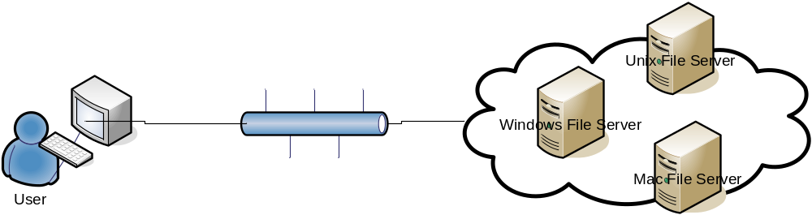
Sample scenario : File Server
File Server Scenario
Basic Requirements ( File Server )
  Get the files from the File Server on specific directory
  Create new files on the File Server
  Create new directories on the File Server
  Delete files or directory on the File Server
Client
  A File Browser to explore the file system on the File Server supporting view, create and delete functionalities.

Slide 24
Programming File Server
Create RMI remote interface
  public interface FileServer extends Remote {
  public Map getFiles(String baseDir) throws RemoteException;
  public Map getFiles(String baseDir,boolean upper) throws RemoteException;
  public void createFile(String filename,boolean isDir) throws RemoteException;
  public void deleteFile(String filename) throws RemoteException;
  }
Implement the Servant
  FileServerImpl.java [FileServerImpl implements FileServer]
Implement the Server
public class RMIFileServer{
public static void main(String [] args){
try{
String host = "localhost";
if(args.length == 1){
host = args[0];
}
Naming.rebind("//"+host+"/FileServer",new FileServerImpl());
}catch(Exception e){}
}
}
Generate Stub
  rmic –keep cs652.rmi.server.FileServerImpl (keep option is to keep the generated java file)
Notes:
rmic -d can place stubs in a certain directory (e.g. you might place them in /var/www/classes and make them available via web server)

Slide 25
Programming File Browser
Create a Subclass of JFrame
  RMIFileBrowser.java
Locate the FileServer Object
  private FileServer findFileServer(String serviceURI)throws Exception{
  return (FileServer)Naming.lookup("rmi://"+serviceURI);
  }
Invoke the appropriate methods
  Get Files : Map result = getFileServer().getFiles(dir,upper);
  Create File: getFileServer().createFile(absoluteFilePath,false/*isDir=false*/);
  Create Dir: getFileServer().createFile(absoluteFilePath,true/*isDir=true*/);
  Delete File: getFileServer().deleteFile(absoluteFilePath);
Write a local policy file
  Grant{
  java.security.AllPermission;
  };

Slide 26
Run it!
Two steps
  Start the server
    start rmiregistry (be aware of your classpath)
    java cs652.rmi.server.RMIFileServer
  Start the client
    java -Djava.security.manager -Djava.security.policy=local.policy
      cs652.demo.RMIFileBrowser
  Note: Required classes including the generated stubs must be visible by java classloader.
Notes:
Client is using default security manager and our defined local.policy
VERY Important to set CLASSPATH correctly for client, server and rmiregistry…. Can lead to hours of frustration if not!

Slide 27
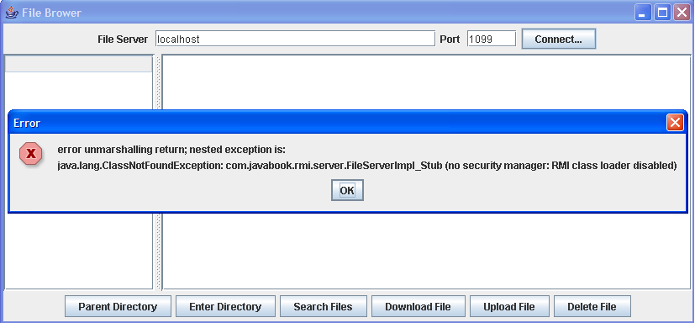
Potential error - no security manager!

Slide 28
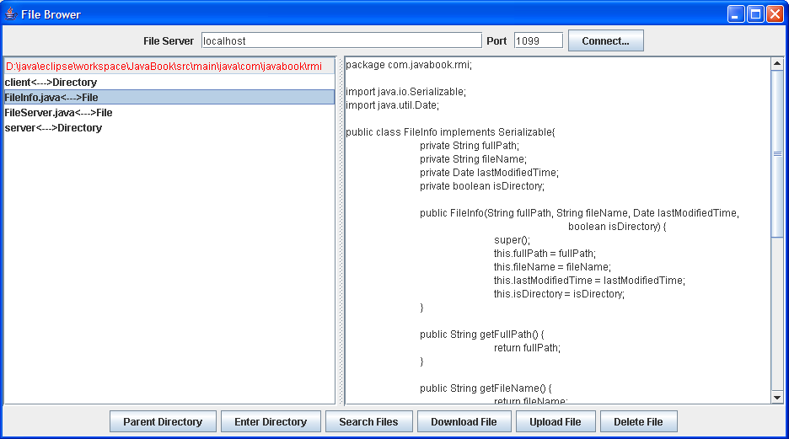
Successful execution
Notes:
DEMO!!!!

Slide 29
Summary: RMI Programming
RMI greatly simplifies creation of distributed applications (e.g., compare RMI code with socket-based apps)
Server Side
  Define interface that extend java.rmi.Remote
  Servant class both implements the interface and extends java.rmi.server.UnicastRemoteObject
  Register the remote object into RMI registry
  Ensure both rmiregistry and the server is running
Client Side
  No restriction on client implementation, both thin and rich client can be used. (Console, Swing, or Web client such as servlet and JSP)
Notes:
Hugely simplified over sockets for complex interactions. Imagine doing the file browser with sockets. We would have to define a shared protocol between client and server, parse the messages over the network to try and figure out what the client wants us to do

