Slide 1
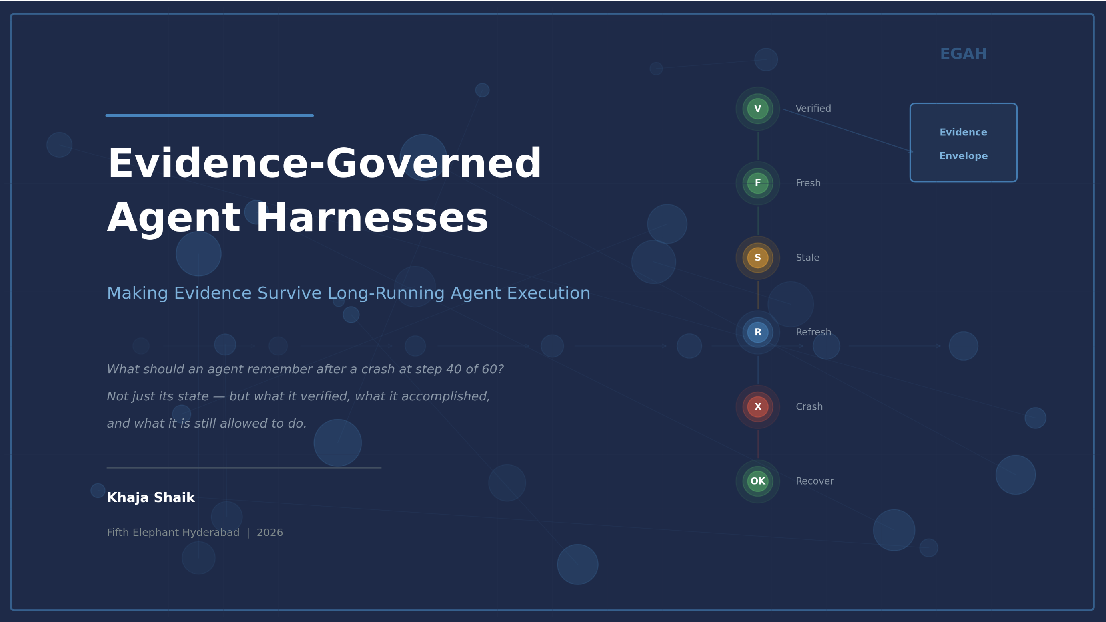
Evidence-Governed Agent Harnesses
Making Evidence Survive Long-Running Agent Execution
What should an agent remember after a crash at step 40 of 60?
Not just its state — but what it verified, what it accomplished and what it is still allowed to do.
Khaja Shaik
Fifth Elephant Hyderabad | 2026

Slide 2
The production gap
Modern harnesses restore execution state. They do not necessarily restore decision-worthy evidence.
A checkpoint answers WHERE to resume. Safe continuation also needs WHAT was known, verified, still fresh, and authorized.
The distinction matters most in:
LONG-RUNNING
Evidence can expire
before later actions.
CRASH + RESUME
Execution returns;
evidence context may not.
CONSEQUENTIAL ACTIONS
Stale inputs can
change the outcome.
Evidence-Governed Agent Harnesses | Fifth Elephant Hyderabad | 2026
Notes:
Timing: 0:45–3:15. Establish the distinction; do not survey frameworks. Selection signal: one narrow production problem, not a grand framework claim.
[Sources]
- agentic-systems/eagh/README.md — Context and Problem Statement
- agentic-systems/eagh/src/egah/recovery.py — state-only vs evidence-governed recovery
[/Sources]

Slide 3
A crash preserves state—not evidence
Implemented PoC · 10-step document analysis · evidence at steps 3, 6, 9 · crash at step 7
Steps 1–6 complete → step 7 crashes → recovery must decide what remains usable
What the trace can restore
What recovery must decide
Steps completed: 1–6
Outputs and resource records
Two evidence envelopes
Crash location: step 7
Execution can restart
Is step 3 evidence fresh?
Is step 6 evidence valid?
Was each envelope verified?
Must evidence be refreshed?
Is continuation authorized?
Evidence-governed recovery
Step 3 — Extract Entities
REFRESH
simulated stale evidence
Step 6 — Assess Risk
ACT
fresh and verified
Step 7 — Generate Findings
WAIT
resume only after required refresh
Decision: refresh stale evidence, then resume from step 7
Evidence-Governed Agent Harnesses | Fifth Elephant Hyderabad | 2026
Notes:
Timing: 3:15–5:45. Narrate the actual local PoC. Be explicit that staleness is simulated for demonstration; the preservation and recovery paths are implemented.
[Sources]
- agentic-systems/eagh/src/egah/egah_agent.py — WORKFLOW_STEPS and CHECKPOINT_STEPS
- agentic-systems/eagh/src/egah/recovery.py — egah_recovery(simulate_stale=True)
- agentic-systems/eagh/tests/test_egah.py — crash-at-step-7 tests
[/Sources]

Slide 4
Evidence is first-class runtime state
An envelope carries the decision context—not just the value
Source / Provenance
Where did it originate?
Observed at
When was it captured?
Freshness / Validity
Is it still applicable?
Verification
Was it checked, and by whom?
Content
What was observed?
Resource record
What did this step cost?
Outcome link
Which decision did it support?
A checkpoint stores position. An evidence envelope stores the basis for safe continuation.
Evidence-Governed Agent Harnesses | Fifth Elephant Hyderabad | 2026
4 / 9
Notes:
Timing: 5:45–8:15. Define the minimum evidence envelope. Avoid claiming that every tool result deserves one; emphasize consequential boundaries.
[Sources]
- agentic-systems/eagh/src/egah/models.py — EvidenceEnvelope and VerificationRecord
- agentic-systems/eagh/src/egah/evidence_store.py — durable envelope, verification, and resource records
[/Sources]

Slide 5
The harness adds a policy gate to the loop
Checkpoint only where the next action depends on durable evidence
Traditional: Plan → Tool → Result → Next
EGAH: Plan → Checkpoint → Tool → Verify → Update evidence → Decide
At a consequential boundary
After a crash
1. Capture execution + evidence state
2. Persist provenance, time and content
3. Verify against policy
4. ACT / REFRESH / ASK / ABSTAIN
1. Restore state, envelopes and history
2. Recheck freshness and validity
3. Build a recovery plan
4. Resume, refresh, escalate—or stop
Evidence-Governed Agent Harnesses | Fifth Elephant Hyderabad | 2026
Notes:
Timing: 8:15–11:15. Walk the two loops. The useful abstraction is the policy gate and durable evidence record; the rest should be judged by measured reliability benefit.
[Sources]
- agentic-systems/eagh/src/egah/egah_agent.py — checkpoint and verification flow
- agentic-systems/eagh/src/egah/models.py — PolicyDecision
- agentic-systems/eagh/src/egah/recovery.py — recovery plan generation
[/Sources]

Slide 6
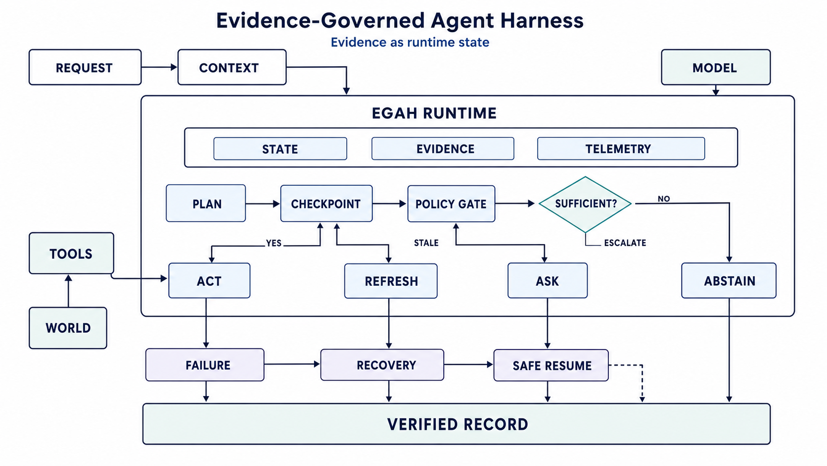
Architecture
End-to-end evidence-governed workflow
Three core subsystems: State (graph, checkpoints, memory) · Evidence (provenance, validity, verification) · Telemetry (tokens, cost, latency)
Flow: Plan → Checkpoint → Policy Gate → Sufficient? → ACT / REFRESH / ASK / ABSTAIN
Evidence-Governed Agent Harnesses | Fifth Elephant Hyderabad | 2026

Slide 7
Recovery must restore the decision basis
Aspect
Traditional Recovery
EGAH Recovery
Execution state
Restored
Restored
Evidence state
Not checked
2 envelopes restored
Verification history
Not analysed
2 records analysed
Evidence freshness
Unknown
Step 3 stale; step 6 fresh
Resume decision
Resume at step 7
Refresh, then resume
Risk
May use stale evidence
Policy-gated continuation
Audit trail
Recovery gap
Continuous recovery record
Evidence-Governed Agent Harnesses | Fifth Elephant Hyderabad | 2026
Notes:
Timing: 15:15–18:15. Make the decision contrast explicit: both approaches restore execution; only one evaluates whether prior evidence supports continuation.
[Sources]
- agentic-systems/eagh/src/egah/recovery.py — traditional_recovery and egah_recovery
- agentic-systems/eagh/tests/test_egah.py — TestRecovery and TestCrashAtStep7Scenario
[/Sources]

Slide 8
Five-minute demo
Local Streamlit PoC · simulated mode works without an API key
1
Run the 10-step document workflow and inject a crash at step 7
2
Inspect two preserved evidence envelopes and verification records
3
Compare state-only recovery with evidence-governed recovery
4
Mark step 3 stale; generate a REFRESH recommendation
5
Resume safely and inspect the audit and resource trail
6
Local verification: 35 automated tests pass
The demo must show a changed recovery decision—not only a restored screen.
Evidence-Governed Agent Harnesses | Fifth Elephant Hyderabad | 2026
Notes:
Timing: 20:00–25:00. Rehearse a deterministic path: reset → crash at 7 → Evidence Inspector → Recovery comparison → EGAH plan → resume. Keep screenshots ready as fallback.
[Sources]
- agentic-systems/eagh/src/egah/app.py — Streamlit demo tabs and controls
- agentic-systems/eagh/README.md — simulated mode and demo behavior
- Local command on 2026-08-28: python3 -m pytest -q — 35 passed
[/Sources]

Slide 9
What should earn a place in the harness?
Six production checks
1
Separate execution state from evidence state
2
Persist provenance, freshness and verification
3
Revalidate at consequential boundaries
4
Use evidence-backed capability boundaries for smaller models
5
Link tokens and cost to verified outcomes
6
Measure reliability gain against harness overhead
After a crash, remember not only WHERE the agent was—but WHY it may continue.
Discussion: Which actions in your system deserve an evidence checkpoint?
Evidence-Governed Agent Harnesses | Fifth Elephant Hyderabad | 2026
9 / 9
Notes:
Timing: 18:15–20:00, then return here after the demo if needed. Close with the audience question and reserve 25:00–30:00 for Q&A.
[Sources]
- agentic-systems/eagh/README.md — central result and key takeaways
- agentic-systems/eagh/src/egah/models.py — evidence and policy boundaries
[/Sources]

