Slide 1
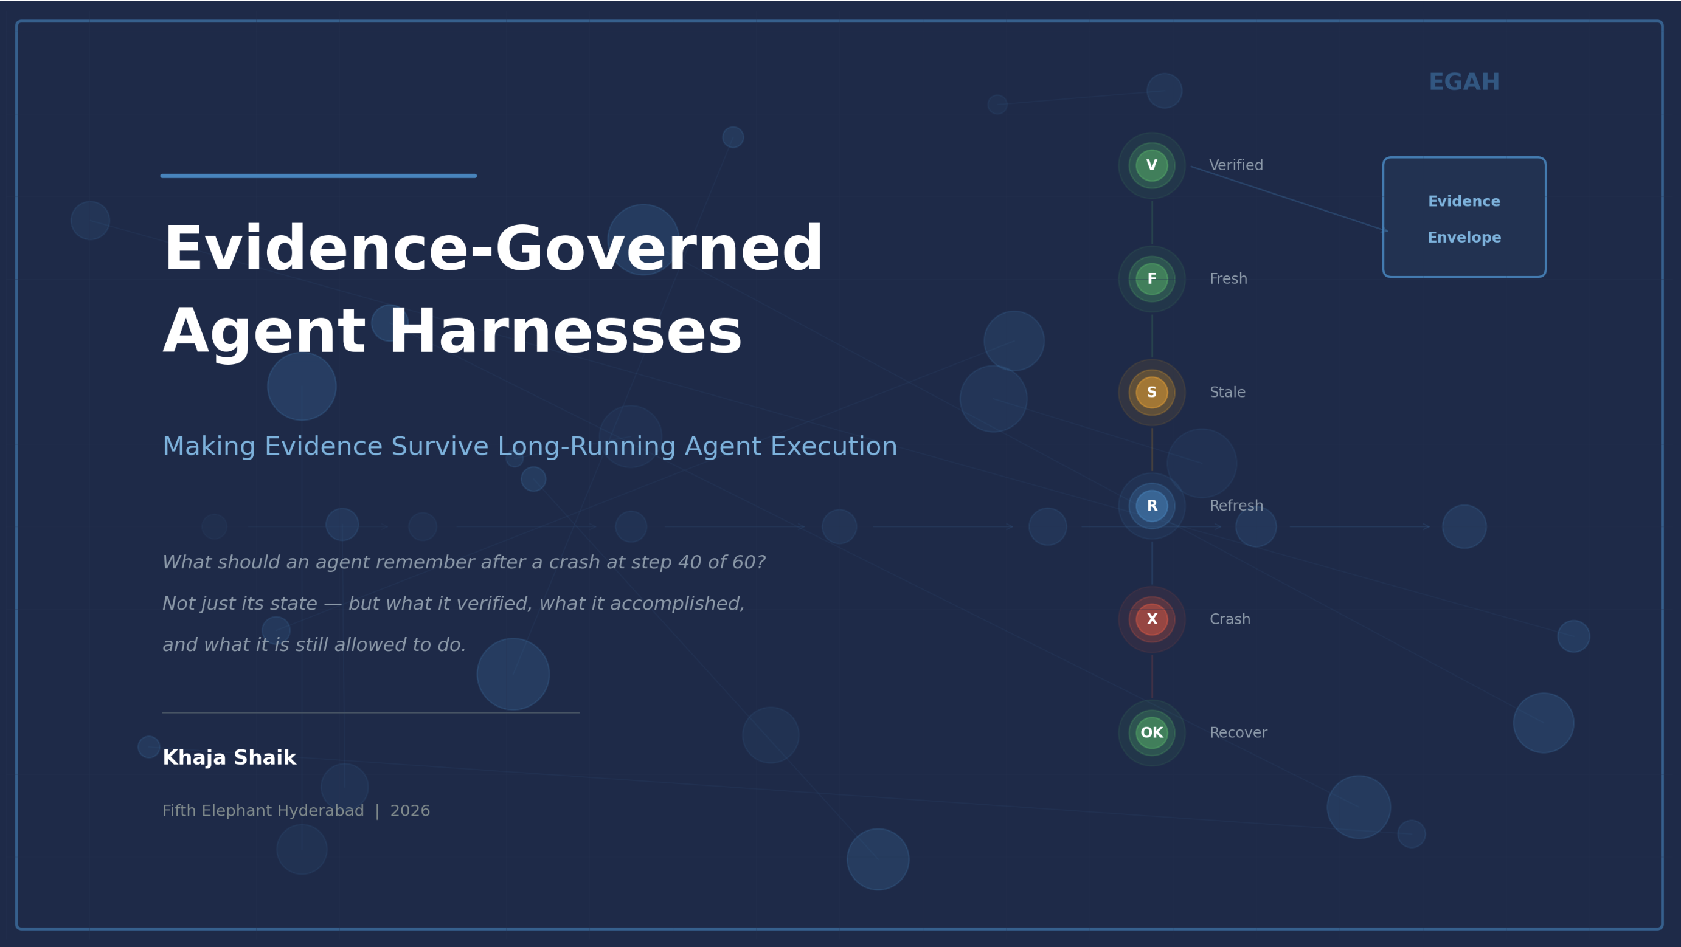
Evidence-Governed Agent Harnesses
Making Evidence Survive Long-Running Agent Execution
What should an agent remember after a crash at step 40 of 60?
Not just its state — but what it verified, what it accomplished and what it is still allowed to do.
Khaja Shaik
Fifth Elephant Hyderabad | 2026

Slide 2
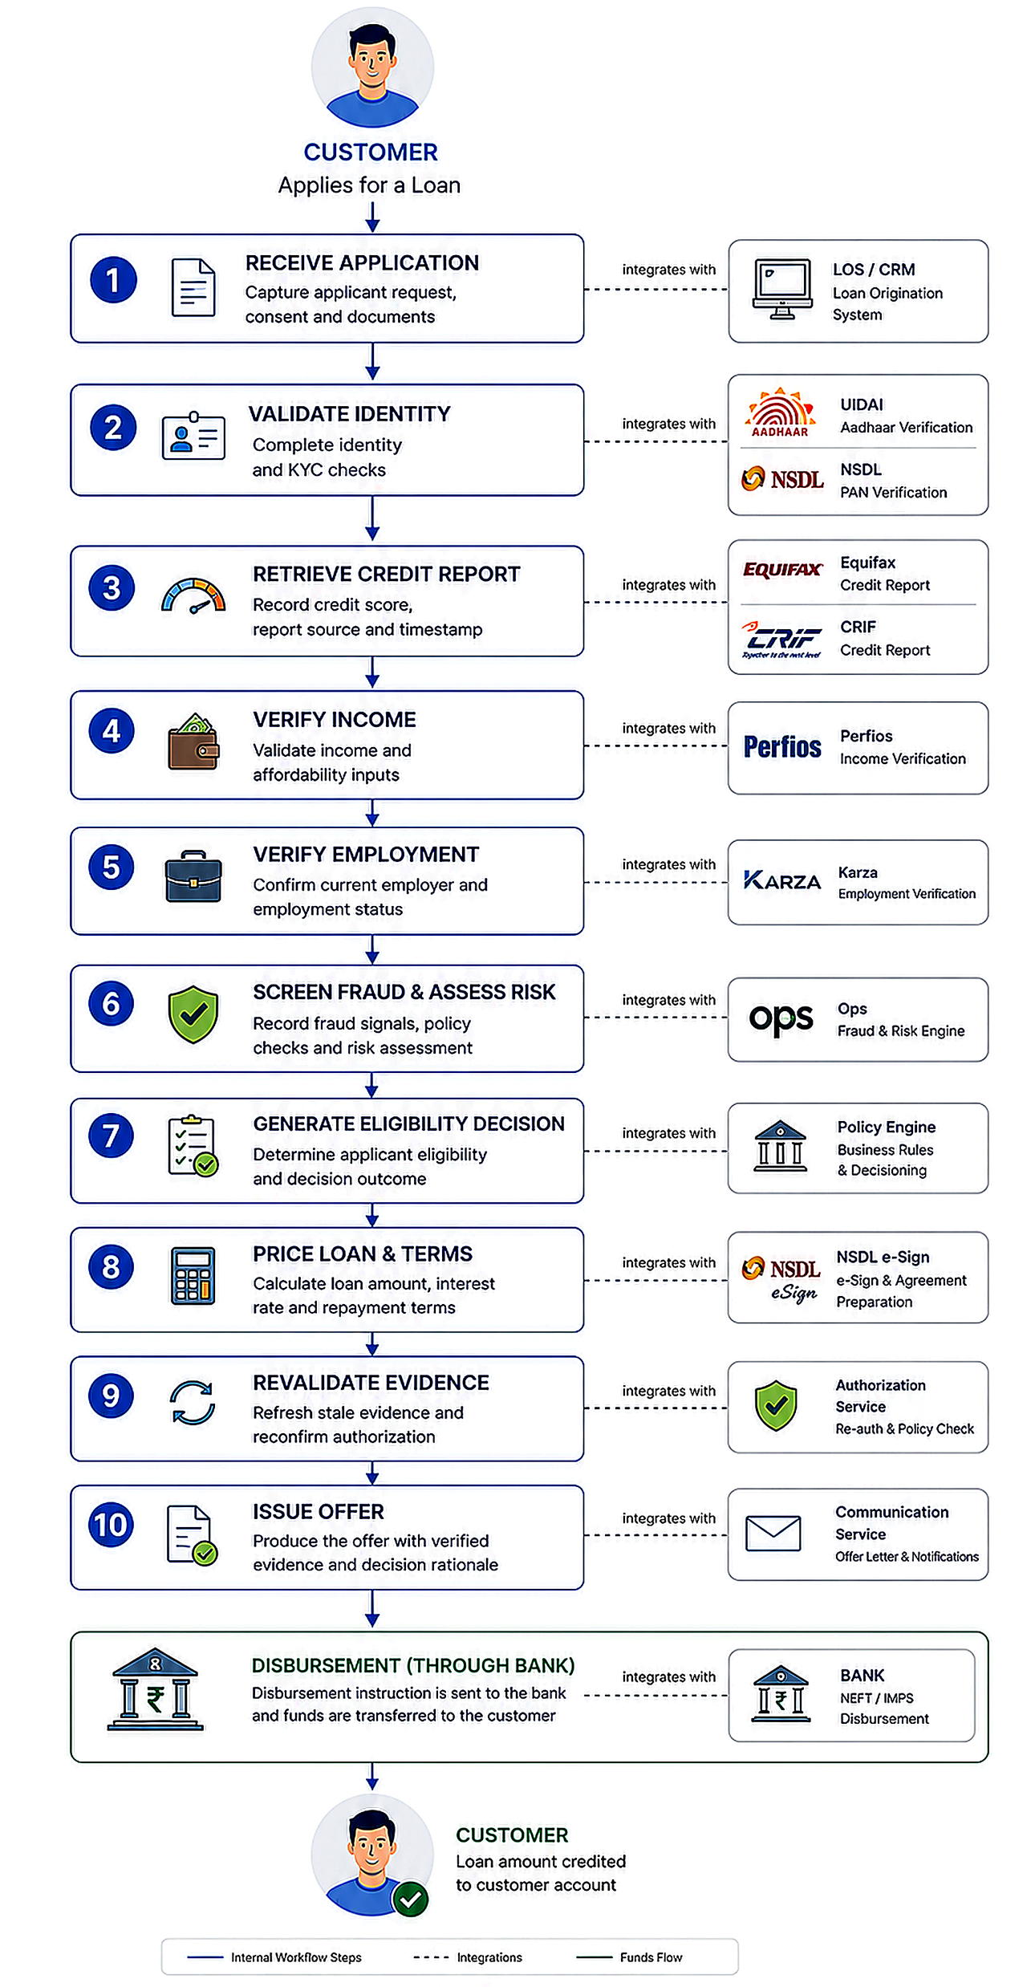
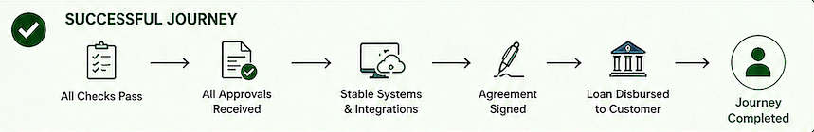
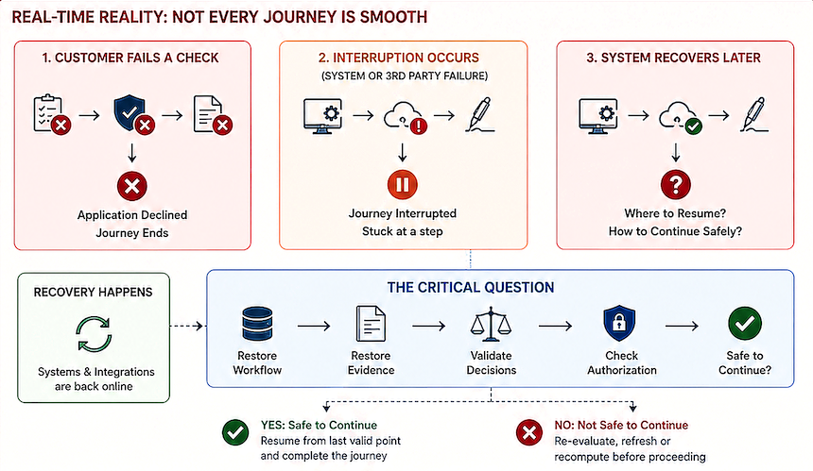
End-to-End Loan Journey
Customer must complete entire process successfully to receive disbursed amount.
Can system safely continue with evidence information collected before crash/ restart ?..
Execution State ≠ Evidence State : Successful State Recovery Does Not Imply Safe Agent Continuation
Evidence-Governed Agent Harnesses | Fifth Elephant Hyderabad | 2026
Notes:
Timing: 0:45–3:15. Establish the distinction; do not survey frameworks. Selection signal: one narrow production problem, not a grand framework claim.
[Sources]
- agentic-systems/eagh/README.md — Context and Problem Statement
- agentic-systems/eagh/src/egah/recovery.py — state-only vs evidence-governed recovery
[/Sources]

Slide 3
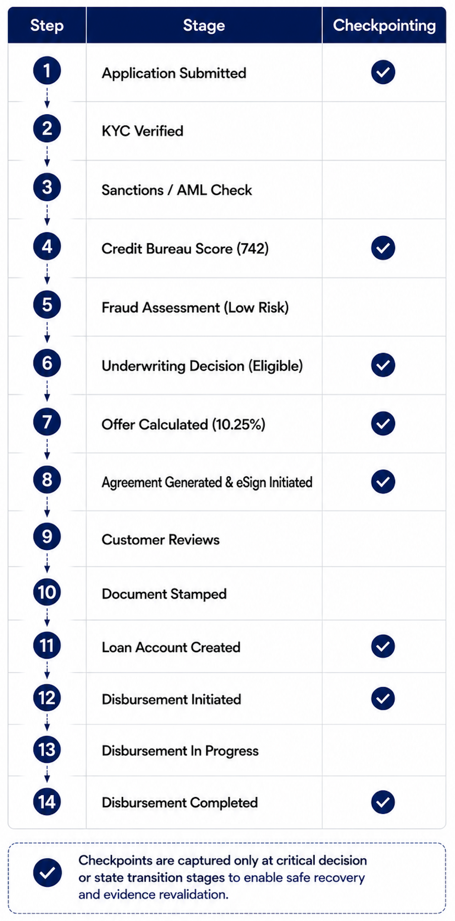
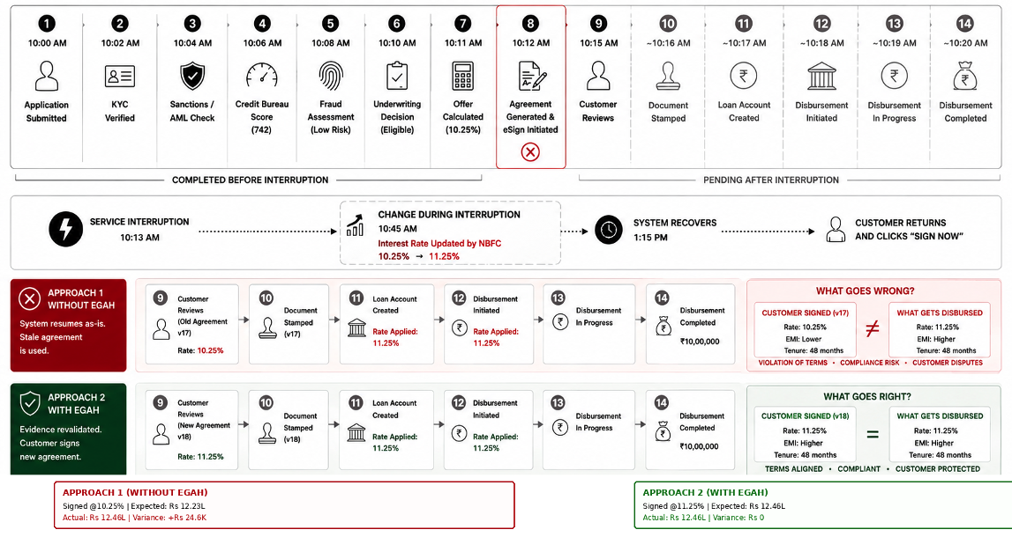
Loan Journey Interruption at e-Sign stage
Interest rate changed during interruption from 10.25% to 11.25%

Slide 4
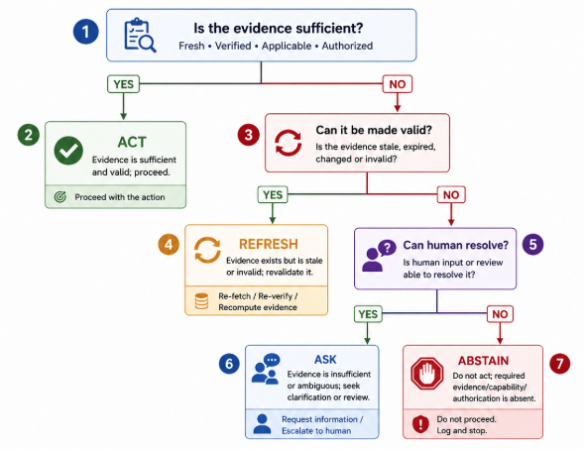
When Resuming Execution Is Not Enough
WHAT is the problem? → WHY does it matter? → HOW does EGAH address it? → WHERE does it apply? → WHO needs it?. Harness provides reusable, cross-cutting governance
What traditional applications address workflow by workflow. EAGH governs consistently through a shared harness layer.
EGAH is run-time governance layer that persists/ensures that an AI agent resumes with valid evidence not just recovered state.
a. Durable Execution State: Where are we?
b. Durable Evidence State: What justifies us being here?
c. Policy / Decision Control: What are we allowed to do next?
ACT → REFRESH → ASK → ABSTAIN
ACT: Evidence is sufficient and valid; proceed
REFRESH: Evidence exists but is stale or changed; revalidate it
ASK: Evidence is insufficient or ambiguous; seek clarification or human review
ABSTAIN: Do not act; required evidence/capability/authorization is absent
WHAT
State can be recovered but decision basis may not still be valid.
WHY
Evidence may expire or change while execution is interrupted
HOW
Restore and validate decision basis before continuation.
WHERE/ WHO
AI agents & long-running workflows where actions matter.
Evidence-Governed Agent Harnesses | Fifth Elephant Hyderabad | 2026
Notes:
Timing: 0:45–3:15. Establish the distinction; do not survey frameworks. Selection signal: one narrow production problem, not a grand framework claim.
[Sources]
- agentic-systems/eagh/README.md — Context and Problem Statement
- agentic-systems/eagh/src/egah/recovery.py — state-only vs evidence-governed recovery
[/Sources]

Slide 5
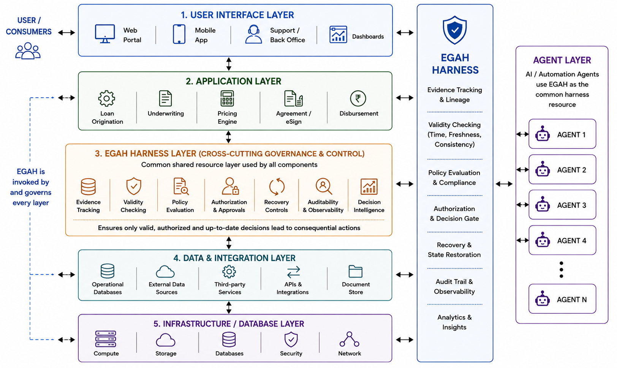
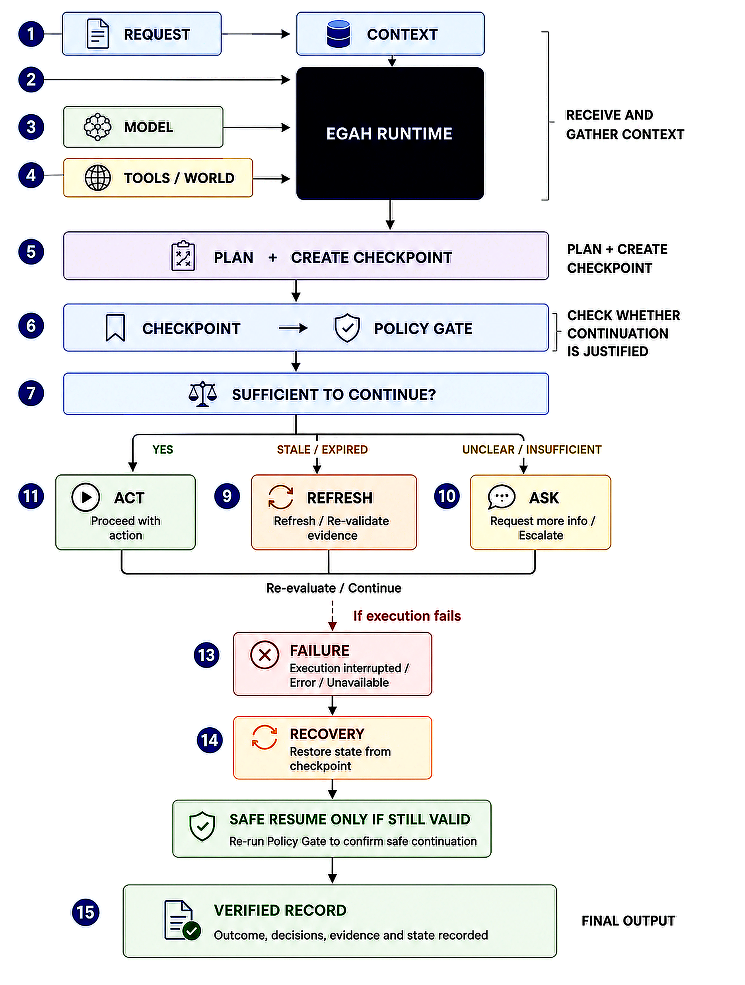
Architecture
End-to-end evidence-governed control layer between intelligent decision-making and consequential action
EMBEDDED SDK
Python library around consequential nodes; store + decide.
RUNTIME HOOKS
LangGraph, Temporal, Dapr or Prefect; SQL/NoSQL evidence stores.
SERVICE + EVENTS
REST/gRPC; OTel export; OPA/Cedar; bureau, KYC,fraud and pricing adapters.
Evidence-Governed Agent Harnesses | Fifth Elephant Hyderabad | 2026

Slide 6
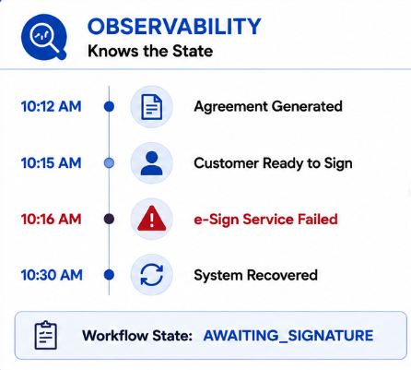
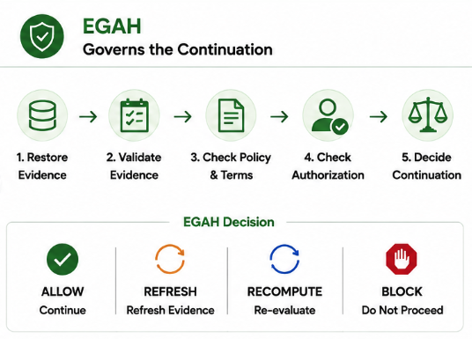
Observability vs EGAH
Knowing What Happened to Governing What’s Next. Telemetry gives EGAH inputs which leverages verified information into runtime governance state.
EAGH sits on top of observability, leveraging traces/telemetry with evidence to validate outcome/ continuation.
Type
Observability
EGAH
Primary question
What happened ?.
Can we safely continue ?.
Focus
Execution visibility
Evidence-governed action
Tracks
Logs, traces, metrics, events
Evidence, validity, provenance
After a crash
Where did workflow stop?.
Is previous decision still valid?.
Detects
Failures and anomalies
Valid, Stale/Invalid or insufficient
Recovery role
Helps diagnose and restore
Controls continuation allowed?
Output
Insight/ Visibility
ALLOW/ REFRESH/ RECOMPUTE/ BLOCK
Output
System failed/recovered during e-sign stage
Validate before allowing continuation
Evidence-Governed Agent Harnesses | Fifth Elephant Hyderabad | 2026
Notes:
Timing: 5:45–8:15. Define the minimum evidence envelope. Avoid claiming that every tool result deserves one; emphasize consequential boundaries.
[Sources]
- agentic-systems/eagh/src/egah/models.py — EvidenceEnvelope and VerificationRecord
- agentic-systems/eagh/src/egah/evidence_store.py — durable envelope, verification, and resource records
[/Sources]

Slide 7
EGAH complements OSS stack
EAGH makes the decision to continue itself evidence-governed and policy-controlled
Existing frameworks answer
Can the workflow resume?
EAGH additionally answers
Should the workflow resume, based on evidence that is still valid, fresh, authorized and sufficient?
Capability
Existing OSS(Open Source Software) strength
Why it is Not Sufficient Alone
LangGraph
Graph checkpoints, replay, HIL
Restores workflow state, but does not explicitly govern whether prior evidence is still valid
Temporal
Durable history and replay
Knows execution history, but not whether external facts have become stale
Dapr Workflow
Retries; signed history
Handles execution recovery, but not the lifecycle of evidence behind a decision
Prefect
Flow/task state and retries
Can resume execution, but continuation may require renewed authorization
OpenTelemetry
Traces, metrics, logs, baggage
Observes what happened, but does not decide whether it is safe to continue
Langfuse / Phoenix
LLM traces, evals, cost, latency
Provides observability, but does not maintain durable dependencies between evidence and consequential decisions
EGAH
Composes above any runtime
ACT · REFRESH · ASK · ABSTAIN
Evidence-Governed Agent Harnesses | Fifth Elephant Hyderabad | 2026
Notes:
Capability review, not a hands-on product benchmark. The comparison identifies documented strengths and the domain semantics EGAH adds; it does not claim these tools cannot be extended.
[Sources]
- https://docs.langchain.com/oss/python/langgraph/persistence — checkpoints, replay, fault tolerance
- https://docs.temporal.io/temporal — durable execution and event history
- https://docs.dapr.io/developing-applications/building-blocks/workflow/workflow-overview/ — durable workflows, signed history and history propagation
- https://docs.prefect.io/v3/concepts/flows — flow state, retries and observability
- https://opentelemetry.io/docs/concepts/signals/ — traces, metrics, logs and baggage
- https://langfuse.com/docs/observability/overview — LLM tracing, evaluations, latency and cost
- https://arize.com/docs/phoenix/tracing/tutorial — open-source tracing
[/Sources]

Slide 8
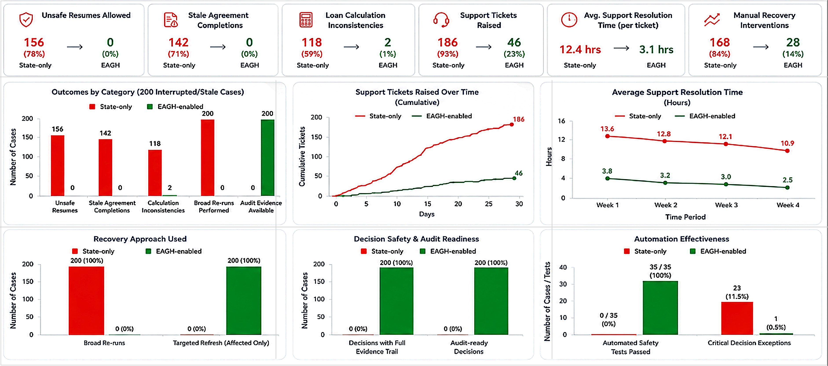
Impact: Operations & Risk Outcomes
State-only vs EAGH enabled operating model
Evidence-Governed Agent Harnesses | Fifth Elephant Hyderabad | 2026
Notes:
This is an operating-model comparison, not measured production productivity. Instrument a pilot for mean time to identify the invalid dependency, operator touch time, repeat-work ratio, audit-response time, and false-safe-resume rate.
[Sources]
- agentic-systems/eagh/src/egah/evidence_store.py — run/evidence/verification/resource records
- agentic-systems/eagh/src/egah/recovery.py — explicit revalidation plan and reasons
- agentic-systems/eagh/resources/documents/cfp/egah_review_preparation_guide.md — operational value and pilot boundary
[/Sources]

Slide 9

Learnings & Limitations
Key insights gained, current limitations, and areas for future evolution
Learning
What the PoC exposed
Next engineering step
Evidence Freshness
TTL alone cannot determine validity
Support events, versions and authorization checks
Selective Checkpointing
Checkpointing every step is wasteful
Place at consequential decision boundaries
Dependency Awareness
Stale inputs invalidate downstream decisions
Maintain evidence dependency relationships
Limitations
What the PoC exposed
Next engineering step
Live Staleness Detection
Aging simulated by workflow position
No real-time invalidation from providers
Performance
~28% median latency overhead
Checkpointing must remain selective
Scope Fit
Best for deterministic/predictable risky work-flows
Low-risk workflows may not justify EAGH overhead
Evidence-Governed Agent Harnesses | Fifth Elephant Hyderabad | 2026
Notes:
Each roadmap item follows directly from a prototype limitation observed in the current code and tests.
[Sources]
- agentic-systems/eagh/src/egah/models.py — current envelope schema and validity logic
- agentic-systems/eagh/src/egah/evidence_store.py — separate SQLite commits
- agentic-systems/eagh/src/egah/recovery.py — plan generation
- agentic-systems/eagh/resources/documents/cfp/egah_review_preparation_guide.md — production extensions
[/Sources]

