Slide 1
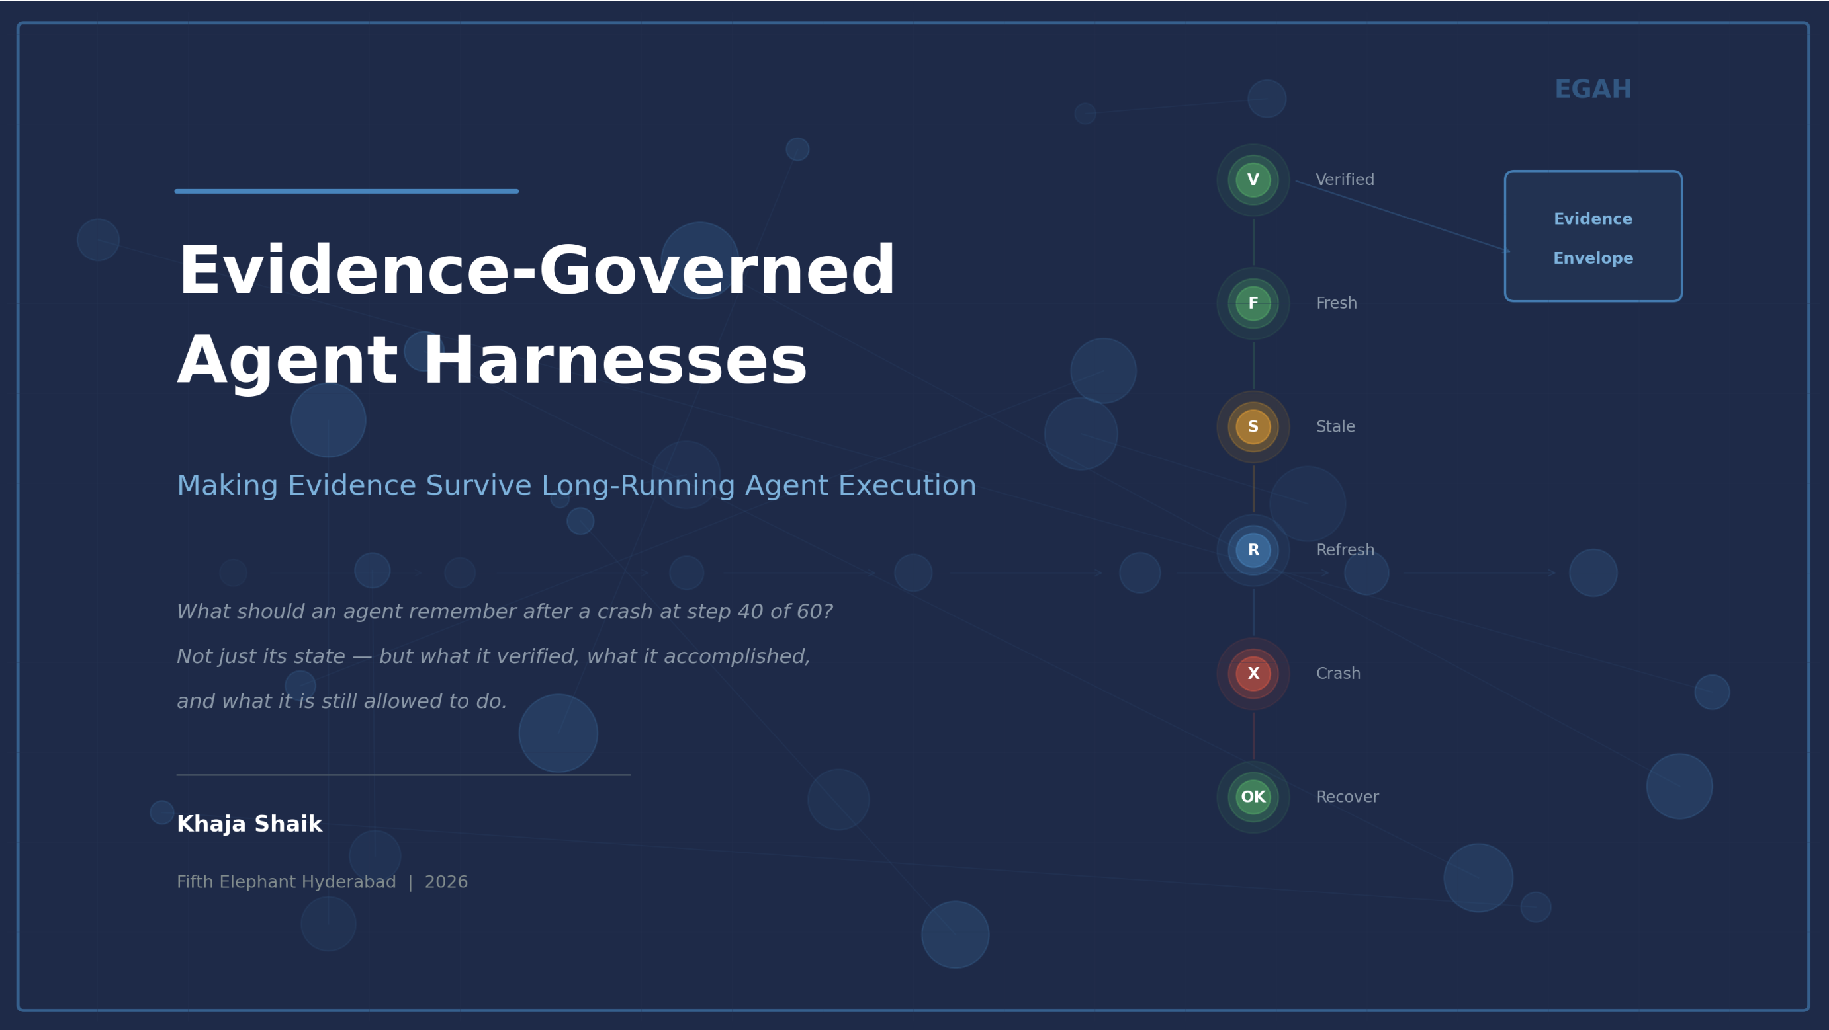
Evidence-Governed Agent Harnesses
Making Evidence Survive Long-Running Agent Execution
What should an agent remember after a crash at step 40 of 60?
Not just its state — but what it verified, what it accomplished and what it is still allowed to do.
Khaja Shaik
Fifth Elephant Hyderabad | 2026

Slide 2
The production gap
Modern harnesses restore execution state. They do not necessarily restore decision-worthy evidence.
A checkpoint answers WHERE to resume. Safe continuation also needs WHAT was known, verified, still fresh, and authorized.
The distinction matters most in:
LONG-RUNNING
Evidence can expire
before later actions.
CRASH + RESUME
Execution returns;
evidence context may not.
CONSEQUENTIAL ACTIONS
Stale inputs can
change the outcome.
Evidence-Governed Agent Harnesses | Fifth Elephant Hyderabad | 2026
Notes:
Timing: 0:45–3:15. Establish the distinction; do not survey frameworks. Selection signal: one narrow production problem, not a grand framework claim.
[Sources]
- agentic-systems/eagh/README.md — Context and Problem Statement
- agentic-systems/eagh/src/egah/recovery.py — state-only vs evidence-governed recovery
[/Sources]

Slide 3
A crash preserves state—not evidence
Implemented PoC · 10-step document analysis · evidence at steps 3, 6, 9 · crash at step 7
Steps 1–6 complete → step 7 crashes → recovery must decide what remains usable
What the trace can restore
What recovery must decide
Steps completed: 1–6
Outputs and resource records
Two evidence envelopes
Crash location: step 7
Execution can restart
Is step 3 evidence fresh?
Is step 6 evidence valid?
Was each envelope verified?
Must evidence be refreshed?
Is continuation authorized?
Evidence-governed recovery
Step 3 — Extract Entities
REFRESH
simulated stale evidence
Step 6 — Assess Risk
ACT
fresh and verified
Step 7 — Generate Findings
WAIT
resume only after required refresh
Decision: refresh stale evidence, then resume from step 7
Evidence-Governed Agent Harnesses | Fifth Elephant Hyderabad | 2026
Notes:
Timing: 3:15–5:45. Narrate the actual local PoC. Be explicit that staleness is simulated for demonstration; the preservation and recovery paths are implemented.
[Sources]
- agentic-systems/eagh/src/egah/egah_agent.py — WORKFLOW_STEPS and CHECKPOINT_STEPS
- agentic-systems/eagh/src/egah/recovery.py — egah_recovery(simulate_stale=True)
- agentic-systems/eagh/tests/test_egah.py — crash-at-step-7 tests
[/Sources]

Slide 4
Evidence is first-class runtime state
An envelope carries the decision context—not just the value
Source / Provenance
Where did it originate?
Observed at
When was it captured?
Freshness / Validity
Is it still applicable?
Verification
Was it checked, and by whom?
Content
What was observed?
Resource record
What did this step cost?
Outcome link
Which decision did it support?
A checkpoint stores position. An evidence envelope stores the basis for safe continuation.
Evidence-Governed Agent Harnesses | Fifth Elephant Hyderabad | 2026
4 / 9
Notes:
Timing: 5:45–8:15. Define the minimum evidence envelope. Avoid claiming that every tool result deserves one; emphasize consequential boundaries.
[Sources]
- agentic-systems/eagh/src/egah/models.py — EvidenceEnvelope and VerificationRecord
- agentic-systems/eagh/src/egah/evidence_store.py — durable envelope, verification, and resource records
[/Sources]

Slide 5
The harness adds a policy gate to the loop
Checkpoint only where the next action depends on durable evidence
Traditional: Plan → Tool → Result → Next
EGAH: Plan → Checkpoint → Tool → Verify → Update evidence → Decide
At a consequential boundary
After a crash
1. Capture execution + evidence state
2. Persist provenance, time and content
3. Verify against policy
4. ACT / REFRESH / ASK / ABSTAIN
1. Restore state, envelopes and history
2. Recheck freshness and validity
3. Build a recovery plan
4. Resume, refresh, escalate—or stop
Evidence-Governed Agent Harnesses | Fifth Elephant Hyderabad | 2026
Notes:
Timing: 8:15–11:15. Walk the two loops. The useful abstraction is the policy gate and durable evidence record; the rest should be judged by measured reliability benefit.
[Sources]
- agentic-systems/eagh/src/egah/egah_agent.py — checkpoint and verification flow
- agentic-systems/eagh/src/egah/models.py — PolicyDecision
- agentic-systems/eagh/src/egah/recovery.py — recovery plan generation
[/Sources]

Slide 6
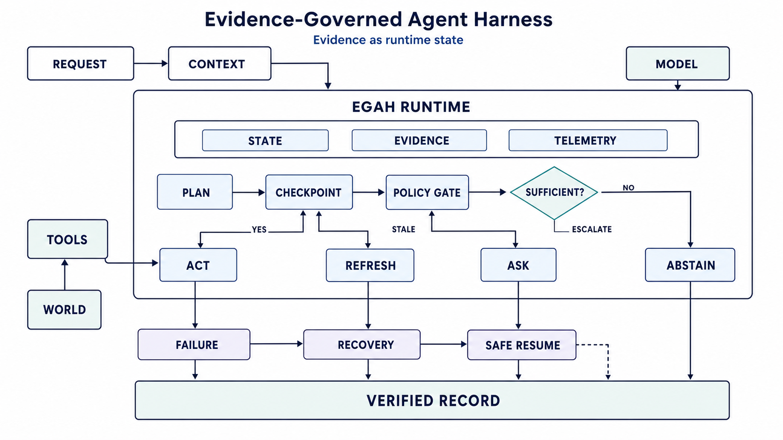
Architecture
End-to-end evidence-governed workflow
Three core subsystems: State (graph, checkpoints, memory) · Evidence (provenance, validity, verification) · Telemetry (tokens, cost, latency)
Flow: Plan → Checkpoint → Policy Gate → Sufficient? → ACT / REFRESH / ASK / ABSTAIN
Evidence-Governed Agent Harnesses | Fifth Elephant Hyderabad | 2026

Slide 7
Recovery must restore the decision basis
Aspect
Traditional Recovery
EGAH Recovery
Execution state
Restored
Restored
Evidence state
Not checked
2 envelopes restored
Verification history
Not analysed
2 records analysed
Evidence freshness
Unknown
Step 3 stale; step 6 fresh
Resume decision
Resume at step 7
Refresh, then resume
Risk
May use stale evidence
Policy-gated continuation
Audit trail
Recovery gap
Continuous recovery record
Evidence-Governed Agent Harnesses | Fifth Elephant Hyderabad | 2026
Notes:
Timing: 15:15–18:15. Make the decision contrast explicit: both approaches restore execution; only one evaluates whether prior evidence supports continuation.
[Sources]
- agentic-systems/eagh/src/egah/recovery.py — traditional_recovery and egah_recovery
- agentic-systems/eagh/tests/test_egah.py — TestRecovery and TestCrashAtStep7Scenario
[/Sources]

Slide 8
Five-minute demo
Local Streamlit PoC · simulated mode works without an API key
1
Run the 10-step document workflow and inject a crash at step 7
2
Inspect two preserved evidence envelopes and verification records
3
Compare state-only recovery with evidence-governed recovery
4
Mark step 3 stale; generate a REFRESH recommendation
5
Resume safely and inspect the audit and resource trail
6
Local verification: 35 automated tests pass
The demo must show a changed recovery decision—not only a restored screen.
Evidence-Governed Agent Harnesses | Fifth Elephant Hyderabad | 2026
Notes:
Timing: 20:00–25:00. Rehearse a deterministic path: reset → crash at 7 → Evidence Inspector → Recovery comparison → EGAH plan → resume. Keep screenshots ready as fallback.
[Sources]
- agentic-systems/eagh/src/egah/app.py — Streamlit demo tabs and controls
- agentic-systems/eagh/README.md — simulated mode and demo behavior
- Local command on 2026-08-28: python3 -m pytest -q — 35 passed
[/Sources]

Slide 9
What should earn a place in the harness?
Six production checks
1
Separate execution state from evidence state
2
Persist provenance, freshness and verification
3
Revalidate at consequential boundaries
4
Use evidence-backed capability boundaries for smaller models
5
Link tokens and cost to verified outcomes
6
Measure reliability gain against harness overhead
After a crash, remember not only WHERE the agent was—but WHY it may continue.
Discussion: Which actions in your system deserve an evidence checkpoint?
Evidence-Governed Agent Harnesses | Fifth Elephant Hyderabad | 2026
9 / 9
Notes:
Timing: 18:15–20:00, then return here after the demo if needed. Close with the audience question and reserve 25:00–30:00 for Q&A.
[Sources]
- agentic-systems/eagh/README.md — central result and key takeaways
- agentic-systems/eagh/src/egah/models.py — evidence and policy boundaries
[/Sources]

Slide 10
Recovery has two separate failure modes
Execution recovery restores control flow; evidence-validity recovery restores permission to continue.
A resumed workflow is not safe merely because it is runnable. Required evidence must still be current, verified and authorized.
Two layers—one explicit boundary:
EXECUTION RECOVERY
Restores checkpoint,
state and next step.
EVIDENCE-VALIDITY
RECOVERY
Rechecks freshness,
provenance and policy.
EGAH'S FOCUS
Turns validity into
ACT / REFRESH /
ASK / ABSTAIN.
Evidence-Governed Agent Harnesses | Fifth Elephant Hyderabad | 2026
Notes:
Opening: separate recovery of execution mechanics from recovery of the decision basis. EGAH focuses on the second and can use the first.
[Sources]
- agentic-systems/eagh/README.md — Context, Problem Statement and Solution Approach
- agentic-systems/eagh/src/egah/recovery.py — traditional_recovery and egah_recovery
[/Sources]

Slide 11
EGAH complements the OSS stack
Capability
Existing OSS strength
Gap EGAH makes explicit
LangGraph
Graph checkpoints, replay, HIL
Evidence schema + validity gate
Temporal
Durable history and replay
External-fact freshness
Dapr Workflow
Retries; signed history
Decision-evidence lifecycle
Prefect
Flow/task state and retries
Resume-authorization policy
OpenTelemetry
Traces, metrics, logs, baggage
Executable continuation decision
Langfuse / Phoenix
LLM traces, evals, cost, latency
Durable evidence dependencies
EGAH
Composes above any runtime
ACT · REFRESH · ASK · ABSTAIN
Evidence-Governed Agent Harnesses | Fifth Elephant Hyderabad | 2026
Notes:
Capability review, not a hands-on product benchmark. The comparison identifies documented strengths and the domain semantics EGAH adds; it does not claim these tools cannot be extended.
[Sources]
- https://docs.langchain.com/oss/python/langgraph/persistence — checkpoints, replay, fault tolerance
- https://docs.temporal.io/temporal — durable execution and event history
- https://docs.dapr.io/developing-applications/building-blocks/workflow/workflow-overview/ — durable workflows, signed history and history propagation
- https://docs.prefect.io/v3/concepts/flows — flow state, retries and observability
- https://opentelemetry.io/docs/concepts/signals/ — traces, metrics, logs and baggage
- https://langfuse.com/docs/observability/overview — LLM tracing, evaluations, latency and cost
- https://arize.com/docs/phoenix/tracing/tutorial — open-source tracing
[/Sources]

Slide 12
Adapter-first integration
EGAH can sit beside existing workflow, data, policy and observability investments.
Current PoC: Python package + SQLite + Streamlit. Production interfaces below are a staged roadmap—not implemented claims.
Three community entry points:
EMBEDDED SDK
Python library around
consequential nodes;
store + decide.
RUNTIME HOOKS
LangGraph, Temporal,
Dapr or Prefect; SQL/
NoSQL evidence stores.
SERVICE + EVENTS
REST/gRPC; OTel export;
OPA/Cedar; bureau, KYC,
fraud and pricing adapters.
Evidence-Governed Agent Harnesses | Fifth Elephant Hyderabad | 2026
Notes:
Current versus roadmap: the current repository is an importable Python package with SQLite persistence and a Streamlit UI. Runtime adapters, service APIs, production stores, policy engines and provider integrations are proposed extension points.
[Sources]
- agentic-systems/eagh/pyproject.toml — Python packaging
- agentic-systems/eagh/src/egah/evidence_store.py — SQLite repository
- agentic-systems/eagh/src/egah/app.py — Streamlit interface
- agentic-systems/eagh/README.md — technology boundaries
[/Sources]

Slide 13
Safety gain has a measurable cost
Metric
State-only baseline
EGAH · 3 checkpoints
Median · 10 steps
13.53 ms
17.31 ms (+28.0%)
p95 · 10 steps
15.63 ms
21.24 ms (+35.8%)
Throughput
73.9 workflows/s
57.8/s (−21.9%)
Logical payload
6.70 KB / run
10.66 KB (+3.95 KB)
Recovery assessment
0.157 ms
0.539 ms (+0.382)
Stale-case block
0 / 200
200 / 200 unsafe resumes
Automated tests
Same codebase
35 / 35 passing
Evidence-Governed Agent Harnesses | Fifth Elephant Hyderabad | 2026
Notes:
Method: local simulated-mode microbenchmark on 2026-08-29, Python 3.9 + SQLite, no network or LLM calls. Ten warm-ups plus 200 measured runs per execution variant; 200 crash/recovery trials. “Logical payload” sums JSON data lengths, not allocated database pages. These are PoC measurements, not production SLAs.
[Sources]
- /private/tmp/egah-deck-v14.R3crmb/benchmark_egah.py — benchmark method
- Local benchmark output on 2026-08-29 — values shown on slide
- Local command: PYTHONPATH=src python3 -m pytest tests/ -q — 35 passed in 1.05s
[/Sources]

Slide 14
Operations move to targeted action
Event
State-only operating model
EGAH-enabled model
Failure
Restart at checkpoint
Assess evidence before restart
Alert
Crash, retry, latency
+ stale / invalid / policy signal
Incident triage
Correlate logs + DB manually
Run → evidence → verification
Support ticket
Broad rerun or manual checks
Refresh affected provider only
Audit query
Assemble proof after event
Query envelope + decision
Escalation
Operator infers next action
ASK / ABSTAIN with reason
Pilot KPI
MTTI + touch time unmeasured
Measure before / after; no claim
Evidence-Governed Agent Harnesses | Fifth Elephant Hyderabad | 2026
Notes:
This is an operating-model comparison, not measured production productivity. Instrument a pilot for mean time to identify the invalid dependency, operator touch time, repeat-work ratio, audit-response time, and false-safe-resume rate.
[Sources]
- agentic-systems/eagh/src/egah/evidence_store.py — run/evidence/verification/resource records
- agentic-systems/eagh/src/egah/recovery.py — explicit revalidation plan and reasons
- agentic-systems/eagh/resources/documents/cfp/egah_review_preparation_guide.md — operational value and pilot boundary
[/Sources]

Slide 15
Loan journey: each decision earns a gate
Scenario demo · customer reaches signature after a long interruption
1
Application and consent captured
2
KYC and sanctions checks verified → evidence A
3
Bureau score 742; valid for 2 hours → checkpoint B
4
Fraud signals + underwriting policy evaluated → checkpoint C
5
Offer generated: 10.25%, clauses v17 → document hash D
6
Customer views offer; network fails before signature
Execution can resume at signature. The decision evidence supporting that agreement may no longer be valid.
Evidence-Governed Agent Harnesses | Fifth Elephant Hyderabad | 2026
Notes:
Scenario parameters are illustrative and are not a bank SLA or a claim about any bureau's actual validity window. Use the sequence to demonstrate where evidence dependencies are captured before pricing and signature.
[Sources]
- agentic-systems/eagh/resources/documents/cfp/egah_review_preparation_guide.md — representative loan process
- agentic-systems/eagh/src/egah/models.py — evidence validity and provenance fields
[/Sources]

Slide 16
Recovery must re-earn permission to sign
Three hours later · bureau expired · fraud signal changed · pricing moved
1
Restore “await signature”; load evidence A / B / C / D
2
Reassess: KYC current; bureau expired; fraud changed
3
Policy returns REFRESH; invalidate the v17 agreement
4
Re-fetch bureau + fraud; rerun affected underwriting
5
Pull current rate + clauses; generate v18 and a new hash
6
Expose only v18 for signature; append verification + audit
Safe continuation means the obsolete 10.25% agreement cannot be signed. Only the regenerated, currently justified offer remains active.
Evidence-Governed Agent Harnesses | Fifth Elephant Hyderabad | 2026
Notes:
Demo narration: the restored screen is not the outcome. The changed decision is: invalidate the stale agreement, refresh only affected dependencies, create a new verified offer, and expose only the new version for signature. Live provider refresh is roadmap, not implemented.
[Sources]
- agentic-systems/eagh/resources/documents/cfp/egah_review_preparation_guide.md — recovery flow and honest limits
- agentic-systems/eagh/src/egah/recovery.py — RecoveryPlan and revalidation_required
[/Sources]

Slide 17
Implementation lessons shape the roadmap
Learning
What the PoC exposed
Next engineering step
Evidence semantics
A value alone is insufficient
Typed provider schemas + hashes
Freshness
TTL is only one invalidator
Events, versions, authorization
Checkpoint placement
Every step is wasteful
Risk-based action boundaries
Dependency refresh
Stale input invalidates outputs
Evidence dependency DAG
Atomicity
Separate commits can diverge
Transactional outbox + HA store
Enforcement
UI guard is not sufficient
Plan-bound backend resume API
Privacy
Evidence may be sensitive
Minimize, encrypt, retain, control
Evidence-Governed Agent Harnesses | Fifth Elephant Hyderabad | 2026
Notes:
Each roadmap item follows directly from a prototype limitation observed in the current code and tests.
[Sources]
- agentic-systems/eagh/src/egah/models.py — current envelope schema and validity logic
- agentic-systems/eagh/src/egah/evidence_store.py — separate SQLite commits
- agentic-systems/eagh/src/egah/recovery.py — plan generation
- agentic-systems/eagh/resources/documents/cfp/egah_review_preparation_guide.md — production extensions
[/Sources]

Slide 18
Where EGAH does not fit
Limitation
Current PoC truth
Why it matters
Verification
Output length > 10 chars
Not factual correctness
Staleness
Demo aging by step position
No live invalidation feed
Refresh
Recommendation only
No bureau / fraud adapter
Execution
Sequential Python loop
LangGraph graph not active
Persistence
SQLite; separate commits
Not HA or crash-atomic
Performance
+28% median local latency
Checkpoint selectively
Poor fit
Short, low-risk, deterministic
Policy/storage may not pay back
Evidence-Governed Agent Harnesses | Fifth Elephant Hyderabad | 2026
Notes:
Do not overclaim the PoC. Verification is syntactic, demo staleness is simulated, refresh adapters are absent, orchestration is sequential, and SQLite is not a production HA design. EGAH is inappropriate when evidence cannot become stale or the next action is low-consequence and cheap to replay.
[Sources]
- agentic-systems/eagh/src/egah/egah_agent.py — simplified verification and sequential execution
- agentic-systems/eagh/src/egah/recovery.py — simulated staleness and recommendation-only refresh
- agentic-systems/eagh/src/egah/evidence_store.py — SQLite persistence
- agentic-systems/eagh/resources/documents/cfp/egah_review_preparation_guide.md — honest technical limits
[/Sources]

Slide 19
What this submission proves
Objective evidence for a practitioner-focused CFP
1
Problem is precise: resume position ≠ valid decision basis
2
Distinct gap: complements durable engines and observability
3
Working core: envelopes, verification, recovery plan, audit
4
Repeatable proof: 35/35 tests; 200/200 stale cases blocked
5
Measured cost: +28% latency; +3.95 KB logical payload/run
6
Honest boundary: live refresh, policy/authorization + HA remain
Evaluate EGAH as a composable evidence-governance layer at consequential recovery boundaries.
Reviewer decision: Is the control problem clear, testable and useful to practitioners?
Evidence-Governed Agent Harnesses | Fifth Elephant Hyderabad | 2026
19 / 19
Notes:
Close on the differentiated, testable claim. Offer the framework as a composable experiment for consequential recovery boundaries, not as a finished production platform.
[Sources]
- agentic-systems/eagh/README.md — implemented PoC scope
- agentic-systems/eagh/tests/test_egah.py — automated coverage
- Local pytest and microbenchmark outputs on 2026-08-29
[/Sources]

