Slide 1
Evidence-Governed Agent Harnesses
Making Evidence Survive Long-Running Agent Execution
What should an agent remember after a crash at step 40 of 60?
Not just its state — but what it verified, what it accomplished and what it is still allowed to do.
Khaja Shaik
Fifth Elephant Hyderabad | 2026

Slide 2
Purpose
CEGAH proposition
"Observability tells us what happened. EGAH determines whether what happened is still sufficient evidence for what the agent is about to do."
A working, demoable implementation why evidence must be treated as durable runtime state, not just telemetry.
• Evidence checkpoints at consequential workflow boundaries
• Crash recovery with evidence-governed continuation
• Verification history and resource accounting
• Full audit trail from request to outcome
• Interactive Traditional vs EGAH recovery comparison
Evidence-Governed Agent Harnesses | Fifth Elephant Hyderabad | 2026

Slide 3
Context
Agent engineering has progressed from prompts to context, harnesses, loops and graphs. Most production agent frameworks now provide checkpointing, state persistence and observability.
Critical gap: Checkpoint recovery can restore WHERE the agent was without restoring WHAT the agent knew, verified, accomplished, and is still authorized to do.
This gap becomes consequential in:
Long-running workflows Evidence collected early may become stale before later actions execute
Crash-and-resume scenarios Agent restores execution state but loses evidentiary context
Consequential actions Acting on unverified or expired evidence produces unsafe outcomes
Evidence-Governed Agent Harnesses | Fifth Elephant Hyderabad | 2026

Slide 4
Real-World Production Scenario
Bank AI agent · Loan application · 10-step pipeline · Crash at step 7
Crashes at 2:14 PM (pod eviction) → Recovers at 5:47 PM → 3.5 hours later
What Observability Provides
What Observability Cannot Answer
✅ Full trace of steps 1–7
✅ Every LLM call, latency, token count
✅ Cost: ₹2.40 across 7 steps
✅ Pod eviction error logged
✅ "What happened?" — answered
❌ Is credit score (1:58 PM) still valid?
❌ Is employment verification current?
❌ Have fraud signals changed?
❌ Is risk assessment still applicable?
❌ Is the agent still authorized?
EGAH Recovery Plan at 5:47 PM
Step 2 — Credit Score
→ REFRESH
(stale, TTL 2h exceeded by 3h 49m)
Step 3 — Employment
→ ACT
(fresh, TTL 24h, only 3h 45m old)
Step 6 — Risk Assessment
→ REFRESH
(upstream dependency on stale credit score)
Decision: REFRESH steps 2, 6 → then RESUME at step 7
Evidence-Governed Agent Harnesses | Fifth Elephant Hyderabad | 2026

Slide 5
Problem Statement
10-step document analysis agent · Evidence checkpoints at steps 3, 6, 9 · Crash at step 7
Step 01
Receive Document
✅ completed
Step 02
Parse Structure
✅ completed
Step 03
Extract Entities
✅ 🔒 CHECKPOINT
Step 04
Classify Content
✅ completed
Step 05
Cross-Reference
✅ completed
Step 06
Assess Risk
✅ 🔒 CHECKPOINT
Step 07
Generate Findings
💥 CRASH
Step 08
Validate Findings
⬜ pending
Step 09
Create Report
⬜ 🔒 CHECKPOINT
Step 10
Finalize & Sign-off
⬜ pending
Traditional recovery resumes at step 7 — blindly. No check on entity validity, risk freshness, authorization, or evidence state.
State survived. But did the evidence survive?
Evidence-Governed Agent Harnesses | Fifth Elephant Hyderabad | 2026

Slide 6
How EGAH Differs from Existing Observability
What already exists (OTel, Langfuse, Phoenix, Datadog)
What EGAH adds on top
• LLM generations, tool calls, retrieval
• Token usage, cost, latency
• Hierarchical traces across steps
• Quality scores and evaluations
• Answer: "What happened?"
• Decision-bearing evidence layer
• Evidence envelopes with provenance & TTL
• Freshness analysis and validity checks
• Policy: ACT / REFRESH / ASK / ABSTAIN
• Answer: "What can happen next?"
Dimension
Observability
EGAH
Primary question
What happened?
What can happen next?
Purpose
Records execution
Governs continuation
Nature
Retrospective
Prospective
Verification
Not built-in
First-class
Freshness
Timestamp on logs
Active validity analysis
Crash recovery
Shows trace to crash
Restores + validates evidence
Policy decisions
Not applicable
ACT / REFRESH / ASK / ABSTAIN
Evidence-Governed Agent Harnesses | Fifth Elephant Hyderabad | 2026

Slide 7
Solution Approach
EGAH introduces an evidence layer directly into the agent execution graph
Traditional: Plan → Tool Call → Result → Next Step
EGAH: Plan → Evidence Checkpoint → Tool Call → Result Verification → Evidence Update → Next Step
At each evidence checkpoint:
On crash recovery, EGAH:
1. Captures current execution + evidence state
2. Creates an evidence envelope
(provenance, timestamp, content, status)
3. Verifies evidence against a policy
4. Decides: ACT / REFRESH / ASK / ABSTAIN
5. Persists envelope + verification durably
1. Restores execution state
2. Restores evidence state (all envelopes)
3. Restores verification history
4. Analyses evidence freshness & validity
5. Generates a recovery plan
(resume / refresh / escalate / abstain)
Evidence-Governed Agent Harnesses | Fifth Elephant Hyderabad | 2026

Slide 8
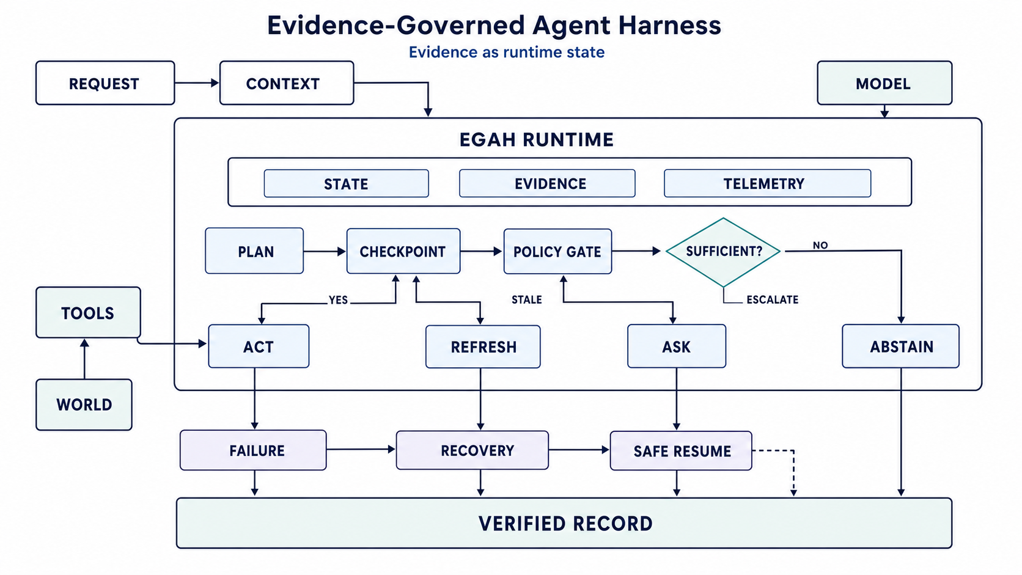
Architecture
End-to-end evidence-governed workflow
Three core subsystems: State (graph, checkpoints, memory) · Evidence (provenance, validity, verification) · Telemetry (tokens, cost, latency)
Flow: Plan → Checkpoint → Policy Gate → Sufficient? → ACT / REFRESH / ASK / ABSTAIN
Evidence-Governed Agent Harnesses | Fifth Elephant Hyderabad | 2026

Slide 9
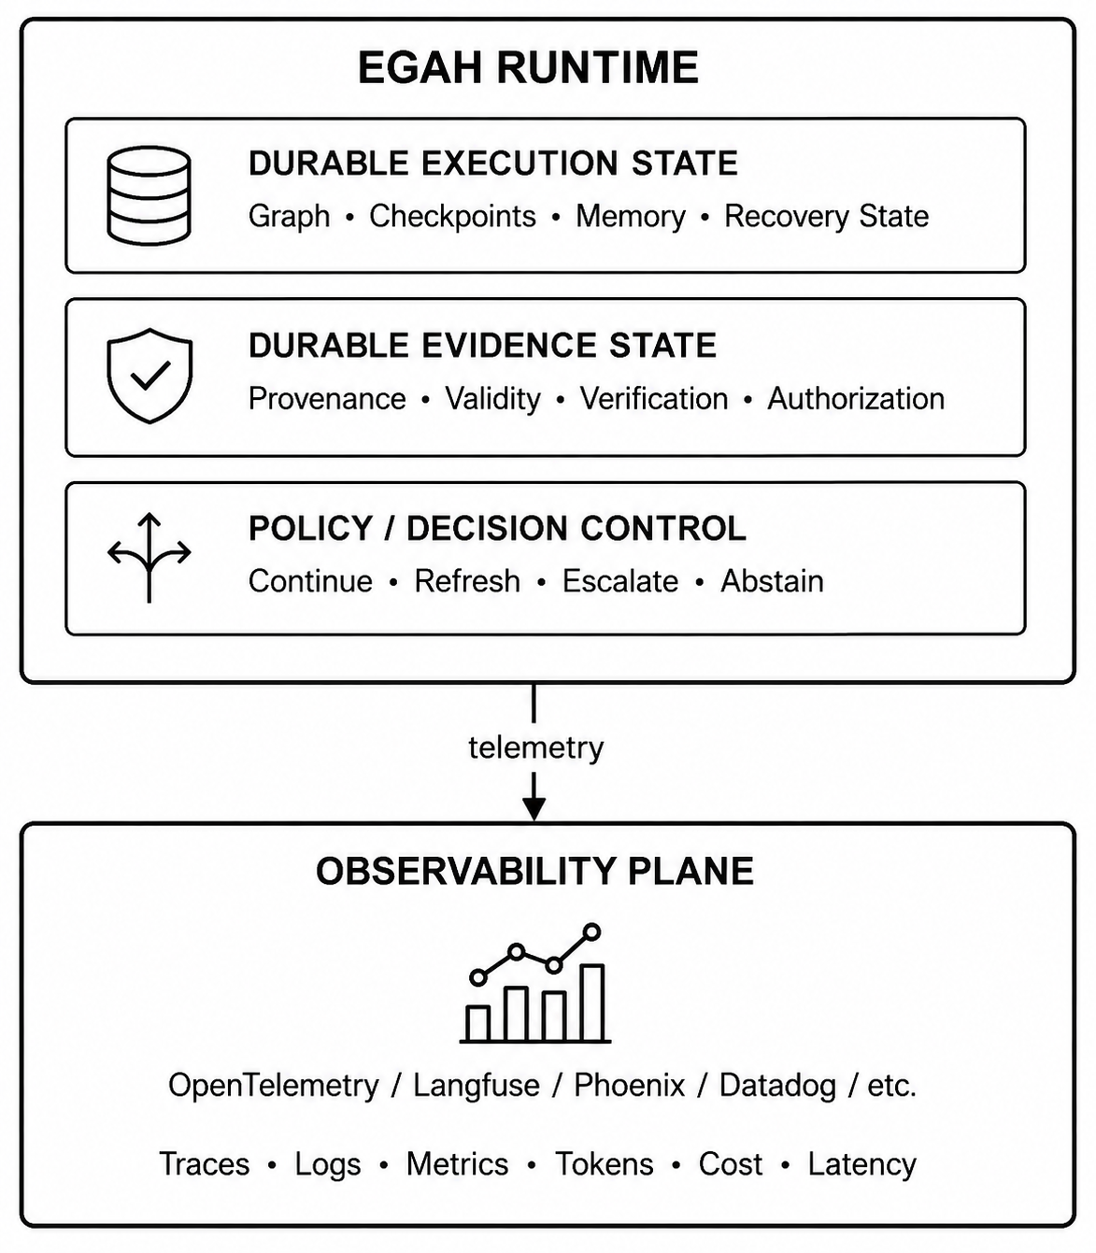
Runtime & Observability Plane
EGAH sits above observability — consumes telemetry but governs continuation
Durable evidence state with verification and policy control above the observability plane
Evidence-Governed Agent Harnesses | Fifth Elephant Hyderabad | 2026

Slide 10
The 10-Step Example — Normal Execution
Step 01
Receive Document
✅ output recorded
Step 02
Parse Structure
✅ output recorded
Step 03
Extract Entities
✅ 🔒 Evidence Envelope created + verified
Step 04
Classify Content
✅ output recorded
Step 05
Cross-Reference
✅ output recorded
Step 06
Assess Risk
✅ 🔒 Evidence Envelope created + verified
Step 07
Generate Findings
✅ output recorded
Step 08
Validate Findings
✅ output recorded
Step 09
Create Report
✅ 🔒 Evidence Envelope created + verified
Step 10
Finalize & Sign-off
✅ output recorded
Result: 10 steps completed, 3 evidence envelopes, 3 verifications, full audit trail
Evidence-Governed Agent Harnesses | Fifth Elephant Hyderabad | 2026
8 / 17

Slide 11
Crash at Step 7 — Traditional vs EGAH Recovery
Aspect
Traditional Recovery
EGAH Recovery
Execution state
✅ Restored
✅ Restored
Evidence state
❌ Not checked
✅ Restored (2 envelopes)
Verification history
❌ Not analysed
✅ Analysed (2 records)
Evidence freshness
❌ Unknown
✅ Step 3 stale, Step 6 fresh
Resume decision
Blind resume at step 7
Conditional: refresh then resume
Risk
May act on expired evidence
Evidence-governed continuation
Audit trail
Gap between crash/resume
Full continuity with recovery
Evidence-Governed Agent Harnesses | Fifth Elephant Hyderabad | 2026

Slide 12
Outcome
The PoC demonstrates in a single end-to-end flow
1
Evidence checkpoints fire at steps 3, 6, 9 — creating durable evidence envelopes with provenance, verification, freshness, and resource consumption
2
Crash at step 7 — execution state persisted, evidence state persisted, verification history persisted
3
Traditional recovery — resumes blindly with 4 warnings about unchecked evidence
4
EGAH recovery — analyses 2 envelopes, flags 1 as stale, recommends revalidation
5
Full audit trail — every step, envelope, verification, token/cost record traceable
6
Interactive comparison — side-by-side Traditional vs EGAH in Streamlit UI
Central result: A production agent harness should persist not only WHERE the agent was, but also WHAT it knew, WHAT it verified, WHAT it accomplished, and WHAT it is still authorized to do.
Evidence-Governed Agent Harnesses | Fifth Elephant Hyderabad | 2026

Slide 13
The Outcome Difference
Without EGAH vs With EGAH
Without EGAH
With EGAH
Resumes using 1:58 PM credit score
Detects stale score, refreshes it
Offer on potentially outdated data
Offer on current, verified data
Credit drop 782→640 = incorrect offer
Catches change, recomputes risk
Compliance gap at resume
Full evidence trail preserved
Risk: regulatory violation, financial loss
Safe, evidence-governed, auditable continuation
EGAH exists not to replace observability, but to add the layer observability was never designed to provide: evidence governance for agent continuation.
Evidence-Governed Agent Harnesses | Fifth Elephant Hyderabad | 2026
13 / 17

Slide 14
Evidence as First-Class Runtime State
An evidence envelope carries more than a value
Identity / Provenance
Where did this evidence come from?
Observation Time
When was it captured?
Freshness TTL
How long is it considered valid?
Verification Status
Was it verified? By whom?
Content / Payload
What was actually observed?
Resource Consumption
Tokens, cost, latency for this step
Outcome Attribution
What decision did this evidence support?
From "I have a value" → "I have evidence that is traceable, verified and applicable"
Evidence-Governed Agent Harnesses | Fifth Elephant Hyderabad | 2026
14 / 17

Slide 15
The Evidence Lifecycle
Not every observation becomes evidence. Not every evidence is sufficient for action.
Tool Result / LLM Output
Raw output from execution
↓
Telemetry Event
← Observability captures this
↓
Evidence Candidate
Promoted to evidence candidate
↓
Verification
Provenance? Freshness? Integrity? Authorization?
↓
Durable Evidence
← EGAH persists this
↓
Policy Decision
ACT / REFRESH / ASK / ABSTAIN
Evidence-Governed Agent Harnesses | Fifth Elephant Hyderabad | 2026
15 / 17

Slide 16
Key Takeaways
What practitioners should leave with
1
Treat evidence as first-class runtime state in long-running agents
2
Preserve evidence and verification history alongside execution checkpoints
3
Revalidate evidence at consequential boundaries — not everything, everywhere
4
Use evidence-backed capability boundaries for smaller models
5
Link resource consumption to verified outcomes, not cost alone
6
Measure overhead and reliability benefit before adding harness abstractions
The harness should remember not only WHERE the agent was — but WHY it was allowed to continue.
State ≠ Evidence · Evidence needs lifecycle · Verify at boundaries · Capability boundaries · Semantic recovery · Governance earns its place
Evidence-Governed Agent Harnesses | Fifth Elephant Hyderabad | 2026
16 / 17

