Slide 1
HANDS-ON WORKSHOP
goose
$ brew install block-goose-cli
$ goose configure
◇ Configure Providers
◇ Anthropic
└ Saved
$ goose session
goose › _
Building with open-source AI agents
From “what is an agent?” to shipping a pull request — sessions, context engineering, recipes, tool permissions, MCP, ACP and the goose Development Kit.
Deconstruct the abstraction.
Expose the kernel truth.
Azeez Syed
AIYatra
Notes:
Welcome. Full-day, terminal-first workshop on goose. We go bottom-up: agent fundamentals, then goose itself, then every major feature, then architecture, then two live labs, then where the project is heading with GDK. Everything we cover maps to goose-docs.ai/docs/category/guides.

Slide 2
1
What Is an Agent?
Prompt → Context → Agent — 3 layers, each one strictly larger than the last
›
›
01
02
03
PROMPT
CONTEXT
AGENT
The instruction. Natural language describing intent. On its own a model can only produce text — “text in, text out.” No side effects, no state.
Everything the model can see this turn: conversation history, file contents, tool schemas, project rules. Context quality sets the ceiling on output quality.
All three in a loop. Model proposes a tool call → harness runs it → result is fed back → repeat until the goal is met or a limit is hit.
Why the Agent is the interesting part
• The model is stateless and cannot execute anything — it can only emit a JSON tool call. Something else has to run it.
• That “something else” decides what the model is allowed to touch, what happens when a call fails, and what stays in context.
• Swap the model and you change quality. Swap the harness and you change what the agent is capable of doing at all.
• Every agent product you know — goose, Claude Code, Cursor, Codex — is a harness competing on loop design, tooling and safety.
Reference: goose-docs.ai/docs/goose-architecture
Notes:
Land the point that the model is only one of four layers. Ask the room: who has written a for-loop around an LLM call? That is an agent in embryo. Everything else in goose is hardening that loop.

Slide 3
2
Introduction to goose
An open-source, on-machine AI agent — originally built at Block, now governed under the Agentic AI Foundation
What it actually is
Open source
github.com/aaif-goose/goose · AAIF, under the Linux Foundation
Written in Rust
Local-first runtime; Desktop + CLI share ~/.config/goose
goose is a local agent runtime that pairs an LLM with real tools and runs the loop on your machine. It reads and writes your files, runs shell commands, calls APIs, and keeps working until the task is done — not a chat window that suggests snippets.
It ships as a Desktop app and a CLI. Both share one configuration, and a session started in one can be resumed in the other.
Provider-agnostic
Anthropic, OpenAI, Gemini, Ollama, OpenRouter, Tetrate and more
MCP-native
Capabilities arrive as “extensions” = Model Context Protocol servers
What you get out of the box
$ goose session # start an interactive session
$ goose run -i plan.md # run instructions headlessly
$ goose configure # providers, extensions, perms
$ goose info -v # show every active setting
$ goose acp # expose goose as an ACP server
$ goose update # upgrade in place
goose › analyze the auth flow in src/ and
tell me what calls authenticate()
• Developer extension — shell, file edit, and the analyze tool
• Memory, Computer Controller, Chat Recall and other bundled MCPs
• Persistent sessions in SQLite, resumable across CLI and Desktop
• Recipes: shareable, parameterised, one-click workflows
• Skills, subagents, hooks, plugins and custom slash commands
• Four permission modes, from full autonomy to read-only chat
Reference: goose-docs.ai/docs/quickstart
Notes:
Emphasise: local-first and open source. The agent runs on your laptop, your keys stay in your keyring, and nothing forces you onto one model vendor. Mention the AAIF move (April 2026) — this is now foundation-governed, not a single-company project.

Slide 4
3
goose vs Claude Code, Cursor & Codex
They are all harnesses. They differ in openness, form factor and who owns the runtime.
goose
AAIF / open source
Claude Code
Anthropic
Cursor
Anysphere
Codex
OpenAI
Form factor
Desktop app + CLI + ACP server
CLI + IDE + desktop
Full IDE (VS Code fork) + CLI agent
CLI + cloud + IDE extension
Openness
Fully open source, Rust
Proprietary client
Proprietary
CLI open source, service is not
Model choice
Any provider; swap freely
Anthropic models
Mixed / routed models
OpenAI GPT-5 series
Extensibility
MCP extensions, recipes, skills, hooks, subagents
MCP servers, skills, subagents
IDE-centric rules and tooling
Skills, sandboxed execution
Where it wins
You own the runtime — embed or fork it
Deep Anthropic model integration
Best-in-class in-editor UX
Cloud-delegated long tasks
The twist: goose can drive the others
Configure claude-acp or codex-acp as ACP providers and goose delegates execution to Claude Code or Codex while keeping its own sessions, recipes and scheduling. The older pass-through CLI providers (claude-code, codex, cursor-agent, gemini-cli) still exist but are deprecated — and they do not give you goose’s extension ecosystem.
Reference: goose-docs.ai/docs/guides/acp-providers · /guides/cli-providers
Notes:
Be fair here — this is not a takedown. The honest differentiator for goose is that it is open source, model-agnostic and embeddable. Note the deprecation: CLI providers are backward-compat only, ACP providers are the supported path and they preserve MCP extensions.

Slide 5
4
Installation & Configuration
Desktop, CLI, or both — they share one configuration store
1 · Install
2 · Set an LLM provider
# macOS / Linux - CLI
curl -fsSL https://github.com/aaif-goose/goose/\
releases/download/stable/download_cli.sh | bash
# macOS via Homebrew
brew install block-goose-cli # CLI
brew install --cask block-goose # Desktop
# Windows (PowerShell)
.\download_cli.ps1
goose update # upgrade later
$ goose configure
┌ goose-configure
◇ What would you like to configure?
│ Configure Providers
◇ Which model provider should we use?
│ Anthropic
◇ Provider requires ANTHROPIC_API_KEY
│ ▪▪▪▪▪▪▪▪▪▪▪▪▪▪▪▪▪▪▪▪▪▪▪▪▪▪▪
└ Configuration saved successfully
Keys live in the keyring
Never in config.yaml — goose ignores keys there. Keyring, secrets.yaml, or an env var.
Desktop first-run options
Quick setup with an API key, ChatGPT subscription, Tetrate Agent Router, or OpenRouter.
Tool calling matters
The docs note goose leans heavily on tool calling and currently works best with Claude 4 models.
Pin versions in CI
Set GOOSE_VERSION for reproducible, non-interactive installs in pipelines.
Verify everything with goose info -v — it prints every active setting and where it came from.
Reference: goose-docs.ai/docs/getting-started/installation
Notes:
Lab checkpoint: everyone should have goose running and a provider configured before we move on. Free options: Google Gemini free tier, or Ollama for fully local. Windows users — decline the keyring prompt and use environment variables if you hit keyring errors.

Slide 6
5
The goose Folder Structure
Where state lives — and the precedence rules that decide which setting wins
~/.config/goose/ # macOS + Linux
├─ config.yaml provider, model, extensions,
│ global GOOSE_* settings
├─ permission.yaml tool permission levels
├─ secrets.yaml keys, only if no keyring
├─ permissions/
│ └─ tool_permissions.json runtime decisions (auto)
└─ prompts/ custom prompt templates
~/.local/share/goose/
├─ sessions/sessions.db SQLite store (v1.10.0+)
└─ recipes/ saved recipes
Windows: %APPDATA%\Block\goose\config\config.yaml
<your-repo>/
├─ AGENTS.md | .goosehints project context & rules
└─ .gooseignore paths goose must not touch
Precedence: highest wins
1. Environment variables
2. config.yaml settings
3. Built-in defaults
Settings worth knowing on day one
GOOSE_MODE — auto | approve | smart_approve | chat
GOOSE_MAX_TURNS — turns without input (default 1000)
GOOSE_AUTO_COMPACT_THRESHOLD — default 0.8
GOOSE_TEMPERATURE, GOOSE_MAX_TOKENS
GOOSE_ALLOWLIST — restrict installable extensions
SECURITY_PROMPT_ENABLED — injection detection
Gotcha worth ten minutes of debugging
goose does not read provider API keys from config.yaml. A key placed there is silently ignored and surfaces later as “No api key passed in.” Store it in the system keyring via goose configure, in secrets.yaml when no keyring is available (headless servers, containers, CI), or export the provider’s environment variable — which takes precedence over stored secrets. Direct file edits usually need a restart to affect existing sessions.
Reference: goose-docs.ai/docs/guides/config-files · /guides/environment-variables
Notes:
Open the config file live and walk it. Point out that extensions are just YAML entries with a type: builtin, platform, stdio, streamable_http, frontend, inline_python. Show available_tools as a token-saving filter.

Slide 7
6
Feature — Session Management
A session is one continuous interaction. goose treats it as a first-class, persistent object.
Start & name
Names are auto-generated from your first prompt; IDs use YYYYMMDD_<count>. Disable AI naming with GOOSE_DISABLE_SESSION_NAMING for CI.
Resume
goose session -r --name <name>. The 10 most recent sit in the Desktop sidebar; older ones come from Session History.
Search
Cmd+F within a session, or across sessions from history. Or just ask goose — the Chat Recall extension searches your history for you.
Duplicate vs Fork
Duplicate copies a whole session to reuse its setup. Fork branches from a specific edited message to explore a different path.
Import & export
Export any session to JSON for backup, sharing or migration; import creates a new session rather than overwriting.
Smart context
Automatic compaction at 80% of the window by default, plus a max-turns ceiling so a runaway loop stops on its own.
$ goose session # new session
$ goose session list -l 1 # most recent
20260213_9 - react-migration - 2026-02-13 16:20 UTC
$ goose session -r --name react-migration # resume
$ sqlite3 ~/.local/share/goose/sessions/sessions.db \
"SELECT id, description FROM sessions LIMIT 10;"
Practitioner rules
• Sessions auto-save on exit — nothing to commit.
• Start in Desktop, resume in the CLI. One database, both interfaces.
• New task, new session. Resuming a stale one invites a doom spiral.
• Deleting in Desktop deletes it in the CLI too. No undo.
Reference: goose-docs.ai/docs/guides/sessions
Notes:
The doom-spiral point is the practical one. Long sessions accumulate contradictory context; the model starts fighting its own history. New task, new session — treat it like a clean branch.

Slide 8
7
Feature — Context Engineering
Define how you work once, instead of re-explaining it every session. The deepest feature area in goose.
.goosehints
Project context, conventions and preferences loaded automatically at session start.
Agent Skills
Reusable instruction sets — workflows, scripts, resources — loaded on demand, not always-on.
Custom Agents
Create, edit, import and export specialised agents with reusable prompts and metadata.
Plugins
Installable packages that bundle skills, hooks and other reusable components together.
Hooks
Run your own scripts on session start, prompt submit, tool call, file edit or shell execution.
Slash Commands
Custom /shortcuts that fire reusable instructions or launch a recipe in any chat.
Prompt Templates
Override the built-in prompts that govern how goose responds, plans and compacts.
Subagents
Delegate focused work to isolated instances, sequential or parallel, without polluting your context.
.gooseignore
Global or per-project rules for files and directories goose must never read or touch.
Planning Mode
Break complex work into reviewed steps before any implementation starts. Separate planner model supported.
Persistent Instructions
Injected into working memory every single turn — for guardrails that must never be forgotten.
Memory Extension
Durable knowledge across sessions: commands, snippets, preferences goose can recall later.
Pick the right tool: hint vs skill vs memory vs persistent instruction
.goosehints is always loaded — keep it small and stable. Skills load on demand — put long procedures there. Memory persists across sessions — use it for facts you will need again. Persistent instructions re-inject every turn — reserve them for hard guardrails, because they cost tokens on every single call. Everything competes for the same context window, so budget it deliberately.
Reference: goose-docs.ai/docs/guides/context-engineering (12 guides)
Notes:
This is the slide to slow down on. Context engineering is where practitioners get the biggest wins. Demo: add a .goosehints file with build commands and coding conventions, then show the difference in a fresh session.

Slide 9
8
Feature — Recipes & Subrecipes
Package a working session — tools, prompt, parameters, settings — into something a teammate can launch in one click
What a recipe carries
Reusable Recipes
Share a session setup others launch with one click, including via deeplink.
Recipe Reference
The full technical schema for authoring recipes from the CLI.
• The instructions and goal for the session
• Which extensions must be enabled
• Parameters the runner fills in at launch
• Provider, model and behaviour settings
• Optional subrecipes for delegated sub-tasks
Saving Recipes
Save, organise and discover recipes; back them with a GitHub repo.
Recipe Cookbook
Ready-made recipes for common development scenarios, ready to adapt.
Subrecipes
A recipe can call other recipes to handle specific tasks — sequentially, or several instances in parallel. This is how you fan out repetitive work (audit twenty services, migrate thirty files) without one enormous context window trying to hold all of it at once.
# config.yaml — bind a recipe to a slash command
slash_commands:
- command: "run-tests"
recipe_path: "/path/to/recipe.yaml"
- command: "daily-standup"
recipe_path: "~/.local/share/goose/recipes/\
standup.yaml"
# point goose at a shared team recipe repo
GOOSE_RECIPE_GITHUB_REPO: "aaif-goose/goose-recipes"
goose › /run-tests
Reference: goose-docs.ai/docs/guides/recipes · goose-docs.ai/recipes
Notes:
Frame recipes as the unit of team scale. One engineer figures out a workflow; a recipe turns that into something the rest of the team runs without rediscovering it. Show the Recipe Cookbook and the deeplink generator on the docs site.

Slide 10
9
Feature — Managing Tools & Permissions
How much autonomy the agent gets, which tools it may reach for, and how much of it you have to watch
GOOSE_MODE — four levels of autonomy
auto
smart_approve
approve
chat
Full autonomy. goose runs tools without asking. Fast, and appropriate only in a sandbox or a throwaway branch.
goose judges risk and prompts only for consequential actions. The sensible everyday default.
Every tool call waits for your explicit yes. Slow, but right when the blast radius is production.
No tool execution at all. Conversation only — useful for design discussions and code review.
Tool Permissions
Fine-grained, per-tool control layered under the global mode, persisted in permission.yaml.
Code Mode
Instead of pre-loading every tool schema, goose discovers and calls MCP tools programmatically, on demand.
Adjust Tool Output
Dial verbosity from full transcripts to clean summaries with GOOSE_CLI_MIN_PRIORITY.
Tool Filtering
available_tools in config.yaml loads only the tools you need — fewer schemas, fewer tokens.
Ollama Tool Shim
Experimental interpreter layer that adds tool calling to local models that lack native support.
Extension Allowlist
GOOSE_ALLOWLIST restricts which MCP servers can be installed — essential in corporate estates.
Reference: goose-docs.ai/docs/guides/managing-tools
Notes:
Workshop guidance: start everyone in smart_approve. Let them feel the prompts, then explain why auto mode belongs in a container or a disposable branch, never on a machine with production credentials loaded.

Slide 11
10
Feature — Security & Safe Autonomy
An agent with shell access is a supply-chain surface. goose ships controls for that.
Adversary Mode
Prompt Injection Detection
An independent agent reviewer that silently watches tool calls as they happen, so there is a second opinion in the loop if the primary agent starts going somewhere it should not.
Think of it as a runtime guard rather than a policy file — it evaluates what is actually being executed, not what was declared up front.
Screens for harmful or hijacking instructions before they run — the file you read, the issue you fetched and the web page you scraped are all untrusted input.
SECURITY_PROMPT_ENABLED turns it on; SECURITY_PROMPT_THRESHOLD (default 0.8) tunes strictness. An optional ML classifier endpoint can be self-hosted against a published API spec.
macOS Sandbox
Apple sandbox controls over file access, network connections and process restrictions for goose Desktop.
Extension Allowlist
Point GOOSE_ALLOWLIST at a URL of approved MCP servers so only vetted extensions install.
.gooseignore
Keep secrets, key material and vendored directories out of the agent’s reach entirely.
Secrets handling
Keyring by default. secrets.yaml is plaintext fallback — treat it accordingly in CI and containers.
Before you connect any MCP server: read what it actually does. An extension is code you are granting your agent’s privileges to — the docs have a dedicated guide on judging whether an MCP server is safe.
Reference: goose-docs.ai/docs/guides/security · /guides/sandbox · /guides/allowlist
Notes:
Make the supply-chain point concretely: an MCP server runs on your machine with your credentials. The threat model is not the model going rogue, it is a poisoned tool description or a malicious README instructing your agent.

Slide 12
11
Feature — MCP Surface & Platform Operations
The rest of the guides: protocol capabilities on the left, running goose at scale on the right
MCP PROTOCOL CAPABILITIES
RUNNING GOOSE AT SCALE
MCP Sampling
Lets an MCP server ask goose’s model to think — turning a passive tool into an intelligent one.
MCP Elicitation
Extensions request structured input from you mid-task instead of guessing or failing.
Multi-Model Config
Cheap model for routine turns, strong model for planning — optimise cost against results.
LLM Rate Limits
Strategies for working within provider request ceilings without stalling a run.
MCP Roots
How goose shares your working directory with roots-aware extensions.
MCP Apps / MCP-UI
Interactive UI surfaces rendered inside the chat by an extension.
Remote Server
Run goose serve on a VM and point Desktop at it — heavy work off your laptop.
Run Tasks
goose run with a file or one-liner: headless execution for CI and cron.
Custom Distributions
Fork goose into your own branded distro with preconfigured providers and bundled extensions.
Logging & Usage Data
Unified local storage of conversations; OTLP export; telemetry is opt-in.
ALSO IN THE GUIDES
Enhanced Code Editing
File Management
Terminal Integration
Desktop Sidebar
Offline Docs
CLI Commands
Quick Tips
VMware Tanzu
Reference: goose-docs.ai/docs/category/guides — full index
Notes:
Do not read this slide line by line. Point at it, say these exist, and flag the three that matter most for this audience: multi-model config for cost, remote server for heavy runs, and run tasks for CI integration.

Slide 13
12
Introduction to the Agent Client Protocol
ACP is to agents what LSP was to language tooling — one interface, many clients, many agents
—
CLIENT
Zed · JetBrains · goose Desktop · your own app
ACP
AGENT
goose acp — the runtime, running as its own process or daemon
MCP
extensions & tools
← stdio / JSON-RPC →
Direction 1 — goose as an ACP server
Direction 2 — ACP agents as goose providers
goose acp starts goose as an ACP server over stdio. Editors that speak ACP — Zed, JetBrains and others — connect to it directly and drive the agent from inside the editor.
The interface and the agent runtime stay separate processes, which is exactly what you want for a durable local agent.
goose can also delegate to an external ACP agent such as Claude Code (claude-acp) or Codex (codex-acp). That agent handles tool execution internally, while goose passes its configured extensions through as MCP servers.
You keep goose’s sessions, recipes and scheduling on top of someone else’s model subscription.
Why it matters: ACP decouples the interface from the runtime. One protocol means an agent is no longer trapped inside the client that shipped it — and it is the same protocol the goose Development Kit builds on.
Reference: agentclientprotocol.com · goose-docs.ai/docs/guides/acp-clients · /guides/acp-providers
Notes:
The LSP analogy lands well with engineers. Before LSP, every editor implemented every language. ACP is the same bet for agents: implement the protocol once and any compliant client can drive any compliant agent.

Slide 14
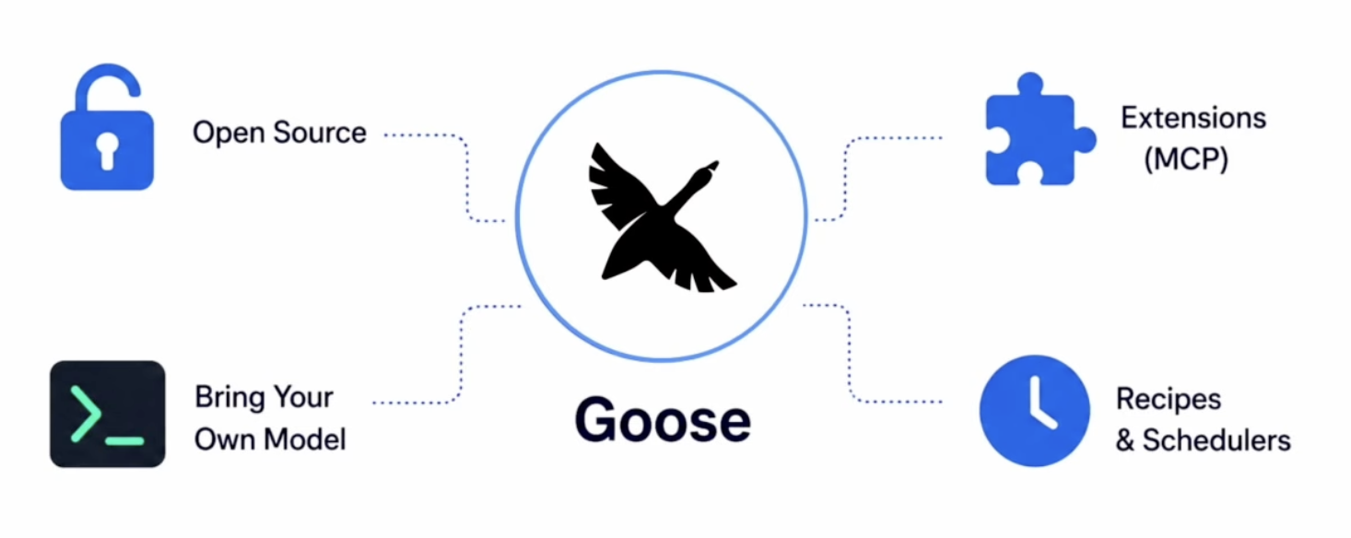
13
goose Architecture
Three components, one interactive loop — this is the whole system
Notes:
Draw the loop on the whiteboard as you talk. Step 5 is the one people miss — context revision is why goose stays usable on long tasks where a naive loop would blow the window in twenty turns.

Slide 15
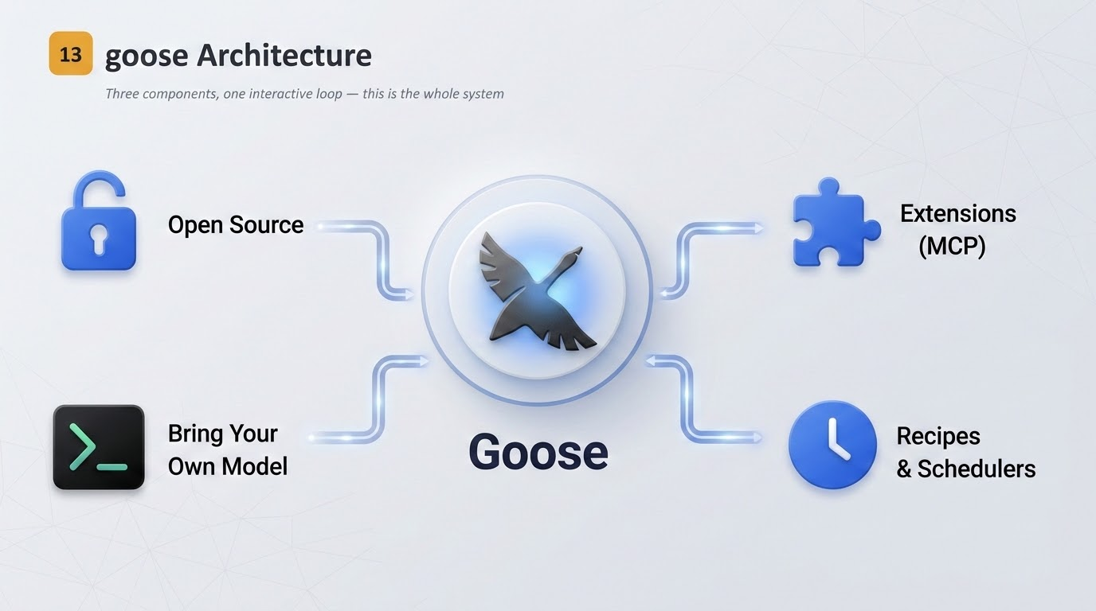

Slide 16
13
goose Architecture
Three components, one interactive loop — this is the whole system
INTERFACE
AGENT
EXTENSIONS
Desktop app or CLI. Collects your input, renders output, and spins up agents — more than one at a time if needed.
The core logic that runs the interactive loop: calls the provider, executes tool calls, revises context, handles errors.
MCP servers exposing tools. Built-in, external, or ones you write yourself. This is where capability actually comes from.
THE INTERACTIVE LOOP
1
›
2
›
3
›
4
›
5
›
6
Human request
Provider chat
Tool call
Response to model
Context revision
Model response
You state a goal.
Request plus available tool schemas go to the LLM.
Model emits JSON; goose executes it and collects results.
Results return. More tools needed? Repeat 2–4.
Old or irrelevant content is pruned to manage tokens.
Final answer to you. Loop restarts on your reply.
Errors do not break the flow
Context revision keeps the bill down
Invalid JSON, a missing tool, a failed command — goose captures these and returns them to the model as tool responses. The LLM then has the information it needs to correct itself and continue, instead of the run simply dying.
Summarise with smaller, faster models · algorithmically drop stale content · find-and-replace rather than rewriting whole files · ripgrep to skip system files · compress verbose command output.
Reference: goose-docs.ai/docs/goose-architecture · /goose-architecture/extensions-design
Notes:
Draw the loop on the whiteboard as you talk. Step 5 is the one people miss — context revision is why goose stays usable on long tasks where a naive loop would blow the window in twenty turns.

Slide 17
14
Hands-On — Two End-to-End Labs
Everything from the last ten slides, applied to a real repository
LAB A
LAB B
Code Analysis
Fix an Issue & Raise a PR
The Developer extension ships an analyze tool that maps structure, tracks symbols and builds call graphs across a codebase — no embeddings, no index to maintain.
Three modes: Structure (a directory) · Semantic (one file) · Focus (one symbol, traced across files).
1. Set up — enable the GitHub MCP extension, run in smart_approve, add a .goosehints with build and test commands.
2. Understand — fetch the issue, then use analyze with focus on the symbols it names.
3. Plan — planning mode first. Review the steps before a single line changes.
4. Implement — branch, edit, run the test suite, iterate on failures. Commit early and often so you can roll back.
5. Ship — push and open the PR with a description generated from the actual diff, not from the issue text.
6. Capture — turn the whole thing into a recipe so the next person runs it in one click.
analyze path="src/" max_depth=2
analyze path="main.py"
analyze path="src/" focus="authenticate"
analyze path="." focus="UserClass" follow_depth=3
goose › show me the call graph for authenticate
Practitioner notes: results over 1000 lines return a warning instead of output — narrow the scope, lower max_depth, or set force=true. For a whole repository, hand the job to a subagent so the raw output never lands in your main context. Keep node_modules and build artefacts out via .gooseignore.
Features exercised: sessions · .goosehints · planning mode · subagents · tool permissions · MCP extensions · codebase analysis · recipes.
Reference: goose-docs.ai/docs/guides/codebase-analysis · /guides/context-engineering/creating-plans
Notes:
Timebox: 40 minutes for Lab A, 60 for Lab B. Have a pre-seeded repo with a genuinely small, well-scoped bug. Lab B is the payoff of the whole day — resist the urge to demo it yourself; let them drive.

Slide 18
15
The goose Development Kit (GDK)
goose is becoming a platform: not one agent app, but the infrastructure other agentic apps are built on
The thesis
Two ways to integrate
GDK is an open-source SDK, written in Rust, for building agentic applications that are model-agnostic, locally runnable and independent of any single provider. Instead of every team rebuilding the agent loop, tool calling and context management, they compose these as shared infrastructure.
ACP — talk to goose as a separate process or daemon, keeping the runtime independent of your interface.
Rust API — embed the agent directly in your application. goose Desktop and the goose CLI are themselves first-party examples built this way.
BUILDING BLOCKS ON OFFER
Agent orchestration
In-process local models
50+ model providers
Routing & model selection
Context management
Tools & MCP
Memory
Remote execution
Automations & scheduling
Skills
Subagents
Code mode
Flexible agent loop
Slash command infra
Where to go next
Docs
goose-docs.ai
Source
github.com/aaif-goose/goose
Community
discord.gg/goose-oss
Recipes
goose-docs.ai/recipes
Skills
goose-docs.ai/skills
Governed by the Agentic AI Foundation, under the Linux Foundation — open standards over closed platforms.
Kubernetes over Koffee · AIYatra
Notes:
Close on the platform story: goose today is a good agent; GDK is the bet that the agent loop becomes shared infrastructure the way the Lightning Development Kit did for payments. Invite the room to contribute — it is foundation-governed and genuinely open to outside contributors.

