Slide 1
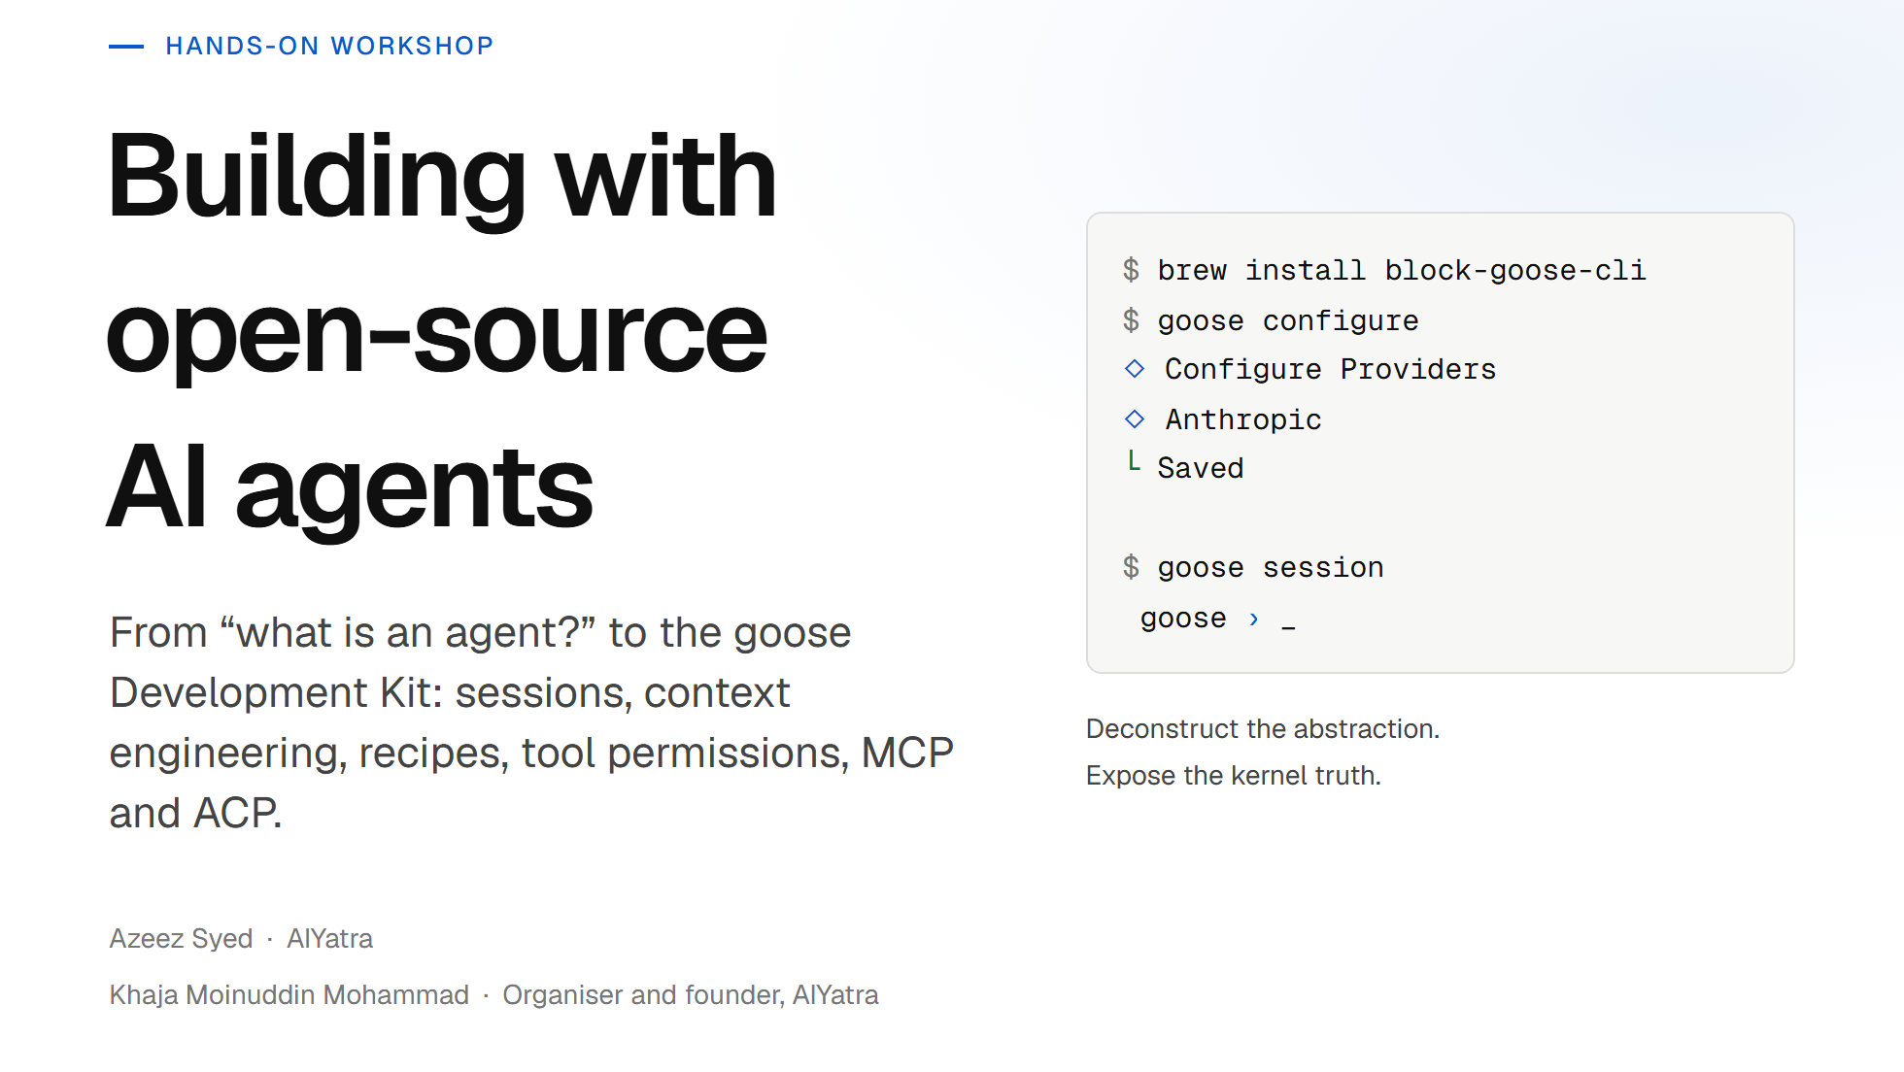
Notes:
Welcome. Full-day, terminal-first workshop on goose. We go bottom-up: agent fundamentals, then goose itself, then every major feature, then architecture, then where the project is heading with GDK. Everything we cover maps to goose-docs.ai/docs/category/guides.

Slide 2
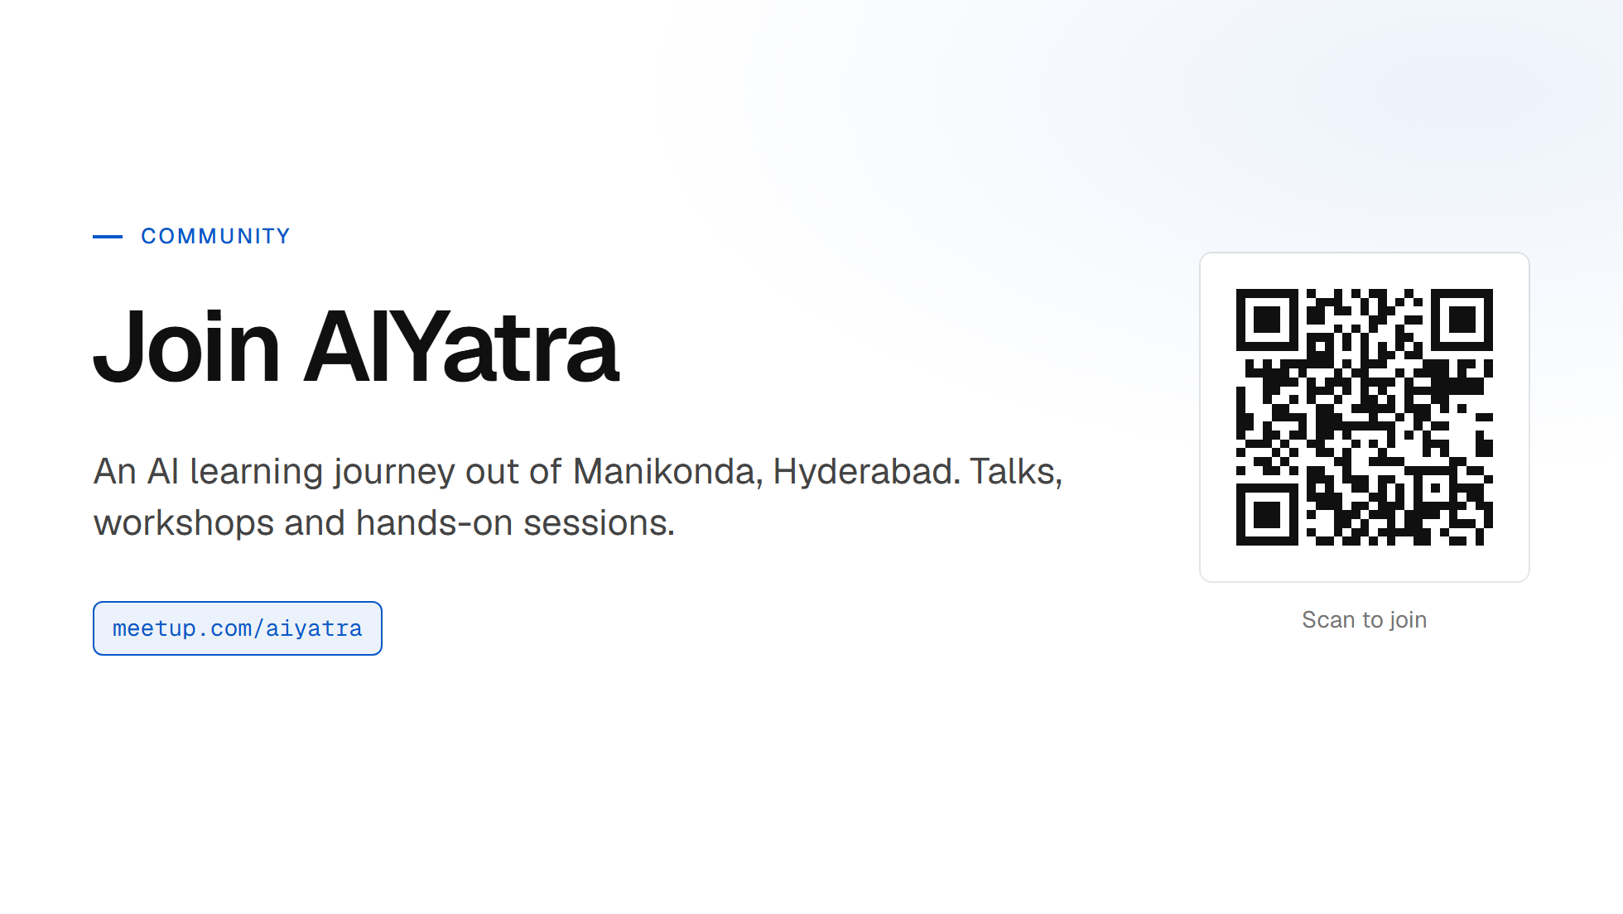
Notes:
Put this up while the room settles. Scanning takes ten seconds and people can do it before we start rather than at the end when they are packing up.

Slide 3
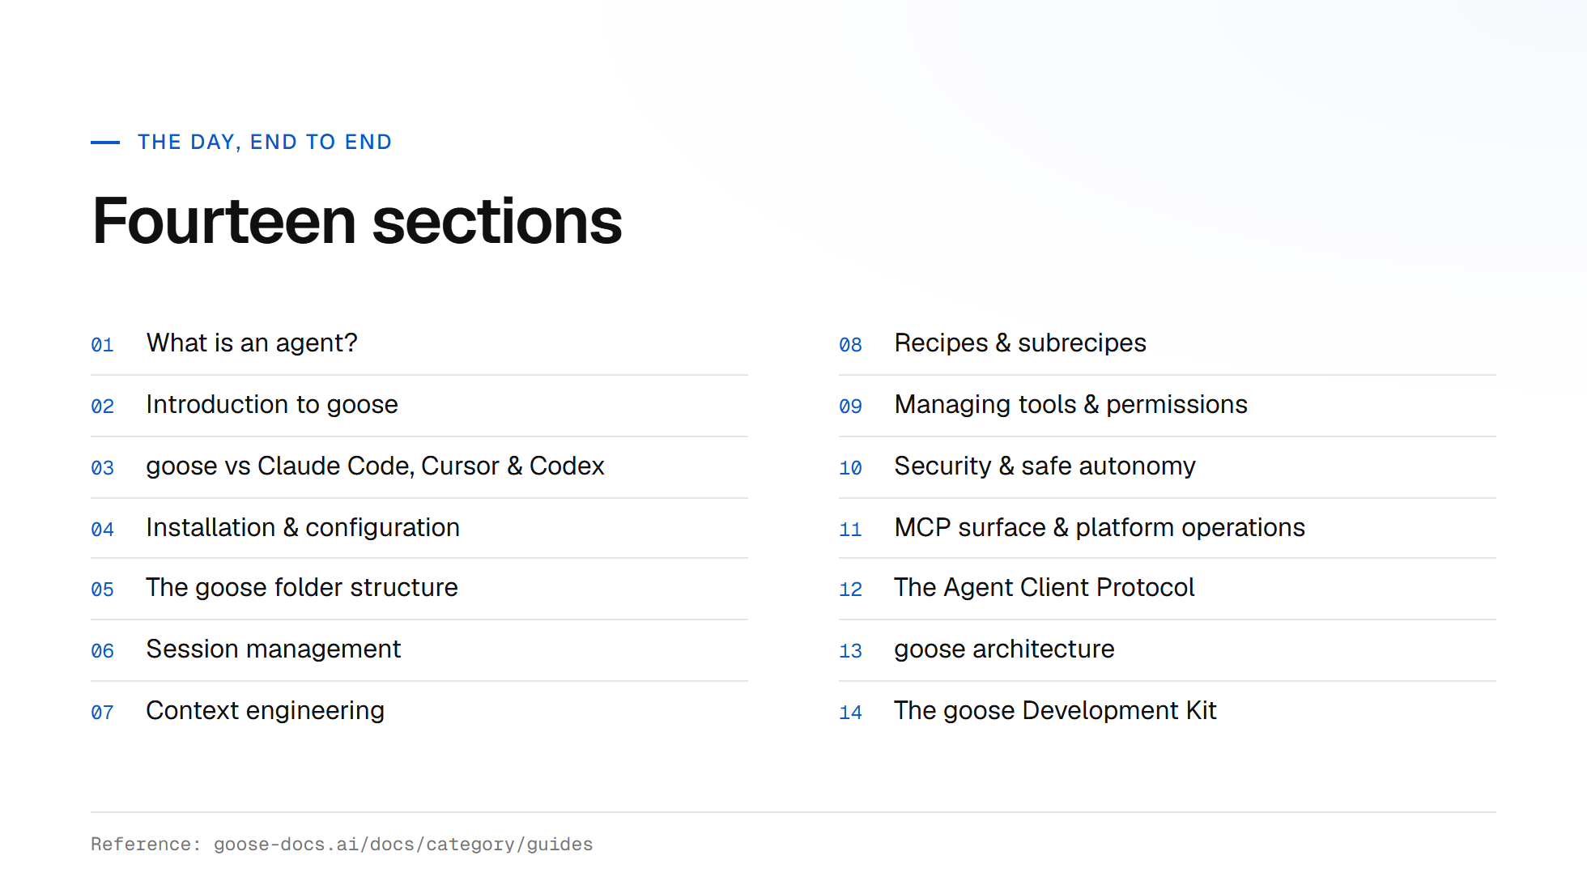

Slide 4
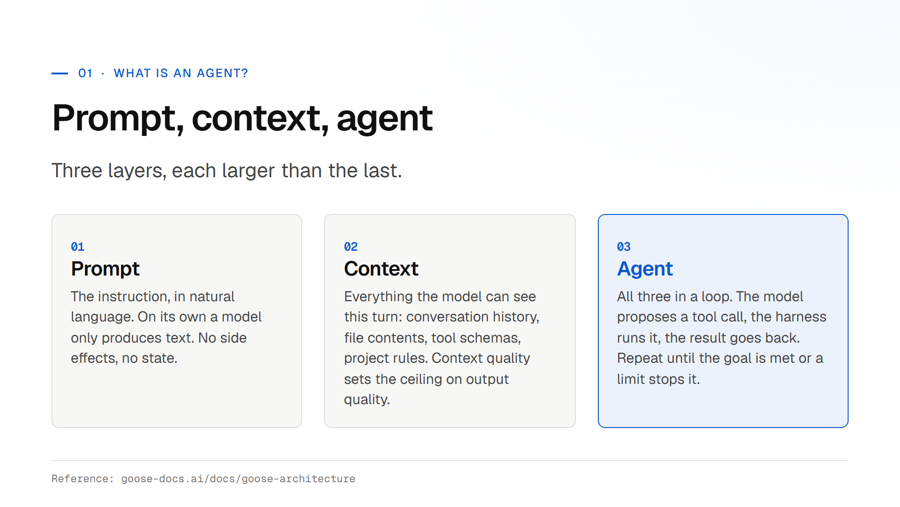
Notes:
Land the point that the model is only one of four layers. Ask the room: who has written a for-loop around an LLM call? That is an agent in embryo. Everything else in goose is hardening that loop.

Slide 5
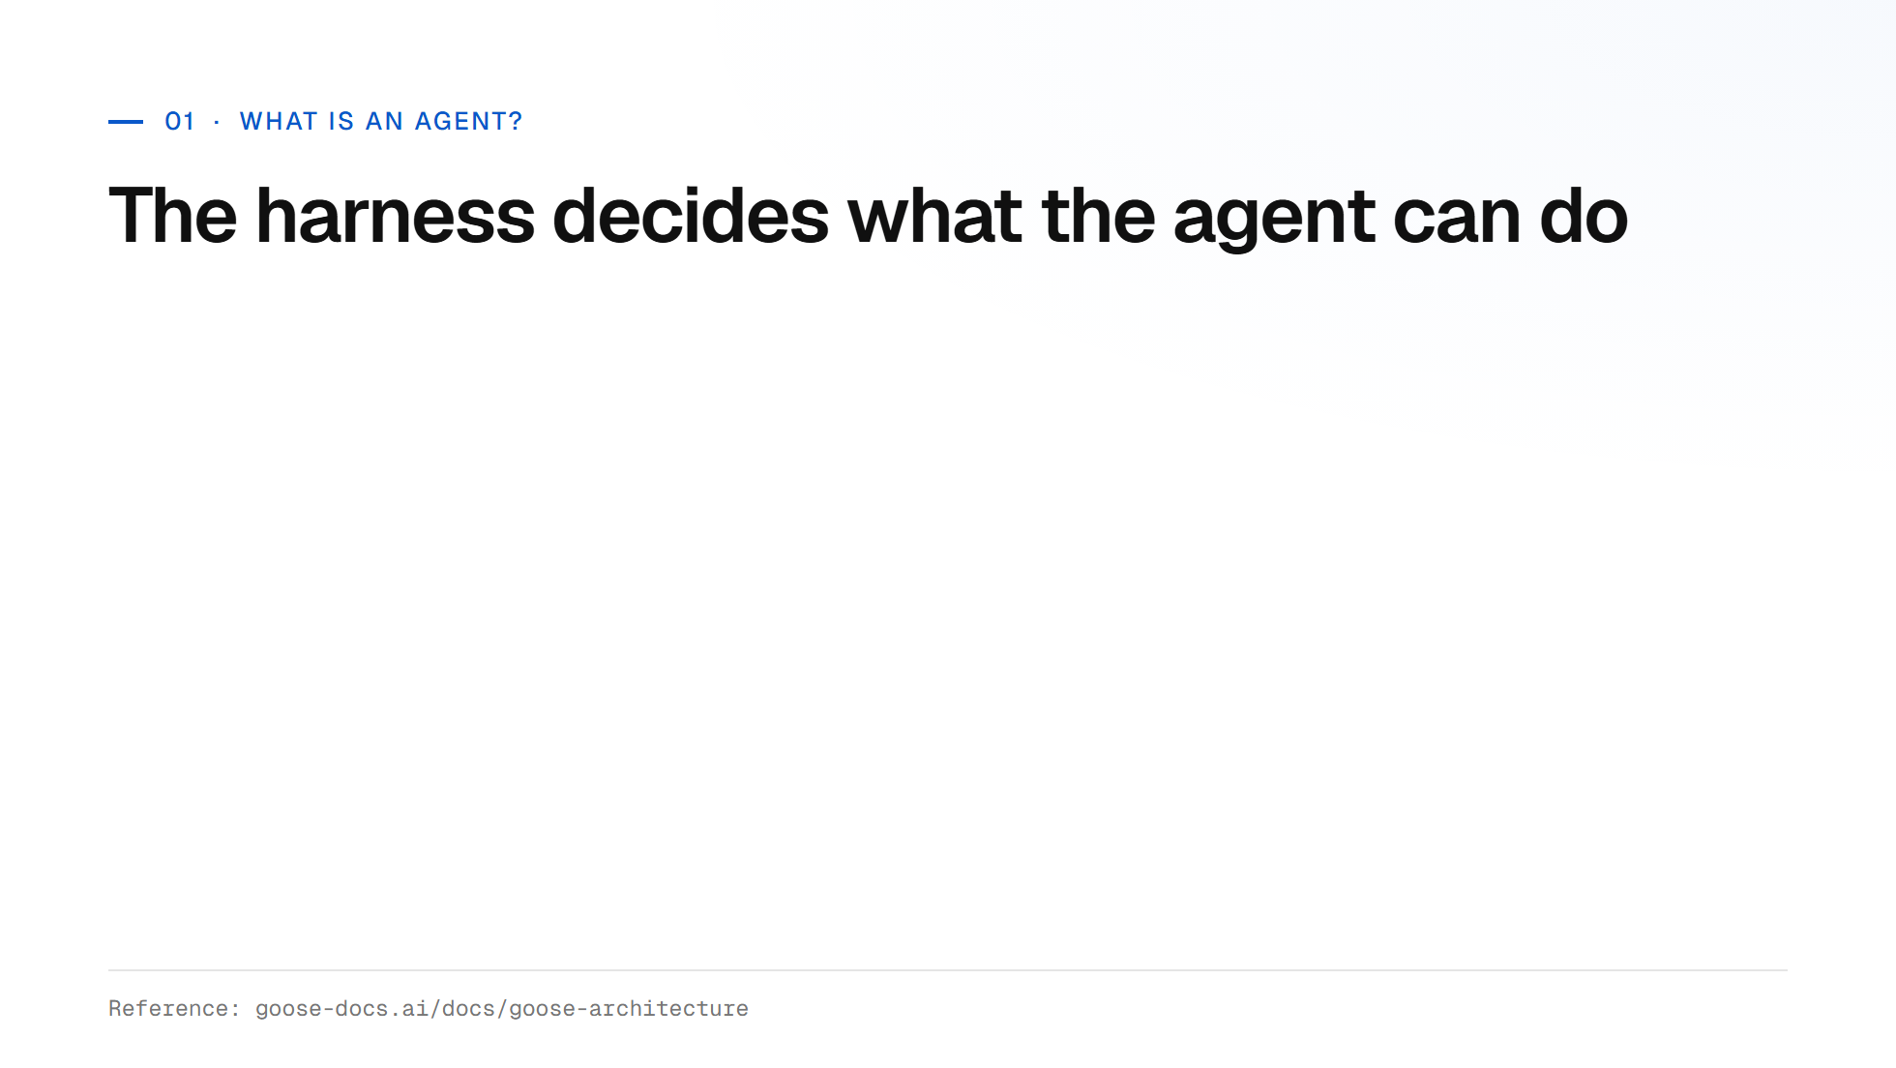

Slide 6
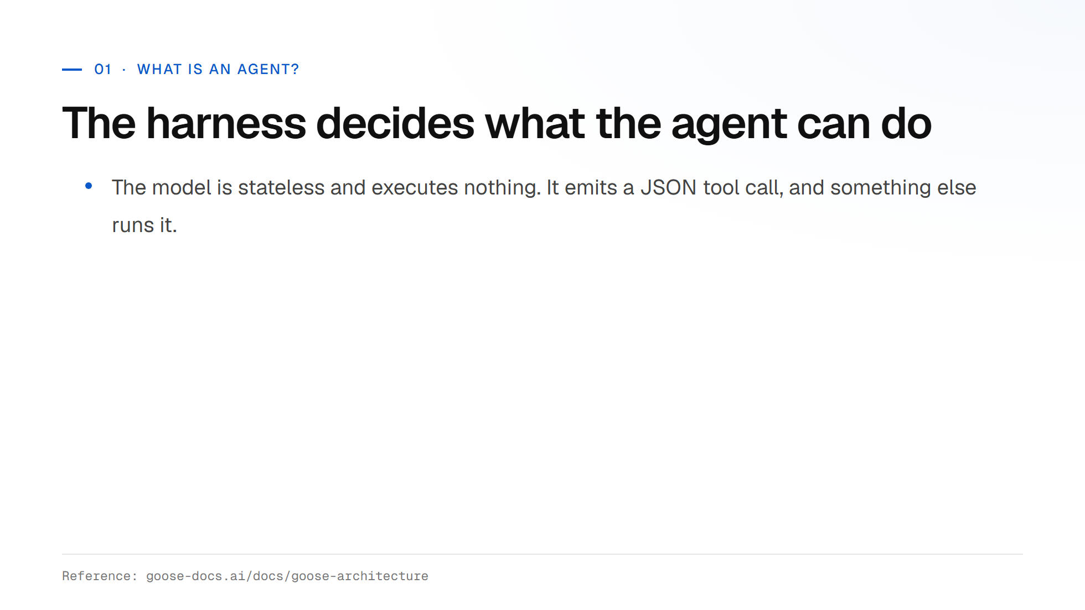

Slide 7
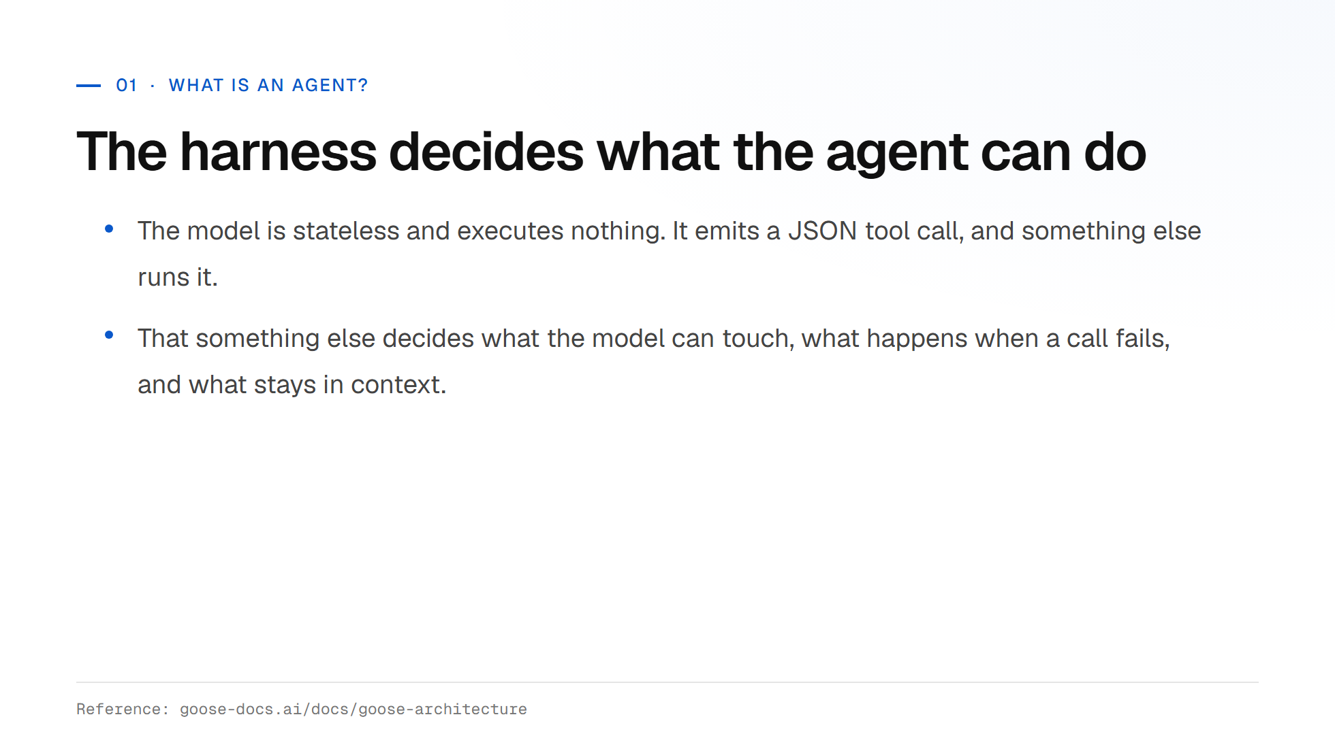

Slide 8
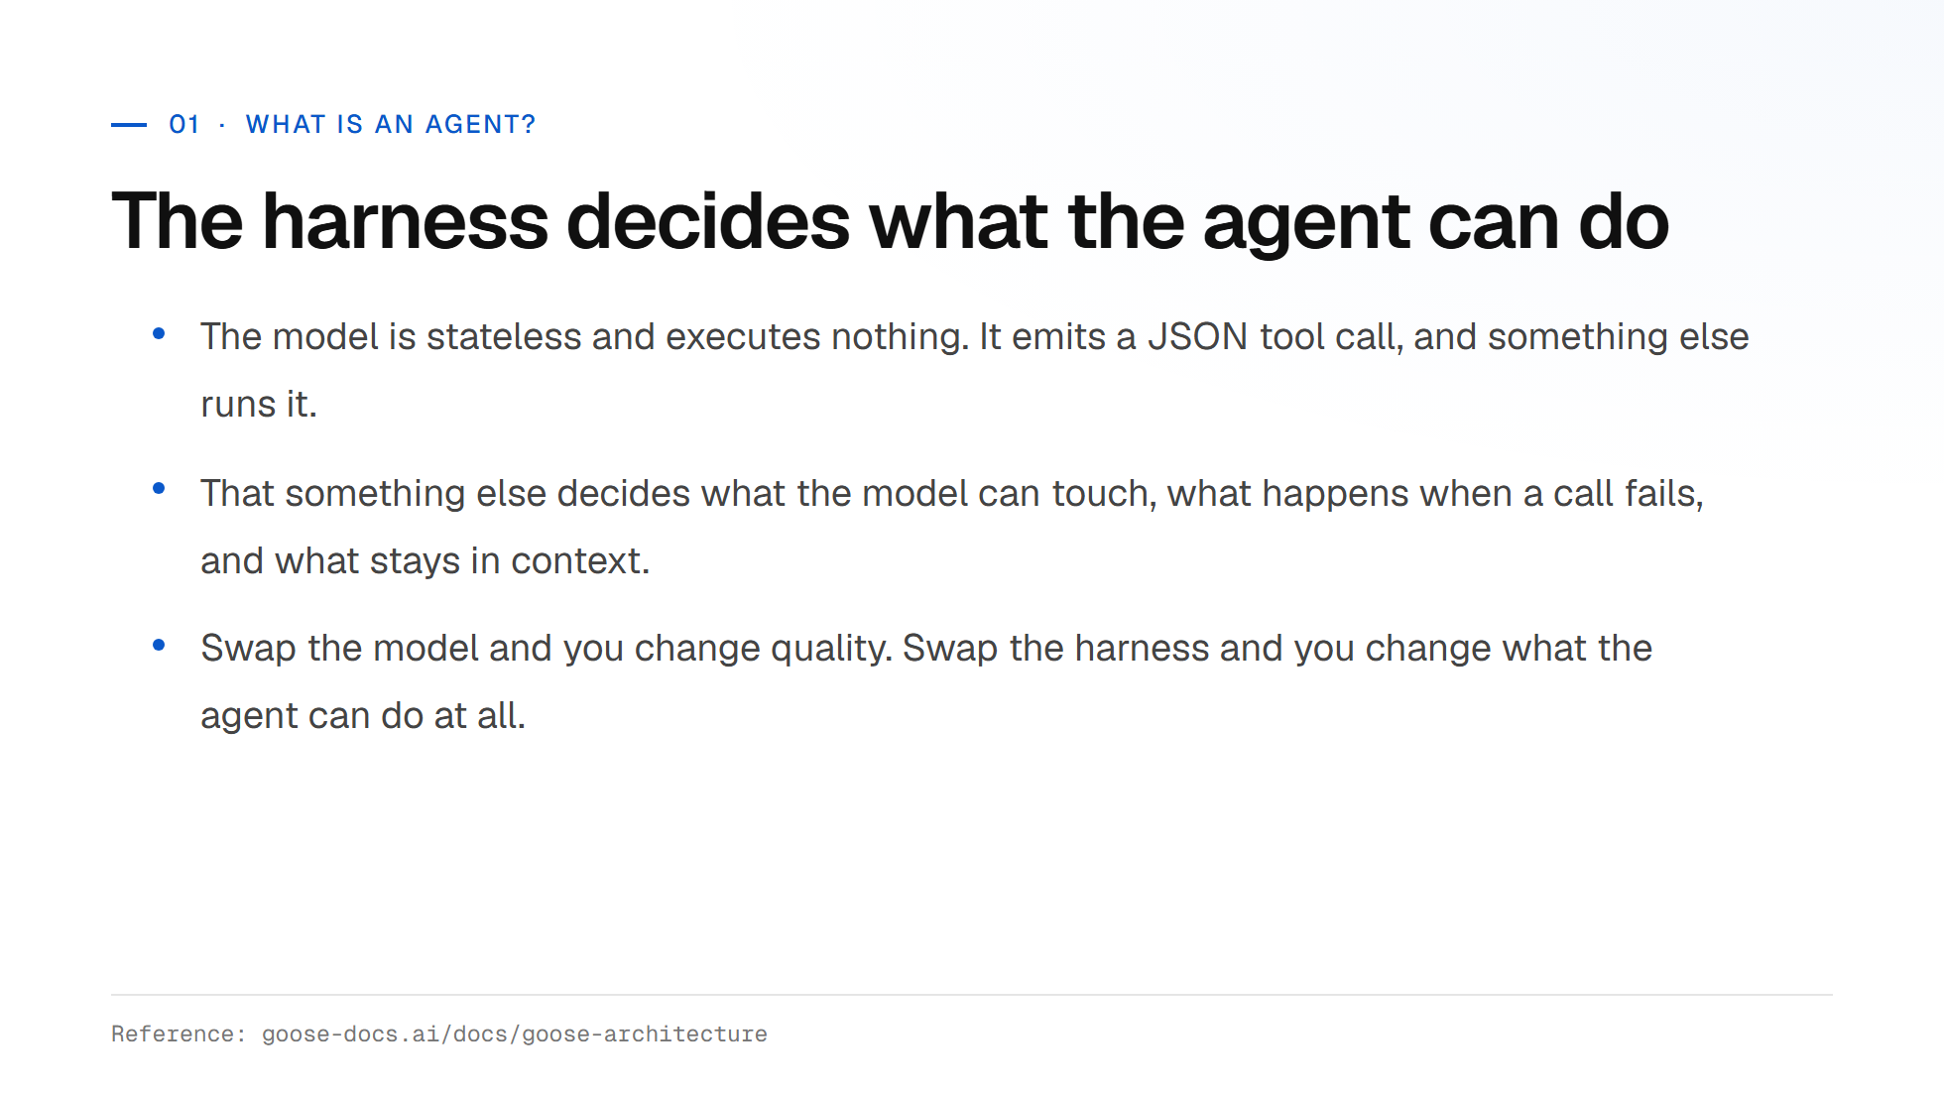

Slide 9
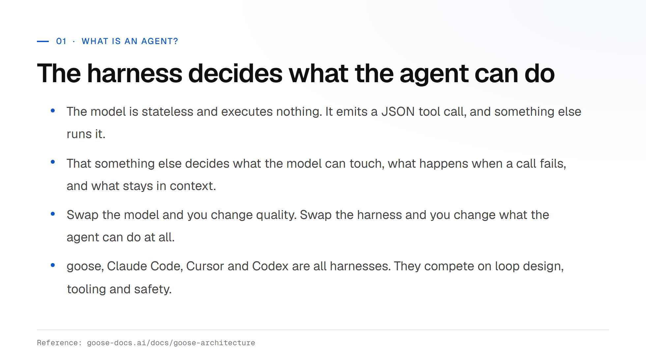

Slide 10
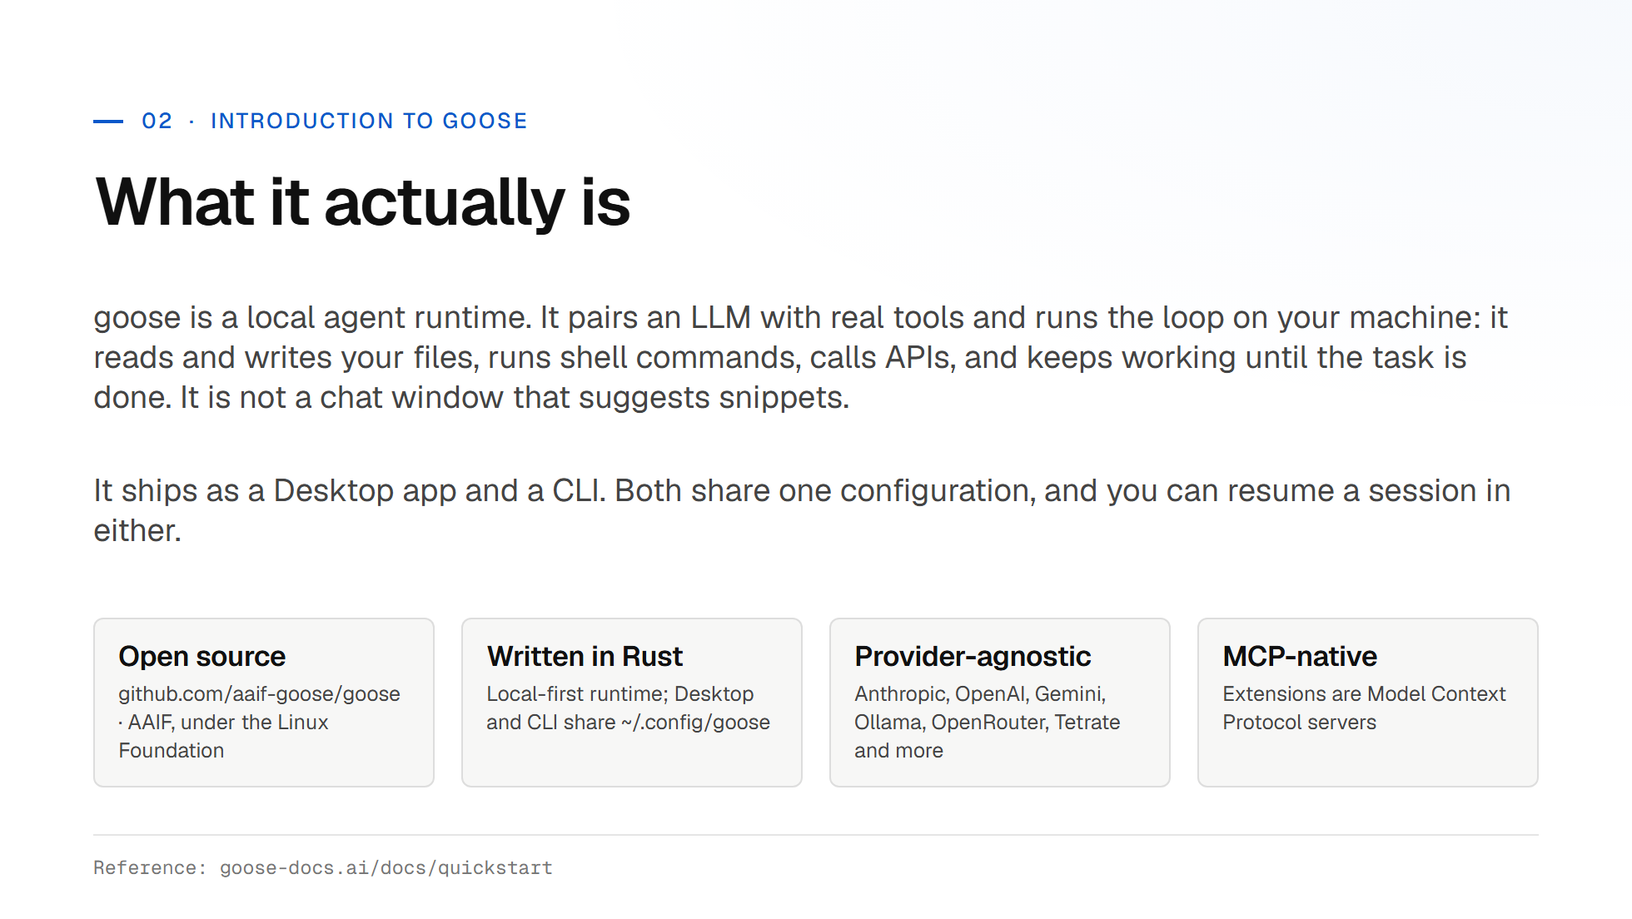
Notes:
Emphasise: local-first and open source. The agent runs on your laptop, your keys stay in your keyring, and nothing forces you onto one model vendor. Mention the AAIF move (April 2026). This is now foundation-governed, not a single-company project.

Slide 11
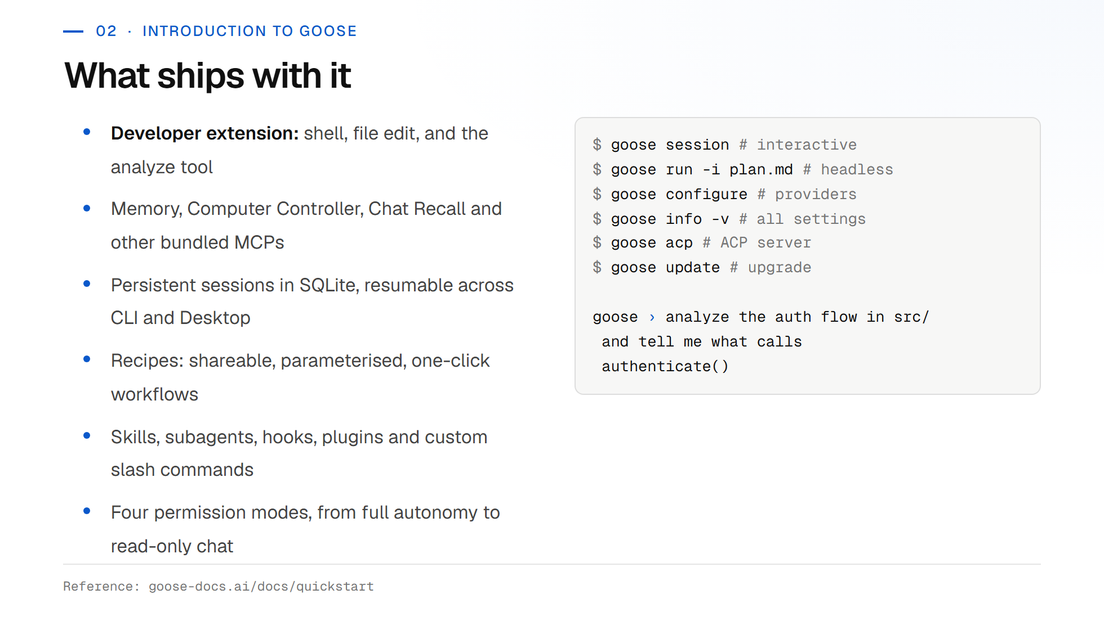

Slide 12
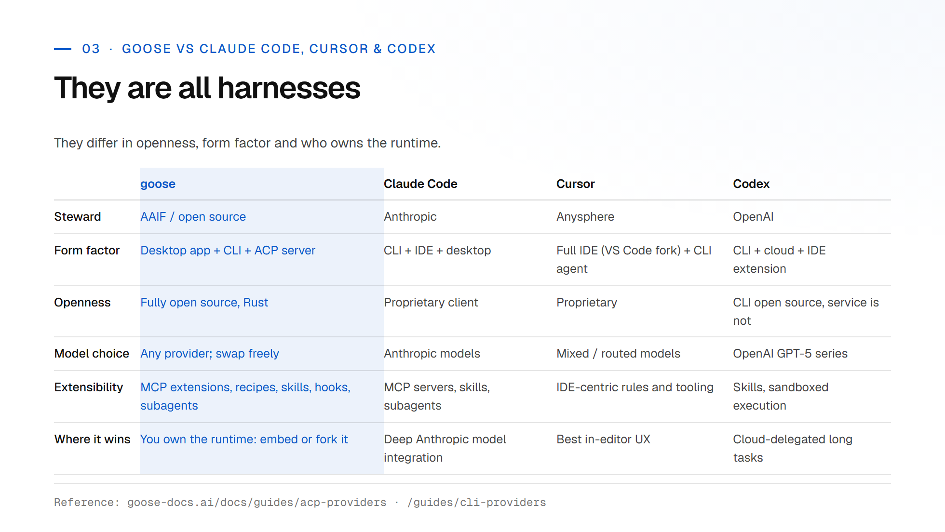
Notes:
Be fair here. This is not a takedown. The honest differentiator for goose is that it is open source, model-agnostic and embeddable. Note the deprecation: CLI providers are backward-compat only, ACP providers are the supported path and they preserve MCP extensions.

Slide 13
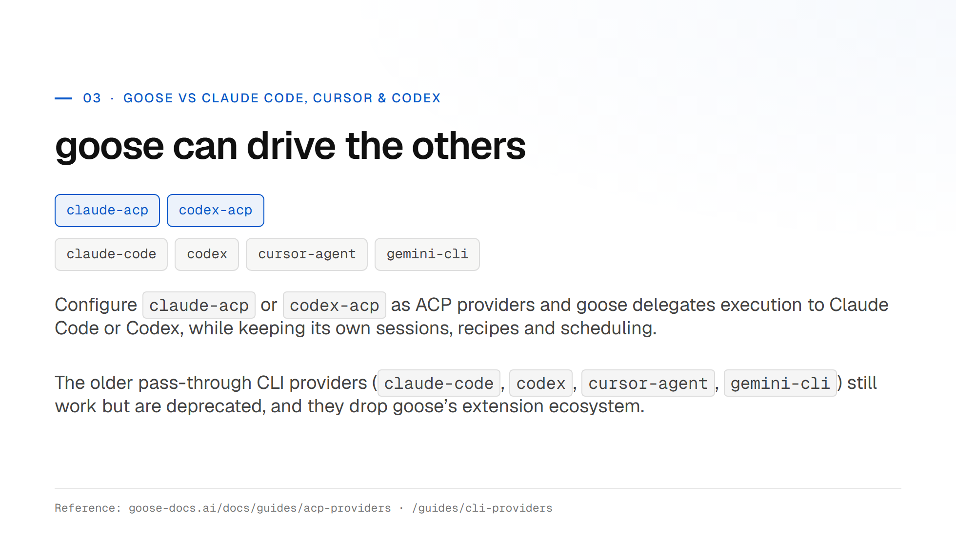

Slide 14
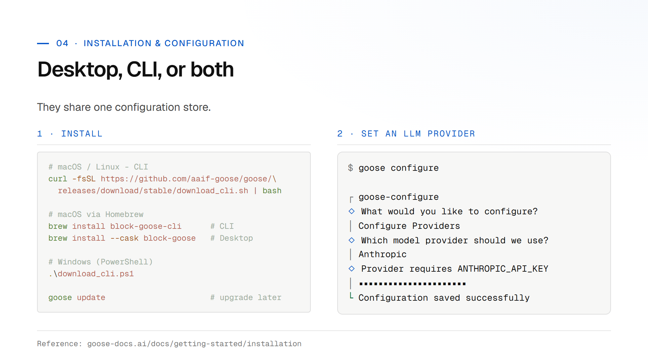
Notes:
Checkpoint: everyone should have goose running and a provider configured before we move on. Free options: Google Gemini free tier, or Ollama for fully local. Windows users, decline the keyring prompt and use environment variables if you hit keyring errors.

Slide 15
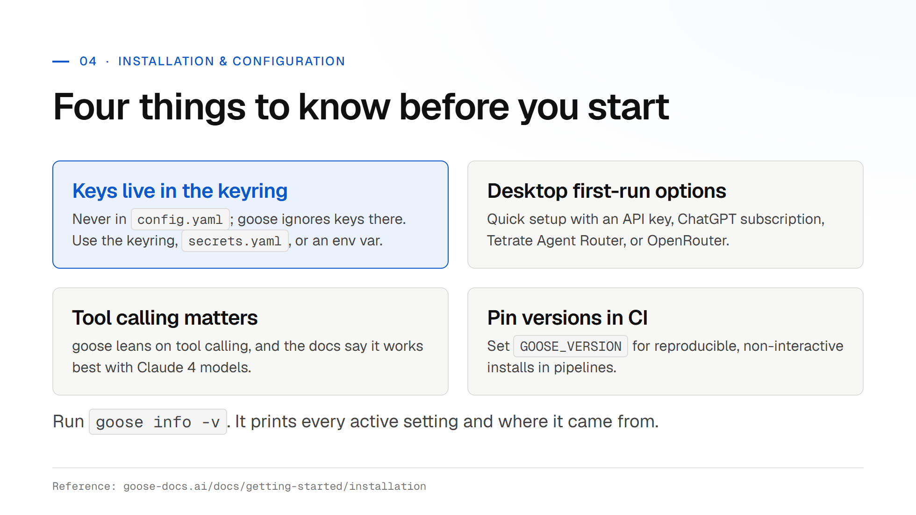

Slide 16
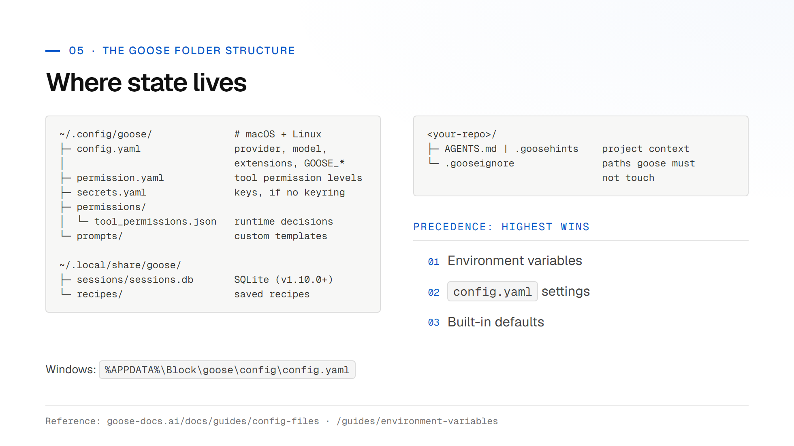
Notes:
Open the config file live and walk it. Point out that extensions are just YAML entries with a type: builtin, platform, stdio, streamable_http, frontend, inline_python. Show available_tools as a token-saving filter.

Slide 17
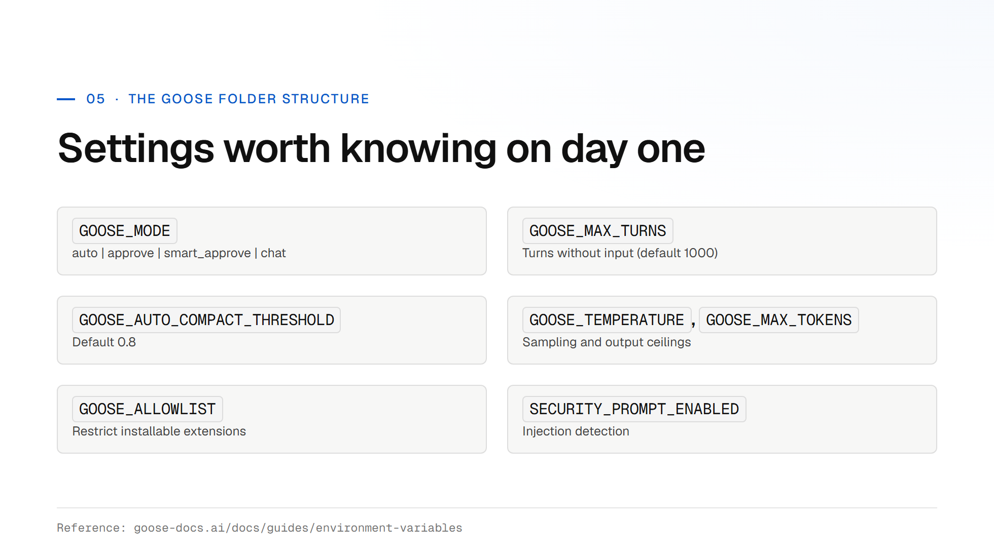

Slide 18
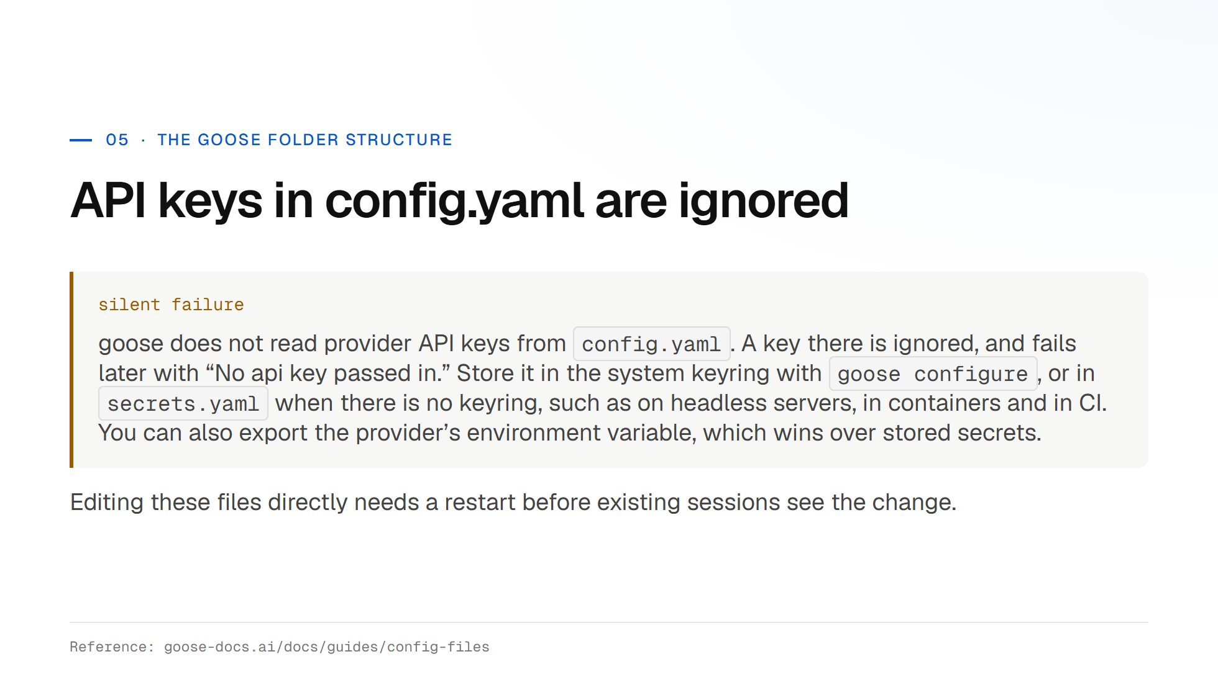

Slide 19
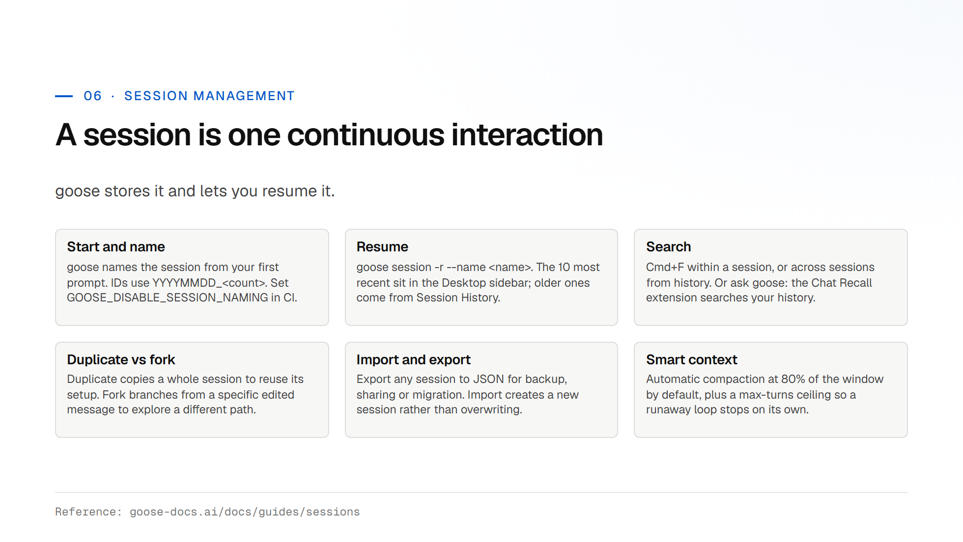
Notes:
The stale-session point is the practical one. Long sessions accumulate contradictory context and the model starts fighting its own history. New task, new session. Treat it like a clean branch.

Slide 20
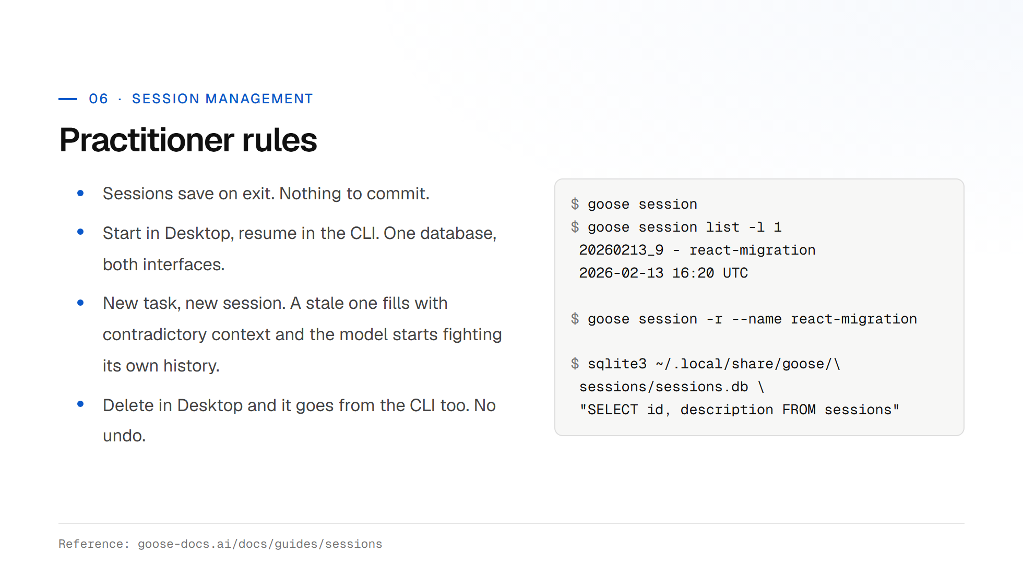

Slide 21
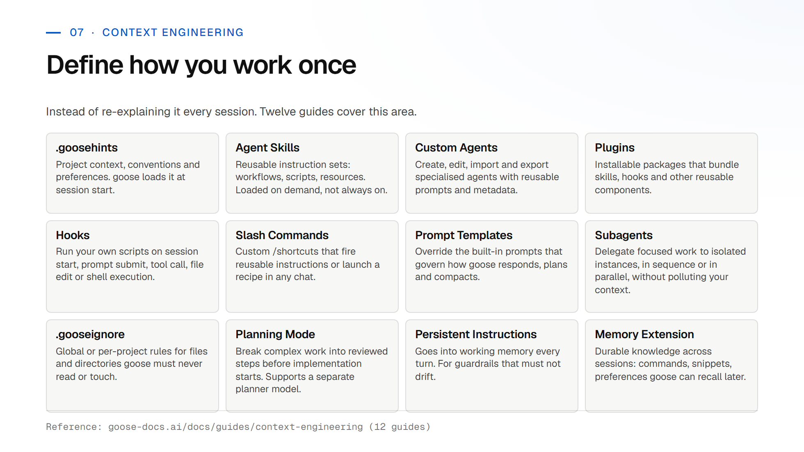
Notes:
This is the slide to slow down on. Context engineering is where practitioners get the biggest wins. Demo: add a .goosehints file with build commands and coding conventions, then show the difference in a fresh session.

Slide 22
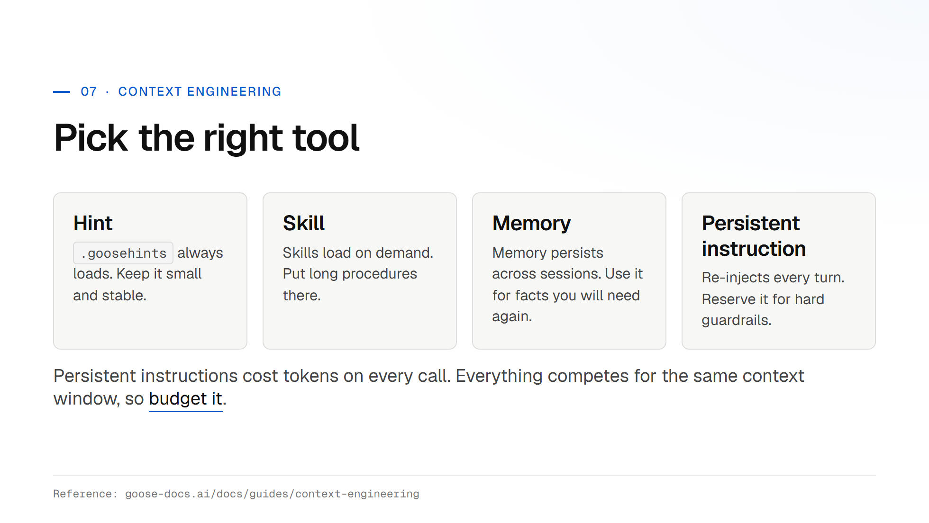

Slide 23
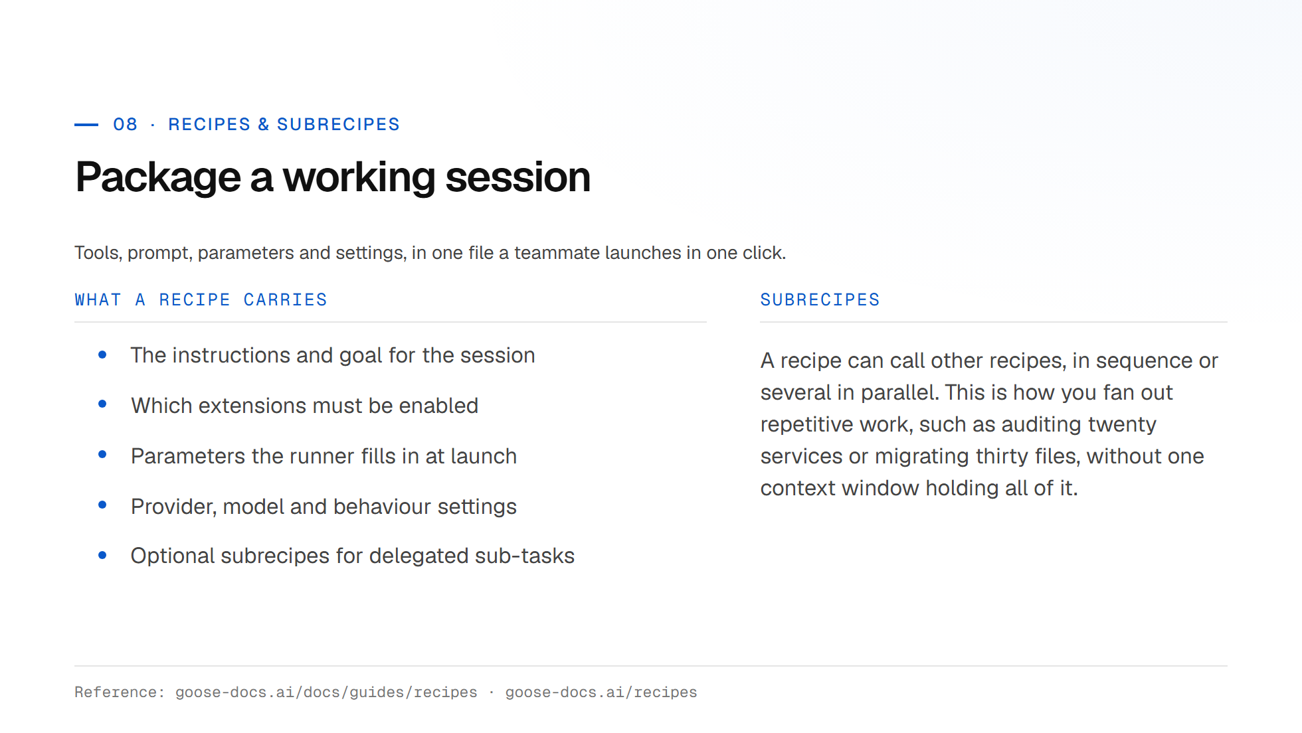
Notes:
Frame recipes as the unit of team scale. One engineer works out a workflow; a recipe turns that into something the rest of the team runs without rediscovering it. Show the Recipe Cookbook and the deeplink generator on the docs site.

Slide 24
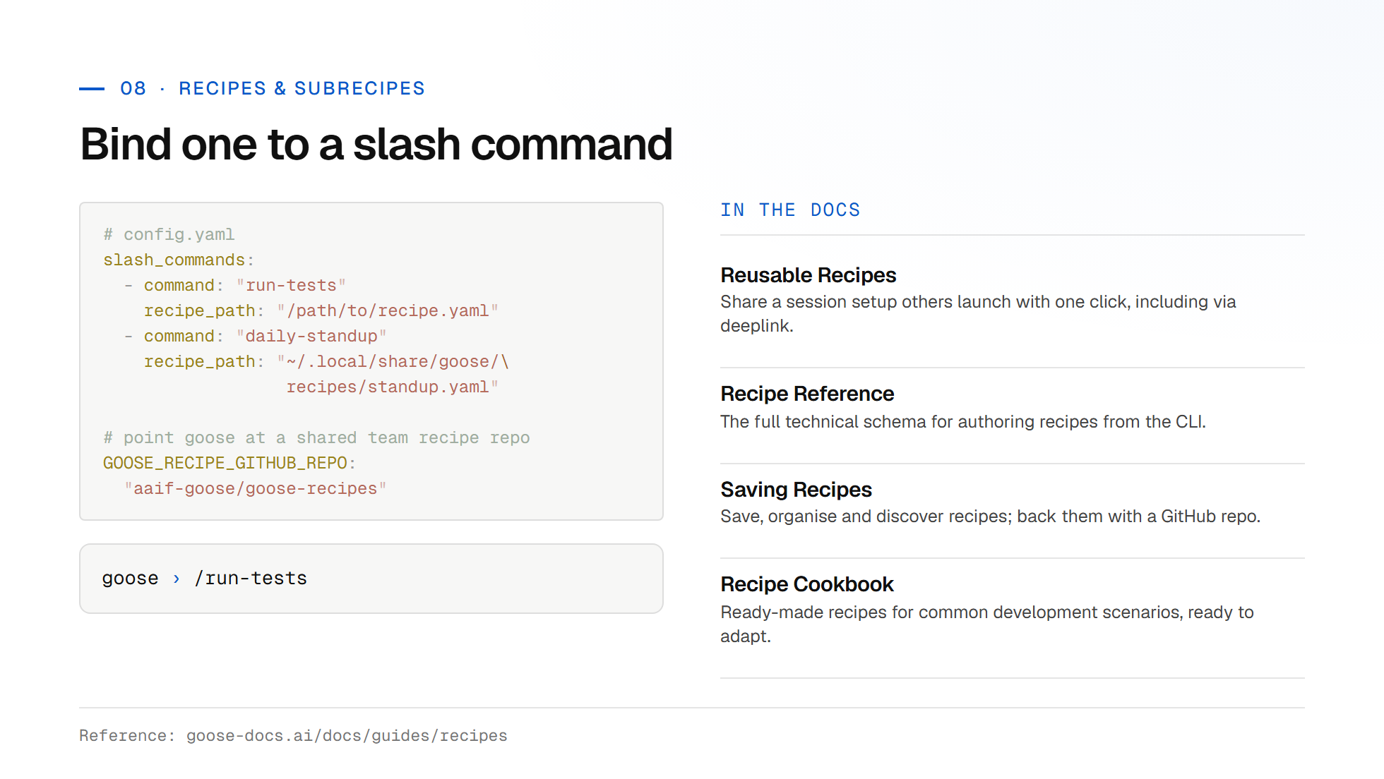

Slide 25
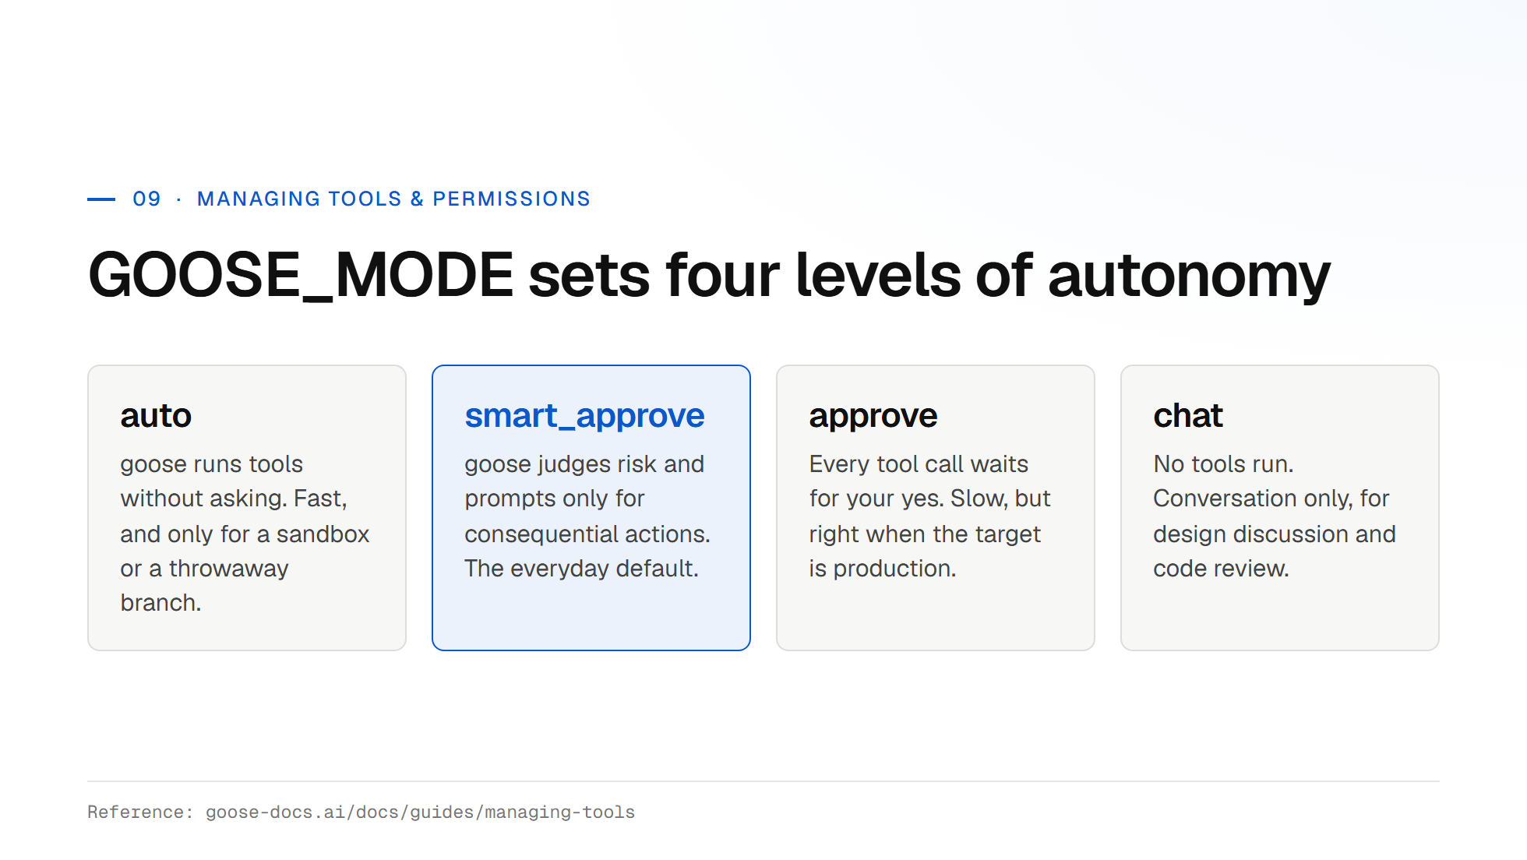
Notes:
Guidance: start everyone in smart_approve. Let them feel the prompts, then explain why auto mode belongs in a container or a disposable branch, never on a machine with production credentials loaded.

Slide 26
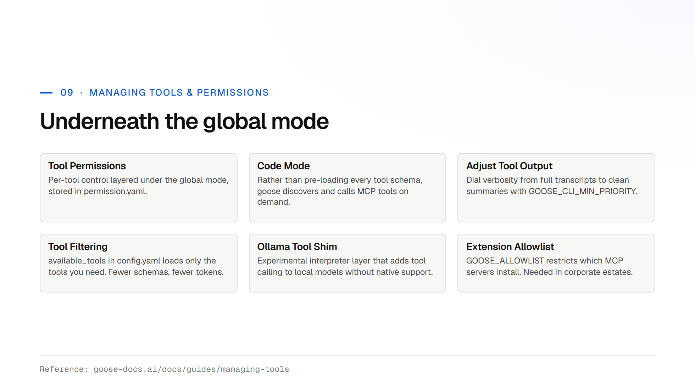

Slide 27
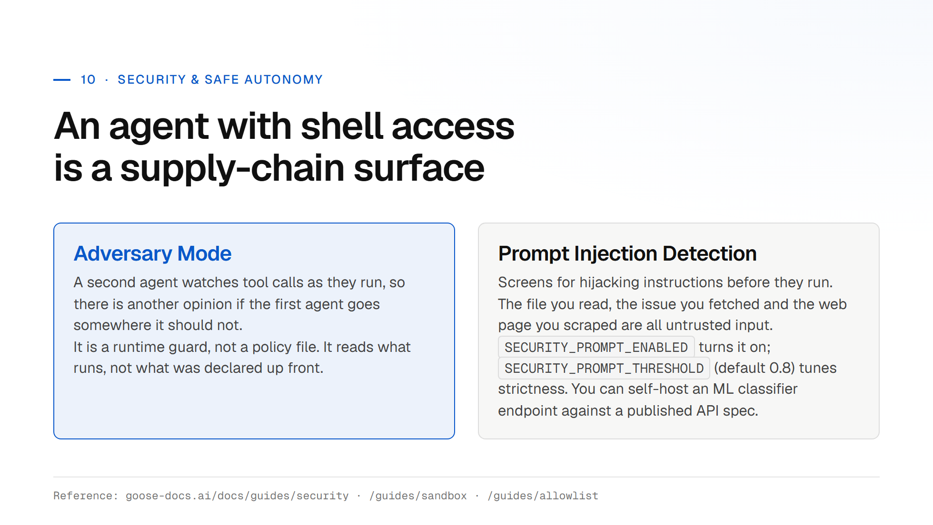
Notes:
Make the supply-chain point concretely: an MCP server runs on your machine with your credentials. The threat model is not the model going rogue, it is a poisoned tool description or a malicious README instructing your agent.

Slide 28
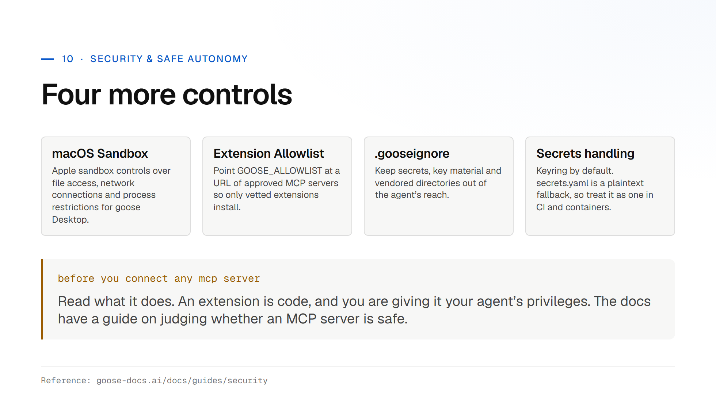

Slide 29
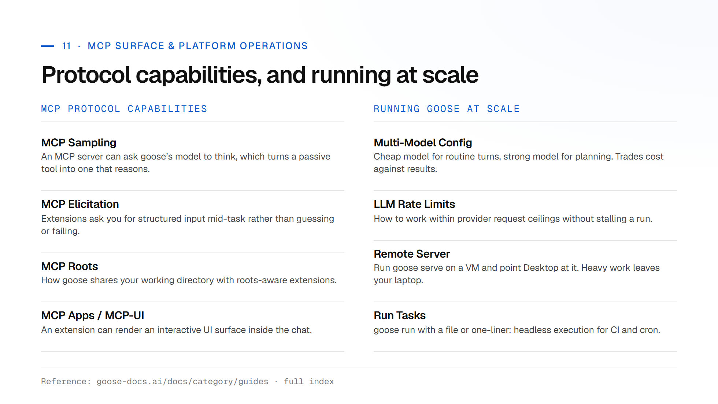
Notes:
Do not read this slide line by line. Point at it, say these exist, and flag the three that matter most for this audience: multi-model config for cost, remote server for heavy runs, and run tasks for CI integration.

Slide 30
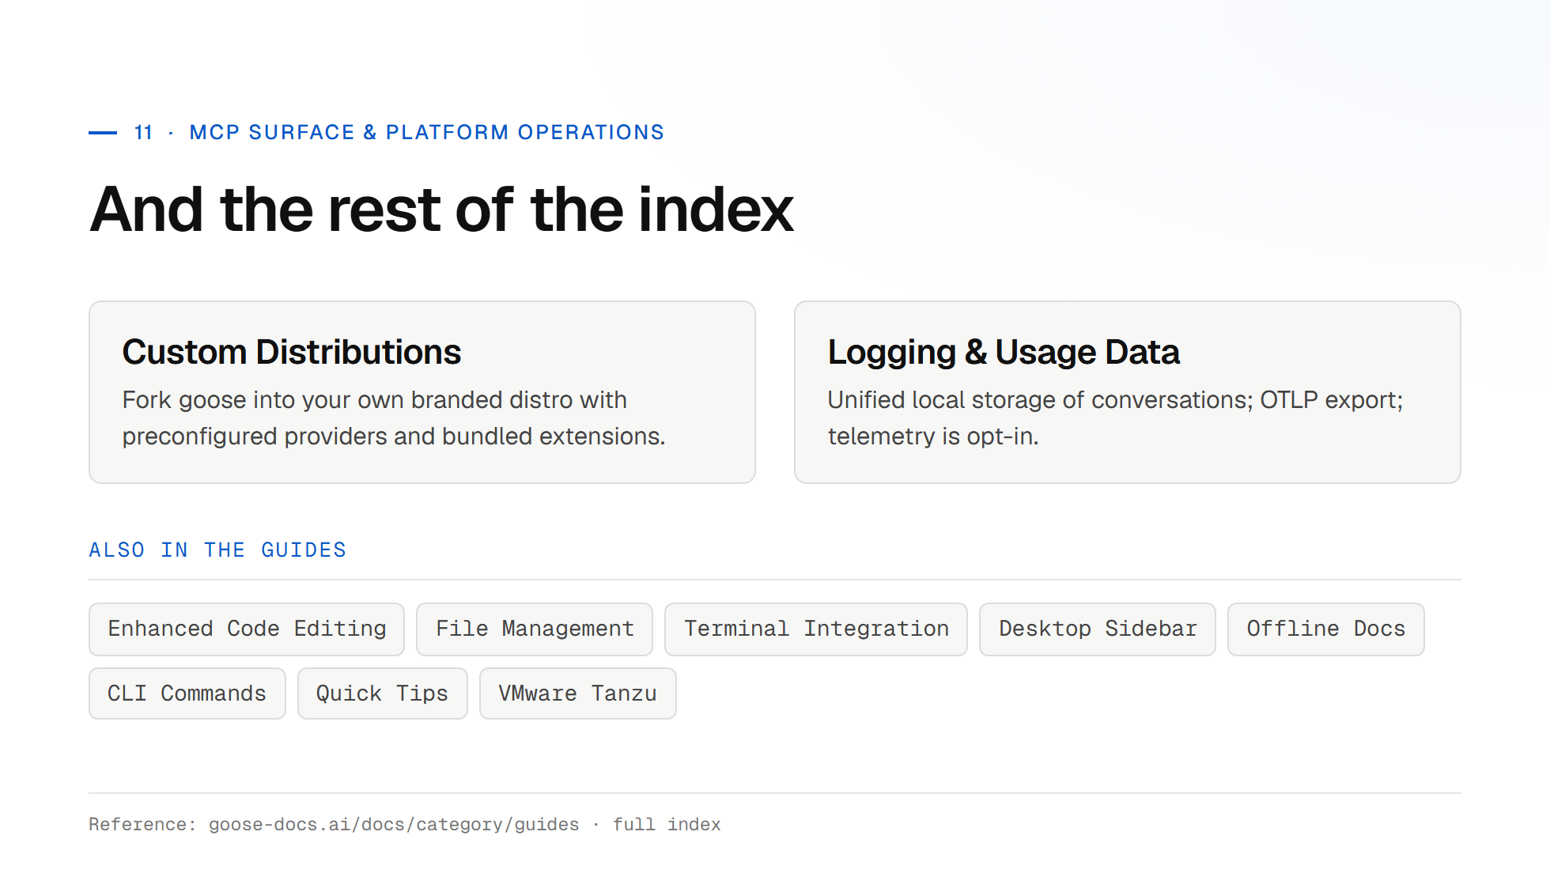

Slide 31
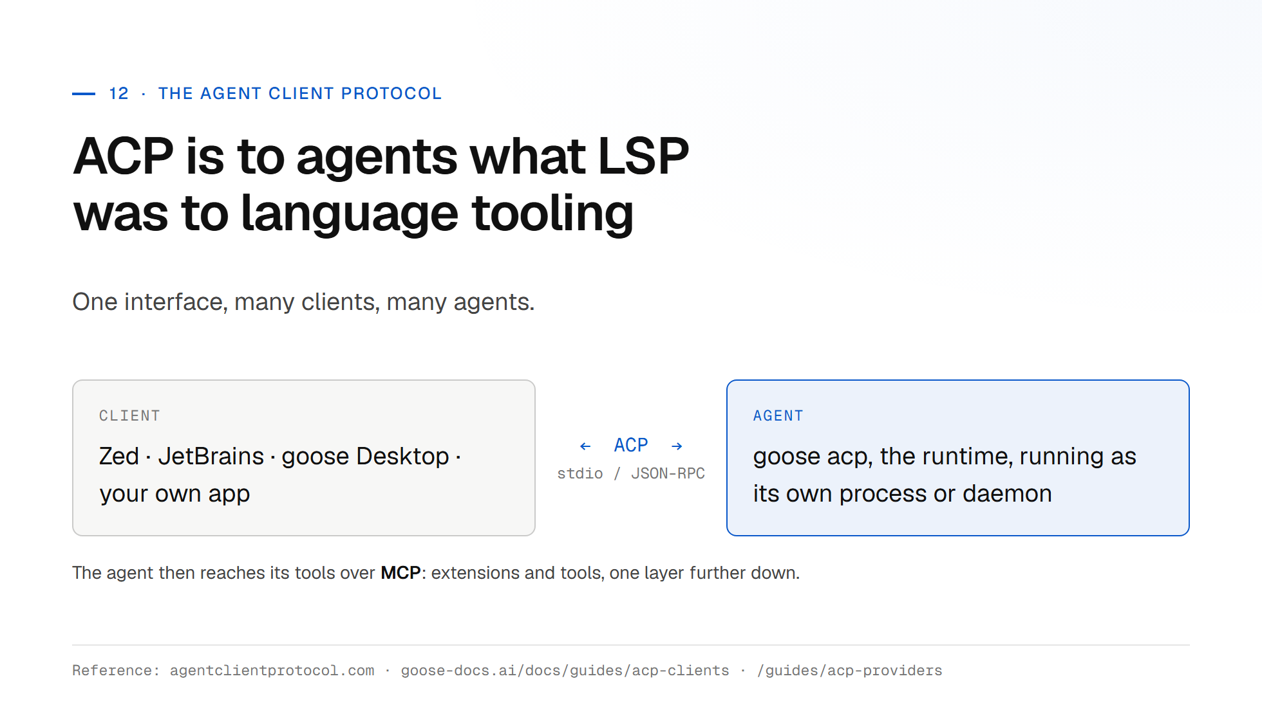
Notes:
The LSP analogy lands well with engineers. Before LSP, every editor implemented every language. ACP is the same bet for agents: implement the protocol once and any compliant client can drive any compliant agent.

Slide 32
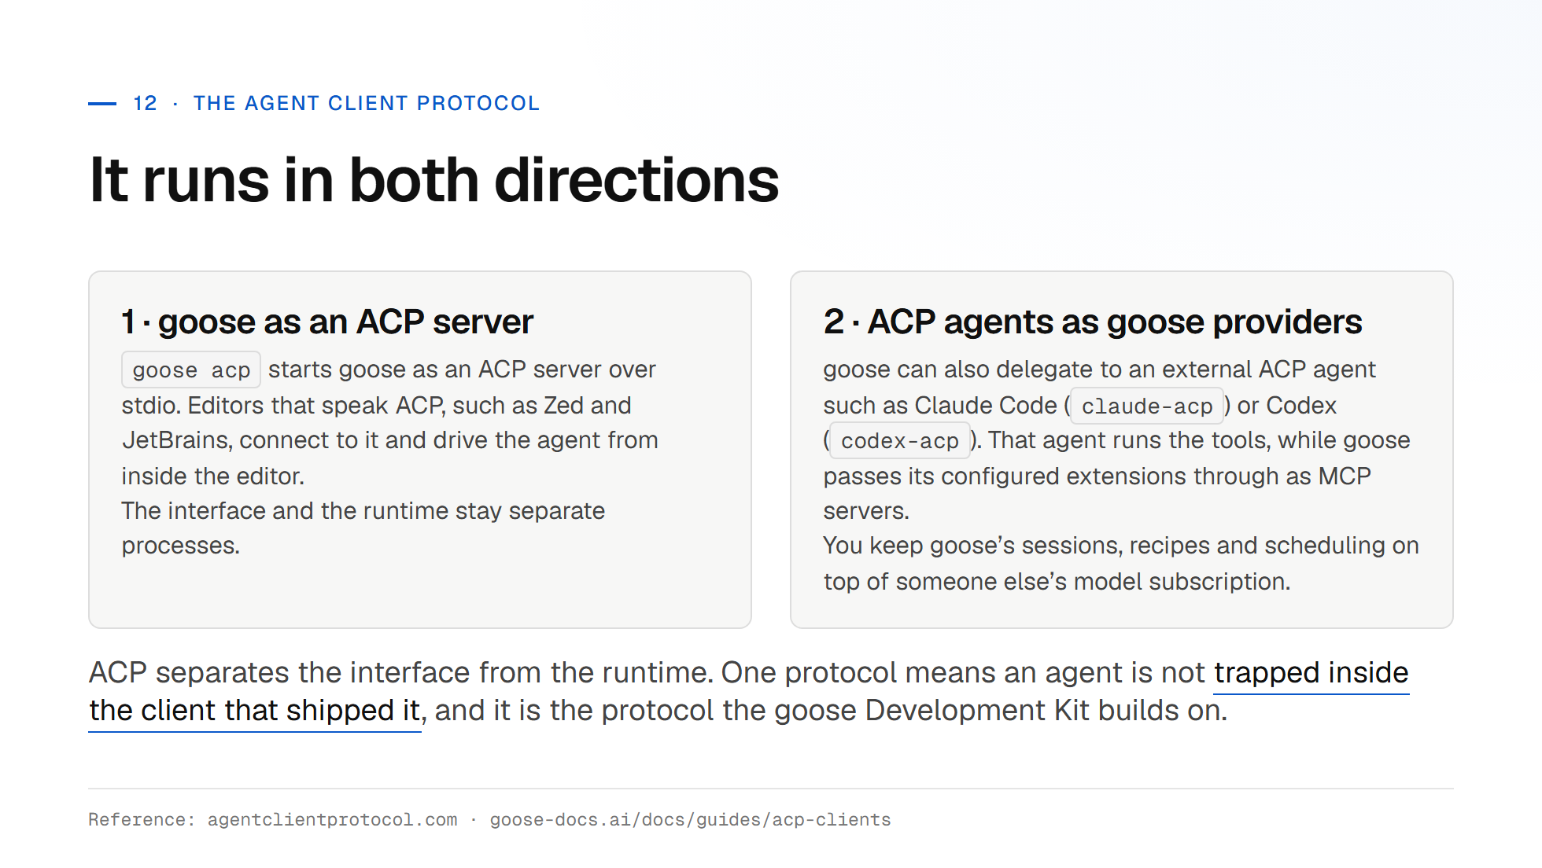

Slide 33
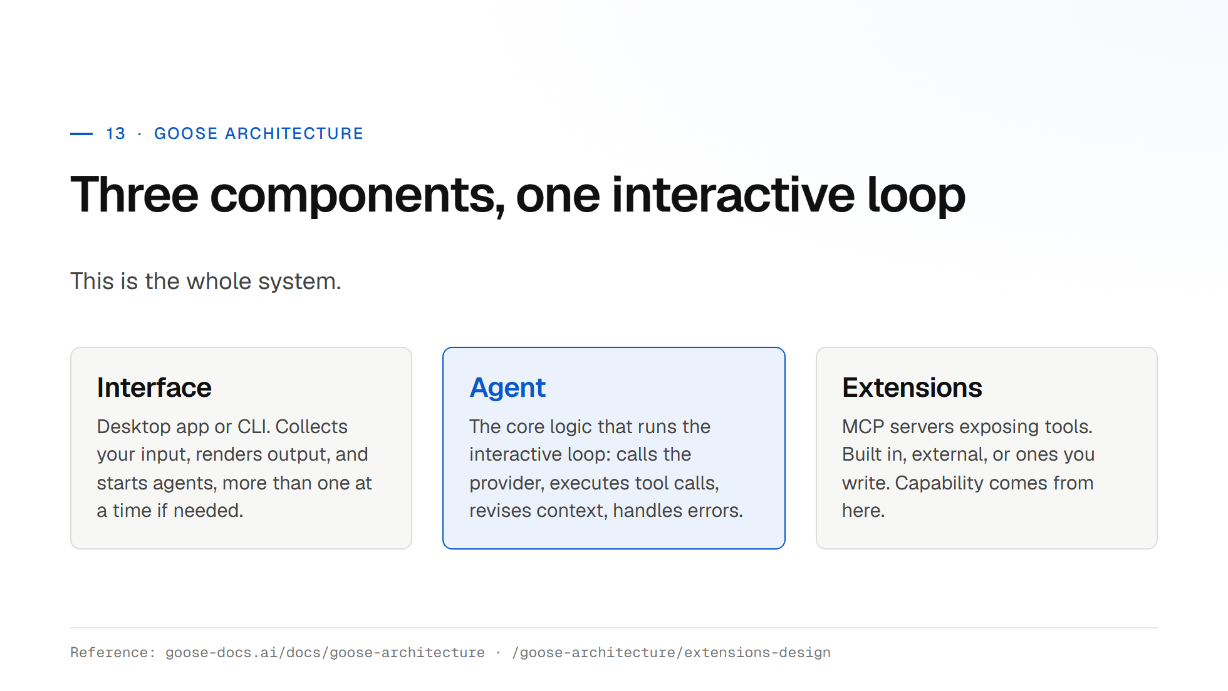
Notes:
Draw the loop on the whiteboard as you talk. Step 5 is the one people miss. Context revision is why goose stays usable on long tasks where a naive loop would blow the window in twenty turns.

Slide 34
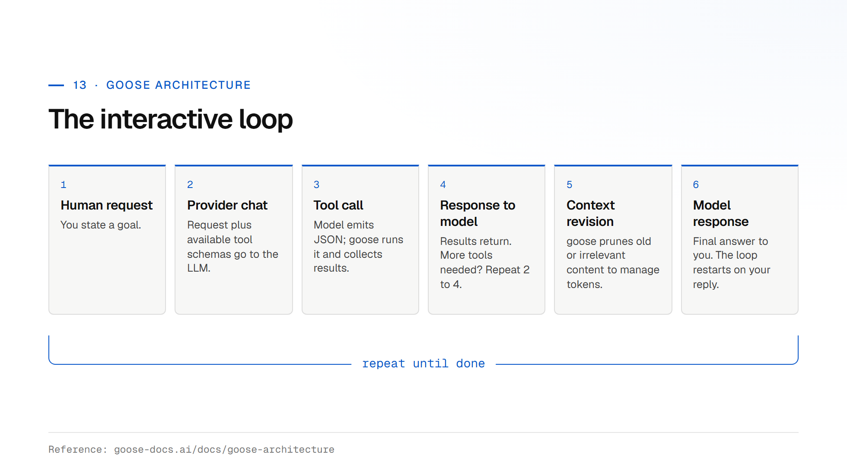

Slide 35
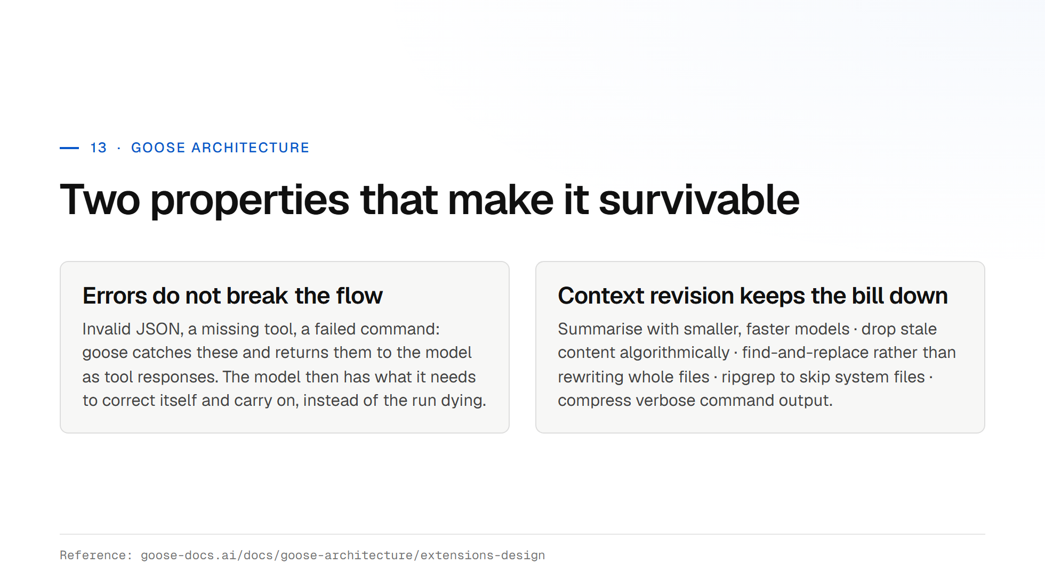

Slide 36
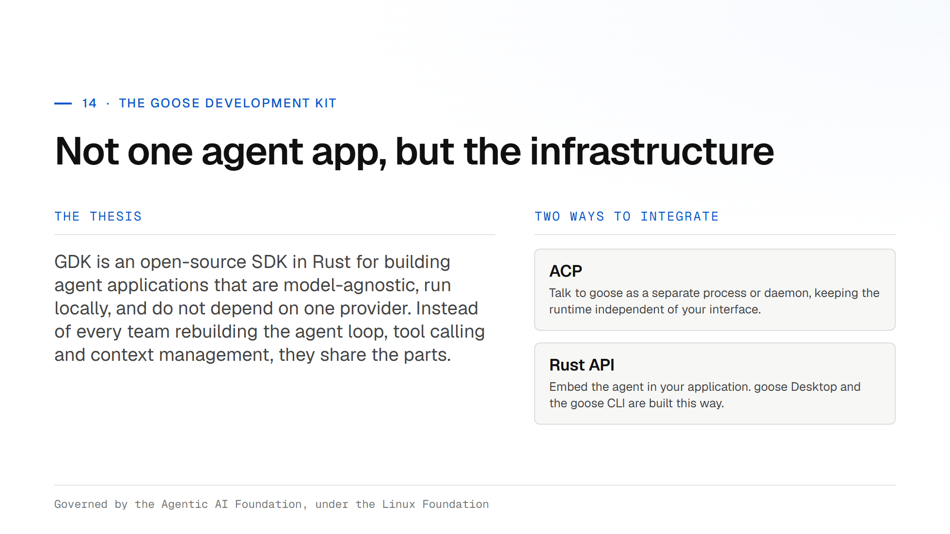
Notes:
Close on the platform story: goose today is a good agent; GDK is the bet that the agent loop becomes shared infrastructure the way the Lightning Development Kit did for payments. Invite the room to contribute. It is foundation-governed and open to outside contributors.

Slide 37
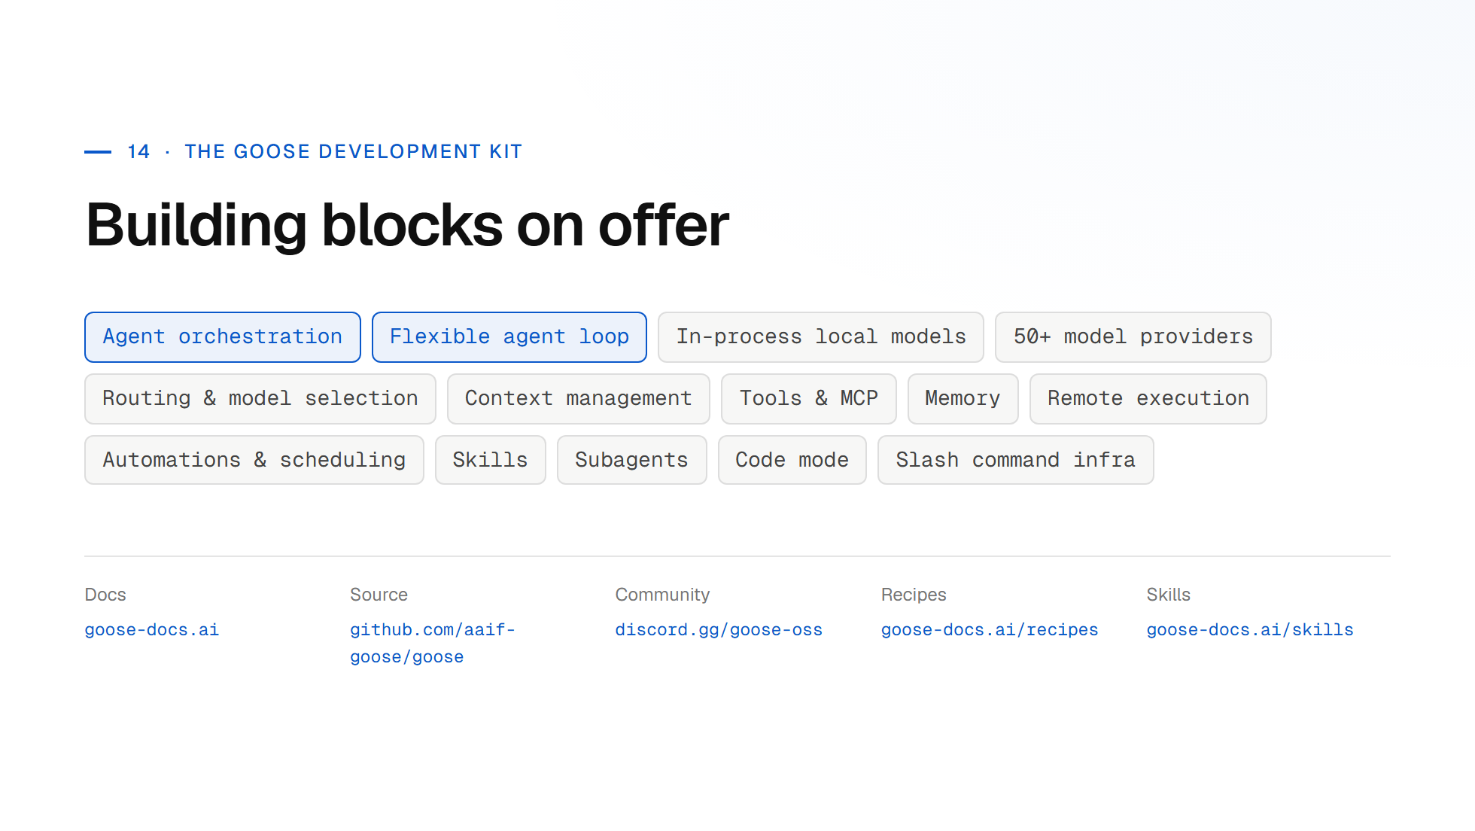

Slide 38
