Slide 1

Strategy and Template Method_

Slide 2
Strategy_
Consists of:
Strategy interface
Concrete Strategy classes
Context class
Pros:
2-3 points of changes
SOLID following
Cons:
To many classes
Takes time to understand logic

Slide 3
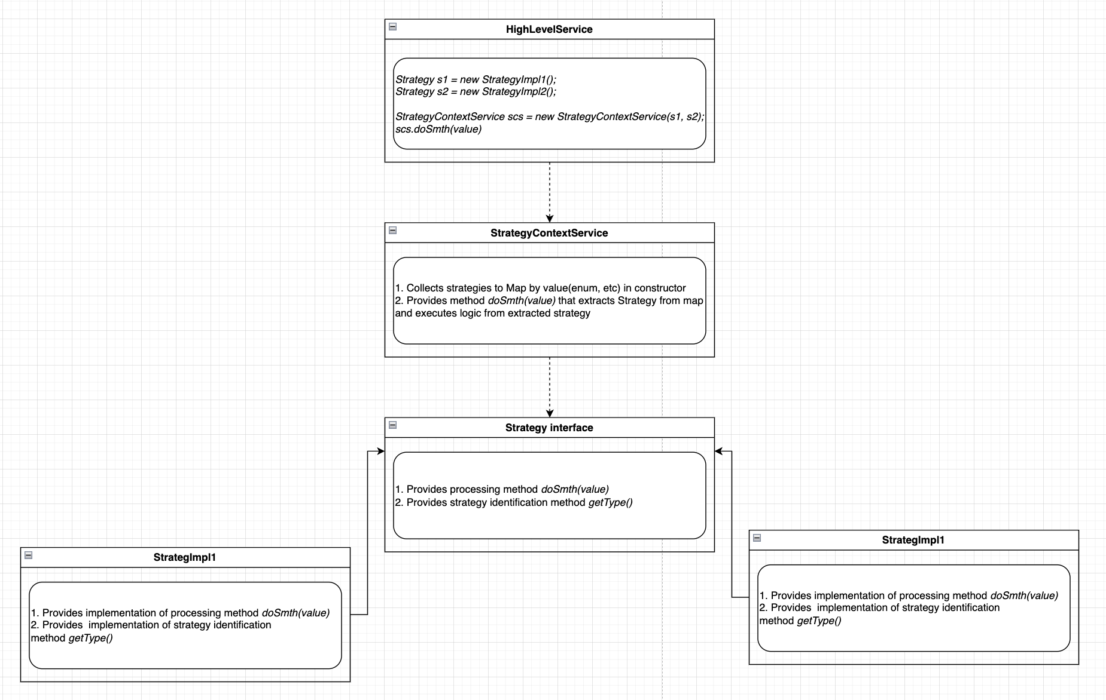
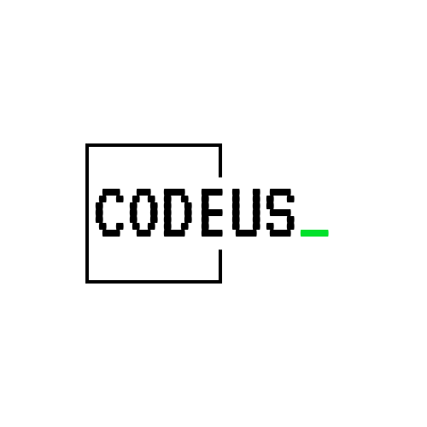

Slide 4
Template Method_
Consists of:
class (abstract usually)
Method with commonly used logic
Method usually protected final
Pros:
Deduplication
Cons:
We cannot extend one more class
Takes time to understand logic in inheritance flow

Slide 5
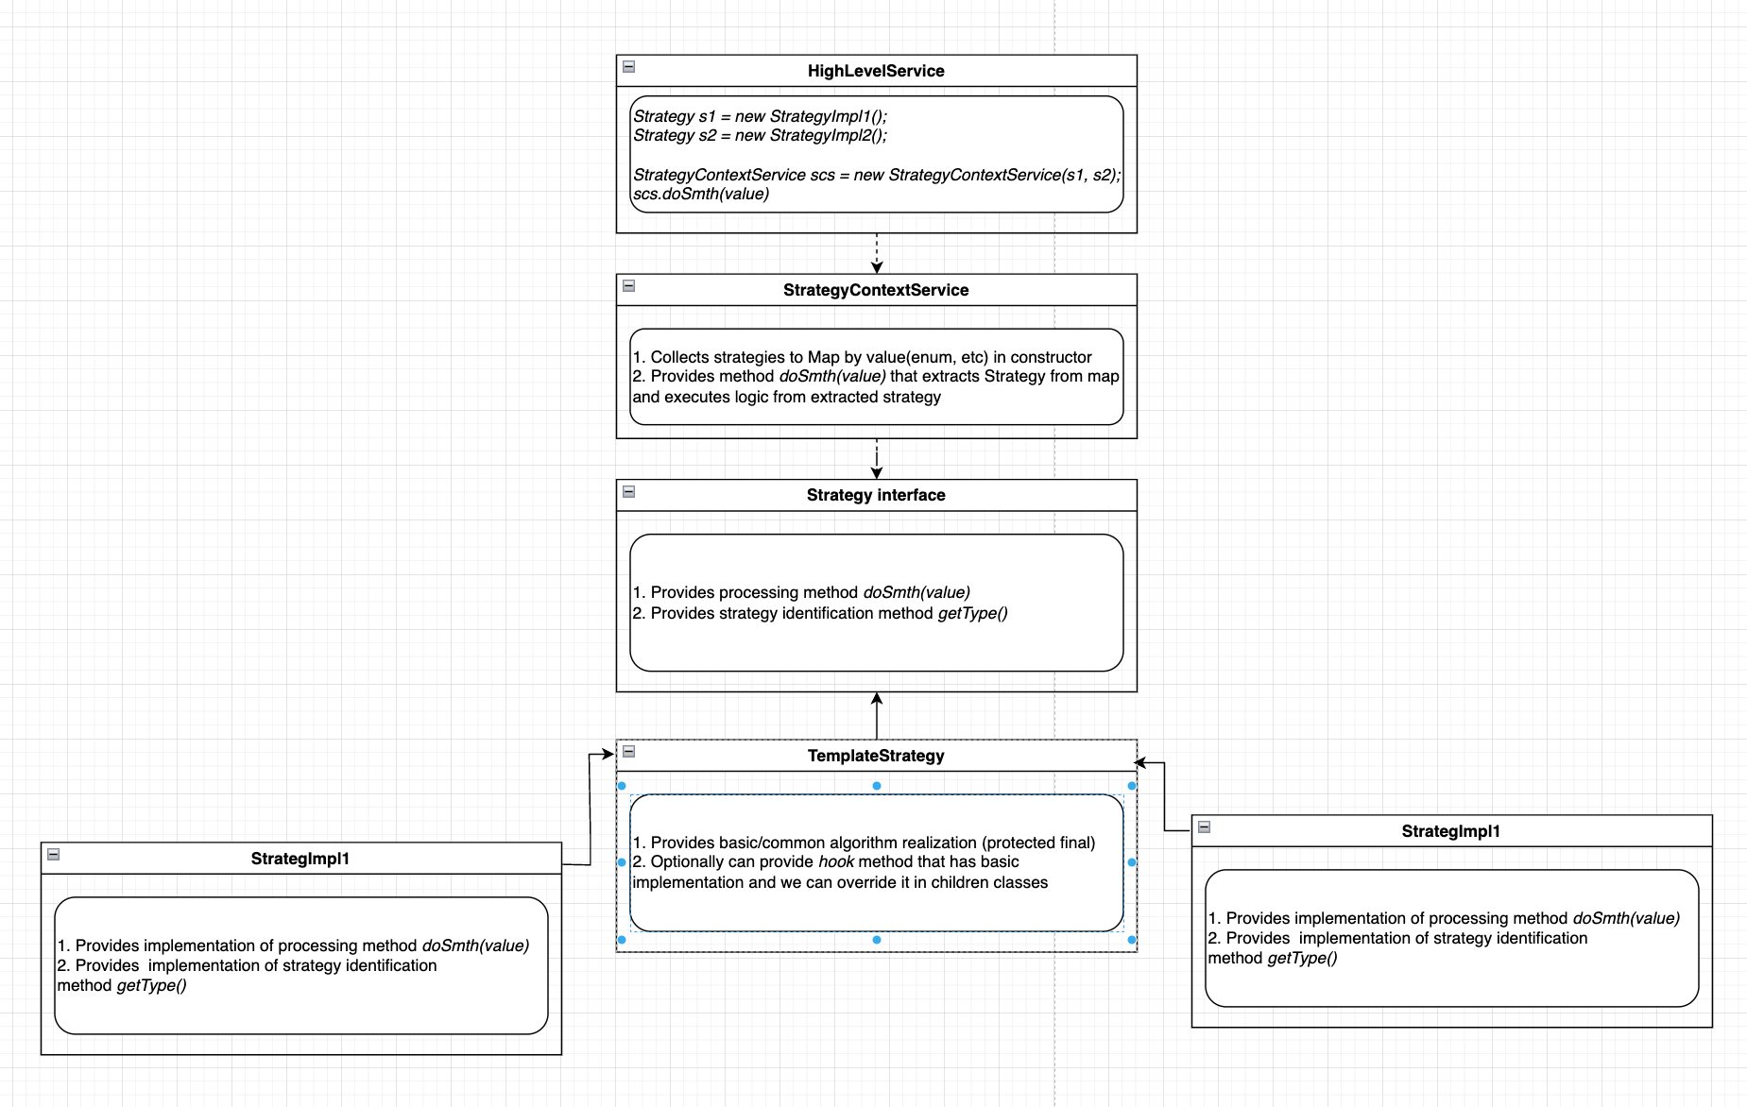

Slide 6
Q&A

Slide 7
Thank you

