Slide 1

Strategy and Template Method_

Slide 2
Strategy_
Consists of:
Strategy interface
Concrete Strategy classes
Context class
Pros:
2-3 points of changes
SOLID following
Cons:
Complexity
Overhead
Behavioral pattern.
The primary purpose of the Strategy Pattern is to define a family of algorithms, encapsulate each one, and make them interchangeable. This pattern allows the algorithm to vary independently from the clients that use it.

Slide 3
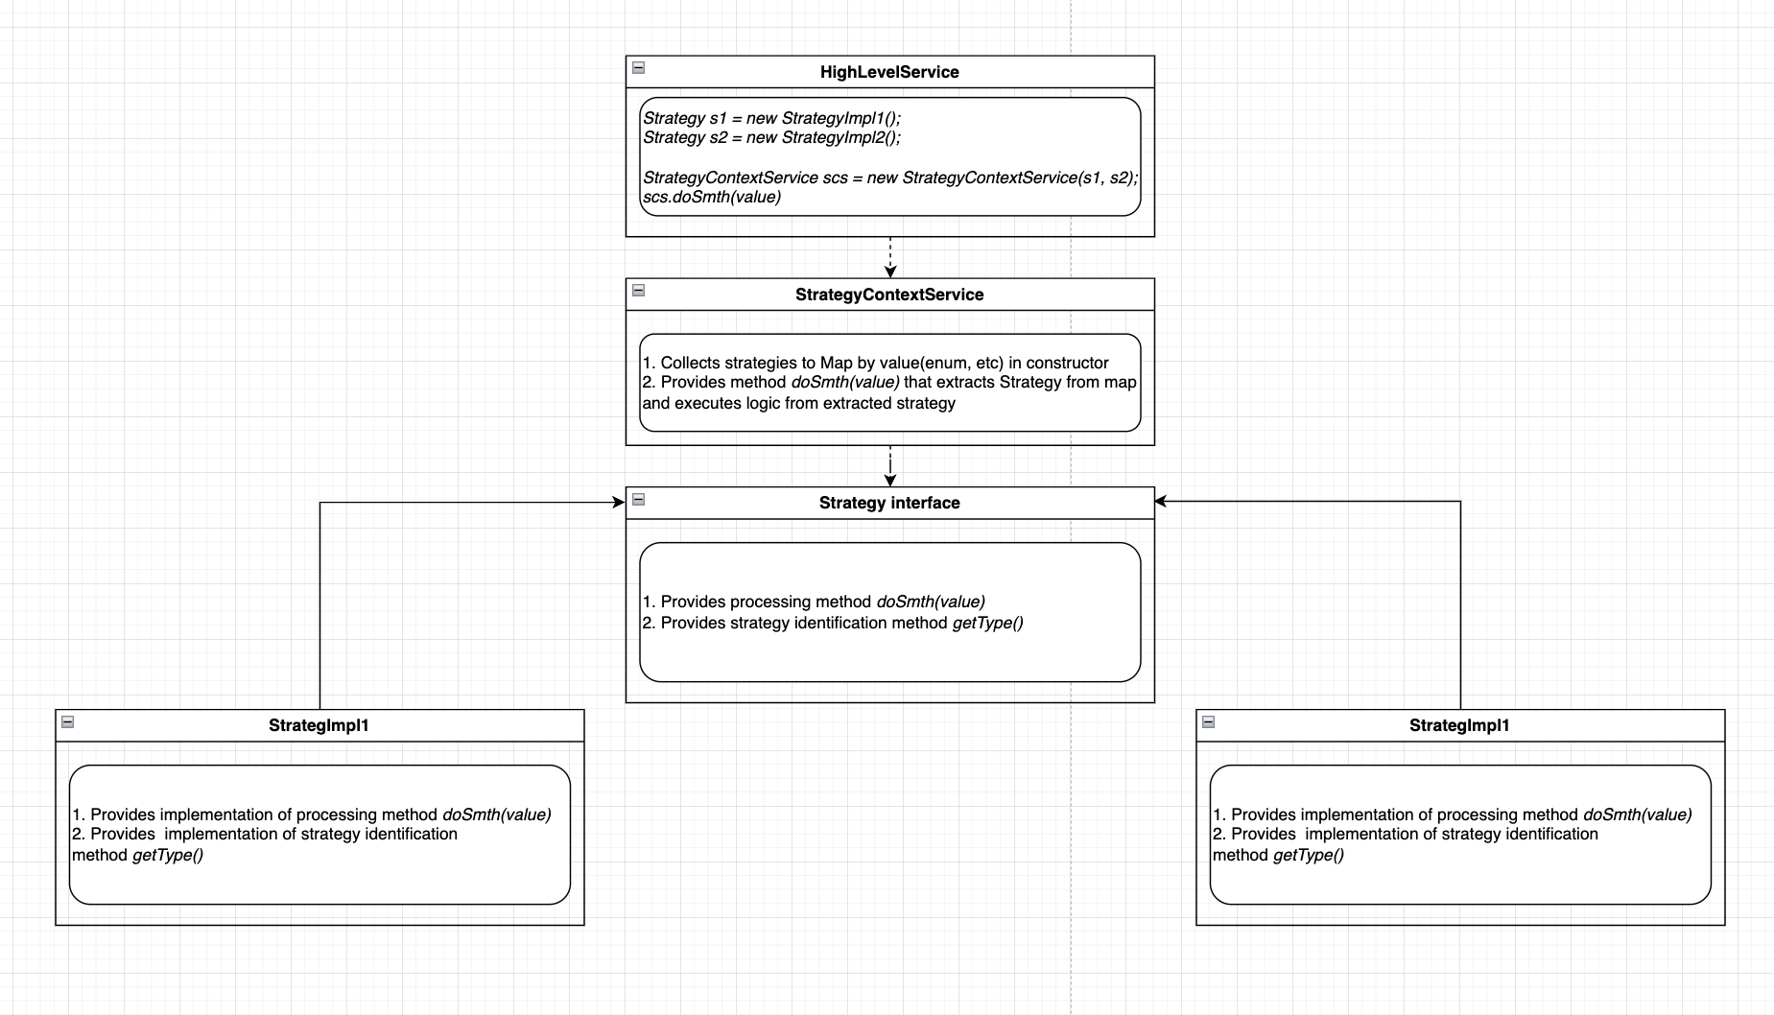
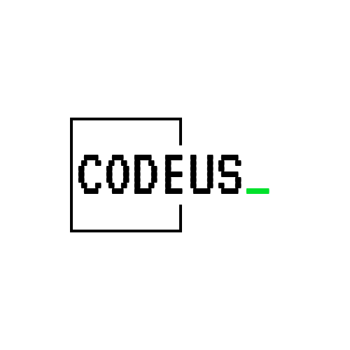

Slide 5
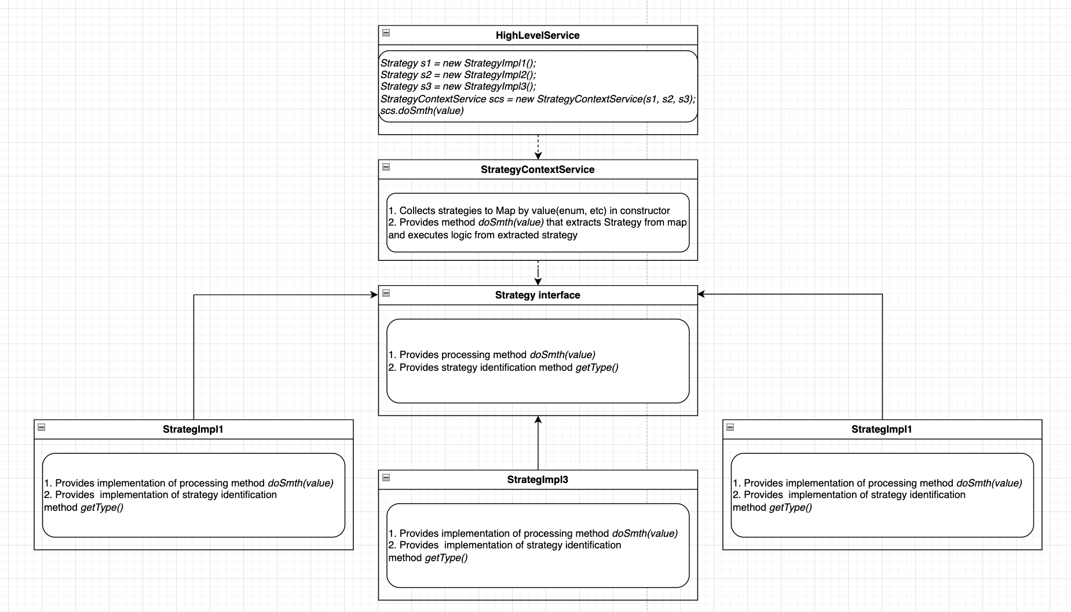

Slide 6
Template Method_
Consists of:
class (abstract usually)
Method with commonly used logic
Method usually protected final
Pros:
Deduplication
Maitability
Cons:
Limited flexibility
Takes time to understand logic in inheritance flow
Behavioral pattern.
The Template Method Pattern defines an algorithm's structure in a base class, allowing subclasses to customize specific steps without altering the overall sequence.

Slide 7
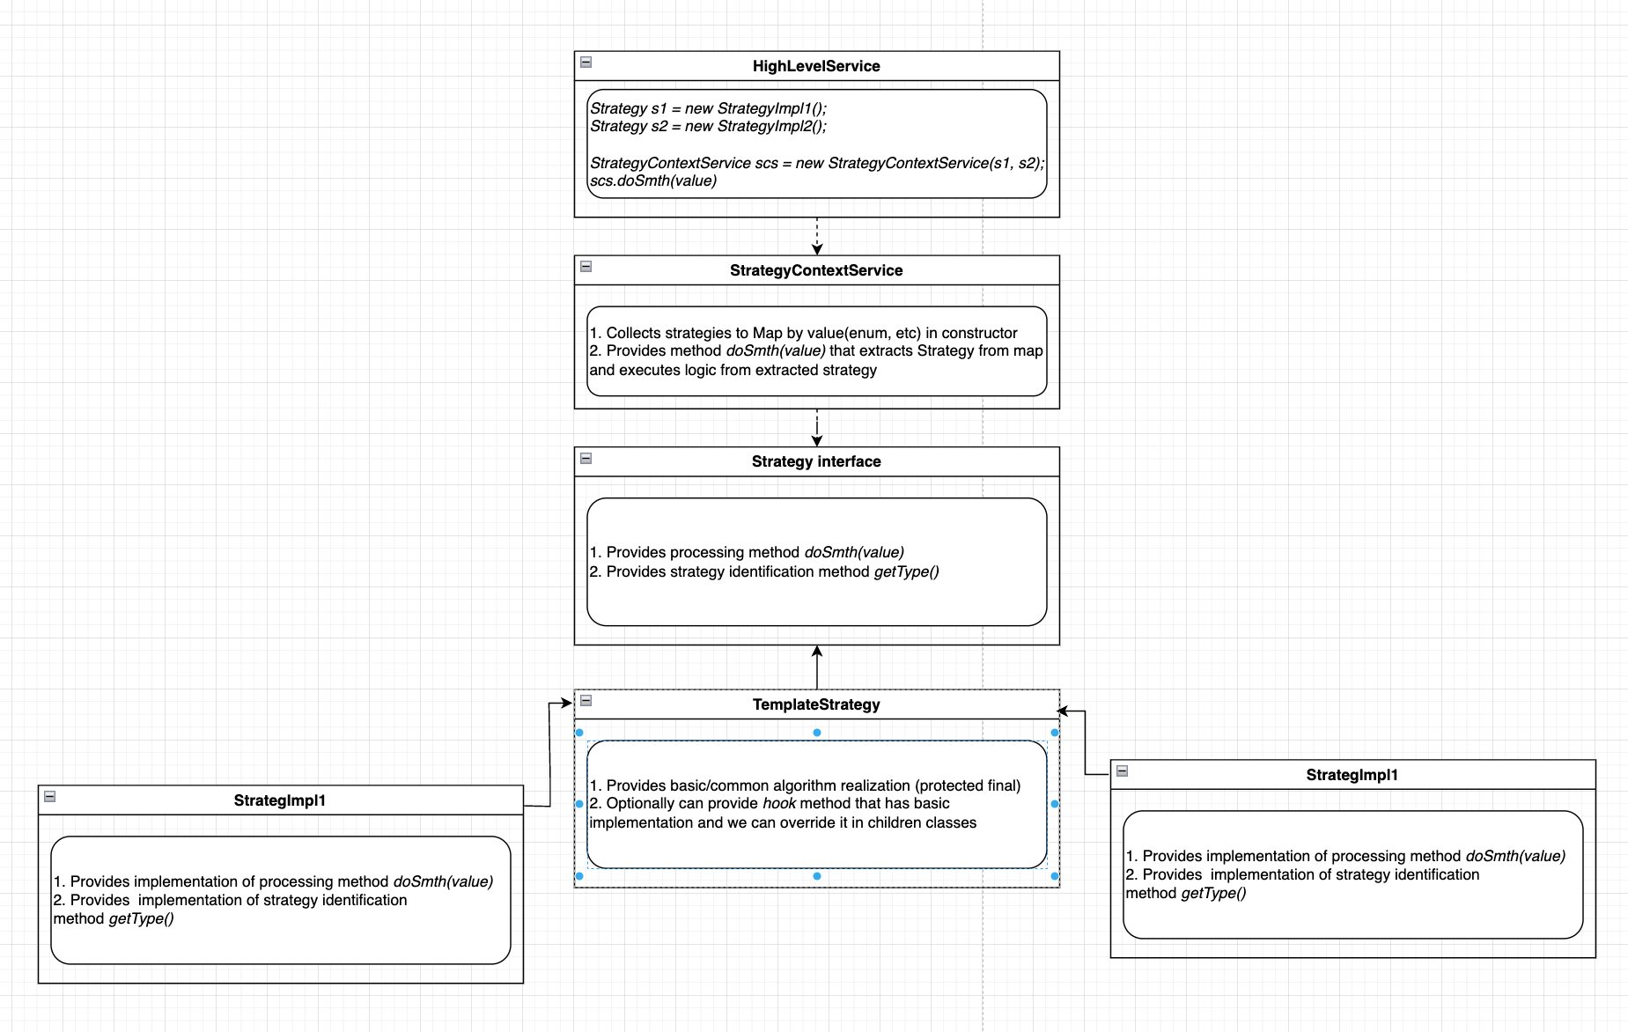

Slide 8
Q&A

Slide 9
Thank you

