Slide 1
CP HotSpots
Group 6: Nisarg Patel, Kai-Hsiang Lin, Parth Nanwani, and Snigdha Madiraju
December 6th, 2021

Slide 2



Background
Target users:
Potential/future restaurant business owners in College Park
Newcomers in College Park
Database includes:
Restaurant
Customers/reviewers
Review information
Database also includes:
Operation hours
Restaurant categories
Across 3 of the largest online review sites:
Yelp
Google/Google Reviews
TripAdvisor

Slide 3
Introduction
Mission Statements
To offer insights to potential new business owners and help them understand target customers and determine pricing strategy to maximize growth potential and profit margin.
To provide useful information about restaurants around College Park and to help newcomers explore local restaurants and find a good place to dine at.
Mission Objectives
To identify which city the most reviewers come from so restaurants can recognize their target customers.
To identify the most popular price level so that restaurants can make better pricing decisions that attract more customers.
To find the highest rated restaurant across all price level so that consumers have a wide variety of choices of high quality restaurants.
To find the top 3 highest rated restaurants, so newcomers can find the best places to dine at.
To find the restaurant that operates for the longest time so newcomers know the restaurant with the highest possibility to be opened.

Slide 4
Business Processes / Transactions
Which city has the most number of customers that posted a review?
What PriceLevel is the most popular among all restaurants?
Which restaurant, across all PriceLevel, has the highest rating?
Which are the names of the top 3 restaurants without considering their PriceLevel?
Which restaurant has the highest opening hours?

Slide 5
Conceptual Database Design: ER Schema
Restaurant (rstId, rstName, rstLocation, -rstStreet, -rstCity, -rstState, -rstZip, rstPhone, rstStar, rstPriceLevel, rstReviewCount, rstCategory [1..5])
Customer (cusId, cusName, -cusFName, -cusLName, cusOrigin, -cusCity, -cusState)
Source (srcId, srcName)
OperationTime (oprDay, oprHours, -oprStart, -oprEnd, =totalHours)

Slide 6
ER Schema: Relationships, Degrees and Constraints
Review (rvwId, rvwStar, rvwDate, rvwPhotoCount): ternary relationship
1 Customer and 1 Restaurant to 1 Source
1 Customer and 1 Source to 0 or many Restaurants
1 Restaurant and 1 Source to 0 or many Customers
Open: binary relationship
1 Restaurant to 1 or many OperationTime
1 OperationTime to 1 Restaurant

Slide 7
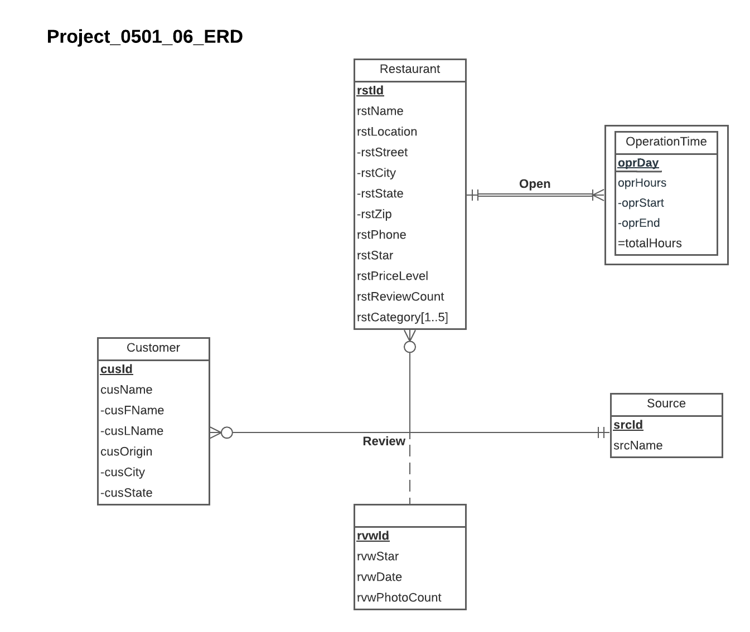
ER Diagram

Slide 8
Logical Database Design: Relational Schema
Restaurant (rstId, rstName, rstStreet, rstCity, rstState, rstZip, rstPhone, rstStar, rstPriceLevel, rstReviewCount)
Customer (cusId, cusFName, cusLName, cusCity, cusState)
Source (srcId, srcName)
RestaurantCategory (rstId, rstCat)
OperationTime (rstId, oprDay, oprStart, oprEnd)
Review (rvwId, rstId, cusId, scrId, rvwStar, rvwDate, rvwPhotoCount)

Slide 9
Relational Schema: Functional Dependencies
rstId → rstName, rstStreet, rstCity, rstState, rstZip, rstPhone, rstStar, rstPriceLevel, rstReviewCount
cusId → cusFName, cusLName, cusCity, cusState
srcId → srcName
rstId, rstCat →
rstId, oprDay → oprStart, oprEnd
rvwId → rstId, cusId, scrId, rvwStar, rvwDate, rvwPhotoCount

Slide 10
Business Rules (1)
[R1] When a restaurant is deleted from the database, the corresponding restaurant category information should be deleted from the database.
[R2] When a restaurant changes information in the database, the corresponding restaurant category information should be changed accordingly.
[R3] When a restaurant is deleted from the database, the operation time information of that restaurant shall be removed from the database.
[R4] When the information on a restaurant is changed in the database, the corresponding operation time information should be changed accordingly.

Slide 11
Business Rules (2)
[R5] When a restaurant is removed from the database, all reviews posted for that restaurant should be removed.
[R6] When information about a restaurant is updated or changed in the database, the corresponding review information for that restaurant should be changed accordingly.
[R7] When a customer is removed from the database, all reviews posted by the customer should be removed.
[R8] When a customer updates his or her information, the corresponding review information posted by that customer should be changed accordingly.

Slide 12
Business Rules (3)
[R9] When a source is removed from the database, all reviews posted on that source should be removed.
[R10] When information about a source is updated or changed in the database, the corresponding review information posted on that source should be updated accordingly.

Slide 13
Referential Integrity Actions
Relation | Foreign Key | Base Relation | Primary Key | Business Rule | Constraint: ON DELETE | Business Rule | Constraint: ON UPDATE
RestaurantCategory | rstId | Restaurant | rstId | R1 | CASCADE | R2 | CASCADE
OperationTime | rstId | Restaurant | rstId | R3 | CASCADE | R4 | CASCADE
Review | rstId | Restaurant | rstId | R5 | CASCADE | R6 | CASCADE
Review | cusId | Customer | cusId | R7 | CASCADE | R8 | CASCADE
Review | srcId | Source | srcId | R9 | CASCADE | R10 | CASCADE

Slide 14
Sample Data
Restaurant ('R08', 'Ledo Pizza', '4509 Knox Rd', 'College Park', 'MD', '20740', '3014228122', 4.2, '$$', 804)
Customer ('C13', 'Ronnie', 'T', 'Hyattsville', 'MD')
Source (‘S01’, ‘Yelp’)
RestaurantCategory (‘R08’, ‘Pizza’)
OperationTime (‘R08’, ‘Mon’, 1100, 2200)
Review ('V40', 'R08', 'C40', 'S02', 3.0, '2019-11-15', 3)

Slide 15
CREATE TABLE [Hotspots.Restaurant] (
rstId CHAR (3) NOT NULL,
rstName VARCHAR (30) NOT NULL ,
rstStreet VARCHAR (40) ,
rstCity VARCHAR (15) ,
rstState CHAR (2) ,
rstZip CHAR (10) ,
rstPhone CHAR (10) ,
rstStar FLOAT,
rstPriceLevel VARCHAR (4),
rstReviewCount INTEGER,
CONSTRAINT pk_Restaurant_rstId PRIMARY KEY (rstId))
CREATE TABLE [Hotspots.Customer] (
cusId CHAR (3) NOT NULL,
cusFName VARCHAR (20) ,
cusLName VARCHAR(20) ,
cusCity VARCHAR(20) ,
cusState CHAR(2) ,
CONSTRAINT pk_Customer_cusId PRIMARY KEY (cusId))
​​
Physical Database Design -
CREATE TABLE

Slide 16
CREATE TABLE [Hotspots.Source] (
srcId CHAR (3) NOT NULL,
srcName VARCHAR (15),
CONSTRAINT pk_Source_srcId PRIMARY KEY (srcId))
CREATE TABLE [Hotspots.RestaurantCategory] (
rstId CHAR (3) NOT NULL,
rstCat VARCHAR (20) NOT NULL,
CONSTRAINT pk_RestaurantCategory_rstId_rstCat PRIMARY KEY (rstId,rstCat),
CONSTRAINT fk_RestaurantCategory_rstId FOREIGN KEY (rstId)
REFERENCES [HotSpots.Restaurant] (rstId)
ON DELETE CASCADE ON UPDATE CASCADE)
​​
CREATE TABLE [Hotspots.OperationTime] (
rstId CHAR (3) NOT NULL,
oprDay CHAR (3) NOT NULL,
oprStart INTEGER,
oprEnd INTEGER,
CONSTRAINT pk_OperationTime_rstId_oprDay PRIMARY KEY (rstId, oprDay),
CONSTRAINT fk_OperationTime_rstId FOREIGN KEY (rstId)
REFERENCES [Hotspots.Restaurant] (rstId)
ON DELETE CASCADE ON UPDATE CASCADE)
Physical Database Design -
CREATE TABLE

Slide 17
CREATE TABLE [Hotspots.Review] (
rvwId CHAR (3) NOT NULL,
rstId CHAR (3),
cusId CHAR (3),
srcId CHAR (3),
rvwStar FLOAT,
rvwDate DATE,
rvwPhotoCount INTEGER,
CONSTRAINT pk_Review_rvwId PRIMARY KEY (rvwId),
CONSTRAINT fk_Review_rstId FOREIGN KEY (rstId)
REFERENCES [Hotspots.Restaurant] (rstId)
ON DELETE CASCADE ON UPDATE CASCADE,
CONSTRAINT fk_Review_cusId FOREIGN KEY (cusId)
REFERENCES [Hotspots.Customer] (cusId)
ON DELETE CASCADE ON UPDATE CASCADE,
CONSTRAINT fk_Review_srcId FOREIGN KEY (srcId)
REFERENCES [Hotspots.Source] (srcId)
ON DELETE CASCADE ON UPDATE CASCADE)
Physical Database Design -
CREATE TABLE

Slide 18
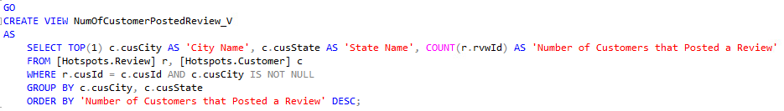
Which city has the most number of customers that posted a review?

Slide 19

Results

Slide 20
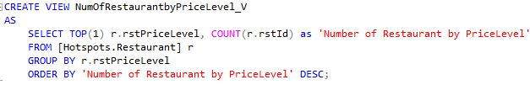
What PriceLevel is the most popular among all restaurants?

Slide 21

Results

Slide 22
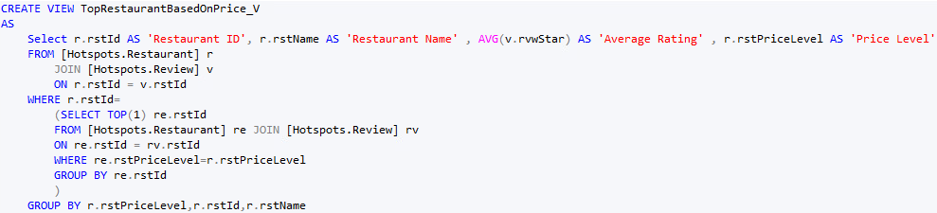
Which restaurant, across all price levels, has the highest rating?

Slide 23
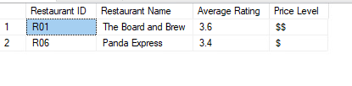
Results

Slide 24
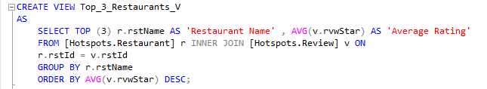
What are the names of the top 3 restaurants, without considering their price level?

Slide 25

Results

Slide 26
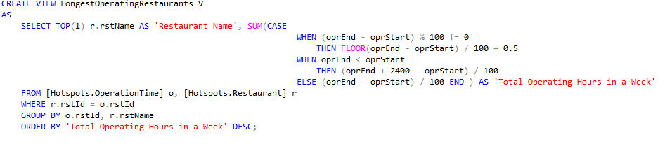
Which restaurant has the highest opening hours?

Slide 27

Results

