Slide 1
SWE General Meeting
Monday, January 23, 2011
5:00pm-6:00pm
Bourns A265

Slide 2
Ice Breaker Time
Let’s get to know each other!

Slide 3
Ice Breaker Time
So you have that mysterious piece of paper in front of you…
← paper

Slide 4
Ice Breaker Time
Write down your initials
Write two things you like, and 2 things you dislike.
Attempt a self-portrait.

Slide 5
Ice Breaker Time
Now use it to make a paper airplane
If you do not know how to make a paper airplane, find someone who is taking ENGR 180. They have instructions.
Now for the next two minutes, make them fly!
If you see one fall near you, pick it up and make it fly again!

Slide 6
Ice Breaker Time
Now pick up ONE airplane
Find its owner!

Slide 7
Ice Breaker Time
Let’s REALLY get to know each other!

Slide 8
Ice Breaker Time
See that number in your hand?
Find the matching number!
#
← number

Slide 9
Ice Breaker Time
Run out of things to say? Here are some ideas:
Favorite movie?
Most embarrassing moment?
Why did you choose your major?
Dream career?

Slide 10
Outline of Upcoming Events
Social/Fundraising Events
Jan. 27 – Ice Skating Social
Feb. 10 – Valentine’s Auction
Feb. 17 to Feb. 19 – Big Bear Trip
Mar. 7 – TV Taping (Mike and Molly)
Mar. 31 – Warrior Dash
Outreach/Prof. Dev
WEDNESDAY, JAN 25 – ENGR & TECH CAREER FAIR
Feb. 29 to Mar. 3 –
SWE Regional Conference
in Hawaii
Feb. 17 – YEMP, Norco
Feb. 22 - MESA Engineering Nite
Perris High School Tutoring
FIRST Robotics Team Mentoring

Slide 11
Social Event: Ice Skating
FRIDAY, JANUARY 25 – 8pm-11pm
Riverside Ice Town
Carpools will be provided
No experience is needed!

Slide 12
SPACE SCIENCE AND ENGINEERING DAY
First Committee Meeting this THURSDAY!
Thursday, January 26th, 12:30pm noonish
Winston Chung Hall (EBUII) 102
Lunch will be provided!

Slide 13
Professional Development - Engineering Career Fair
Wednesday, January 25th – 10:00am – 2:00pm
HUB 302
Bring your Resumes!
Dress professionally!

Slide 14
Career Fair tips:
Be prepared! Do the research.
Look up these companies early!
Dress professionally.
Slacks and blouse/dress shirt are appropriate
Practice makes perfect.
Cater your resume to specific positions
Need help? Stick around and we’ll help you go over your resume.

Slide 15
Social Event – Valentine Auction
Friday, February 10th
Winston Chung Hall (EBUII) 205/206
We need volunteers to be auctioned off!
Includes free dinner!

Slide 16
Outreach Event: YEMP
Friday, February 17th – 8am-10am
Norco Middle School
Speak to middle school students about engineering!
COMMUNITY SERVICE HOURS!
Carpool provided
No experience necessary

Slide 17
Social Event – Big Bear Trip
President’s Day Weekend – Feb. 17 – 19th
Spend the weekend at a Big Bear Cabin!
Snowboarding on Saturday!
We will figure out costs soon

Slide 18
Fundraising/Social Event- TV Taping (Mike and Molly)
Wednesday, March 7^{th ,}
Taping begins at 5:00pm
Burbank, CA
Need min. 10 people!
Carpool leaves 3:00pm

Slide 19
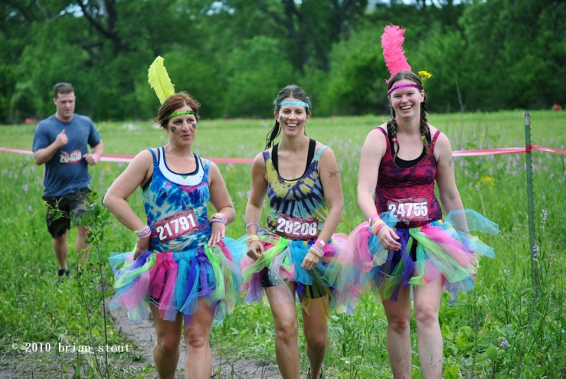

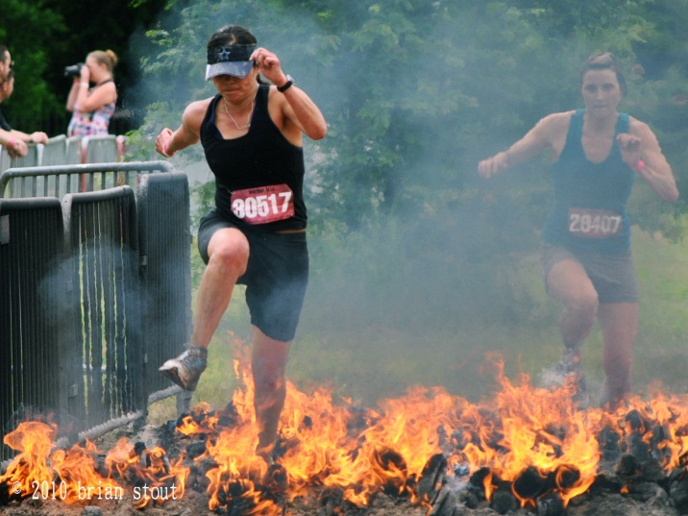
Fundraising Event- Warrior Dash

Slide 20
Regional Conference – in Hawaii
Wednesday, February 29th- Sunday, March 3rd
*End of week 8, winter quarter
Sign up early! And save up early!
Cost so far:
$125/night/person for lodging
~$350 for round-trip flight (we’ll keep you posted for deals)
~$190 registration fee with LUAU, ~$125 without LUAU
SOME OF THESE COSTS WILL BE REIMBURSED
http://www.swewestern2012.org/aloha.php

Slide 21
Outreach Event- Perris High Tutoring
Mon- Thurs, 3:00pm – 4:30pm
Where: Perris Charter High School
Tutoring in Math and sciences
No experience is needed!
Joint program with NSBE and SHPE

Slide 22
Outreach Event – FIRST Robotics Mentoring
3-4 times a week, 3pm-7/8pm
January/February
Temecula Prep School
No experience is necessary!

Slide 23
Were you paying attention?

Slide 24
See you next time!
Next Event:
ICE SKATING, this Friday!!!

