Slide 1
SWE General Meeting
Monday, October 17, 2011
5:00pm-6:00pm
Bourns A265

Slide 2
Ice Breaker Time
Let’s get to know each other!

Slide 3
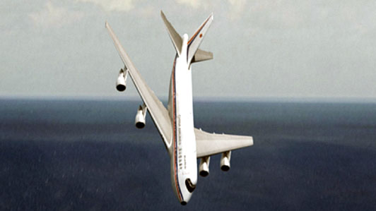
OH NO!
On our way to the Regional Conference in Hawaii, our plane has malfunctioned and gone down in somewhere in the Pacific Ocean.

Slide 4
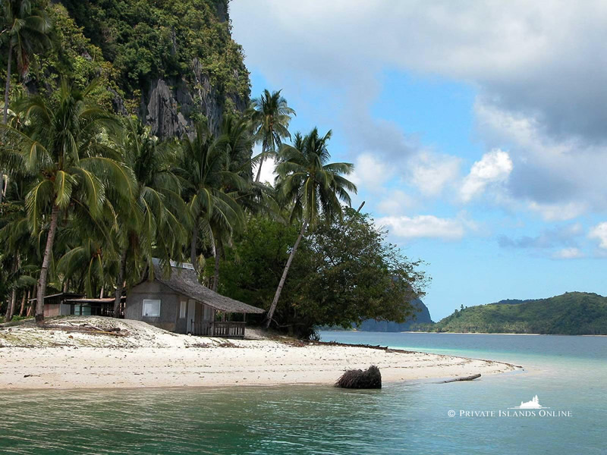
Saved?
Lucky for us, we’ve miraculously landed in a deserted island with no injuries or casualties.

Slide 5
Trouble in Paradise
Unfortunately, not all of us got along. We all broke off into groups of three (now is the time to break into groups of three).
All groups were equally given materials salvaged from the crashed plane (receive your ‘materials;).

Slide 6
But wait…
In the distance you see a bigger island that looks like it might be civilized (Catalina Island maybe?)
It looks like your group just might be able build a bridge across to that island—you are engineers and scientists, after all.

Slide 7
How bad do you want to survive?
Icebreaker Challenge:
Using your materials, get your
entire group across to the other
room.
You MUST use spoons to bridge between plates.
Only one foot per plate

Slide 8
Outline of Upcoming Events
Social/Fundraising Events
Oct. 17 – Engr. Take Over
Oct. 27 – Rock Climbing
Oct. 31 – Halloween Social
Nov. 18 – Thanksgiving Potluck
Outreach/Prof. Dev
Nov. 5 – Alzheimer’s Walk
Nov. 7 – Tiffany Shenelle
Nov. 17 – Mock Career Fair
Dec. 3 – GS Badge Day

Slide 9
Fundraising – Engineering TAKE OVER
BMES Fundraiser – BOBA
Wednesday, October 19th
12pm – 3pm, Belltower
$3 regular price, $2 with any BCOE shirt.
Special event: Freeze Flash Mob
Belltower – 2:15pm sharp!
Show your pride!
Where a BCOE/BCOE Organization shirt

Slide 10
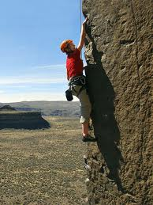
Social Event – Rock Climbing
Thursday, October 27th
6pm – 8pm
REC center
FREE for UCR students (bring your ucr card)
http://www.facebook.com/event.php?eid=231470706911520

Slide 11
Fundraising Event- Alzheimer’s Walk
Saturday, November 5th
9:15 am, Huntington Beach Boardwalk (Beach and PCH)
Carpools provided

Slide 12
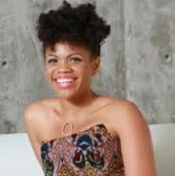
Professional Development – Speaker: Tiffany Shenelle
Monday, November 7th
5 pm – 6:30pm, Bourns A265
"An interactive, practical and fun look at communication and how to effectively say and ask for anything with results!”

Slide 13
Professional Development - Mock Career Fair
ASME-Hosted Event
Thursday, November 17th,
5:30-6:30pm, EBUII 205/6 & Patio
Bring your Resumes
“Apply” for a research position
Get good tips on how you present yourself
*Disclaimer: The event is only a mock career fair. Students should not expect to receive a research position through this event.

Slide 14

Social Event – Thanksgiving Potluck
Friday, November 18th
Bourns A265
Food! Movies!

Slide 15
Outreach Event – Girls Scouts Badge Day
Saturday, December 3rd
8:00am – 12:00pm (donuts provided)
Boeing Facilities in Huntington Beach
Carpools will be provided

Slide 16
Membership
Signup between Oct. 17 and Oct. 21 and SWE UCR will cover $10 of your membership
Signup between Oct. 22 and Oct. 28 and SWE UCR will cover $5 of your membership
www.swe.org/memberservices
Show us your receipt
OR turn-in a hardcopy! (email or in person)
UCR Communities

Slide 17
Were you paying attention?

Slide 18
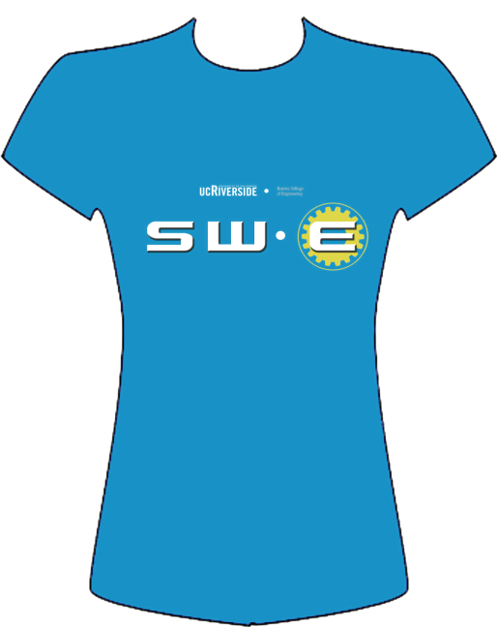

T-Shirt Design Contest
Email/facebook us your designs!
swe@engr.ucr.edu

Slide 19
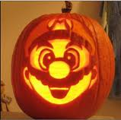
See you next time!
Next Meeting:
Monday, October 31st, 2011 OUR HALLOWEEN MEETING ☺

