Slide 1
SWE General Meeting
Monday, November 14, 2011
5:00pm-6:00pm
Bourns A265

Slide 2
Ice Breaker Time
Let’s get to know each other!

Slide 3
Fast and Furious: SWE Style
Get into groups of no more than 5 people
You will receive the following materials:
1 sheet of Tissue paper
4 CD-Rs
2 index cards
Straws
Masking tape
Make a car with a sail!

Slide 4
Race them!
The rules:
You may only blow on your sail to advance your car forward.
First team to cross the finish line gets a prize!

Slide 5
Volunteering Opportunity: GRID Alternatives
Please give all attention to our guest, Jared McCreary, from GRID Alternatives.
For more information: http://www.gridalternatives.org/

Slide 6
Outline of Upcoming Events
Social/Fundraising Events
Nov. 18 – Thanksgiving Potluck
Outreach/Prof. Dev
Nov. 17 – Mock Career Fair
Dec. 3 – GS Badge Day
Feb. 29 to Mar. 3 –
SWE Regional Conference
in Hawaii

Slide 7
BCOE’s Rube Goldberg Project
BCOE Organizations collaborative event
Goals: Blow up a balloon and pop it!
All majors are encouraged to attend.
Talk to us for more details!
http://www.youtube.com/watch?v=qybUFnY7Y8w

Slide 8
Regional Conference – in Hawaii
Wednesday, February 29th- Sunday, March 3rd
*End of week 8, winter quarter
Sign up early! And save up early!
Cost so far:
$75/night/person for lodging
~$600 for round-trip flight (we’ll keep you posted for deals)
~$178 registration fee with some meals, ~$108 without meals
SOME OF THESE COSTS WILL BE REIMBURSED
http://www.swewestern2012.org/aloha.php

Slide 9

Social Event – Thanksgiving Potluck
Friday, November 18th
Bourns A265
Food! Movies!
Please sign-up
what you will be
bringing!

Slide 10
Outreach Event- Celebrating Women in Engineering and Sciences
Friday, December 2nd
Where: Chaffey College
Carpools will be provided
Had an awesome engineering internship over summer? Share your story!
Share your college experience with high school/community college students

Slide 11
Outreach Event – Girls Scouts Badge Day
Saturday, December 3rd
8:00am – 12:00pm (donuts provided)
Boeing Facilities in Huntington Beach
Carpools will be provided

Slide 12
Professional Development - Mock Career Fair
ASME-Hosted Event
Thursday, November 17th,
5:30-6:30pm, EBUII 205/6 & Patio
Bring your Resumes
“Apply” for a research position
Get good tips on how you present yourself
*Disclaimer: The event is only a mock career fair. Students should not expect to receive a research position through this event.

Slide 13
Mock Career Fair tips:
Be prepared! Do the research.
Look up these professors early!
Dress professionally.
Slacks and blouse/dress shirt are appropriate
Practice makes perfect.
Cater your resume to specific professors/positions
Need help? Stick around and we’ll help you go over your resume.

Slide 14
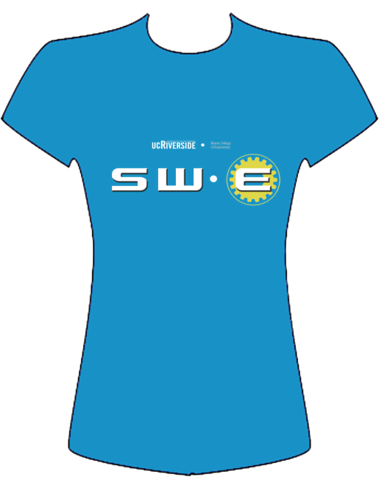

T-Shirt Design Contest
Email/facebook us your designs!
swe@engr.ucr.edu
We will be
ordering them
over break!

Slide 15
Were you paying attention?

Slide 16
See you next time!
Next Event:
Mock Career Fair and Thanksgiving Potluck

