Slide 1
SWE general meeting
February 4th 2013

Slide 2
Ice Breaker

Slide 3
Pass the carrot
Form two large circles outside on the patio.
Place carrot between your knees.
Pass to your neighbor on the right.

Slide 4
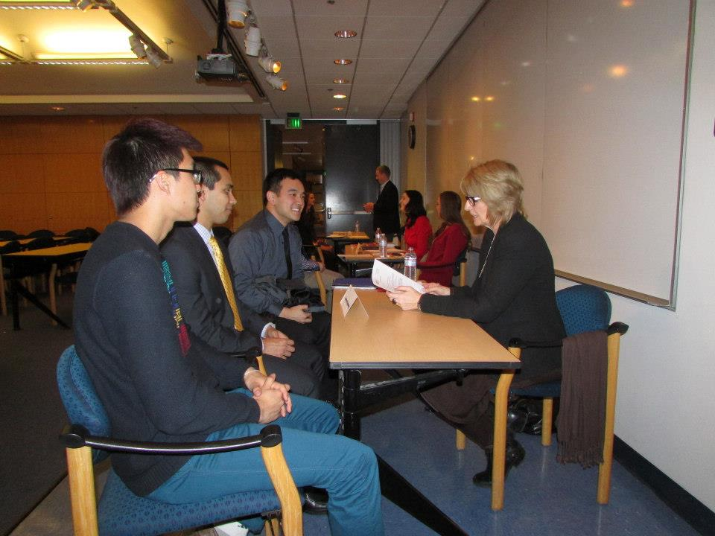
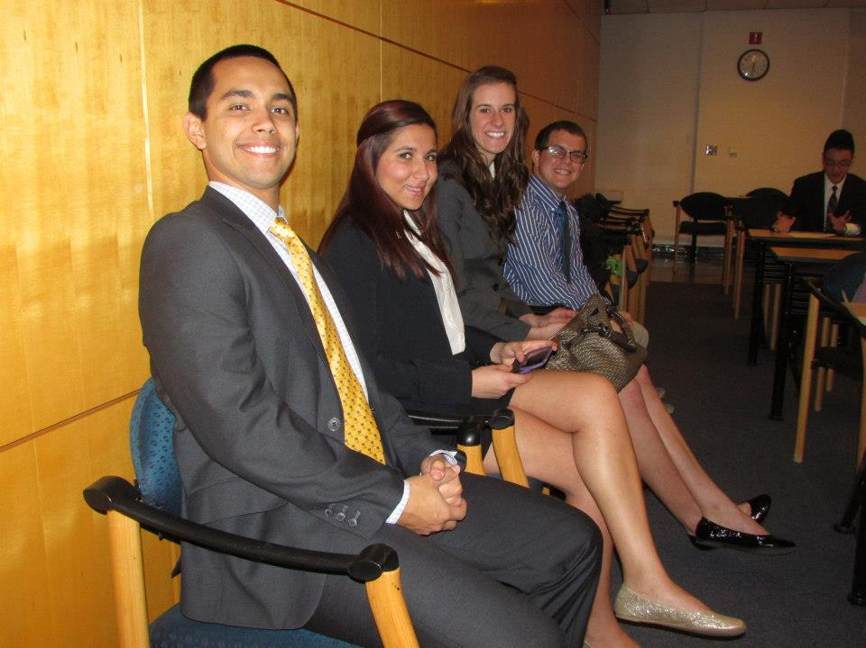
SWE Fashion Show

Slide 5

Fluor Information Session

Slide 6

Ice Skating

Slide 7
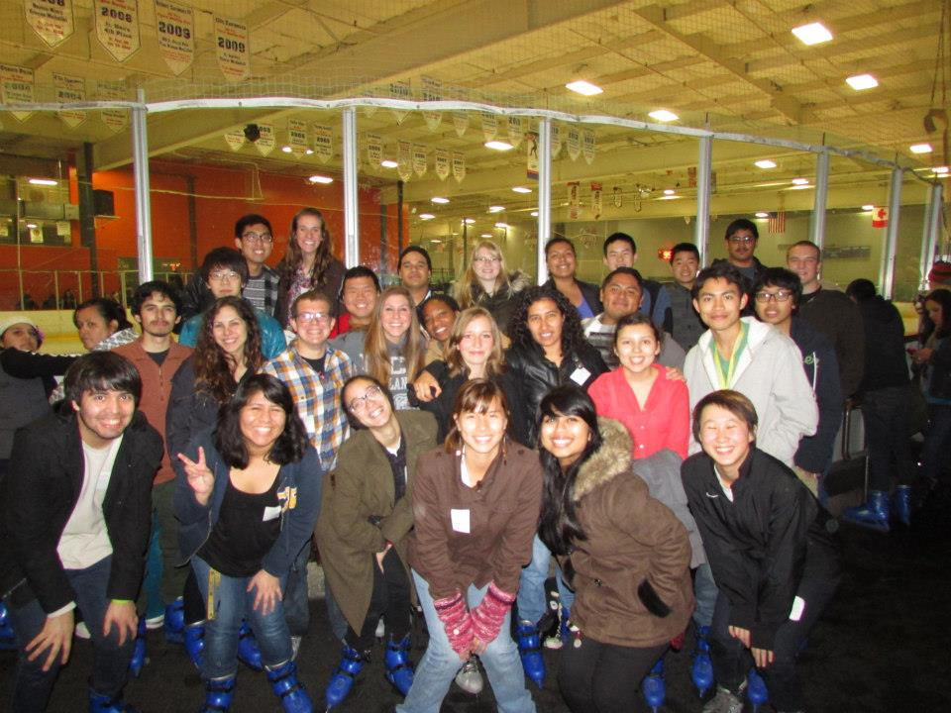

Slide 8
SoCal Edison
Wednesday (two days from today)
A265
7-8PM
Yes, food.

Slide 9
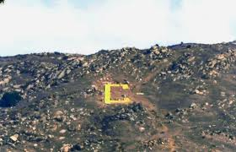
Hike to the C
Saturday Feb 9th
Meet at Goodwins at noon.

Slide 10
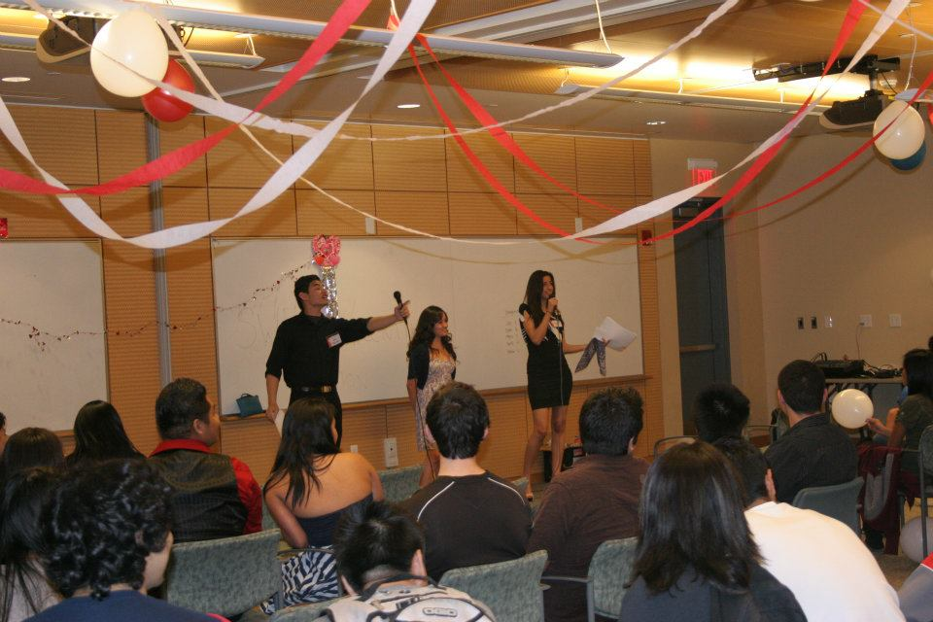
Valentine Auction
February 15th
5pm
WCH 205/206

Slide 11

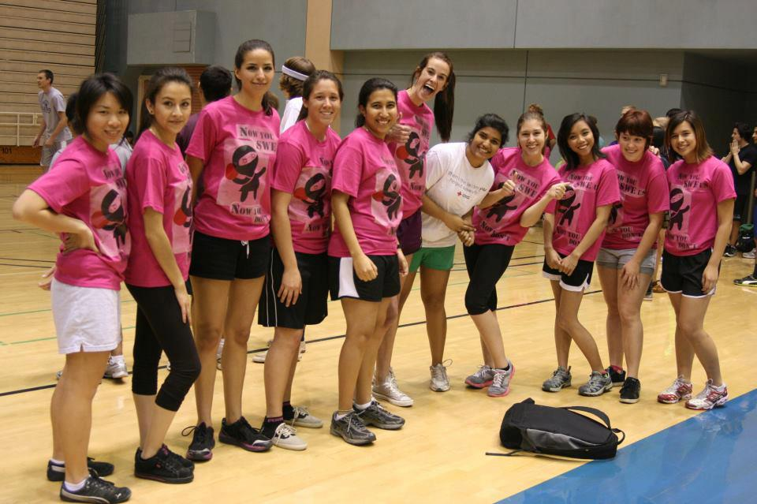
Dodge ball Tournament Team
BMES Tournament
Feb 21st 7-10PM

Slide 12
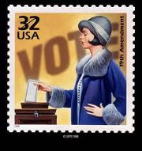
Officer Elections
Information Session
February 11th WCH 102
Officer Elections
March 4th –Week 9

Slide 13
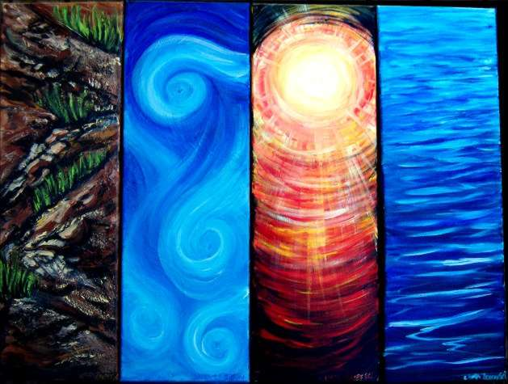
Bourns Engineering Day
Innovation for the Earth
April 6th 2013 – week1
Volunteer! : http://ssedvolunteer2013.eventbrite.com/

Slide 14
Shirts for Sale
Shirts $15
Sweaters $20
Engineering Paper $1

