Slide 1
2nd General Meeting
10-22-2012

Slide 2
New board members
Rosalva (Salsa) Chavez
Outreach Coordinator
Danah Alkurdi
Historian

Slide 3
Ice Breaker
Count off people 1-7
Split into their numbered groups.

Slide 4
Carla De los Santos
Guest Speaker

Slide 5
Upcoming Events
Wednesday 10/24/12 INROADS
Tuesday 10/30/12 Resume Workshop: Career Readiness Tools with Theta Tau
ABET Review Nov 4-6
Outreach Event: Robotics Competition (judging on campus) 11/10
11/19 3rd General Meeting Time Management Theme
Tuesday 11/20 Thanksgiving Potluck

Slide 6

Inroads event
Presented by: The National Society of Black Engineers UC Riverside Chapter
“The Mixer”
YOU’RE INVITED…
to our INROADS COLLEGE TOUR EVENT
Wednesday, October 24th at
University of California Riverside
Bourns Hall A265
6pm-8pm
This is your opportunity to learn in-depth knowledge about our professional
development and internship placement process. Our alumni and current interns
throughout the Northern and Southern California who have participated in the
INROADS program will be on hand to talk about their experiences as an INROADS
intern. In addition, our Pacific Southwest INROADS staff will be at this event to
answer any questions you may have about our internship opportunities throughout the
region and the rest of the United States.
Pizza will be provided on a first come first serve basis. Seats will fill up fast so please register using the link below by 2PM Tuesday, Oct 23rd, 2012:
https://creator.zoho.com/inroadspsw/inroads-college-tour-registration-/form-perma/UC_Riverside_INROADS_Mixer/NmzeK8XTZmVSAZrNNDM12ngJUf7jjgr0B0Kh2StpQrmNDVh7Uat5GupwMrdBuABOCyK3daBV0DkvSZnPxbqzA3sT6VH7neHKABxB/

Slide 7
Professional Development
Resume Workshop: Career Readiness Tools with Theta Tau
Tuesday, October 30, 2012
3:30pm until 4:30pm
Bourns A 265

Slide 8

Outreach Event: Robotics Competition
Qualifying Tournament this year is at UC Riverside on November 10th.
Robotics Competition for Middle School students.
http://firstlegoleague.org/challenge/2012seniorsolutions

Slide 9
JPL Internship
NASA DEVELOP Internship Program 2013
Call for Spring 2013 Interns: All degree levels (Bachelors, Masters, PhD) are welcome to
apply.
Spring 2013 applications must be postmarked by November 15, 2013.
https://docs.google.com/a/ucr.edu/viewer?a=v&pid=gmail&attid=0.1&thid=13a7020a7ad1c43d&mt=application/vnd.openxmlformats-officedocument.wordprocessingml.document&url=https://mail.google.com/mail/u/0/?ui%3D2%26ik%3D2b3f116da6%26view%3Datt%26th%3D13a7020a7ad1c43d%26attid%3D0.1%26disp%3Dsafe%26realattid%3De5ef5405debc3c9d_0.1%26zw&sig=AHIEtbRt30j2RJGpl_n5LyfKvDtRYfPISg

Slide 10
Next Meeting
11/19
WCH 205/206
Time Management
6pm

Slide 11
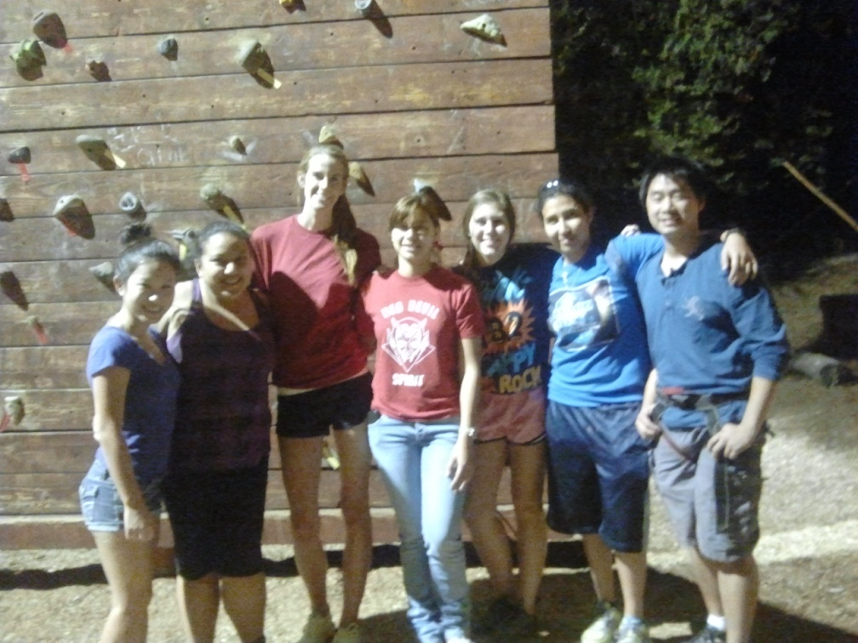
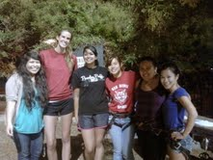
Rock Climbing
Thank you for coming.

Slide 12
Apparel Sale
Tanks- $10
Shirts- $15
Sweaters- $20
Older designs are $5 each

Slide 13
T shirt design
We need new designs for this year.
due date Nov. 16th for the designs.
Send designs to swe.ucr@gmail.com
We will be voting the week of Nov.19 -23.
Shirt that gets chosen will receive a prize.

