Slide 1
3rd General Meeting
11-19-2012

Slide 2
Ice Breaker!

Slide 3
Guest Speaker
Time Management and Study Skill workshop conducted by Shrina Kurani, the Academic Success Counselor in BCOE.

Slide 4
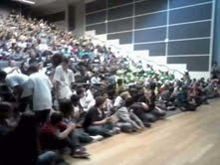
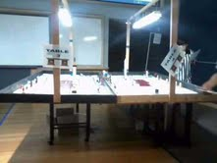
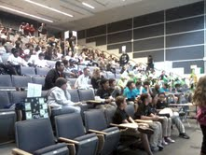
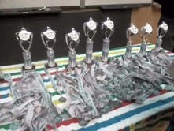
MESA Robotics Competition
Thank you Danielle C. for the pictures

Slide 5
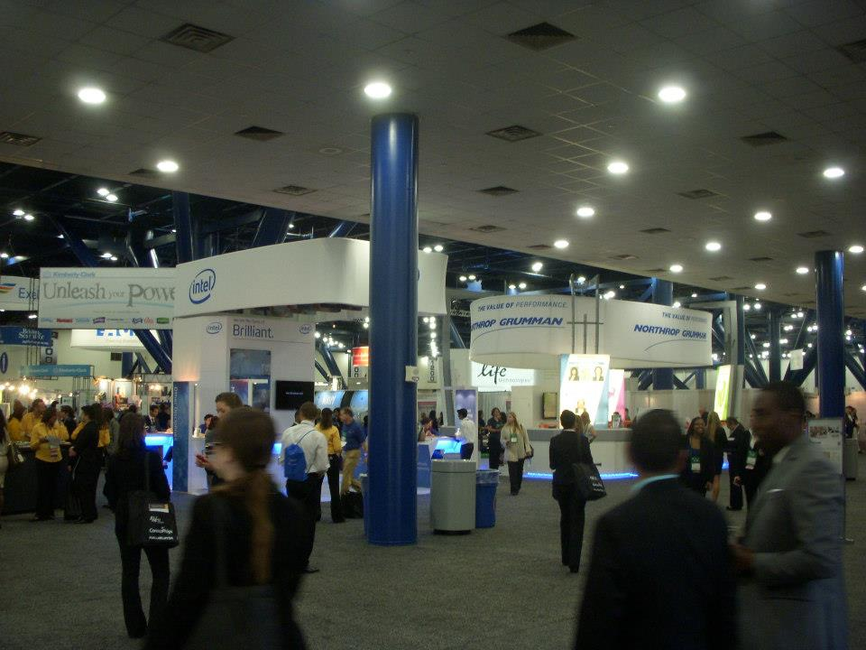
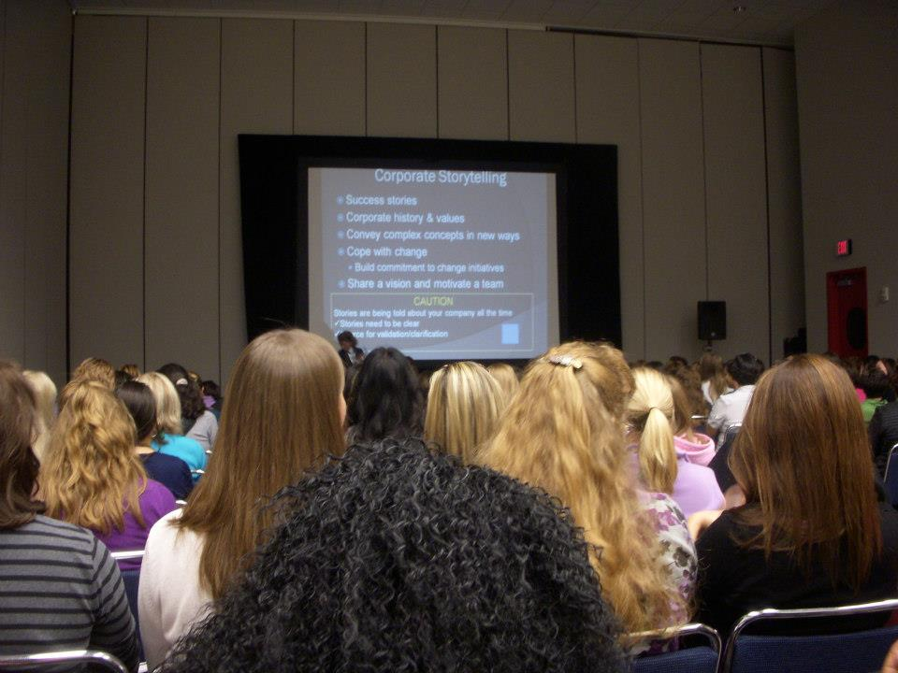
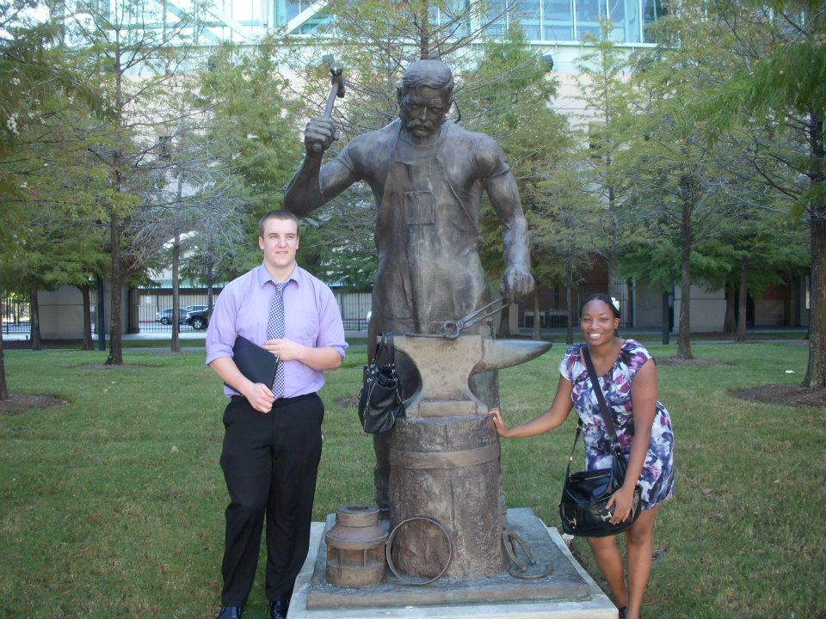
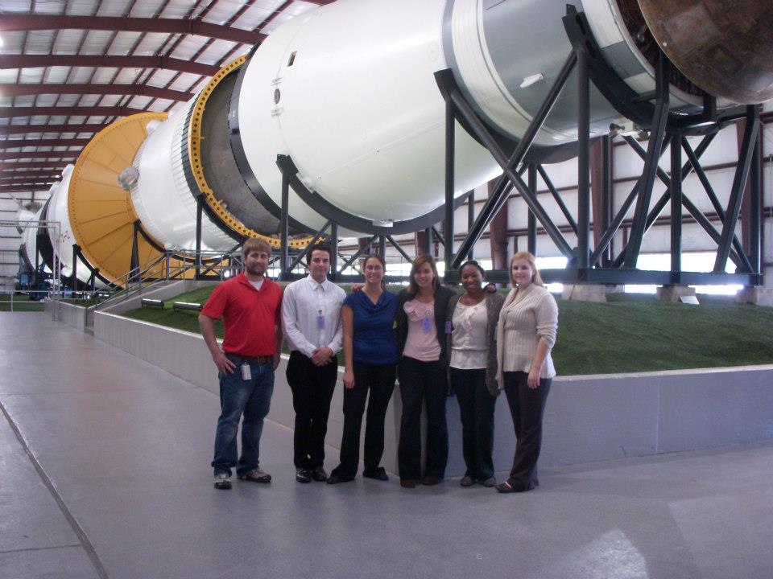
WE 12-13 Houston,TX

Slide 6
Conferences
Salt Lake City, Utah
Reaching New Heights!
Downtown Salt Lake Radisson Hotel, SLC
March 1st –March 3rd, 2013

Slide 7

Upcoming Events
Tuesday, November 20th 6:00pm-8:00pm
Bourns A265
!Tomorrow!

Slide 8
Bourns Engineering Day
We need to start planning.
Must make a committee!
Let’s try to win 1st place this time for outreach in our SWE region.
http://sweregionb.org/outreach/sweeter-futures

Slide 9


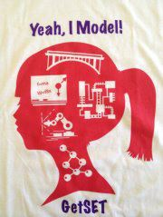

T shirt design
Monica Marks
Paige’s friend
Isabel Davila
Rachael Lomax

Slide 10
Design Winner! Isabel Davila

Slide 11
Apparel Sale
Tanks- $10
Shirts- $15
Sweaters- $20
Older designs are $5 each

Slide 12
Good luck on finals!
Next quarters meetings will probably be at 7pm on Mondays.

Slide 13
Preview of Winter Quarter Events
Ice Skating
Big bear snow day trip
Valentines Auction
Fluor information session
Resume review
New shirts will be on sale

