Slide 1
SWE Meeting
January 7,2013

Slide 2
Icebreaker
2 truths and a lie.

Slide 3

Guest Speaker: Gene Sherman
Vocademy.com
http://www.vocademy.com/classes/machine-shop-101/

Slide 4
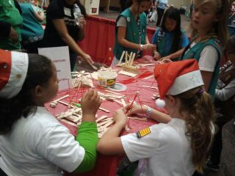
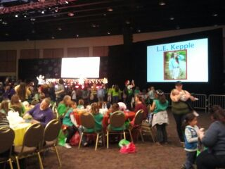
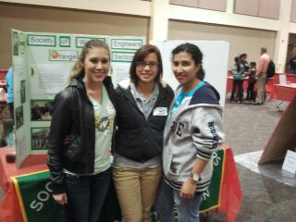
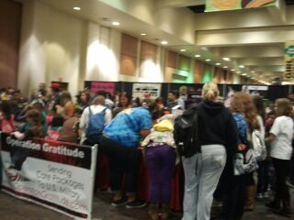
Girls Scouts B.I.G. Expo

Slide 5
Upcoming Events
Fashion Show 1/22
Fluor Event 1/23
Why STEM!....Why WOMEN! 1/16
Valentines Auction 2/15
Other Events:
Ice Skating 1/25
Big Bear Day snow trip

Slide 6
The SOCIETY OF WOMEN ENGINEERS FASHION SHOW 2013
We will show you what you need to make a stellar first impression with models that are dressed to impress, and companies to test your 30-second elevator pitch on!
January 22 at 5:30pm
Bourns A265
We need models ;)

Slide 7

Fluor Company Event
WCH 205/206
Wednesday, January 23, 2013
7:00pm until 8:30p
Description of companies
Job descriptions
Openings
Engineers and hiring managers will be attending

Slide 8
Why STEM!....Why WOMEN!
AWIS-IE and SWE-UCR present: Dr. Pamela Clute
Comments will focus on engaging female students in creative, innovative and relevant learning using techniques that inform, inspire and set the stage for meaningful and continued exploration in the STEM fields.
Coffee and refreshments will be served!
Wednesday, January 16, 2013
2:00pm until 3:00pm
Bourns A 265

Slide 9
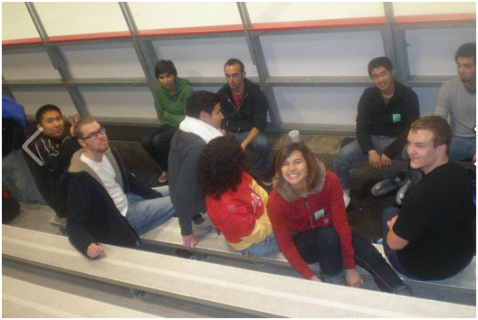
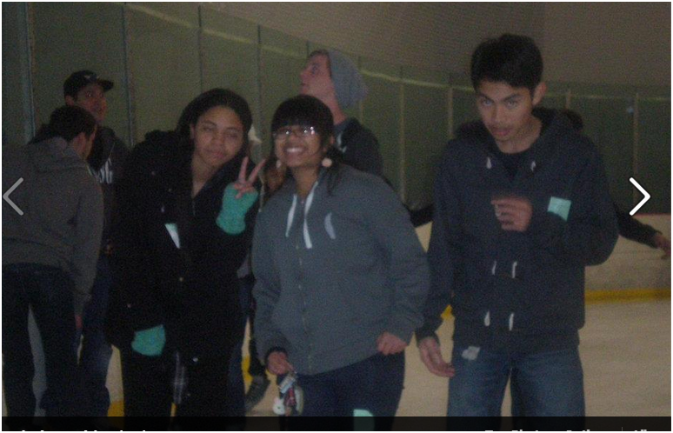
Ice Skating
January 25th at Ice Town from 8:00pm to 11:00pm.

Slide 10
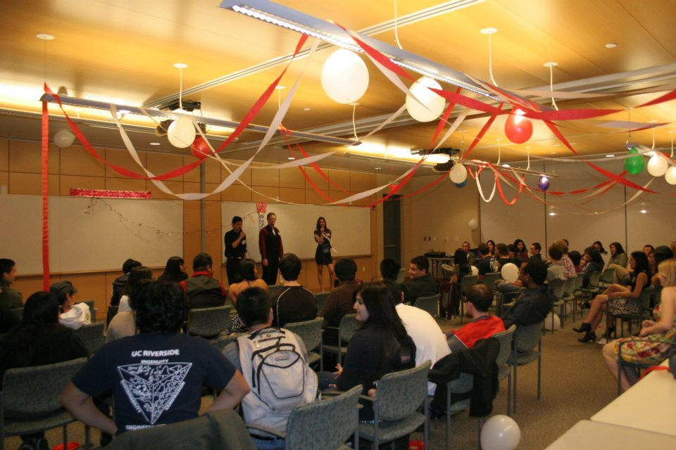
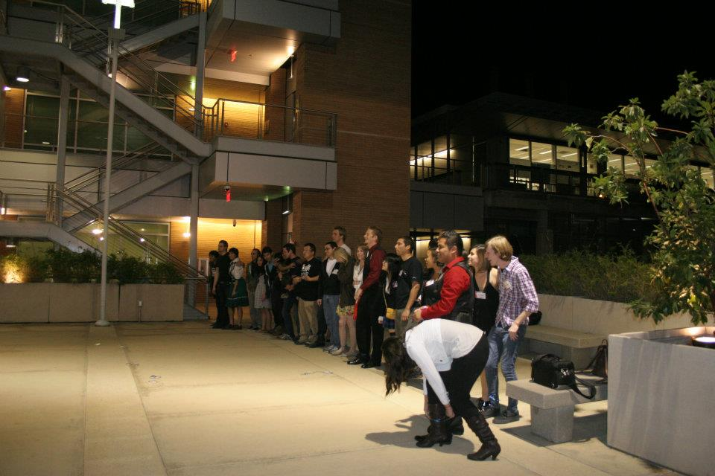
Valentines Auction
We would like to have 15 to 20 people get auctioned off

Slide 11
Bourns Engineering Day Committee (SSED)
Groups
Activities : Young & HS
Registration
Publicity
Speakers
https://docs.google.com/a/ucr.edu/document/d/1QibG2bSSugqUSpmTYwxzwggJpMnZtfiRIOxl1lIb2EU/edit

Slide 12
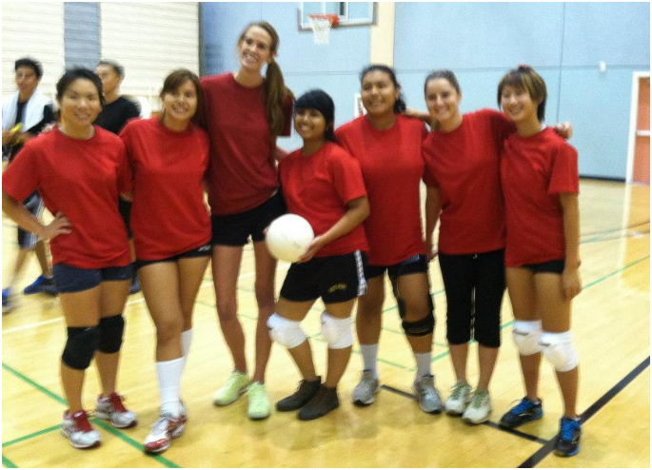
SWE Winter Sports Team
Last quarter- volleyball
This quarter - ???
Manager: Brenda Pena

Slide 13
Regional Conference
Salt Lake City, Utah
Reaching New Heights!
Downtown Salt Lake Radisson Hotel, SLC
March 1st –March 3rd, 2013
Career Fair
Workshops
Networking
Professional Development
http://sweregionb.org/region-conference

Slide 14
SWE Scholarships: National
Students who will be sophomores through graduate students can apply on-line by February 15, 2013.
In 2012, SWE disbursed 198 new and renewed scholarships valued at over $577,000.
www.swe.org/scholarships

Slide 15
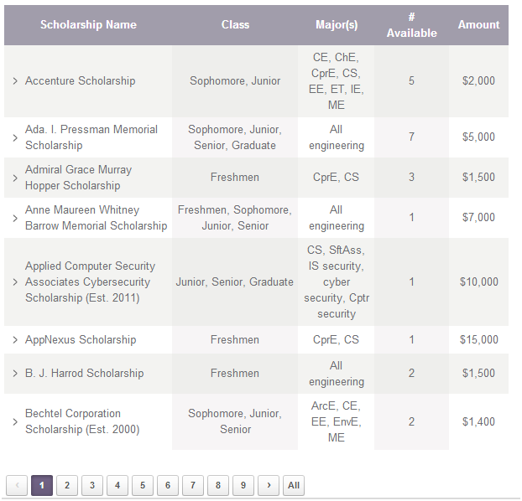

Slide 16
How Swe works
SWE National
Region B: Arizona, New Mexico, Southern California, Southern Nevada, and Utah.
OC Section: CSUF, CSULB, UCI, & UCR
Scholarships due April.
http://www.swe-oc.org/OUTREACH/SCHOLARSHIPS/tabid/86/Default.aspx

Slide 17

Shirt Design
Bring money next meeting!
$15

Slide 18
Contact Information
If you have any question, comments, or concerns.
Swe.ucr@gmail.com
Or Rachael Lomax
rloma002@ucr.edu
Next Meeting: January 21^{st.}Here.7-8.

