Slide 1



Slide 2

BUILD A BALLOON CAR
*Get into groups of 3 people
*You will need:
1 balloon
1 wooden tongue depressor or craft stick
1 straight straw
2 candy mints (with a hole in the middle)
tape

Slide 3

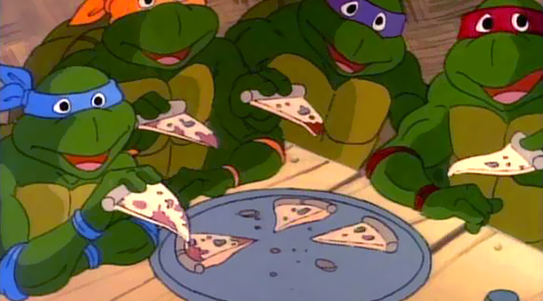

Slide 4

Develop programs to enable our members to improve their leadership, time management, communication and problem solving skills
Encourage girls and women to study engineering
Provide women with a sense of belonging in the College, the University, the community and in the field of engineering
Demonstrate the value of diversity and teamwork
Promote the engineering profession as a positive force in improving the quality of life

Slide 5

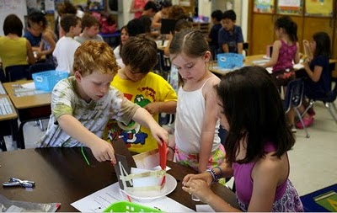
Outreach is a way to reach out to the local community
  UCR
  Highschool
  Elementary school

Slide 6


We want to teach people about Engineering
Female empowerment in the STEM Field
want to CHANGE LIVES

Slide 7

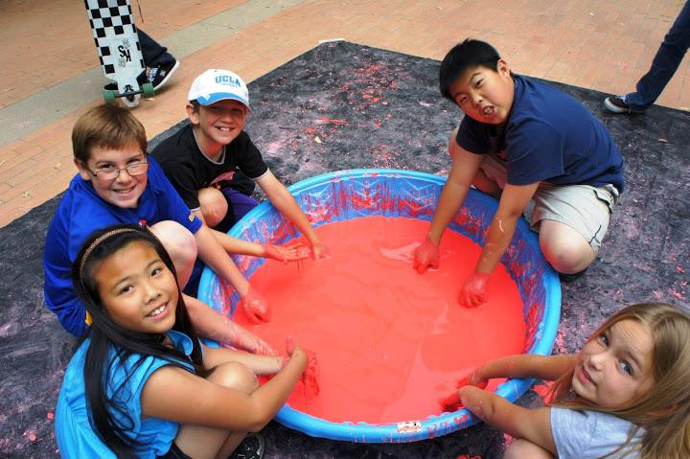

Slide 8

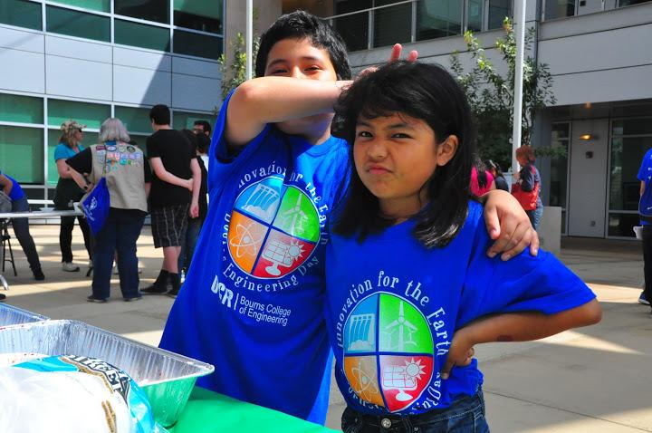
Biggest Outreach Event hosted by SWE
Various science and engineering activities
Over 500 Elementary - High School students participate
Hosted at UCR!
To get kids excited about engineering and STEM fields!

Slide 9
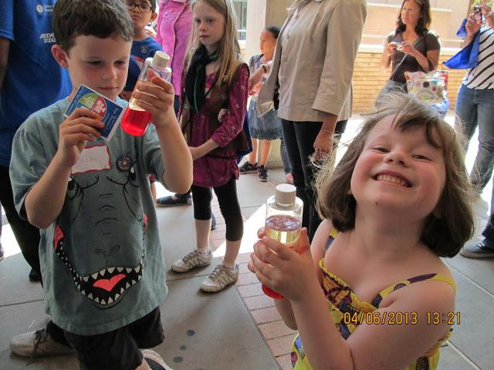
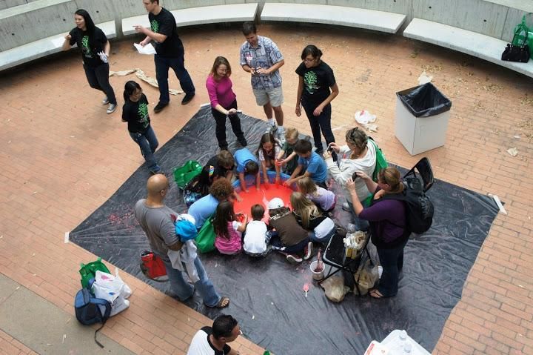
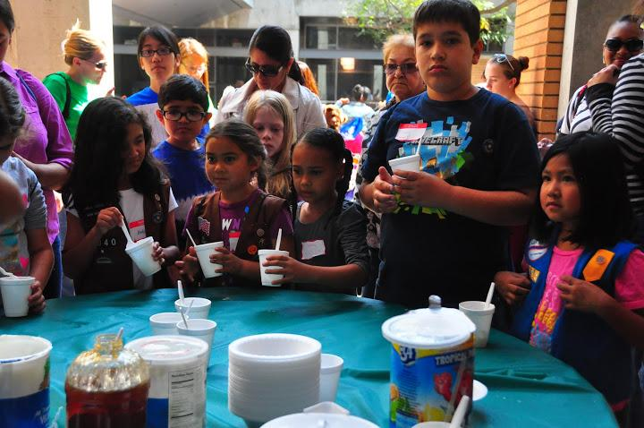
A lot of work, BUT it is very rewarding!
A VERY FUN DAY!
WE NEED HELP! ^_^

Slide 10

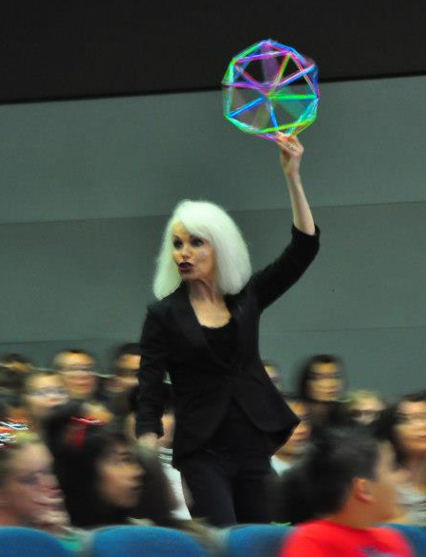
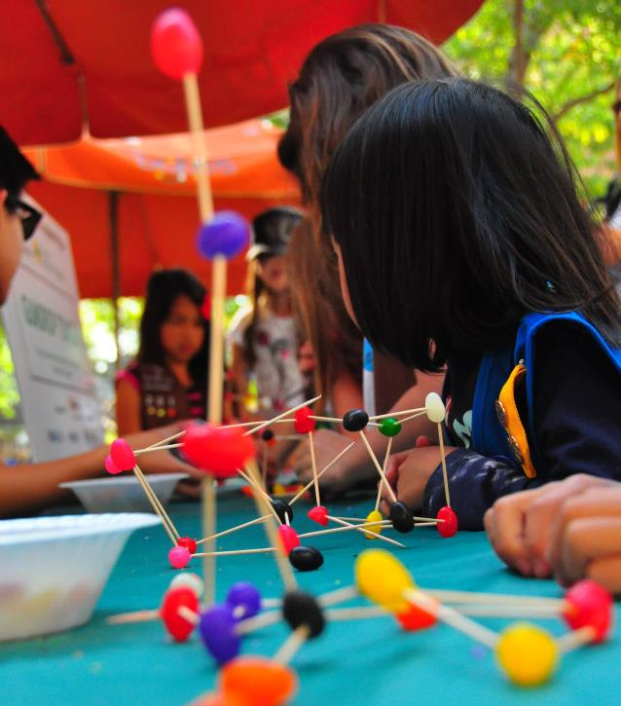
Speakers
Find a professor or other professional to be our keynote speaker.
Activities
Find fun activities for the kids to do during the event that have to do with science, engineering, or this year’s theme.

Slide 11
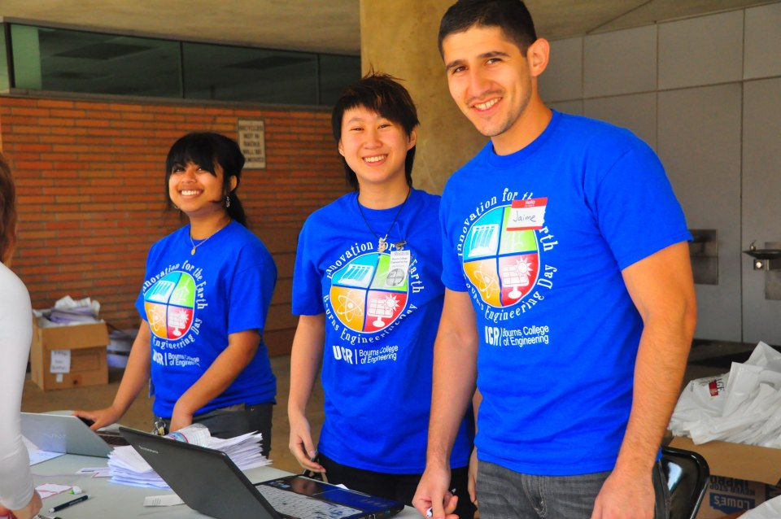

Registration
Manage the sign ups for participants and volunteers through the registration website (EventBrite).
Publicity
Invite the Girl Scouts, and local elementary and middle schools to the event. Send out our flyer!
Creativity
Design a logo and other media such as flyers, t-shirt, and signs.
Meet Wed 10/23 in the clubroom at 1pm to learn more!

Slide 12



Slide 13

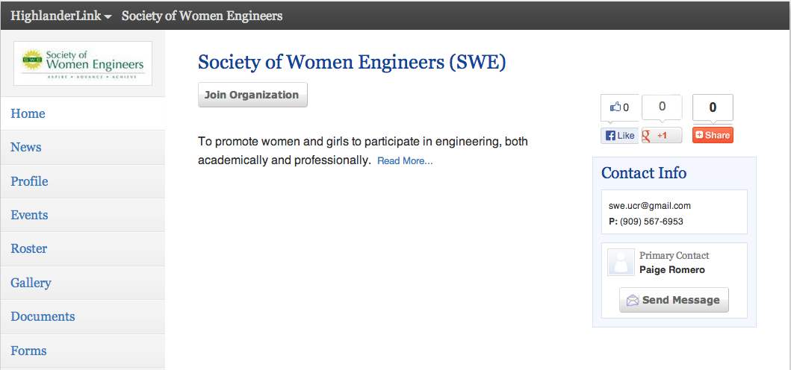

https://highlanderlink.ucr.edu/organization/swe

Slide 14

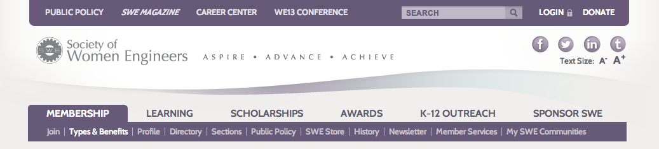

http://societyofwomenengineers.swe.org/index.php/membership
Under the membership tab, click on “Join”!

Slide 15

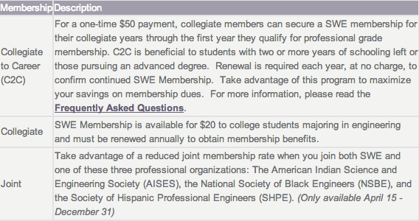

Slide 16

Community of Support
Education and Development
Resources and Information
Leadership Skills
http://societyofwomenengineers.swe.org/index.php/membership/benefits-a-discounts#activePanels_

Slide 17

Irvine Ask a Scientist Day : October 16
SWE-OC Engineering Day : October 19
WE13 : October 24-26
Fundraiser with BMES (TBA)
NEXT MEETING
  OCTOBER 29 7-8 PM WCH 205/206
  HALLOWEEN FUN

