Slide 1
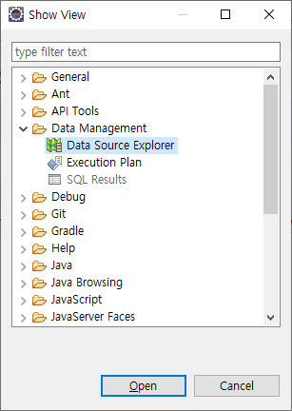
[Window] – [Show View] – [Other…] – [Data Management] – [Data Source Explorer]

Slide 2


Slide 3
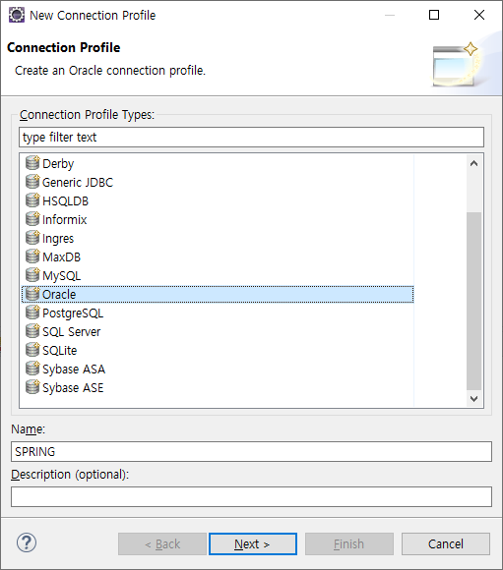
Connection Profile
Name은 마음대로!

Slide 4
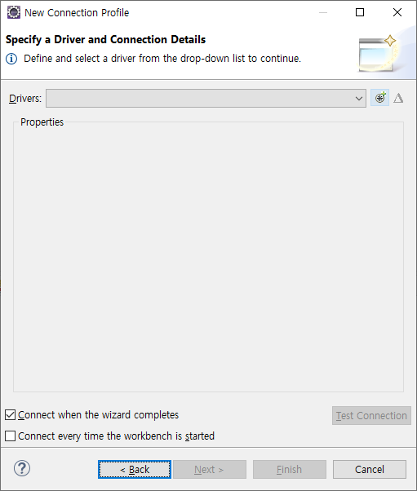
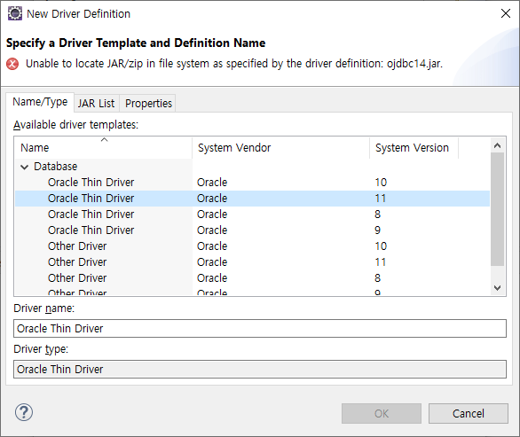
New Connection Profile

Slide 5
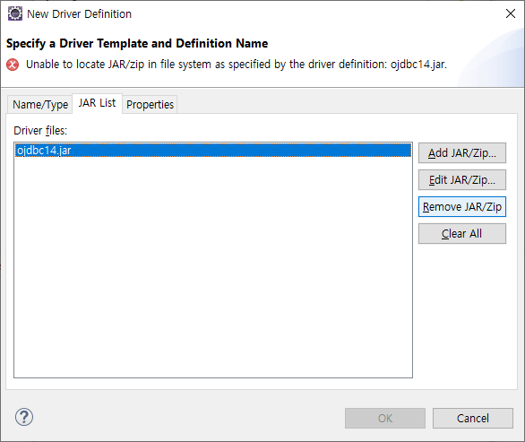
New Connection Profile

Slide 6
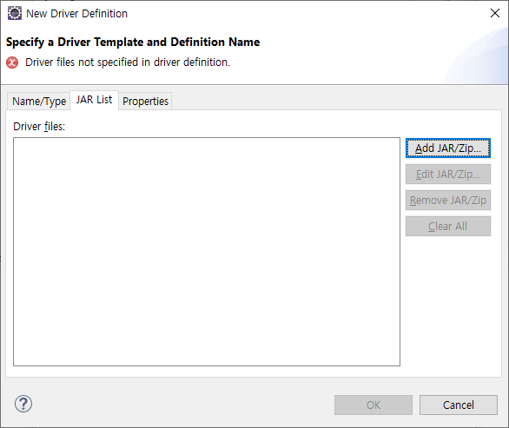
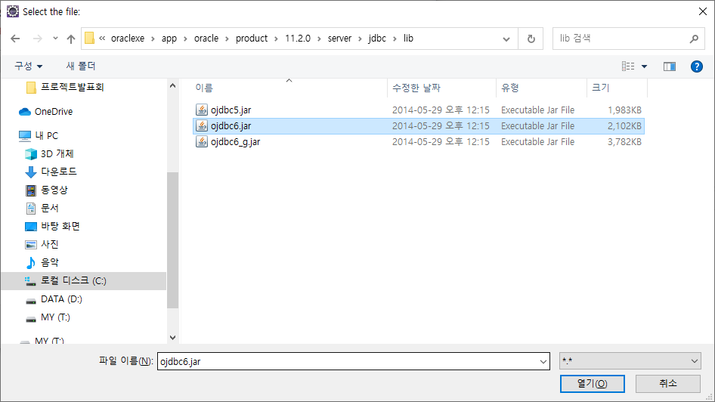
New Connection Profile

Slide 7
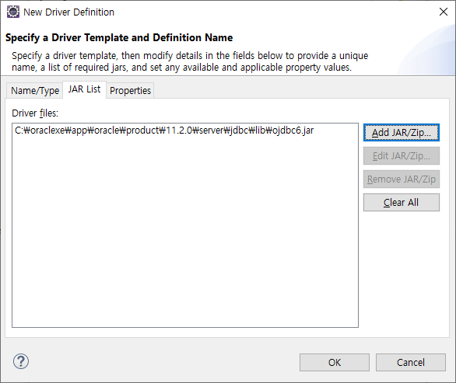
New Connection Profile

Slide 8
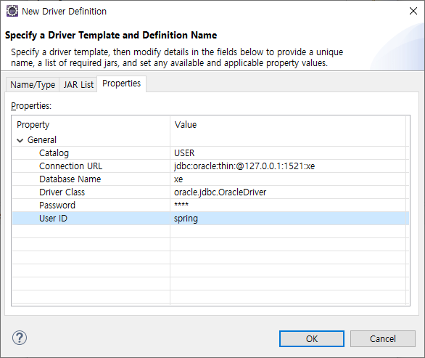
New Connection Profile

Slide 9
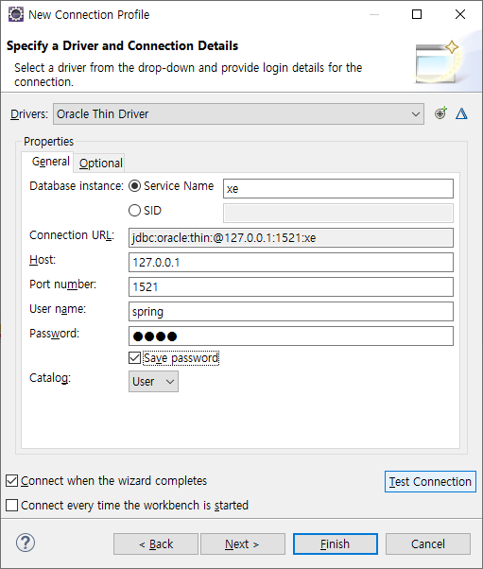

New Connection Profile

Slide 10
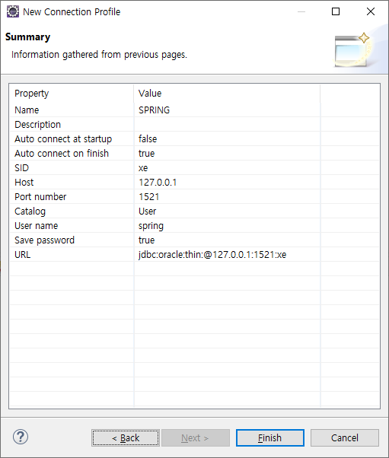
New Connection Profile

