Slide 1
WEARABLE-DATA DIGITAL TWIN · SLEEP ANALYSIS
Sleep Twin
Classifying Wake / NREM / REM from wrist sensors, then turning the sleep timeline into a transparent virtual human-state model.
80.35%
0.6993
540
6
Test accuracy
Macro F1 (best)
Features / epoch
Human-state scores
Final Project Report · Walch et al. PSG dataset + Apple Health · FastAPI single-page app

Slide 2


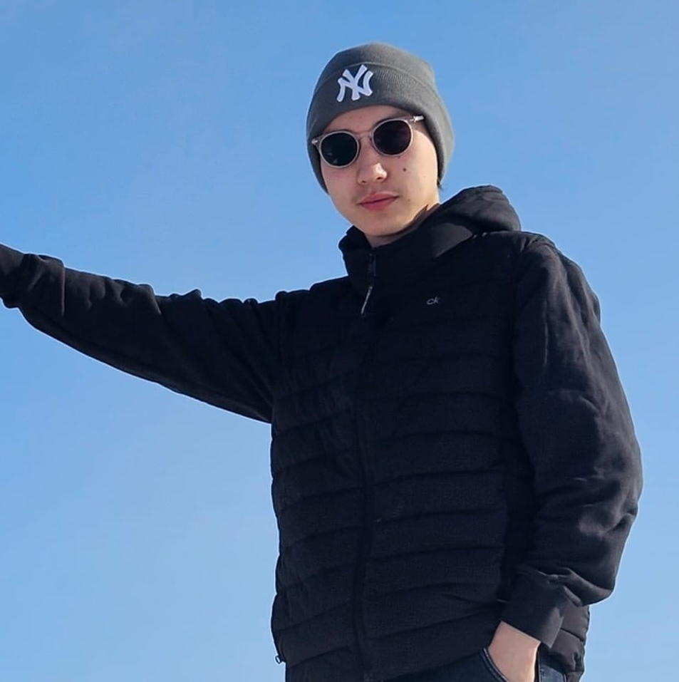

00 · TEAM
Group members & SCRUM roles
AIoT Final Project · Digital Twin-Based Smart System Development · Class CS
Tsogbat Baterdene
Khuslen Gantumur
Student ID 113021197
Student ID 113021189
Product Owner
Scrum Master
Dulguun Munkhtur
BM
Bayarmagnai Munkhbat
Student ID 114021153
Student ID 113021195
Developer
Developer

Slide 3
01 · OVERVIEW
What Sleep Twin is
Goal. Classify each 30-s epoch of wrist data into Wake / NREM / REM, then convert that timeline into a virtual human-state.
Pipeline. Raw accelerometer + wrist HR + steps → 540 engineered features → 5 base learners → geometric-mean ensemble → HMM/Viterbi smoothing.
Scoring layer. Six interpretable scores, each a weighted sum of named, literature-grounded components surfaced in the UI.
Two data sources. Walch PSG research dataset and personal Apple Health exports through one pipeline.
Headline result
80.35% accuracy + κ 0.5695 (geo-mean + HMM)
0.7159 balanced acc + 0.6993 macro F1 (CatBoost + HMM)
Beats the demo best single model (76.46%, κ 0.5050)
Six human-state scores
Recovery
Sleep quality
Stress
Fatigue
Energy
Sleep debt

Slide 4
02 · MOTIVATION
Why a Digital Twin for sleep
Dense, hard-to-read signals
Sleep drives health
Most trackers are black boxes
Sleep quality strongly affects recovery, fatigue, cognition and health — automated staging has clear value.
Wearables produce longitudinal sensor streams that are difficult to interpret in raw form.
Consumer systems rely on closed proprietary algorithms — not reproducible for learning or research.
The approach. Treat the user as the physical system and build a virtual human-state model on top of sleep-stage predictions — going beyond a standalone classifier into a compact Digital Twin that exposes its reasoning at every step.

Slide 5
03 · PROBLEM DEFINITION
Three-class sleep-stage classification
Target. Each 30-second epoch → Wake, NREM, or REM.
Label mapping. PSG 0 → Wake; 1–4 → NREM; 5 → REM.
Why 3 classes, not 5. Wrist data lacks the signal to reliably split N1/N2/N3 — 3 classes are stable to learn and rich enough for the twin layer.
Why balanced metrics. NREM dominates ~7×, so macro F1 and balanced accuracy matter more than raw accuracy.
Class distribution · 26,773 epochs
NREM
18,460
REM
5,884
Wake
2,429
31 subjects · one night each · 540 features per epoch

Slide 6
04 · DATA & PREPROCESSING
Dataset and the single biggest lever
26,773
Robust per-subject normalization
labelled 30-s epochs
the largest single classifier improvement over the demo
540
Subtract each subject's median HR, divide by their IQR; same scheme on the ENMO motion stream.
Baseline HR varies enormously — a 50 bpm sleep HR for one person is 80 bpm for another.
Z-scoring against each subject's own distribution makes the signal portable across people.
Other cleaning: HR clipped 25–240 bpm, jerk clipped at p99.5, steps ≥ 0, median imputation downstream.
features / epoch
31
subjects (1 night each)
Walch et al. wrist-wearable + PSG dataset (PhysioNet): triaxial accelerometer, wrist HR, step counts, PSG stage labels.
Dataset from:
https://physionet.org/content/sleep-accel/1.0.0/

Slide 7
05 · FEATURE ENGINEERING
540 features in four groups
8
290
235
7
Time
Motion
Heart rate
Steps
night progress, sin/cos cycles, daily clock proxy
8 series × 4 windows × 9 stats + activity constants
4 series × 6 windows × 9 stats + HRV proxies
rolling sums over 15 min → 24 h + 2 constants
Why the larger feature set helps
A larger feature set without subject normalization mostly adds noise. The combination is what matters: wider HR context windows (up to 1 hour), HRV-style summaries and subject-normalized series together gave the boosters enough physiologically-grounded structure to push past the 76% accuracy plateau from the demo.

Slide 8
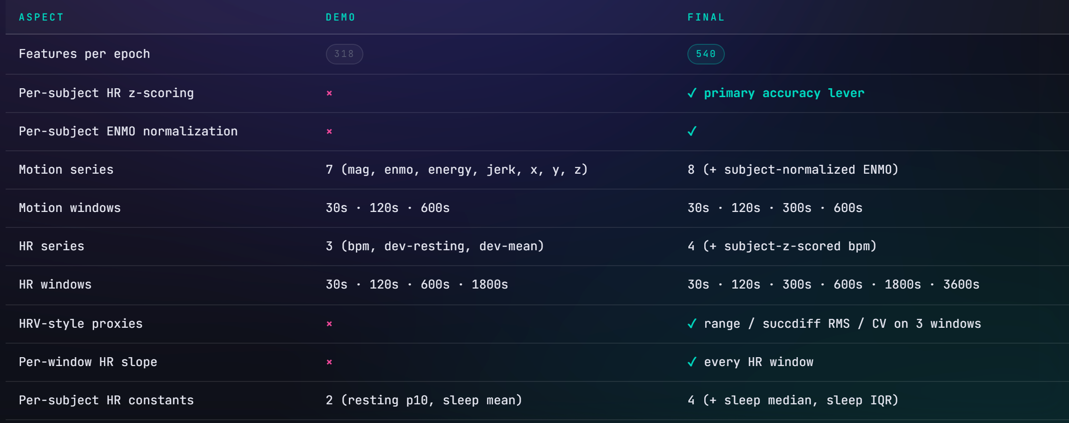
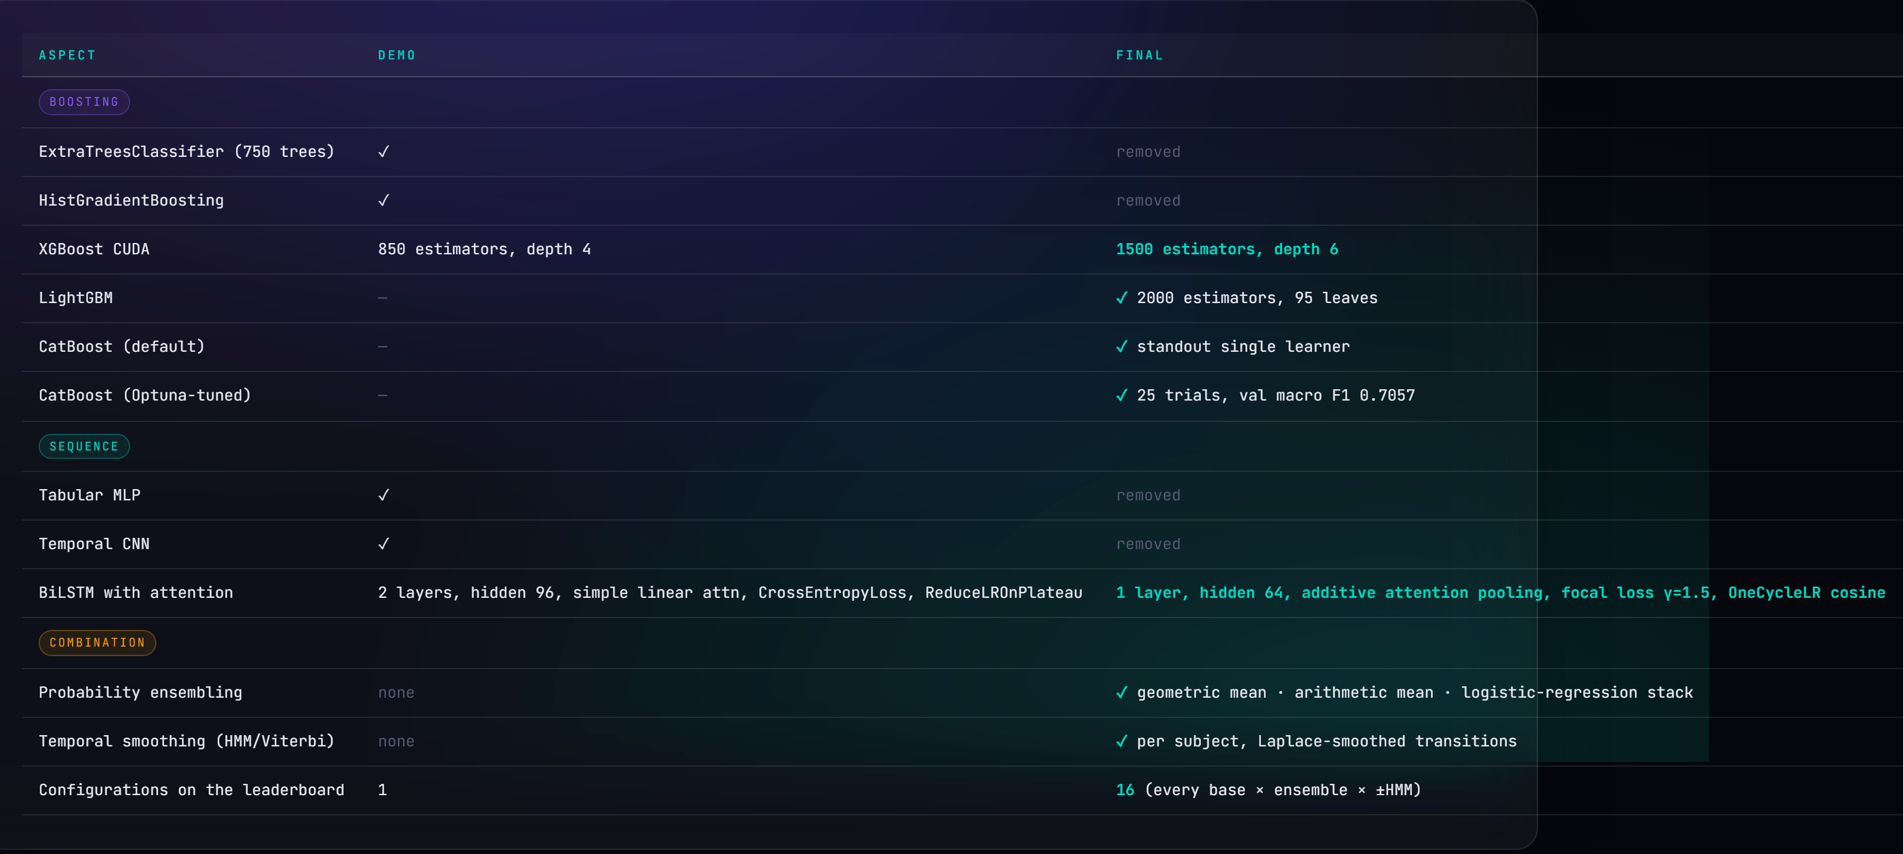
06 · DEMO vs FINAL
Feature engineering & models compared
Feature engineering
Models and Combination

Slide 9
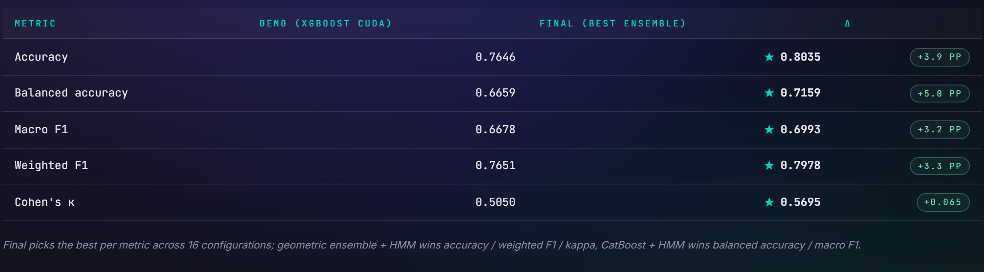
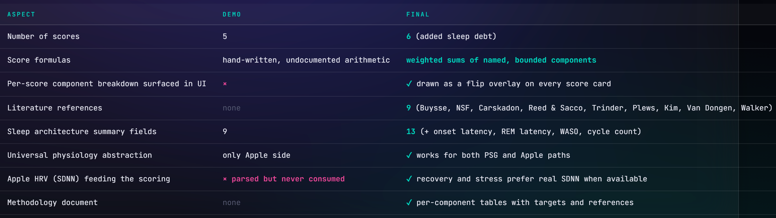
06 · DEMO vs FINAL
Headline results & scoring layer
Headline Results
Digital Twin Scoring

Slide 10
07 · EVALUATION STRATEGY
Subject-level train / val / test split
19
5
7
Training subjects
Validation subjects
Test subjects
GroupShuffleSplit, seed 42. Subject-level grouping — no subject appears in more than one fold.
Why it matters. If epochs from the same subject land in both train and test, the model memorizes subject-specific patterns and inflates performance.
Result. Reported numbers measure generalization to unseen subjects, not memorization.

Slide 11
08 · MODELS
Five base learners
XGBoost (CUDA)
1500 trees · depth 6 · lr 0.03 · GPU histogram, CPU fallback
LightGBM
2000 trees · 95 leaves · lr 0.025 · balanced weighting
CatBoost (default)
2000 iters · depth 7 · lr 0.04 — standout single learner
CatBoost (Optuna)
TPE sweep · depth 9 · lr 0.034 · val macro F1 0.7057
BiLSTM + attention
focal loss γ=1.5 · hidden 64 · 15-epoch context window
Median imputation shared across boosters · BiLSTM trained in a sidecar Python 3.11 conda env (CPU PyTorch)

Slide 12
09 · ENSEMBLE & POST-PROCESSING
Geometric mean + HMM/Viterbi smoothing
Ensemble heads
Raw wearable data
Arithmetic mean. Per-class average across the five learners.
Geometric mean (winner). Log-space average — robust when one learner is confidently wrong.
Logreg stack. Meta-learner; underperforms because boosters memorize their training set.
↓
540-feature extraction
↓
5 base learners
↓
Geometric-mean ensemble
HMM / Viterbi smoothing
↓
Counts label transitions (Laplace-smoothed) + initial-stage frequencies.
Treats per-epoch probabilities as emission likelihoods; Viterbi-decodes per subject.
Lifts accuracy and κ by 1–3 pp, smoothing single-epoch flicker.
HMM / Viterbi smoothing
↓
Digital Twin scoring → 6 scores

Slide 13
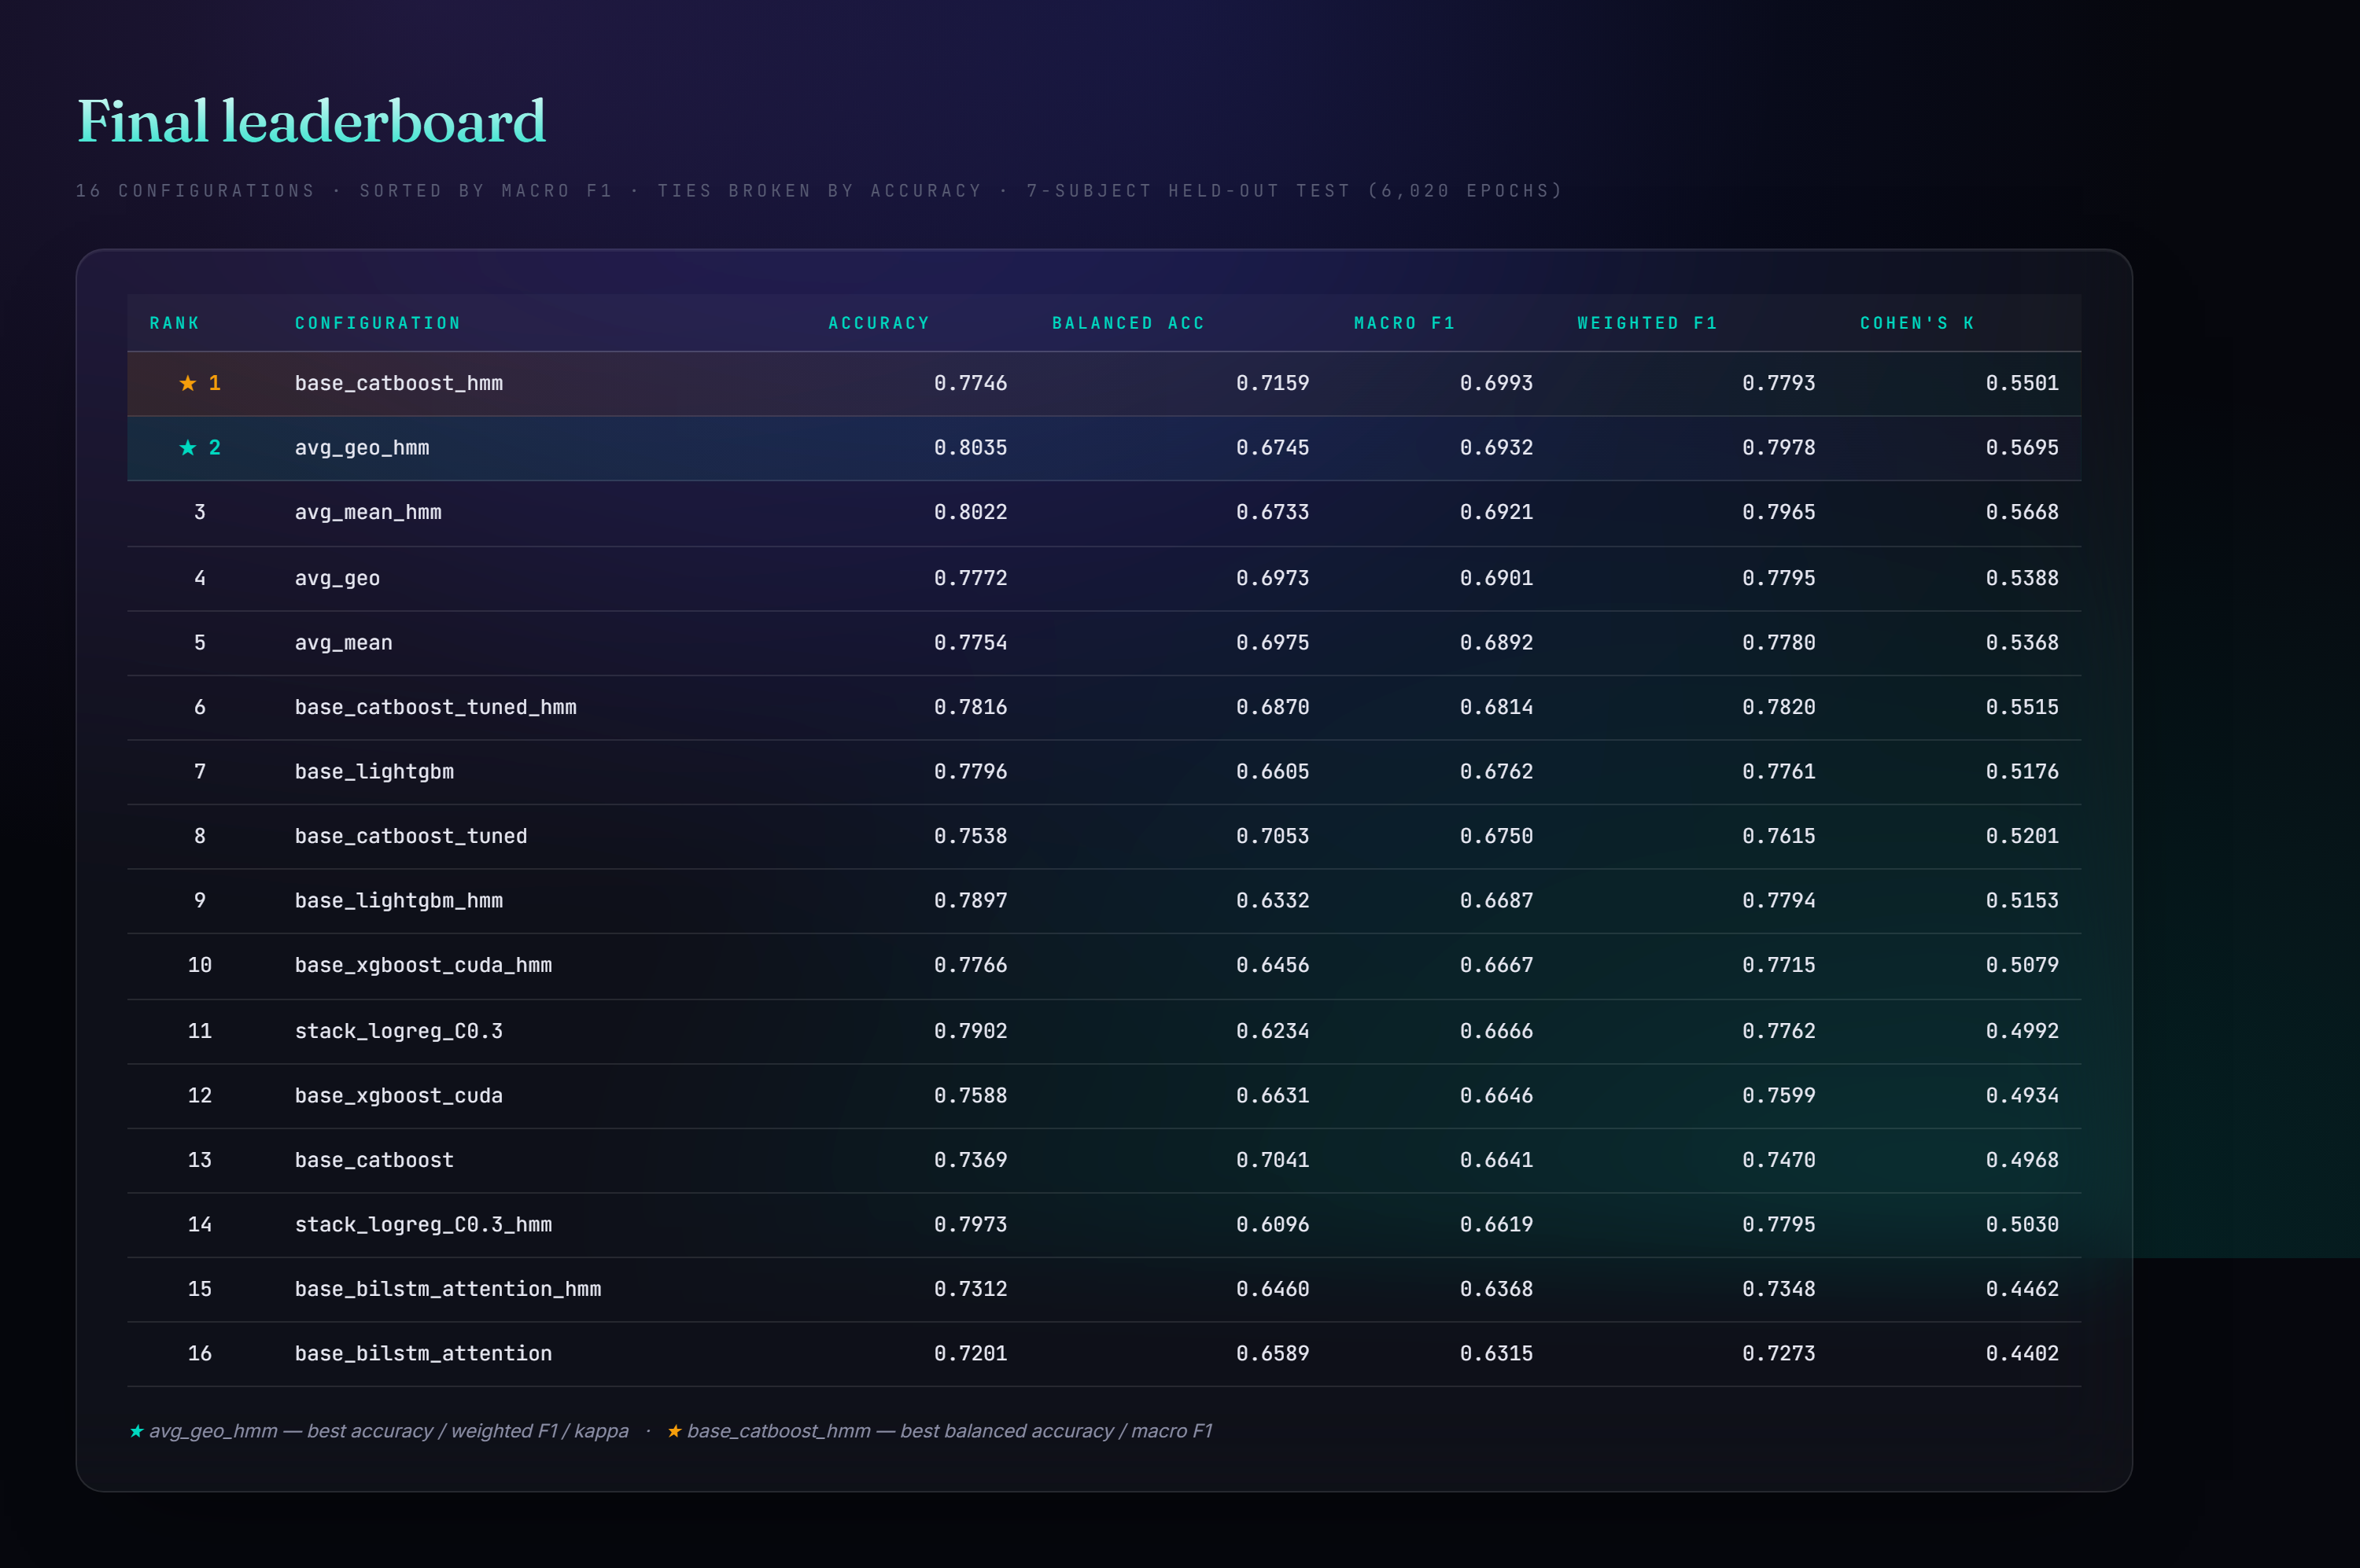
10 · RESULTS
Final leaderboard — 16 configurations

Slide 14
10 · RESULTS
Two co-winners on the held-out test set
avg_geo_hmm
base_catboost_hmm
Geometric mean + HMM
CatBoost + HMM
Accuracy
0.8035
Balanced acc
0.7159
Cohen's κ
0.5695
Macro F1
0.6993
Weighted F1
0.7978
Accuracy
0.7746
Recommended general-purpose — first to cross 80% accuracy
Best when minority-class (Wake) recall matters most
Reading it. CatBoost is the standout single model — aggressive Wake/REM prediction gives the best balanced accuracy; HMM cleans transitions while preserving minority recall (+3.8 pp accuracy). Geometric mean edges arithmetic because log-averaging is robust to one model being confidently wrong. Both vs the demo's 76.46% / κ 0.5050.

Slide 15
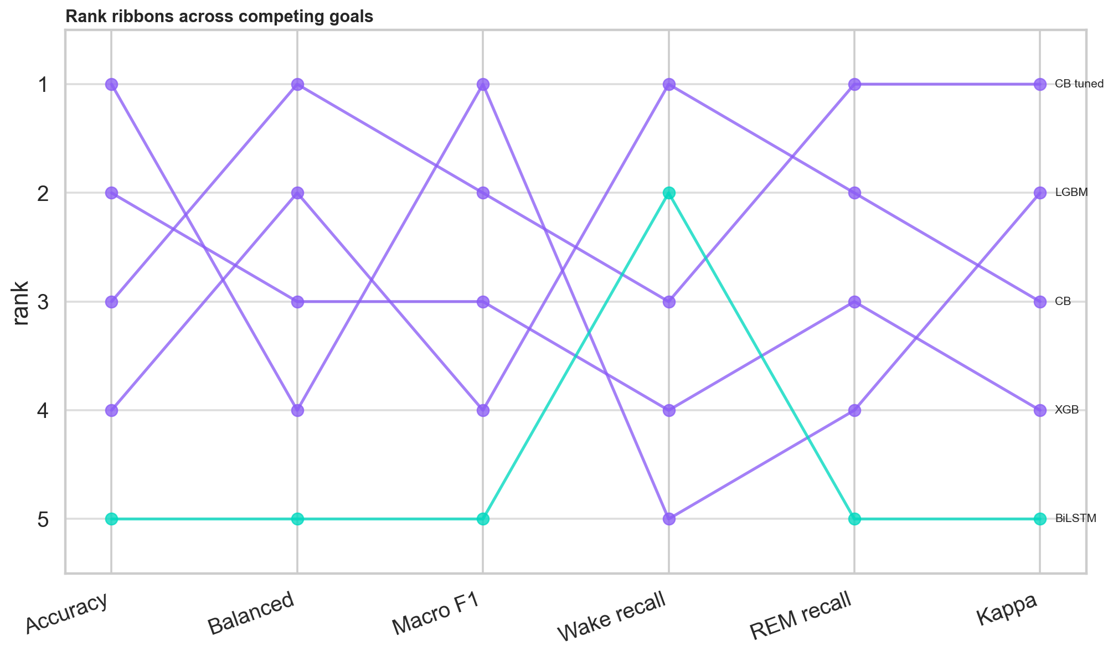
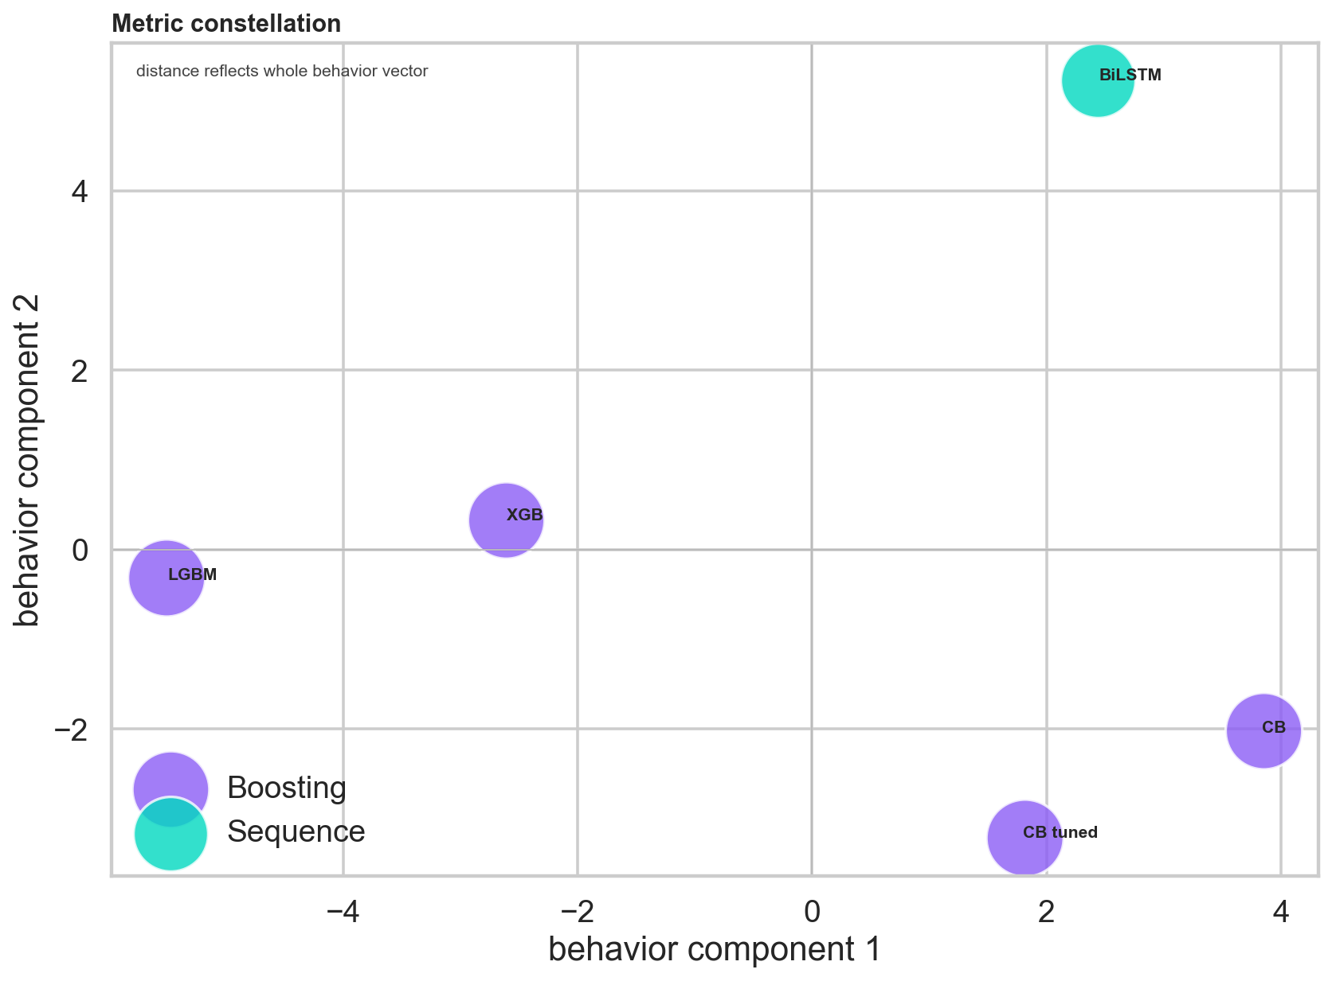
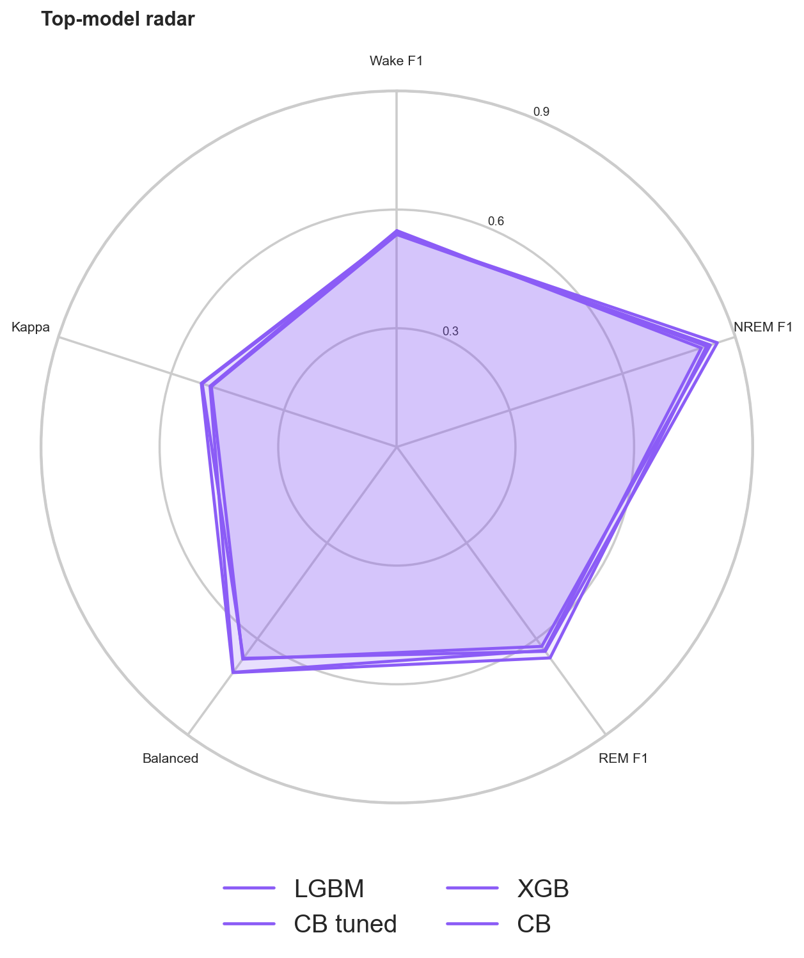
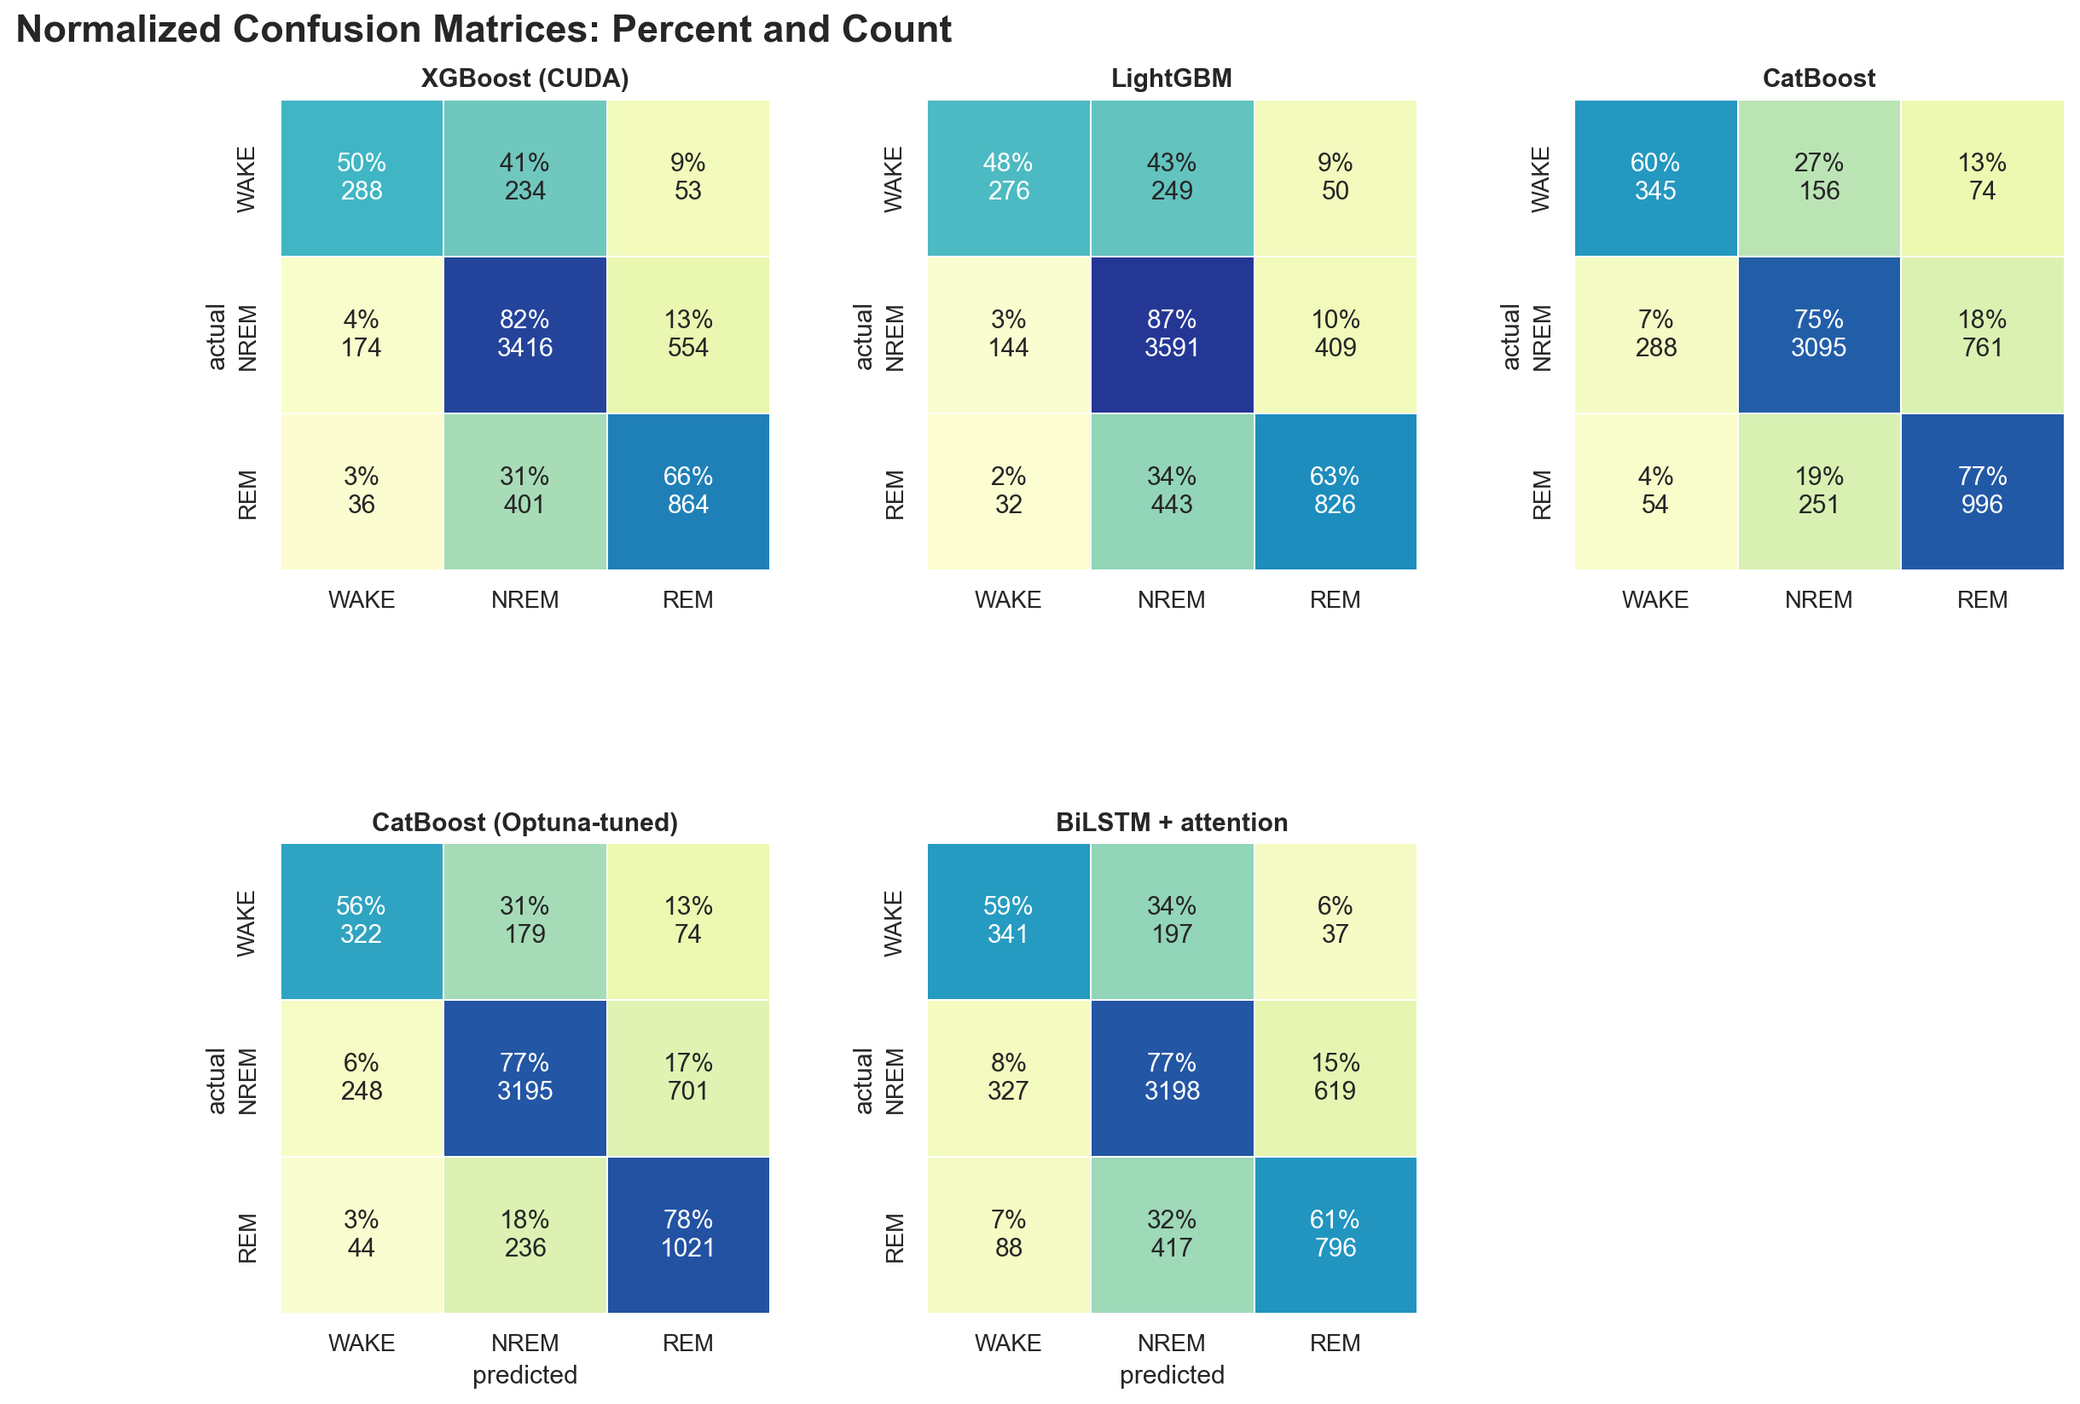
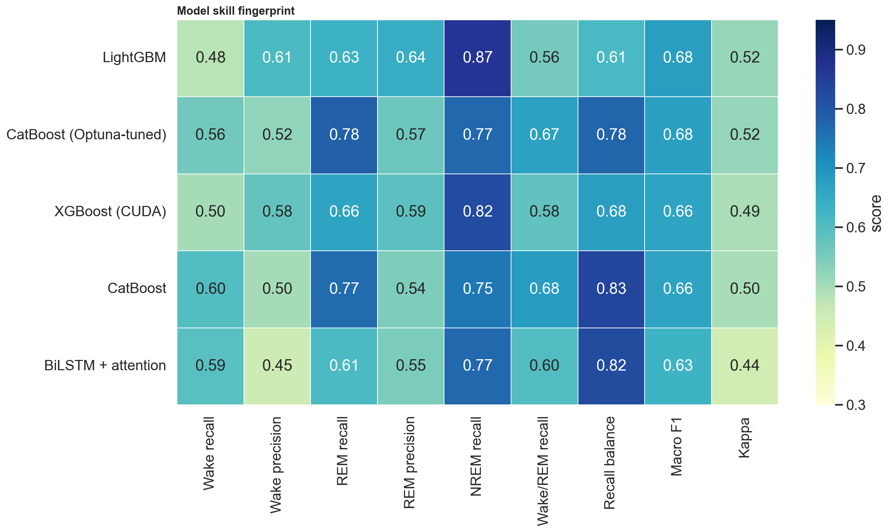
10 · RESULTS
Model comparison panels

Slide 16
11 · DIGITAL TWIN
From hypnogram to virtual human-state
Sleep architecture summary. 13 fields — TIB, TST, stage minutes, efficiency, REM/NREM fractions, onset latency, REM latency, WASO, awakenings, cycle count.
Universal physiology summary. Pre-sleep HR, sleep HR, HR dip %, overnight drift, HRV proxy, movement index — real Apple SDNN used when available.
Six scores. Each a 100-pt weighted sum of named, individually-bounded components tied to a literature target.
Surfaced, not hidden. Tap any score card → flip overlay shows each component as a bar with points and its reference.
Example: Recovery (100 pts)
Sleep contribution
40
HR dip
25
HRV proxy / real SDNN
20
HR stability
15
Each component has a bounded source signal, a literature target, and a capped point contribution — so no single term can dominate.

Slide 17
11 · DIGITAL TWIN
The six human-state scores
Sleep quality
Sleep debt
7 components: duration, efficiency, REM/NREM balance, WASO, onset latency, cycles
Tonight's deficit vs 8 h target — labelled honestly (1 night per subject)
Recovery
Stress
Sleep contribution + HR dip + HRV + HR stability (real SDNN preferred)
Inverse HR dip + low HRV + overnight HR climb + activity + inefficiency
Fatigue
Energy
Inverse recovery + activity load + sleep deficit + fragmentation + strain
Thin composite: 0.5×recovery + 0.3×(100−fatigue) + 0.2×sleep quality

Slide 18
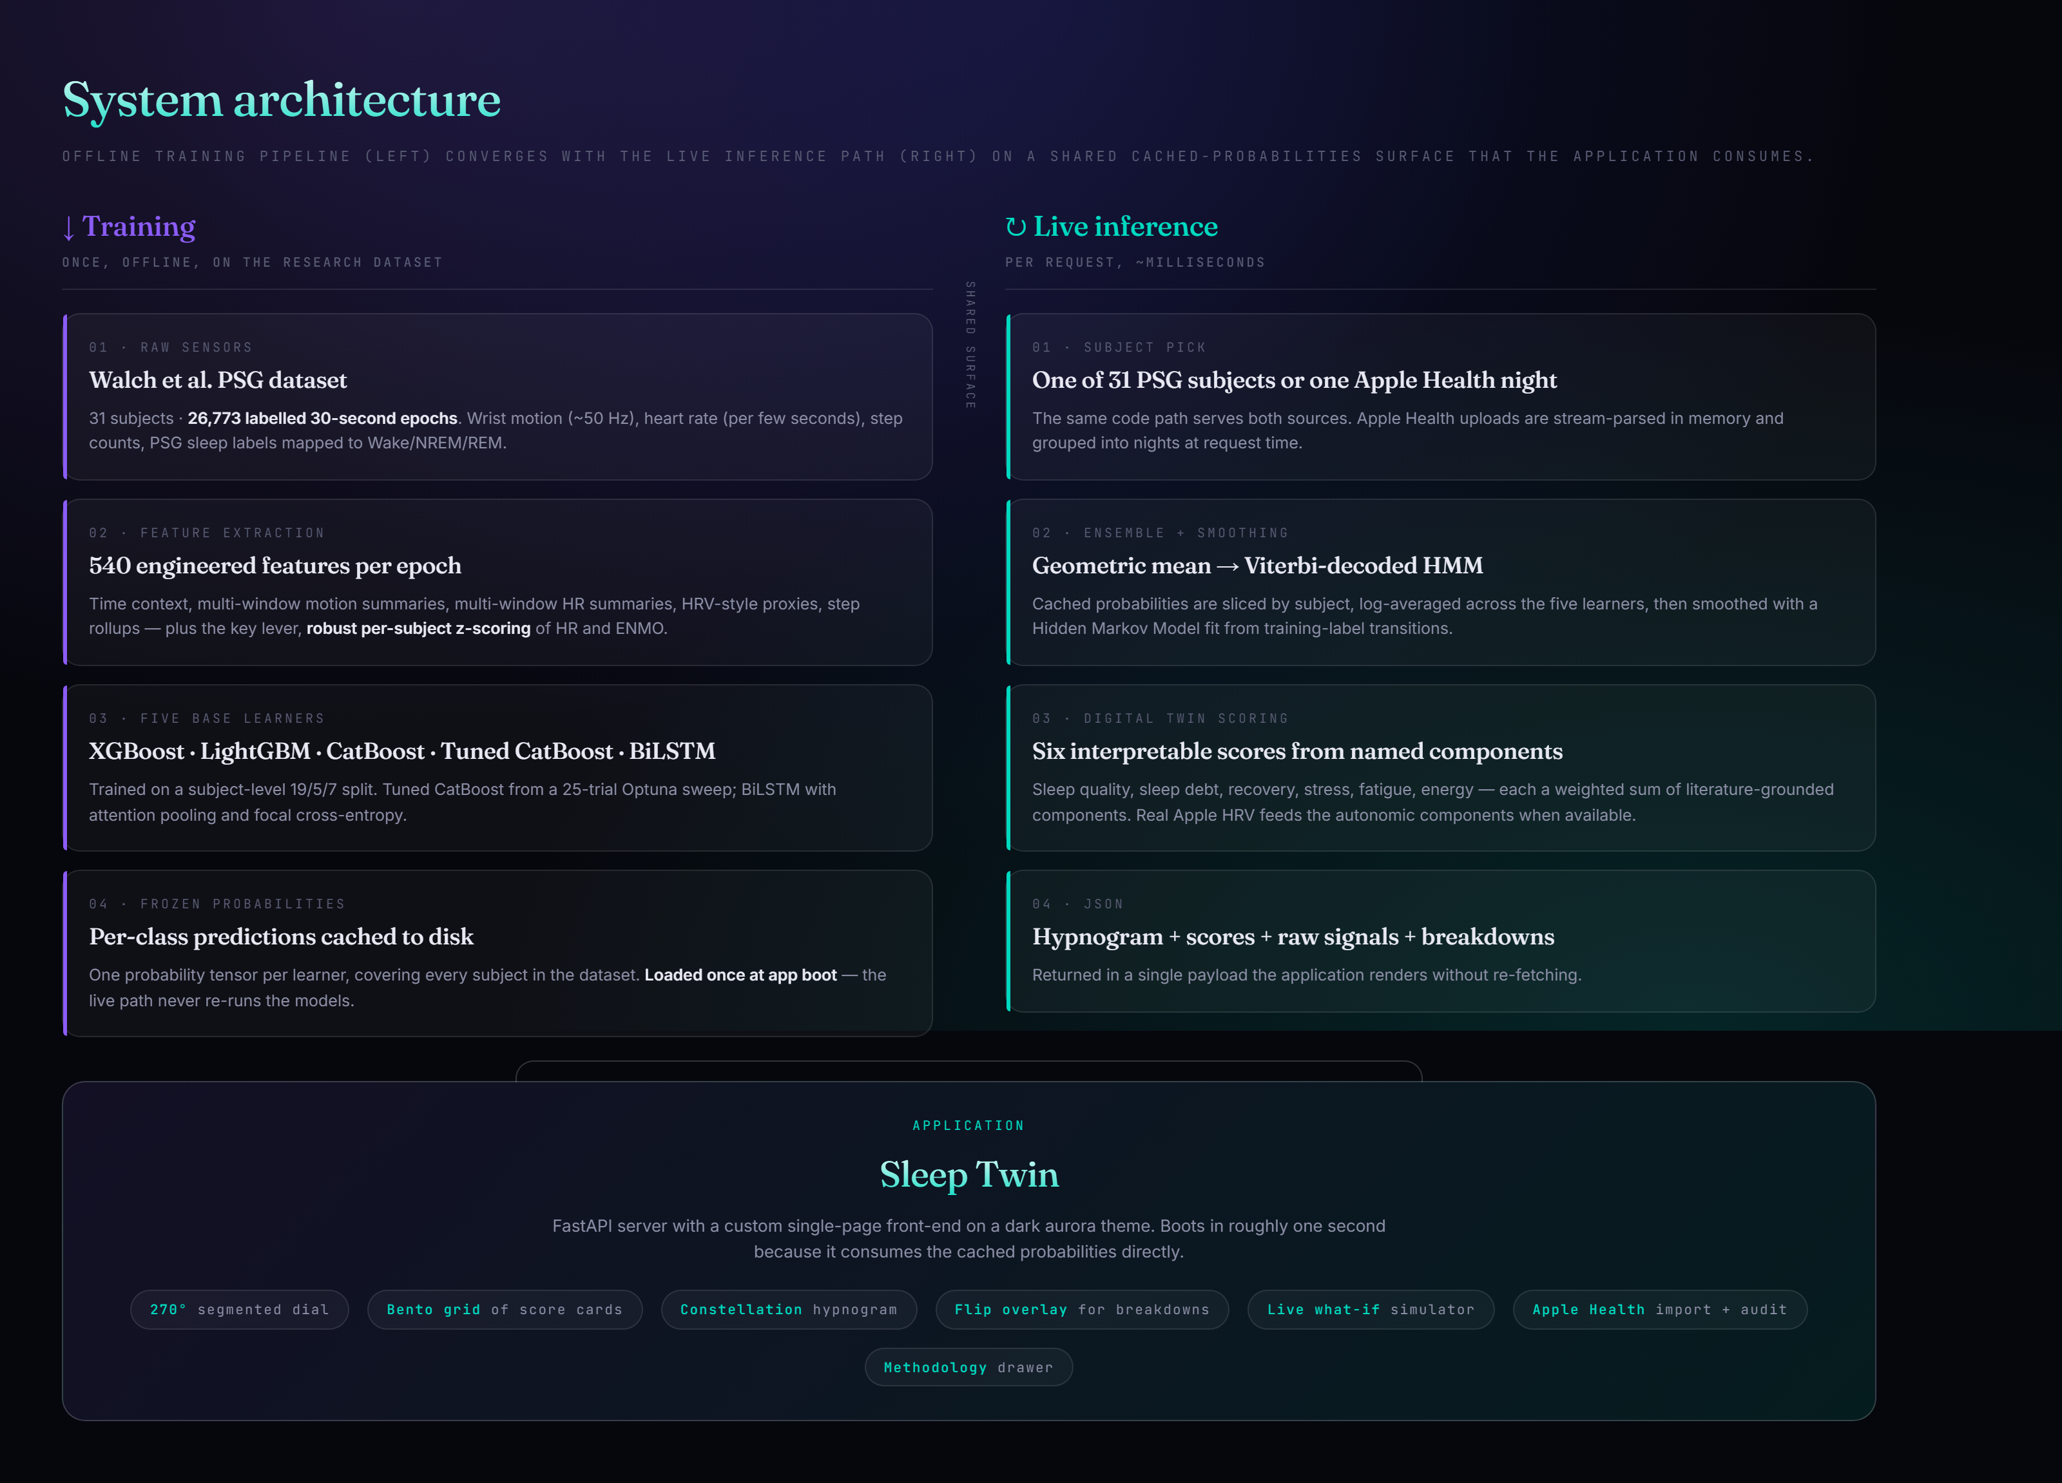
12 · SYSTEM ARCHITECTURE
Offline training · live inference
Training runs once, offline → frozen probabilities on disk.
Live path slices cached probabilities, smooths, scores — in ms.
FastAPI + single-page app boots in ~1 s; no model re-deserialization per request.

Slide 19
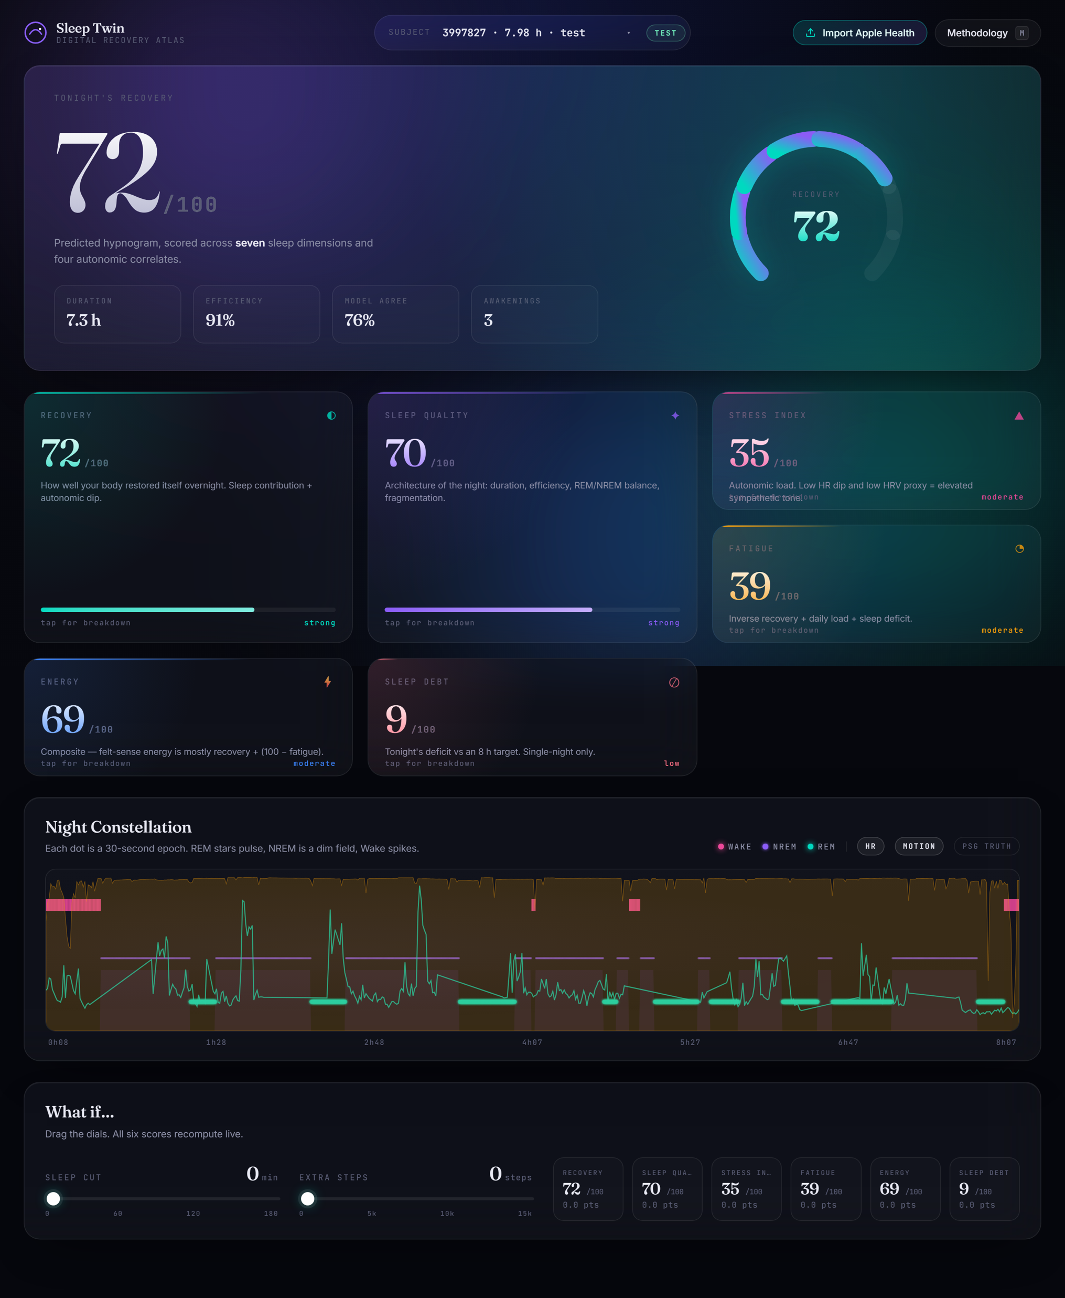
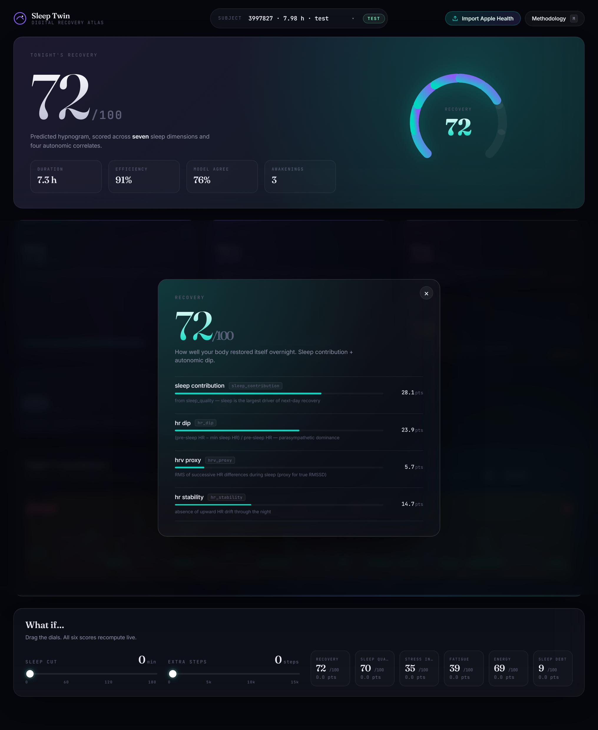
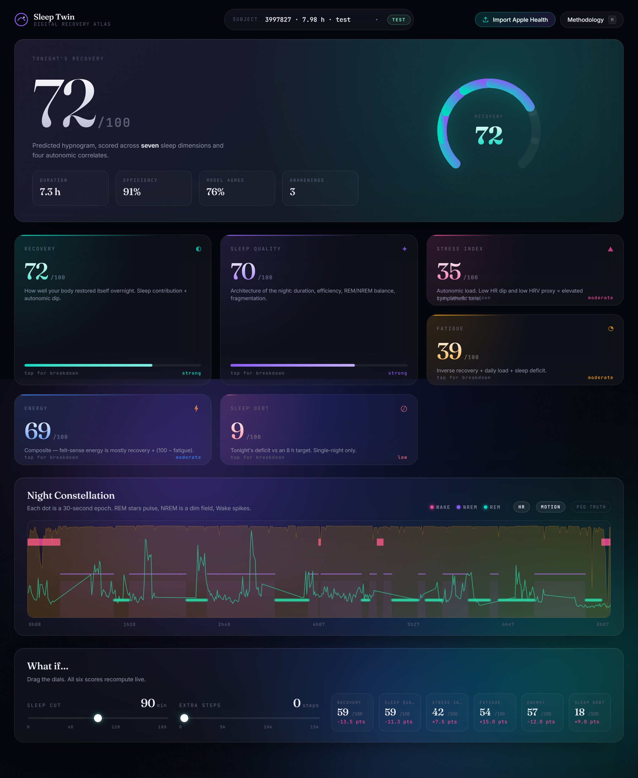
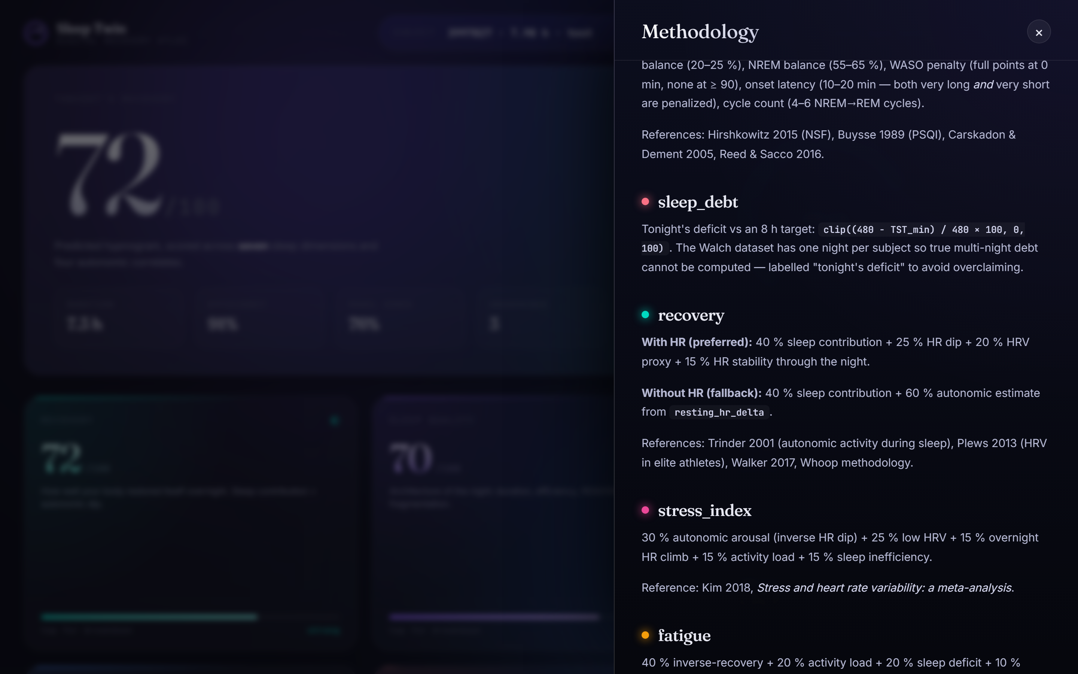
13 · APPLICATION
Interface walkthrough
Landing
Score flip
What-if sim
Methodology
Dark “aurora” theme · 270° segmented dial · bento-grid score cards · constellation hypnogram (REM = pulsing stars, Wake = spikes) · live what-if dials updating all six scores in ~120 ms.

Slide 20
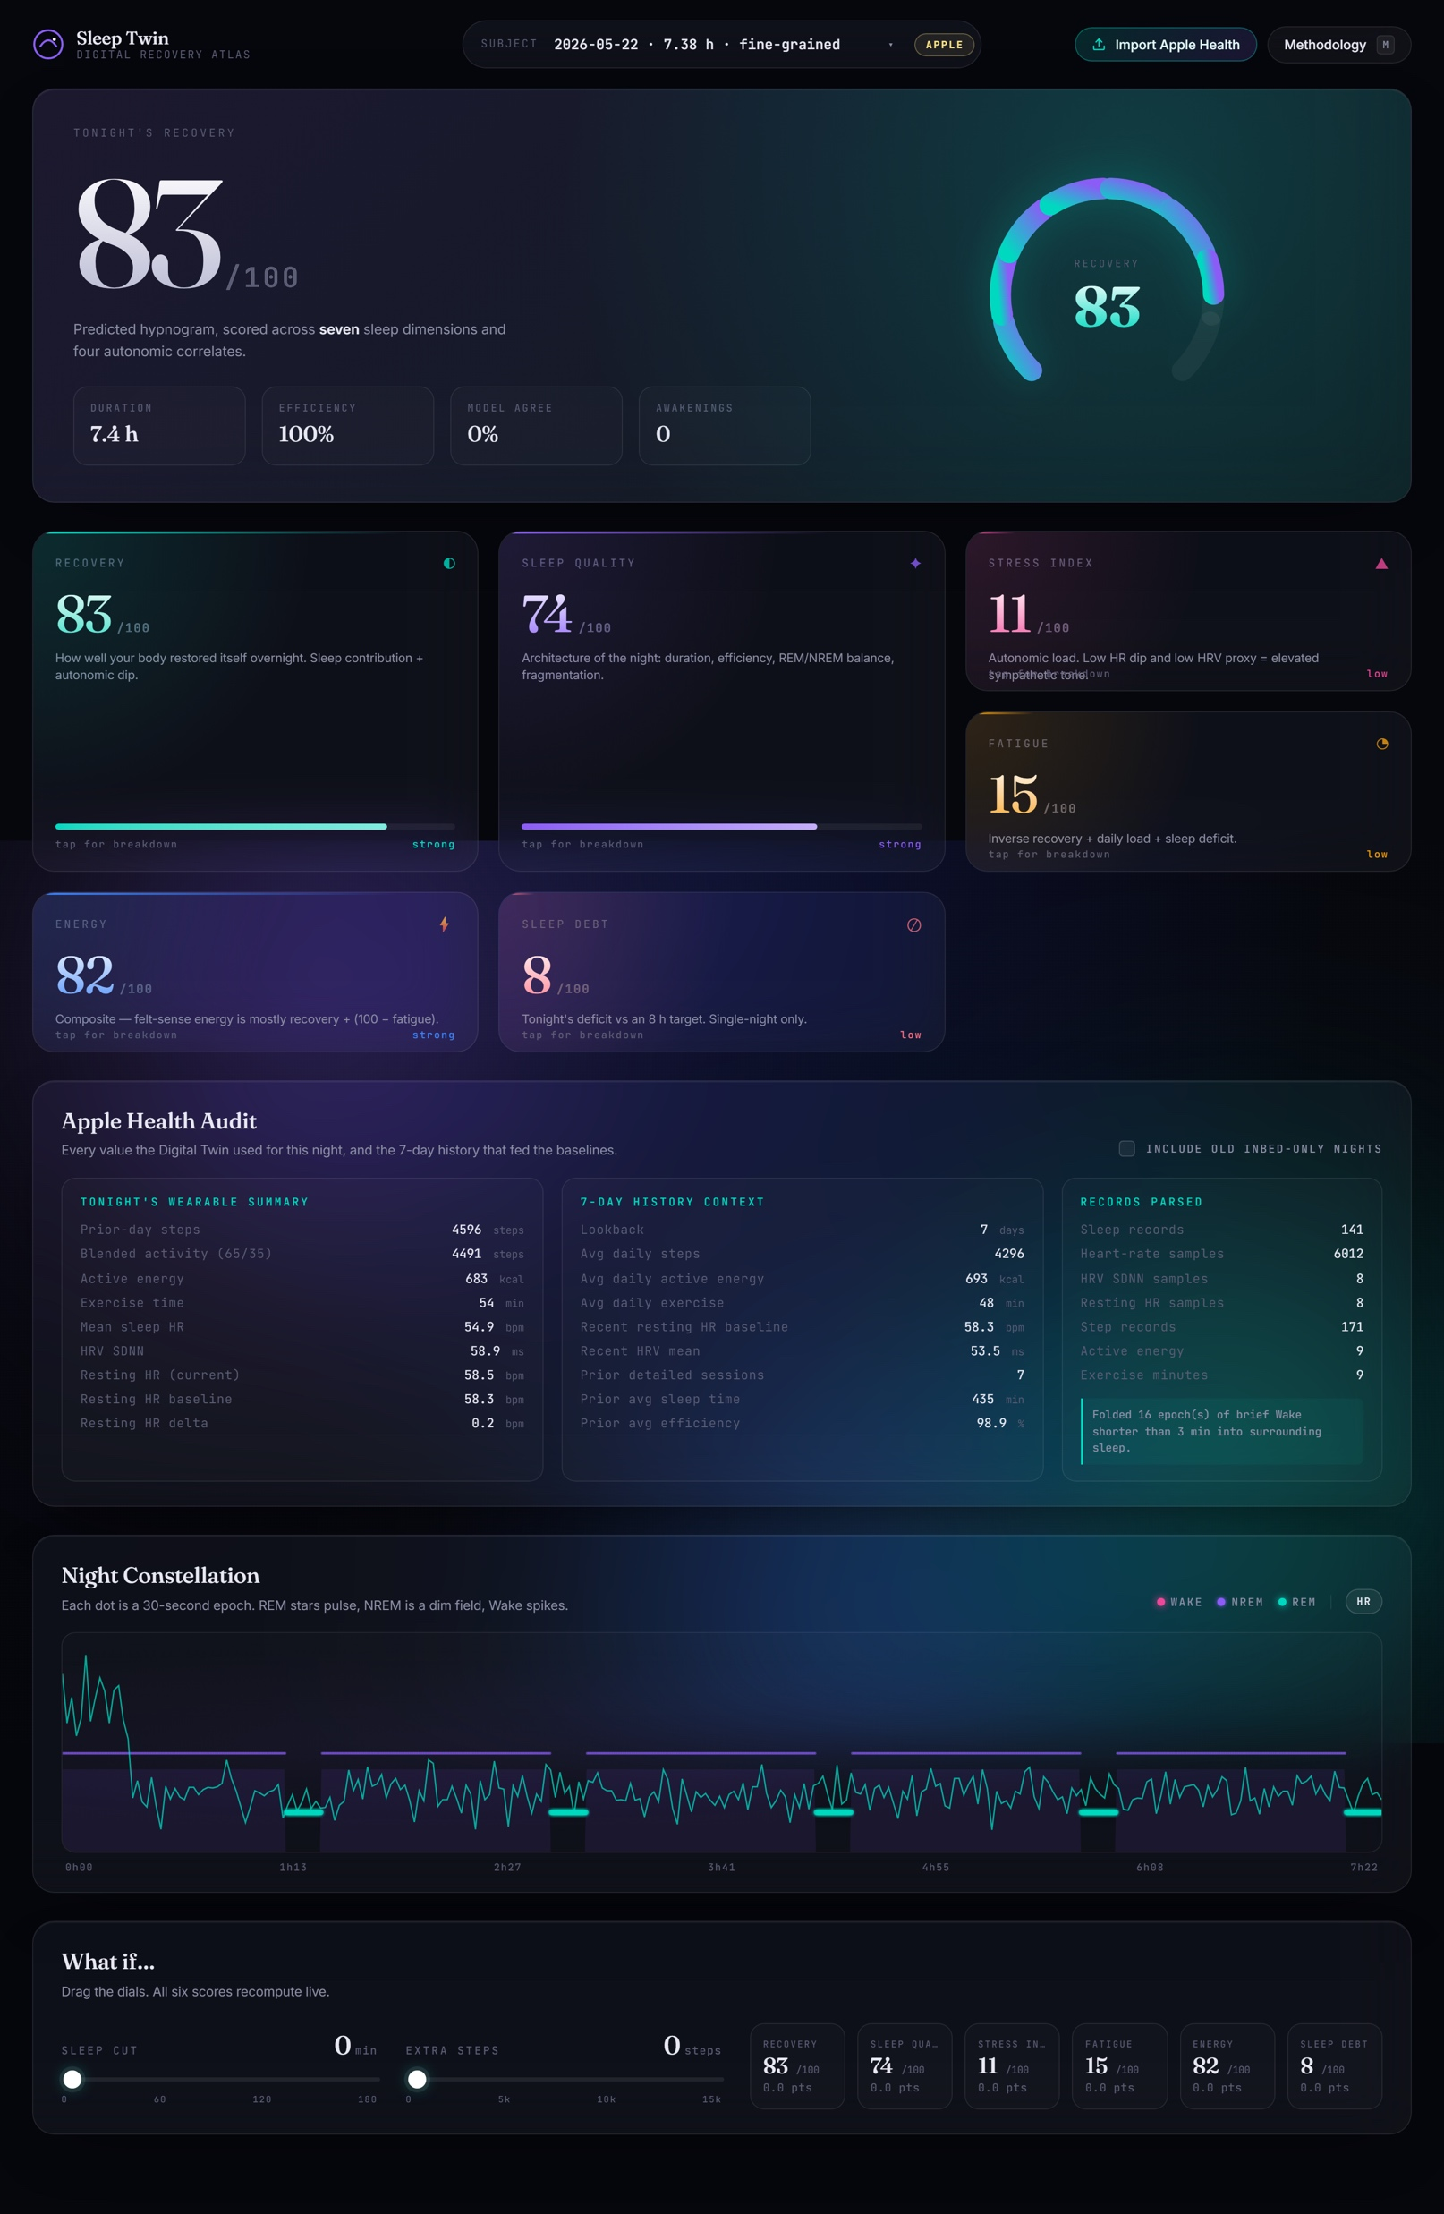
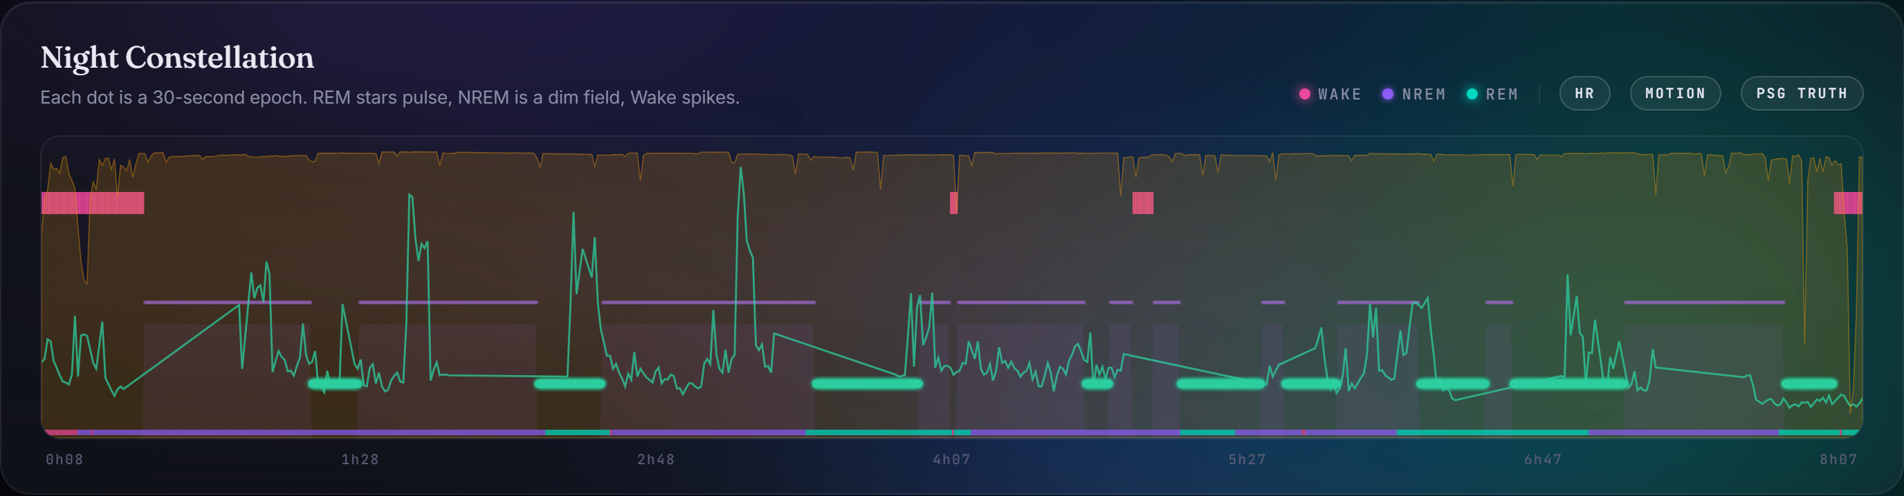
13 · APPLICATION
Apple Health import & audit
Drop your own export.zip. Switches to the most recent detailed-stage night, scored through the same pipeline.
Audit card. Tonight's wearable summary, 7-day history context, and per-record-type parse counts — full transparency.
Real HRV consumed. Apple SDNN (ms) feeds recovery & stress directly — not just displayed in a table.
Memory-bounded. Retains only the last 30 days so multi-GB histories can't exhaust RAM.

Slide 21
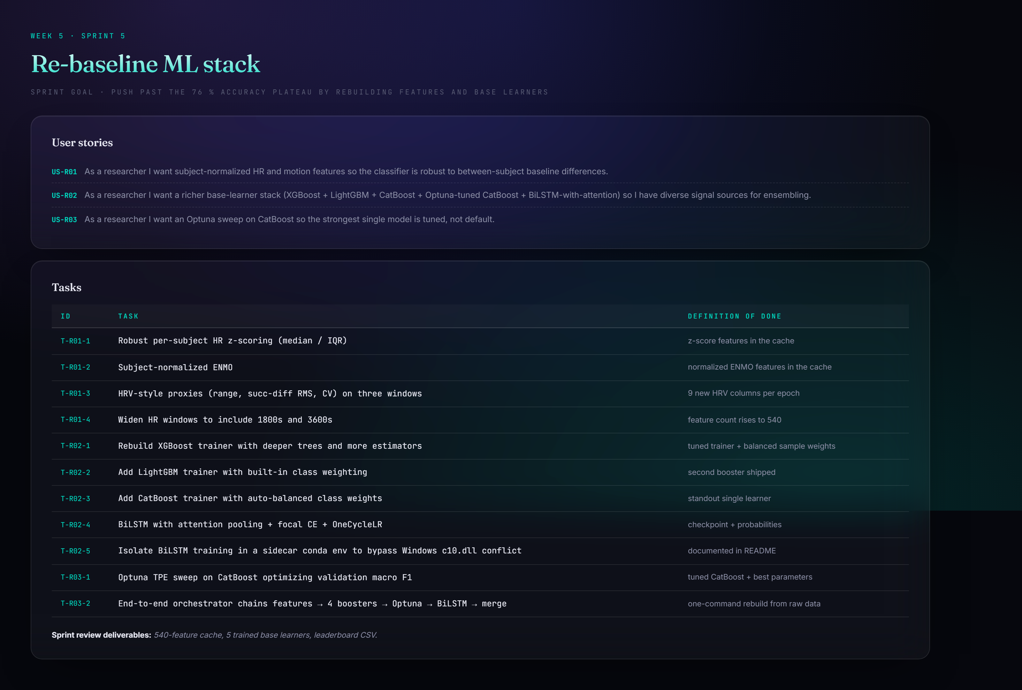
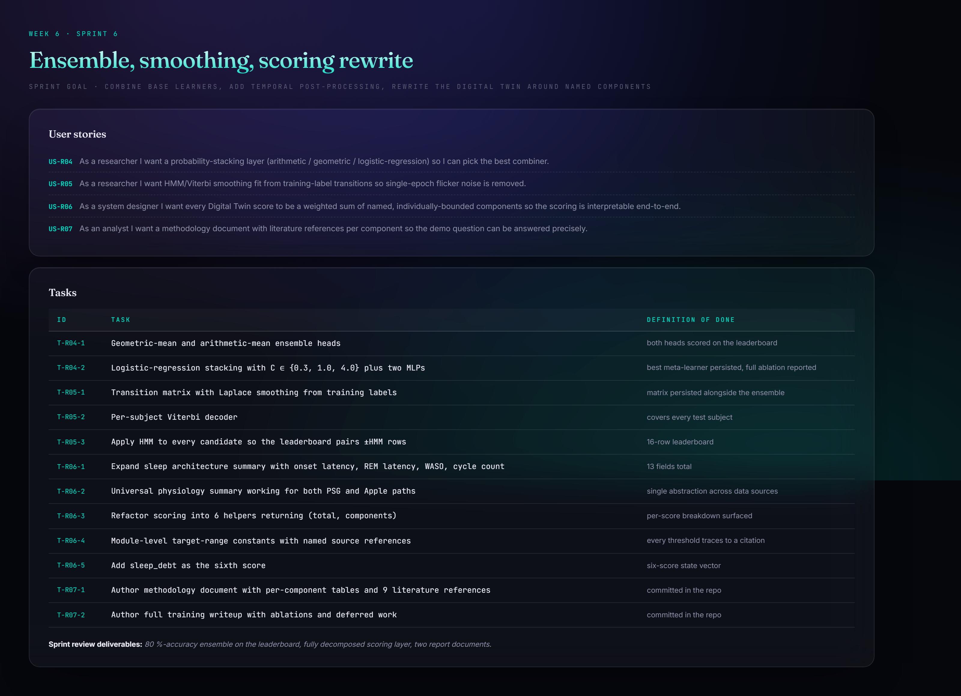
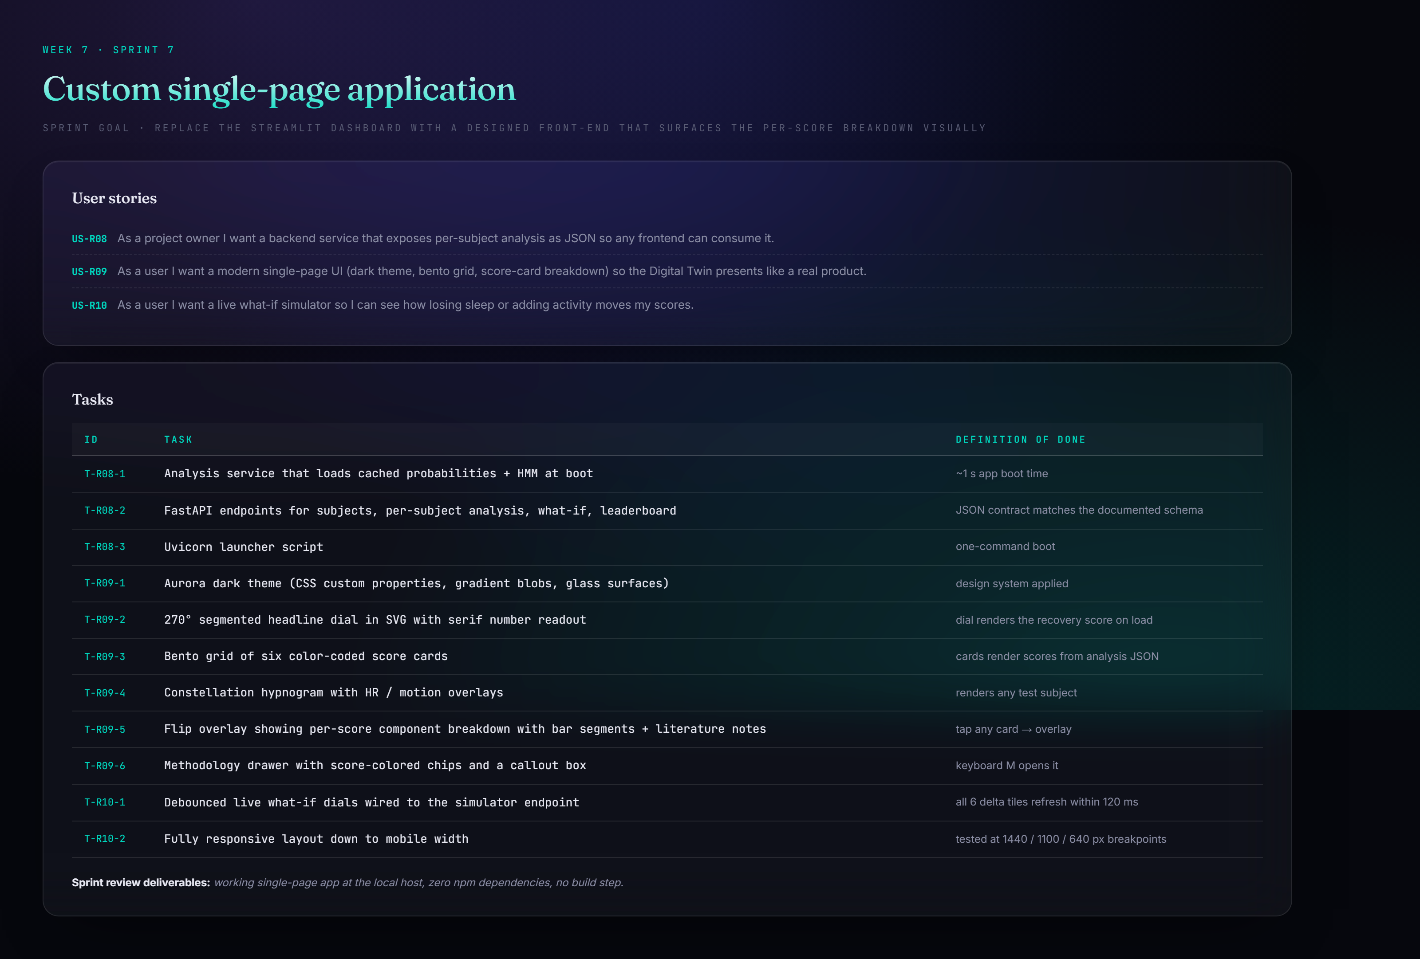
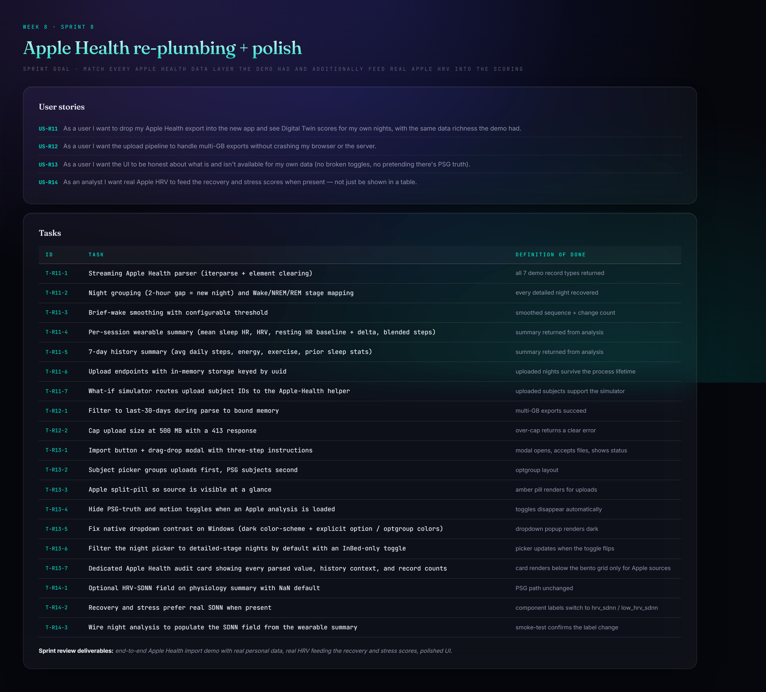
14 · SPRINT PLAN
Weeks 5–8 — re-baselined post-demo
Sprint 5 — Re-baseline ML stack
Sprint 6 — Ensemble, smoothing, scoring
Sprint 7 — Single-page application
Sprint 8 — Apple Health re-plumbing

Slide 22
15 · LIMITATIONS
Stated honestly
Scores are engineering estimates
Apple path doesn't re-run the classifier
No subjective ground truth (KSS/PSQI/RPE) — weights come from literature, not supervised learning.
Apple's export lacks raw 50 Hz accel — it validates the scoring layer, not the model.
Wake is the hardest class
One night per subject
Typical of wrist staging; HMM helps but can't fully resolve short awakenings.
True multi-night sleep debt can't be computed from training data.
Out-of-fold stacking deferred
No demographic adjustment
Logreg meta-learner overfits in-sample probabilities; geo-mean shipped instead.
Same 8 h target for a 25- and a 65-year-old — no age/sex normals in dataset.

Slide 23
16 · CONCLUSION
A complete end-to-end Digital Twin for sleep
Crossed every threshold the demo couldn't. Geo-mean + HMM = 80.35% accuracy, κ 0.5695; CatBoost + HMM = 0.7159 balanced acc, 0.6993 macro F1.
Four compounding changes. Per-subject normalization · CatBoost + LightGBM diversity · focal-loss BiLSTM · HMM smoothing — none enough alone.
Transparent scoring by construction. Six scores as named, bounded, literature-grounded components — “what is recovery?” answered in two taps.
One app, two data sources. Same scores, same breakdown UI, same what-if simulator for PSG subjects and personal Apple Health nights.
Wearable signal in, virtual human state out — every step of the reasoning visible to inspection.

Slide 24
17 · REFERENCES
Selected references
[1] Walch, Huang, Forger & Goldstein (2019). Sleep stage prediction with raw acceleration & PPG HR. Sleep, 42(12).
[2] Buysse et al. (1989). The Pittsburgh Sleep Quality Index. Psychiatry Research, 28(2).
[3] Hirshkowitz et al. (2015). NSF sleep time duration recommendations. Sleep Health, 1(1).
[4] Carskadon & Dement (2005). Normal human sleep: an overview. Principles & Practice of Sleep Medicine.
[5] Reed & Sacco (2016). Measuring sleep efficiency. J. Clinical Sleep Medicine, 12(2).
[6] Trinder et al. (2001). Autonomic activity during human sleep. J. Sleep Research, 10(4).
[7] Plews et al. (2013). HRV in elite endurance athletes. Sports Medicine, 43(9).
[8] Kim et al. (2018). Stress and HRV: a meta-analysis. Psychiatry Investigation, 15(3).
[9] Van Dongen et al. (2003). The cumulative cost of additional wakefulness. Sleep, 26(2).
[10] Walker, M. (2017). Why We Sleep. Scribner.
[11] WHOOP Inc. (2020). Heart Rate Variability methodology overview.

