Slide 1
Git and GitHub Version Control

Slide 2
Agenda
High level overview of Git and GitHub
Demo GitHub
Demo Enterprise Guide integration with Git

Slide 3
What is Git
A Brief History
Git is a decentralized version control system.
Git allows you to keep a history of the significant changes made to your local documents such as computer programs, text or design documents.
Git like other version control systems manages and stores revisions of computer code for projects.
Git can be used to manage any many types of files, such as Word documents and Text documents. Think of it as a filing system for every draft of a document.
Git can also backup this history through remote hosting services like GitHub or GitLab.
Git was developed for Linux kernel by Linus Torvalds in 2005.
The Linux kernel community could no longer use their revision control system BitKeeper and no other Source Control Management (SCMs) met their needs for a distributed system so Linus Torvalds spent a weekend writing Git.
Git is an open source and is free

Slide 4
What is Git
A Brief History
Git is a decentralized version control system.
Full repositories of content are stored on each individuals laptops or destops
Git allows you to keep a history of the significant changes made to your local documents such as computer programs, text or design documents.
Git was developed for Linux kernel by Linus Torvalds in 2005.
The Linux kernel community could no longer use their revision control system BitKeeper and no other Source Control Management (SCMs) met their needs for a distributed system so Linus Torvalds spent a weekend writing Git.
Git is an open source and is free
GitHub, GitLab or some other hosting service is helpful to facilitate collaboration
act as a “hub” for managing the versioning.

Slide 5
Git vs. Subversion
Git is a distributed version control system (DVCS); SVN is a non-distributed but a centralized version control (CVCS.)
The content in Git is stored as metadata; SVN stores files of content.
Git branches are “easier” to work with than SVN branches.
Git does not have the global revision number feature like SVN has.
Git has better content protection than SVN.

Slide 6
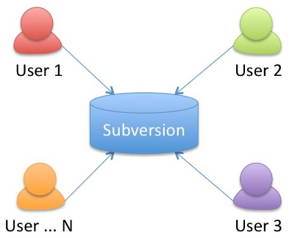
Subversion (SVN) vs. Git
SVN is a centralized version control (CVCS.)
Git is a distributed version control system (DVCS)

Slide 7
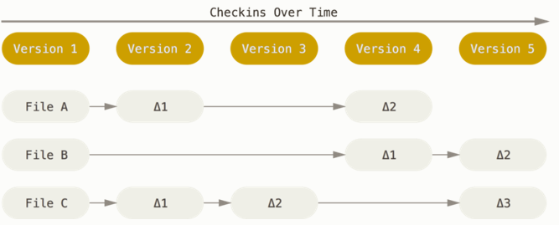
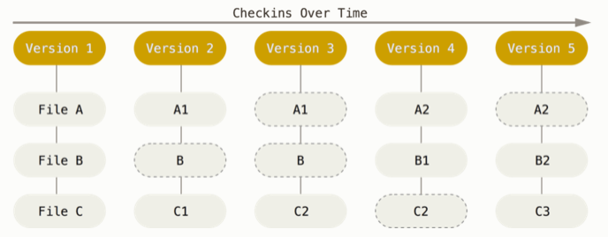
Subversion (SVN) vs. Git
SVN stores files of content and changes of files over time.
Git thinks of data more like a series of snapshots of a miniature filesystem. With Git, every time you commit you save the state of your project.
Source: The Pro Git Book Section 1.3

Slide 8
Subversion vs. Git
Advantages and Disadvantages
Subversion (CVCS) -
Advantages
Administrators have fine-grained control over who can do what
Easier to administer a CVCS than it is to deal with local databases on every client
Easier to use and/or learn than Git
Disadvantages
Clients check out only the latest versions of files
CVCS’s have a single server that contains all the versioned files. Single point of failure.
Need to be connected to a network to access the central server
Git (DVCS) –
Advantages
Check out the full repository to client (desktop/laptop)
Allows you to set up several types of workflows that aren’t possible in centralized systems
Allows for commits and tracking version when not able to connect to server
Better content protection
Disadvantages
Git is harder to learn and use. Steeper learning curve.
Slower when working on large projects

Slide 9

Git
All users have a Git repository on a local computer or laptop.
But this causes an issue because to share work or versions of work people need to access each other’s computers to collaborate.
How to do we facilitate collaboration/sharing of work securely?

Slide 10
GitHub

Slide 11
Git
Advantages and Disadvantages
Git (DVCS) –
Advantages
Check out the full repository to client (desktop/laptop)
Allows you to set up several types of workflows
Allows for commits and tracking version when not able to connect to a server
Better content protection
Disadvantages
Git is harder to learn and use - steeper learning curve.
Harder to administer all the local repositories
Slower when working on large projects

Slide 12
What is GitHub ?
GitHub provides
Web-based GUI
Access Control
Public – free to the public
Private – for $9 per month GitHub will host a private repository
Enterprise Version - $21 dollars per month for 10 seats.
Mobile Integration
Apps to facilitate workflows and collaboration
Collaboration Features
Project Wikis
Basic task management tools for projects.

Slide 13
What is GitHub?
Competitors
There are numerous web-based repository hosting services for managing the decenteralized Git repositories:
GitHub
GitLab
BitBucket
SourceForge
Many more….

Slide 14
Tools Used at SAS
SAS IT provisions access to our Enterprise GitHub. It’s used for IT projects mostly, not R&D. Seats cost money, so you need business justification.
R&D uses Gitlab (hosted internal) for project collaboration outside of the normal product source management process.

Slide 15
Git Basics
Files not to store on Git
Operating system files
Application files
Language and framework files
Files downloaded with package managers
Credentials
Large files such as videos
Creating a .gitignore file tells Git which files to ignore.
GitHub automates this process.
http://gitignore.io helps to create the file.

Slide 16
Best Practices
Commit related code
Commit Often
Don’t Commit half done work
Only commit when code is completed
Test before you commit
Write good commit messages
Use and delete branches when finished with them
Version Control is not a back up systems
Back up work on a remote server
Agree on a workflow
Depends on factors such
The project
Overall development and deployment workflows
personal preferences of the team

Slide 17
GitHub Workflow
Workflow is flexible
New repositories can be created locally then “pushed” to GitHub
Repositories can be created and managed on GitHub then “cloned” locally
Changes to files can either be “pushed” or “pulled” from local repositories to GitHub
There is a central point of contact who is responsible for managing the main repository on GitHub

Slide 18
Using Git and GitHub

Slide 19
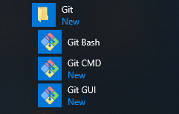
Using Git
First step is to load Git to a local computer or laptop.
Git can be found here:
https://git-scm.com/book/en/v2/Getting-Started-Installing-Git
Installs 3 pieces:

Slide 20
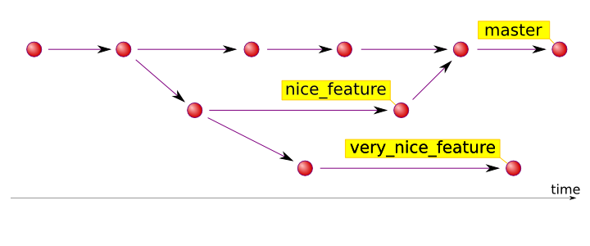
Using Git
Creating “Playpens”
With Subversion we often create a path on the file system and copy files to make playpens
With Git we create one path for the repository and branch from the “master” branch to create playpens.
Branches are then merged back to the “master” when we are satisfied that the work in the playpen is completed

Slide 21
Demos

Slide 22
Make a repository with GitHub Desktop.
Add a SAS program to the repository.
Enterprise Guide integration with Git.
Create a repository on the GitHub website.

Slide 23
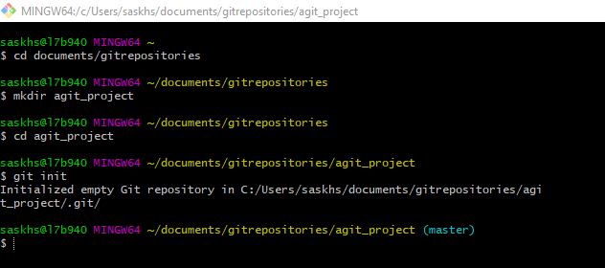
Using Git
Step 0 Create account on GitHub
Step 1 Create a “repository” and initiate the repository

Slide 24
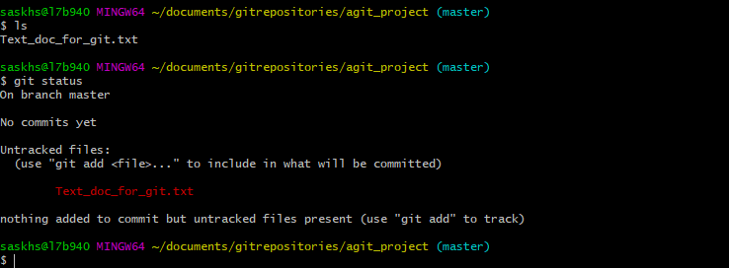
Using Git
Step 2 Add file to the repository and check to see if Git knows about it

Slide 25
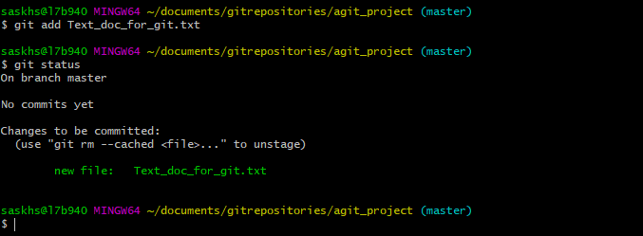
Using Git
Step 3 Add the files(s) to Git

Slide 26
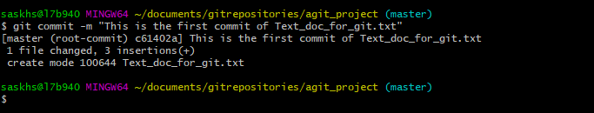
Using Git
Step 4 Committing the file(s)
The message at the end of the commit should be something related to what the commit contains.

Slide 27
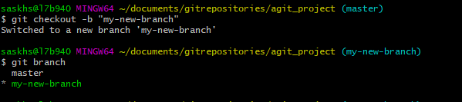
Using Git
An example of a Git repo with a branch

Slide 28

Using Git and “pushing” to GitHub
An example of a Git repo with a branch
Created a path on my local computer
C:\Users\saskhs\Documents\GitRepositories\agit_project
Using git init command initiated the repo which created the master branch
Added a file to the master path - Text_doc_for_git.txt
Created one branch – my-new-branch
git checkout –b “my-new-branch
Automatically switches to new branch

Slide 29
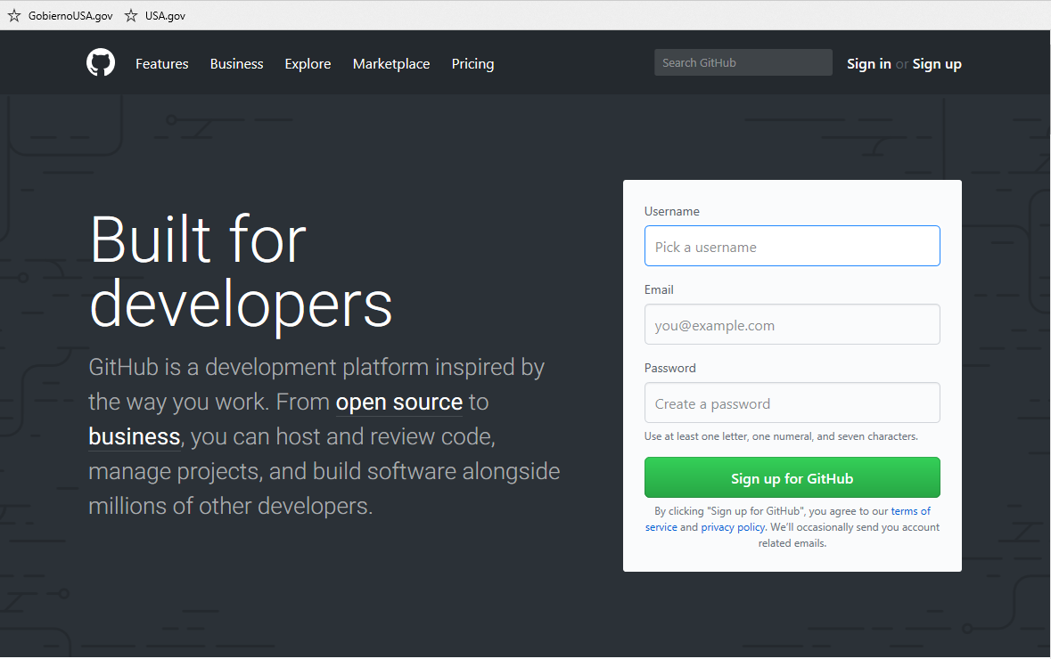
Using GitHub
First need to set up an account.

Slide 30
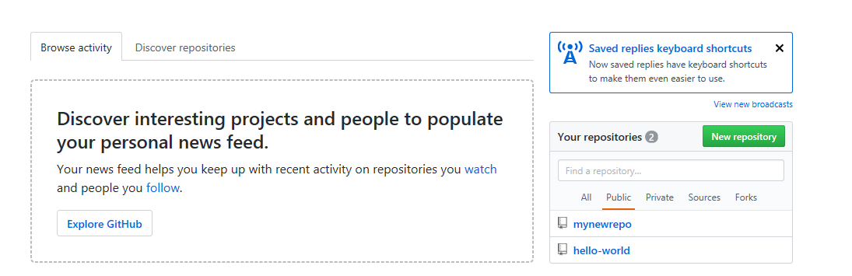
Using GitHub
Create a GitHub Repository
If you only want to keep track of your code locally, you don't need to use GitHub. But if you want to work with a team, you can use GitHub to collaboratively modify the project's code.

Slide 31
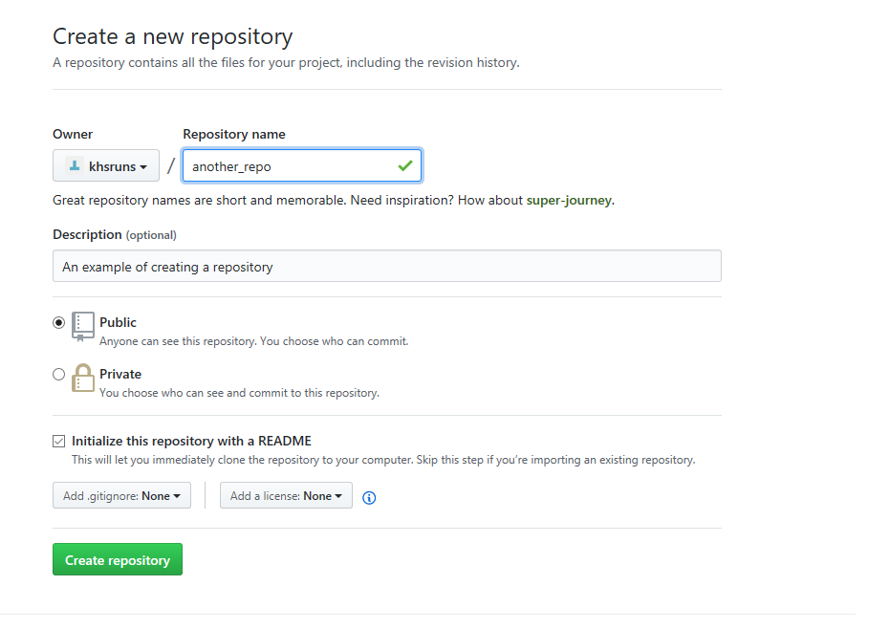
Using GitHub

Slide 32
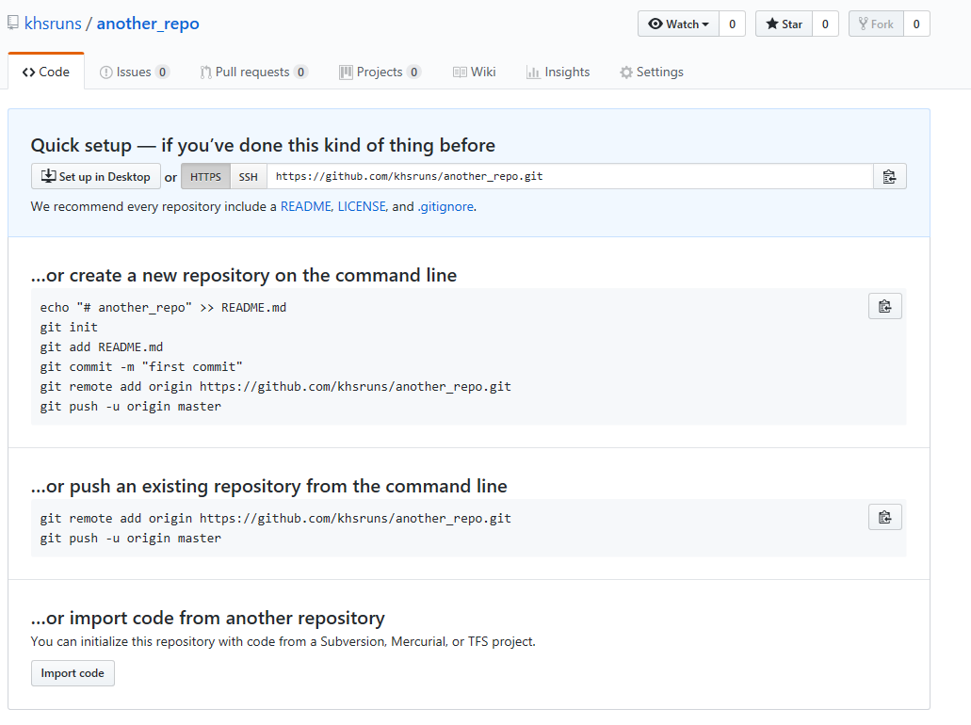
Using GitHub

Slide 33
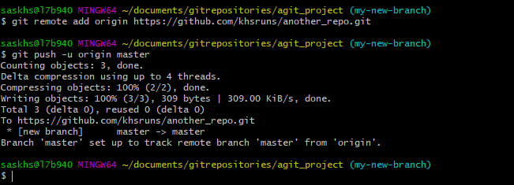
Using GitHub
Push the project to GitHub
git remote add – tells git that there is a remote repo and what it is
git push – pushes the master to GitHub

Slide 34
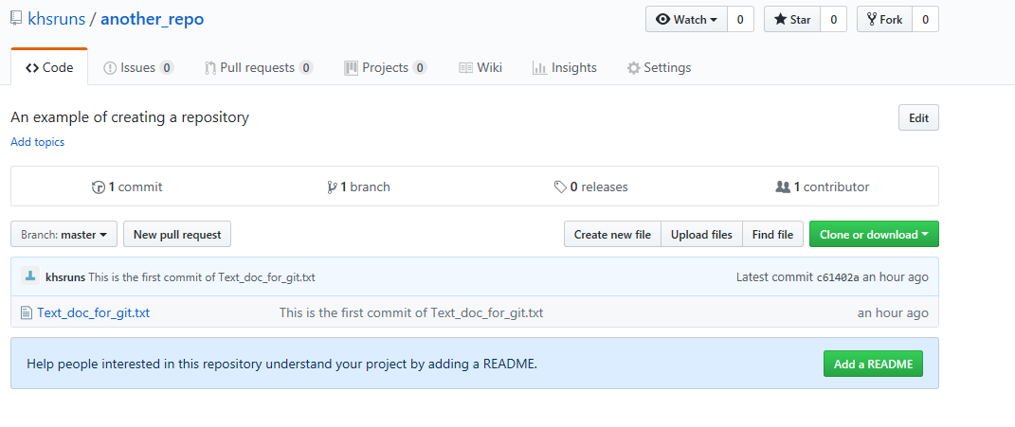
Using GitHub
View of GitHub After “Push”

Slide 35
Enterprise Guide Integration

Slide 36
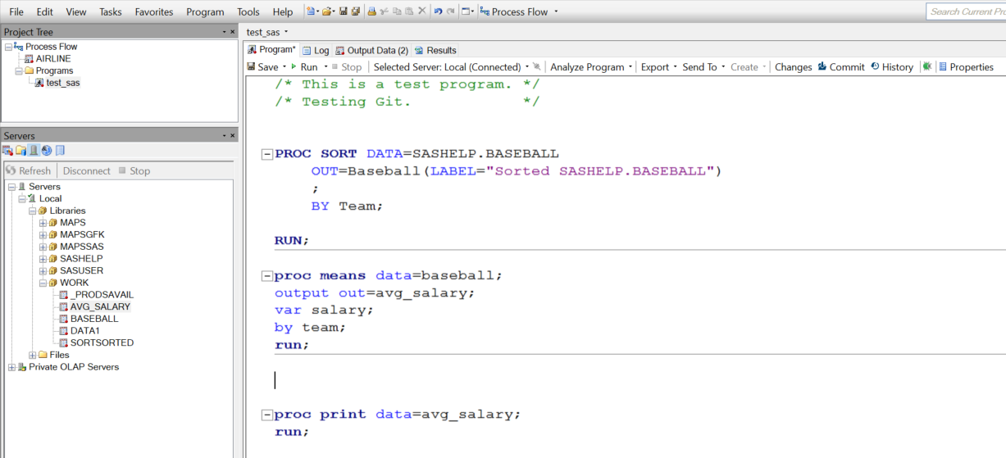
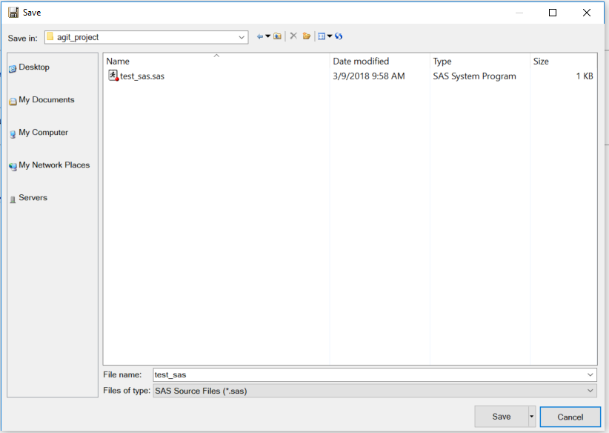
Enterprise Guide Git Integration
Enterprise Guide 7.1 has capabilities to integrate with Git repositories.
SVN integration is not available.

Slide 37
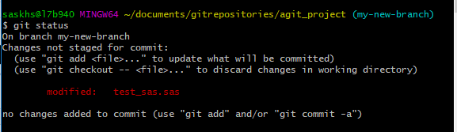
Enterprise Guide Git Integration
After saving the code to the Git repo it needs to be committed to make an update to the code.
Once committed then code can be “pushed” or “pulled” to GitHub repository.

Slide 38
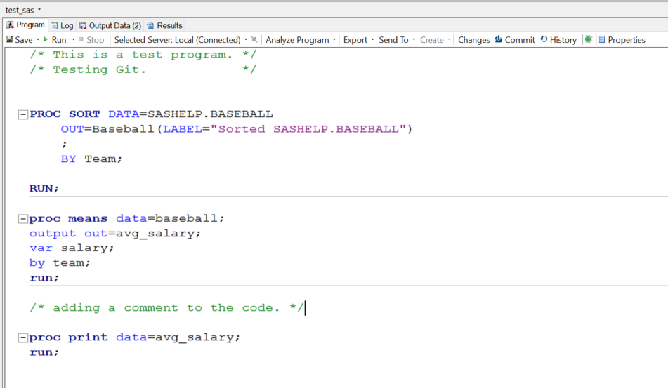
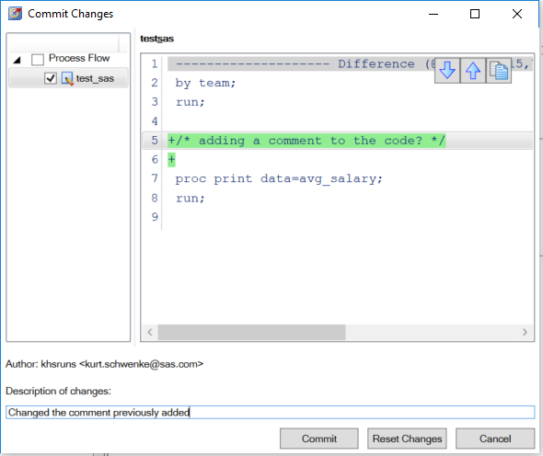
Enterprise Guide Git Integration
Enterprise Guide 7.1 has capabilities to integrate with Git repositories.
SVN integration is not available.

Slide 39
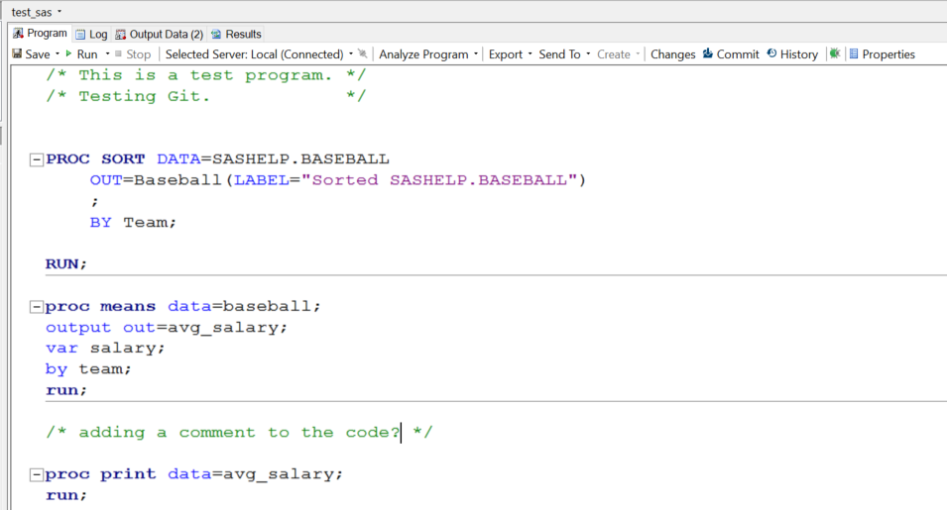
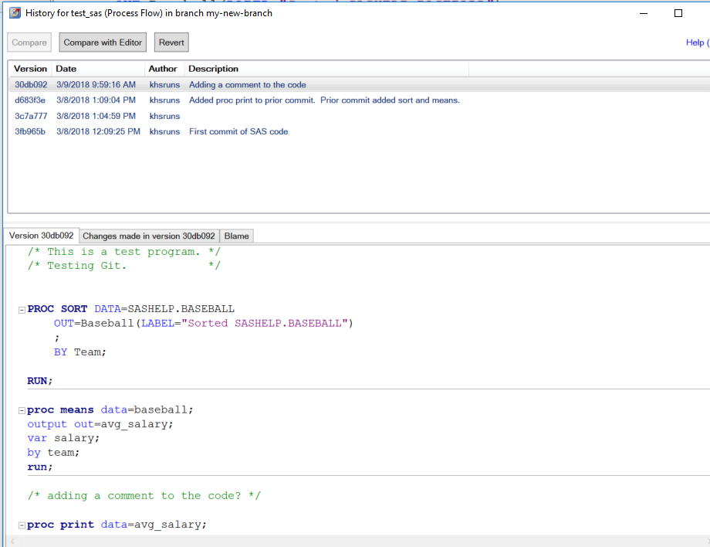
Enterprise Guide Git Integration

Slide 40
Resources
The Pro Git Book
https://git-scm.com/book/en/v2
Intro to Git and GitHub for Beginners:
https://product.hubspot.com/blog/git-and-github-tutorial-for-beginners
Git Hub for Noobs 1-4 YouTube Series:
https://www.youtube.com/watch?v=1h9_cB9mPT8
https://www.youtube.com/watch?v=_ALeswWzpBo
https://www.youtube.com/watch?v=BKr8lbx3uFY
https://www.youtube.com/watch?v=JPKOESR1k04
How EG works with Git:
http://support.sas.com/resources/papers/proceedings14/SAS179-2014.pdf
https://blogs.sas.com/content/tag/git/

