Slide 1
Project T Final: Data Cleaning
Team .N.A.N.T.S.

Slide 2
Visualizing Data with Matplotlib/Seaborn [Optional Review Topic]

Slide 3
Motivation
Condense large datasets into human comprehensible images
Sanity check data and model
Identify outliers
Explain findings

Slide 4
Best Practices when Creating Visualizations
Add descriptive titles and axis labels.
Use appropriate scaling so that your data is readable.
Avoid plotting too much data and cluttering your graph (overplotting).
Consider if you’re plotting categorical or numerical data.

Slide 5
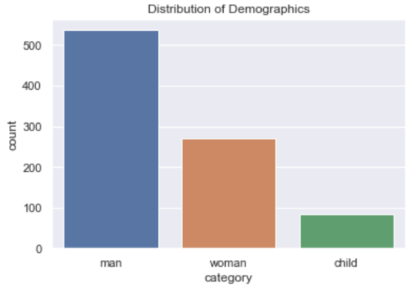
Single Categorical Variable: Bar Chart
Bar charts visualize the distribution of a single categorical variable. The y-axis can be either counts or percentages.
Ex. The bar chart on the right shows the distribution of passengers of the Titanic by gender (except child).

Slide 6
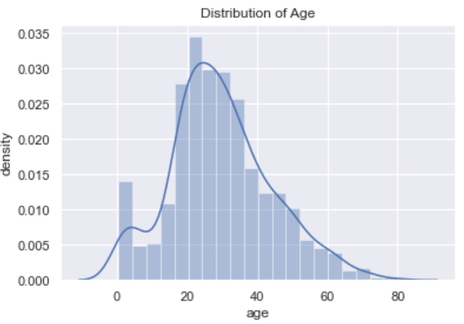
Single Numerical Variable: Histogram
Histograms show the distribution of a single numerical variable. Histograms can use either counts or densities for the y-axis units.
The histogram on the right shows the distribution of the ages of Titanic passengers.

Slide 7
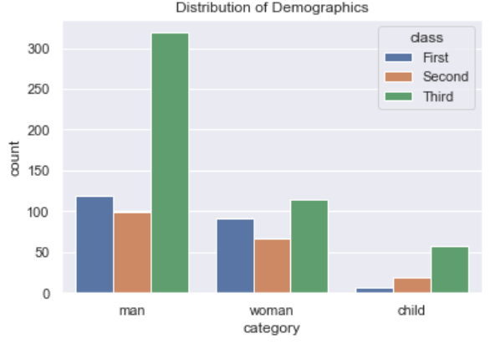
2+ Categorical Variables: Multi-Level Bar Chart
Multi-level bar charts can help visualize multiple categorical variables. Be wary of using this visualization on variables with many labels, as that may compromise readability.
The two-level bar chart on the right shows the distribution of passengers of the Titanic by gender and class.

Slide 8
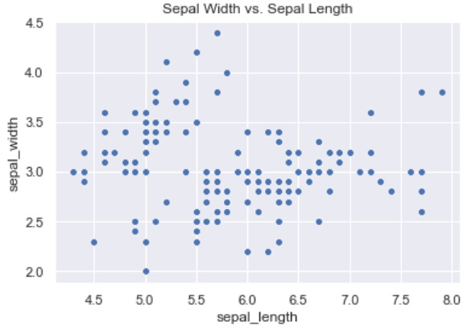
2 Numerical Variables: Scatter Plot
Scatter plots show how two variables are related. While they are powerful visualizations, scatter plots have a few limitations.
The scatter plot on the right shows how sepal width and sepal length are related in the iris dataset.

Slide 9
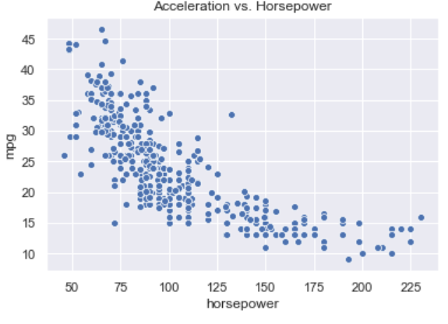
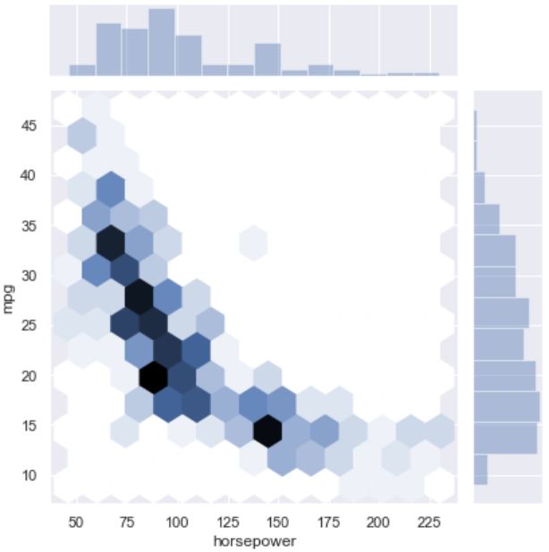
2 Numerical Variables: Hex Plot
Hex plots alleviate the problem of overcrowded scatter plots by smoothing out regions. The plots below are a bad scatter plot and its corresponding hex plot:

Slide 10
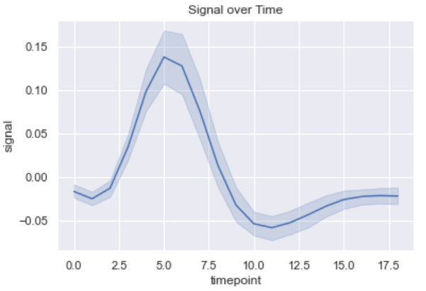
2 Numerical Variables: Line Plot
While scatter plots are useful in the general case when plotting two numerical variables, line plots are more appropriate when one variable does not or rarely repeat, such as in time series data.
The line plot on the right shows signal over time in FMRI time series data.

Slide 11
Additional Notes
Some visualizations such as scatter plots can include a third variable by using a 3D visualization instead. However, 3D visualizations require a computer to view and sacrifice some readability.
Numerical visualizations like scatter plots can also incorporate a categorical variable by using different colors (eg. blue points indicate category 1, orange points indicate category 2, etc.).

Slide 12
Normalizing and Standardizing Data

Slide 13
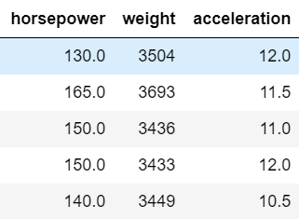
Motivation
Handle data with features with vastly different ranges of values
Performed before PCA
Ex. Seaborn’s mpg dataset has features with different orders of magnitude

Slide 14
When to Use Standardization and Normalization
Algorithms such as SVMs, regularized Regression, k-means clustering and NNs, stochastic gradient descent (SGD)
In general, algorithms that need a similarity metric between samples which are sensitive to transformations

Slide 15


Normalization
Normalizing a feature maps its values to the range [0, 1]; in other words, fixing the min and max to 0 and 1 respectively. For a data point , the following equation performs the normalization:

Slide 16
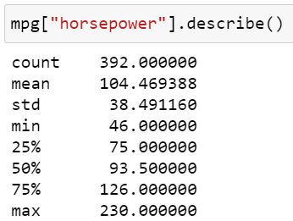
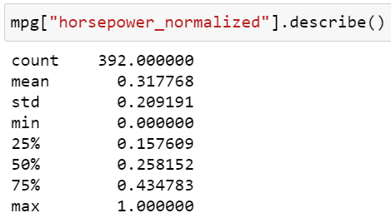
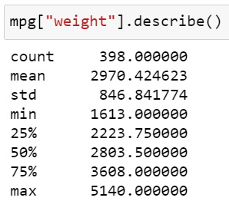
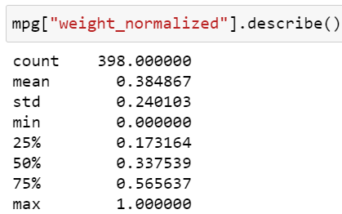
Normalization Example
This slide shows how the “horsepower” and “weight” features of the mpg dataset are normalized. Notice that even though the features have different min and max values, they both end up with 0 and 1 as the new min and max after normalization.
Horsepower
Weight

Slide 17

Standardization
Standardization fixes the mean and standard deviation of the feature to be 0 and 1 respectively (note that this does NOT mean exactly a unit gaussian. Given a data point , we have the following equation:

Slide 18
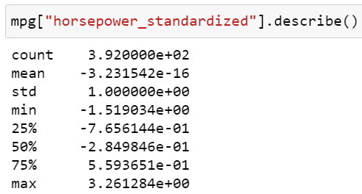
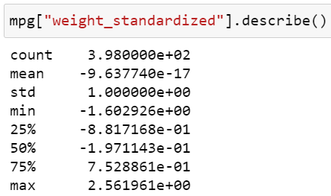
Standardization Example
This slide shows how the “horsepower” and “weight” features of the mpg dataset are standardized. Notice that the new mean is roughly 0 (numerical imprecision) and the new standard deviation is 1. Additionally, the maximum and minimum describe how much the furthest points vary from the mean.
Horsepower
Weight

Slide 19
Additional Notes
You cannot both standardize and normalize a feature; this is because normalizing transforms the feature’s range to [0, 1], so the new mean of the feature will be larger than 0 (except in the degenerate case when all values are the same in a feature). This means you must pick one or the other.
There exists a version of standardization that is more robust to outliers by using median and interquartile range instead of mean and standard deviation. You can read more about sklearn’s robust scaler here.

Slide 20
One-Hot Encoding Categorical Data

Slide 21
Motivation
Generally, most models cannot train on a categorical variable, instead requiring numbers rather than labels. One-hot encoding transforms categorical variables into a more computer useable format.

Slide 22


Naive Approach: Enumeration
Replace a set of string labels {label 1, label 2, …, label n}, with indices {1, 2, …, n}.
Ex. passenger class from Titanic dataset:
String labels:
Enumerated labels:

Slide 23
Problems with Enumeration
Enumeration adds nonsensical mathematical constraints (eg. mapping “First Class” to 1 and “Third Class” to 3 in the Titanic dataset implies that 3 * “First Class” is equal to “Third Class”, or “Second Class” + 1 is equal to “Third Class”).

Slide 24
One-Hot Encoding Technique
Given n unique labels, map label i to a list of n booleans, in which boolean i is the only one marked True.
Ex.
Label 1: [1, 0,…, 0]
Label 2: [0, 1, 0, ... , 0]
Label n: [0, …, 0, 1]

Slide 25

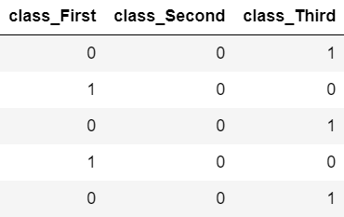
One-Hot Encoding on the Titanic Dataset
Ex. passenger class of the Titanic dataset:
String labels:
One-hot labels:

Slide 26
Additional Notes
Not all “numerical” data is quantitative. In addition to the previously mentioned enumeration, where a number serves as a proxy for a class, data such as zip codes or phone numbers where mathematical relationships are unclear can also be encoded.
Can prune away rare labels by merging them together as “Other”.

Slide 27
Processing Text Fields with Regular Expressions

Slide 28
Motivation
Clean poorly formatted strings, unwanted punctuation
Extracting useful features from raw text
Particularly useful in natural language processing NLP

Slide 29
What is Regex?
Programming tool for performing string manipulations (ex. extracting features from text, replacing substrings)
Can create a set of characters, or a pattern, that can match substrings in other input strings

Slide 30
Common Regex Functions
Regex is commonly imported as “re” in Python. Assuming this is true:
re.search(pattern, text): Detects whether regular expression pattern is present in the given text.
re.sub(pattern, substitute, input): Substitutes substrings in input text that match the given pattern with the substitute substring.
re.findall(pattern, string): Returns a list of all pattern matches in a string.
re.compile(pattern): Stores the regex pattern in cache memory for faster searches, which is useful if a pattern is reused many times.

Slide 31
Literals
Straightforward identical pattern
Ex. "https://eecs.berkeley.edu/" will match exactly the string "https://eecs.berkeley.edu/", and will fully match with no other string
Partial matches (Ex. for the string "https://eecs.berkeley.edu/news", the trailing “/news” will not be matched)

Slide 32
Character Sets
Commonly used sets:
[xyz]: Matches exactly the characters “x”, “y”, or “z”
[a-z]: Matches any lowercase alphabetic character
[A-Z]: Matches any uppercase alphabetic character
[a-zA-Z]: Matches any alphabetic character
[0-9]: Matches any digit between 0 and 9
Can be inverted by using the ^ operator. (Ex. [^0-9] matches all non-numeric characters)

Slide 33
Meta Sequences
Commonly used sets may also have a corresponding meta sequence.
Ex. [0-9] is also represented by \d, \s represents all whitespace characters

Slide 34
Quantifiers and Wildcards
In addition to the previously mentioned character sets and meta sequences, a period (.) is a wildcard matches any single character.
Character sets, meta sequences, and wildcards only match single characters. Quantifiers can specify how many times they need to match:
*: The preceding character needs to match 0 or more times
+: The preceding character needs to match 1 or more times
?: The preceding character matches 0 or 1 times
{m, n}: The preceding character matches between m and n times

Slide 35

Basic Regex Example
Task: Extracting a float value from an uncleaned dollar string (eg. “$1,200,689.84 USD").
The pattern first finds all characters that are not (^) numeric (\d) or periods (.), and replaces them with empty strings. This removes the dollar sign, commas, and suffix of the string, creating a valid string that can be converted into a float.

Slide 36
Additional Notes
If you want to specify a special character such as a plus sign or period as a literal that’s not in a character set, you need to escape the character with backslash.
The pipe operator (|) specifies an or, which may be useful for specifying different possible characters/substrings at a location in the pattern.
A great site to debug or sanity check your regex is https://regex101.com/, which highlights exactly what parts a pattern matches in a given input string and pattern, as well as explaining why the match exists.

Slide 37
Handling Imbalanced Class Distributions

Slide 38
Motivation
Ex. Given dataset with distribution: 99% class A, 1% class B
Naive classifier can achieve training accuracy of 99% by simply classifying everything as class A!
Naive classifier then generalizes very poorly to real world with distribution of 50% class A, 50% class B

Slide 39
Alternatives to Dataset Modification
Collecting more data: can be expensive or difficult in practice
Use a different evaluation metric:
Naive classifier weighs false positives and false negatives equally
Ex. A receiver operating characteristic (ROC) curve can help weigh the tradeoff between false positives and false negatives

Slide 40
Resampling Datasets
Common methods:
Undersampling: Sample a subset of data points from the majority class, so that fewer majority class points are included.
Oversampling: Sample data points from the minority class with replacement, so that minority class points have greater representation.
Generating synthetic data: Generate new synthetic data for the minority class; the SMOTE method is commonly used. Synthetic data is similar in concept to oversampling, except data points are not exact copies.

Slide 41
A Warning about Resampling
Given real world with 99% class A and 1% class B, it is actually correct to present training dataset with 99% class A and 1% class B.
Presenting training dataset with 50% class A and 50% class B is actually incorrect in this case!

Slide 42
Handling Null/Missing Values

Slide 43
Motivation
Can skew dataset with large amounts of default inputs
Ex. Unfilled age data defaults to 0, average age becomes much lower with large amount of missing data

Slide 44
Two Approaches to Handling Null Values
Deletion: Remove the offending variables or rows that contain null values.
Imputation: Substitute the null values with some kind of filler value.

Slide 45
Method 1: Deletion
Two options:
Deleting rows: Deleting rows is appropriate when there’s only a small number of null values, and if the data is missing at random. If there is a pattern where the data is null, deleting these rows may lose valuable information and produce biased models.
Dropping variables: Dropping a variable is appropriate when a large portion of the variable’s values are null (eg. optional field in a survey with few responses), and the variable is insignificant.

Slide 46
Method 2: Imputation (Summary Statistic)
Replace all null values in a variable with the variable’s mean, median, or mode.
Mean and median apply to numerical data while mode applies to categorical or discrete numerical data.
Easy to implement and not computationally taxing.
May be prone to bias and takes no advantage of relationships between other variables.

Slide 47
Method 2: Imputation (Linear Regression)
Use a correlation matrix to select good predictors of the variable to impute and train a linear regression model to predict the null values.
Model may overfit
Relies on the strong assumption that a linear relationship exists.

Slide 48
Method 2: Imputation (K-Nearest Neighbors)
A kNN model is trained on the dataset, where the imputed variable are what the model predicts. A distance metric between data points is decided, and the model uses the present values of the nearest neighbors to impute the null value.
KNN model may also overfit.
Works around the linear relationship assumption linear regression imposed.

Slide 49
Additional Notes
Categorical variables: can mark null values as “Other” category instead of imputing or deleting.
With all techniques listed, it is important to consider if the data is missing at random or systematically. Systematically missing data is much more difficult to deal with, since it may be indicative of some unseen, underlying pattern.

Slide 50
Removing Outliers (without OMP)

Slide 51
Motivation
Outliers skew the results of models trained on the data, since the model may try to fit to outliers while sacrificing generalizability.

Slide 52
Defining Outliers
Three common definitions:
Data point violates constraints defined by domain knowledge of dataset
Data point is visually separated from other points on a graph
Data point fails a statistical test or rule

Slide 53
Method 1: Data Point Violates “Common Sense”
Ex. Given age data, a value such as 280 is unrealistic and can be labeled an outlier.
Introduces subjective bias by introducing curator’s personal notion of “common sense”
“Common sense” may not exist for more complex real world instances

Slide 54
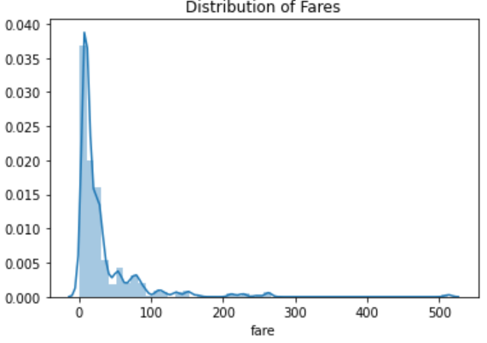
Method 2: Data Point is Visually Separated on Plot
Ex. distribution of passenger fares in the Titanic dataset:
Also introduces subjective bias
Also can have ambiguity
While you could reasonably assume the points above 500 are outliers, what about the points between 200 and 300?

Slide 55
Method 3: Using Statistical Tests
Common tests: Peirce’s Criterion, Chauvenet’s Criterion, IQR rule
Ex. the IQR rule applied to Titanic passenger fares:
The IQR rule states that any fare lower than the q1 - 1.5 * IQR or larger than q3 + 1.5 * IQR is an outlier.
More objective than previous tests
Still relies on data scientists to make appropriate choice of test to apply

Slide 56
Additional Notes
It is not always advantageous to remove outliers. If a work is very critical, such as studying the relationship between temperatures and airplane engine failures, removing outliers would be inappropriate.
Make sure that outliers removed are sparse; if there are many outliers with similar values, that may hint at some underlying true pattern in the data.
In addition to the methods we’ve listed, there exists another way to determine outliers with Orthogonal Matching Pursuit (OMP) that is out of scope for this project.

Slide 57
Image Data Augmentation

Slide 58
Motivation
Increase the effective size of our training dataset by introducing variations of existing samples
Allow trained model to become more robust to the test and deploy environment

Slide 59

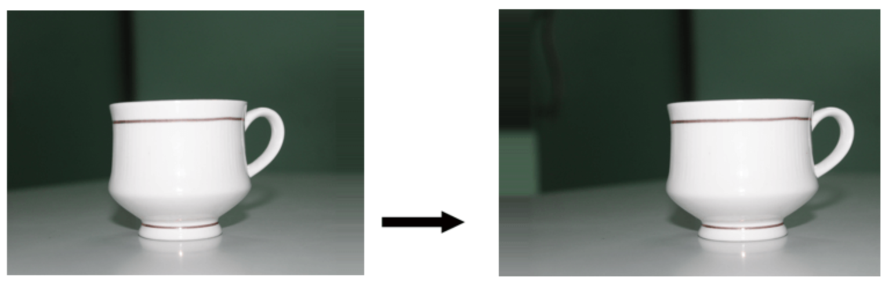
Horizontal and Vertical Shifting
Shifting involves moving the focus of the image up or down, left or right by some number of pixels.
Ex. Vertical shift
Ex. Horizontal shift

Slide 60
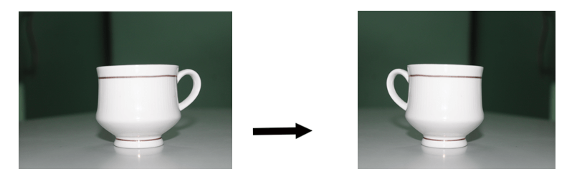

Horizontal and Vertical Flipping
Flipping reflects the image across either axis.
Ex. Horizontal flip
Ex. Vertical flip

Slide 61

Random Rotating
Rotation involves rotating the image at a random angle
Ex. Random rotation

Slide 62
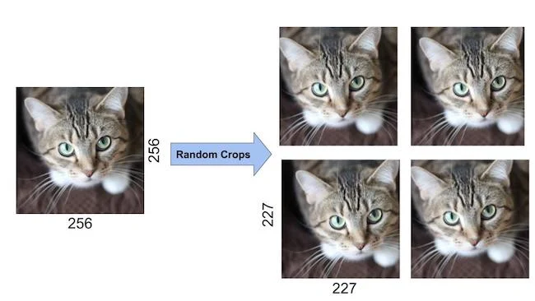
Random Cropping
Cropping involves taking a smaller random crop of the original image.
Ex. Random cropping

Slide 63

Random Brightness
Random brightness involves altering the intensities of the RGB channels in the training images. The exact algorithm involves PCA and is described in the Alexnet paper (2012).
Ex. Random brightness

Slide 64
Standard practices (Common transforms)
Standard practice for image data augmentation is as follows:
Scale resolution down to 256 x 256
Take a random 224 x 224 crop (alternatively, consistently take crops of corners and center)
Generate horizontal flip
Perform brightness augmentation (optional)

Slide 65
Standard practices (How it is applied)
Augmentation is usually performed at the dataloader step.
Training pipeline requests a batch of images during an epoch
Dataloader grabs a batch of raw images from the saved folder of training / val data
Dataloader applies transforms (perhaps with random factors) onto batch of raw images
Dataloader sends transformed images as input into model

Slide 66
Data Decorrelation and Whitening

Slide 67
Correlation in Data
The concept of a correlation matrix for our data matrix should be familiar since this was part of teaching SVD and PCA in EE16B
In general, we would like for our data to have uncorrelated features:
Uncorrelated features makes the optimization of Neural Networks more efficient
Correlations in data potentially means that there is redundant information which means that we can compress our data
Our discussion of decorrelation and later whitening will depend heavily on the PCA/SVD topics discussed in class, so if you are unfamiliar, we recommend brushing up with those topics

Slide 68

Decorrelating Data
To decorrelate data, it means to remove the any correlations between different features in the data
We decorrelate data by zero meaning the features and multiplying by the U matrix that we get from the SVD
This allows us to get a data matrix that has a diagonal correlation

Slide 69
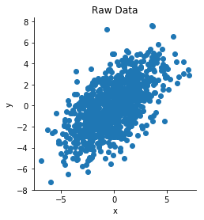
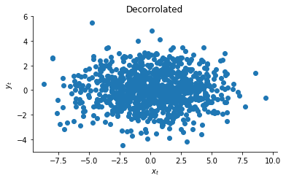
Decorrolated Data Example
As we can see, after decorrelating the data, the features are now independent of each other

Slide 70
Whitening Data
Whitening is a linear transformation used to both decorrelate different features and set the variances of different features to be identical
This names comes from the term “white noise”
In our case, it means that we wish for the covariance matrix of the data to be the identity matrix rather than just diagonal
We can accomplish this by simply scaling each feature by the singular values:
This also known as PCA Whitening

Slide 71
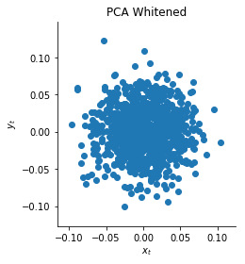
PCA Whitening example
As we can see, PCA whitening lets us transform the data into a spherical blob of data

Slide 72

ZCA Whitening
One thing of note is that the linear transformation by PCA whitening is not unique: any rotation matrix applied on top of the rotation matrix maintain a identity as the covariance
In Zero-Phase Component Analysis (ZCA) whitening, we decide to choose the matrix U as our rotation matrix:

Slide 73
PCA whitening vs. ZCA whitening
PCA whitening is ideal if your goal is to try and compress the data after applying whitening
You can always just keep the top k principal components, and you will still have identity as your covariance
ZCA whitening is ideal if you want the transformed random vector to be as similar as possible to the original vector
See source for the exact proof which we will leave out here

Slide 74
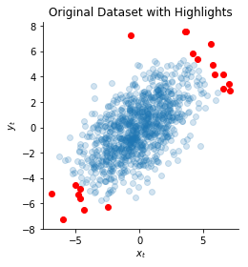
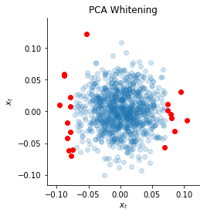
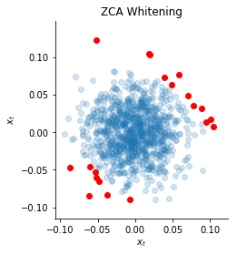
PCA vs ZCA Whitening
The orientation of the data is loosely preserved with ZCA

Slide 75
Remarks
Avoid the common pitfall of not applying the transformations from the training set to the test set when testing
The effect of whitening can be substantial on neural networks, but it really depends on the specific optimizer
Whitening is not commonly used in Convnets, standardizing and zero-mean is more common
See this source for more about gradient descent

