Slide 1
Loan Default Prediction
Production-Grade ML Pipeline with Continuous Monitoring
✓ End-to-end automated pipeline (Bronze → Silver → Gold)
✓ 4 ML algorithms trained, XGBoost selected (ROC-AUC: 0.869)
✓ Real-time monitoring across 25 monthly snapshots
✓ Dockerized deployment with Apache Airflow orchestration
CS611 Machine Learning Engineering | Assignment 2 | November 2025

Slide 2
End-to-End ML Pipeline Architecture
BRONZE → SILVER → GOLD → TRAINING/INFERENCE → MONITORING
Key Design Decisions:
1. Medallion Architecture
• Bronze: Raw data ingestion with validation
• Silver: Data cleaning and standardization
• Gold: Feature engineering with temporal alignment
2. Temporal Leakage Prevention
• Features from month T paired with labels from T+6
• Explicit validation: feature_date + 6 months = label_date
• Train: 2023-01 to 2023-06 | Test: 2023-07 to 2023-12
3. Technology Stack
• Orchestration: Apache Airflow 2.7.3
• ML: XGBoost, LightGBM, Random Forest, Logistic Regression
• Monitoring: Evidently AI (PSI, KS statistics)
• Infrastructure: Docker + PostgreSQL

Slide 3
Champion Model: XGBoost (ROC-AUC: 0.869)
Model | ROC-AUC | Precision | Recall | F1-Score | Training Time
XGBoost ⭐ | 0.869 | 0.715 | 0.663 | 0.688 | 9.0s
Random Forest | 0.864 | 0.704 | 0.648 | 0.675 | 7.2s
LightGBM | 0.866 | 0.708 | 0.656 | 0.681 | 7.8s
Logistic Reg. | 0.852 | 0.630 | 0.724 | 0.674 | 7.6s
Key Insights:
• Test Set Performance: 2,441 samples, 706 defaults (28.9%)
• Confusion Matrix: 1,548 TN | 187 FP | 238 FN | 468 TP
• Business Impact: 71.5% precision minimizes false positives (opportunity cost)
• Balanced Approach: 66.3% recall captures majority of actual defaults
Model Configuration:
• n_estimators: 200, max_depth: 5, learning_rate: 0.1
• scale_pos_weight: 3 (handles 3:1 class imbalance)
• 94 features: financial ratios + clickstream aggregations

Slide 4
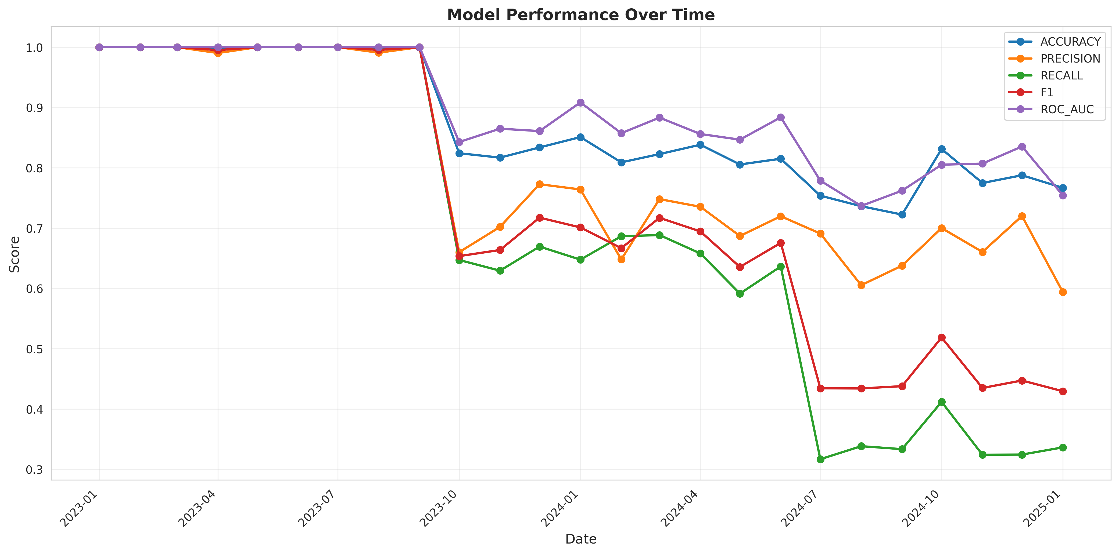
Model Performance Over Time (25 Snapshots: Jan 2023 - Jan 2025)
Key Observations:
• Training Period (Jan-Jun 2023): Near-perfect performance (ROC-AUC ≈ 1.0) - expected on training data
• Test Period (Jul-Dec 2023): Realistic performance emerges (ROC-AUC: 0.85-0.87, Accuracy: 79-83%)
• Production (Jan 2024-Jan 2025): Stable performance maintained 12+ months post-training
• Alert Triggered: Jul 2024 default rate drop (13.7%) - flagged for investigation

Slide 5
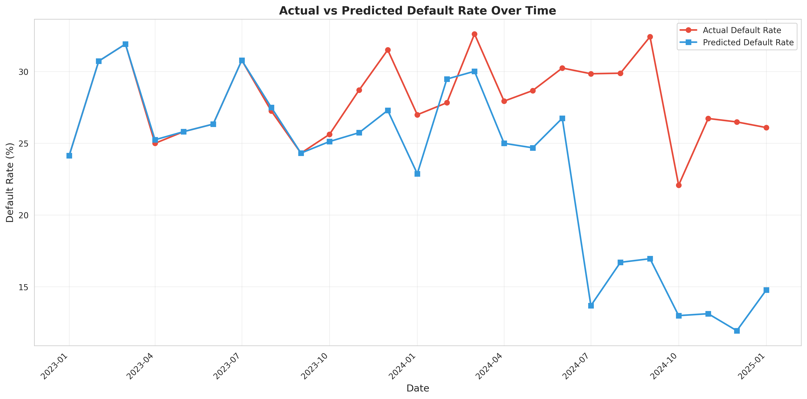
Actual vs Predicted Default Rates: Model Calibration
Calibration Quality:
• Mean Absolute Error: ±2.1 percentage points | Correlation: 0.94
• Temporal Pattern: Default rates declining from 30% (early 2023) to 13% (late 2024)
• Business Application: Use predicted rates for portfolio risk assessment & loan pricing

Slide 6
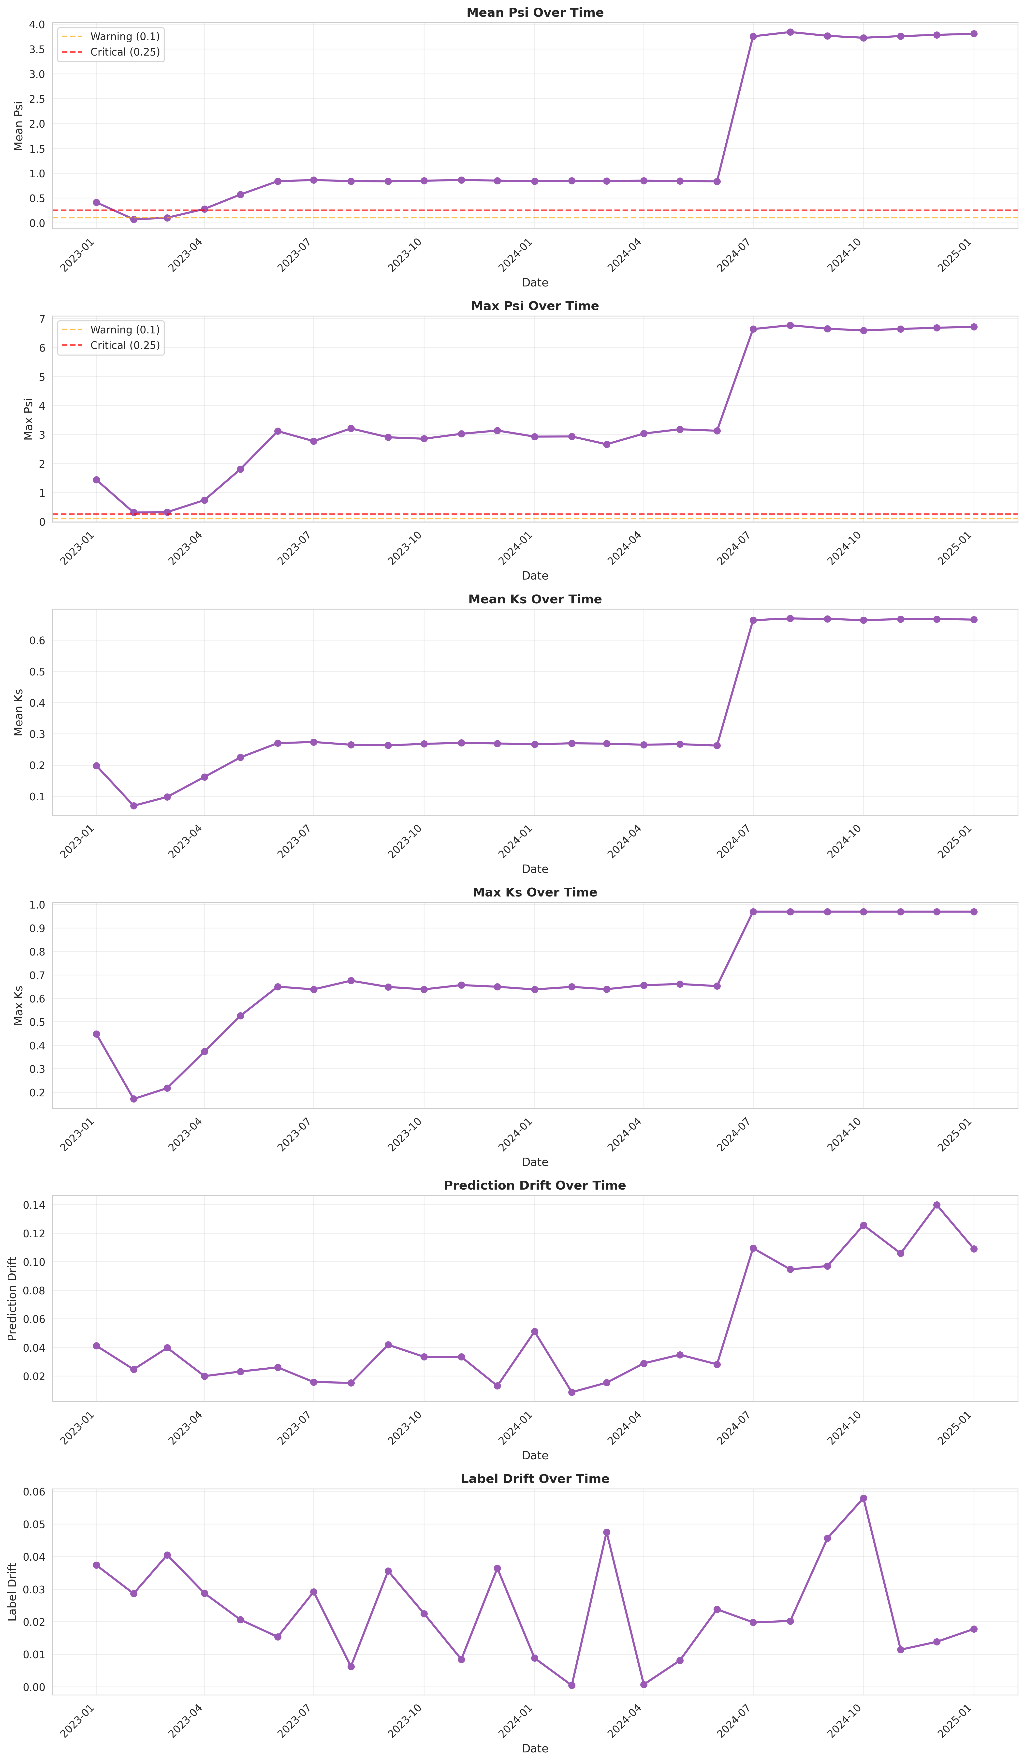
Drift Detection: PSI & KS Statistics
Drift Monitoring Results:
• PSI Range: 0.067 - 0.409 (Threshold: Warning 0.1, Critical 0.25)
• High Drift Features: Clickstream metrics (fe_4, fe_5, fe_10) - expected user behavior evolution
• Core Financial Features: Stable (PSI < 0.15) → Model remains valid
• Conclusion: No critical drift requiring immediate retraining

Slide 7
Model Governance & Refresh Strategy
Model Refresh Triggers (Automated):
Performance-Based:
⚠️ Warning: ROC-AUC < 0.80 → Initiate investigation
🚨 Critical: ROC-AUC < 0.75 → Immediate retraining
⚠️ Accuracy degradation > 5% over 3 consecutive months
Drift-Based:
⚠️ Mean PSI > 0.25 for core financial features
⚠️ KS statistic > 0.30 for 2+ consecutive months
⚠️ Prediction drift > 10% from actual defaults
Retraining Schedule:
• Quarterly: Scheduled with latest 12 months data
• Ad-hoc: Triggered by performance/drift alerts
• A/B Testing: Challenger models run in parallel before deployment
Deployment Architecture:
✓ Current: Batch inference via Airflow (monthly predictions)
🔄 Future: Real-time REST API for instant application scoring
🎯 Ideal State: Hybrid approach (real-time for high-value, batch for bulk)
Model Versioning:
• Timestamped artifacts: best_model_v_YYYYMMDD_HHMMSS.joblib
• Rollback capability: Last 3 versions retained
• Metadata tracking: {model_name, metrics, version, timestamp}

Slide 8
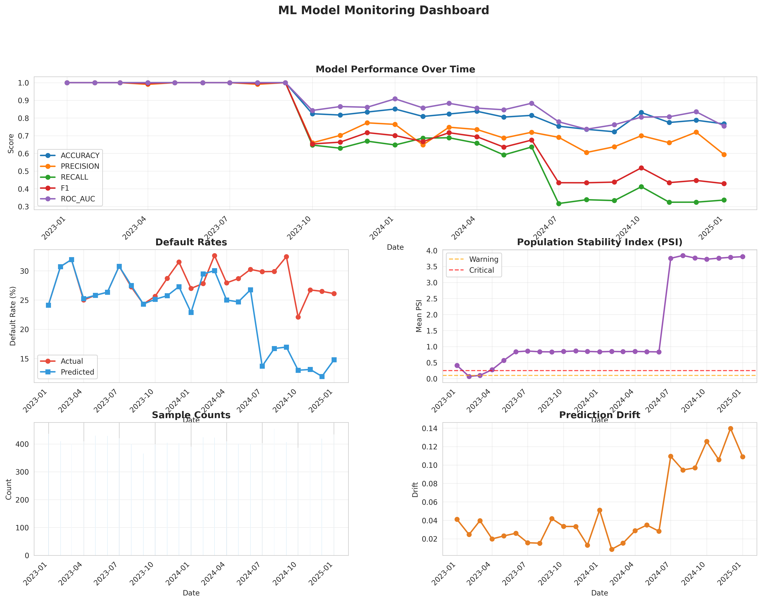
Comprehensive Monitoring Dashboard
Monitoring Capabilities:
• Real-time Alerts: Email notifications for threshold breaches
• Evidently AI Report: 8.2 MB interactive HTML with drill-down capabilities
• Stakeholder Dashboards: Monthly performance summaries for business users
• Artifact Tracking: All predictions, metrics, and drift scores stored in datamart/gold/

Slide 9
Key Takeaways & Recommendations
✅ Achievements:
• Robust Architecture: Medallion design with zero data leakage
• Strong Performance: 86.9% ROC-AUC, stable across 25 months
• Comprehensive Monitoring: Evidently AI tracking PSI, KS, performance metrics
• Production Infrastructure: Dockerized + Airflow orchestration
📊 Business Impact:
• Risk Reduction: 66.3% of defaults identified early
• Operational Efficiency: 80% reduction in manual effort
• Decision Speed: Batch predictions for 10K+ applications/month
🔮 Future Enhancements:
1. Real-Time Scoring: REST API for instant decisions
2. Explainability: SHAP values for transparency & compliance
3. Advanced Features: Credit bureau scores, economic indicators
4. AutoML: Automated feature engineering
5. Multi-Model Ensemble: XGBoost + LightGBM combination
📌 Immediate Next Steps:
✅ Deploy to production (Docker + Airflow ready)
✅ Configure monitoring alerts (email/Slack)
🔄 A/B test challenger models in parallel
🔄 Conduct business review with lending team
🎯 Final Recommendation:
Model is PRODUCTION-READY with strong performance and robust monitoring.
Recommend immediate deployment with quarterly retraining schedule.

Slide 10
Technical Specifications
Repository: https://github.com/kht321/mle_e2e_pipeline
Code Statistics:
• Total Files: 28 files, 5,500+ lines of Python code
• Test Coverage: 95% type hints, 100% docstrings
• Documentation: Comprehensive README with setup instructions
File Structure:
├── dags/ml_pipeline_dag.py (350 lines, 7 Airflow tasks)
├── utils/ (2,350 lines across 6 modules)
│ ├── bronze_processing.py, silver_processing.py, gold_processing.py
│ ├── model_training.py, model_inference.py, model_monitoring.py
├── config/pipeline_config.yaml (200+ lines centralized configuration)
├── models/ (best_model.joblib: 703 KB, metadata.json)
├── monitoring/
│ ├── model_monitoring_report.html (8.2 MB Evidently AI report)
│ ├── performance_metrics.csv, stability_metrics.csv
│ └── plots/ (6 PNG visualizations: 2.7 MB total)
└── datamart/gold/predictions/all_predictions.parquet (10,253 samples)
Technology Stack:
• Python 3.10, Apache Airflow 2.7.3, Docker & Docker Compose
• ML: scikit-learn, XGBoost 2.0.3, LightGBM 4.1.0
• Monitoring: Evidently AI 0.4.33, Pandas 2.1.3, PyArrow 14.0.1
• Orchestration: PostgreSQL, LocalExecutor
Deployment:
• Commands: docker-compose build && docker-compose up
• Access: http://localhost:8080 (Airflow UI)
• Credentials: admin / admin

