Slide 1
Web Service Defined
Web Service is programable application logic accessible using standard Internet Protocol.
Web Service represent a black-box functionality that can be reuse without worry about how the service is implement

Slide 2
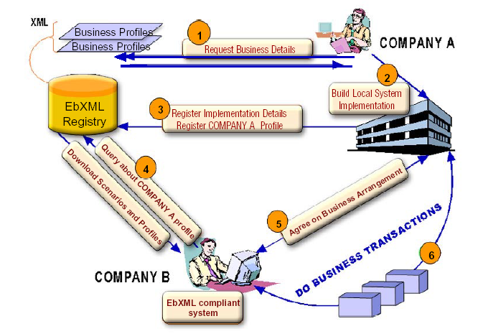
Example of Web Service

Slide 3
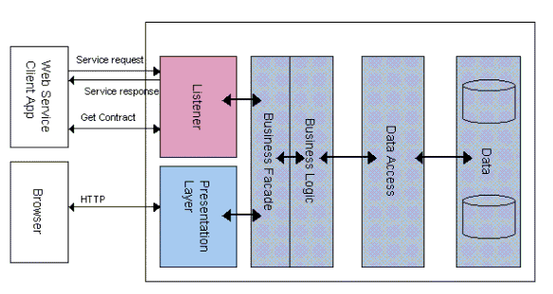
Service Request & Response

Slide 4
Fundamental of Technology
Object-Orented Concept
Distributed computing
Electronic Data Interchange
Enterprise application integration
Application Service Provider
Data Mining

Slide 5
Basic Concept
Web Service based on SOA
“Service-Oriented Architecture”
has 3 component
Service provider
Service requester
Service broker

Slide 6
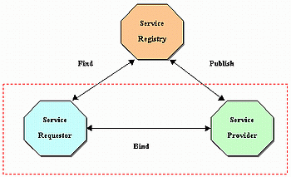
Service-Oriented Architecture

Slide 7
The Web Services Platform
The basic platform is XML plus HTTP.
HTTP is a ubiquitous protocol, running practically everywhere on the Internet.
XML provides a metalanguage in which you can write specialized languages.

Slide 8
Development Technologies
XML (The Extensible Markup Language)
SOAP(Simple Object Access Protocol)
WSDL(Web Service Description Language)
UDDI (Universal Description, Discovery and Integration Service)

Slide 9
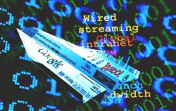
What is XML?
XML is a syntax that allows users to create markup languages.
XML is a technical recommendation from the W3C.
XML is easy to learn and use.
XML is also free.

Slide 10
XML Syntax
An XML document can be either
The Well-Formed XML Document
The Valid XML Document

Slide 11
Examples of Well-Formed XML Documents
<?xml version="1.0"?> <Joke author="Groucho Marx">
<Setup>Outside of a dog, a book is man's best friend.</Setup>
<Punchline>Inside of a dog, it's too dark to read.</Punchline>
</Joke>

Slide 12
Examples of Valid
XML Documents
<?xml version="1.0"?> <!TYPE Joke SYSTEM "Joke.dtd"> <Joke author="Groucho Marx">
<Setup>Outside of a dog, a book is man's best friend</Setup>
<Punchline>Inside of a dog, it's too dark to
read.</Punchline>
</Joke>

Slide 13
Namespaces
Namespaces have two basic purposes:
to enable the sharing of schema structures and datatypes
to uniquely qualify element names in a multischema environment.

Slide 14
Document Type Definition
A DTD are defined as templates for or a specification of files of a specific extensible markup language.
The DTD is used for validation of the XML files and they specify which elements are allowed in different contexts, how many times every element can or must occur and which data types are allowed for specific elements

Slide 15
Examples of DTD
<!ELEMENT Joke (Setup, Punchline) >
<!ATTLIST Joke author CDATA #REQUIRED firstTold CDATA #IMPLIED >
<!ELEMENT Setup (#PCDATA) >
<!ELEMENT Punchline (#PCDATA) >

Slide 16
Limit the DTD's applicability
DTD is not written using XML syntax.
DTD has just a single useful data type: TEXT.
DTD is that a document can have only one document type to describe the entire document, making it fairly inflexible.

Slide 17
Schemas
W3C XML Schema Working Group is
focusing on three improvement areas:
  want to see schemas written using XML syntax
  want the new schema standard to support
  common data types
  want the XML Schema to have open content models.

Slide 18
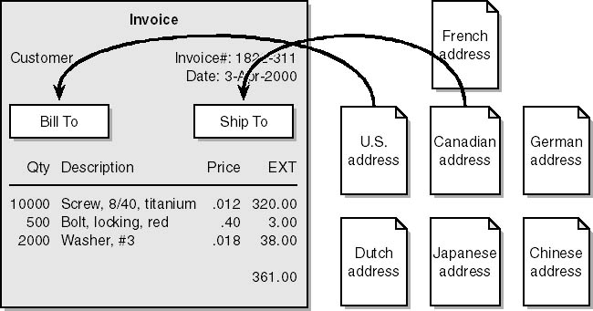
A business document can include other documentswhich has a different way of specifying physical address information.

Slide 19
XML Paser
XML paser(XML Processors) is used to read XML documents and provide access to their content and structure.
  Validating &non-validating processors
  DOM & SAX processsors

Slide 20
DOM
(Document Object Modeling)
Tree-based APIs map an XML document into an internal tree structure, then allow an application to navigate that tree.

Slide 21
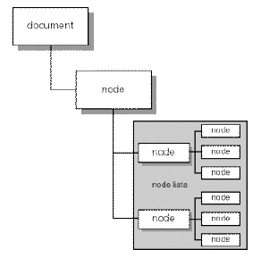
Hierachy of tree DOM
Document Object
Node Object
Node List Object
Parser Error

Slide 22
Examples DOM for XML
<Name>
<First> Ichitaka </First>
<Last> Seto </Last>
</Name>
Document
Name
Root Element
First
Last
Child Element

Slide 23
SAX
(Simple API for XML)
Event-driven APIs reports parsing events directly to the application through callbacks, and generally do not build an internal tree.
The application implements handlers to deal with the different events, much like handling events in a graphical user interface.

Slide 24
Example SAX
→ start document
<Name> → start element Name
<First> → start element First
Ichitaka → character Ichitaka
</First> → end element First
<Last> → start element Last
Seto → character Seto
</Last> → end element Last
</Name> → end element Name
→ end document

Slide 25
DOM
useful in a wide range of applications
can put a hefty strain on system resources
application is document-centric
parse very large documents which may not fit into memory
Easy access to element & coding
SAX

Slide 26
XSL
( Extensible Style Language )
It is the language used to transform or make a
format for the document XML.
Transforming means changing of the document
XML from one particular format to another.
We can use XSL to transform XML document
in order for it to show the results in HTML or XML
format.

Slide 27
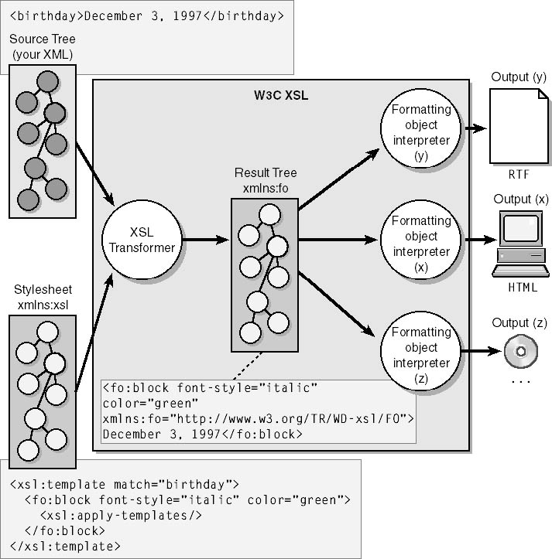
XSL works

Slide 28
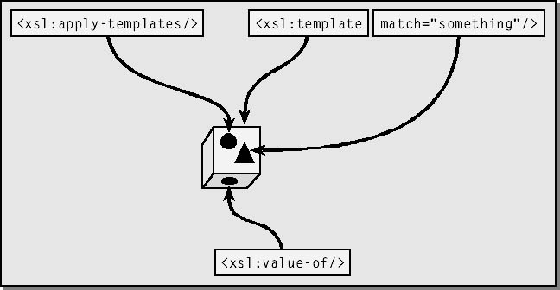
XSLT work

Slide 29
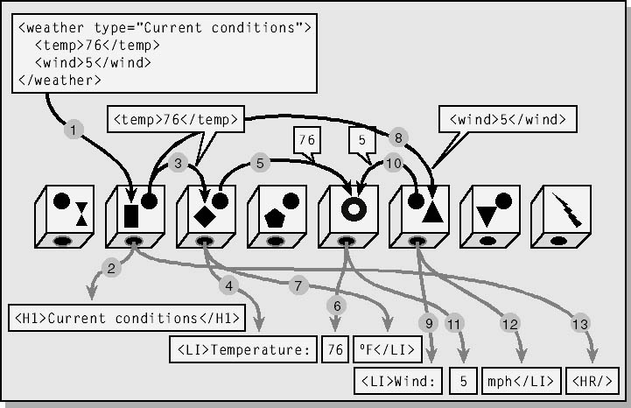
XSLT work

Slide 30

SOAP
(Simple Object Access Protocol)
SOAP provides a simple and lightweight mechanism for exchanging structured and typed information between peers in a decentralized, distributed environment using XML.

Slide 31
SOAP consists of 3 parts:
The SOAP envelope construct defines an overall framework for expressing what is in a message; who should deal with it.
The SOAP encoding rules defines a serialization mechanism that can be used to exchange instances of application-defined datatypes.
The SOAP RPC representation defines a convention that can be used to represent remote procedure calls and responses.

Slide 32
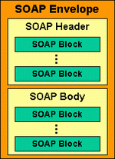
SOAP Message
SOAP Envelope is the top element of the XML document representing the message.
SOAP Header is a generic mechanism for adding features to a SOAP message
SOAP Body is a container for mandatory information intended of the message.

Slide 33
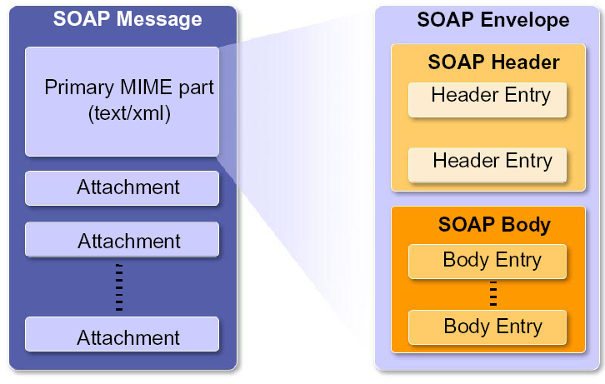
SOAP Message Format

Slide 34
Example 1 SOAP Message Embedded in
HTTP Request
POST /StockQuote HTTP/1.1
Host: www.stockquoteserver.com
Content-Type: text/xml; charset="utf-8"
Content-Length: nnnn
SOAPAction: "Some-URI"
<SOAP-ENV:Envelope
xmlns:SOAP-ENV="http://schemas.xmlsoap.org/soap/envelope/"
SOAP-ENV:encodingStyle="http://schemas.xmlsoap.org/soap/encoding/">
<SOAP-ENV:Body>
<m:GetLastTradePrice xmlns:m="Some-URI">
<symbol>DIS</symbol>
</m:GetLastTradePrice>
</SOAP-ENV:Body>
</SOAP-ENV:Envelope>

Slide 35
Example 2 SOAP Message Embedded in
HTTP Response
HTTP/1.1 200 OK
Content-Type: text/xml; charset="utf-8“
Content-Length: nnnn
<SOAP-ENV:Envelope
xmlns:SOAP-ENV="http://schemas.xmlsoap.org/soap/envelope/"
SOAP-ENV:encodingStyle="http://schemas.xmlsoap.org/
soap/encoding/"/>
<SOAP-ENV:Body>
<m:GetLastTradePriceResponse xmlns:m=
"Some-URI">
<Price>34.5</Price>
</m:GetLastTradePriceResponse>
</SOAP-ENV:Body>
</SOAP-ENV:Envelope>

Slide 36
SOAP Encoding
The SOAP encoding style is based on a simple type
system that is a generalization of the common
features found in type systems in programming
languages, databases and semi-structured data.
given a schema in any notation consistent with the type system described, a schema for an XML grammar may be constructed.
given a type-system schema and a particular graph of values conforming to that schema

Slide 37
SOAP Encoding
Rules of expressing application-defined data types in XML
Based on W3C XML Schema
Simple values
– Built-in types from XML Schema, Part 2
(simple types, enumerations, arrays of bytes)
Compound values
– Structs, arrays, complex types

Slide 38
The SOAP Message
Exchange Model
A SOAP application receiving a SOAP message MUST process that message by performing the following actions in the order listed below:
Identify all parts of the SOAP message intended for that application

Slide 39
The SOAP Message
Exchange Model(cont.)
2. Verify that all mandatory parts identified in step 1 are supported by the application for this message and process them accordingly. If this is not the case then discard the. The processor MAY ignore optional parts identified in step 1 without affecting the outcome of the processing.
3. If the SOAP application is not the ultimate destination of the message then remove all parts identified in step 1 before forwarding the message.

Slide 40
Using SOAP in HTTP
SOAP naturally follows the HTTP request/response message model providing SOAP request parameters in a HTTP request and SOAP response parameters in a HTTP response.
Note, however, that SOAP intermediaries are NOT the same as HTTP intermediaries.

Slide 41
SOAP HTTP Request
SOAPAction HTTP request header field can
be used to indicate the intent of the SOAP
HTTP request.
soapaction = "SOAPAction" ":" [ <"> URI-reference <"> ]
soapaction = SOAPAction: “http://electorcommerce.org/abc#Mymessage”

Slide 42
SOAP HTTP Response
SOAP HTTP follows the semantics of the HTTP
Status codes for communicating status information
in HTTP.
For example, a 2xx status code indicates that theclient's
request including the SOAP component was successfully
received, understood, and accepted etc.

Slide 43
Example 3 SOAP HTTP Using POST
POST /StockQuote HTTP/1.1
Content-Type: text/xml; charset="utf-8"
Content-Length: nnnn
SOAPAction: "http://electrocommerce.org/abc#MyMessage"
<SOAP-ENV:Envelope...
HTTP/1.1 200 OK
Content-Type: text/xml; charset="utf-8"
Content-Length: nnnn
<SOAP-ENV:Envelope...

Slide 44
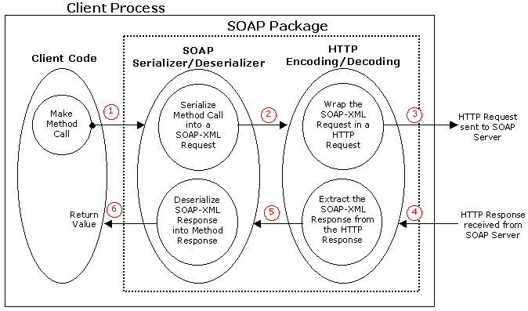
Client Process

Slide 45
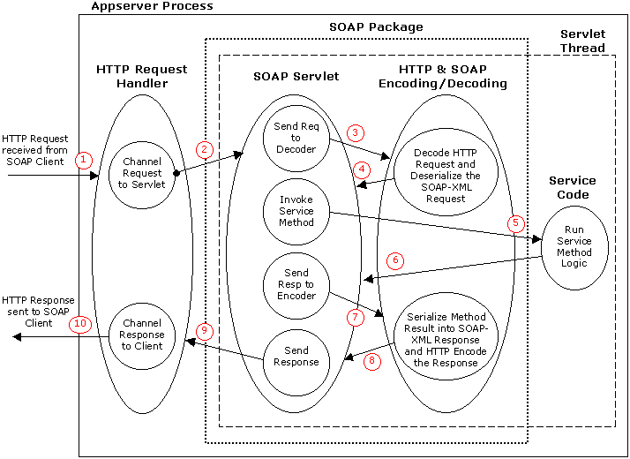
Server Process

Slide 46
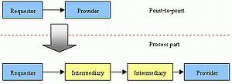
SOAP Intermediaries
Crossing trust domains
Extend service on Distributed System
Value-added for System

Slide 47
Using SOAP for RPC
One of the design goals of SOAP is to encapsulate and exchange RPC calls using the extensibility and flexibility of XML. This section defines a uniform representation of remote procedure calls and responses.

Slide 48
Using SOAP for RPC
Using SOAP for RPC is orthogonal to the SOAP protocol binding
an RPC call maps naturally to an HTTP request and an RPC response maps to an HTTP response.

Slide 49
SOAP RPC Request Example
<SOAP-ENV:Envelope
xmlns:SOAP-ENV="…"
SOAP-ENV:encodingStyle="…">
<SOAP-ENV:Header>
<!-- Optional context information -->
</SOAP-ENV:Header>
<SOAP-ENV:Body>
<m:GetLastTradePrice xmlns:m=“some_URI">
<tickerSymbol>SUNW</tickerSymbol>
</m:GetLastTradePrice>
</SOAP-ENV:Body>
</SOAP-ENV:Envelope>

Slide 50
SOAP RPC Response Example
<SOAP-ENV:Envelope
xmlns:SOAP-ENV="…"
SOAP-ENV:encodingStyle="…">
<SOAP-ENV:Header>
<!-- Optional context information -->
</SOAP-ENV:Header>
<SOAP-ENV:Body>
<m:GetLastTradePriceResponse xmlns:m=“some_URI">
<price>30.5</price>
</m:GetLastTradePriceResponse>
</SOAP-ENV:Body>
</SOAP-ENV:Envelope>

Slide 51
SOAP RPC
Information needed for a method call:
The URI of the target object
<SOAP-ENV:Body>
<m:GetLastTradePrice
xmlns:m=“http://stocks.com/StockQuotes">
<tickerSymbol>SUNW</tickerSymbol>
</m:GetLastTradePrice>
</SOAP-ENV:Body>

Slide 52
SOAP RPC
Information needed for a method call:
The URI of the target object
Method name
<SOAP-ENV:Body>
<m:GetLastTradePrice
xmlns:m=“http://stocks.com/StockQuotes">
<tickerSymbol>SUNW</tickerSymbol>
</m:GetLastTradePrice>
</SOAP-ENV:Body>

Slide 53
SOAP RPC
Information needed for a method call:
The URI of the target object
Method name
Parameters
<SOAP-ENV:Body>
<m:GetLastTradePrice
xmlns:m=“http://stocks.com/StockQuotes">
<tickerSymbol>SUNW</tickerSymbol>
</m:GetLastTradePrice>
</SOAP-ENV:Body>

Slide 54
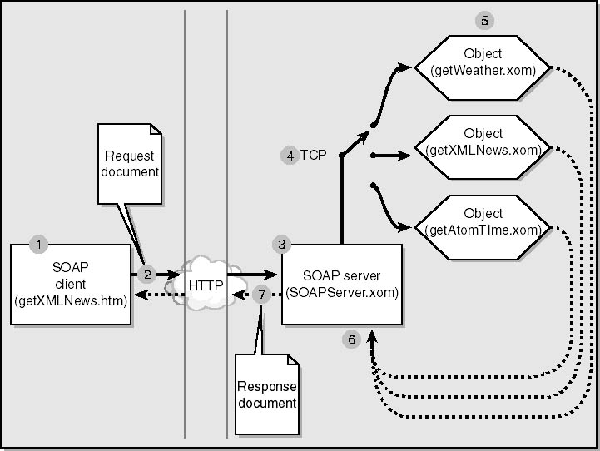
SOAP Client Application

Slide 55
WSDL
( Web Service Description Language )
Web Services Description Language is an XML-based
language used to define Web services and describe how
to access them. Example : Web Services Name , COM
component ’s method is published for services , parameter that is sent to method , type of parameter. These examples are all depended on XML syntax.

Slide 56
1.) Abstract Definitions Group
types consist of schema that define many difference formats which don not depend on any platforms and languages.
message is to explain every informations that are tranfered between Web Services providers and users in which each web methods has 2 messages : input and output.
portType consist of a set of abstract operations.
This operation is refer input message and output message.

Slide 57
2.) Concrete Descriptions Group
binding is to explain ptotocol consist of operations, input message , output message as a portType.
service consist with collection of ports that each port support a difference protocol.
also:
ports define address of binding and then to define single communicaton endpoint.
- operations a collection of related ports.

Slide 58
Abstract Definitions
Types
Reference
Modifier
Message
Containment
PortTypes
Operations
Containment
Bindings
Operations
Containment
Services
Ports
Concrete Definitions

Slide 59
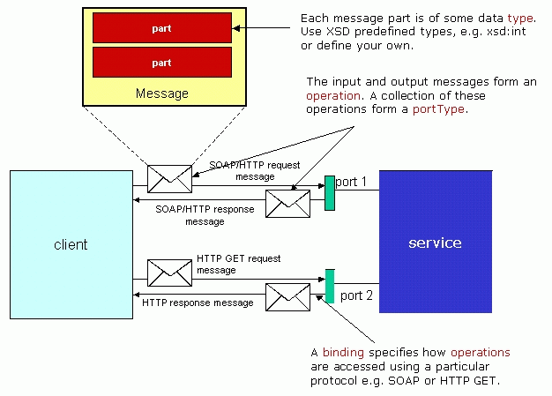
WSDL terminology used for descripting Web Services

Slide 60
UDDI (Universal Description Discovery and Integration)
is provide method for to built and find the detail
of Web Services. Which UDDI data entities are define
business and data of services. Service datas are defined
in WSDL is compiled into UDDI registry.
UDDI data types
1.) BusinessEntity
2.) BusinessService
3.) BindingTemplate
4.) tModel

Slide 61
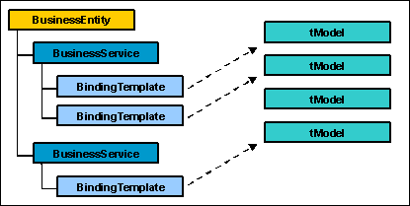
UDDI data types

Slide 62
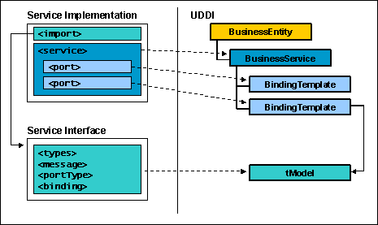
Overview of WSDL to UDDI mapping

Slide 63
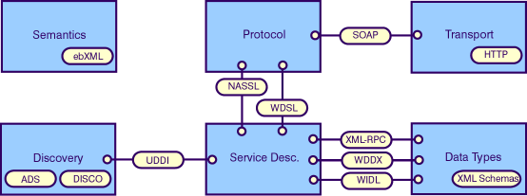
Service roles and interactions
SOAP - Simple Object Access Protocol
WIDL - WebMethods’ Web Interface Definition Language
UDDI - Universal Description Discovery and Integration
DISCO - Discovery of services
NASSL - Network Accessible Service Specification Language
ADS - Advertisement and Didcovery of Services

Slide 64
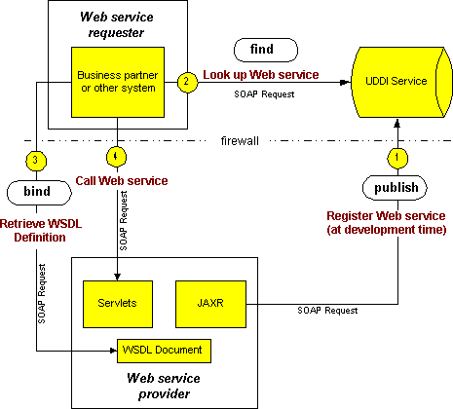
WSDL works on Java

