Slide 1
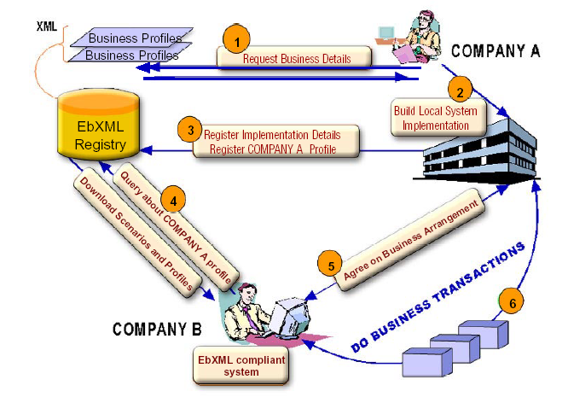
Embedded Web Service Development
โครงงานการพัฒนาเว็บเซอร์วิสบนระบบฝังตัว
อาจารย์ที่ปรึกษา
ผศ. อภิเนตร อูนากูล
อ. ดุสิต นิยะโต
ผู้จัดทำโครงงาน
นาย สุวิทย์ มัชคาม 42010411
นาย เอกราช อินนอก 42010452

Slide 2

Agenda
Overview
  Background
  Objective
  Goal
  Benefit
Scope of Project
  Related Technology
  Feature list
  Design
Progress

Slide 3


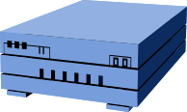
Managing Ubiquitous Device
Project Overview
Embedded Web Service
Device
16 bit device
Network
Management Station
PC based

Slide 4

Background
We want to message between application
SNMP (Simple Network
Management Protocol)
  Use Set and Get method
  Remote configuration & management
  Limited access
  Can’t be used to complicated method

Slide 5


Background
Telnet
  Technical knowledge
  Dependent device
TCP/IP Programming with socket
  Use Read and Write
  Complicate programming

Slide 6



Background
RPC (Remote Procedure Call)
  Distributed Object Framework
  Example DCOM,EJB or CORBA
  Not design for use with HTTP
  Proprietary Problem
  Not design for Embedded System

Slide 7


Background
SOAP (Simple Object
Access Protocol)
  Distributed Object Framework
  Open Standard Protocol
  Design for use with HTTP
  Use XML structure
  Can be used complicated method
  Messaging between application

Slide 8
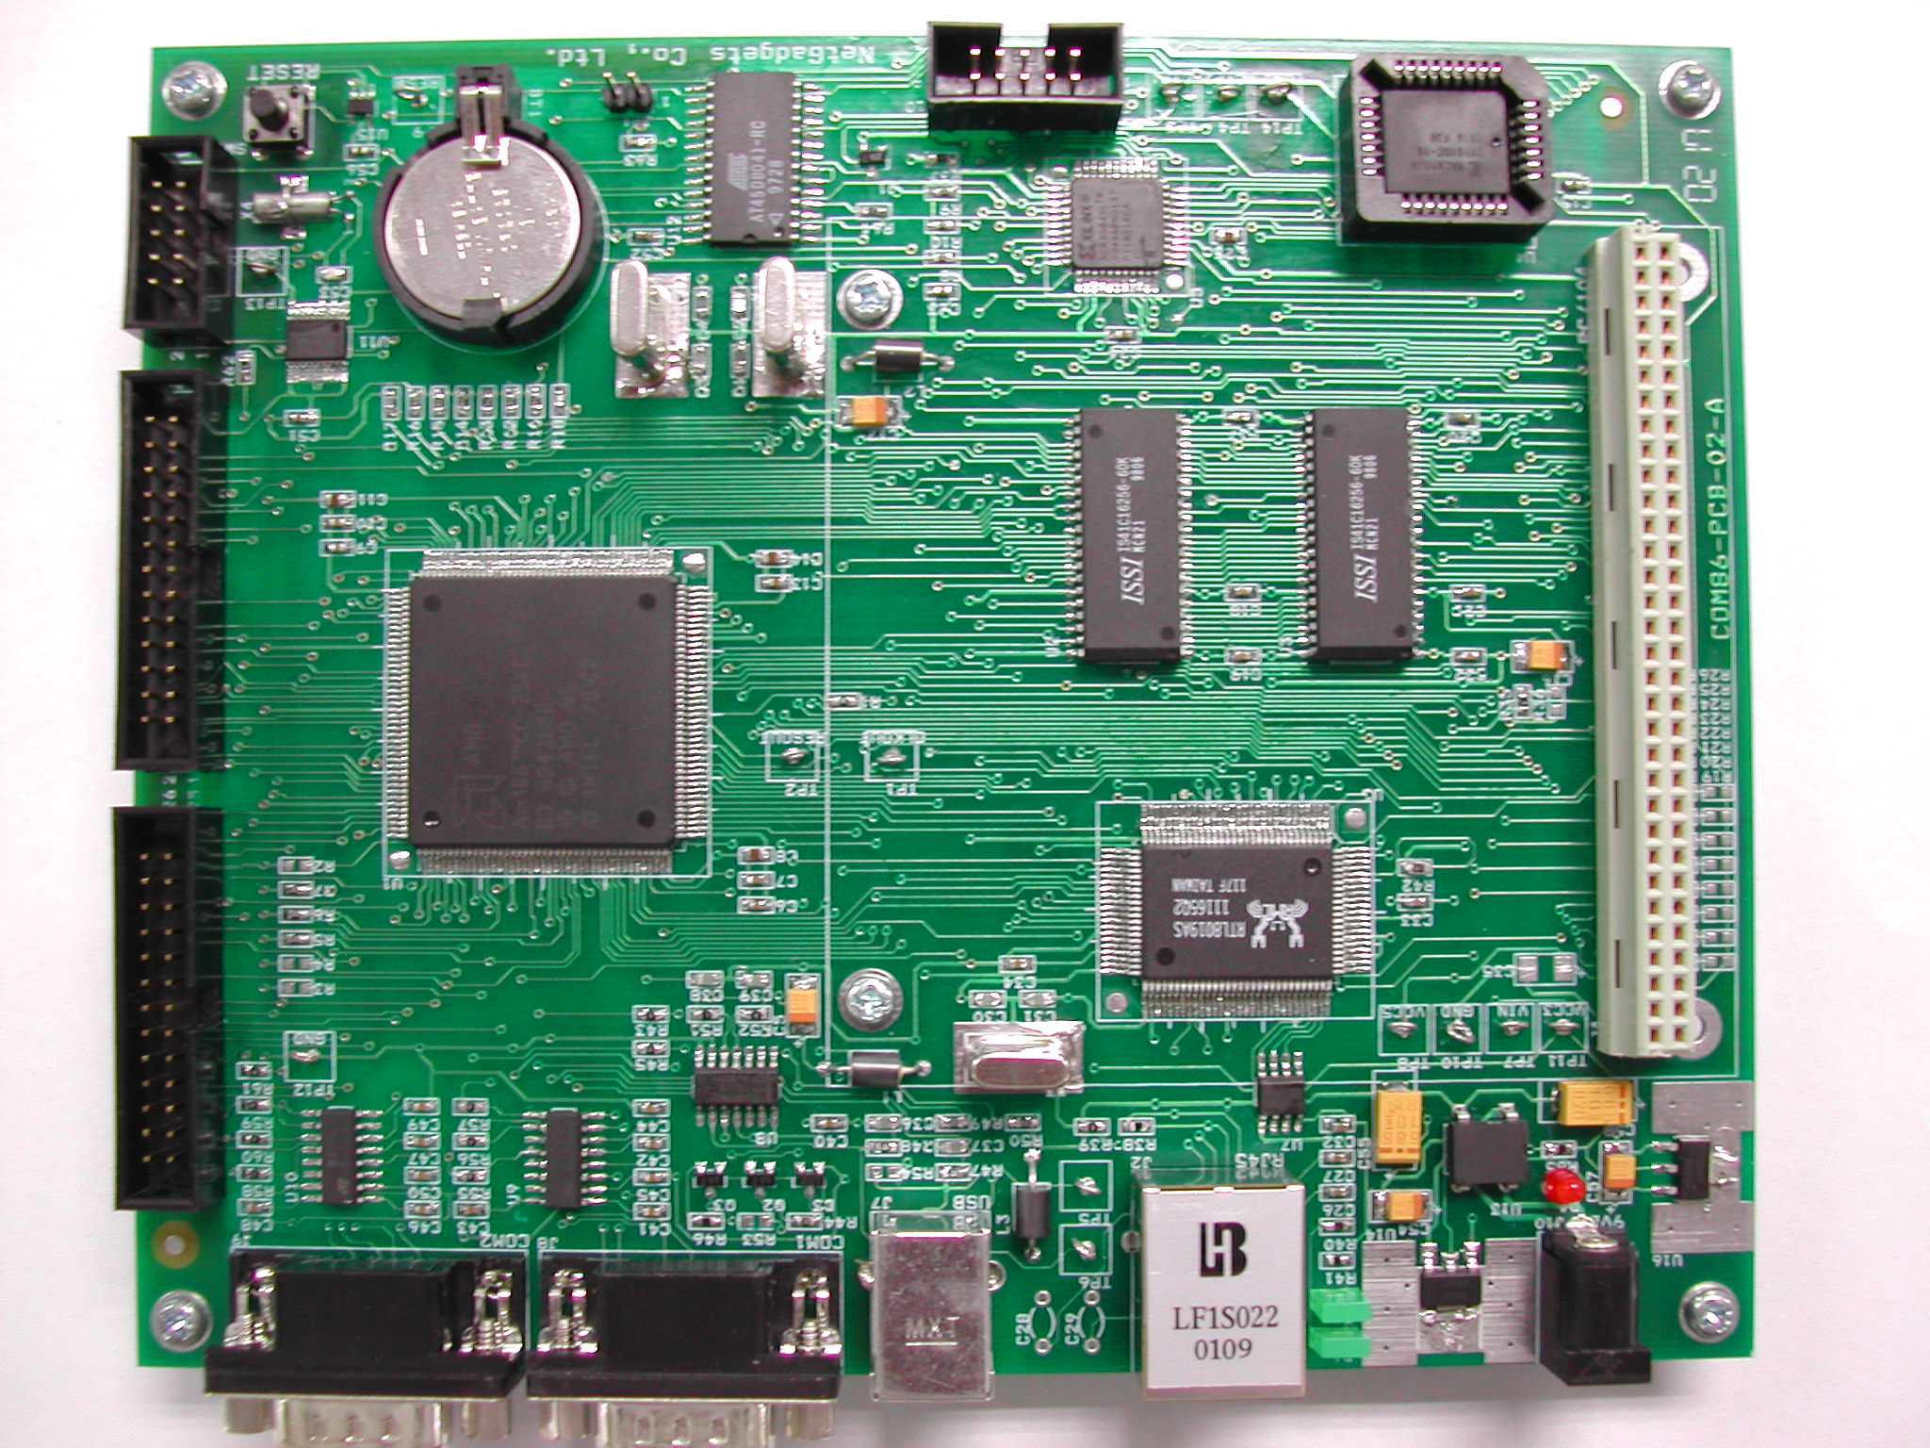
Background
Why Embedded?
COM86
  Environment in work
  Reduce Cost
  Support OS & TCP/IP Stack
  Support in Thailand
  Many interface to connect device

Slide 9



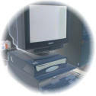

Background
RMI
Client
Server
CORBA
Database
Client
Server

Slide 10
Background
Client
Server
Database
Web Service
Client
Server

Slide 11


Objective
Developing and Testing Web Service
on Embedded System.
Developing Flexible Operation for
Embedded device with standard protocol.

Slide 12
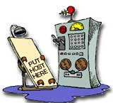

Goal
Embedded SOAP Library Package
Demo Application
  Server Application
  Client Application

Slide 13
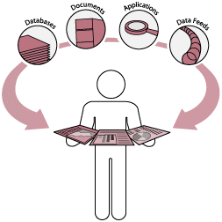

Benefit
Operation of Device
  Scalability
  Automatic
  Ubiquitous
Support ideal of Embedded Development
Understand in Operation
of Web Service

Slide 14
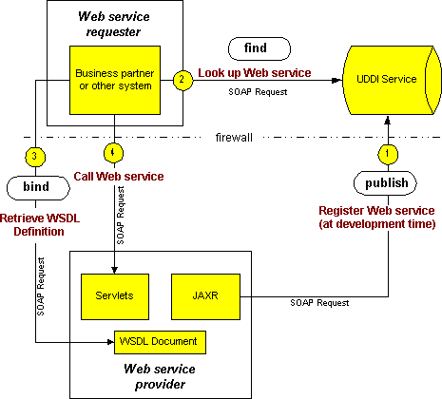
Web Service Overview

Slide 15

Related technology
XML (eXtensible Markup Language)
  is a syntax that allows users to create markup languages.
SOAP (Simple Object Access Protocol)
  provides a simple and lightweight mechanism for exchanging structured and typed information

Slide 16

Related technology
WSDL (Web Service Description Language)
  define Web services and describe how to access them.
UDDI (Universal Description, Discovery,
and Integration)
  is provide method for to built and find the detail of Web Services.
  business and data of services

Slide 17
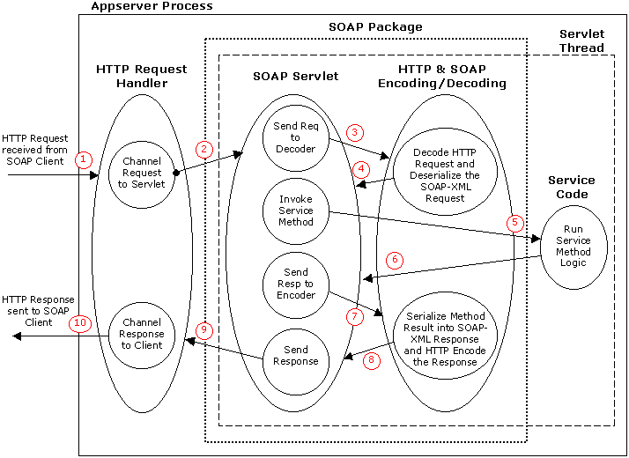
Server Process

Slide 18

Feature list
Server
Embedded SOAP Parser Library Package
  C++ Programming
  On COM86 Platform
    Operating System
    TCP/IP Stack
  Subset of Apache SOAP
    HTTP encoder/decoder
    SOAP serializer/deserializer

Slide 19

Feature list
Server
Demo Application (Server)
  C++ Programming
  On COM86 Platform
    Operating System
    TCP/IP Stack
  Define WSDL
  Publish to UDDI Registry

Slide 20
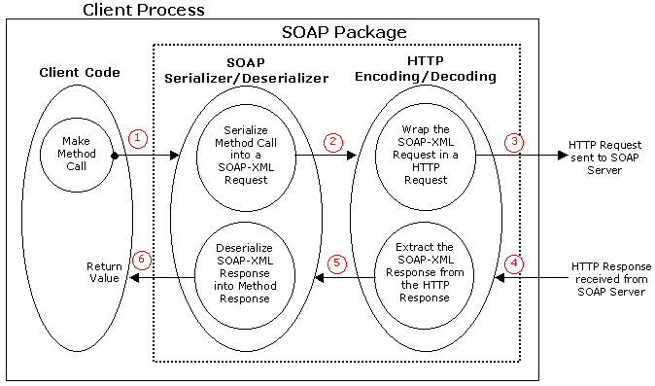
Client Process

Slide 21

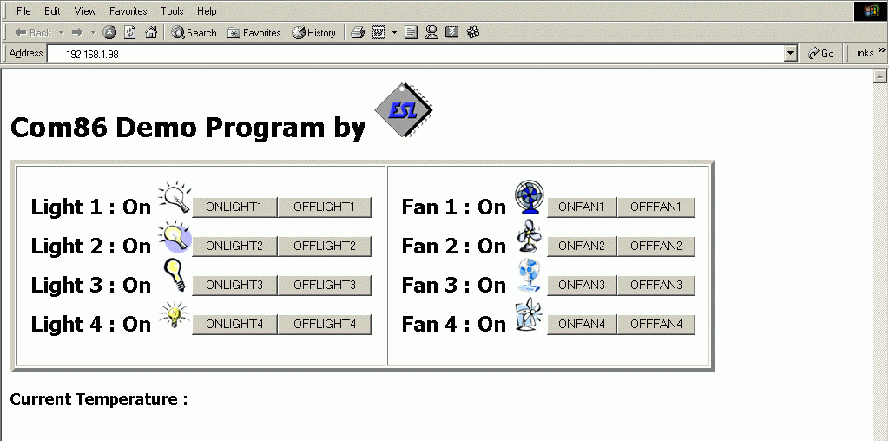
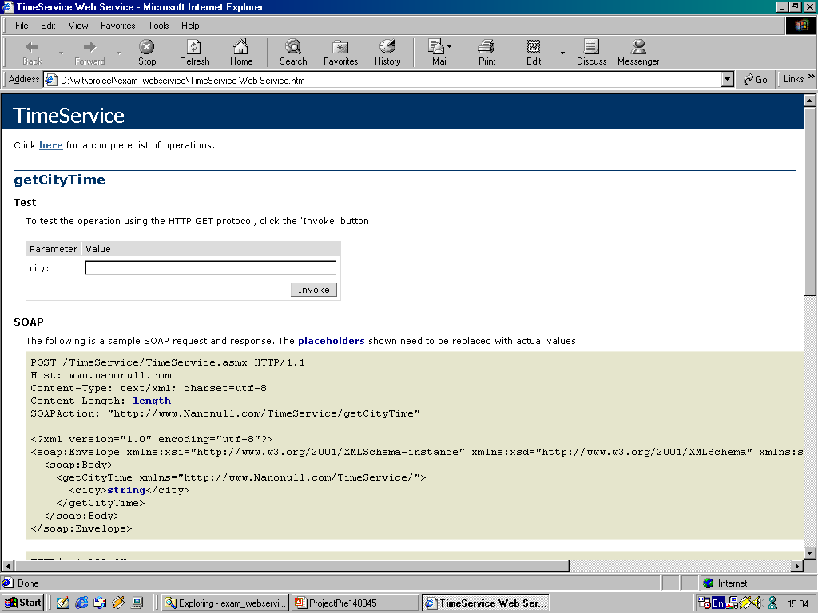
Feature list
Client
Demo Application (Client)
Web

Slide 22
Context Diagram
Server
Application
Client
Application
Call
Communication
Embedded
Web Service
Communication
UDDI
Registry

Slide 23


Use Case diagram
Publish
Web Service
Find
Web Service
Retrieve WSDL
Service Provider
Register
Application
Client User
Call
Web Service
Response

Slide 24
Structural
TCP/IP
Stack
Operating
System
Embedded
Web Service
Embedded
SOAP Parser
Library Package
Server
Application
HTTP
Encoder/
Decoder
SOAP
Serializer/
Deserializer

Slide 25
State chart Diagram
Request to
Wait for Request
HTTP Decode
Decode HTTP
HTTP Decode
Complete
Send HTTP Response
Complete
Detected Error
Deserialize SOAP
Create SOAP Fault
Send HTTP
Response
Deserialize
Request HTTP
Encode
Use Service
HTTP Encode
Complete
Result
Complete
Request HTTP
Serialize Result
Object
HTTP Encode
Encode

Slide 26
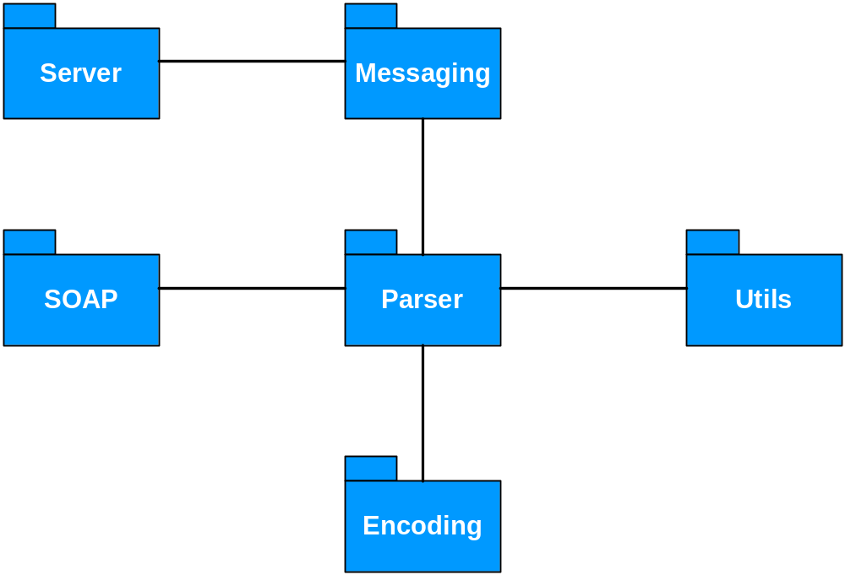
Package Library

Slide 27
Package Library
Embedded SOAP Paser Library Package
SOAP
Messaging
Encoding
Perser
Server
Util
Envelop
Message
XMLParameter
Serializer
SAXParser
DefaultConfig
Manager
XMLParserUtils
Header
SOAPMapping
Registry
Deployment
Descriptor
XMLC++
MappingRegistry
Body
IntDeserializer
ServiceManager
QName
Constants
FloatDeserializer
TypeMapping
Fault
StringDeserializer
SOAPFaultEvent
Utils
MapSerializer
ServerHTTPUtils
SOAP Exception
ParameterSerializer
FilterTransport
QNameSerializer
TransportMessage

Slide 28

Progress
1st Semester Plan
  Web Service Structure Analysis
  Protocol Analysis
  Design Scope of Project
1st Semester Deliverable
  Technology Report
  Project Proposal
  System Requirement Specification (SRS)
  Design Document

Slide 29
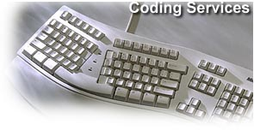

Progress
2nd Semester Plan
  Software Programming
  Software Test
  Integrate System & Test
  Improve Performance
2nd Semester Deliverable
  Embedded SOAP Library Package
  Demo Application on COM86
  Documentation

Slide 30



Question & Answer

