Slide 1
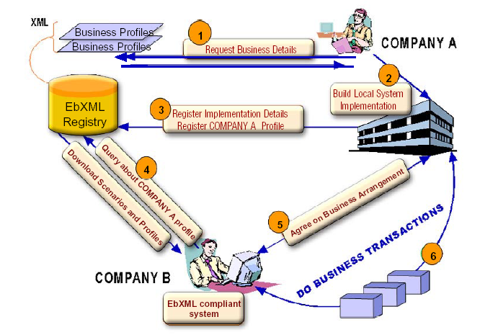
Embedded Web Service
Development
อาจารย์ที่ปรึกษา
ผศ. อภิเนตร อูนากูล
อ. ดุสิต นิยะโต
ผู้จัดทำโครงงาน
นาย สุวิทย์ มัชคาม 42010411
นาย เอกราช อินนอก 42010452

Slide 2

Agenda
Overview
  Background
  Objectives
  Goal
  Benefit
Scope of Project
  Design
  Implementation
  Test

Slide 3

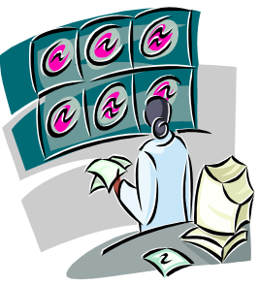
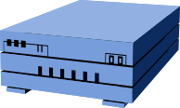
Managing Ubiquitous Device
Project Overview
Embedded Web Service
Device
16 bit device
Network
Management Station
PC based

Slide 4

Background
RPC (Remote Procedure Call)
  Distributed Object Framework
  Example DCOM,EJB or CORBA
  Not design for use with HTTP
  Proprietary Problem
  Not design for Embedded System

Slide 5


Background
SOAP (Simple Object
Access Protocol)
  Distributed Object Framework
  Open Standard Protocol
  Design for use with HTTP
  Use XML structure
  Can be used complicated method
  Messaging between application

Slide 6
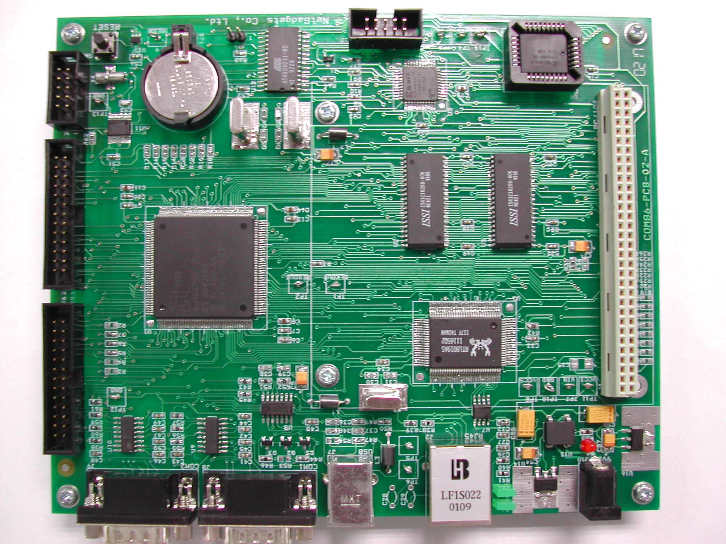
Background
Why Embedded?
  Environment in work
  Reduce Cost
  Support OS & TCP/IP Stack
  Support in Thailand
  Many interface to connect device

Slide 7
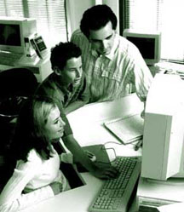

Objectives
Developing and Testing Web Service
on Embedded System.
Developing Flexible Operation for
Embedded device with standard protocol.

Slide 8
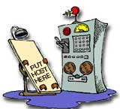

Goal
Embedded SOAP Library Package
Demo Application
  Server Application
  Client Application

Slide 9
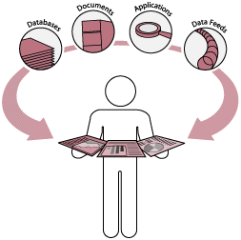
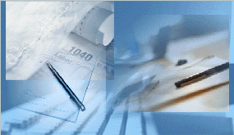
Benefit
Operation of Device
  Scalability
  Automatic
  Ubiquitous
Support ideal of Embedded Development
Understand in Operation
of Web Service

Slide 10
Web Service Overview

Slide 11

Related Technology
XML (eXtensible Markup Language)
  is a syntax that allows users to create markup languages.
SOAP (Simple Object Access Protocol)
  provides a simple and lightweight mechanism for exchanging structured and typed information

Slide 12

Related Technology
WSDL (Web Service Description Language)
  define Web services and describe how to access them.
UDDI (Universal Description, Discovery,
and Integration)
  is provide method for to built and find the detail of Web Services.
  business and data of services

Slide 13
Context Diagram
Server
Application
Client
Application
Register
Communication
Embedded
Web Service
Communication
UDDI
Registry

Slide 14


Use Case diagram
Publish
Web Service
Search
Web Service
Retrieve WSDL
Service Provider
Manage
Service
Service Requester
Call
Web Service

Slide 15
Sequence Diagram
Web Service
Requester
HTTP
Encode/Decode
SOAP Parser
Serialize/Deserialize
Service Code
Service File
SOAP & HTTP request
HTTP encode
SOAP Parse & Build
SOAP Project
SOAP message
Check Service name & Method name
Connect
Check Parameter Pattern
Connect
Parameter
Deserialize Parameter
Write Input File
Write Complete
Call Service Code
Open Input File
Return Result
Run
Write Output File
Return Status
Write Complete
Open Output File
Parameter
Return Result
SOAP Message
SOAP & HTTP Response

Slide 16
Class Diagram (SOAP)
SOAP Server
SOAP Response Handler
Envelope SOAP
String SOAPMessage
SetObjectToDeserialize()
Fault error
BuildSOAPObject()
String
CheckError()
BuildSOAPFault()
RecieveRequest()
SendResponse()
HTTPencodde()
HTTPdecode()
Envelope
ReadServiceName()
Header header
Body body
AttributeHadndler attr
SOAP Response Handler
String envelopeEntries
GetAttribute()
SetAttribute()
SetObjectToSerialize()
GetBody()
BuildSOAPFault()
SetBody()
ReadOutputMap()
GetHeader()
WriteSOAPEnvelope()
SetHeader()
CheckError()
GetEntries()
SetEntries()
Marshall()
Unmarshall()

Slide 17
Class Diagram (SOAP)
SOAP Response Handler
Serialize
SetObjectToSerialize()
SimpleSerialize()
BuildSOAPFault()
StructSerialize()
ReadOutputMap()
ArraySerialize()
WriteSOAPEnvelope()
CheckError()
Envelope
Fault
Header header
String faultcode
Body body
String faultstring
AttributeHadndler attr
String faultactor
String envelopeEntries
String faultEntries
GetAttribute()
GetFaultCode()
SetAttribute()
SetFaultCode()
GetBody()
GetFaultString()
SetBody()
SetFaultString()
GetHeader()
GetFaultActor()
SetHeader()
SetFaultActor()
GetEntries()
GetFaultEntries()
SetEntries()
SetFaultEntries()
Marshall()
Marshall()
Unmarshall()
Unmarshall()

Slide 18
Class Diagram (SOAP)
SOAP Response Handler
Deserialize
SetObjecToDeserialize()
SetObjectToDeserialize()
BuildSOAPObject()
BuildSOAPFault()
CheckError()
ReadInputMap()
BuildSOAPFault()
CheckError()
Envelope
Header header
Body body
AttributeHadndler attr
SOAP Parse
String envelopeEntries
GetAttribute()
XMLParser xmlParser
SetAttribute()
ParseSOAP()
GetBody()
CheckSyntax()
SetBody()
BuildObject()
GetHeader()
SetHeader()
GetEntries()
SetEntries()
Marshall()
Unmarshall()

Slide 19
Class Diagram (SOAP)
Method
Body
Parameter parameter
Method method
AttributeHandler attr
Envelope
AttributeHandler attr
GetParameter()
SetMethod()
SetParameter()
Header header
GetMethod()
GetAttribute()
Body body
SetAttribute()
SetAttribute()
GetAttribute()
Marshall()
AttributeHadndler attr
Ummarshall()
String envelopeEntries
GetAttribute()
SetAttribute()
GetBody()
SetBody()
GetHeader()
Header
Parameter
SetHeader()
GetEntries()
AttributeHandler attr
SetEntries()
String mess
Marshall()
String HeaderEntries
Unmarshall()
GetParameter()
SetAttribute()
RemoveParameter()
GetAttribute()
Marshall()
SetHeaderEntries()
Unmarshall()
GetHeaderEntries()
WriteInput()
Marshall()
Unmarshall()

Slide 20
Class Diagram(XML)
XMLParser
XMLReader
StartTag startTag
String buffer
EndTag endTag
XMLWriter
int index
Legacy TextEvent
int lineNumber
String content
XMLReader xmlr
int size
int columnNumber
String content
int next
writeStartTag()
read()
writeAttribute()
read()
peek()
writeEndTag()
readTo()
parseStartTag()
writeWithEncode()
peek()
parsePI()
writeEmptyTag()
skipTo()
parseText()
writeRaw()
getLineNumber()
readText()
closeAllTag()
setLineNumber()
setXMLReader()
getColumnNumber()
parseCData()
setColumnNumber()
parseEndTag()
parseDocType()

Slide 21
Class Diagram (XML)
Legacy
StartTag
ParseEvent
String text
String name
int lineNumber
int type
String namespace
getName()
getText()
Attribute attr
getNamespace()
getType()
int type
getText()
getError()
getAttribute()
getName()
getType()
getNamespace()
getValue()
getAttribute()
getError()
getType()
getLineNumber()
XMLParser
getValue()
setLineNumber()
getError()
StartTag startTag
getLineNumber()
EndTag endTag
Legacy TextEvent
XMLReader xmlr
EndTag
String content
TextEvent
read()
String name
peek()
int type
parseStartTag()
String text
parsePI()
getName()
int type
parseText()
getType()
readText()
getError()
getText()
setXMLReader()
getLineNumber()
getType()
parseCData()
getError()
parseEndTag()
parseDocType()

Slide 22
Class Diagram (XML)
Attribute
String prefix
PrefixName
String name
Xml
String value
String constants
getPrefix()
getPrefix()
int encode
getNamespace()
getName()
setPrefix()
getValue()
encode()
setNamespace()
setPrefix()
decode()
addPrefixname()
setName()
quote()
deletePrefixname()
setValue()
toPrefixName()
toString()

Slide 23
Structural Model
Client
Application
SOAP
Handler
XML
Parser
Embedded
Web Service
Embedded
SOAP Server
Service
Code
SOAP
Object
SOAP
Serializer/
Deserializer

Slide 24
State Chart Diagram
7
Service Active
8
Check syntax &
Service input
Service run
Check syntax &
Pattern output
Serialize
SOAP
5
Return result
Correct
4
Correct
Call service
Parse with
SOAPParser
Return result
9
6
Incorrect
Wait for
parse
Deserialize
SOAP
Build SOAP
response
Incorrect
Return result
3
HTTP
decode
Return SOAPMessage
10
Wait for
Request
Build
Fault
Encode complete
2
Send HTTP &
SOAP response
HTTP
Encode
Response complete
11
12
1
Enable
Disable
Disable

Slide 25
Deployment Diagram
SOAP
Client
UDDI
Registry
Service
Program
Embedded
SOAP Server
Service File
Management
Service File

Slide 26
Component Diagram
Web Service
Server
SOAP
Handler
HTTP
SOAP
Object
XML
Parser

Slide 27

Implementation
Server Process
  Build Server Process & Handler SOAP message on Server.
Service Process
  Build Service Application that provide service for client

Slide 28

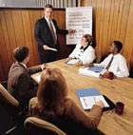

Implementation
Server Process
  SOAP Server Process
  SOAP Request Handler Process
  SOAP Response Handler Process
SOAP Request Handler
SOAP Server Process
SOAP Response Handler

Slide 29



Implementation
Service Process
  Build Service Application : CPUUtils ( Find CPU Utilization on Terminal device )
  Build WSDL Document.
  Register Service to System
Service Application
WSDL Document
Register Service

Slide 30
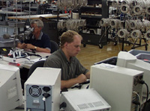

Test
What are test?
  To test process in service that implement on server
How to test?
  Implement Example of Service and Set Environment to build every event that can occur

Slide 31
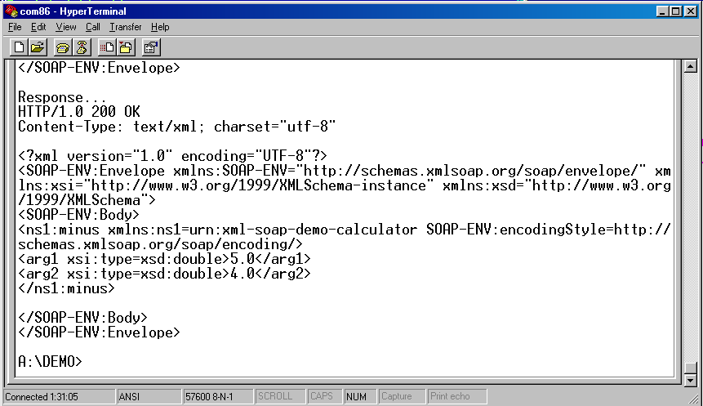
Test
Result and Analysis

Slide 32
Test
Result and Analysis(cont.)
  There are some event that is caused to build same result to Client
  Service Name not exist Service not Register
  Service Method not exist Fault in WSDL Doc.
  Order of Parameter Fault in WSDL Doc.

Slide 33

Solution
Assure you register service to system
Provide simple service to help in use system
Build Log file to save fault event that occur with service
Test service application before use it in system

Slide 34
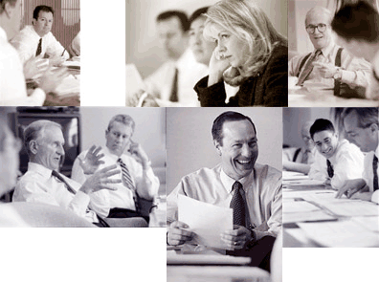

Future Work
Enhance Performance
Co-operate with others protocol
Security

Slide 35

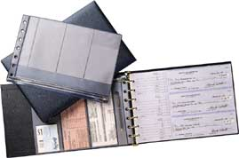
Future Work
Security
Now
  SOAP Intermediary
  1. Crossing trust domain
  2. Value-added
  example : Encrypts, Digital Sign, QoS ,etc.
  VPN or Firewall
Future
  Digital Sign in Header Part
  Secure Socket Layer

Slide 36

Q&A

