Slide 1


Slide 2


GPRS Wireless Router
Present by
Miss Duangrudee Pramualwuttiron 42010114
Mr. Pariwat Wongsomran 42010194

Slide 3

Content
Part 1 Introduction
Part 2 Product in the present
Part 3 How about project
Part 4 5 Topics of project
Part 5 Studying in one month

Slide 4

PART 1
Introduction

Slide 5
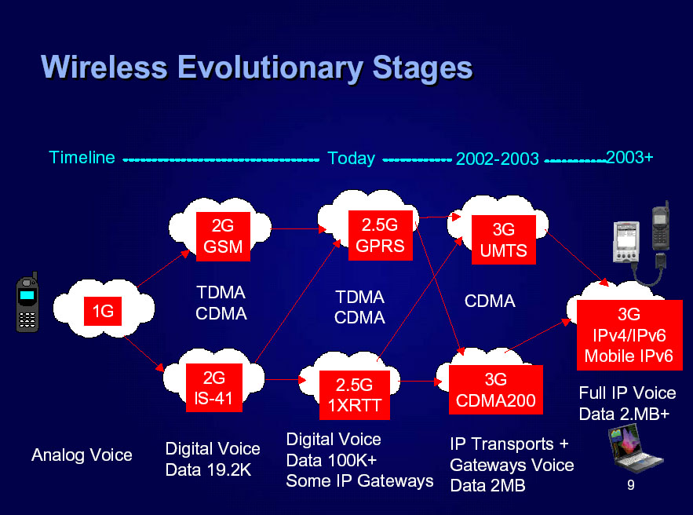
Picture 1 : Wireless Evolutionary Stages

Slide 6

PART 2
Product in the present

Slide 7
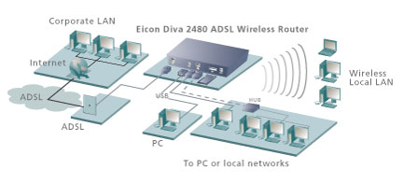
Picture 2 : Product ADSL Wireless Router

Slide 8

How about project
PART 3
GPRS Wireless Router

Slide 9
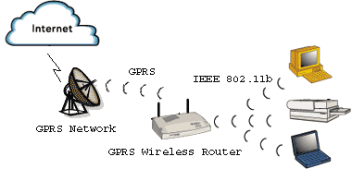
Picture 3 : How GPRS Wireless Router work

Slide 10
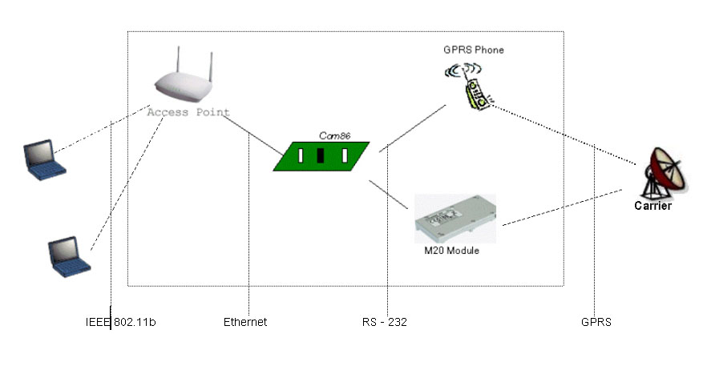
Picture 4 : GPRS Wireless Router Architecture

Slide 11

5 Topics of project
PART 4

Slide 12


5 TOPICS
Router
GPRS Technology
Com86
Access Point
Protocol

Slide 13

Router
    Routing Configuration
      Telnet
      TFTP
      Web Server,Web base configuration
      Console : “ESL GPRS Wireless Router”
    Routing Function
      DNS (Domain name System)
      DHCP (Dynamic Host Configuration Protocol)
      NAT (Network Address Translation)
      PPTP (Point-to-Point Tunnel Protocol)
      PPoE (Point-to-Point over Ethernet)
      IPSec (Optional)
      PPoA (Point-to-Point over ATM : Optional)
      Build – in firewall (Optional)
      VPN (Virtual Private Network : Optional)
    Routing Algorithm
      Route Table ( Look up)

Slide 14

GPRS Technology
Architecture
Service by Carrier (in Thailand)
    DTAC
    AIS
Device Support
    Mobile
    Module : M20
    PDA
Interfacing

Slide 15
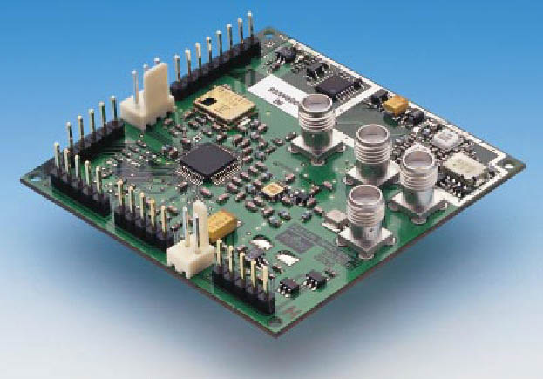
COM 86
Architecture
Performance and Feature
Programmable
Interfacing

Slide 16

Access Point
Architecture
Feature
IEEE 802.11b
Interfacing

Slide 17

Protocol
PPP
TCP/IP
RS-232
Telnet

Slide 18

Studying in one month
PART 6

Slide 19


OVERVIEW ABOUT 3G

Slide 20
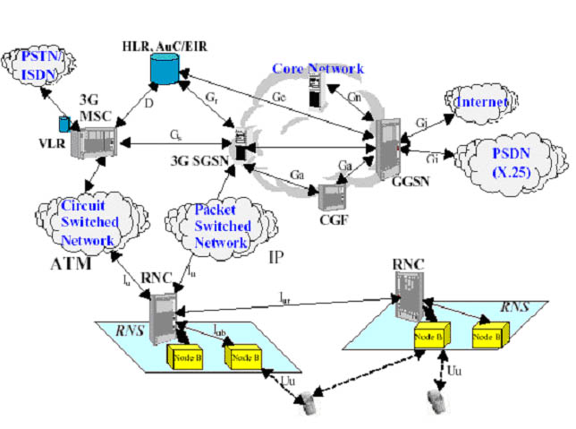
Picture 5 : 3G Network Architecture

Slide 21

Be Born Router
    Routing Function
      DNS (Domain name System)
      DHCP (Dynamic Host Configuration Protocol)
      NAT (Network Address Translation)
      PPTP (Point-to-Point Tunnel Protocol)
      PPoE (Point-to-Point over Ethernet)
      IPSec (Optional)
      PPoA (Point-to-Point over ATM : Optional)
      Build – in firewall (Optional)
      VPN (Virtual Private Network : Optional)

Slide 22

To GPRS Technology
FROM
Architecture
Protocol stack
Service by Carrier (in Thailand)
    DTAC
    AIS
Device Support
    Mobile
    Module : M20

Slide 23
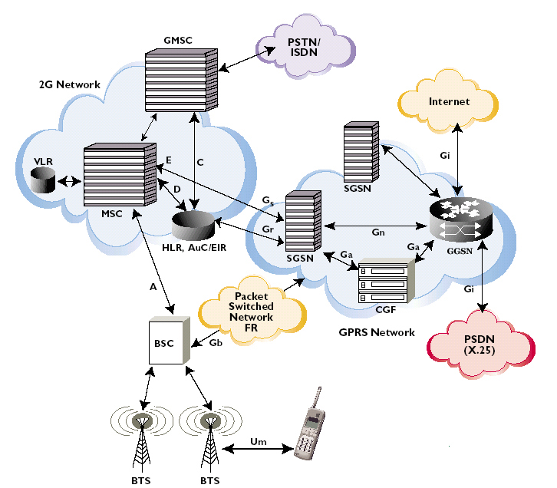
Picture 6 : GPRS Network Architecture

Slide 24
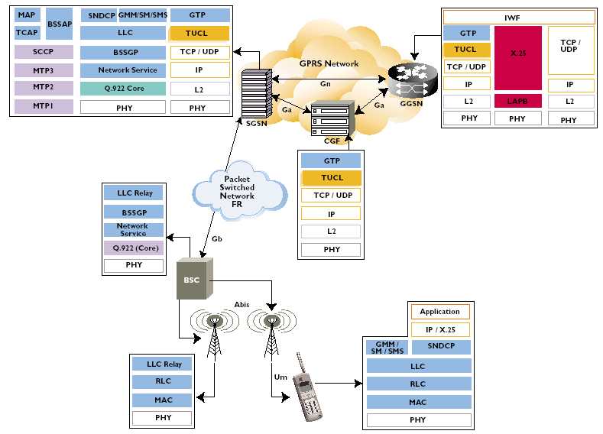
Picture 7 : GPRS Protocol Stack Architecture

Slide 25

GPRS Technology
DTAC
AIS

Slide 26



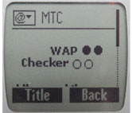




Slide 27








Slide 28

Microsoft Windows XP [Version 5.1.2600]
(C) Copyright 1985-2001 Microsoft Corp.
C:\Documents and Settings\Erik M Sirikhum>ipconfig /all
Windows IP Configuration
Host Name . . . . . . . . . . . . : vangoh
Primary Dns Suffix . . . . . . . :
Node Type . . . . . . . . . . . . : Hybrid
IP Routing Enabled. . . . . . . . : No
WINS Proxy Enabled. . . . . . . . : No
Ethernet adapter Algo:
Media State . . . . . . . . . . . : Media disconnected
Description . . . . . . . . . . . : Intel(R) PRO/100 VE Network Connecti
on
Physical Address. . . . . . . . . : 00-08-02-62-5F-84
PPP adapter GPRS:
Connection-specific DNS Suffix . :
Description . . . . . . . . . . . : WAN (PPP/SLIP) Interface
Physical Address. . . . . . . . . : 00-53-45-00-00-00
Dhcp Enabled. . . . . . . . . . . : No
IP Address. . . . . . . . . . . . : 10.90.96.54
Subnet Mask . . . . . . . . . . . : 255.255.255.255
Default Gateway . . . . . . . . . : 10.90.96.54
DNS Servers . . . . . . . . . . . : 202.183.255.20
202.183.255.21
NetBIOS over Tcpip. . . . . . . . : Disabled
C:\Documents and Settings\Erik M Sirikhum>

Slide 29



Device Support
PDA
Mobile
Module : M20

Slide 30












THANK YOU
START CONNECTING…….

