Slide 1

GPRS Wireless Router
อุปกรณ์ค้นหาเส้นทางแบบไร้สายผ่านเครือข่าย GPRS
Advisor
ผศ. อภิเนตร อูนากูล
อ.ดุสิต นิยะโต
Researcher
นางสาวดวงฤดี ประมวลวุฒิรณ 42010114
นายปริวรรต วงษ์สำราญ 42010194

Slide 2
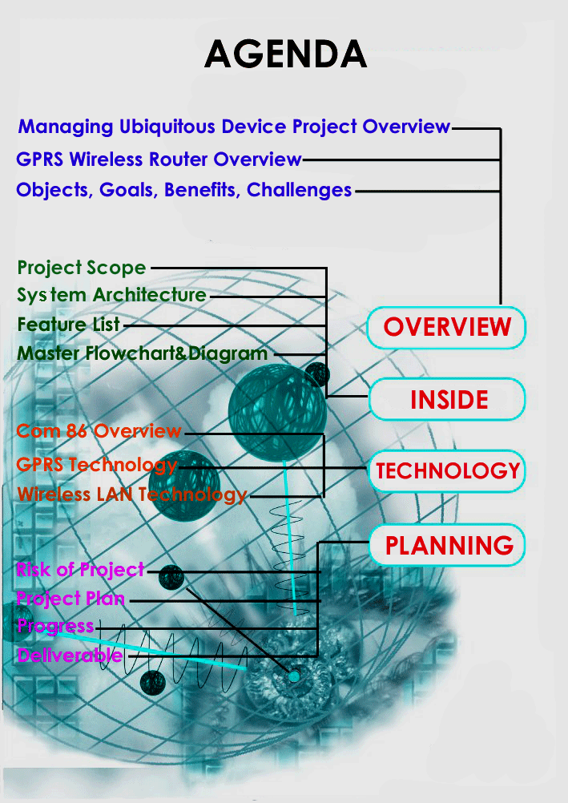

Slide 3

Part I OVERVIEW
Managing Ubiquitous Device Project Overview
GPRS Wireless Router Overview
Objectives, Goals, Benefits and Challenges

Slide 4



Managing Ubiquitous Device Framework
Managing Ubiquitous Device Framework
-Embedded J2ME on Terminal Device
-Embedded Web service on Terminal Device
-Terminal Device
Device Management Station
Wireless Router
Device
16 bit device
Management Station
Network
PC based

Slide 5



Slide 6

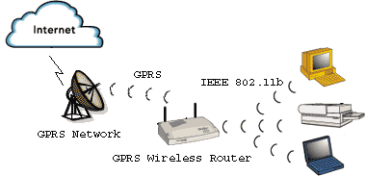

Slide 7

Objective
Develop GPRS Wireless Router
Build Innovative Embedded System product
Reduce Import product
Stimulate Industrial development in term of Embedded System Technology

Slide 8

Goals
Prototype
Software
Configuration Program
Manual
Be Innovation which benefit both Industry and service section

Slide 9

Benefits
Alternative
Increase of wireless technology development
Increase of embedded system development
Challenges
Integrated new technology
Hardware constraint

Slide 10

Part II INSIDE
Project scope
Feature list
System architecture
Master flowchart and diagram

Slide 11

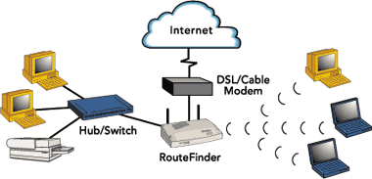
Project Scope
Product in present

Slide 12
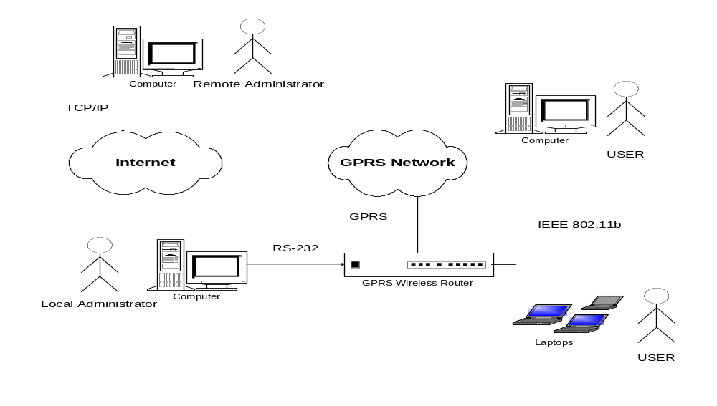
Project Scope
Environment Diagram

Slide 13
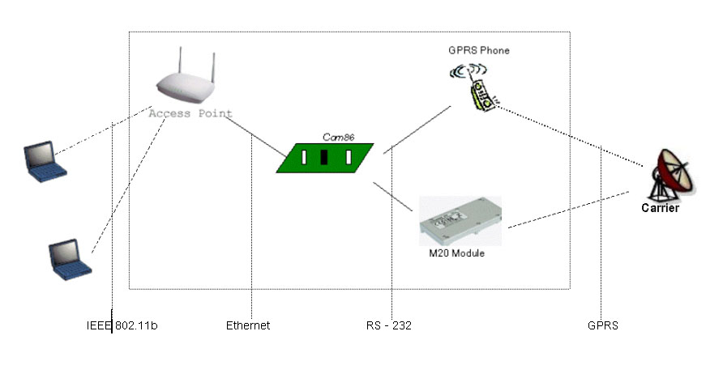
System Architecture

Slide 14
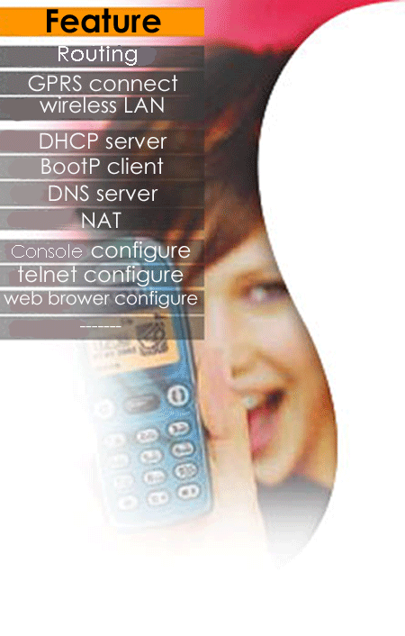

Slide 15
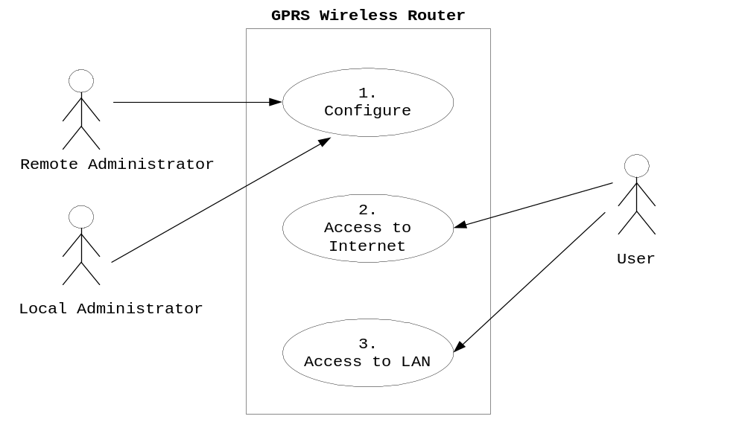
Use Case Diagram

Slide 16
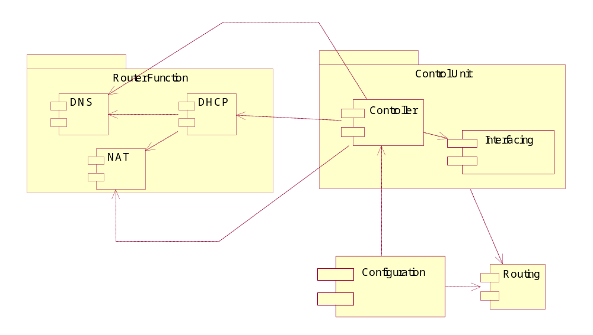
Component Diagram

Slide 17
TCP/IP
Protocol Stack
DNS
BootP
DHCP
Telnet
Controller
Application
UDP
TCP
Transport
ICMP
IP
RIP
Network
GPRS Packet Driver
Ethernet Packet Driver
Data Link

Slide 18
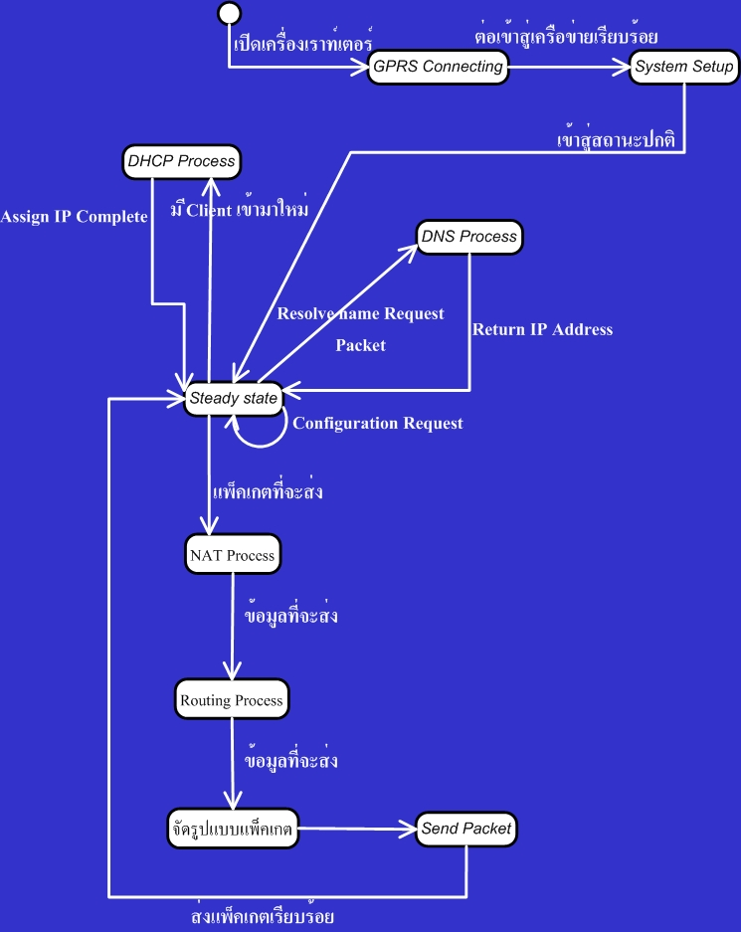
Master Flowchart

Slide 19
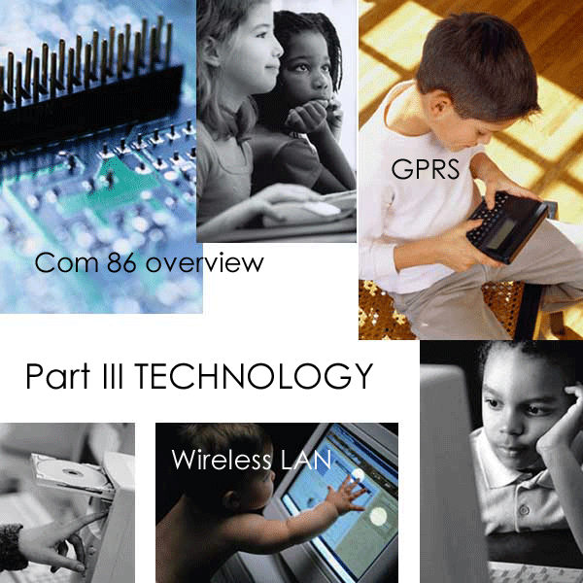

Slide 20
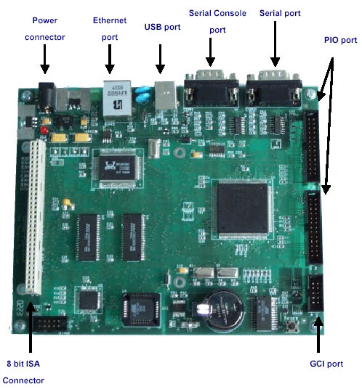

Slide 21

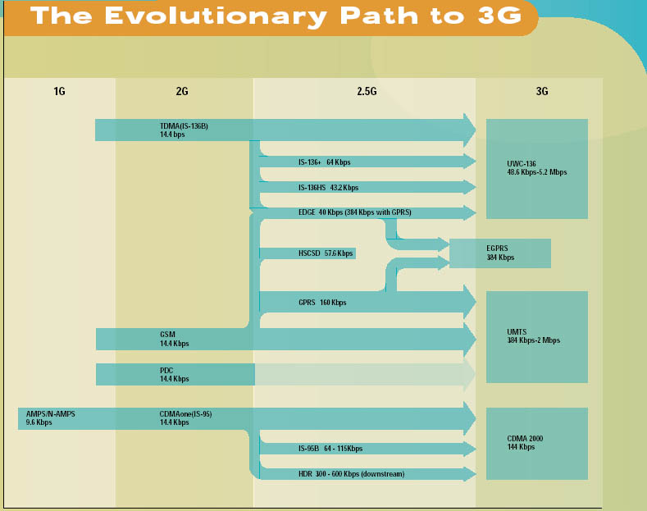

Slide 22
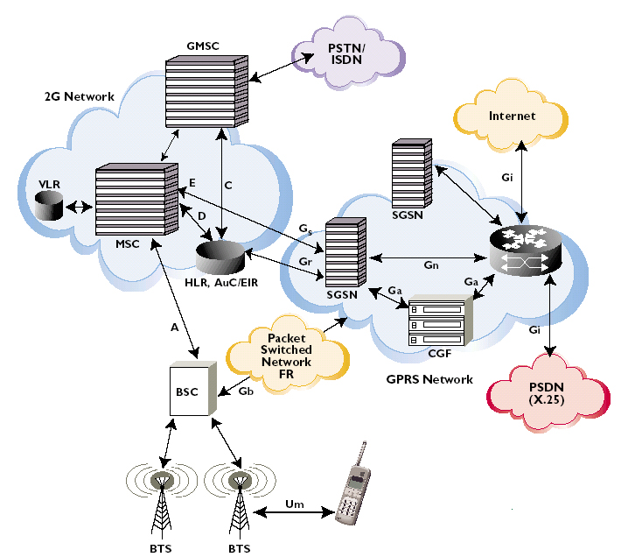
GPRS Network Architecture

Slide 23

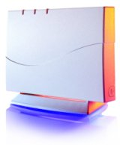
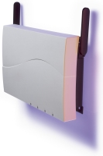
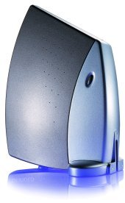
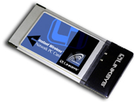


Wireless Access Point
Wireless LAN :
IEEE 802.11x standard (IEEE802.11a,IEEE802.11b,IEEE802.11g ,.etc)
Device : Access point, Wireless Network Adapter,Wireless Communication Device (Mobile phone, Notebook ,.etc)

Slide 24


Slide 25

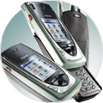
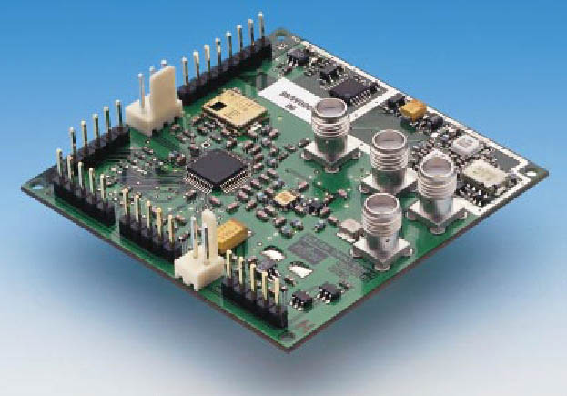
New Technology
GPRS
Wireless LAN
Hardware Constraint

Slide 26

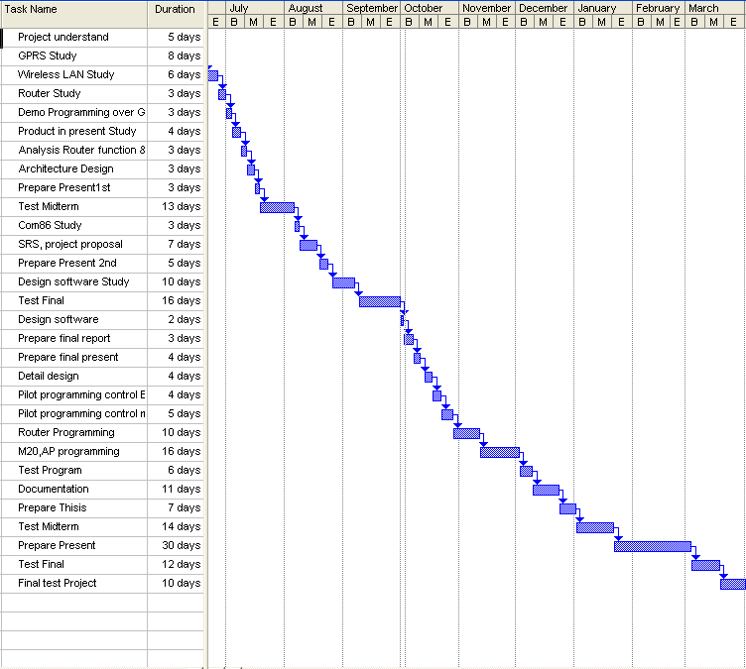
Requirement
Analysis
Design
Implementation
Testing

Slide 27


System Requirements Specification
Design Document
Technology Study
  GPRS
  Wireless LAN
  Routing Technology

Slide 28
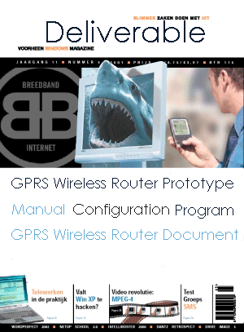

Slide 29

THANK YOU
START CONNECTING…….

