Slide 1

อุปกรณ์เกตเวย์แบบไร้สายด้วยเครือข่าย GPRS
Advisor
ผศ. อภิเนตร อูนากูล
อ.ดุสิต นิยะโต
Researchers
นางสาวดวงฤดี ประมวลวุฒิรณ 42010114
นายปริวรรต วงษ์สำราญ 42010194

Slide 2
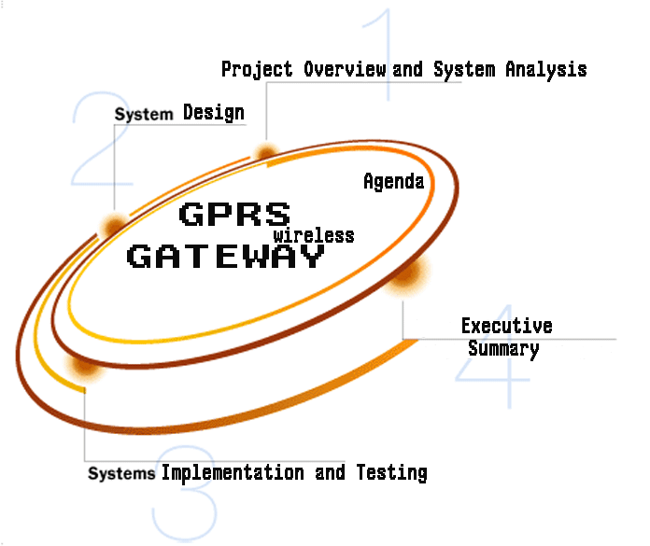

Slide 3

Managing Ubiquitous Device Project Overview
GPRS Wireless Gateway Overview

Slide 4



Managing Ubiquitous Device Framework
- Embedded J2ME on Terminal Device
- Embedded Web service on Terminal Device
- Terminal Device
Device Management Station
Wireless Gateway
Device
16 bit device
Management Station
Network
PC based

Slide 5



Slide 6

Goals
GPRS Wireless Gateway Prototype
NAT function
Console Configuration Program
Web Brower Configuration Program
User Manual
Be Innovation which benefit both Industry and service section

Slide 7


Slide 8

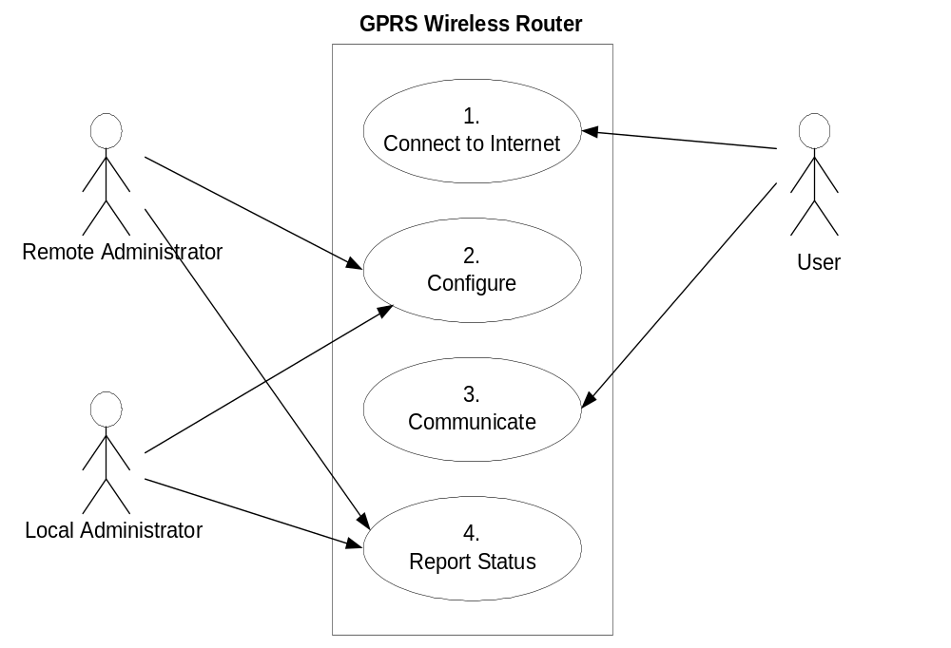

Slide 9

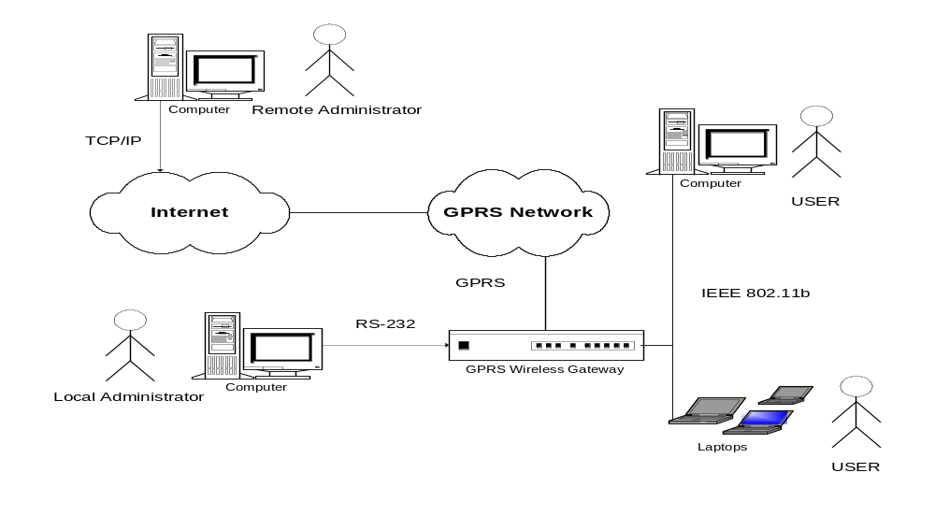

Slide 10

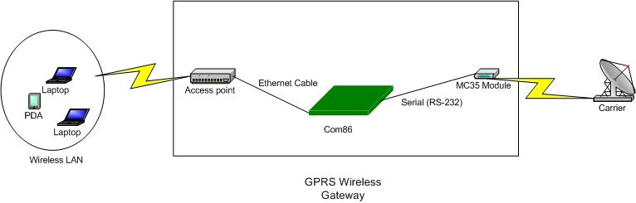

Slide 11
TCP/IP
Protocol Stack
BootP
DHCP
HTTP
Controller
Application
UDP
TCP
Transport
ICMP
IP
Network
GPRS Packet Driver
Ethernet Packet Driver
Data Link

Slide 12
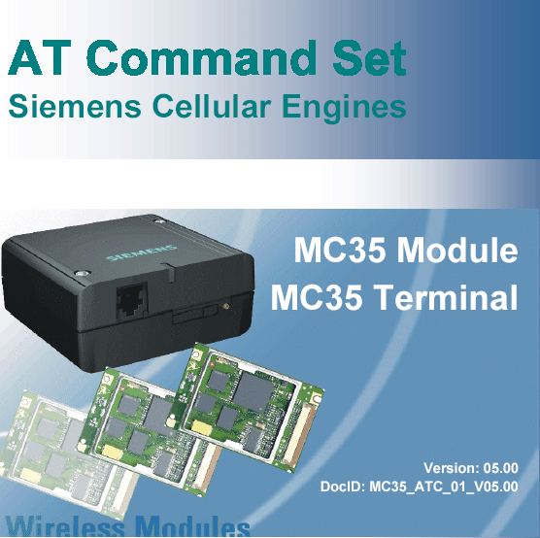

Slide 13

COMMAND | Set PDP Context
WRITE | AT+CGDCONT=[<cid>[,<PDP_type>[, <APN>[,<PDP_addr>]]]]
EXAMPLE | AT+CGDCONT=1,"IP","www.dtac.co.th"
RESPONSE | OK/ERROR

Slide 14

COMMAND | Request GPRS Service
WRITE | ATD*99[*[<called_address>] [*[<L2P>][*[<cid>]]]]#
EXAMPLE | ATD*99***1#
RESPONSE | OK

Slide 15

COMMAND | Reject GPRS Service
WRITE | ATH
EXAMPLE | ATH
RESPONSE | OK

Slide 16



Slide 17

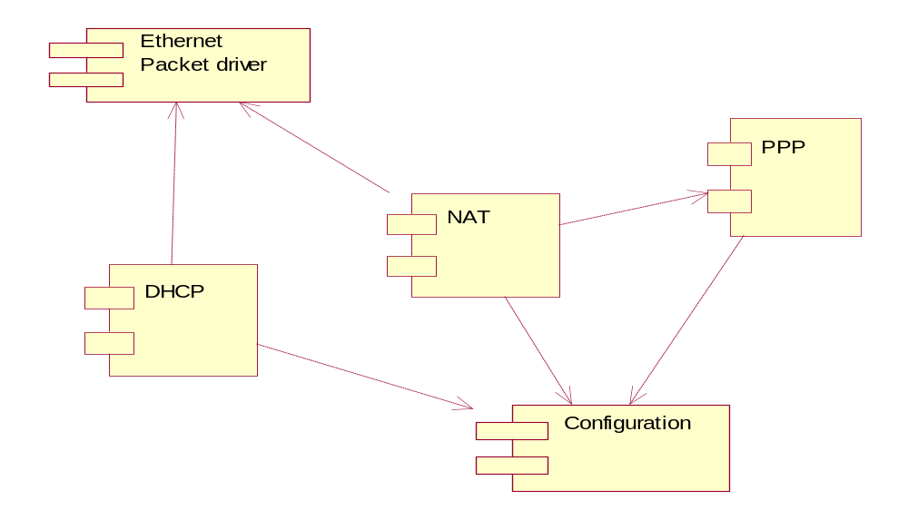

Slide 18

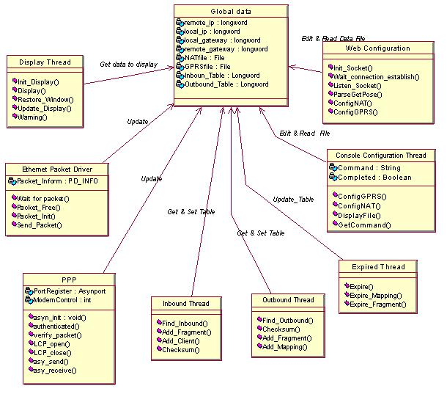

Slide 19

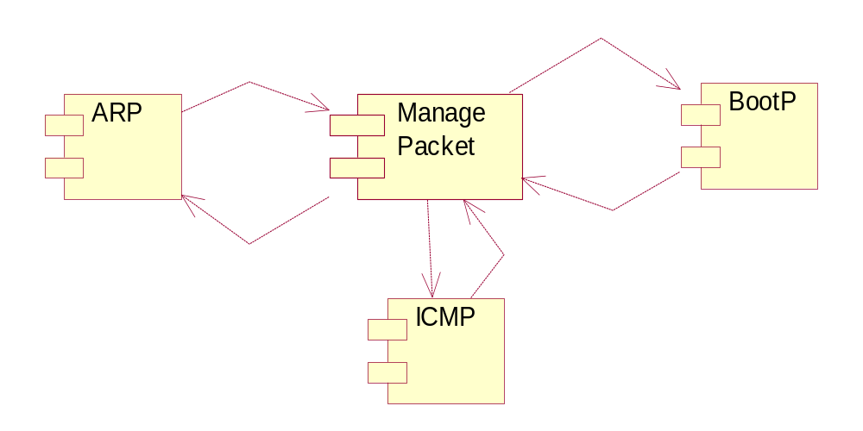

Slide 20

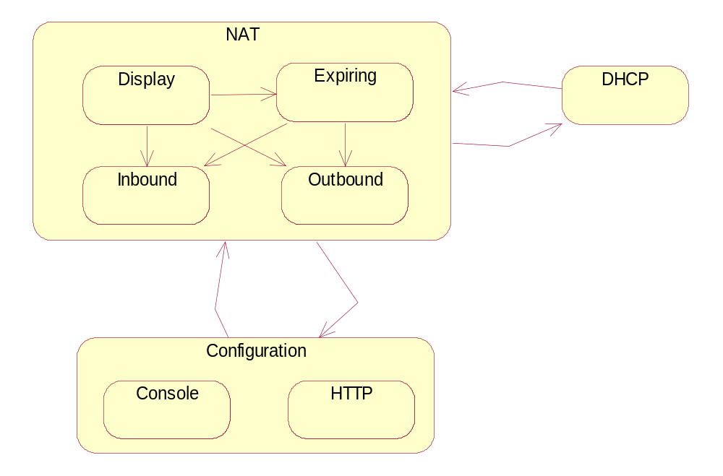

Slide 21

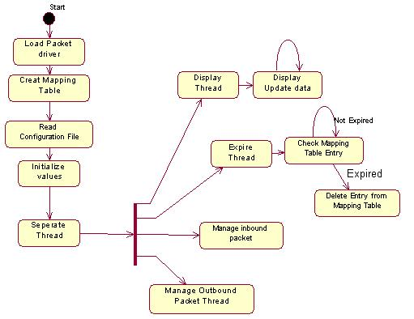

Slide 22

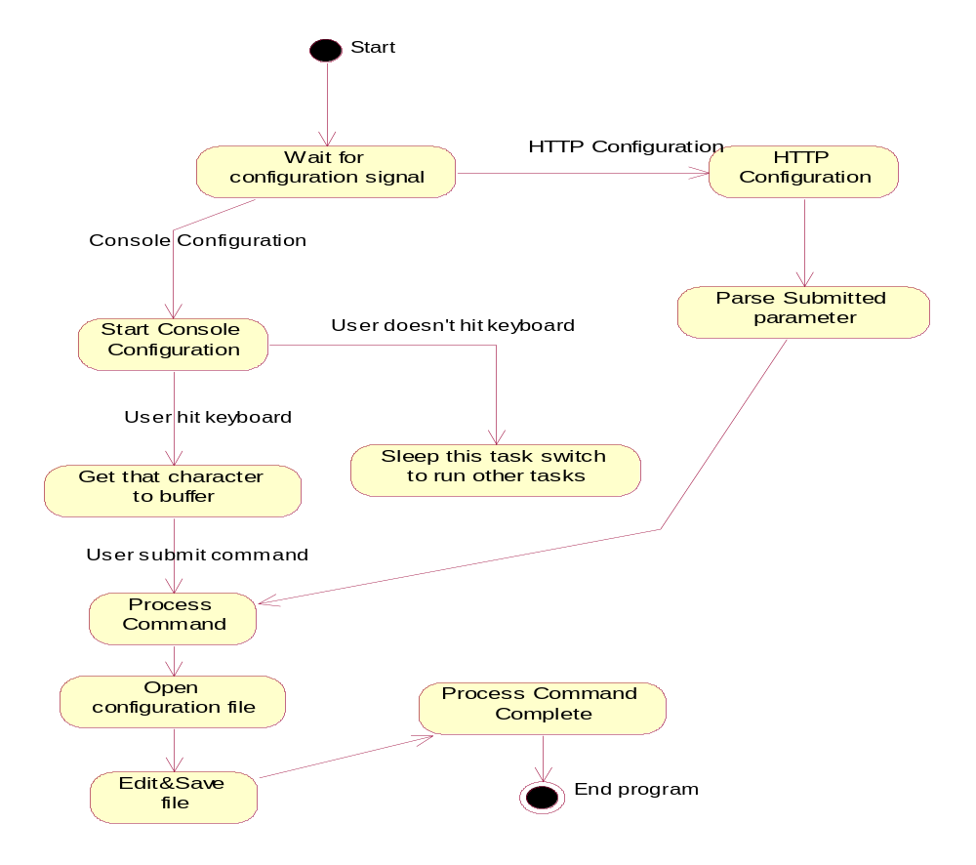

Slide 23

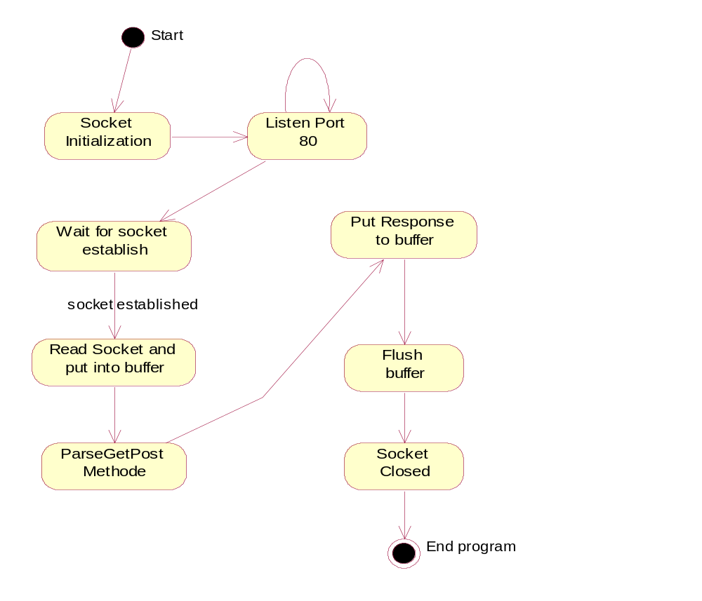

Slide 24




Slide 25

Program | Hardware Constrain
NAT | Implement on DOS
 | Single Task
 | None TCP/IP Protocol Stack
Configuration | Single Task

Slide 26

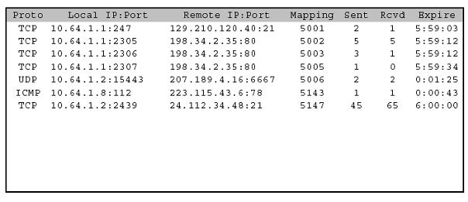

Slide 27

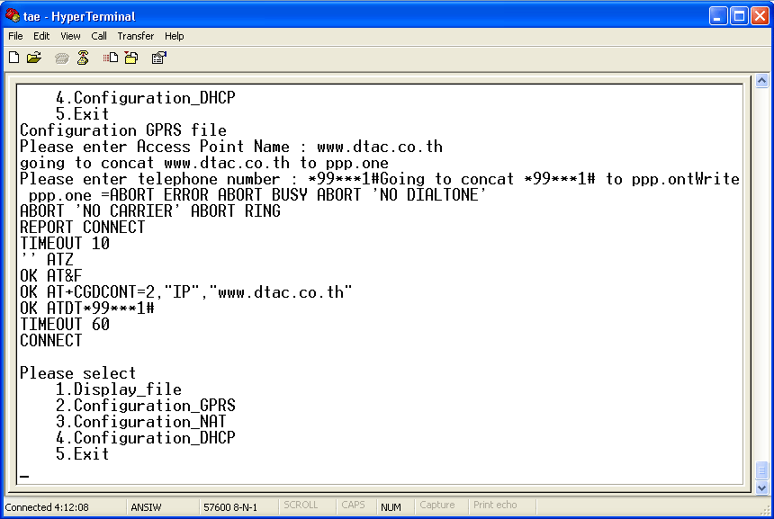

Slide 28

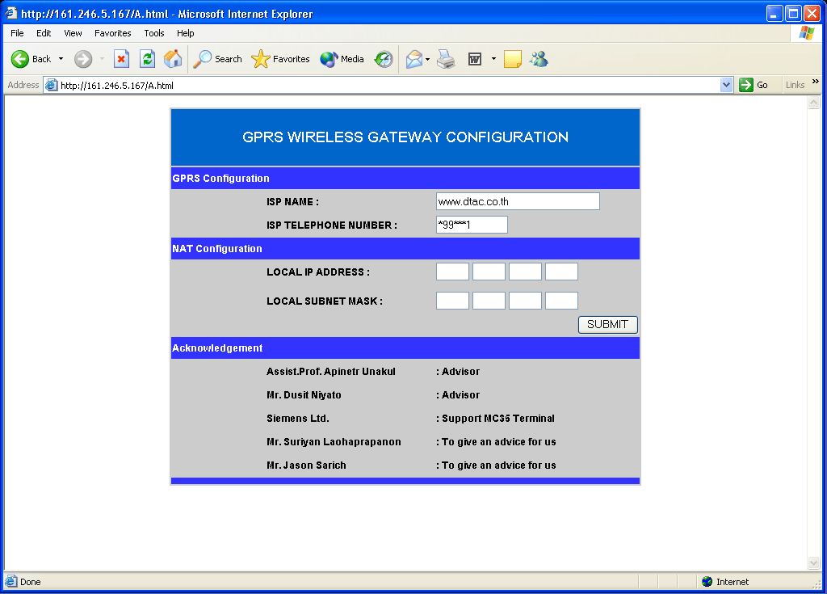

Slide 29



Slide 30

Parameter | To Consider
Environment | Simulate Network
Output | Screen Shot
Throughput | Depend on GPRS network
Test each Module on PC and COM86
LAN and GPRS network on PC
LAN and GPRS network on COM86

Slide 31



Slide 32

FEATURE | PC |  | COM 86 |  | PROBLEM
 | Goal | Achievement | Goal | Achievement
Network Access Translation | YES | YES | YES | YES | None TCP/IP protocol stack
Console Configuration | YES | YES | YES | YES | Multitask
Web Brower Configuration | YES | YES | YES | YES
GPRS PPP | YES | YES | YES | NO | UART Implement
DHCP | YES | NO | YES | NO | Time not enough
Wireless LAN | - | - | - | - | High Cost

Slide 33

SOFTWARE | LICENSE | DISTRIBUTE | MODIFY
Multi-C Library | Mixsoftware co.,ltd | NO | YES
Internet Extender | GNU General Public License | YES | YES
uC/OS-II | Free for educatioal not for commercial | YES ,but have FEE | YES
DOSPPP | GNU General Public License | YES | YES
WATTCP | Free for non commercial | YES ,not for commercial | YES
HARDWARD | LICENSE | DISTRIBUTE | MODIFY
MC35 Terminal | SIEMENS | - | -
COM 86 | Thai Embedded Systems Association | - | -

Slide 34

NO. | FEATURE
1 | Implement PPP on Board Com86
2 | Add DHCP
3 | Add Routing Function
4 | Connect to Wireless LAN
5 | Implement Ad Hoc Network
6 | Add Security Function

Slide 35




: Support MC35 Terminal
: Support Board Com 86

Slide 36

THANK YOU
START CONNECTING…….

