Slide 1
Customer Shopping Behavior Analysis
What drives spending and loyalty?
Python | PostgreSQL | Power BI
Imane Khtib
github.com/khtibimane/customer_behavior_analysis

Slide 2
Dataset Overview
3,900 purchases (one per customer) and 18 columns, with no purchase dates.
3,900
18
$233,081
Purchases
Columns
Total Revenue
Business Questions
Data Notes
01
How loyal are customers, and how many are new?
37 missing review ratings (about 1%)
No purchase dates, so no trends over time
02
Which categories drive revenue, and which products sell most?
03
Do subscriptions, discounts or shipping affect spend?
04
Do age or gender make a difference?
Source: project report, dataset summary

Slide 3
Data Preparation Process
Cleaned in Python, queried in PostgreSQL, and presented in an interactive Power BI dashboard.
1
2
3
4
Python
Feature Engineering
PostgreSQL
Power BI
Load, inspect, clean
Age group, purchase frequency
Store the clean table
Explore and present
Key Cleaning Decisions
Features Created
Filled 37 missing ratings with each category’s median
Renamed columns to snake_case for SQL readability
Dropped promo code: it matched the discount column in every row
age_group
Four age bands using pd.qcut()
purchase_frequency_days
Weekly, Monthly, Quarterly as days
Source: customer_shopping_behavior.ipynb

Slide 4
Customer Segmentation
Most customers are Loyal; very few are New.
80%
of customers are Loyal (3,116)
83
New customers: the weak spot
New = 1 previous purchase | Returning = 2 to 10 | Loyal = 11 or more
Source: SQL customer segmentation (Q7); Power BI dashboard

Slide 5
Revenue by Category
Clothing brings in the most revenue, about 45% of $233K.
45%
of revenue comes from Clothing
Most purchased product
Accessories: Jewelry (171 orders)
Clothing: Blouse (171 orders)
Footwear: Sandals (160 orders)
Outerwear: Jacket (163 orders)
Top products are close: 145 to 171 orders
Source: Power BI dashboard; SQL Q8

Slide 6
Subscriptions, Discounts and Shipping
Subscribing isn't increasing spending, and 43% of purchases used a discount.
Discount usage
Subscription
Shipping
$59.49 vs $59.87
$60.48 vs $58.46
43%
Average spend per purchase, subscribers vs non-subscribers
Express vs Standard, a gap of about $2
Most discounted
Above-average spenders
of purchases used a discount
~50%
839
Hats (50.00%) and sneakers (49.66%) are discounted most; the top five are all close to half
Customers used a discount and still spent above the $59.76 average
1,677 of 3,900
Source: SQL Q2, Q4, Q5 and Q6; Power BI dashboard

Slide 7
Age and Gender
Age barely changes spend; men bring in most of the revenue.
Age
Gender
$59.07 to $60.45
68% of revenue
Average spend across the four age groups. Young Adults bring in the most revenue ($62,143).
Male customers bring in about 68% of revenue ($157,890 vs $75,191), roughly twice as much as female customers.
Source: SQL Q1 and Q10

Slide 8
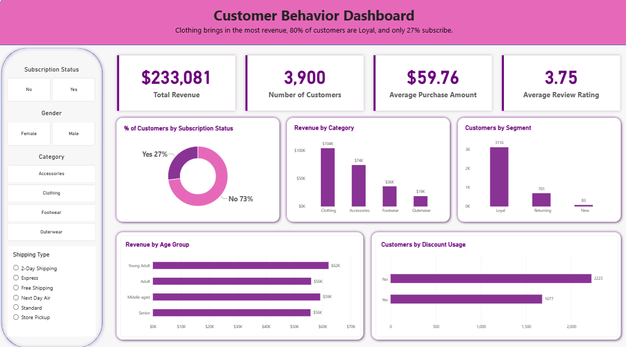
Power BI Dashboard
Interactive, connected to the PostgreSQL customer table.
Filters
Subscription
Gender
Category
Shipping Type
Source: customer_behavior_dashboard.pbix

Slide 9
Recommendations
Ideas to test, not proven conclusions.
Grow New Customers
Test an acquisition incentive on a first purchase.
START HERE
New-customer volume
1
Rethink Subscription Value
Test benefits designed to encourage larger purchases.
TRACK
Subscriber vs non-subscriber spend
2
Test Discounts Before Extending
Reduce the discount on selected products and monitor demand.
TRACK
Units sold and revenue
3
Build on Leading Categories
Feature top sellers and investigate Outerwear.
TRACK
Category revenue
4
Segment by Behavior
Compare behavioral segments with age-based targeting.
TRACK
Campaign results by segment
5
Source: project report, business recommendations

Slide 10
Limitations
These constraints shape what the results can and cannot show.
No Date Variable
Trends, growth and retention over time can’t be analyzed.
Segment Cutoffs
New, Returning and Loyal thresholds are analyst-defined.
Unequal Group Sizes
Repeat-buyer subscription comparison: 3,476 repeat buyers vs 424 other customers.
No Cost Data
The impact of discounts on profit can’t be estimated.
Correlation, Not Causation
Relationships do not prove cause, and no significance tests were run.
Single Dataset
Findings may not generalize beyond these 3,900 purchases.
Full project: github.com/khtibimane/customer_behavior_analysis
Source: project report, limitations

