Slide 1
Donor Retention & Lapse Analysis
Who stops giving, who is worth winning back, and when giving peaks
Imane Khtib
$1.62M
5,000
8,816
1,405
total giving, 2023 to 2025
donors
gifts
lapsed donors analyzed

Slide 2



Most first-time donors never come back
Nonprofits lose most new donors and depend on a few loyal and major givers. Limited staff time has to go where it counts.
Who comes back?
Retention by year and by cohort
7 in 10
Who is worth winning back?
Lapsed donors ranked by past giving
new donors never give a second time
When does giving arrive?
Campaigns, months and channels

Slide 3





End to end, and checked against known answers
Simulate
Load and validate
Analyze
Predict
Extend
Python
PostgreSQL
SQL
scikit-learn
Salesforce
Checked against known answers
The simulation predicts 29.2% first-year retention. The analysis measured 29.4% and 30.8%.
Python and SQL matched on every key metric.

Slide 4
Only 3 in 10 new donors give a second time
Share of each cohort still giving, by years since first gift
29.4%
Year 0
Year 1
Year 2
2023 cohort
1,971 donors
100%
29.4%
19.1%
of the 2023 cohort gave again in 2024
30.8%
2024 cohort
1,651 donors
100%
30.8%
not yet
of the 2024 cohort gave again in 2025
2025 cohort
1,378 donors
100%
not yet
not yet
The biggest loss comes right after the first gift. Donors who survive year 1 tend to stay.

Slide 5
Growth depends on new donors
62%
of 2025 giving came from returning donors
$141 to $267
average gift of the 2023 cohort, first year to year 3
If new donor acquisition slowed, total giving would fall quickly.

Slide 6
77 of 1,405 lapsed donors hold half the lost value
$106K
of past giving sits with the top 77 lapsed donors
$170K
sits with the top 441, which is 80% of lapsed giving
A personal call to 77 people covers half the lost value. The long tail is mostly small one-time donors.

Slide 7
The Year-End Appeal decides the year
35%
of annual giving arrives in November and December
$473,775
raised by the Year-End Appeal, the strongest named campaign
Have messaging, mailing lists and online giving pages ready by autumn.

Slide 8
Lapse risk can be predicted
0.82
ROC-AUC on held-out donors (0.5 is a coin flip)
The top 30% by risk lapse at about 94%. The lowest 10% lapse at 16%.
Best targets are donors who are both valuable and at risk.
The model ranks risk. It does not show that outreach brings donors back. That needs an A/B test.

Slide 9
What a fundraising team should do
# | Action | How to measure success
1 | Send a thank-you, then a second ask soon after the first gift | Second-gift rate within 12 months
2 | Tier win-back: personal contact for the top 77 lapsed donors | Reactivation rate and dollars recovered per tier
3 | Rank outreach by lapse risk and past giving | Reactivation lift against a control group
4 | Plan the Year-End Appeal by autumn | Year-end revenue against the prior year
5 | Track retention by cohort every year | Cohort retention reported annually
The ask Start with personal calls to the top 77 lapsed donors (about $106K of past giving), and test thank-you timing on new donors.

Slide 10
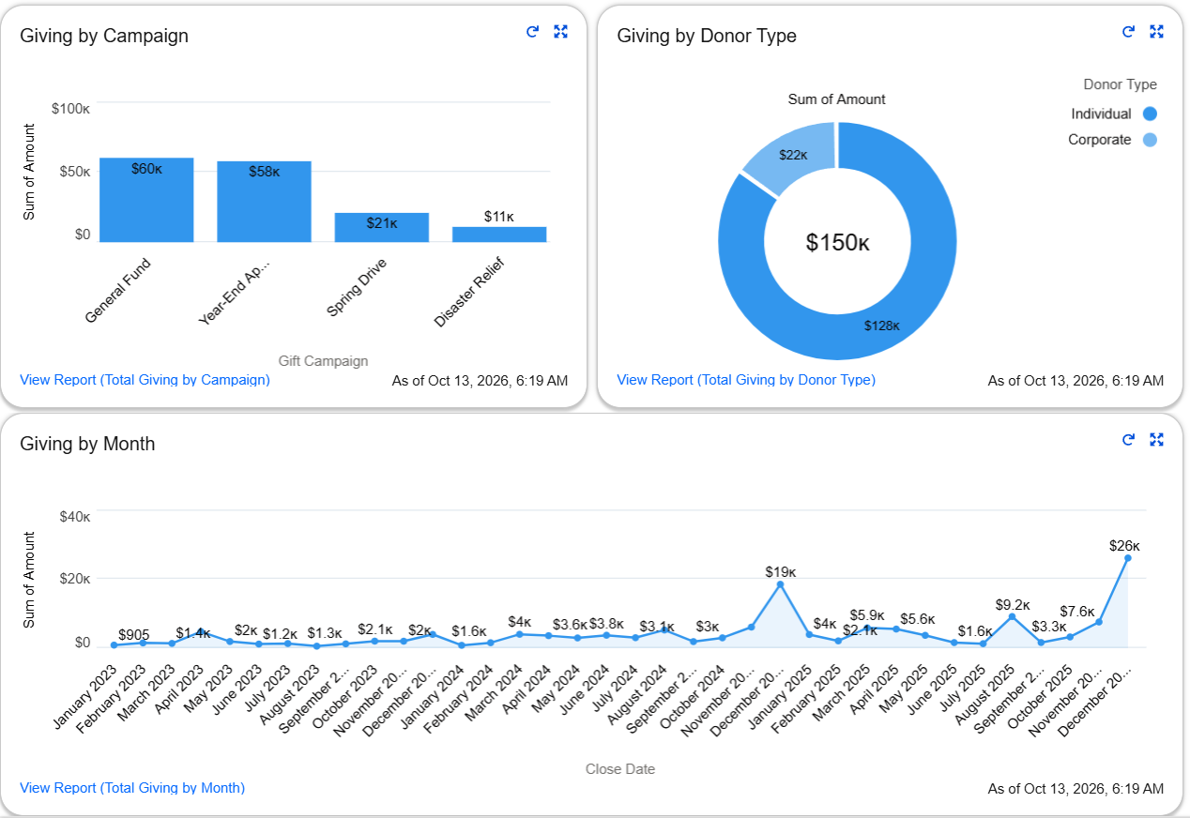
Also built in Salesforce, and what comes next
500
donors became Accounts
901
gifts became Opportunities, linked by an external ID
3 + 1
reports and a dashboard, with 0 import errors
Next, with real data
RFM scoring as an explainable complement
Outreach A/B tests to measure impact
A BI dashboard for cohort tracking

