Slide 1
CRUSTHUT
Pizza Sales

Slide 2
Introduction
Hi, My name is M. Khubaib Arif and I am Business Analytics student. Today I have done a Data Analysis project on MySQL of pizza Sales and my restaurant and Database name is “CRUSTHUT”. They are total of 12 questions which I solved, starting from beginner level to advance level questions. Now moving forward towards SQL queries.

Slide 3
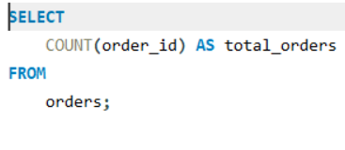
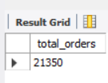
Retrieve the total number of orders placed.

Slide 4
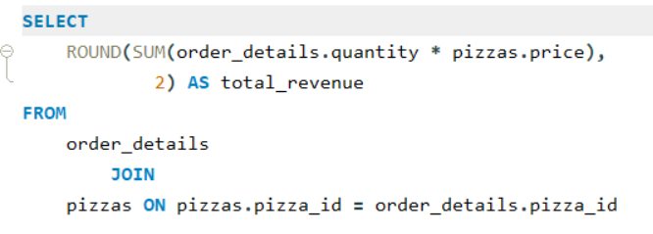
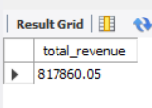
Calculate the total revenue generated from pizza sales.

Slide 5
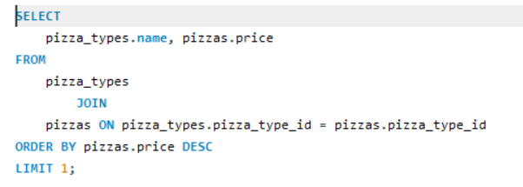
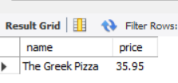
Identify highest price pizza ?

Slide 6
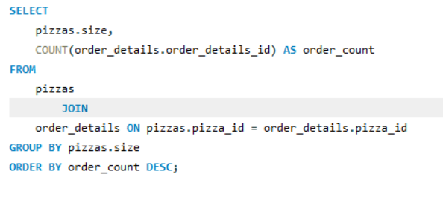
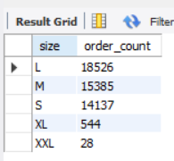
Identify the most common pizza size ordered.

Slide 7
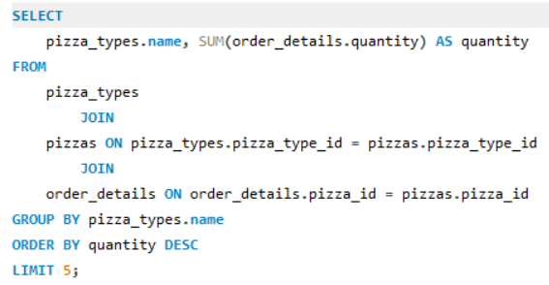
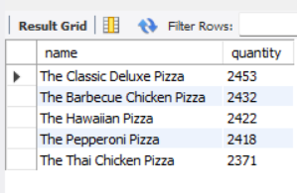
List the top 5 most ordered pizza types along with their quantities.

Slide 8
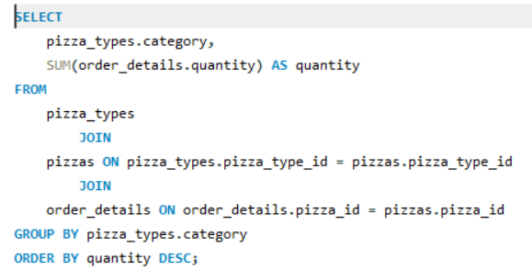
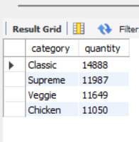
Join the necessary tables to find the total quantity of each pizza category ordered.

Slide 9
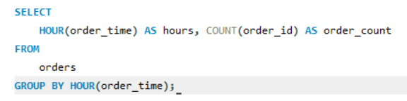
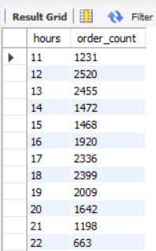
Determine the distribution of orders by hour of the day.

Slide 10
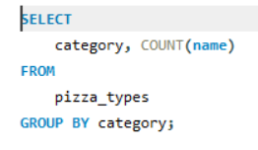
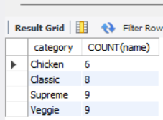
Join relevant tables to find the category-wise distribution of pizzas.

Slide 11
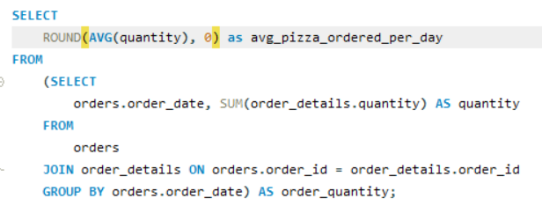
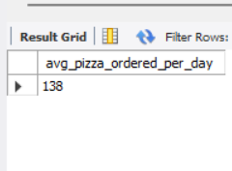
Group the orders by date and calculate the average number of pizzas ordered per day.

Slide 12
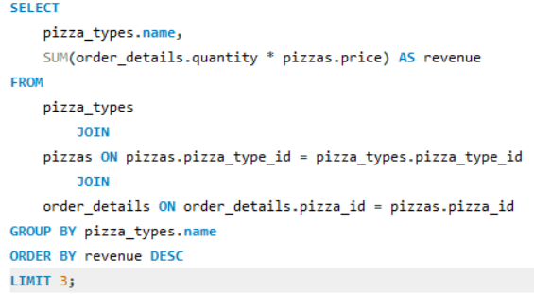
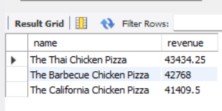
Determine the top 3 most ordered pizza types based on revenue.

Slide 13
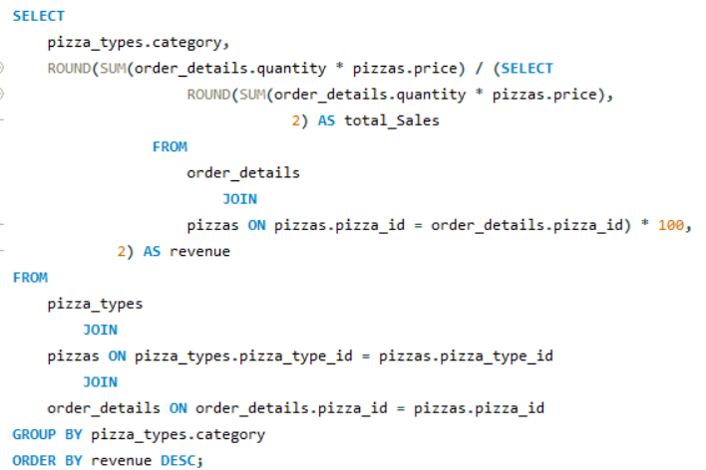
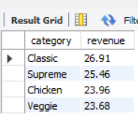
Calculate the percentage contribution of each pizza type to total revenue.

Slide 14
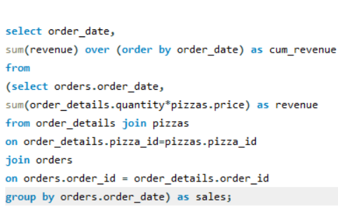
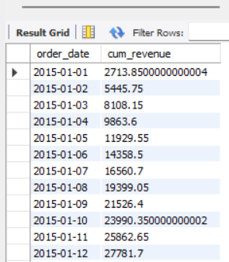
Analyse the cumulative revenue generated over time.

Slide 15
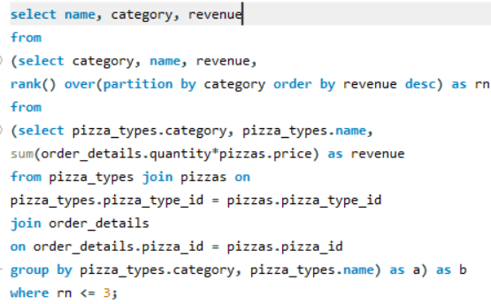
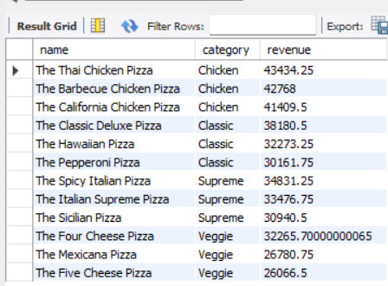
Determine the top 3 most ordered pizza types based on revenue for each pizza category.

