Slide 1
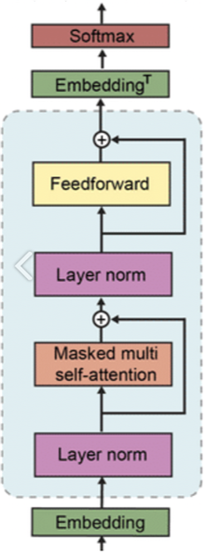
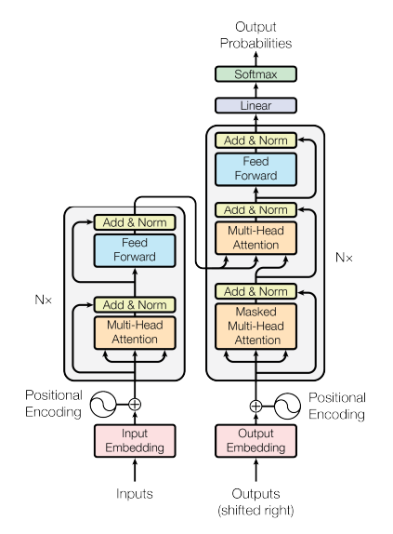
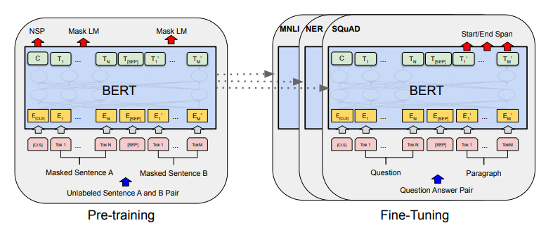

Slide 2
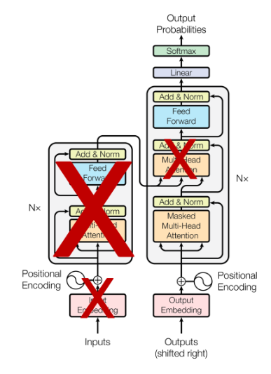
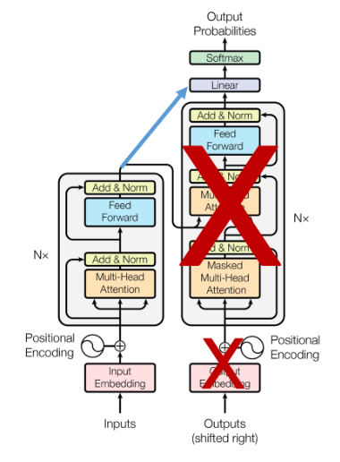
< B E R T >
< G P T 2 >
KoBERT ?
KoGPT2 ?
(SKTBrain)
(SKT-AI)

Slide 3
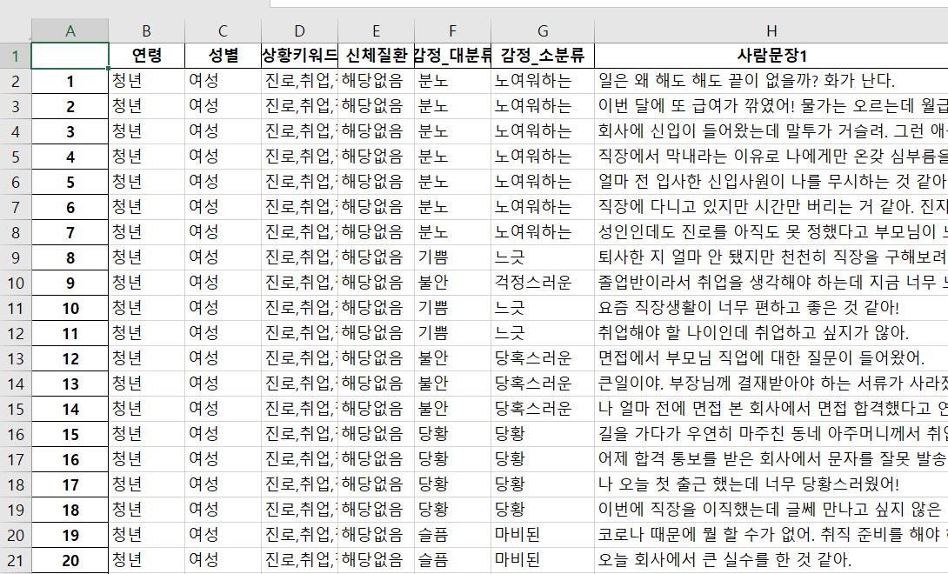
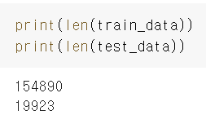
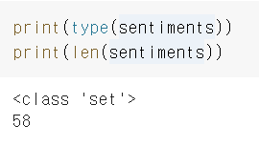

Slide 4
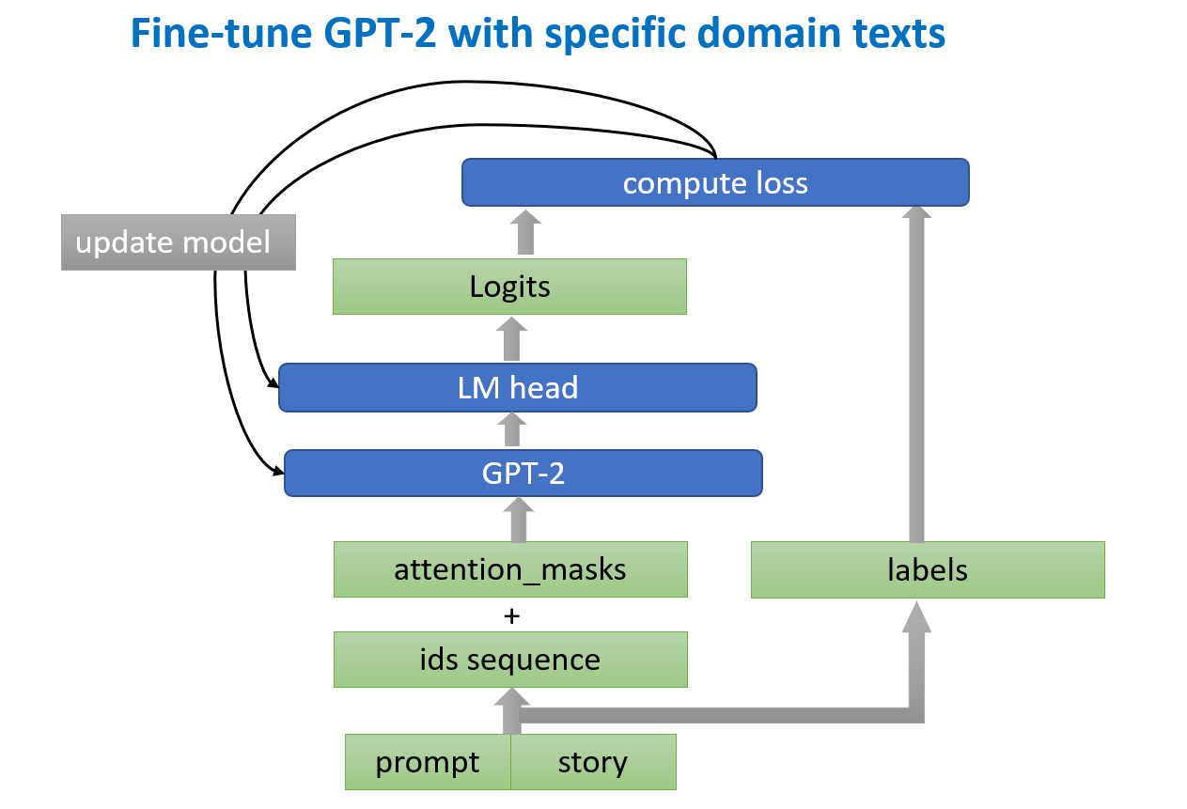
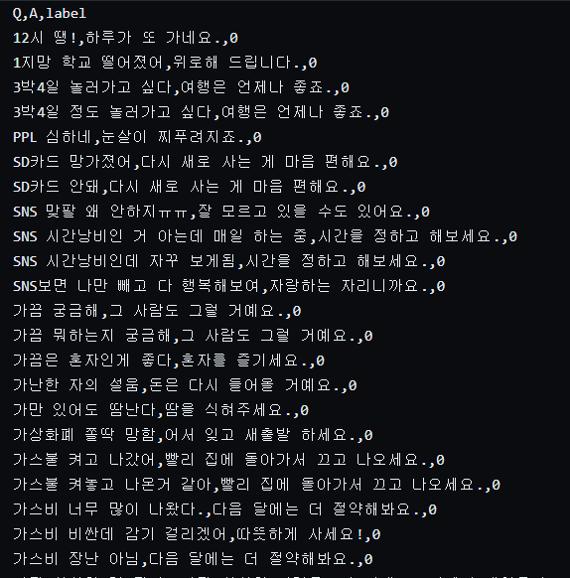


Slide 5
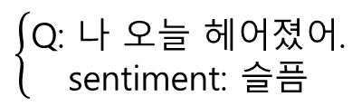
Fine-tuned
BERT model
Inputs
Outputs
Q: 나 오늘 헤어졌어.
sentiment: 슬픔
Fine-tuned
GPT model
Inputs
Outputs
$$\left\{\begin{aligned}\text{Q}\text{: }\text{나 오늘 헤어졌어}\text{. } \\ \text{sentiment}\text{: }\text{슬픔} \end{aligned}\right.$$
A: 정말 안타깝게 생각해 ㅠㅠ

Slide 6
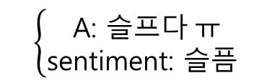
Fine-tuned
GPT model
Inputs
Outputs
Q: 나 오늘 헤어졌어.
A: 슬프다 ㅠ
Fine-tuned
BERT model
Inputs
Outputs
A: 슬프다 ㅠ
sentiment: 슬픔
Fine-tuned
GPT model
Inputs
Outputs
$$\left\{\begin{aligned}\text{A}\text{: }슬프다 ㅠ \\ \text{sentiment}\text{: }\text{슬픔} \end{aligned}\right.$$
A: 정말 안타깝게 생각해 ㅠㅠ

Slide 7








AI
model

