Slide 1


경희대학교 데이터 분석 동아리
KHUDA
2023
KHUDA Github
[ 2023.05.03 ]
Notes:
\

Slide 2
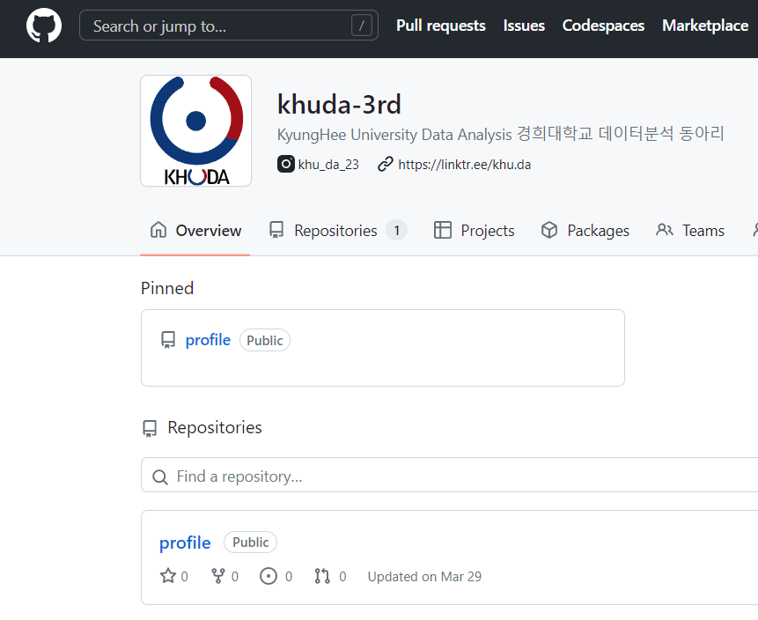
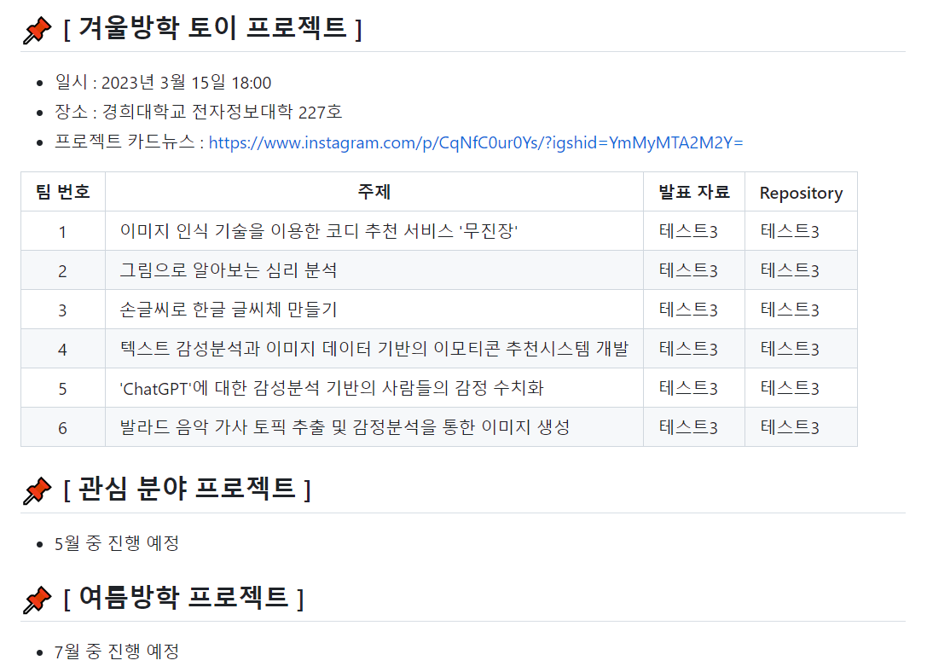
KHUDA Github
Link : https://github.com/khuda-3rd
Notes:
글씨체 : NotoSans

Slide 3
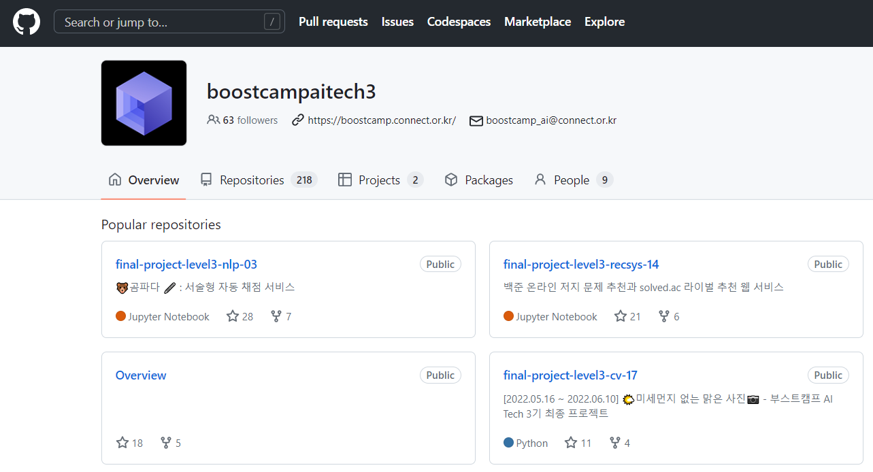
KHUDA Github
Notes:
글씨체 : NotoSans

Slide 4
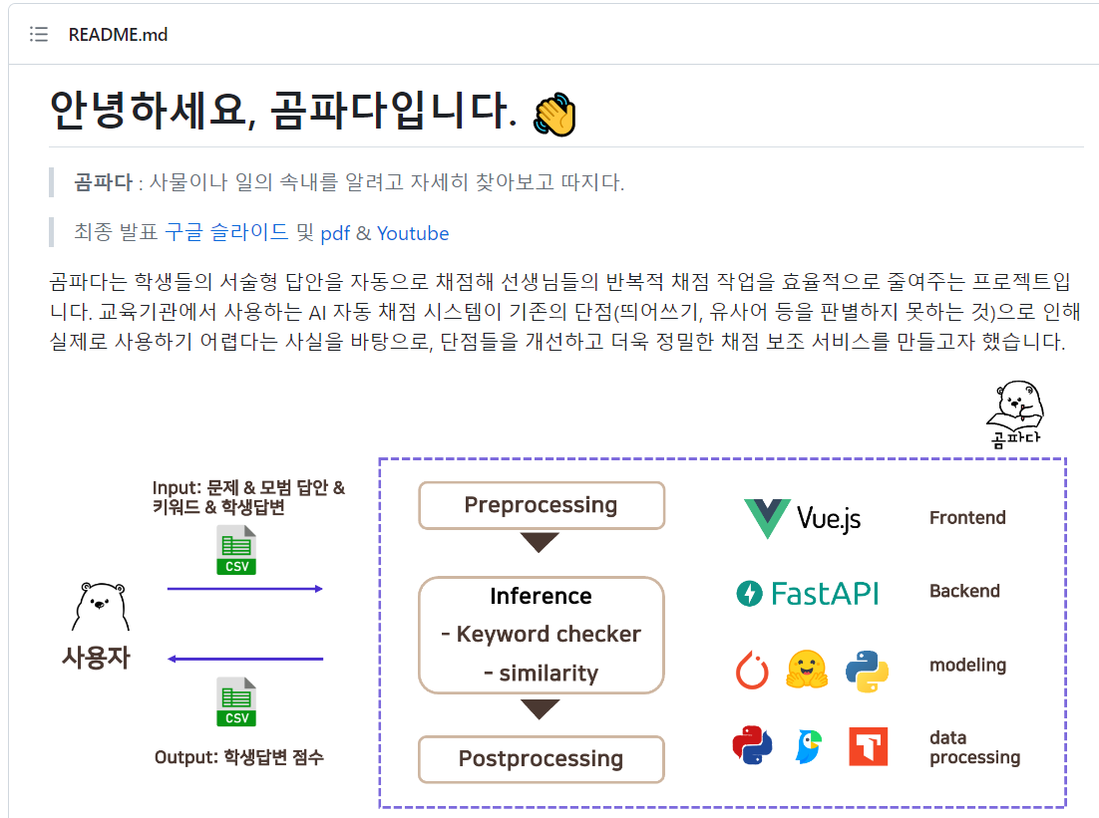
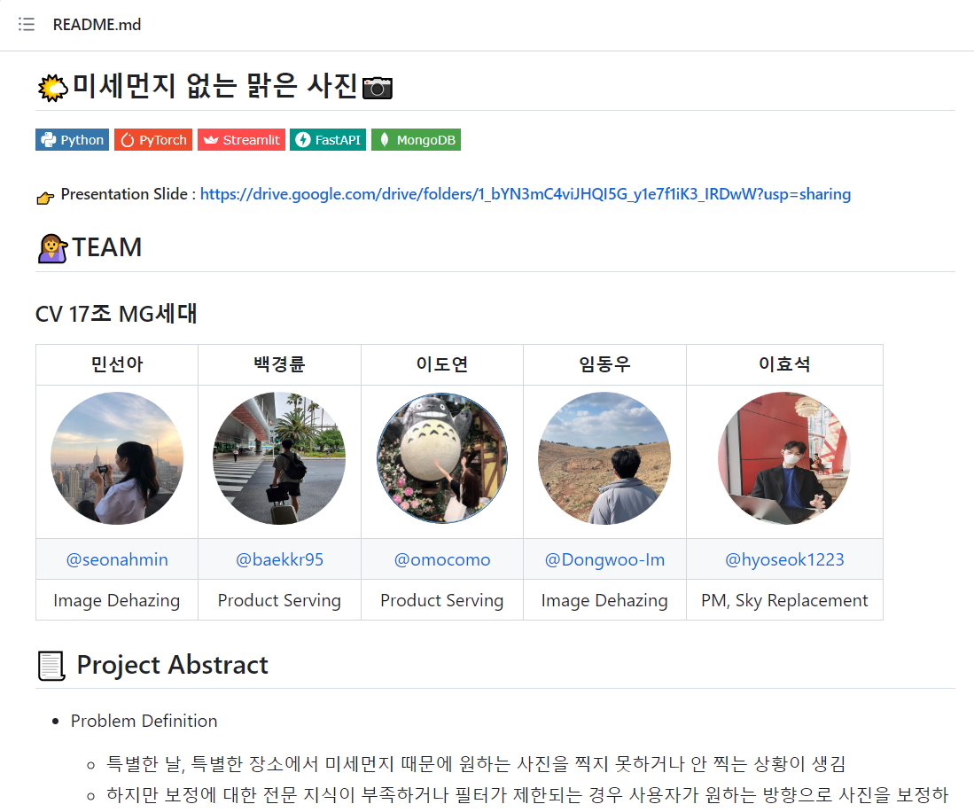
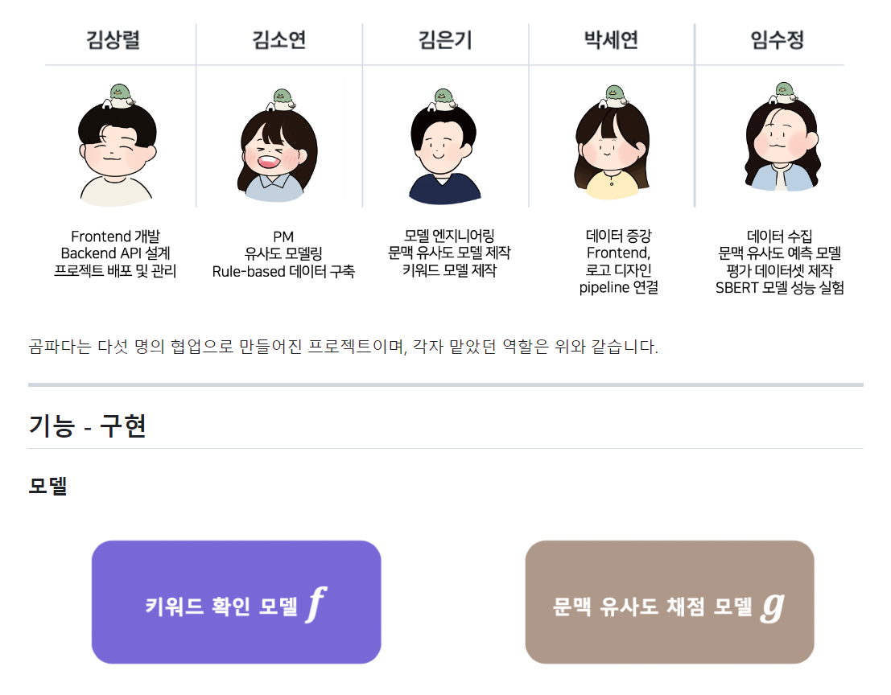
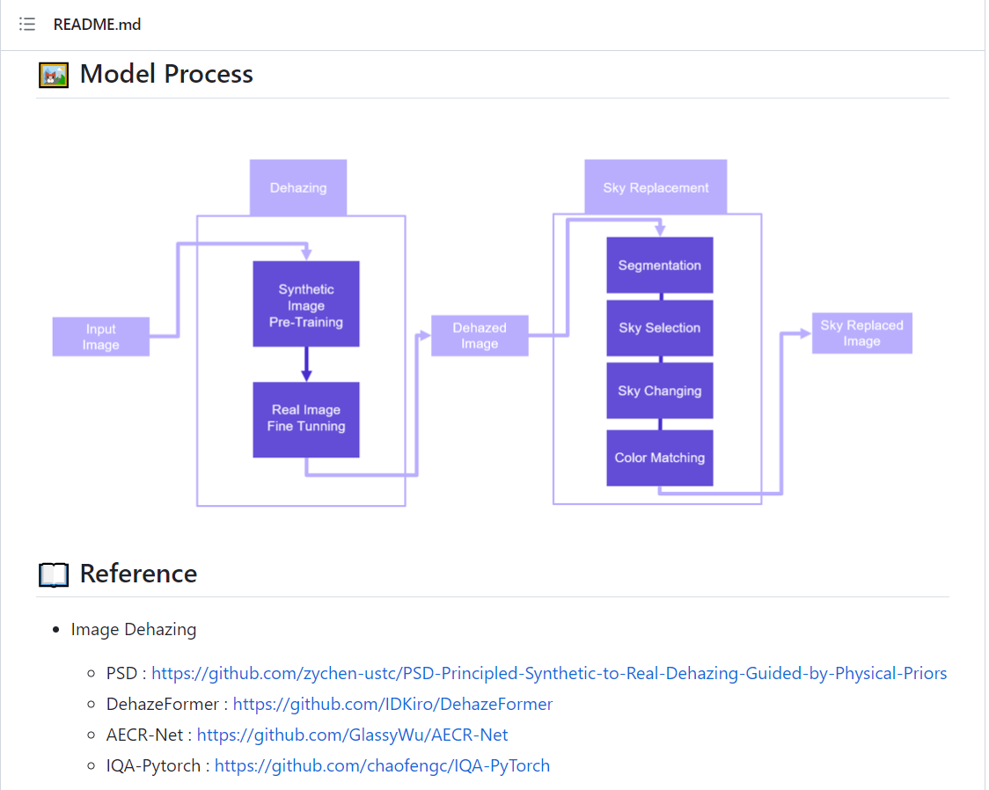
KHUDA Github
Notes:
글씨체 : NotoSans

Slide 5
KHUDA Github
https://github.com/boostcampaitech3
https://github.com/boostcampaitech3/Overview
https://github.com/boostcampaitech3/Overview/blob/main/Final_Project_List.md
https://github.com/boostcampaitech3/final-project-level3-nlp-03
https://github.com/boostcampaitech3/final-project-level3-recsys-14
https://github.com/boostcampaitech3/final-project-level3-cv-17
Notes:
글씨체 : NotoSans

Slide 6
Thank You
Any Question?
Notes:
글씨체 : NotoSans

