Slide 1
Classes
By Anastasiia Khudnytska

Slide 2
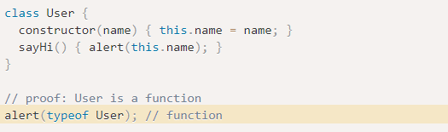
What is Classes?
ES6, also known as ECMAScript2015, introduced classes.
A class is a type of function, but instead of using the keyword function to initiate it, we use the keyword class, and the properties are assigned inside a constructor() method. Under the hood, classes in JS are objects.

Slide 3
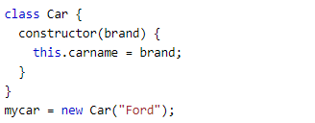
Class Definition
Use the keyword class to create a class, and always add the constructor() method.
The constructor method is called each time the class object is initialized.
Create an object called "mycar" based on the Car class:

Slide 4
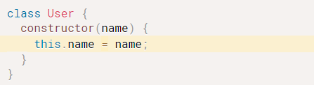
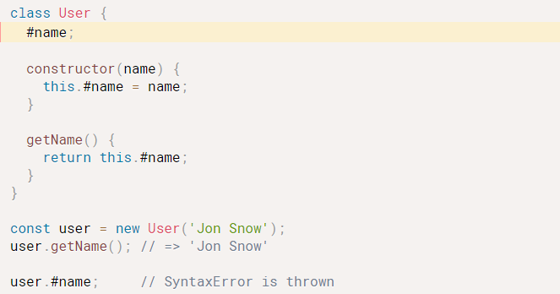

Public instance fields vs Private instance fields
Encapsulation is an important concept that lets you hide the internal details of a class. A good way to hide internal data of an object is to use the private fields. These are the fields that can be read and change only within the class they belong to. The outside world of the class cannot change private fields directly. The prefix # must be kept every time you work with the field: declare it, read it, or modify it.
name is a public field because you can access it outside of the User class body.

Slide 5
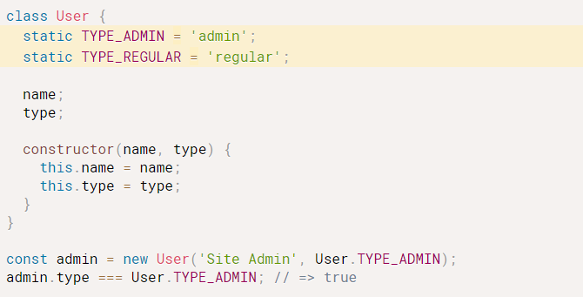
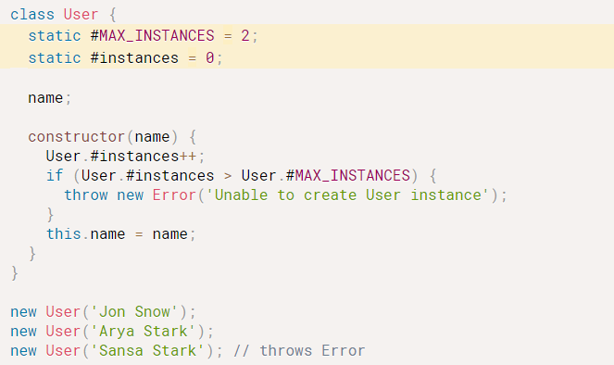
Public static fields vs Private static fields
Static properties are used in cases where we would like to save data at the class level, and not just one object or store information specific to the class.
Let’s say you’d like to limit the number of instances of the User class. To hide the details about instances limits, you can create the private static fields:

Slide 6
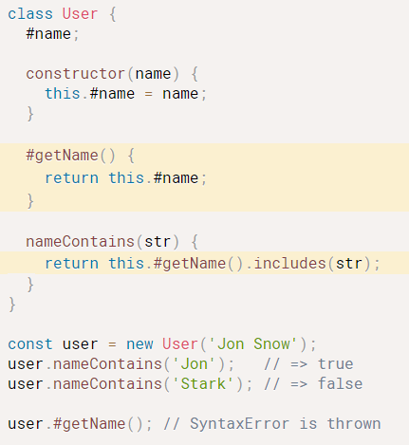
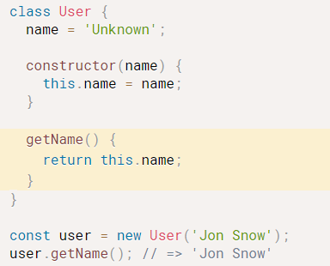
Methods
A method can also be private. To make the method private prefix its name with #.
The fields hold data. But the ability to modify data is performed by special functions that are a part of the class: the methods. The JavaScript classes support both instance and static methods.

Slide 7
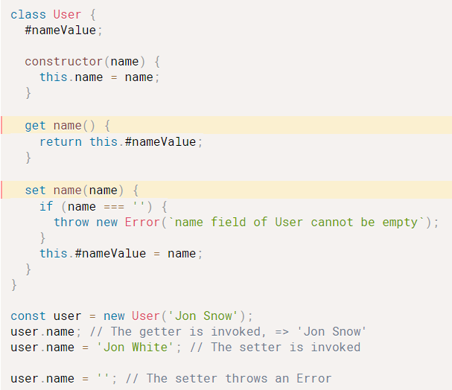
Getters and setters
To make sure that the name property of the User cannot be empty, let’s wrap the private field #nameValue in a getter and setter:
The getter and setter mimic regular field, but with more control on how the field is accessed and changed.
Get and set allows us to run code on the reading or writing of a property. Getters, as the name suggests, is a method that lets us get some data from a class. Setters are methods that gives us the ability to set some fields of the class.

Slide 8
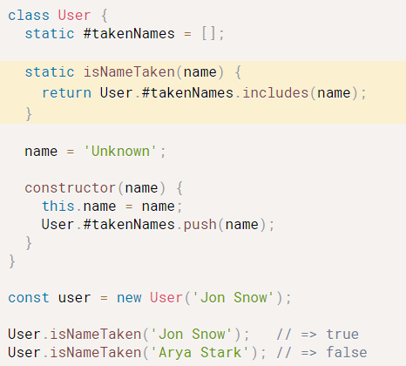
Static methods
The static methods are functions attached directly to the class. They hold logic related to the class, rather than to the instance of the class.
When working with static methods, there are 2 simple rules to remember:
A static method can access static fields
A static method cannot access instance fields.
For example, let’s create a static method that detects whether a user with a specific name was already taken.

Slide 9
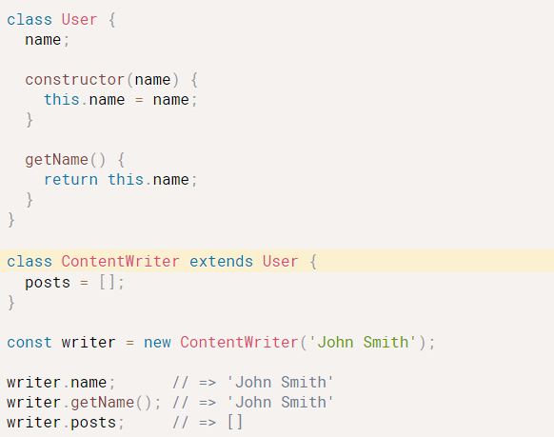
Inheritance: extends
The classes in JavaScript support single inheritance using the extends keyword.
In the expression class Child extends Parent { } the Child class inherits from Parent the constructor, fields, and methods.
For example, let’s create a new child class ContentWriter that extends the parent class User.
ContentWriter inherits from the User the constructor, the method getName() and the field name. As well, the ContentWriter class declares a new field posts.
Note that private members of a parent class are not inherited by the child class.

Slide 10
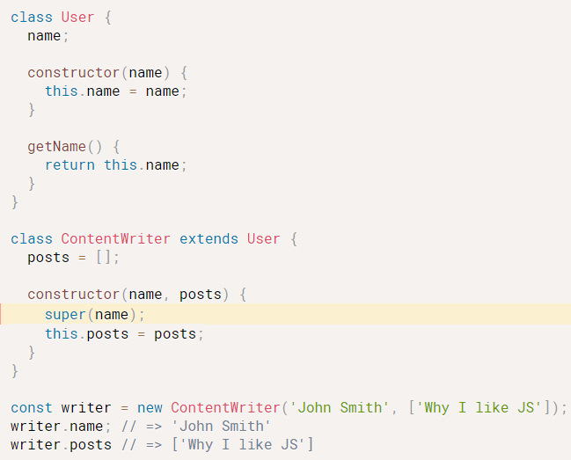
Parent constructor: super() in constructor()
If you’d like to call the parent constructor in a child class, you need to use the super() special function available in the child constructor.
For example, let’s make ContentWriter constructor call the parent constructor of User, as well as initialize the posts field:
super(name) inside the child class ContentWriter executes the constructor of the parent class User.

Slide 11
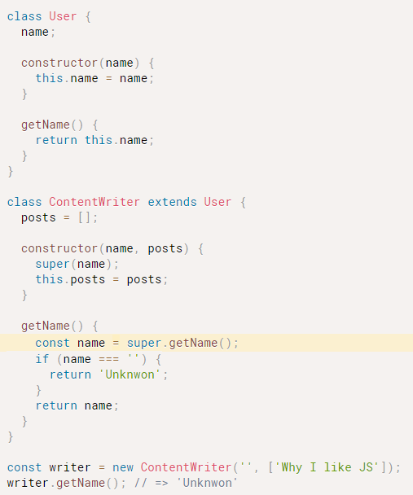
Parent instance: super in methods
If you’d like to access the parent method inside of a child method, you can use the special shortcut super.
getName() of the child class ContentWriter accesses the method super.getName() directly from the parent class User.
This feature is called method overriding.

Slide 12
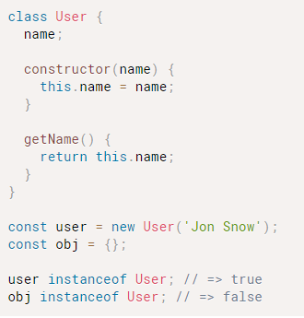
Object type checking: instanceof
object instanceof Class is the operator that determines if object is an instance of Class.
user is an instance of User class, user instanceof User evaluates to true.
The empty object {} is not an instance of User, correspondingly obj instanceof User is false.
instanceof is polymorphic: the operator detects a child as an instance of the parent class.

Slide 13
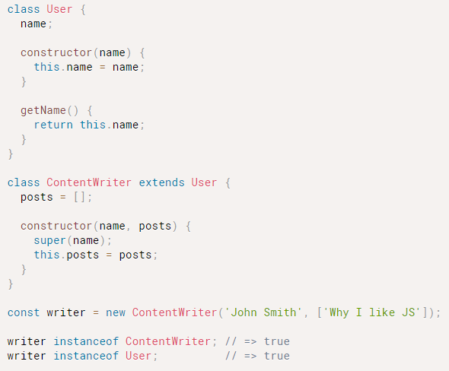
Object type checking: instanceof
writer is an instance of the child class ContentWriter. The operator writer instanceof ContentWriter evaluates to true.
At the same time ContentWriter is a child class of User. So writer instanceof User evaluates to true as well.
What if you’d like to determine the exact class of the instance? You can use the constructor property and compare directly with the class:

Slide 14
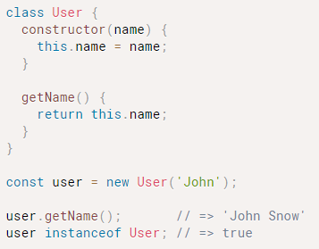
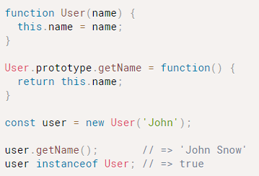
Classes and prototypes
I must say that the class syntax in JavaScript does a great job to abstract from the prototypal inheritance. To describe the class syntax I haven’t even used the term prototype.
But the classes are built on top of the prototypal inheritance. Every class is a function, and creates an instance when invoked as a constructor.
The following two code snippets are equivalent.
The class version:
The version using prototype:

Slide 15
Conclusion
JavaScript classes initialize instances with constructors, define fields and methods. You can attach fields and methods even on the class itself using the static keyword.
Inheritance is achieved using extends keyword: you can easily create a child class from a parent. super keyword is used to access the parent class from a child class.
To take advantage of encapsulation, make the fields and methods private to hide the internal details of your classes. The private fields and methods names must begin with #.
The classes in JavaScript become more and more convenient to use.

Slide 16
Reference
1) https://www.w3schools.com/Js/js_classes.asp
2) https://coryrylan.com/blog/javascript-es6-class-syntax
3) https://dmitripavlutin.com/javascript-classes-complete-guide/#1-definition-class-keyword

Slide 17


