Slide 1
React Hooks
By Anastasiia Khudnytska

Slide 2
What is Hooks?
Hooks are a new addition in React 16.8. They let you use state and other React features without writing a class.
Hooks are functions that let you “hook into” React state and lifecycle features from on components. Hooks don’t work inside classes — they let you use Rfunctieact without classes.
React provides a few built-in Hooks like useState. You can also create your own Hooks to reuse stateful behavior between different components. We’ll look at the built-in Hooks first.

Slide 3
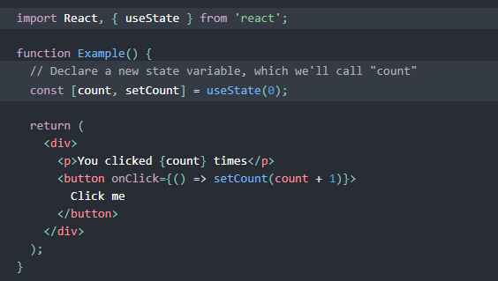

State Hook
This example renders a counter. When you click the button, it increments the value:
Here, useState is a Hook . We call it inside a function component to add some local state to it. React will preserve this state between re-renders. useState returns a pair: the current state value and a function that lets you update it.
The only argument to useState is the initial state. In the example above, it is 0 because our counter starts from zero.

Slide 4
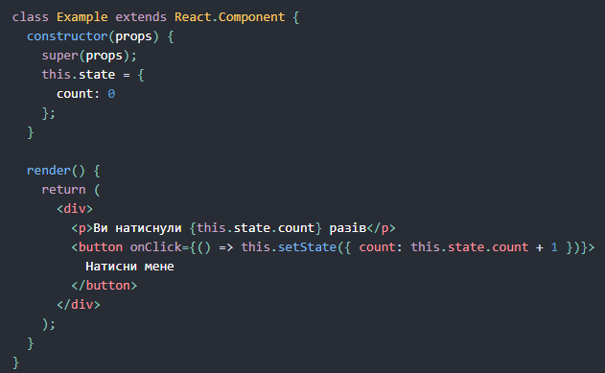
Hook VS Class

Slide 5
Effect Hook
We call these operations “side effects” (or “effects” for short) because they can affect other components and can’t be done during rendering. The Effect Hook, useEffect, adds the ability to perform side effects from a function component. It serves the same purpose as componentDidMount, componentDidUpdate, and componentWillUnmount in React classes, but unified into a single API.

Slide 6
There are two common kinds of side effects in React components: those that don’t require cleanup, and those that do. Let’s look at this distinction in more detail.
Effects Without Cleanup
Sometimes, we want to run some additional code after React has updated the DOM. Network requests, manual DOM mutations, and logging are common examples of effects that don’t require a cleanup. We say that because we can run them and immediately forget about them. Let’s compare how classes and Hooks let us express such side effects.
Effects with Cleanup
For example, we might want to set up a subscription to some external data source. In that case, it is important to clean up so that we don’t introduce a memory leak! Let’s compare how we can do it with classes and with Hooks.

Slide 7
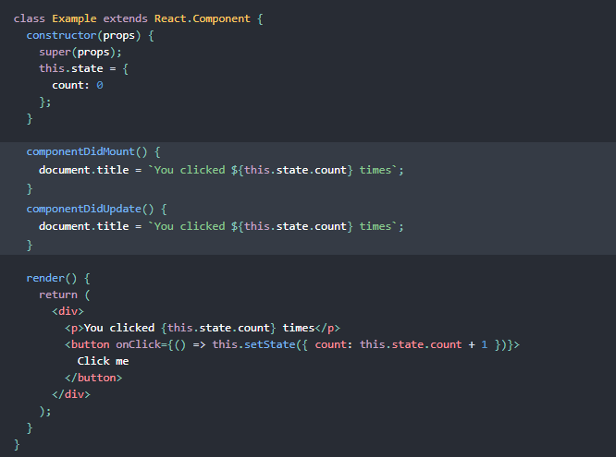
Effects Without Cleanup (Class)
In React class components, the render method itself shouldn’t cause side effects. It would be too early — we typically want to perform our effects after React has updated the DOM.
This is why in React classes, we put side effects into componentDidMount and componentDidUpdate. Coming back to our example, here is a React counter class component that updates the document title right after React makes changes to the DOM

Slide 8
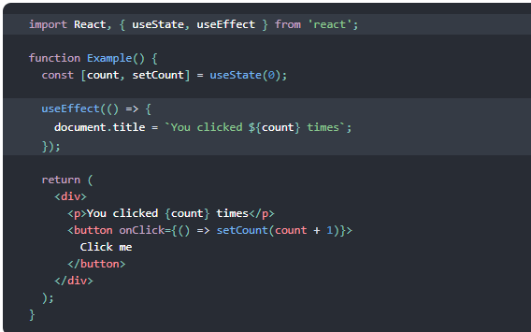
Effects Without Cleanup (Hook)
What does useEffect do?
By using this Hook, you tell React that your component needs to do something after render. React will remember the function you passed (we’ll refer to it as our “effect”), and call it later after performing the DOM updates. In this effect, we set the document title, but we could also perform data fetching or call some other imperative API.
Why is useEffect called inside a component?
Placing useEffect inside the component lets us access the count state variable (or any props) right from the effect. We don’t need a special API to read it — it’s already in the function scope. Hooks embrace JavaScript closures and avoid introducing React-specific APIs where JavaScript already provides a solution.

Slide 9
Tip
Unlike componentDidMount or componentDidUpdate, effects scheduled with useEffect don’t block the browser from updating the screen. This makes your app feel more responsive. The majority of effects don’t need to happen synchronously.

Slide 10
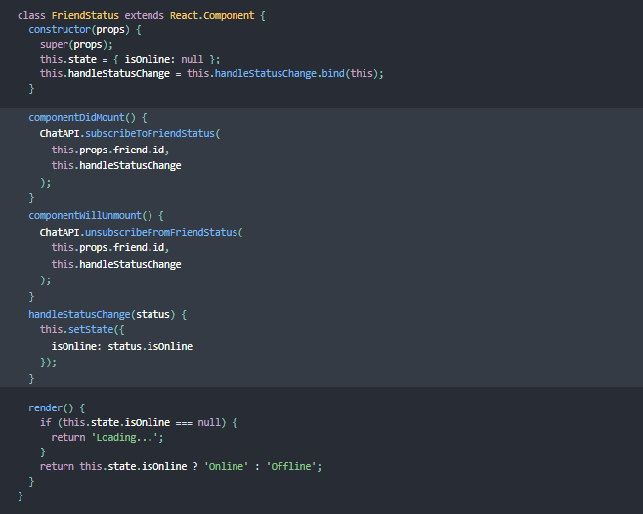
Effects with Cleanup (Class)
Notice how componentDidMount and componentWillUnmountneed to mirror each other. Lifecycle methods force us to split this logic even though conceptually code in both of them is related to the same effect.

Slide 11
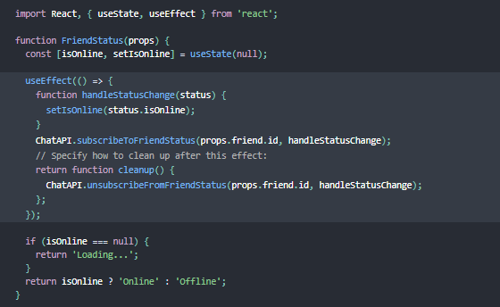
Effects with Cleanup (Hook)
Why did we return a function from our effect?
This is the optional cleanup mechanism for effects. Every effect may return a function that cleans up after it. This lets us keep the logic for adding and removing subscriptions close to each other. They’re part of the same effect!
When exactly does React clean up an effect?
React performs the cleanup when the component unmounts. However, as we learned earlier, effects run for every render and not just once. This is why React also cleans up effects from the previous render before running the effects next time. We’ll discuss why this helps avoid bugs and how to opt out of this behavior in case it creates performance issues later below.

Slide 12
UseContext Hook
Accepts a context object (the value returned from React.createContext) and returns the current context value for that context. The current context value is determined by the value prop of the nearest <MyContext.Provider> above the calling component in the tree.
When the nearest <MyContext.Provider> above the component updates, this Hook will trigger a rerender with the latest context value passed to that MyContext provider.
Don’t forget that the argument to useContext must be the context object itself:
Correct: useContext(MyContext)
Incorrect: useContext(MyContext.Consumer)
Incorrect: useContext(MyContext.Provider)

Slide 13
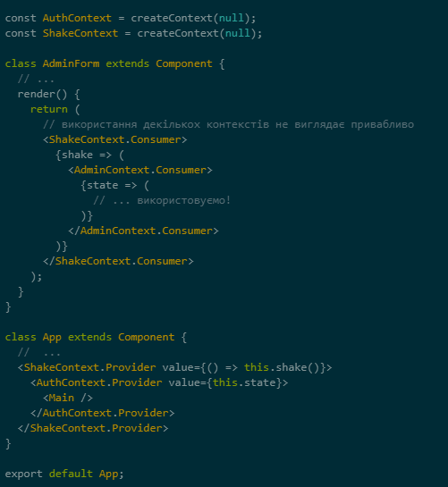
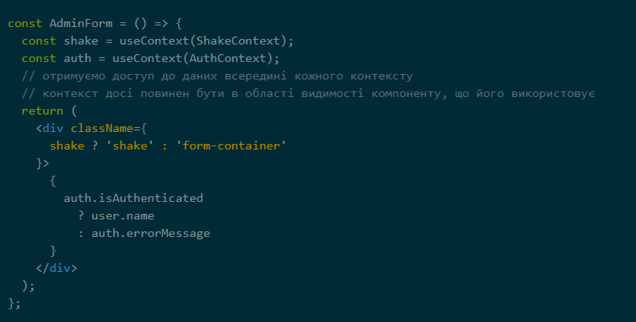
Without / with UseContext Hook

Slide 14
Additional Hooks
useReducer
useCallback
useMemo
useRef
useImperativeHandle
useLayoutEffect
useDebugValue

Slide 15
Reference
1) https://codeguida.com/post/1818
2) https://build-in-saratov.com/usecontext-hook/
3) https://reactjs.org/docs/hooks-intro.html

Slide 16


