Slide 1
TypeScript
By Anastasiia Khudnytska

Slide 2
What is TypeScript?
TypeScript is a programming language compiled into JavaScript and designed specifically for large applications. It has inherited much from languages such as Java and C #, which are more disciplined and rigorous than dynamically typed JS.

Slide 3
Why TypeScript?
Helps in large scale JavaScript application development.
Adds additional features like Static Type (optional), Class, Module etc. (that are not present in JavaScript) to JavaScript
Runs on Any browser, Any host, Any OS.
Open Source. The compiler is an open source project .
Due to static typing, code in TypeScript is more predictable and therefore easy to debug.

Slide 4

How does it work?

Slide 5


Installation
Use npm:
Compile main.ts into main.js:

Slide 6

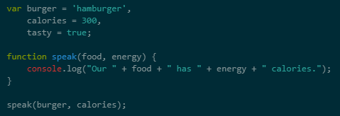

Types
TS
JS

Slide 7
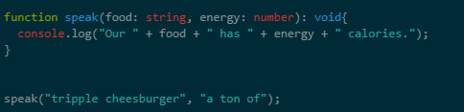
Types

Slide 8
Available types
Any
Primitive
Number
Boolean
String
Void
Null
Undefined
Array
Enum

Slide 9
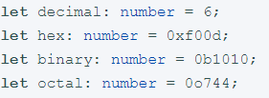


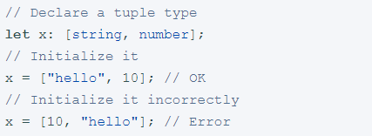


Number ( TS also supports binary and octal literals introduced in ECMAScript 2015.)
Boolean
String
Tuple (Tuple types allow you to express an array with a fixed number of elements whose types are known, but need not be the same.)
Array

Slide 10




Enum
By default, enums begin numbering their members starting at 0. You can change this by manually setting the value of one of its members. For example, we can start the previous example at 1 instead of 0:
Any
We may need to describe the type of variables that we do not know when we are writing an application. These values may come from dynamic content, e.g. from the user or a 3rd party library. In these cases, we want to opt-out of type checking and let the values pass through compile-time checks. To do so, we label these with the any type:
The any type is also handy if you know some part of the type, but perhaps not all of it. For example, you may have an array but the array has a mix of different types:

Slide 11



Void
void is a little like the opposite of any: the absence of having any type at all. You may commonly see this as the return type of functions that do not return a value:
Null and Undefined
Never
The never type represents the type of values that never occur.

Slide 12
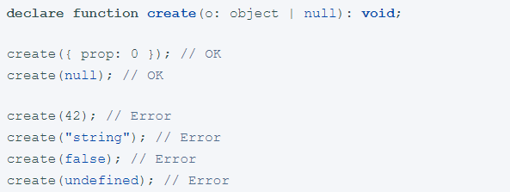
Object
Object.create () and Object.setPrototypeOf () now describe the prototype parameter as object | null:

Slide 13
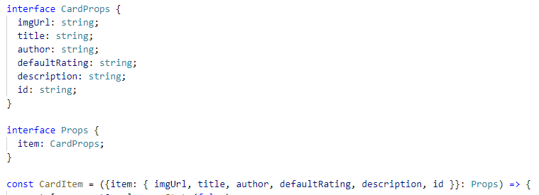
Interfaces
One of TypeScript’s core principles is that type checking focuses on the shape that values have. In TypeScript, interfaces fill the role of naming these types, and are a powerful way of defining contracts within your code as well as contracts with code outside of your project.

Slide 14
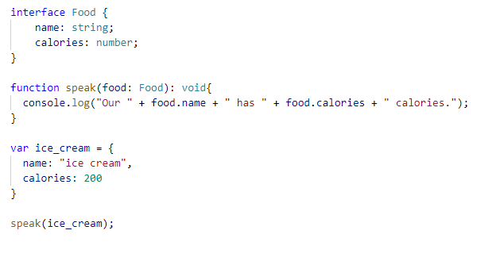
Interfaces

Slide 15
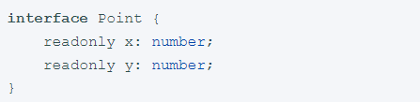
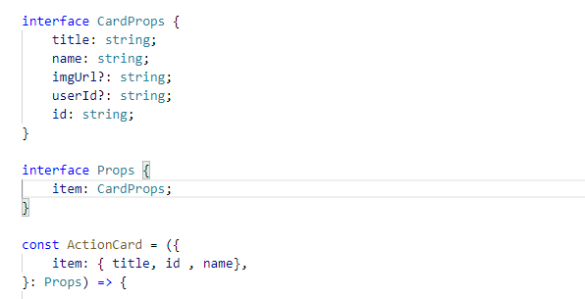

Interfaces
Some properties should only be modifiable when an object is first created. You can specify this by putting readonly before the name of the property:
Not all properties of an interface may be required. Some exist under certain conditions or may not be there at all.
You can construct a Point by assigning an object literal. After the assignment, x and y can’t be changed.

Slide 16
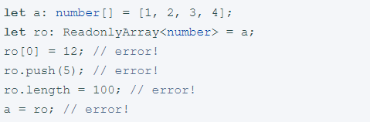
Interfaces
TypeScript comes with a ReadonlyArray<T> type that is the same as Array<T> with all mutating methods removed, so you can make sure you don’t change your arrays after creation:

Slide 17
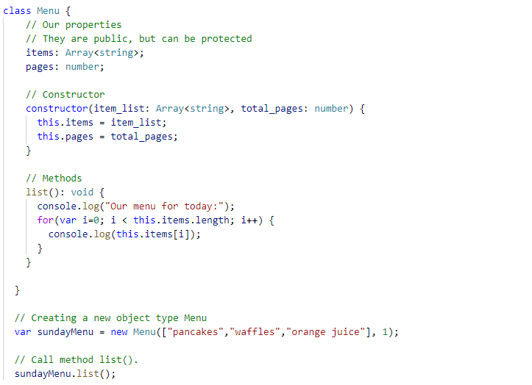
Classes

Slide 18
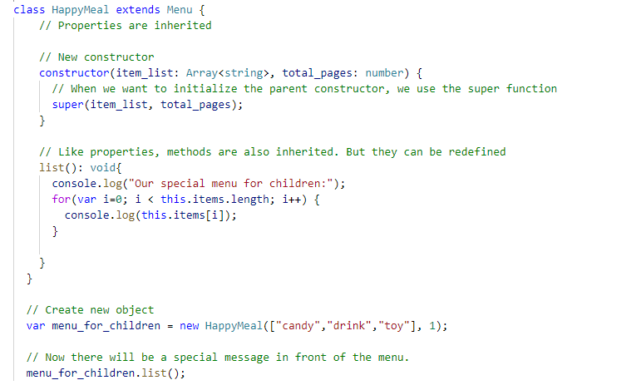
Inheritance

Slide 19
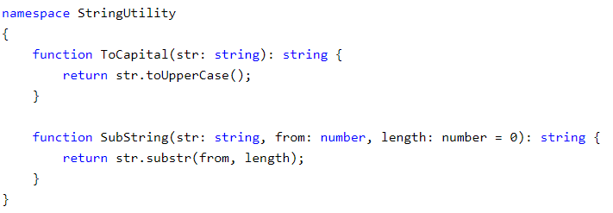
Namespaces
Namespaces can be defines using namespace keyword
A namespace can contain sub module, class, interface or enum. Can not directly contain functions (similar to C#, Java)
Namespace can be nested (sub module)
A namespace is a way that is used for logical grouping of functionalities. It allows us to organize our code in a much cleaner way.
Unlike JavaScript, namespaces are inbuilt into TypeScript. In JavaScript, the variables declarations go into the global scope.
File includes the namespace StringUtility which includes two simple string functions. The StringUtility namespace makes a logical grouping of the important string functions for application.

Slide 20
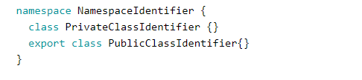
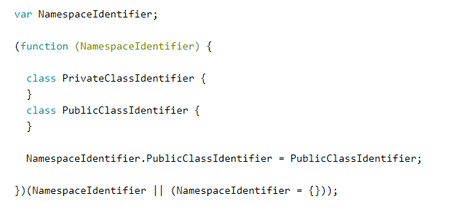
Namespaces
Before compilation
After compilation
It is also worth adding that namespace is a global declaration. This means that the namespace declared as global does not need to be exported and imported, and a link to it is available anywhere in the program.

Slide 21
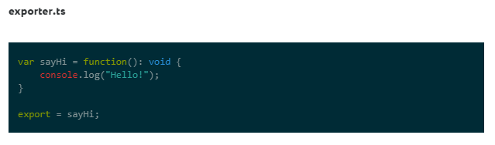
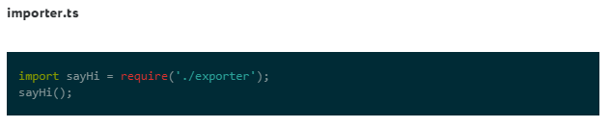
Modules
Modules in TypeScript are defined with support for the export / import keywords and represent the mechanisms for determining memory between modules.

Slide 22
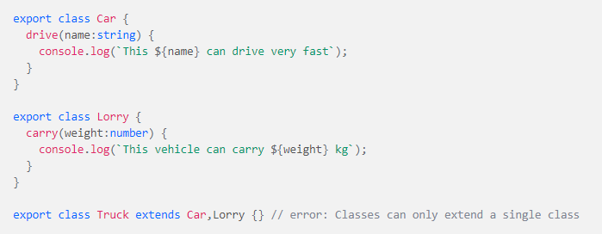
Mixin
Mixins create partial classes which we can combine to form a single class that contains all the methods and properties from the partial classes.
We have two classes, Car and Lorry which contain the drive and carry methods respectively and we want to create a third class called Truck. A truck should contain both drive and carry methods but we can only extend one class in TypeScript. To solve this, we can use mixins:

Slide 23
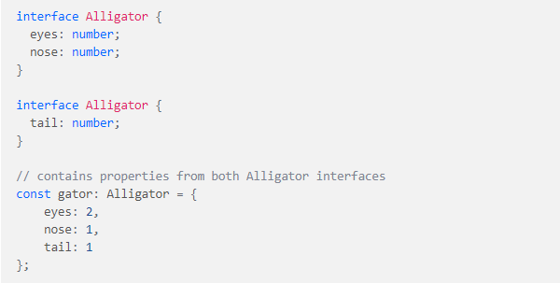

Mixin
To create a mixin, we’ll take advantage of two functionalities of TypeScript:
Interface class extension
Declaration merging
Declaration merging
When two or more declarations are declared with the same name, TypeScript merges them into one.
Interface class extension
Unlike classes, interfaces can extend multiple classes in TypeScript. When an interface extends a class, it extends only the members of the class but not their implementation because interfaces don’t contain implementations.

Slide 24


Mixin
By leveraging these two functionalities in TypeScript, we can create an interface with the same name as Truck and extend both the Car and Lorry classes:
Due to declaration merging, the Truck class will be merged with the Truck interface. This means that, the Truck class will now contain the function definitions from both Car and Lorry classes.
To enable the Truck class to have implementations of the functions inherited from Car and Lorry, we’ll use a helper function found in the TypeScript docs.
The function takes the name of the class to which we want to copy the implementations to as the first argument, which in our case is Truck and takes an array of classes from which we want to copy the implementations as the second argument, which in our case is Car and Lorry.

Slide 25

Mixin
Now, we can access the methods in Car and Lorry from a truck object.

Slide 26
Reference
1)https://www.digitalocean.com/community/tutorials/typescript-mixins
2) https://codeguida.com/post/475
3) https://habr.com/ru/post/258957/
4)

Slide 27


