Slide 1
Tiva Robot Controller Board
Design resources

Slide 2
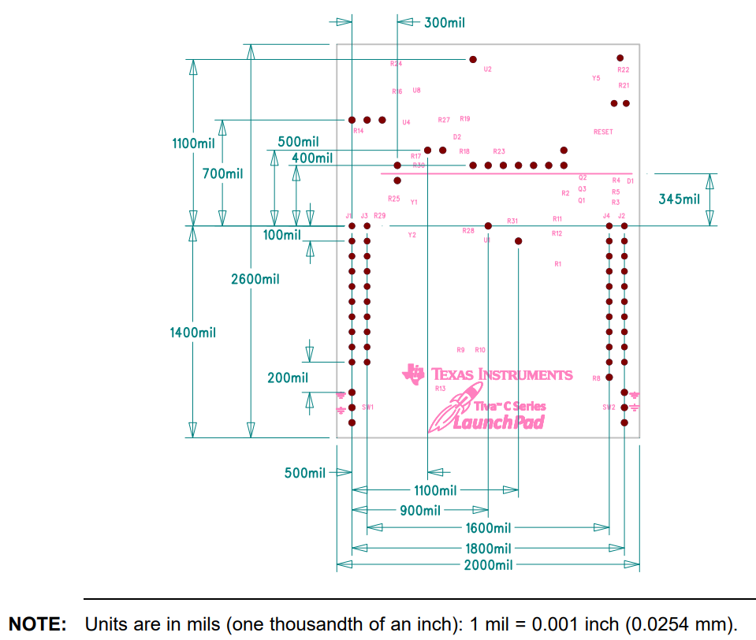
Tiva C LaunchPad Dimensions
https://www.ti.com/lit/ug/spmu296/spmu296.pdf

Slide 3
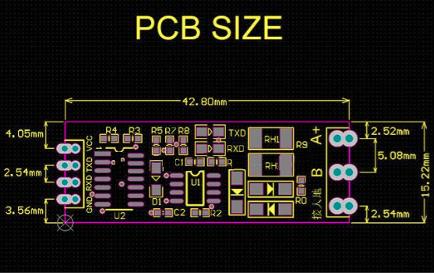
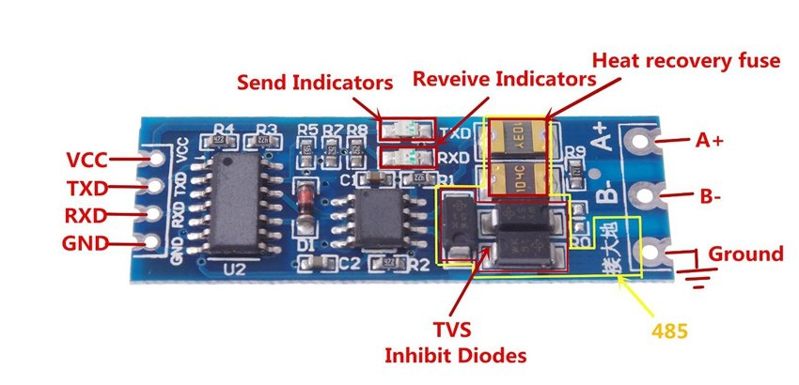
RS485 Module Dimensions

Slide 4
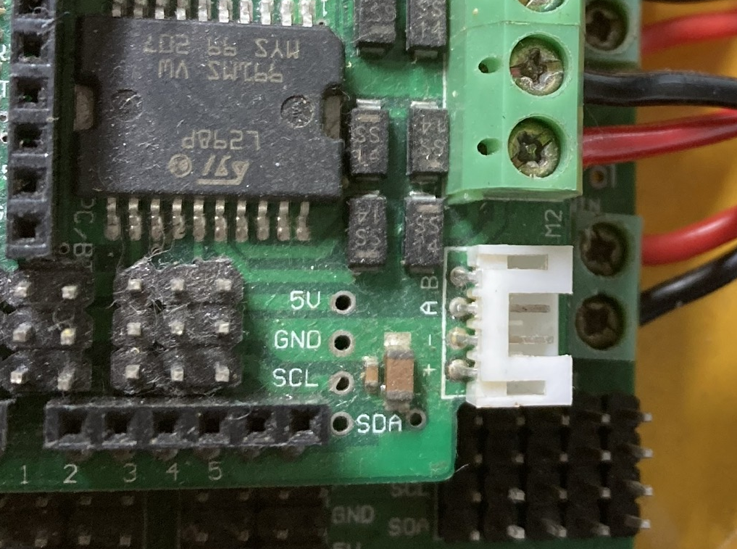
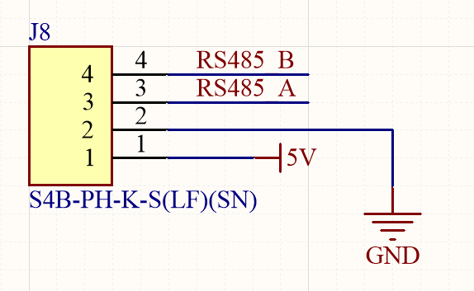
RS485 Pins
+ ： +5V DC Power +5V
- ： GND Ground
A ： A RS485 A(+)
B ： B RS485 B(-)

Slide 5
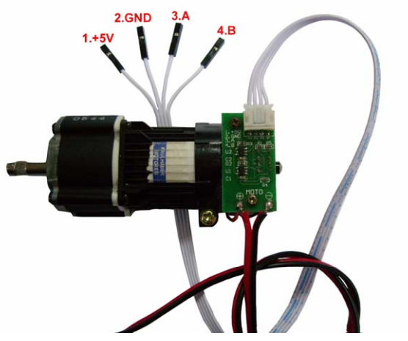
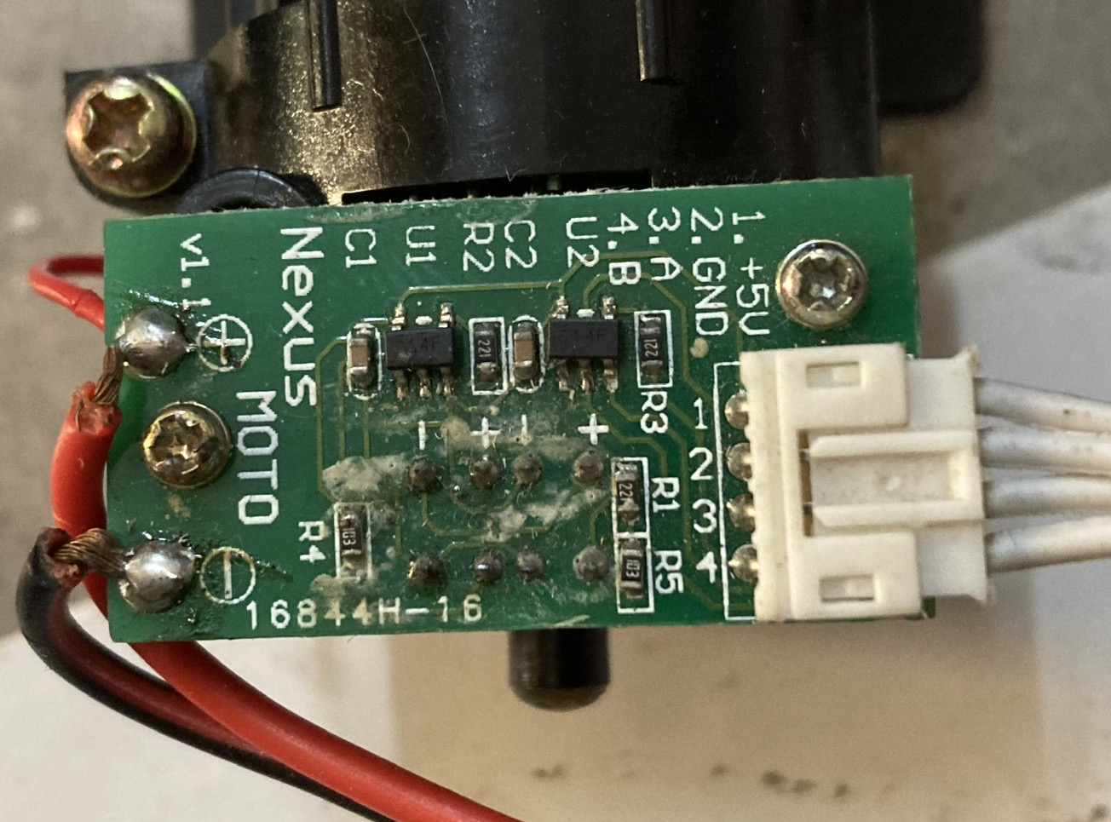
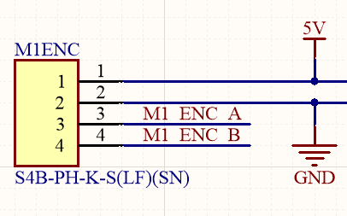
Motor encoder Pins

Slide 6
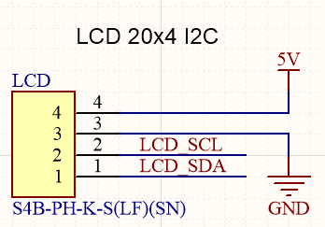
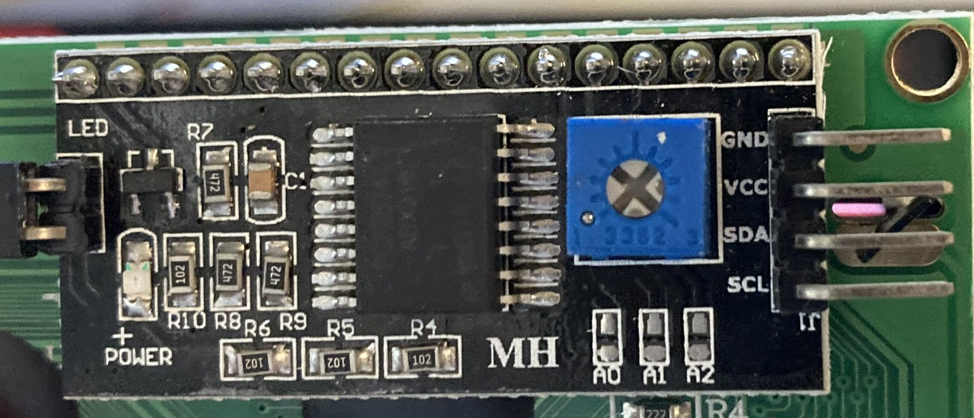
LCD I2C Pins

Slide 7
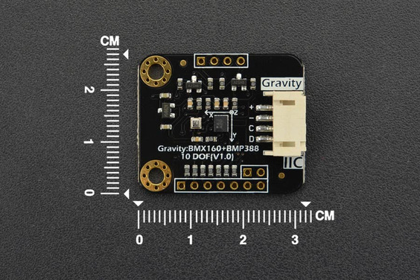
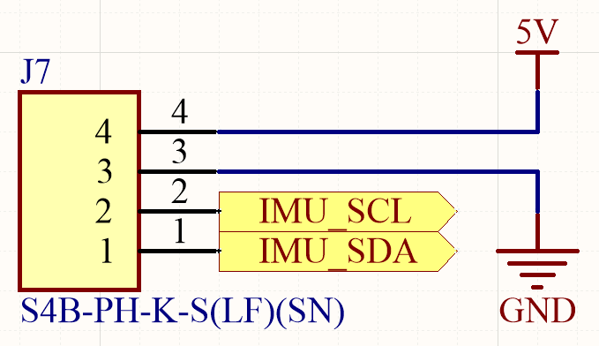
BMX160 I2C Pins

Slide 8
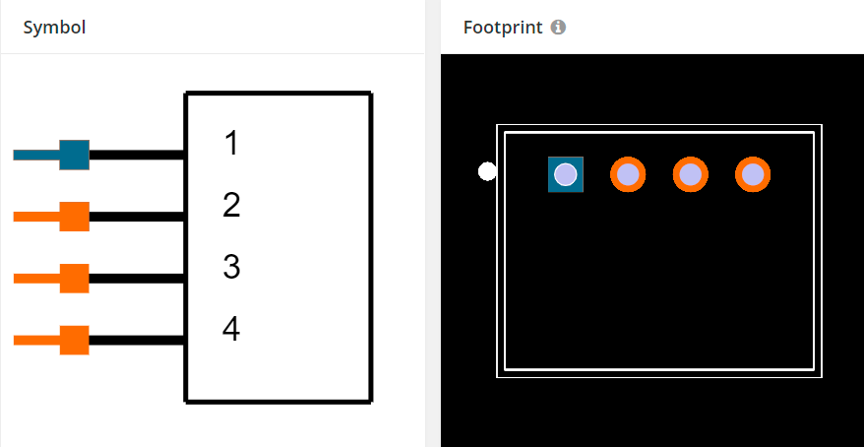
S4B-PH-K-S(LF)(SN) Dimensions
https://www.snapeda.com/parts/S4B-PH-K-S%28LF%29%28SN%29/JST%20Sales/view-part/

