Slide 1
HI02H11_L01_S01 — round 3b: title screen + letter sounds (SME items 1-2)
Page-by-page review · 20 pages

Slide 2
Overall recommendations & open questions
• ROUND-3 FEEDBACK — WHAT WENT IN. Item 1 (title screen) is fully done: subtitle removed, your new greeting line recorded verbatim, and the प/च/म letters now glow. Item 2 (page 2) is PART done: the three sound cards now speak themselves as they appear, which was the third of your three asks. The other two — word-by-word highlight in time with the voice, and highlighting just the four प words during the explanation — are NOT built, because SENTENCE_SOUND has no per-word audio and no per-word timing to hang a highlight on. I did not fake them; details and the engine ask are in _SME_FEEDBACK_ROUND3.md.
• WHAT CHANGED SINCE THE LAST DECK — three things, all from your notes. (1) The LANDING now carries the प / च म letter strip under the heading, using the engine's own [S03P2-p] letter case; it is visual-only by design so it adds no clip. (2) The four sentences I had composed are REPLACED with new ones; the curriculum's own line is untouched. (3) Two presentation conventions adopted from HIKGH04_L01_S02: the stage now sets theme "toybox" (this lesson had NO theme, so the stage was bare — a house-rule miss), and the subtitle now lists the lesson's beats separated by "·", the way that game's does. The eight clips affected by the new sentences were regenerated, all on the lesson's own voice.
• WHAT CHANGED — this is round 2, rebuilt to your recommendations. The lesson went from 17 slides to 19 (6 teach / 5 guided / 8 practice), the TEACH PHASE WAS REORDERED so it opens on the sentence and names the letter afterwards, all three of your 'Must Add' slides were added, and every child-facing line was reworded.
• THE REORDER IS THE MAIN CHANGE. Old flow: letter → sentence → identify → practice. New flow: SENTENCE / AUDIO DISCOVERY → identify the repeated sound → connect that sound to its वर्ण → guided → independent. The teach phase now runs that cycle three times, once each for प, च and म, so every sound the child is tested on was first discovered inside a sentence. This is what the curriculum row actually asks for; the old order taught letter recognition.
• THREE SLIDES ADDED, all from your list. (1) Page 2 «सुनो और खोजो» — sentence-level sound discovery before any letter is named. (2) Page 8 «सुनो और पहचानो» — a one-word हाँ / नहीं check before the first hunt. (3) Page 14 «ध्वनि कहाँ है?» — the beginning-vs-middle bridge, placed immediately before the mixed-position practice.
• NO NEW MECHANIC WAS INVENTED. The हाँ/नहीं check reuses the engine's existing two-option single-stimulus pick (TAP_VACHAN); the position bridge reuses the same two-bin sort as the sound sort. Both are documented modules already in the engine, so nothing here needs dev work.
• WORDING — three rules, applied everywhere. «ध्वनि» → «आवाज़» in everything a child hears or reads. «पंक्ति» → «वाक्य». «प वाले शब्द» → «प की आवाज़ वाले शब्द», so the child listens instead of hunting the printed letter. «ध्वनि» now survives in only two places: the lesson TITLE, which you asked to keep, and the curriculum row quoted verbatim in the metadata, which no child sees.
• PLEASE CHECK 1 — REGISTER, AND THIS ONE BLOCKS NOTHING BUT LOOKS ODD IF LEFT. Your round-2 copy is all TUM («सुनो», «टैप करो», «क्या तुम उसे पहचान सकते हो?»), so the whole lesson is now tum, and the generic retry line was moved out of the shared clip set and re-scripted in tum. BUT the three phase-gate clips the engine plays between phases are SHARED across every game and are recorded in AAP — «ध्यान से देखिए…», «अब आपकी बारी». KG and Grade 1 are aap there too. So Grade 2 currently switches register at each phase gate. One ruling settles it for G2 and G3: re-record the three gates in tum, or take this lesson back to aap.
• PLEASE CHECK 2 — THE NEW CHECK HAS ONLY A «हाँ». Page 8's single item (पानी, प) is correctly answered हाँ, so a child who always answers हाँ passes it. Tell me if you want a second «नहीं» item — there is room in the guided phase.
• PLEASE CHECK 3 — THE FOUR SENTENCES I WROTE ARE ALL NEW THIS ROUND. You asked me to replace my composed lines and keep the curriculum's, so page 2 still carries the row's own example «पीतल के पतीले में पपीता पीला-पीला» unchanged, and the other four are freshly written: page 4 «चूहा चार चने चबाए» (च), page 6 «मामा मीठी मलाई लाए» (म), page 16 «पीला फल पतले पत्ते पर पड़ा» (the ल trap — now stronger: ल recurs 3 times against प opening 5 words), and page 18 «माली ताली खाली» (the rhyme trap — a tighter rhyme, three identical -ाली endings). All words are Sarangi vocabulary; the lines are mine. THESE FOUR ARE THE ONES TO READ ALOUD.
• VOICE IS NOW COMPLETE — all 103 clips are on disk (95 recorded for this lesson + 8 inherited phase-gate/sfx clips). The 67 lines that were silent in the 19:53 build have been generated; audio, flow, wording, layout and interaction are all reviewable now. The receipt rows 'all 95 lines have real audio' and 'every slide SPEAKS its prompt' both went from FAIL to PASS. It is still PLACEHOLDER synthesis — VO_RECORDING_LIST.md carries all 95 lines verbatim for human recording.
• PLEASE CHECK 5 — SEVEN CLIPS CHANGE VOICE, AND IT NEEDS A WORDING TWEAK NOT A RETRY. The lesson is voiced by Kore, but 7 feedback lines are hard-rejected by the TTS model (HTTP 400, "Model tried to generate text") because they read as a question rather than a line to speak. They recovered on Despina/Aoede, so the voice changes on those beats. Retrying does not help — it is deterministic. The 7 are: vo_g1_reveal «पानी में प की आवाज़ है।», vo_g2_try / vo_g4_try / vo_p1_try «इस शब्द की शुरुआत में X की आवाज़ नहीं है। एक बार फिर सुनो।», vo_p3_hint «प की आवाज़ शब्द के बीच में भी हो सकती है।», and vo_g5_prompt / vo_p5_prompt «हर शब्द सुनो और उसे सही टोकरी में डालो।». In round 1 the same class of line was fixed by restructuring it. These are YOUR authored lines so I left them exactly as written — tell me to reword them and all 7 come back on Kore.
• UI CLEAN-UP CARRIED OVER FROM ROUND 1, measured against the KG sibling HIKGH09_L01_S03 that you pointed at. The teach slides no longer print their instruction — it is spoken. The duplicate «फिर सुनो» pill that was landing ON TOP of the answer row is gone. Options now reveal one at a time instead of all at once, and on the tap-all pages the words also fade in one by one and each speaks, so a listening task can no longer be solved by reading.
• ONE THING FOR THE DEV TEAM, NOT FOR YOU. Those three UI fixes exist in engine 2026.08.04b but were LOST in 2026.08.14a and 2026.08.28a, and the round-1 build picked the newest engine and so shipped without them. The builder now rejects any engine whose SENTENCE_SOUND has lost them and lands on 08.04b, printing what it skipped. This needs a forward-port — see _ENGINE_REGRESSION.md in this bundle. Note that 08.04b still emits telemetry as SwiftPAL.emit, not GameBus.emit.
• RECEIPT — 15 pass / 3 FAIL / 6 warn, and every remaining FAIL is a stale expectation in verify_bundle.py rather than a defect: it demands engine 07.16i (which lacks both sound mechanics), the --bg colour the design lead rejected as "yellow", and six retired .gif mascot files. Verified at runtime: 133 resources requested, 0 failures. The 'MCQ-in-costume' warning is a misclassification — it counts the six zero-tap teach slides as tests and bins the tap-all hunt as a pick; computed properly the lesson is 42% scan-and-tap-all / 33% pick / 25% drag-sort and passes. Full evidence in _RECEIPT_ANNOTATION.md. The gate was NOT edited to produce those numbers.

Slide 3
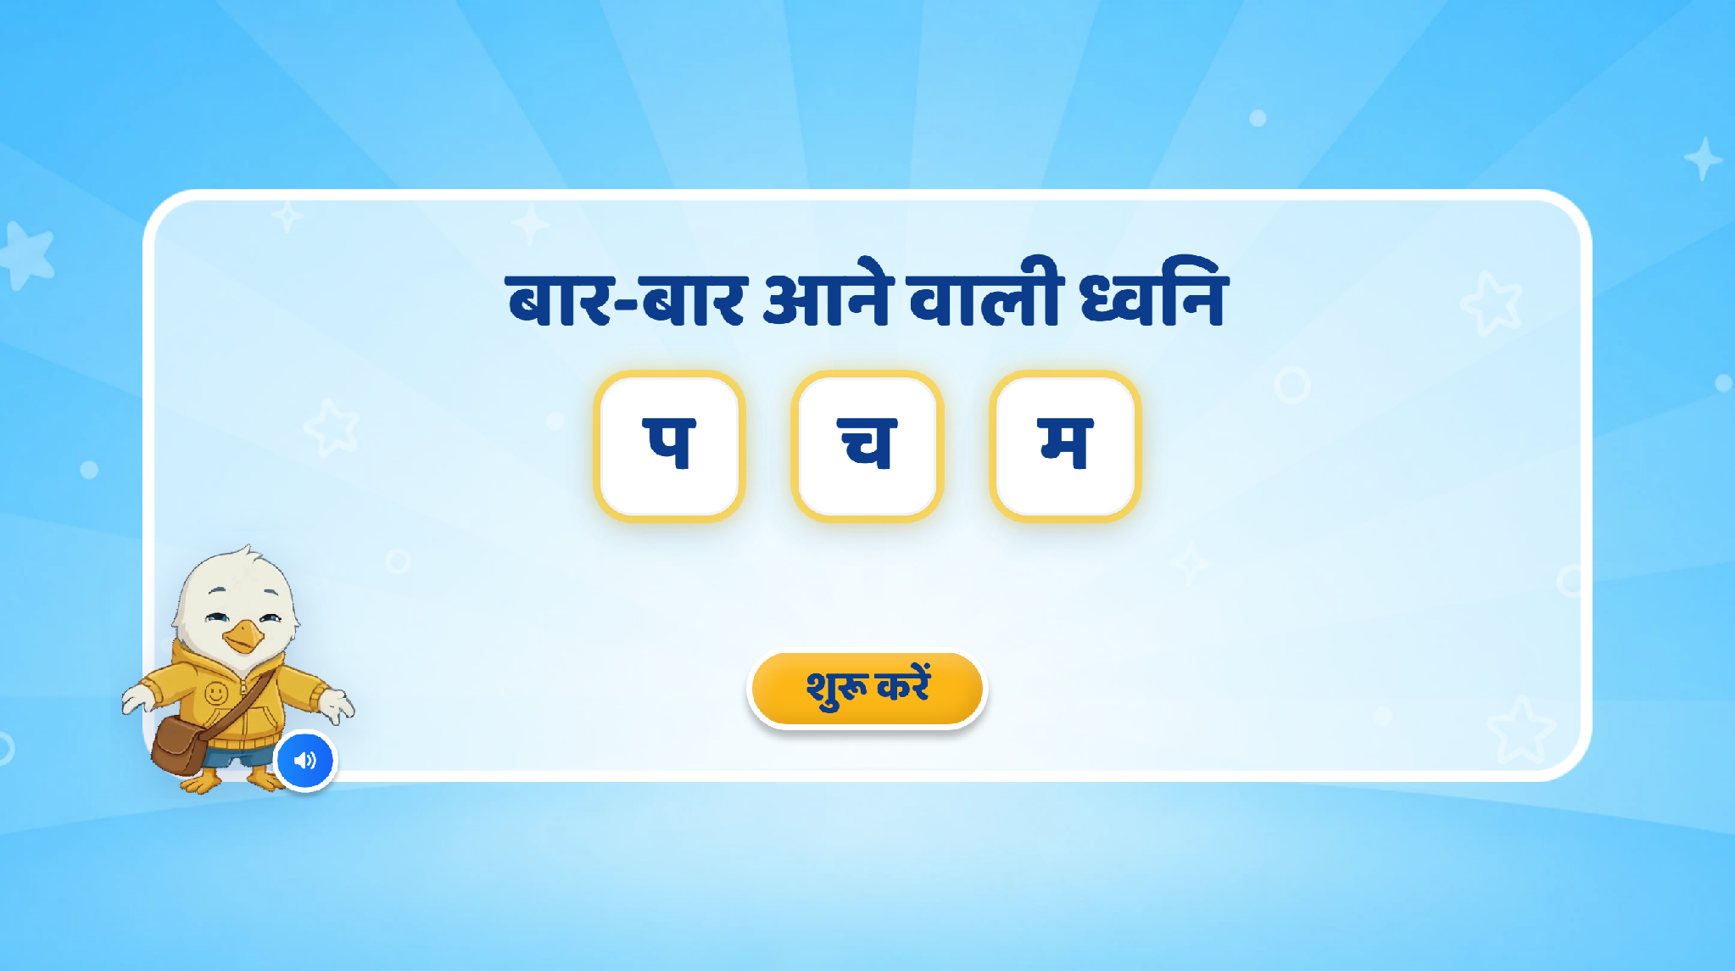
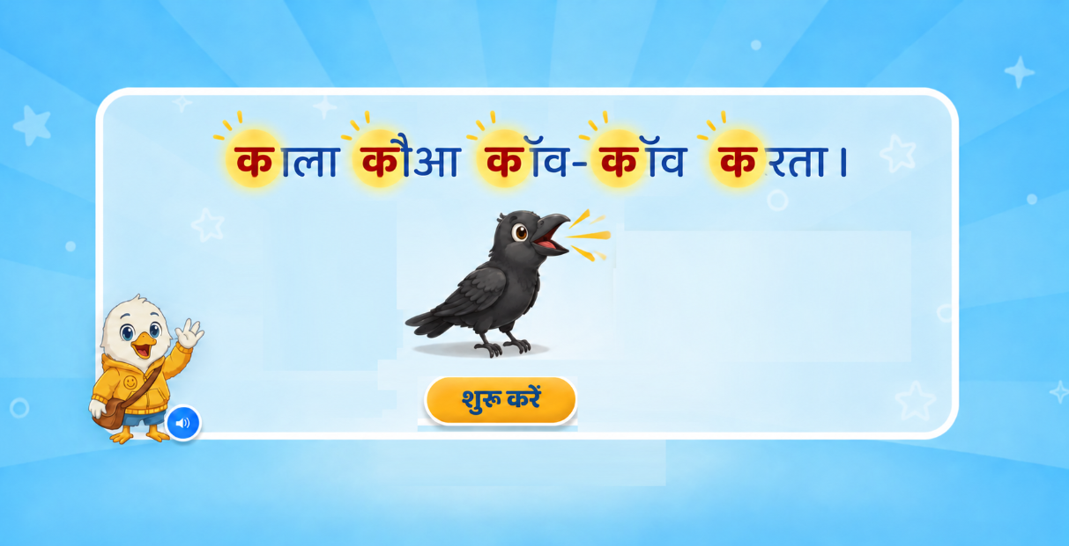
Page 1 · 01_landing.png

Slide 4
Recommendations — Page 1 · 01_landing.png
1. Remove Current Heading Section
Remove the existing heading “बार-बार आने वाली ध्वनि” from this screen.
Remove the current “प, च, म” highlighting animation.
Avoid showing multiple unrelated letters, as this may confuse the learner about the target sound.
2. Add a New Example Heading
Add the following sentence at the top-centre of the screen:
“काला कौआ काँव-काँव करता।”
The sentence should appear with a simple word-by-word animation.
Highlight only the repeated “क” sound in each relevant word:
काला – कौआ – काँव-काँव – करता
Use the same highlight style/colour for every “क”.
Do not highlight the complete word; only highlight the target letter/sound “क”.
3. Add Supporting Visual
Add a clear crow illustration below the sentence.
Keep the crow visually connected to the example but do not let it cover or distract from the sentence.
A small “काँव-काँव” sound effect can play when the crow appears, if suitable.
4. Animation Flow
Recommended sequence:
Sentence appears → words appear one by one → “क” gets highlighted in each word → crow appears → crow sound plays → VO continues.
The highlighting should sync with the VO so the child can hear and visually notice the repeated sound at the same time.
5. Final VO
Suggested VO:
“नमस्ते दोस्त! मैं हूँ Swiftee। आज हम जानेंगे कि वाक्य में कौन-सी ध्वनि बार-बार सुनाई देती है। सुनो—‘काला कौआ काँव-काँव करता।’ इस वाक्य में ‘क’ की ध्वनि यानी आवाज़ बार-बार आ रही है।”

Slide 5
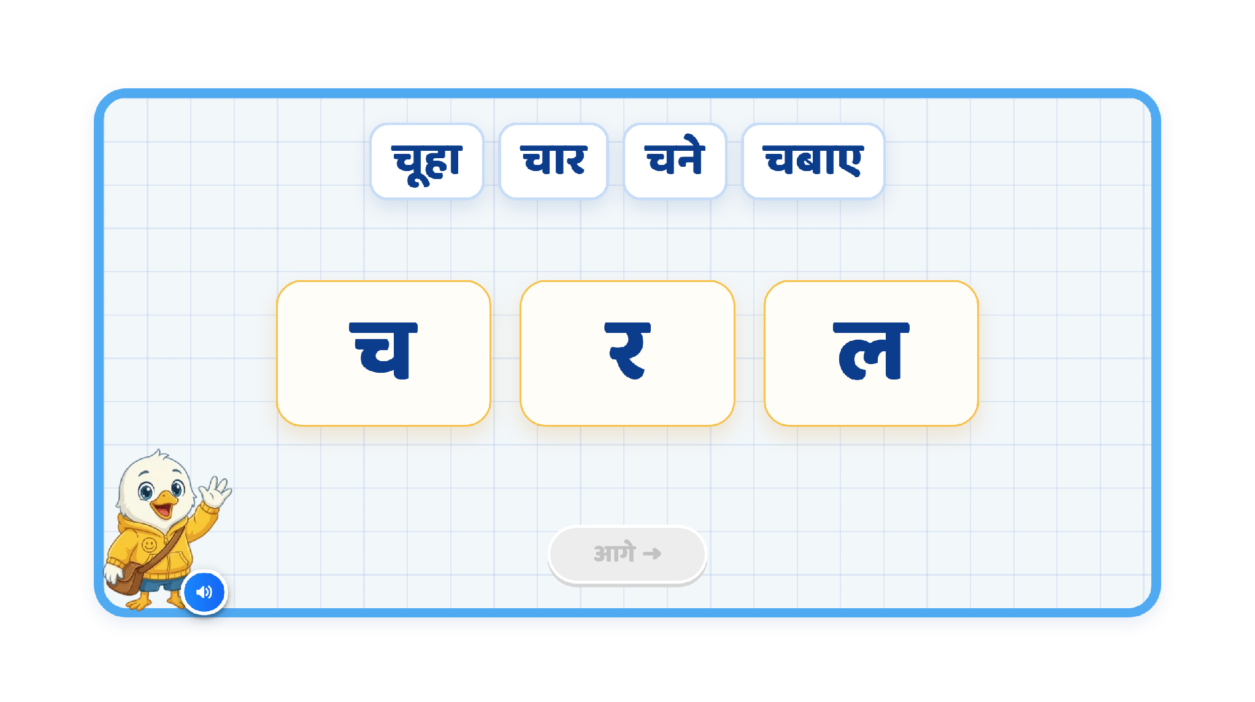
Page 4 · 04_SENTENCE_SOUND.png

Slide 6
Recommendations — Page 4 · 04_SENTENCE_SOUND.png
1. Change the sentence
Replace the current sentence with:
“चूहे ने चार चने चबाए।”
Remove “र” and “ल” from the current activity.
Keep the focus only on the target sound “च”.
2. Sentence Highlight Animation
Play the sentence once with word-by-word highlighting synced with the VO:
चूहे → ने → चार → चने → चबाए
After the sentence is completed, remove the word-level highlighting.
During the explanation, highlight only the letter “च” in:
चूहे, चार, चने, चबाए
Use the same highlight style for every “च”.
3. Sound + Letter Reinforcement
When introducing the target sound, play only the “च” sound.
At the same time, show the letter “च” clearly on screen.
Then explain that the same sound is repeating in different words.
Final VO
VO 1:
“चूहे ने चार चने चबाए।”
VO 2:
“चूहे, चार, चने, चबाए—इन सब शब्दों में ‘च’ की आवाज़ बार-बार आई।”
Keep a brief pause between VO 1 and VO 2 so the child gets a moment to notice the repeated sound before the explanation.

Slide 7
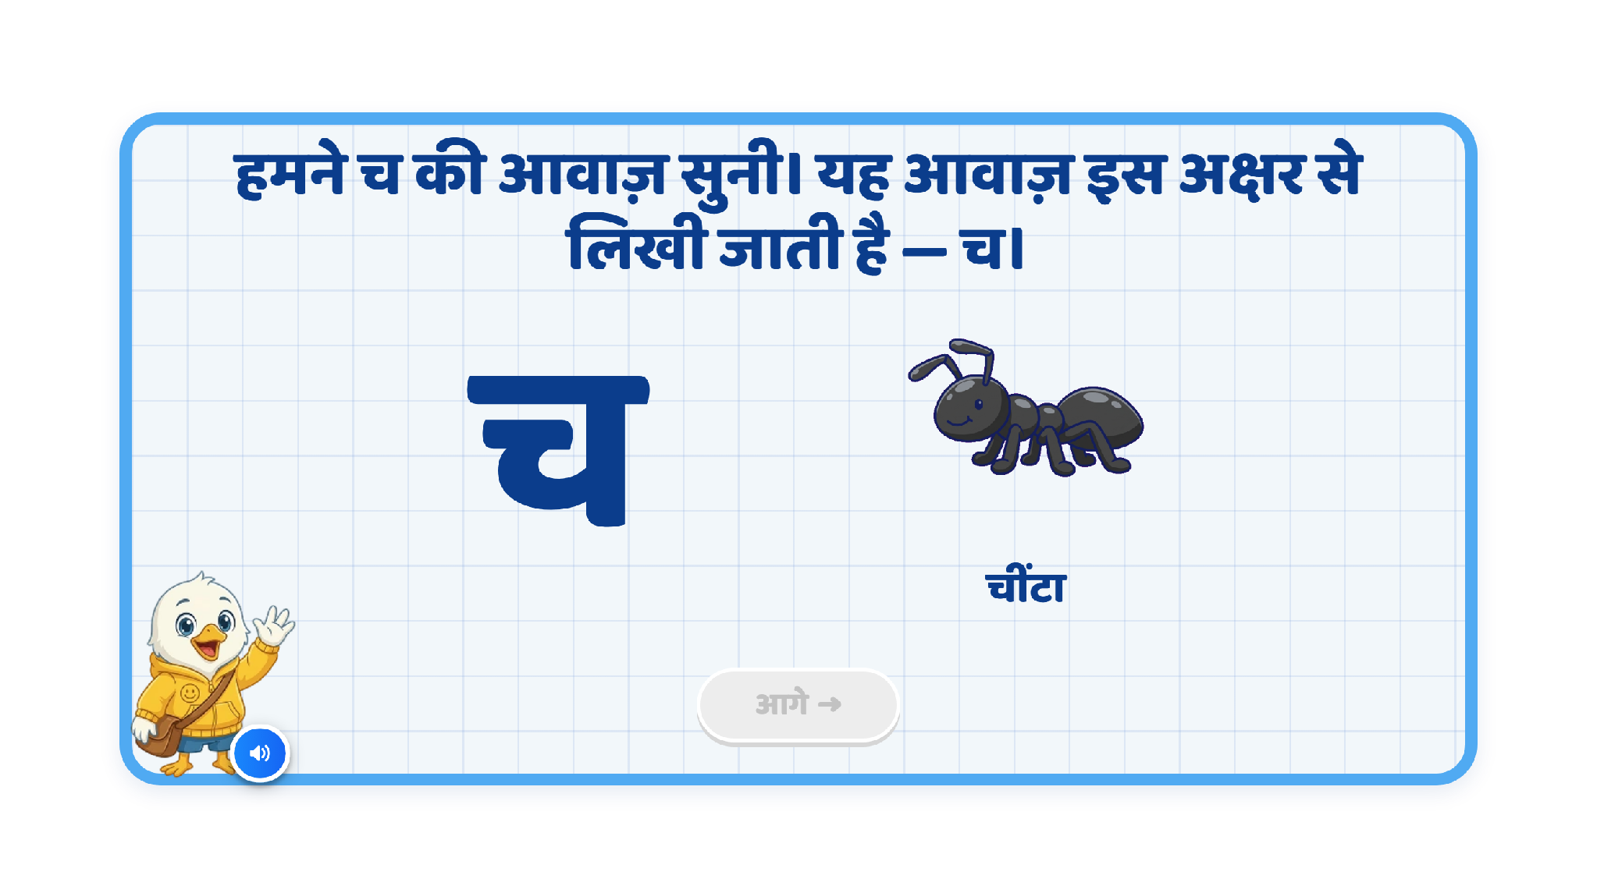
Page 5 · 05_MEET_LETTER.png

Slide 8
Recommendations — Page 5 · 05_MEET_LETTER.png
1. Remove explanatory text from the screen
Remove this text from the screen:
“हमने च की आवाज़ सुनी। यह आवाज़ च अक्षर से लिखी जाती है, जैसे – च से चूहा।”
Keep this as VO only so the screen remains clean and less text-heavy for Grade 2 FLN learners.
2. Letter Highlighting
Keep the letter “च” clearly visible on the left side.
When the VO says “चूहा”, highlight the letter “च”.
The highlighting should appear exactly in sync with the word “चूहा” in the VO.
3. Replace the Current Image
Remove the current ant image.
Add a clear and child-friendly rat/mouse image instead.
Add the label “चूहा” below the image.
Keep the visual large, simple, and easy to recognise.
Final VO
“हमने ‘च’ की आवाज़ सुनी। यह आवाज़ ‘च’ अक्षर से लिखी जाती है। जैसे—च से चूहा।”
Recommended Animation Flow
‘च’ appears → VO explains the sound → ‘च’ gets highlighted → rat/mouse image appears → label ‘चूहा’ appears.

Slide 9
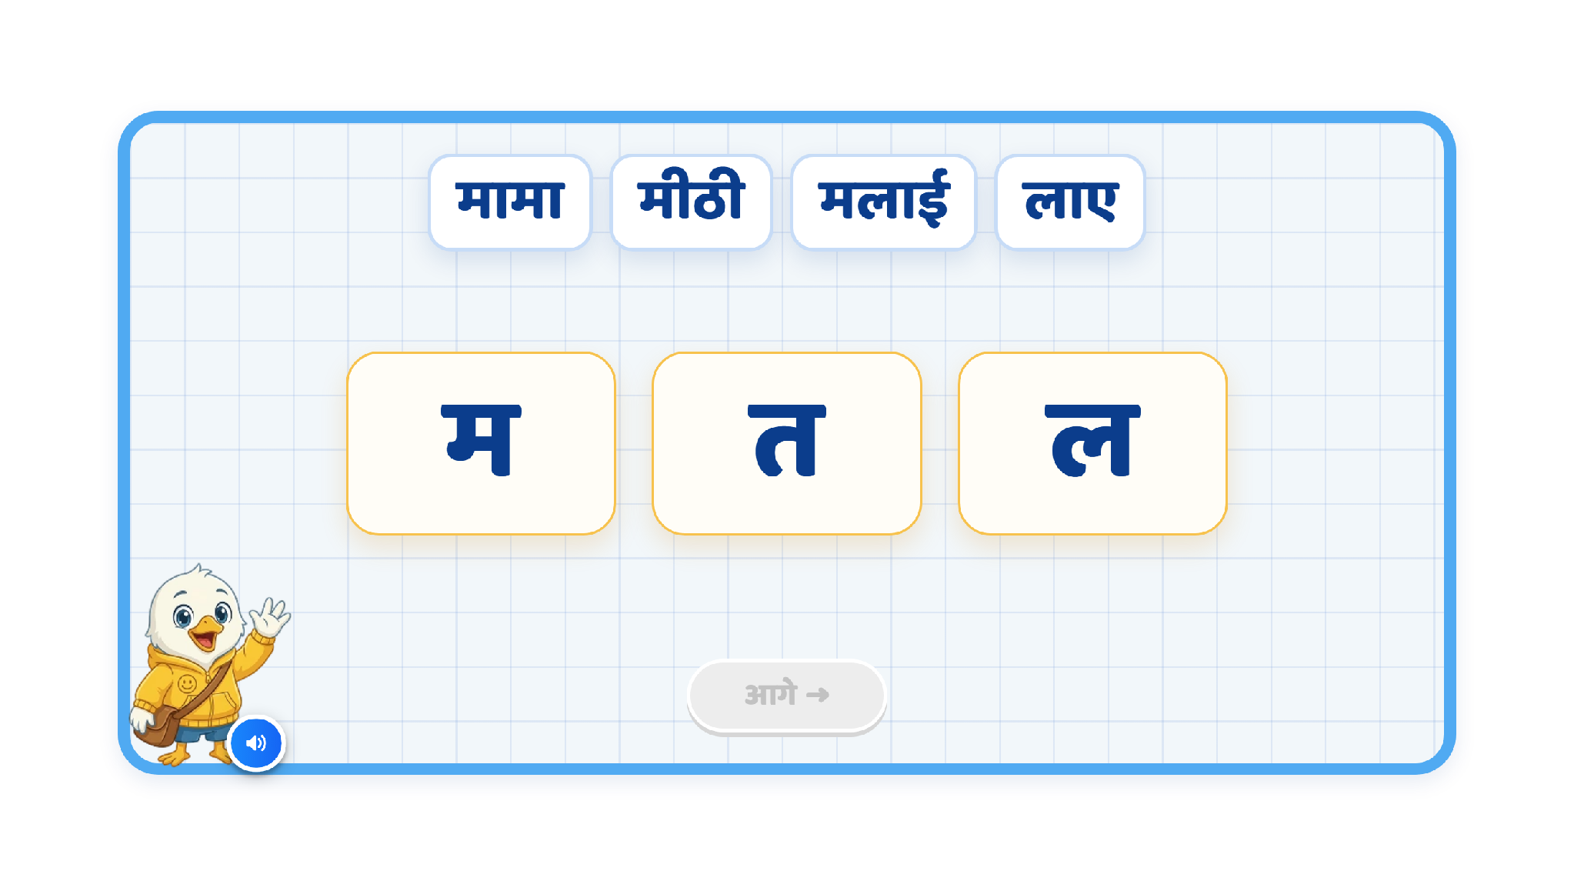
Page 6 · 06_SENTENCE_SOUND.png

Slide 10
Recommendations — Page 6 · 06_SENTENCE_SOUND.png
1. Change the sentence
Replace the current sentence with:
“मेरे मामा मीठी मलाई लाए।”
Remove the current focus on “त” and “ल”.
Keep the focus only on the repeated sound “म”.
2. Sentence Highlight Animation
Play the sentence once with each word highlighted in sync with the VO:
मेरे → मामा → मीठी → मलाई → लाए
After the complete sentence is read, remove the word-level highlighting.
During the explanation, highlight only the “म” sound/letter in the relevant words:
मेरे, मामा, मीठी, मलाई
Do not highlight “लाए”, because it does not contain the target sound “म”.
3. Sound + Letter Reinforcement
When the target sound “म” is introduced, play only the “म” sound.
At the same time, show the letter “म” clearly on screen.
Then highlight “म” in each target word one by one as those words are spoken.
Final VO
VO 1:
“मेरे मामा मीठी मलाई लाए।”
VO 2:
“मेरे, मामा, मीठी, मलाई—इन सब शब्दों में ‘म’ की आवाज़ बार-बार आई।”
Recommended Animation Flow
Sentence appears → words highlight one by one with VO → word highlighting disappears → ‘म’ appears/emphasises → ‘म’ highlights in मेरे, मामा, मीठी, मलाई one by one → explanation VO plays.

Slide 11
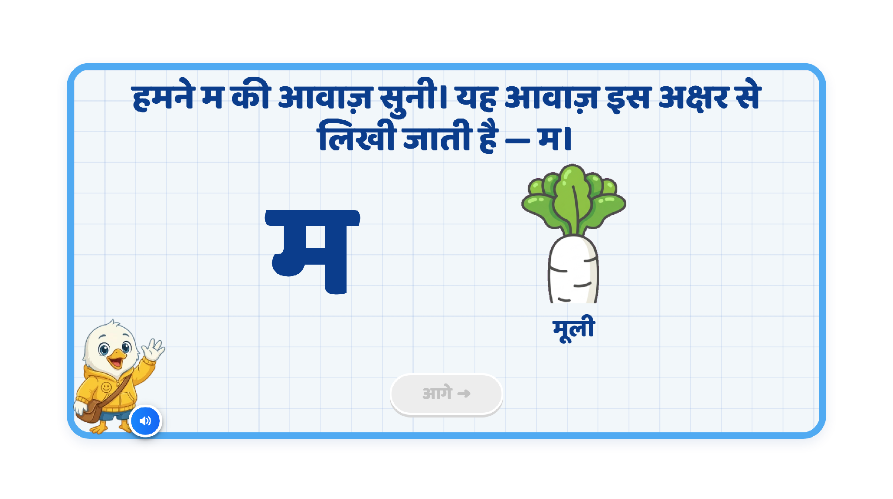
Page 7 · 07_MEET_LETTER.png

Slide 12
Recommendations — Page 7 · 07_MEET_LETTER.png
1. Remove explanatory text from the screen
Remove this text from the screen:
“हमने ‘म’ की आवाज़ सुनी। यह आवाज़ इस अक्षर से लिखी जाती है—म।”
Keep this part as VO only, so the screen remains clean and visually focused.
2. Final VO
Use:
“हमने ‘म’ की आवाज़ सुनी। यह आवाज़ ‘म’ अक्षर से लिखी जाती है। जैसे—म से मूली।”
3. Letter Highlighting
Keep the letter “म” clearly visible on the left side.
When the VO says “म”, highlight the letter.
When the VO says “मूली”, highlight “म” again to reinforce the sound-letter connection.
Keep the highlighting synced exactly with the VO.
4. Replace the Current Image
Remove the current image.
Add a clear, full image of मूली.
Add the label “मूली” below the image.
Keep the image large, simple, and easy to recognise for Grade 2 learners.
5. Recommended Animation Flow
‘म’ appears → VO introduces the sound → ‘म’ gets highlighted → मूली image appears → label “मूली” appears → ‘म’ in “मूली” is highlighted.

Slide 13
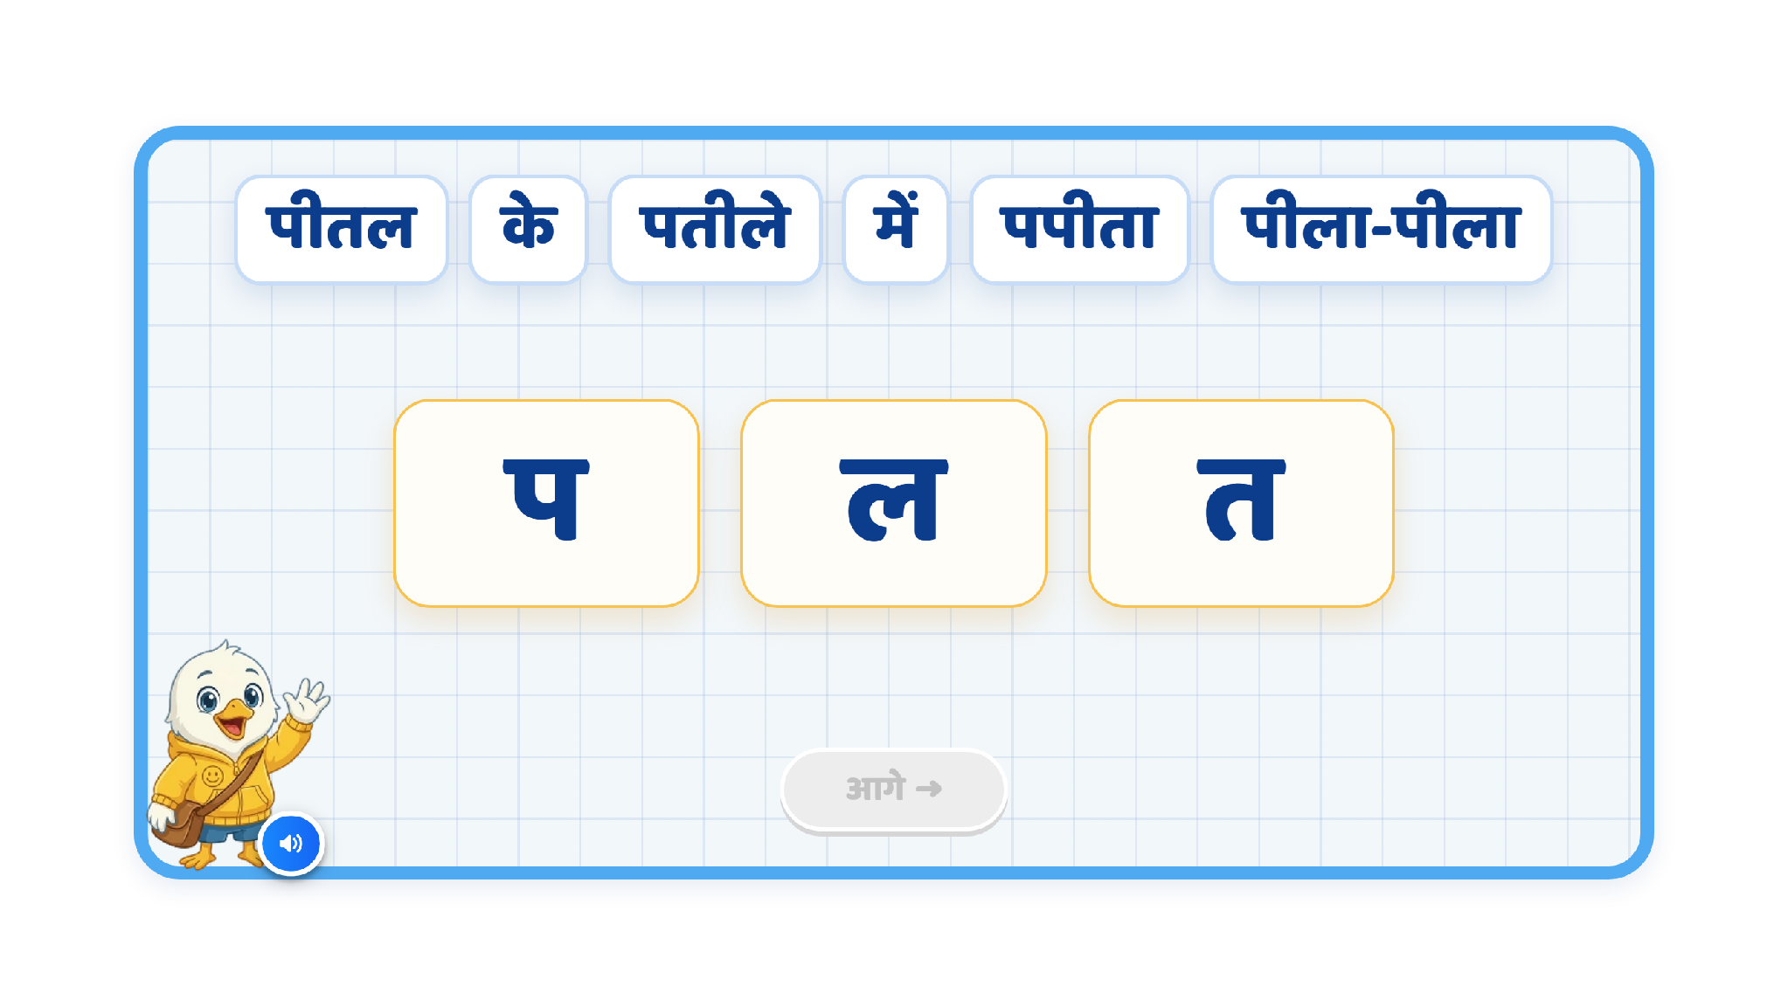
Page 2 · 02_SENTENCE_SOUND.png
highlight asks: highlighting each word in time with the voice. After this animation will remove and
highlighting only पीतल/पतीले/पपीता/पीला during the explanation.
For प only letter sound comes along with letter comes on screen
VO 1: पीतल के पतीले में पपीता पीला-पीला। |
VO 2: पीतल/पतीले/पपीता/पीला
VO 3: पीतल, पतीले, पपीता, पीला — इन सब शब्दों में प की आवाज़ बार-बार आई।

Slide 14
Recommendations — Page 2 · 02_SENTENCE_SOUND.png
1. Sentence Highlight Animation
During VO 1, highlight each word one by one in sync with the voice:
पीतल → के → पतीले → में → पपीता → पीला-पीला
After the full sentence is read, remove the word-level highlighting.
2. Target Sound Highlighting
During the explanation, highlight only the relevant “प” sound/letter in these words:
पीतल, पतीले, पपीता, पीला
Do not keep the full words highlighted. Only the target letter “प” should be visually emphasised.
3. Sound + Letter Reinforcement
When the target sound “प” is introduced:
Play only the “प” sound.
Show the letter “प” clearly on screen at the same time.
Then reinforce that the same sound is heard repeatedly in the target words.
Final VO
VO 1:
“पीतल के पतीले में पपीता पीला-पीला।”
VO 2:
“पीतल, पतीले, पपीता, पीला।”
VO 3:
“इन सब शब्दों में ‘प’ की आवाज़ बार-बार आई।”
Recommended Animation Flow
Sentence appears → words highlight one by one with VO 1 → word highlighting disappears → VO 2 plays with ‘प’ highlighted in each target word → letter ‘प’ appears/emphasises → VO 3 explains the repeated sound.

Slide 15
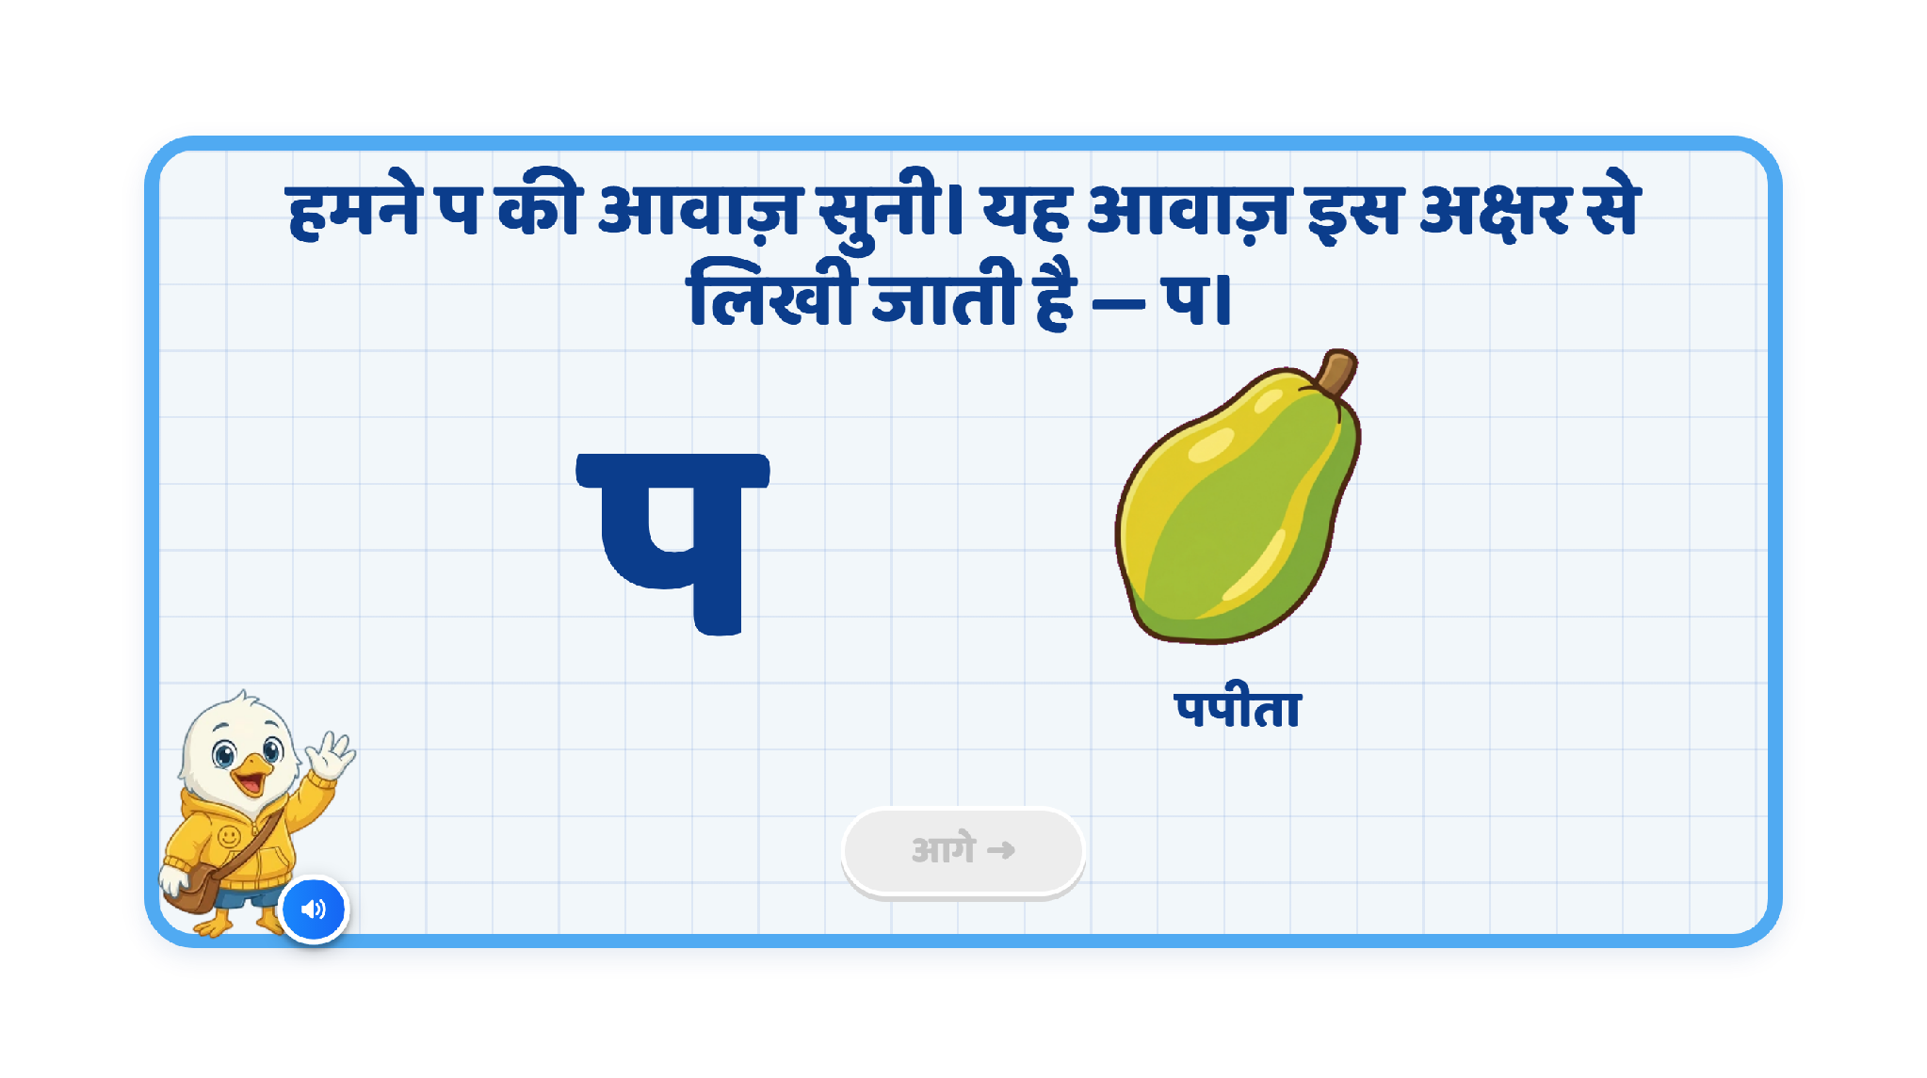
Page 3 · 03_MEET_LETTER.png

Slide 16
Recommendations — Page 3 · 03_MEET_LETTER.png
1. Remove explanatory text from the screen
Remove this text from the screen:
“हमने ‘प’ की आवाज़ सुनी। यह आवाज़ ‘प’ अक्षर से लिखी जाती है। जैसे—प से पपीता।”
Keep this as VO only so the screen stays clean and visually focused.
2. Improve the Papaya Visual
Replace the current papaya image with a clear, full, child-friendly image of पपीता.
The image should be easy to recognise and visually prominent.
Add the label “पपीता” below the image.
3. Letter Highlighting
Keep the letter “प” clearly visible on the left side.
When the VO says “प”, highlight the letter.
When the VO says “पपीता”, highlight “प” again to reinforce the sound-letter connection.
Keep the highlighting precisely synced with the VO.
Final VO
“हमने ‘प’ की आवाज़ सुनी। यह आवाज़ ‘प’ अक्षर से लिखी जाती है। जैसे—प से पपीता।”
Recommended Animation Flow
‘प’ appears → VO introduces the sound → ‘प’ gets highlighted → papaya image appears → label “पपीता” appears → ‘प’ in “पपीता” is highlighted.

Slide 17
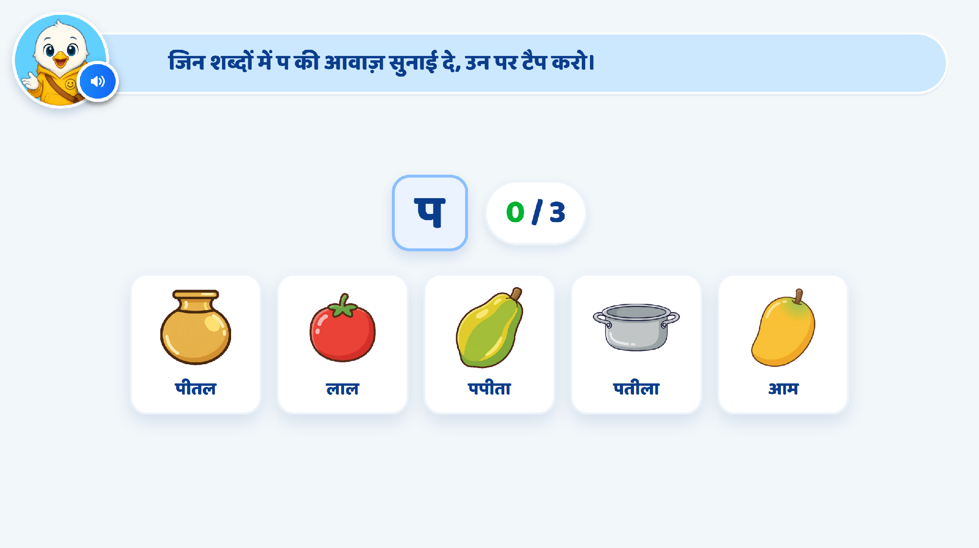
Page 9 · 09_TAP_ALL_WITH_SOUND.png

Slide 18
Recommendations — Page 9 · 09_TAP_ALL_WITH_SOUND.png
Instruction text + VO:
“जिन शब्दों में ‘प’ की आवाज़ सुनाई दे, उन पर टैप करो।”
2. Option Entry
After the instruction VO finishes, show the options one by one with a simple entrance animation.
Use 4 options only:
Correct: पपीता, पतंग
Incorrect: केला, आम
Each option should have a clear image with its word label, similar to the existing screen layout.
3. Correct Selection
If the child taps a correct option:
Highlight the card positively.
Play a small sparkle/tick animation.
Keep the selected option visually marked as correct.
Do not allow repeated selection of the same correct option.
4. Wrong Selection
For example, if the child taps “आम”:
The selected card should give a gentle shake animation.
Show a light red feedback highlight briefly.
Do not remove the option.
Then play a hint VO.
Hint VO:
“हर शब्द को ध्यान से देखो और सुनो। किस शब्द में ‘प’ की आवाज़ आ रही है?”
After the hint VO, allow the child to try again.
5. Existing Hint Logic
Keep the current hint logic already implemented in the activity.
Do not introduce a completely new hint flow.
The hint should support the learner without directly revealing the answer.
If the existing logic includes hand guidance after repeated wrong attempts, retain the same behaviour.
6. Hand Nudge
After repeated incorrect attempts, show a subtle hand nudge on one remaining correct option.
The hand should gently pulse/tap on the option.
Do not auto-select the answer; the child should still tap it independently.
Recommended Flow
Instruction text + VO → options appear one by one → child selects → correct: positive feedback → wrong: shake + red highlight + hint VO → retry → repeated wrong: existing hint/hand nudge logic → both correct selected.

Slide 19
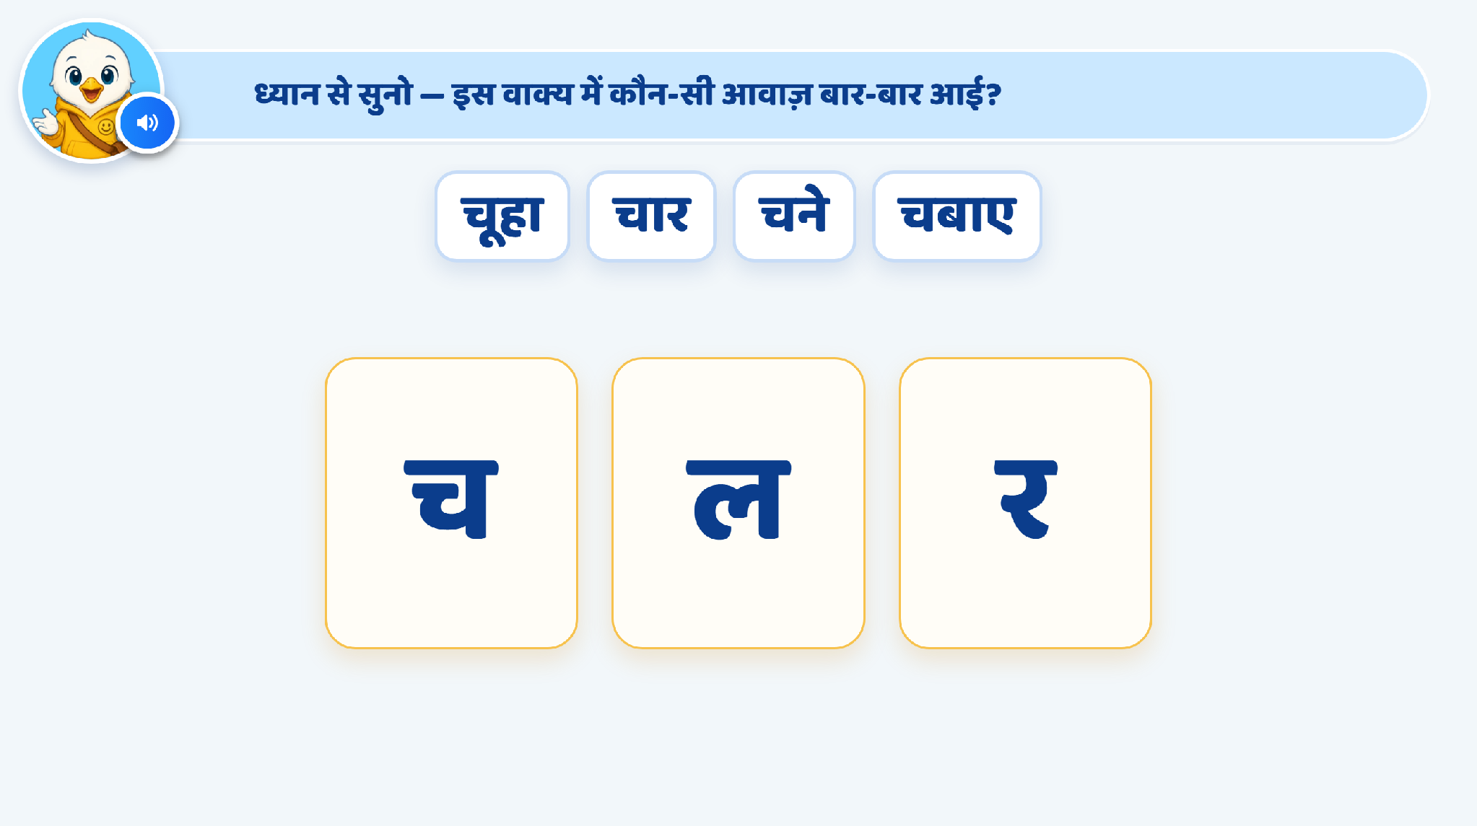
Page 10 · 10_SENTENCE_SOUND.png

Slide 20
Recommendations — Page 10 · 10_SENTENCE_SOUND.png
1.Instruction Text + VO:
“ध्यान से सुनो — इस वाक्य में कौन-सी आवाज़ बार-बार आई?”
2. Sentence Presentation
Use the sentence:
“चूहे ने चार चने चबाए।”
Play the complete sentence through VO.
Keep the sentence/target words visible on screen.
3. Letter Entry Animation
Show 3 large letter options:
च ल र
Letters should appear one by one, not all together.
As each letter appears, play its corresponding sound/VO.
Suggested sequence:
“च” → “ल” → “र”
Keep a short pause between each letter so the child can hear and process the sound.
Once all three letters are visible, enable the options for selection.
Hint 1 – First Wrong Attempt
If the child taps a wrong letter:
The selected card should get a brief red highlight.
Add a gentle shake animation.
VO:
“यह ‘च’ की आवाज़ नहीं है।”
Then allow the child to try again.
Hint 2 – Second Wrong Attempt
If the child selects a wrong option again:
Show a hand nudge on the correct option ‘च’.
The hand should gently pulse/tap on the correct card.
VO on 2nd wrong attempt:
“ध्यान से देखो, सही जवाब ‘च’ है।”
Do not auto-select the answer.
The child should still tap ‘च’ independently.
4. Correct Answer Reinforcement
Once the child taps ‘च’, play the explanation VO:
“चूहे, चार, चने, चबाए — इन सब शब्दों में ‘च’ की आवाज़ बार-बार आई।”
Recommended Flow
Instruction text + VO → sentence VO → ‘च’ appears with sound → ‘ल’ appears with sound → ‘र’ appears with sound → child selects → Hint 1 on first wrong attempt → Hint 2 + hand nudge on second wrong attempt → child taps ‘च’ → explanation VO.

Slide 21
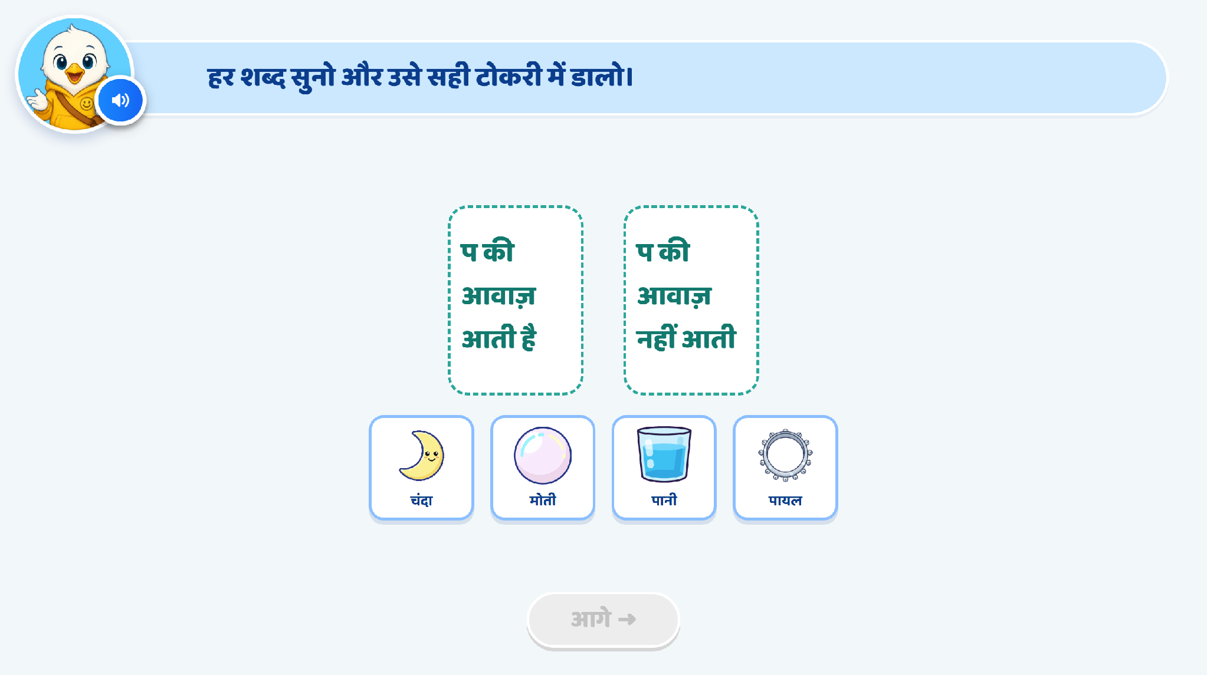
Page 12 · 12_SORT_VACHAN.png

Slide 22
Recommendations — Page 12 · 12_SORT_VACHAN.png
1. Change the Two Categories
Replace the current categories:
“प की आवाज़ आती है”
“प की आवाज़ नहीं आती”
with:
“प की आवाज़ वाला”
“च की आवाज़ वाला”
This will make the activity easier and more concrete for Grade 2 FLN learners.
2. Interaction
The child will drag each picture and drop it into the correct category.
Keep the current drag-and-drop interaction.
Use clear, familiar image options whose names begin with or clearly contain either “प” or “च”.
Keep the number of options limited so the screen remains easy to process.
3. Instruction Text + VO
Keep the instruction at the top.
“हर चित्र का नाम सुनो और उसे सही टोकरी में डालो।”
The same line should also play through VO.
4. Audio Support
When the child taps or picks up an image, play its name through VO.
This will help the child identify whether the word has the “प” sound or the “च” sound before dragging it.
5. Drop Behaviour
If the picture is dropped into the correct category, it should settle into the box with a small positive animation.
If the picture is dropped into the wrong category, it should gently shake and return to its original position.
6. Hint Logic
Keep the existing hint logic exactly as it is currently implemented.
No change is required in the current hint progression or behaviour.

Slide 23
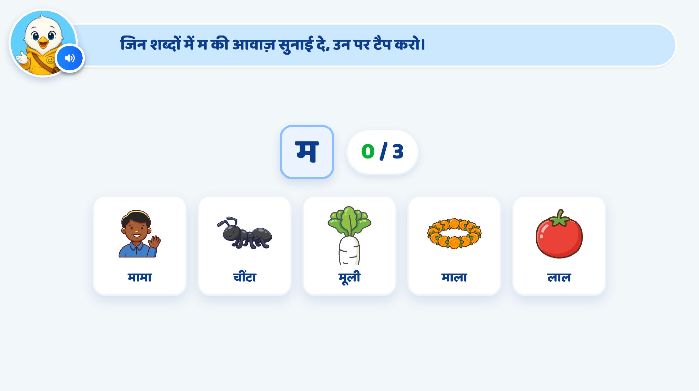
Page 13 · 13_TAP_ALL_WITH_SOUND.png

Slide 24
Recommendations — Page 13 · 13_TAP_ALL_WITH_SOUND.png
1. Keep Only 4 Image Options
Show only 4 image options on the screen.
Keep:
2 correct options with the “म” sound
2 incorrect options without the “म” sound
This will keep the activity simple and less crowded for Grade 2 FLN learners.
Suggested options:
Correct: मामा, मूली
Incorrect: चींटी, लाल
2. Instruction
Keep the current instruction at the top:
“जिन शब्दों में ‘म’ की आवाज़ सुनाई दे, उन पर टैप करो।”
The same instruction should also come through VO.
3. Interaction
The child taps the images whose names contain the “म” sound.
On tapping an option, play the object/word name through VO.
Correct selected cards should remain selected and should not be tappable again.
4. Hint Logic
Keep the same hint logic as already implemented in the previous activity.
No change is required in the existing hint progression.
Wrong selection should follow the same shake/red feedback behaviour.
Hand nudge behaviour should also remain the same as the previous activity.
5. Image Recommendation
Replace the current “माला” image if it is visually unclear.

Slide 25
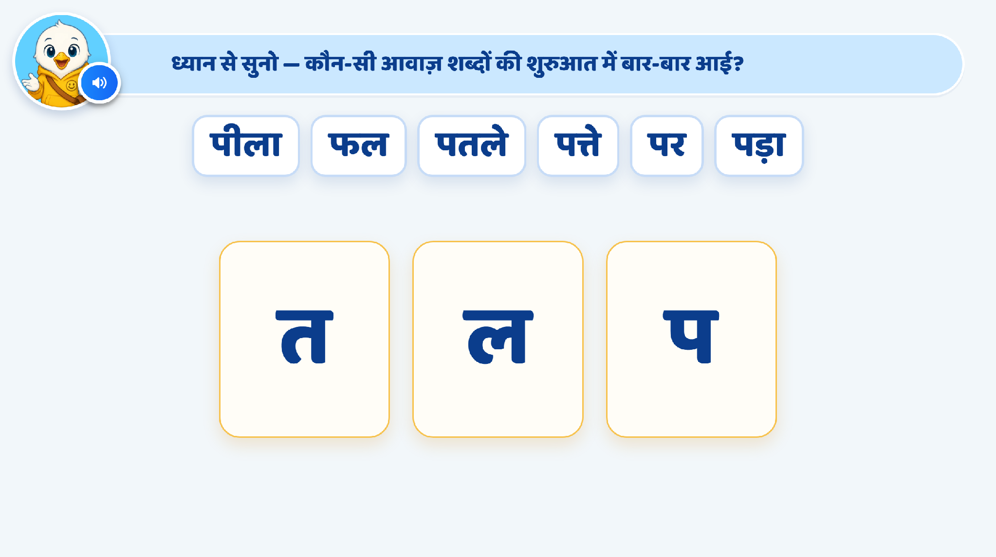
Page 16 · 16_SENTENCE_SOUND.png

Slide 26
Recommendations — Page 16 · 16_SENTENCE_SOUND.png
1. Use a New Sentence to Check Understanding
Use the sentence:
“नानी नई नाव लाई।”
Target repeated sound: “न”
2. Instruction
Keep the instruction at the top:
“ध्यान से सुनो — कौन-सी आवाज़ शब्दों की शुरुआत में बार-बार आई?”
The same instruction should also play through VO.
3. Sentence Presentation
Play the complete sentence through VO:
“नानी नई नाव लाई।”
Keep the sentence visible on screen.
No word-by-word highlighting is required.
4. Letter Options
Show 3 large letter options: with vo one by one comes
म, ल, न
Letters should appear one by one.
As each letter appears, play its corresponding sound/VO.
Keep a short pause between each letter.
Once all three letters are visible, enable selection.
Correct answer: “न”
5. Hint Logic
Keep the existing hint logic exactly the same as currently implemented.

Slide 27
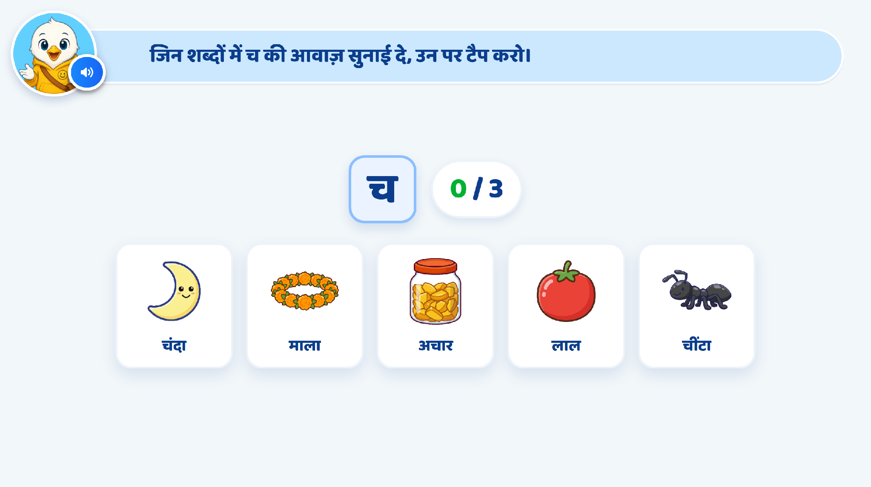
Page 19 · 19_TAP_ALL_WITH_SOUND.png

Slide 28
Recommendations — Page 19 · 19_TAP_ALL_WITH_SOUND.png
1. Keep Only 4 Image Options
Reduce the current 5 options to 4 image options only.
Keep:
2 correct options containing the “च” sound
2 incorrect options without the “च” sound
Suggested Options:
Correct: चाँद, चींटी
Incorrect: माला, लाल
2. Instruction
Keep the current instruction at the top:
“जिन शब्दों में ‘च’ की आवाज़ सुनाई दे, उन पर टैप करो।”
The same instruction should also play through VO.
3. Interaction
The child taps the images whose names contain the “च” sound.
When an image is tapped, play its word name through VO.
Correct selected options should remain selected and should not be tappable again.
4. Hint Logic
Keep the existing hint logic exactly the same as currently implemented.
— Previous round note —
• PRACTICE 7 — the final item: च at the start (चंदा, चींटा) and mid-word (अचार) in one set, with two distractors. Targets and distractors are interleaved on every tap-all page, so tapping the first three or assuming the last one is right both fail.

Slide 29
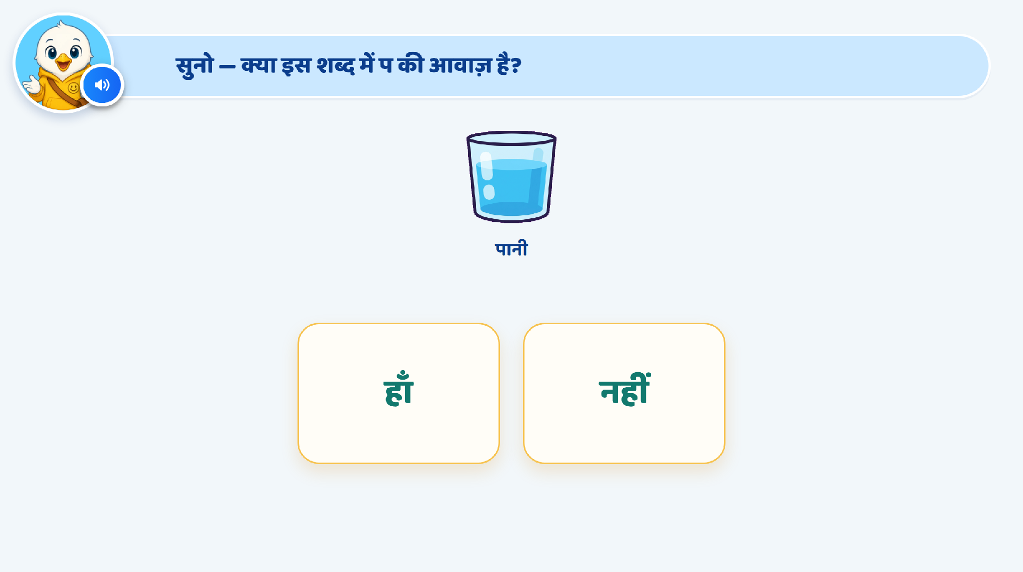
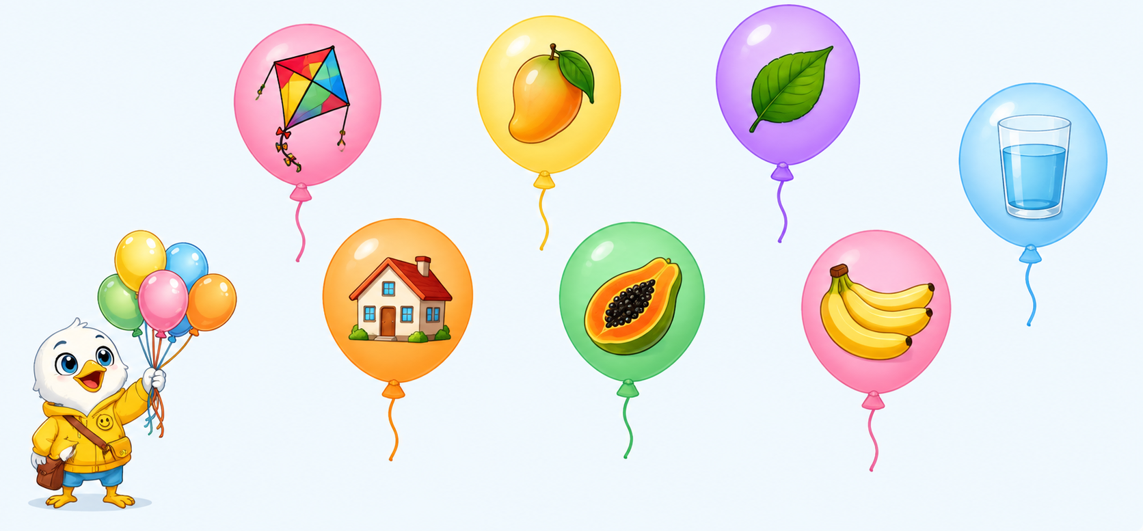
Page 8 · 08_TAP_VACHAN.png

Slide 30
Recommendations — Page 8 · 08_TAP_VACHAN.png
1. Replace the Current Activity
Remove the existing हाँ/नहीं activity and replace it with an interactive balloon-based activity for identifying the “प” sound.
2. Keep the Screen Clean
Do not show any written instruction on the screen.
Do not show feedback text on the screen.
Keep the screen visually clean like the reference image.
Only the mascot, balloons, object images, and required animations should be visible.
All instructions, hints, and feedback should come through VO only.
3. Instruction through VO only
Use VO:
“‘प’ की आवाज़ वाले चित्र पर टैप कीजिए।”
No instruction text should appear on screen.
4. Activity Layout
Show multiple balloons with one clear object image inside each balloon.
Do not add object names or any text inside the balloons.
Maintain enough spacing between balloons for easy tapping.
Keep the background soft, minimal, and distraction-free.
5. Suggested Options
Correct examples:
पतंग, पपीता, पत्ता, पानी
Incorrect examples:
आम, केला, घर, मछली
6. Interaction & Feedback
For a correct selection:
Balloon bursts.
Add a light sparkle/celebration animation.
VO feedback:
“शाबाश! इसमें ‘प’ की आवाज़ है।”
For the first wrong attempt:
Balloon gives a gentle shake.
No text appears.
Use a short negative feedback sound only.
For the second wrong attempt:
Balloon shakes again.
VO hint:
“ध्यान से सुनिए, इसमें ‘प’ की आवाज़ नहीं है।”
If the learner continues to struggle, show a subtle hand nudge towards one correct balloon.
7. Object Audio Reinforcement
When the child taps a balloon, play the object name through VO.
For correct options, naturally emphasise the initial “प” sound where appropriate.
Avoid unnatural stretching of the sound.
Recommended Activity Flow
Clean screen appears → VO gives instruction → balloons appear → child taps an image → object name plays → correct/wrong animation happens → VO feedback plays → activity continues until all correct “प” sound images are selected.

Slide 31
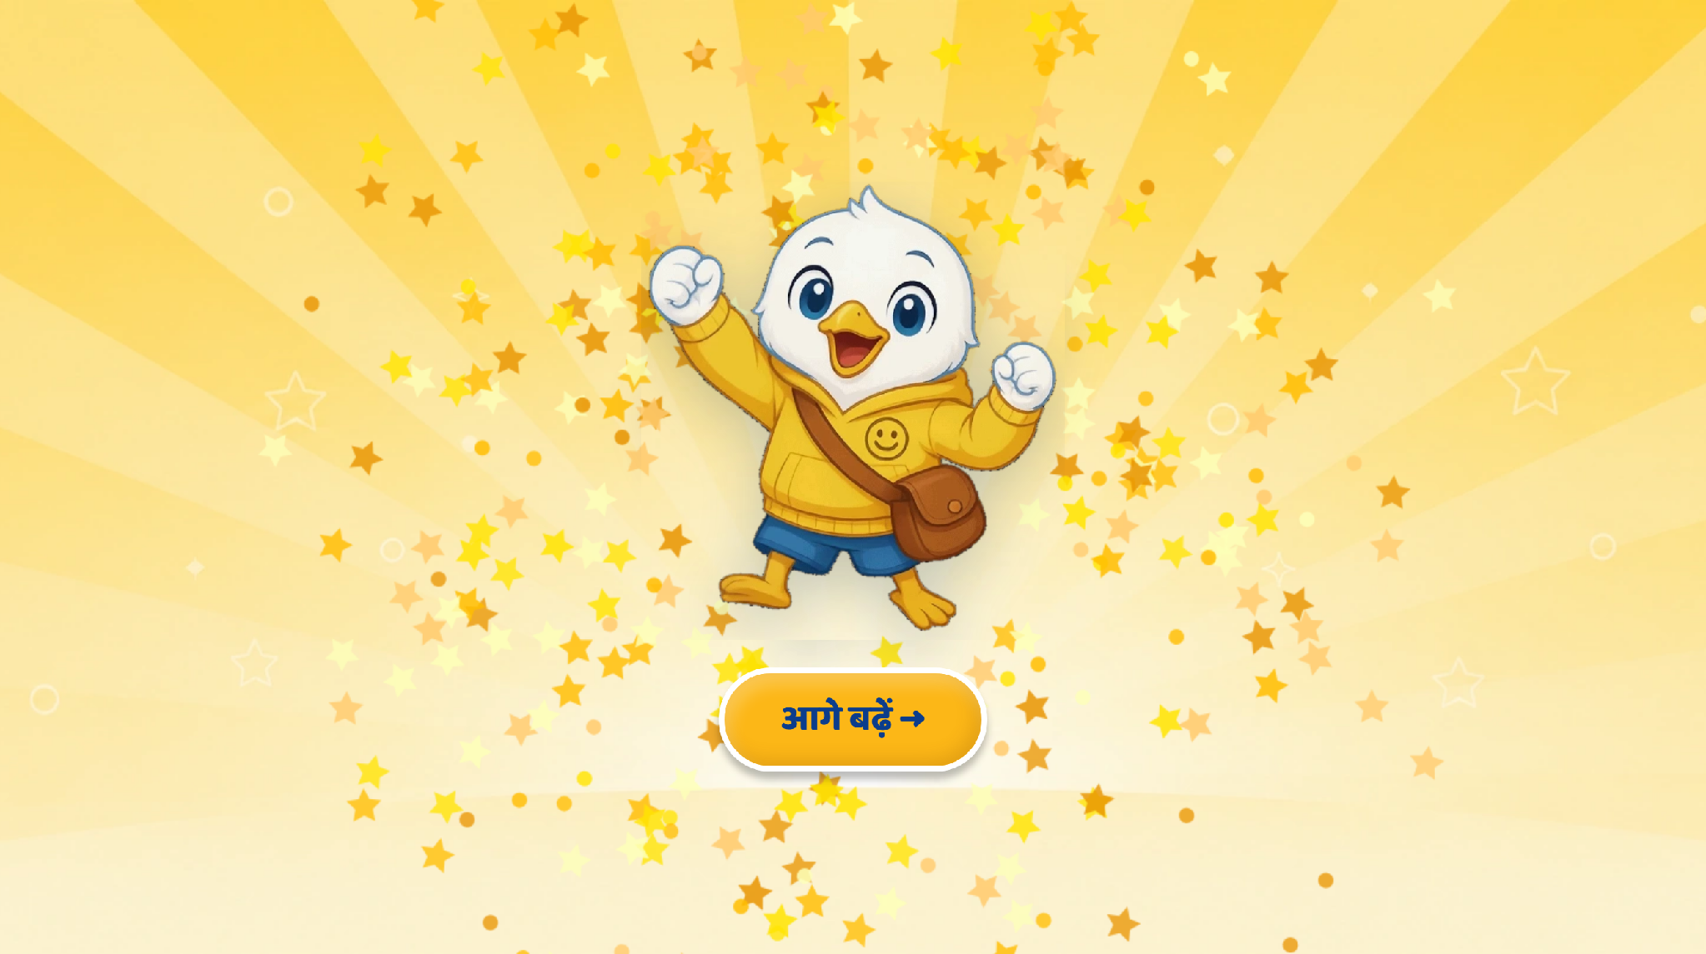
Page 20 · 20_CELEBRATION.png
Recommendations
• CELEBRATION. ✅ NOW RECAPS, per your note: «आज हमने सीखा — वाक्य ध्यान से सुनना, बार-बार आने वाली आवाज़ पहचानना, और प, च और म की आवाज़ ढूँढना।» It names the skill, not just the three letters. No score, no timer, no stars shown to the child — house rule.

