Slide 1
HI02H11_L02_S01 — मात्राओं की रेल
Page-by-page review · 17 pages
reviewing build a1e0bddfe622 (HI02H11_L02_S01.html)

Slide 2
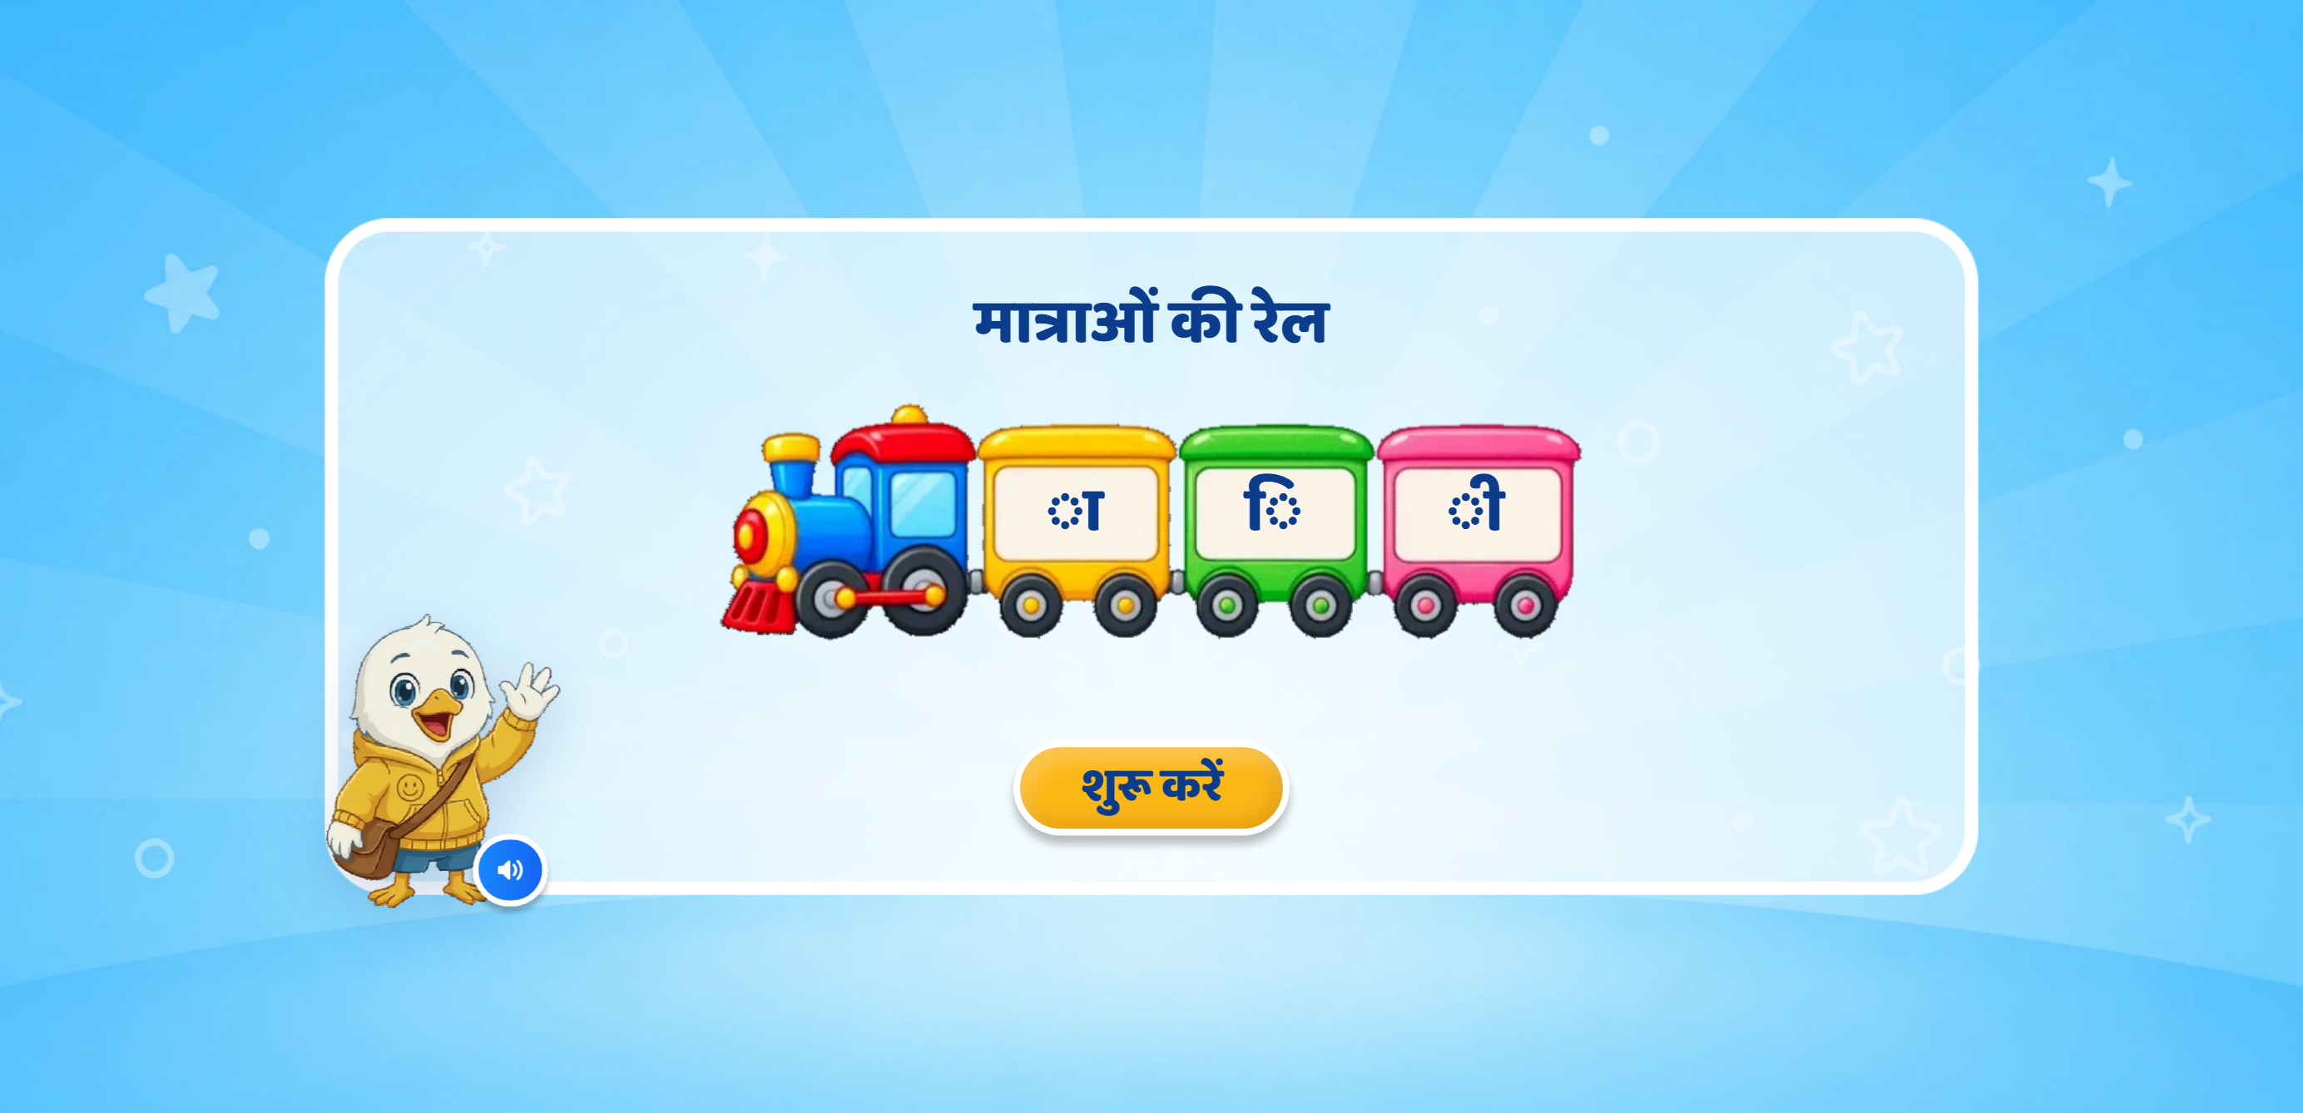
Page 1 · 00_landing.png
Recommendations
• Cover — deck page 3. Title «मात्राओं की रेल», all extra text removed. YOUR animated train (train.gif, re-encoded to 287KB) with the three matra boxes ा ि ी on its coach panels; they appear one by one after the landing VO ends. Right-to-left entry + arrival SFX.

Slide 3
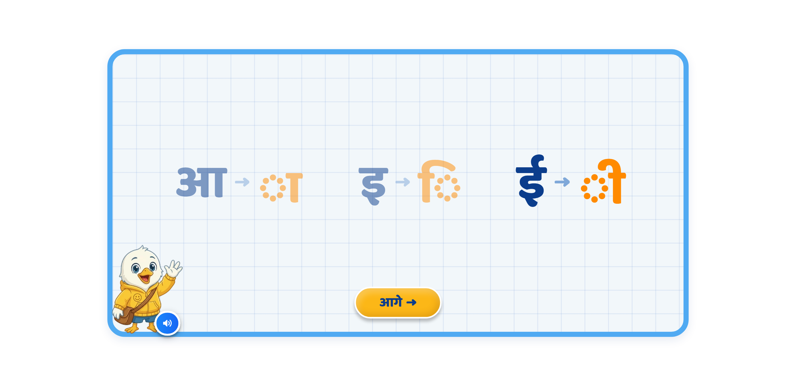
Page 2 · 01_T1_MATRA_PAIRS.png
Recommendations
• Screen 1 · MATRA_PAIRS — deck page 4, reworked. Nothing on screen at mount; the LETTER lands alone first, then its matra pops in beside it with a soft glow. Matras are now BRIGHT ORANGE (#FF8A00); letters and arrows unchanged. Taught pairs fade slightly and stay faded. No card frames. Next disabled until all three are shown AND spoken.

Slide 4
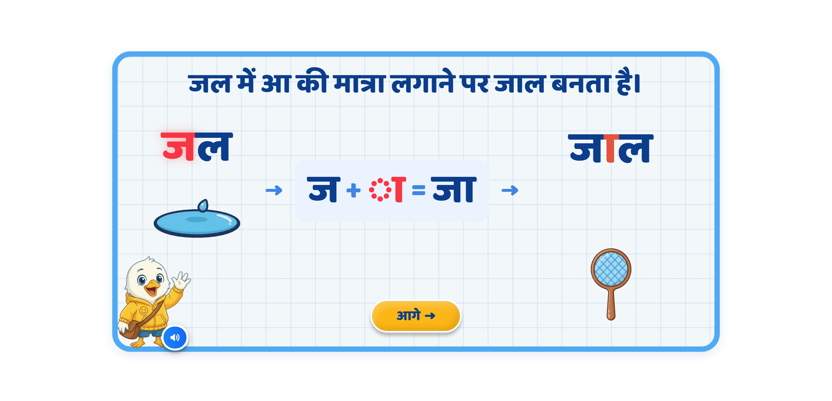
Page 3 · 02_T2_MATRA_BUILD.png
Recommendations
• Screen 2 · MATRA_BUILD जल→जा→जाल — rows #25-#39. Ten-step staging, each step gated on the previous clip ENDING.

Slide 5
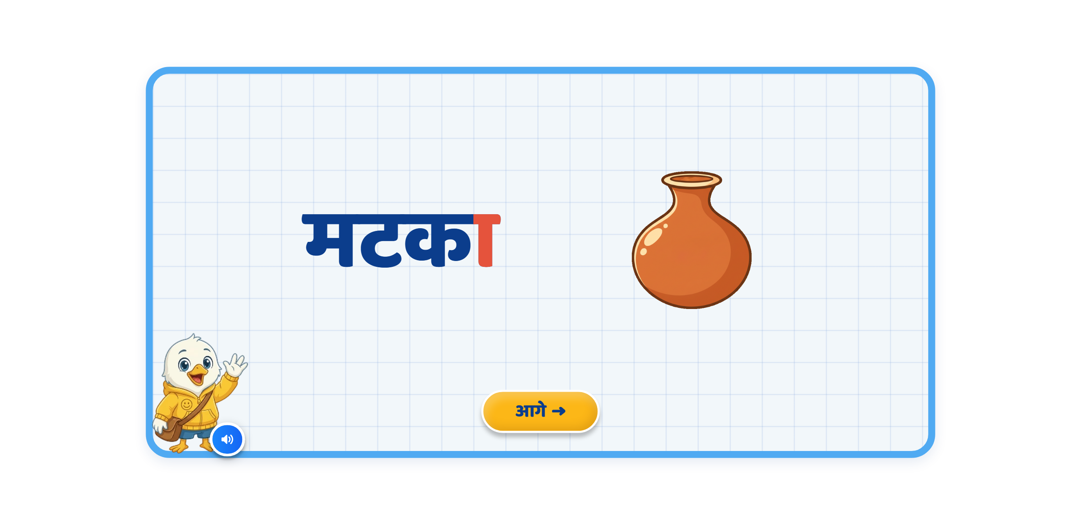
Page 4 · 03_T3_MEET_EXAMPLES.png
Recommendations
• Screen 3 · examples नाक / मटका — rows #40-#50.

Slide 6
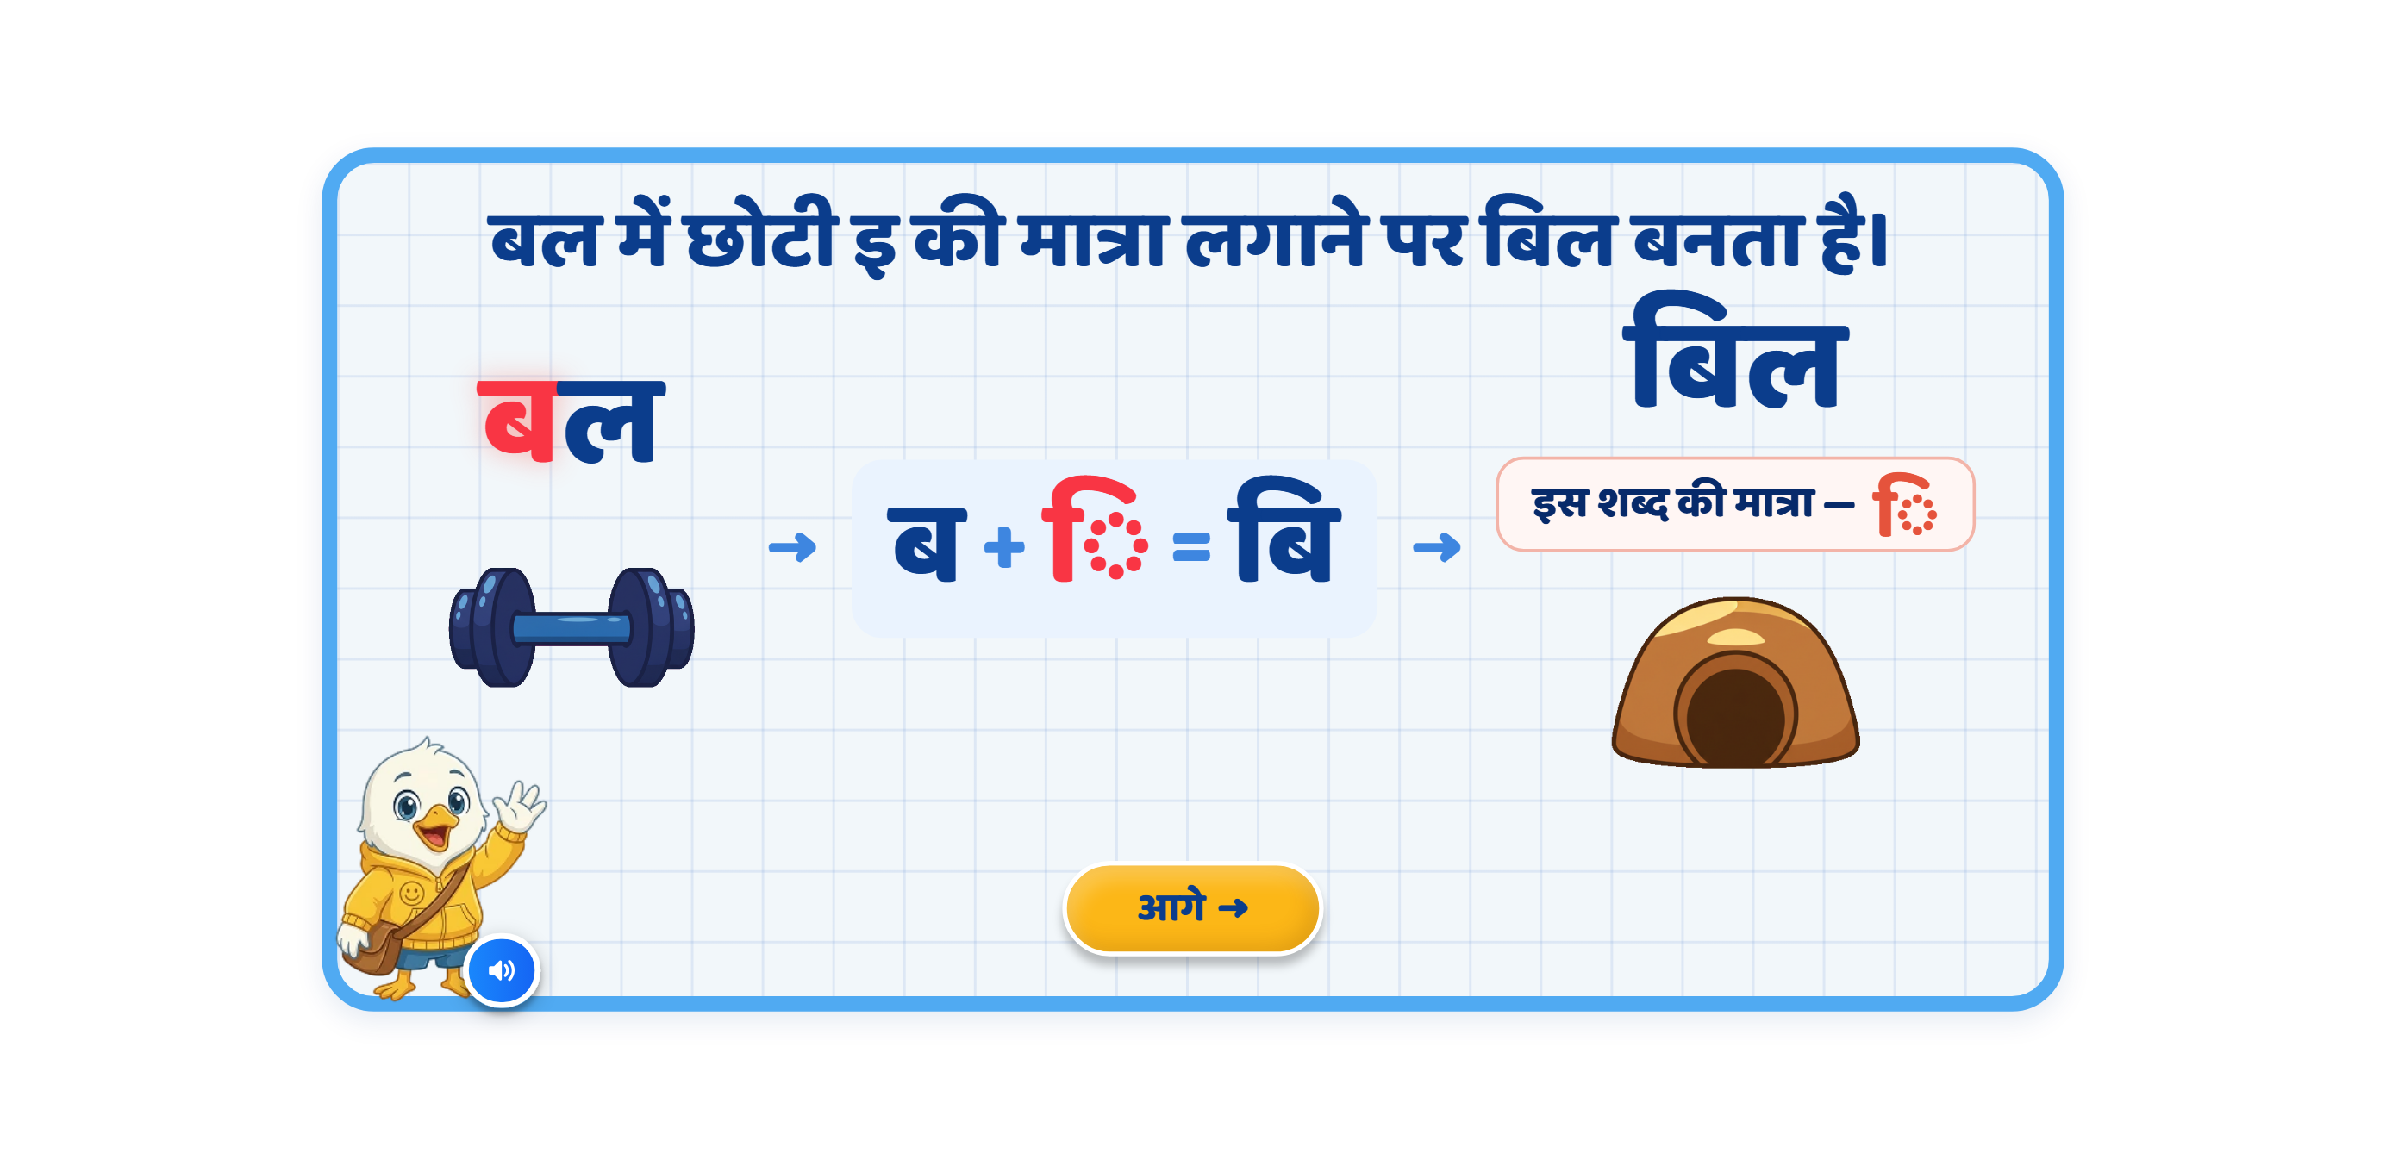
Page 5 · 04_T4_MATRA_BUILD.png
Recommendations
• Screen 4 · MATRA_BUILD बल→बि→बिल — rows #51-#62. The ि travels to the LEFT of ब. It cannot be highlighted inside बिल (reordering matra), so it uses the ◌ि callout — rows #56/#70 flagged.

Slide 7
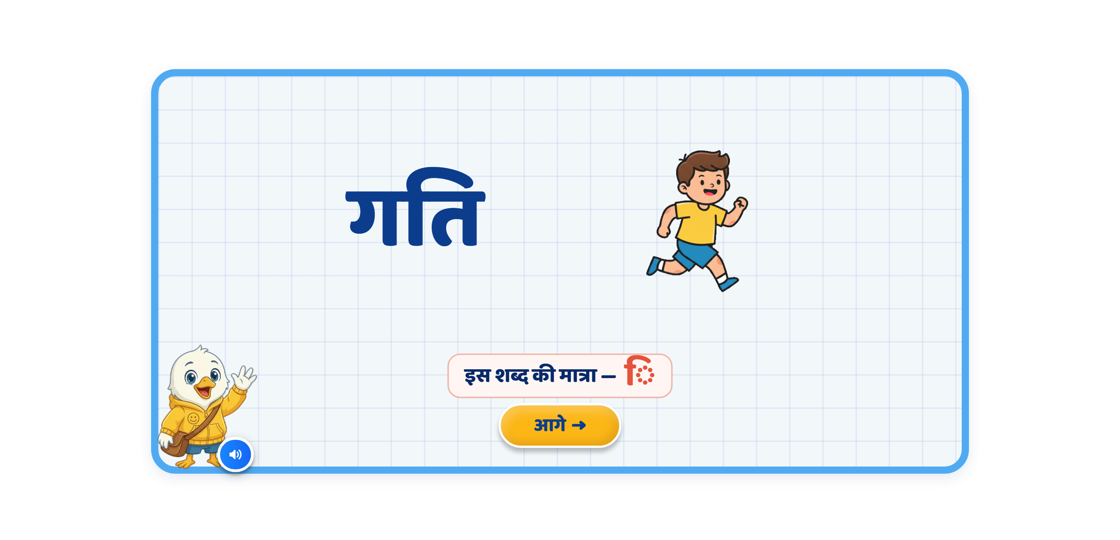
Page 6 · 05_T5_MEET_EXAMPLES.png
Recommendations
• Screen 5 · examples दिन / गति — rows #63-#72.

Slide 8
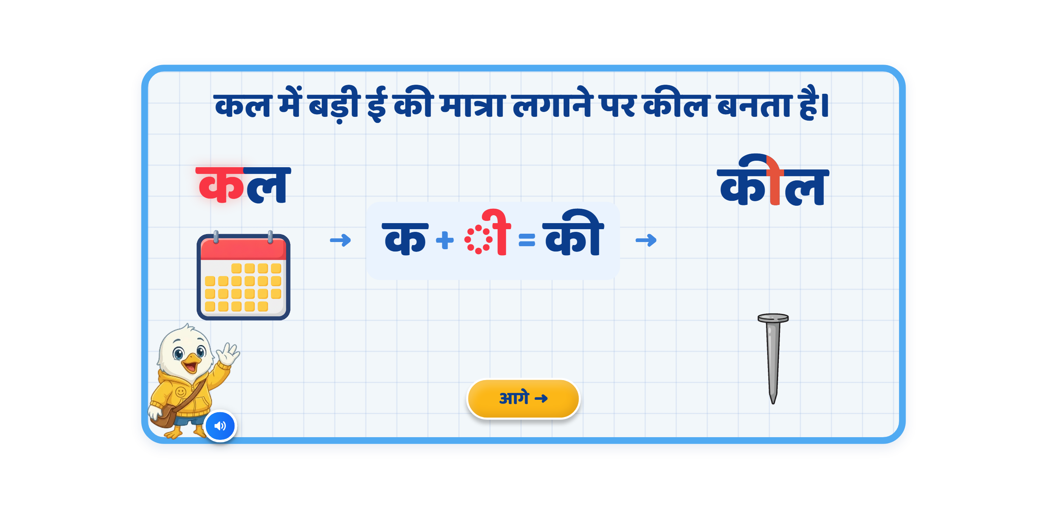
Page 7 · 06_T6_MATRA_BUILD.png
Recommendations
• Screen 6 · MATRA_BUILD कल→की→कील — rows #73-#84.

Slide 9
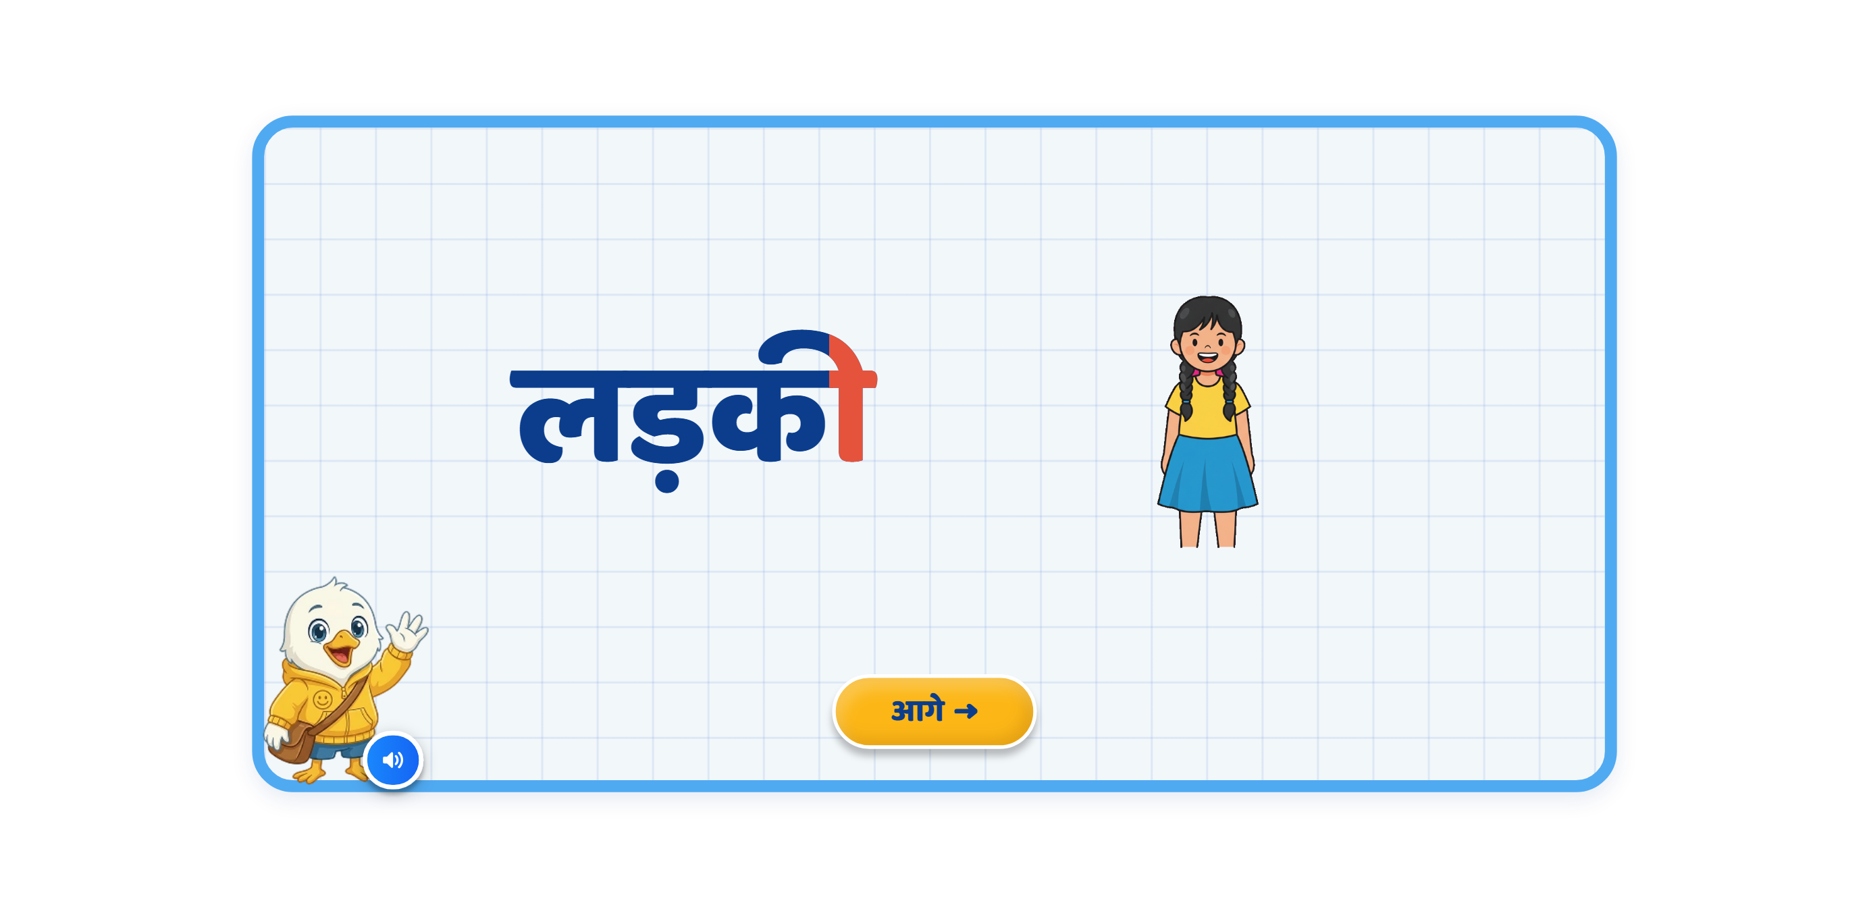
Page 8 · 07_T7_MEET_EXAMPLES.png
Recommendations
• Screen 7 · examples तीर / लड़की — rows #85-#94.

Slide 10
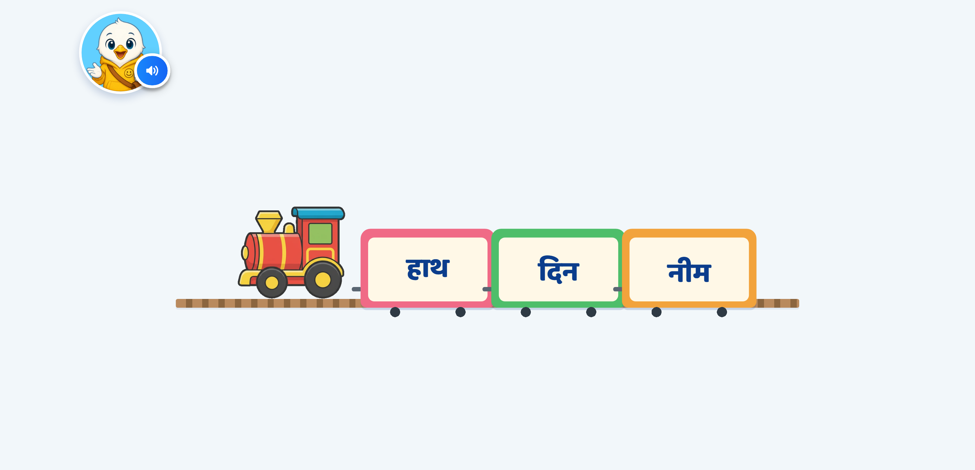
Page 9 · 08_G1_TRAIN_TAP.png
Recommendations
• Screen 8 · TRAIN_TAP आ — rows #95-#106. Ladder proven by walk: rung1 hint + NO hand · rung2 hint + hand, nothing revealed · 3rd correct silent · 3rd wrong reaches the never-stuck reveal.

Slide 11
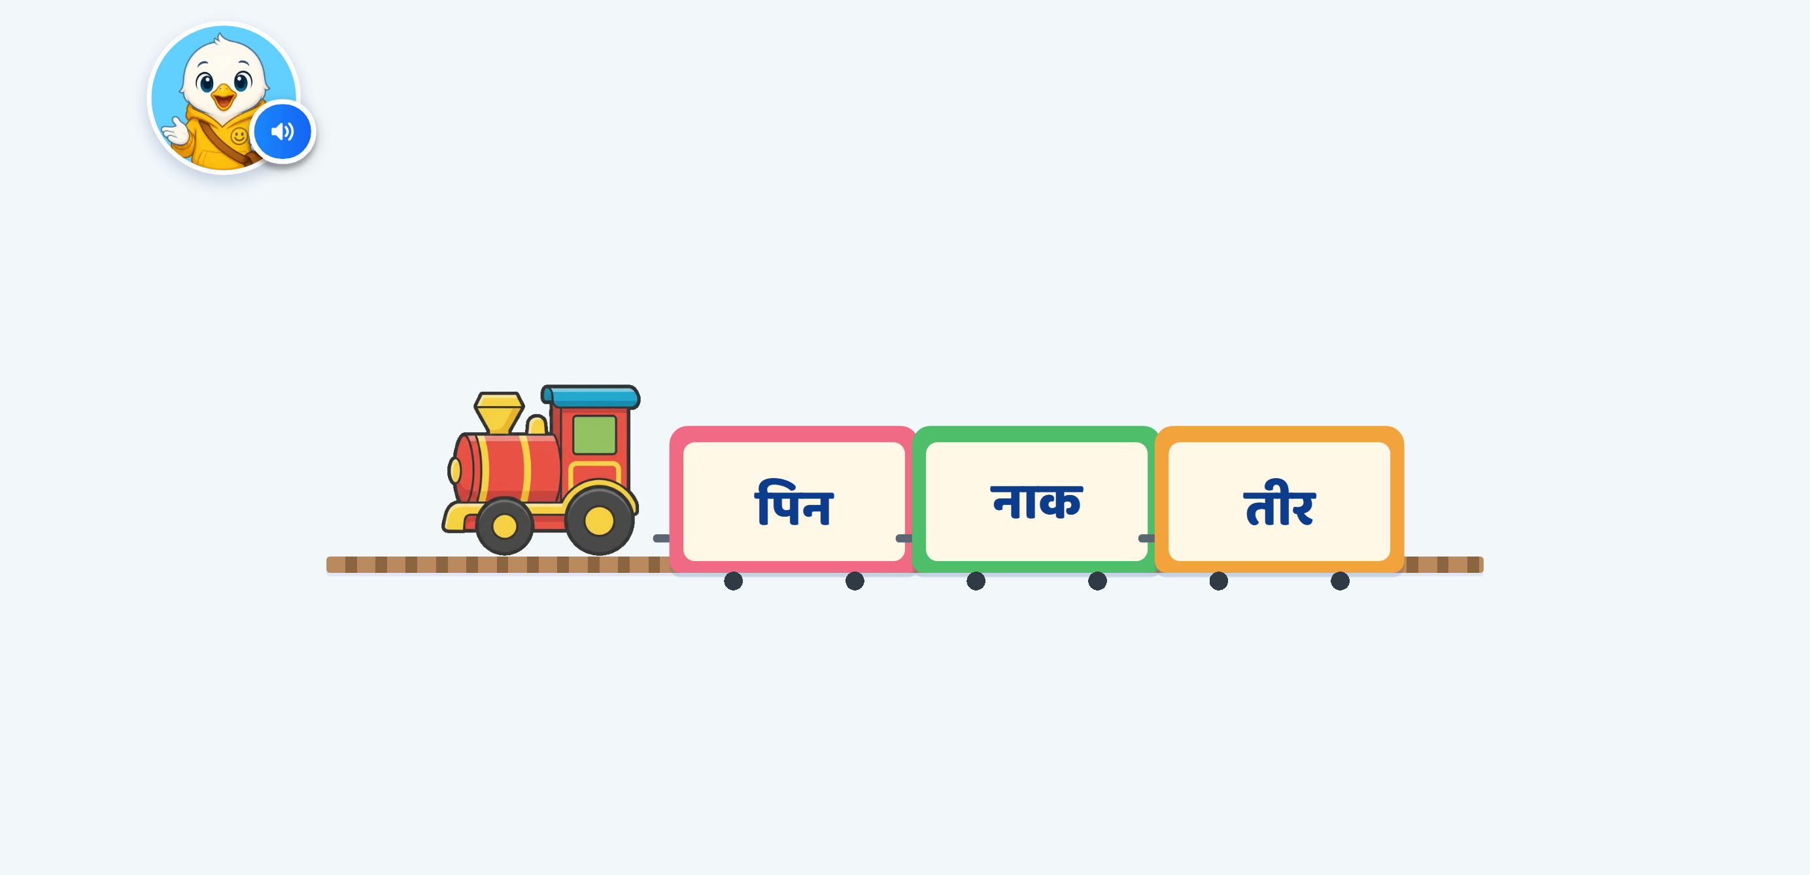
Page 10 · 09_G2_TRAIN_TAP.png
Recommendations
• Screen 9 · TRAIN_TAP छोटी इ — rows #107-#115, incl. your «छोटी इ not छोटी ई» correction.

Slide 12

Page 11 · 10_G3_TRAIN_TAP.png
Recommendations
• Screen 10 · TRAIN_TAP बड़ी ई — rows #116-#123. पानी carries both ा and ी — correct here, but the only non-single-matra test item.

Slide 13
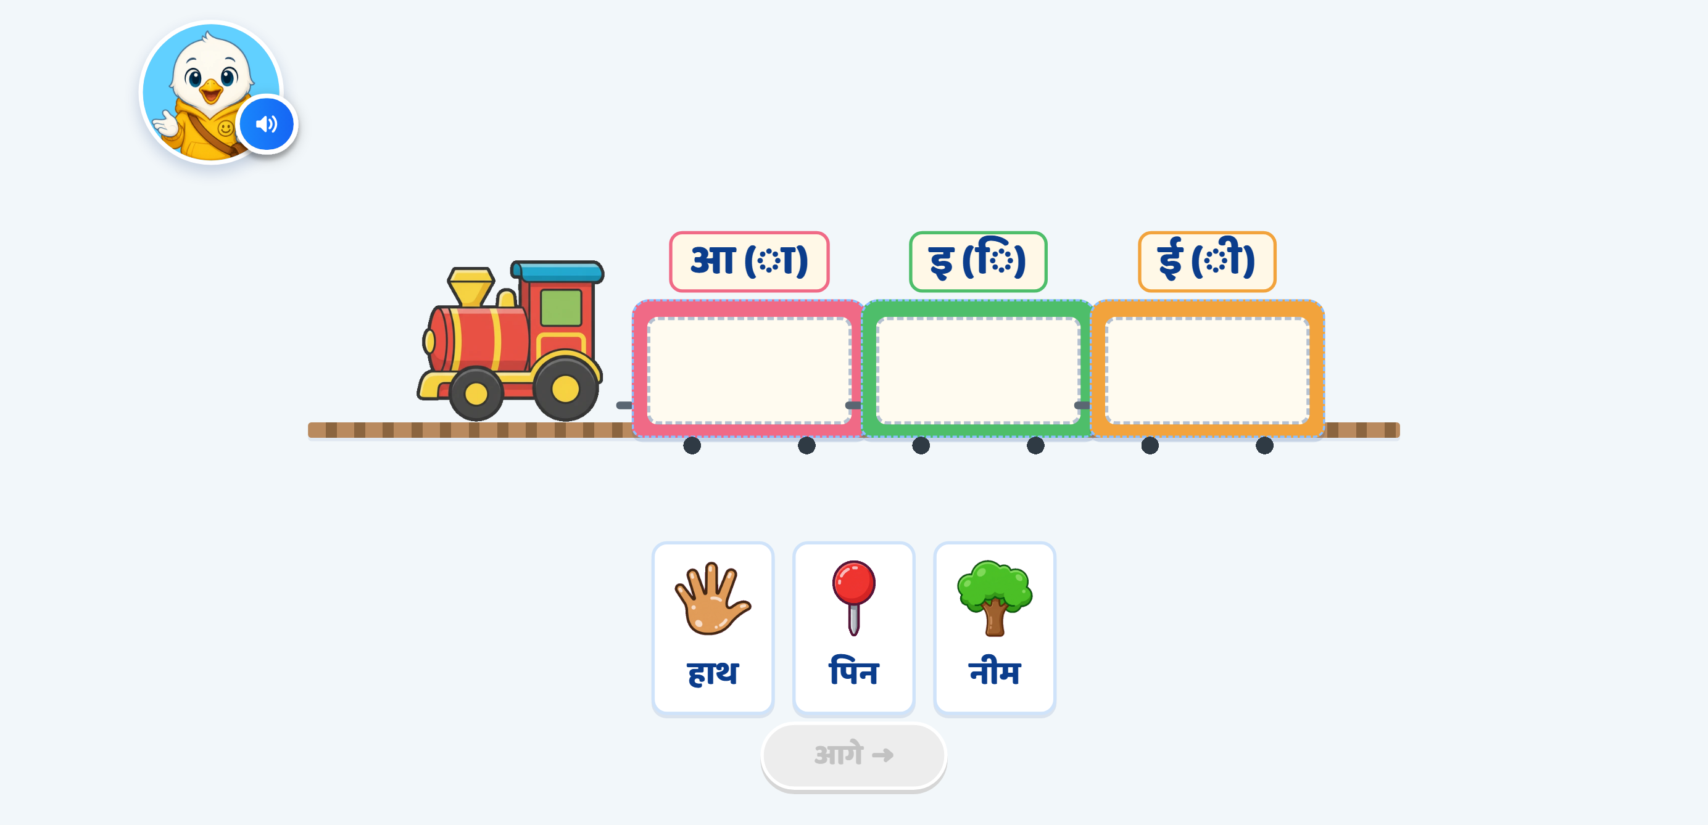
Page 12 · 11_G4_TRAIN_SORT.png
Recommendations
• Screen 11 · TRAIN_SORT word→matra — rows #124-#136. Coach labels use your literal «आ (ा)» form.

Slide 14
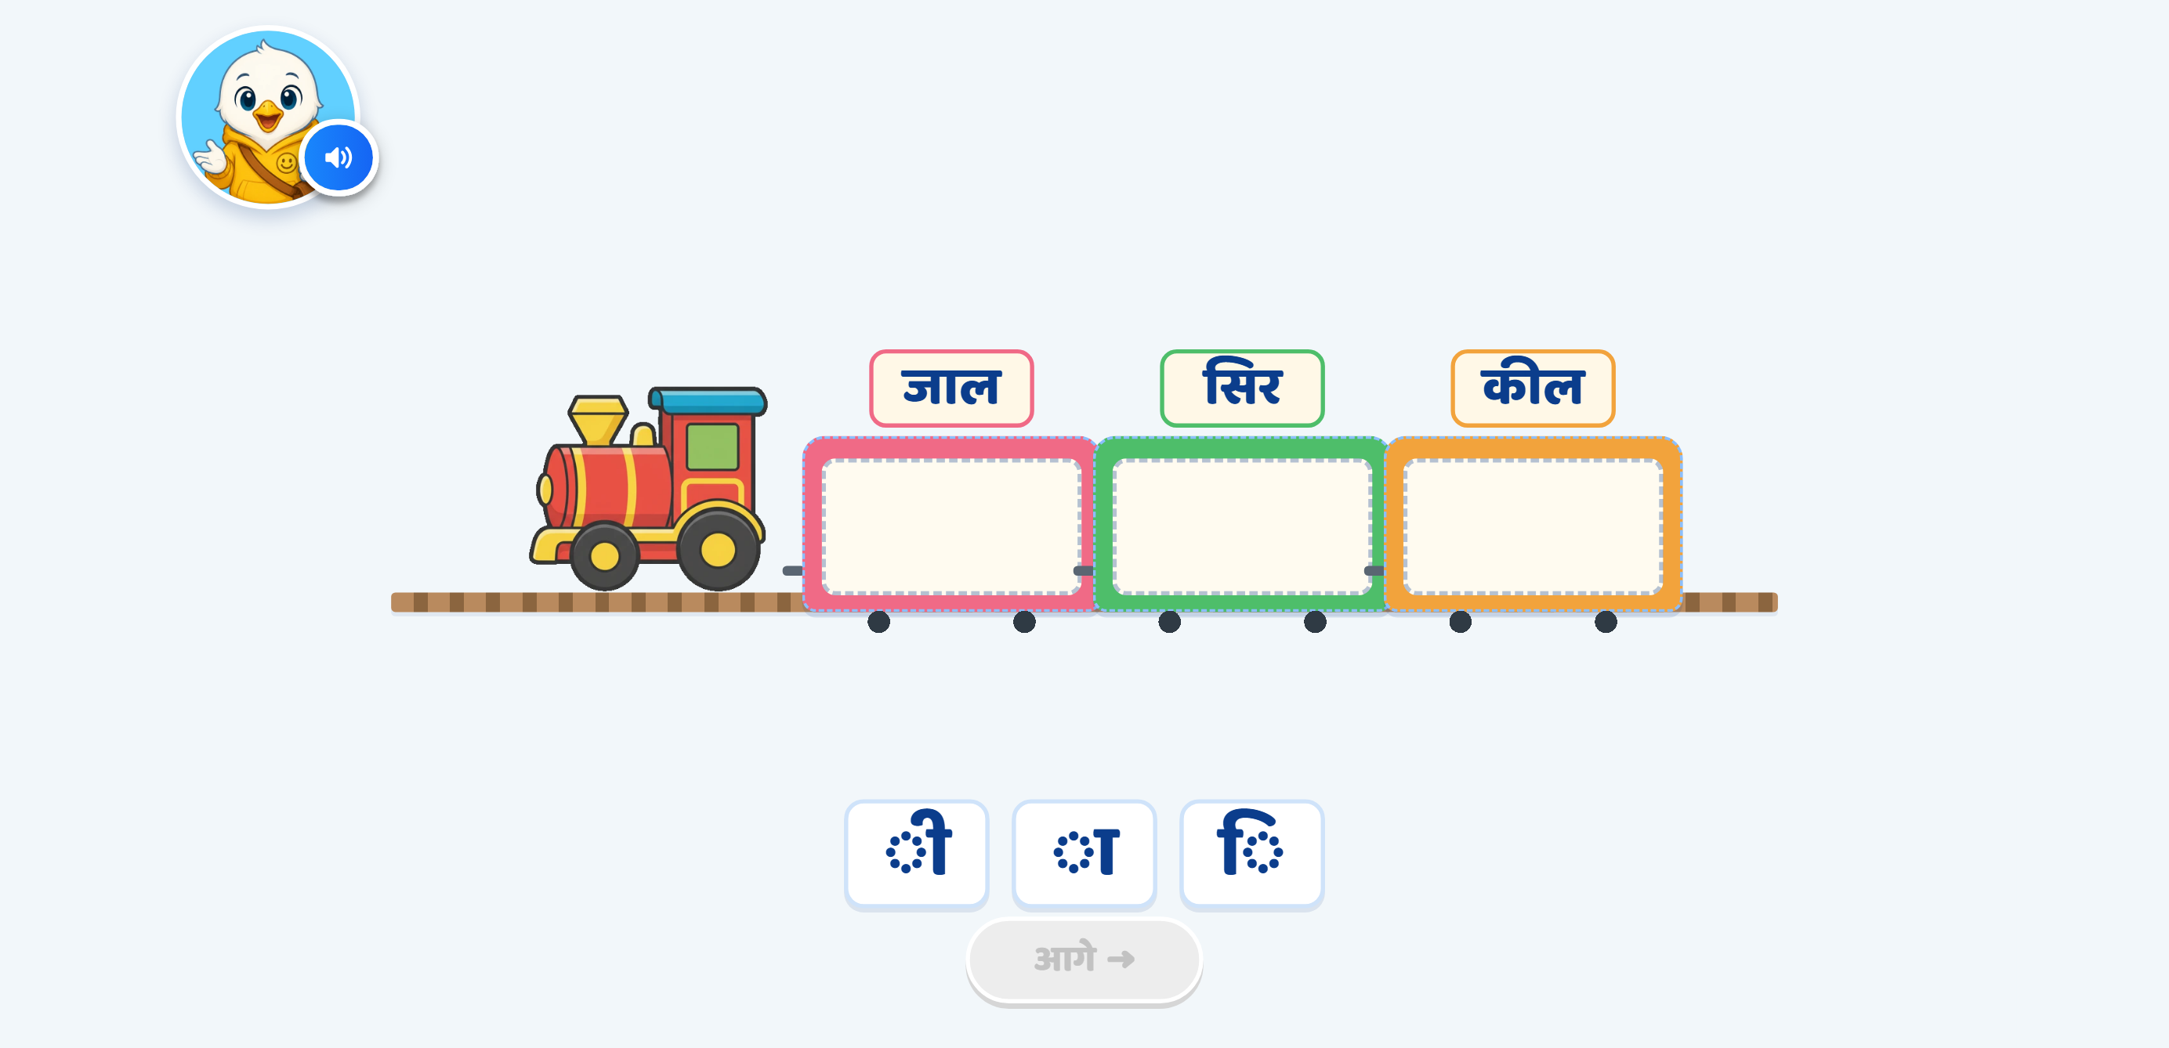
Page 13 · 12_P1_TRAIN_SORT.png
Recommendations
• Screen 12 · TRAIN_SORT matra→word — rows #137-#145, the reverse mapping.

Slide 15
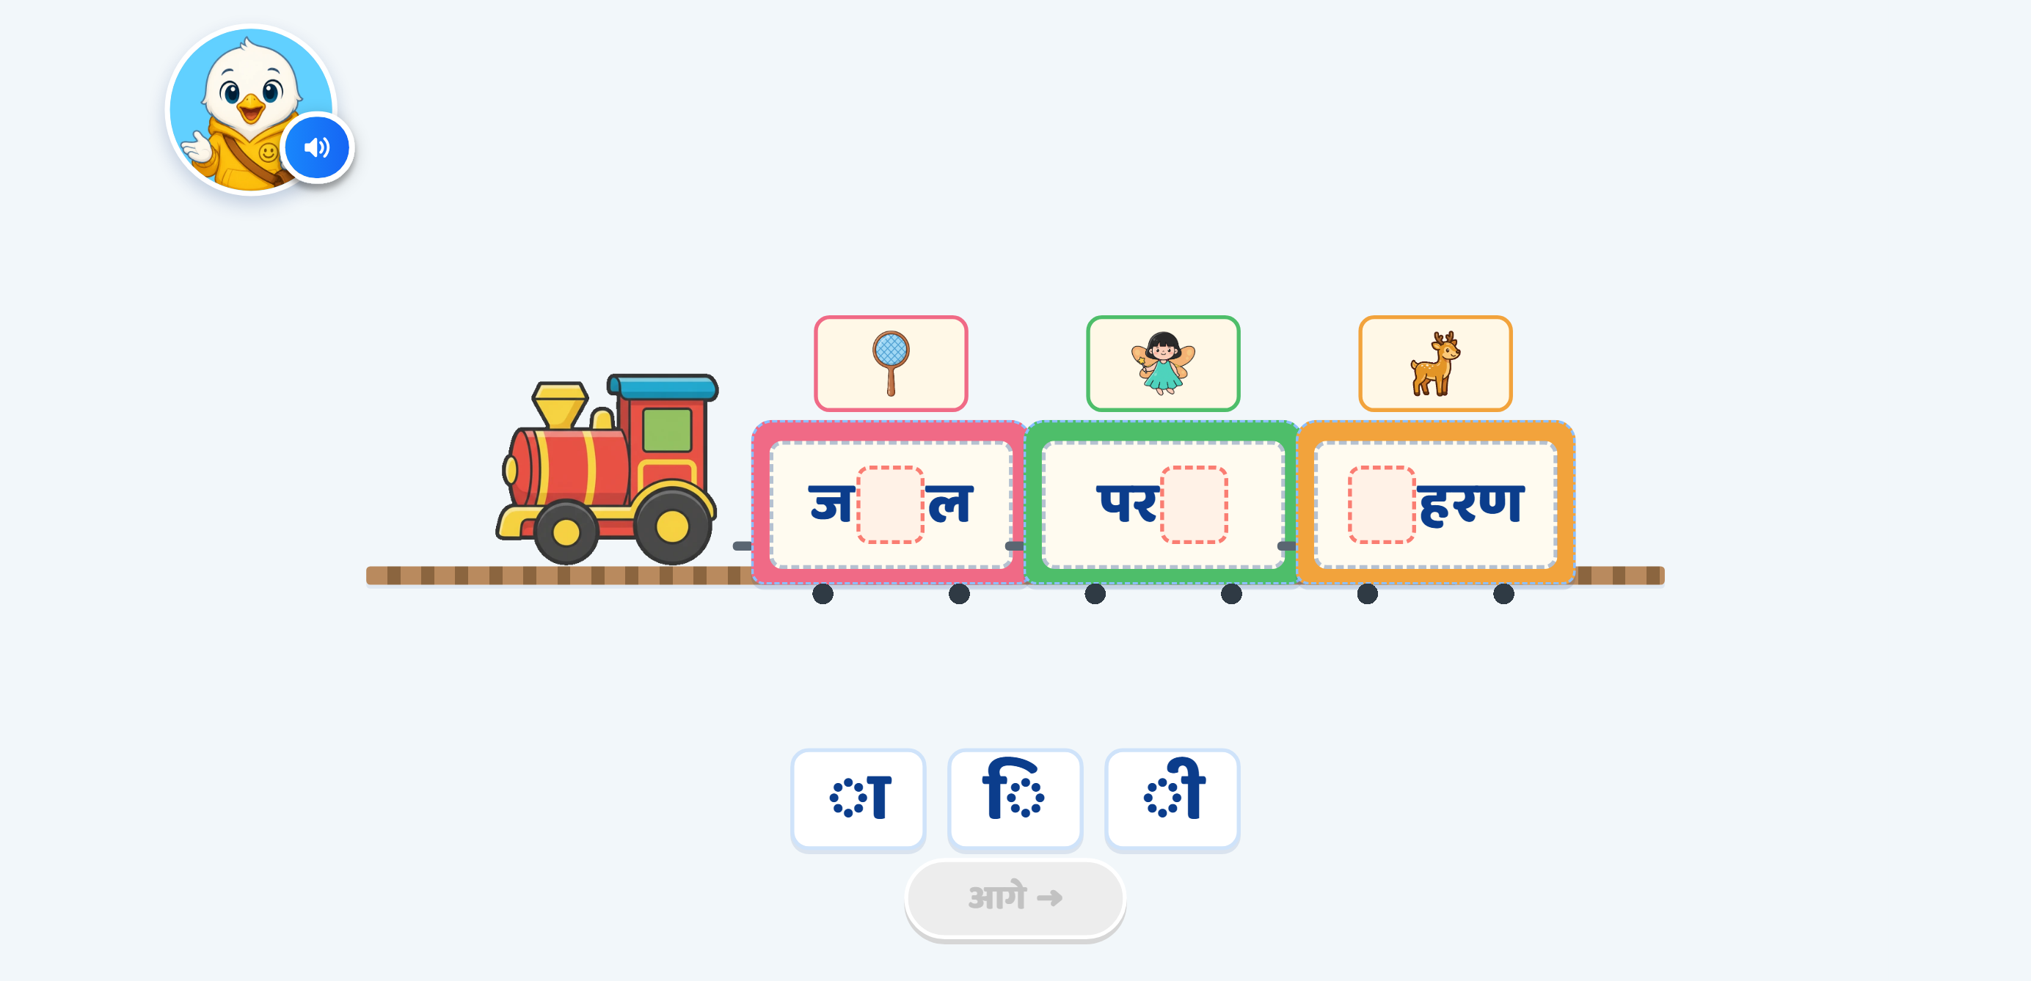
Page 14 · 13_P2_MATRA_FILL.png
Recommendations
• Screen 13 · MATRA_FILL — rows #146-#161. हीरा CORRECTED to हिरण. The blank sits in the matra's DRAWN position; the finished word re-renders as one shaped run so हिरण reads correctly.

Slide 16
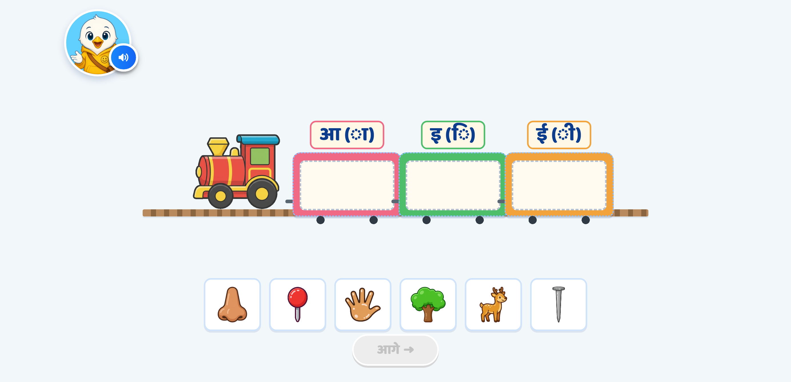
Page 15 · 14_P3_TRAIN_SORT.png
Recommendations
• Screen 14 · TRAIN_SORT pictures only — rows #162-#176. No word text at any point.

Slide 17
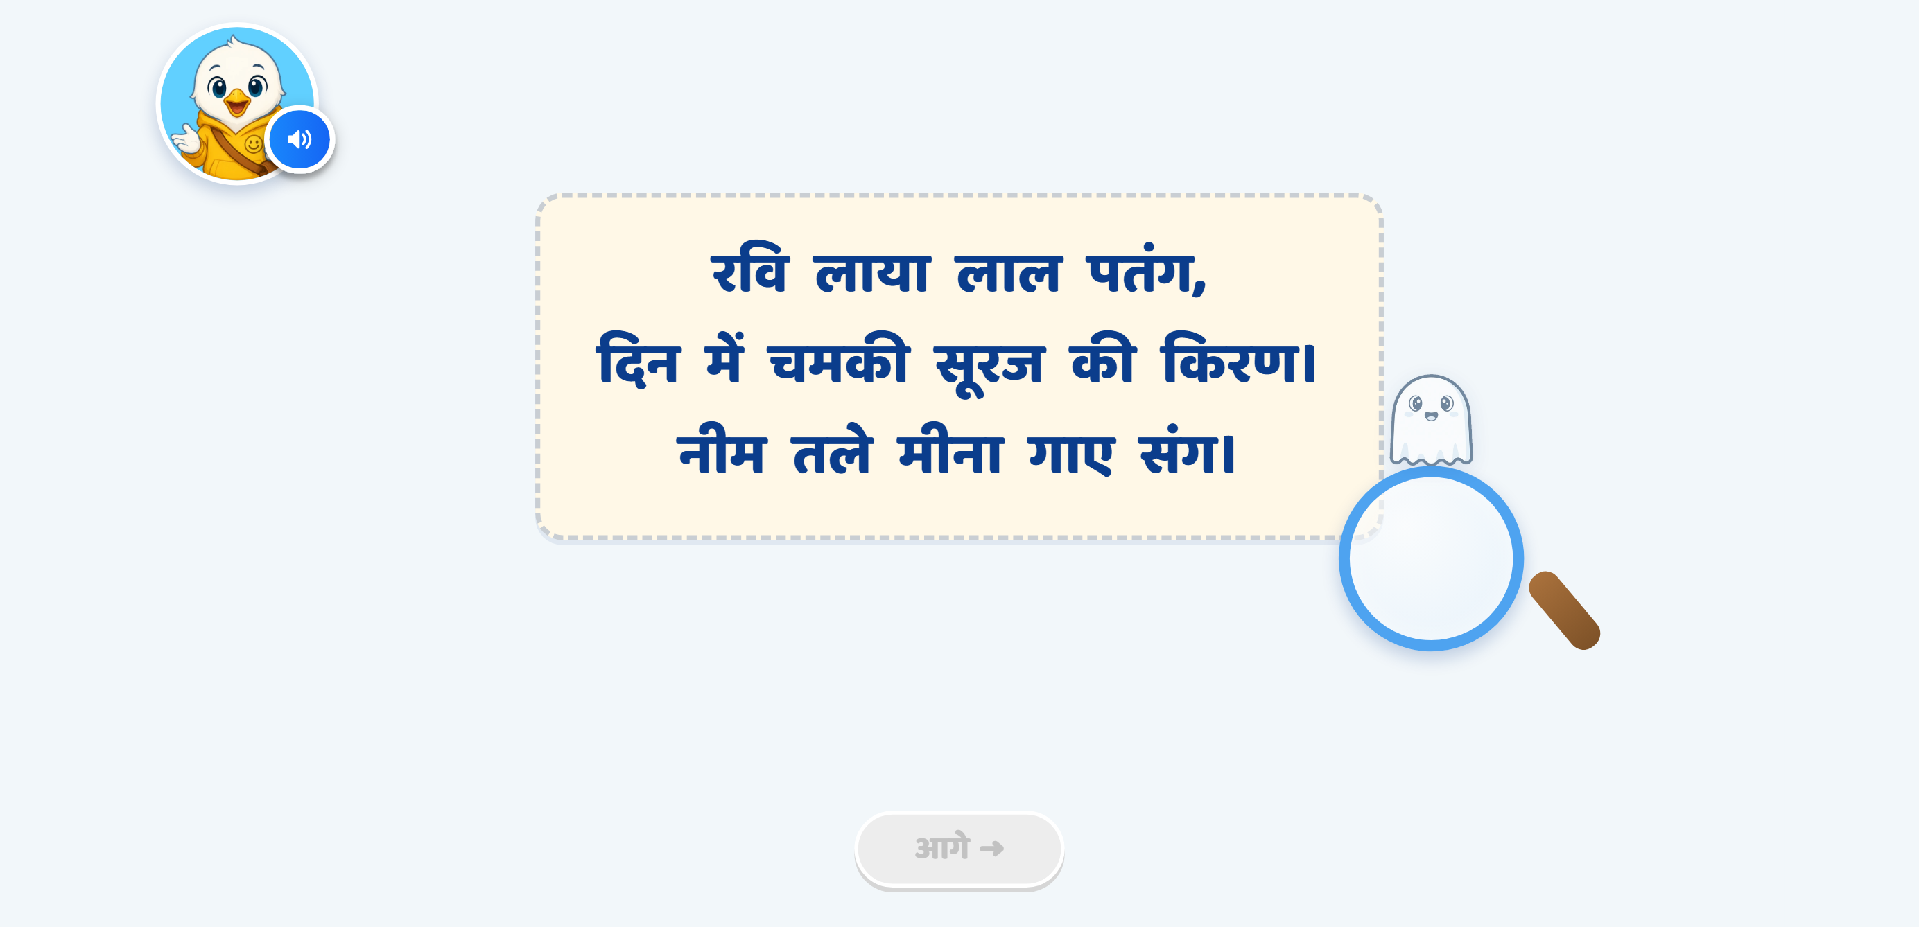
Page 16 · 15_P4_POEM_SEARCH.png
Recommendations
• Screen 15 · POEM_SEARCH — rows #177-#193. Scenery removed; lens + ghost guide. Target list completed per §4 Option A.

Slide 18

Page 17 · 16_CEL_CELEBRATION.png
Recommendations
• Celebration — row #194. N/C, ships as built.

