Slide 1
HI02H11_L02_S01 — आ, इ और ई की मात्रा · SME review
Page-by-page review · 20 pages

Slide 2
Overall recommendations & open questions
• WHAT THIS IS. Your 14-screen design for HI02H11_L02_S01, built: 19 slides (4 teach / 6 guided / 9 practice), all 13 illustrations generated, all 95 voice clips generated, walked page by page. Asset receipt is 0 FAIL / 0 WARN. Every screen you specified is present, and your final check is your exact set — राम, पिन, सीप, बाल, first-try scored.
• YOUR HINT LADDER IS AUTHORED VERBATIM, on every pick slide: first wrong → «फिर से सुनो, दिन।», second wrong → «दि-न। 'दि' में कौन-सी मात्रा सुनाई दे रही है?», then reveal. The only change is a comma where you wrote a dash, and that is a synthesis fix, not an edit — see the punctuation note below.
• THE MATRA HIGHLIGHT: TWO OF YOUR THREE WORK IN-WORD. You asked for the matra alone to be highlighted inside the word. ा (नाक) and ी (तीर) now colour RED INSIDE THE WORD — ी only because I added it to the engine's list in this game's own engine copy; it was missing, not impossible. ि (दिन) CANNOT: it is a reordering matra, drawn before the consonant it follows, so the engine's pixel-column highlight lands on part of the द. I built it, rendered it, saw the red on the wrong glyph, and reverted. ि uses the engine's «इस शब्द की मात्रा — ◌ि» callout instead, and the demo hand points at that and speaks the matra. I would rather tell you than show a child the wrong shape as «the matra».
• THREE THINGS IN YOUR BRIEF THE ENGINE CANNOT DO, AND WHAT I DID INSTEAD — none of them faked. (1) Screens 1-3's «क + ा = का» BUILD BEAT: the module that taps an akshara to hear its sound cannot be voiced at all — a bare akshara is refused by the TTS model (क, न, द, त all HTTP 400) and carrier forms work for some letters and not others, so it would ship silent tiles on some and spoken ones on others. The beat is now SPOKEN at the top of each word slide, so «न के साथ बड़ी आ की मात्रा लगी, तो बना ना» lands immediately before नाक. (2) Screens 5-7's DRAG-A-MATRA-INTO-«न _ क»: no module renders a word with a matra slot — I checked all 59 in this engine and every module in the reference engines. Built as the choice half (नाक · निक · नक) plus the sorts and drags for the produce half. (3) Screen 12's TAP THE MATRA INSIDE THE WORD: needs the word split into tappable parts; nothing does that for a matra. Page 13 is one tap away — the word read with no picture at all. If you want the literal drag-into-blank, that is a new engine module (MATRA_FILL) and a dev ask — say so and I will write it up instead of keeping the substitution.
• EVERY WRONG OPTION IS ONE OF YOUR TWO NAMED MISCONCEPTIONS, never a random word. Each pick offers the real word, the ि/ी POSITION SWAP, and the DROPPED MATRA — नाक · निक · नक; दिन · दीन · दन; सीप · सिप · सप. So a wrong tap is diagnostic: it tells us which error the child made rather than just that they missed. This shape is copied from your Grade 1 sibling HI01H11_L03_S02 (चीनी · चिनि · चनन), which is already signed off.
• PLEASE CHECK 1 — PUNCTUATION TURNED OUT TO BE LOAD-BEARING, and it changed your text by one character. «फिर से सुनो — दिन।» with an em-dash SYNTHESISES TRUNCATED: measured 0.69-1.29 s across four takes for a line that cannot be said in under about 1.5 s. I probed the three punctuations head to head on the same words — em-dash 0.73-1.05 s, comma 1.53-2.21 s, danda 1.13-2.01 s. Every short line now uses a comma. Your WORDS are untouched; only the dash between them moved. It also cut the refusal rate sharply: 33 clips were regenerated after the change and all 33 came back on the lesson's own voice, though a later duration check still caught 4 of them short and those were re-taken. Tell me if you want the dash back and I will flag those clips for human recording instead.
• PLEASE CHECK 2 — ONE WORD SWAPPED FROM YOUR LIST. सिर → हिरण. सिर (head) and बाल (hair) would be nearly identical pictures at 116px on a sort tile, and बाल is in your required final set, so सिर is the one that moved. हिरण is also a single-ि word and is unmistakable as a picture. Nothing else in your word choices or wording changed. Say the word and I will put सिर back with a clearer illustration brief.
• PLEASE CHECK 3 — THE LANDING GREETING DIFFERS FROM THE SIBLING'S BY TWO WORDS, deliberately, and both are still your open ruling. This lesson says «स्विफ्टी» in Devanagari and «सीखेंगे»; the sibling lesson carries «swiftee» in Latin and «जानेगें», recorded verbatim from your note and never corrected without your say. One ruling settles both lessons.
• REGISTER IS TUM throughout, matching the Grade 2 sibling. The three phase-gate clips the engine plays BETWEEN phases are shared across the whole fleet and are still recorded in AAP («ध्यान से देखिए…», «अब आपकी बारी»), so Grade 2 still switches register at each gate. Same open ruling as the sibling lesson — one decision covers G2 and G3.
• TWO VOICE CLIPS ARE ON A DIFFERENT VOICE and it needs a wording tweak rather than a retry. The lesson is voiced by Kore. «फिर से सुनो, दिन।» and «यह दिन है। इसमें छोटी इ की मात्रा है।» are both truncated by the model on Kore no matter how many times they are retried — the word दिन specifically triggers it — and recovered on Aoede at full length. The other 85 clips recorded for this lesson are all on Kore (the remaining 8 are the shared phase-gate and sound-effect files, which are copied, not recorded). Reword those two lines and they come back on the lesson voice.
• MECHANIC MIX IS CHECKED AT BUILD TIME, not discovered afterwards. 14 test slides: drag 6 (43%), pick 8 (57%), against a 60% ceiling — two gesture families and two produce mechanics (the matra sort and the word-to-picture drag). The build now FAILS if that regresses, because the sibling lesson's first receipt flagged this gate after the art and voice had already been paid for.
• FOUR DEFECTS WERE FOUND AND FIXED DURING THE BUILD, all of which pass a naive check. (1) The landing letter strip rendered EMPTY and silently — this engine copy had no `letter` case in its tile renderer, even though it carries the same version string as the copy that does. (2) Two illustrations were WRONG rather than missing: the दिन sun came back as a plain yellow smiley with no rays, which reads as an emoji and not as «day», and the retry came back BLANK because separated rays defeat the background keying. (3) Six voice clips were TRUNCATED — present on disk, correct size, and cut off mid-sentence. (4) Four clips had their text edited while keeping the same clip id, so the OLD audio stayed on disk with nothing flagging it. The bundle now carries a checker for each of these; details on the last page.
• WHAT IS NOT DONE. The literal drag-a-matra-into-a-blank (your Screens 5-7) and tapping a matra inside a rendered word (your Screen 12) are engine asks, not card work, and I have not approximated them. Also still upstream: adding ी to the shared engine's right-spacing matra list so every lesson gets that highlight, and the concept_strip landing glow, which affects all 11 reference bundles that use it.

Slide 3
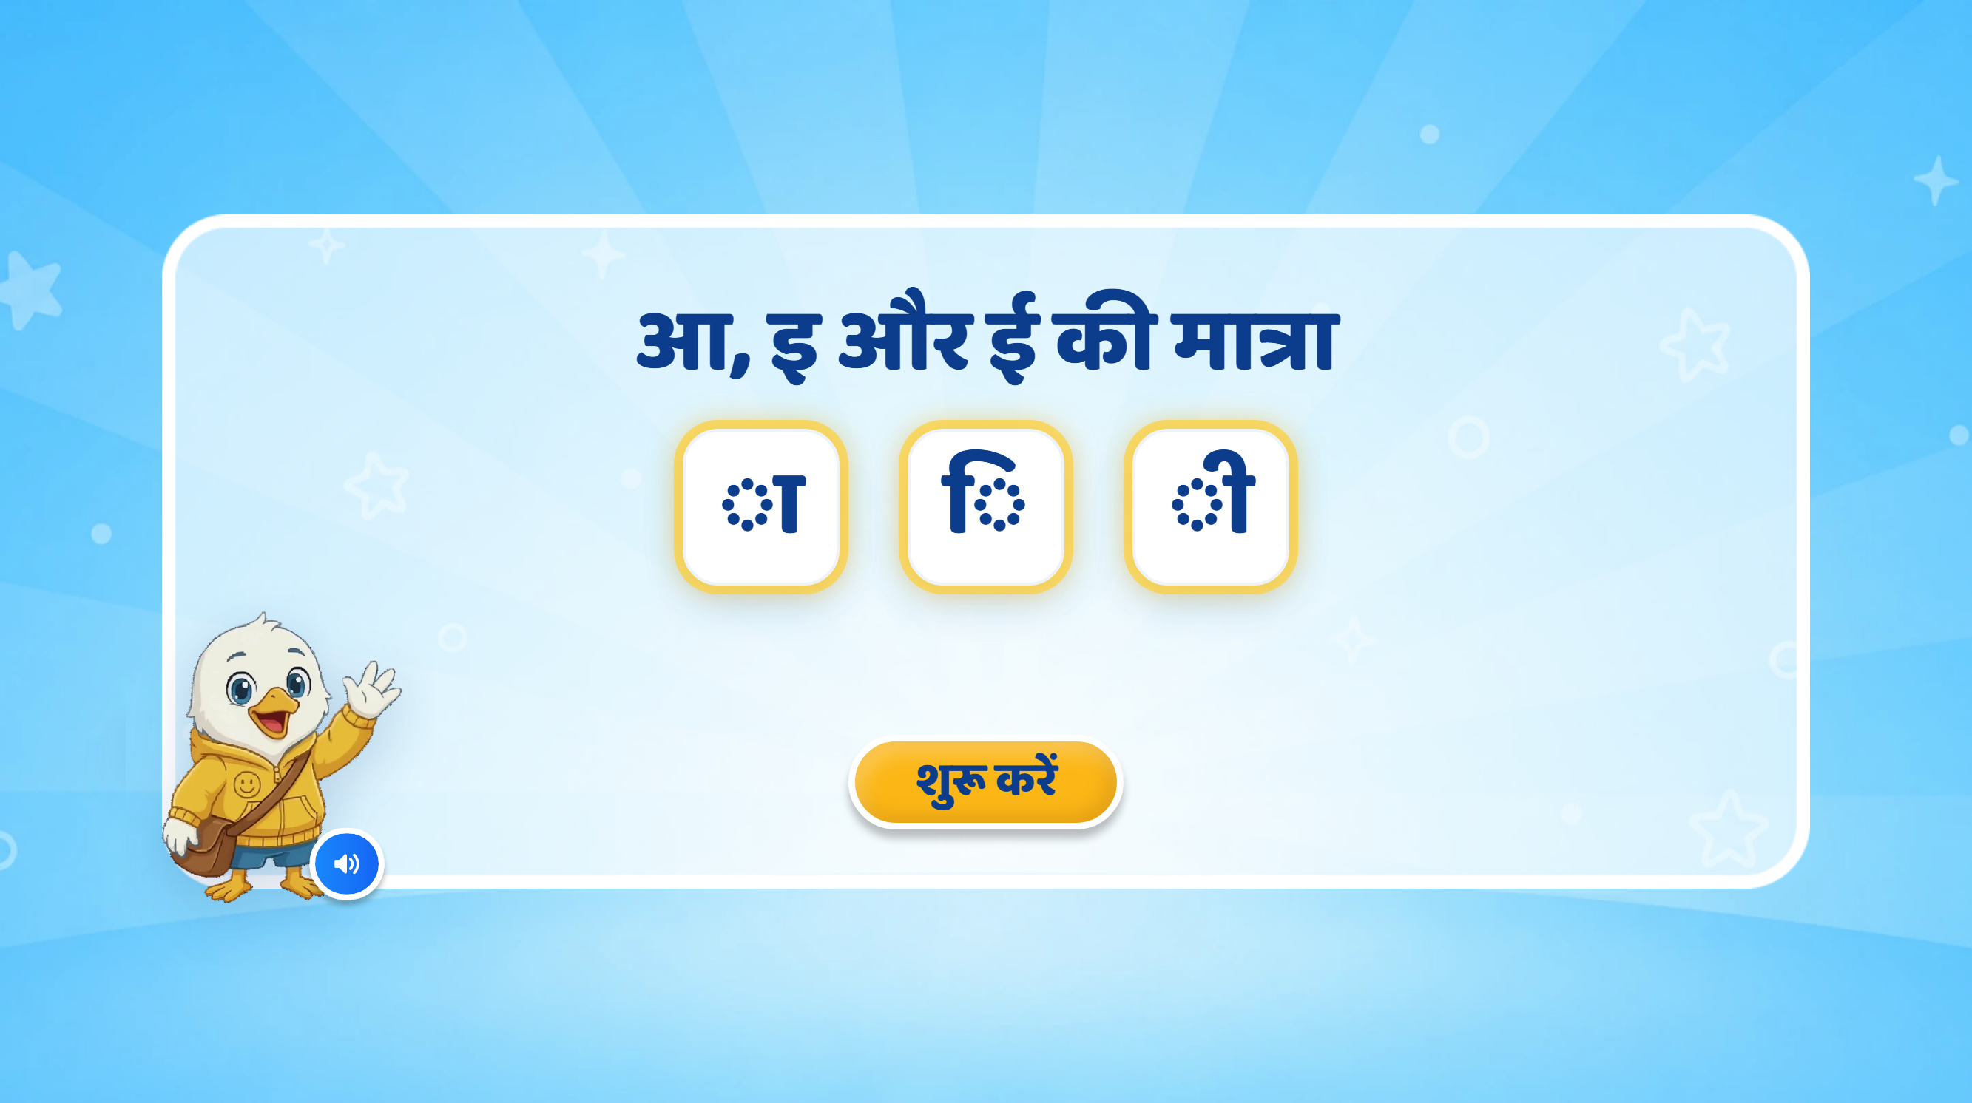
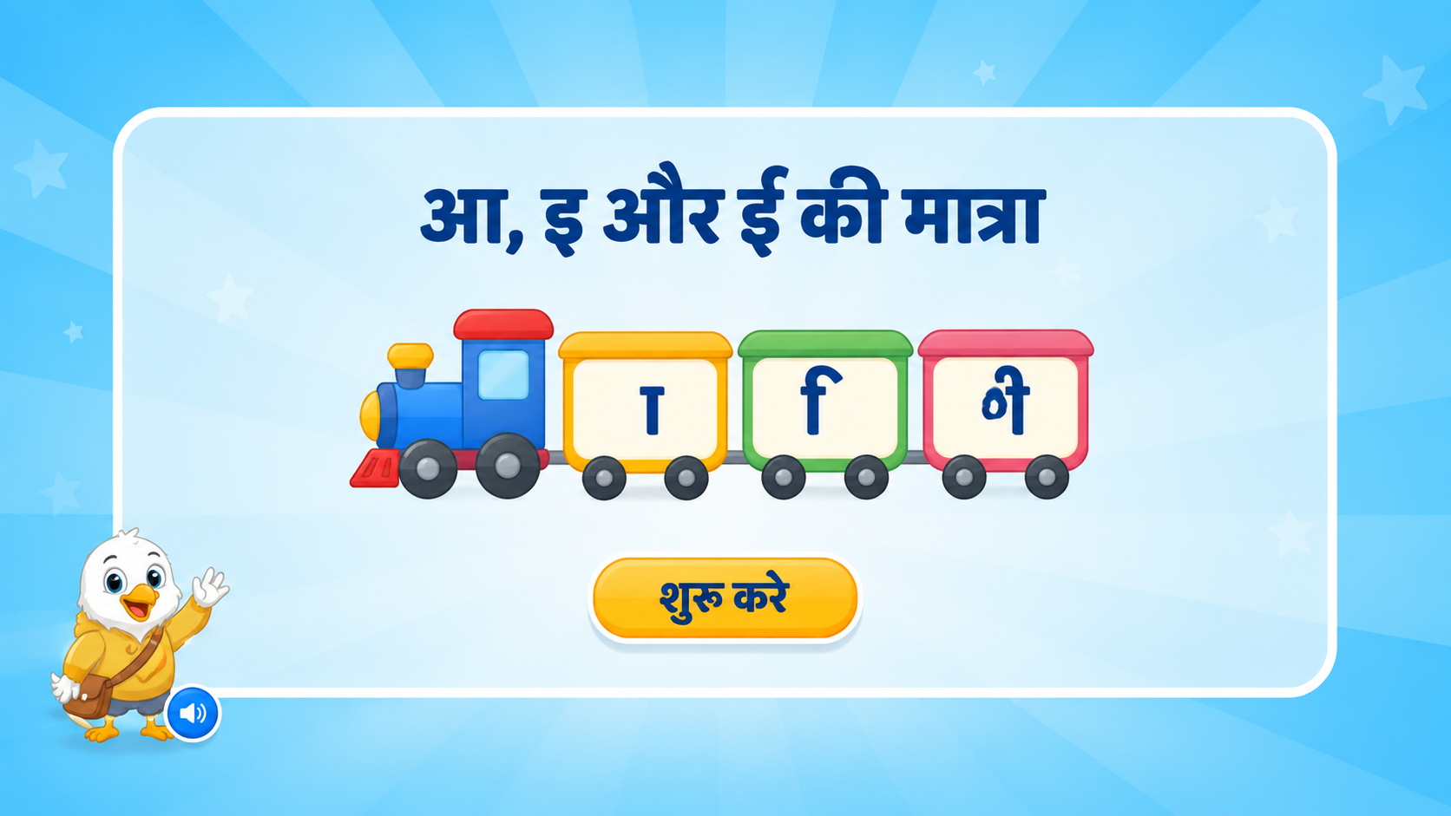
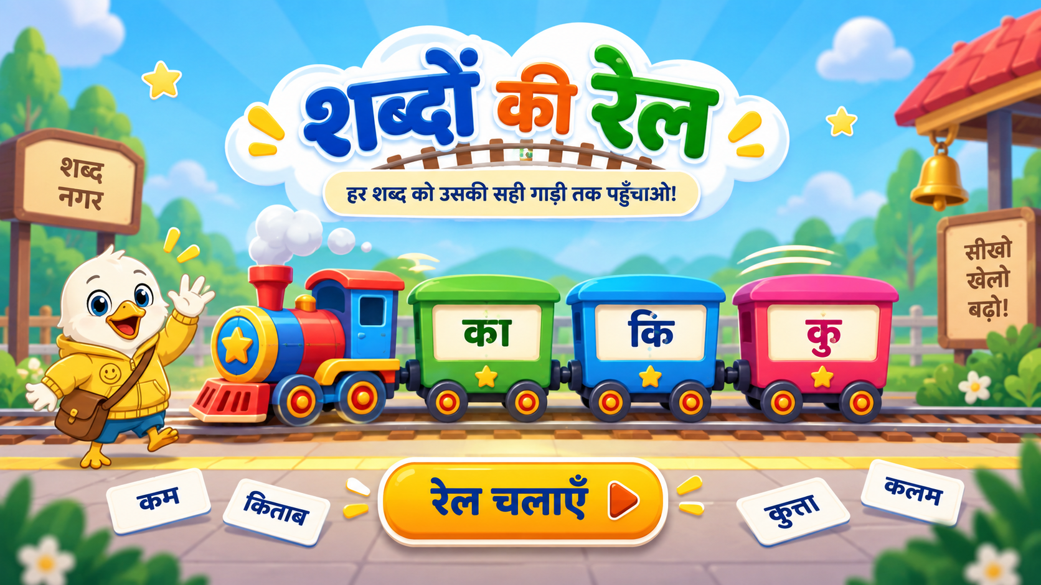
Page 1 · 01_landing.png
Notes:
New Heading:
मात्राओं की रेल
Screen Changes:
Remove all extra text that is not required.
Keep the screen clean and minimal.
Show only three matra boxes/cards:
1st box: ा
2nd box: ि
3rd box: ी
Keep the existing mascot and overall UI/UX style unchanged.
Animation:
If possible, bring the train onto the screen with a smooth right-to-left animation.
The three matra boxes can appear one by one with a soft pop/fade animation.
Keep animations subtle and child-friendly.
SFX:
Add a soft train arrival / whistle SFX when the train enters.
Add a light sparkle/pop SFX when each matra appears.
VO:
“हेलो दोस्त! मैं हूँ स्विफ्टी। आज हम मात्राओं के बारे में जानेंगे।”
After this VO, the three matras ा, ि, ी can appear one by one on screen.

Slide 4
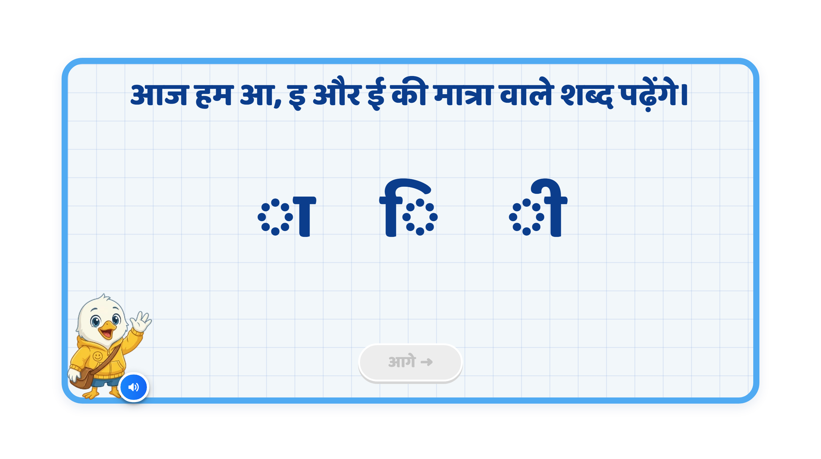
Page 2 · 02_INTRO.png
Notes:
Recommendation
VO:
“आज हम बड़ी आ की मात्रा, छोटी इ की मात्रा और बड़ी ई की मात्रा वाले शब्द पढ़ेंगे।” (removing chota or bada)
On Screen:
Remove the current heading text from the top.
Show the letter and its corresponding matra symbol as a pair, one by one.
Each pair should light up/highlight when its VO plays.
Keep only one pair active at a time.
Sequence:
आ → ा
इ → ि
ई → ी
Animation:
First आ appears, then ा appears beside it with a soft glow.
Then both fade slightly and इ → ि appears.
Finally ई → ी appears.
Use a simple pop/fade animation; no extra decorative elements.
SFX:
Add a soft pop/chime when each matra symbol appears.
Keep SFX subtle so the VO remains clear.
Next Button:
Keep the Next button disabled during the sequence.
Activate it only after all three pairs have been shown and spoken.

Slide 5
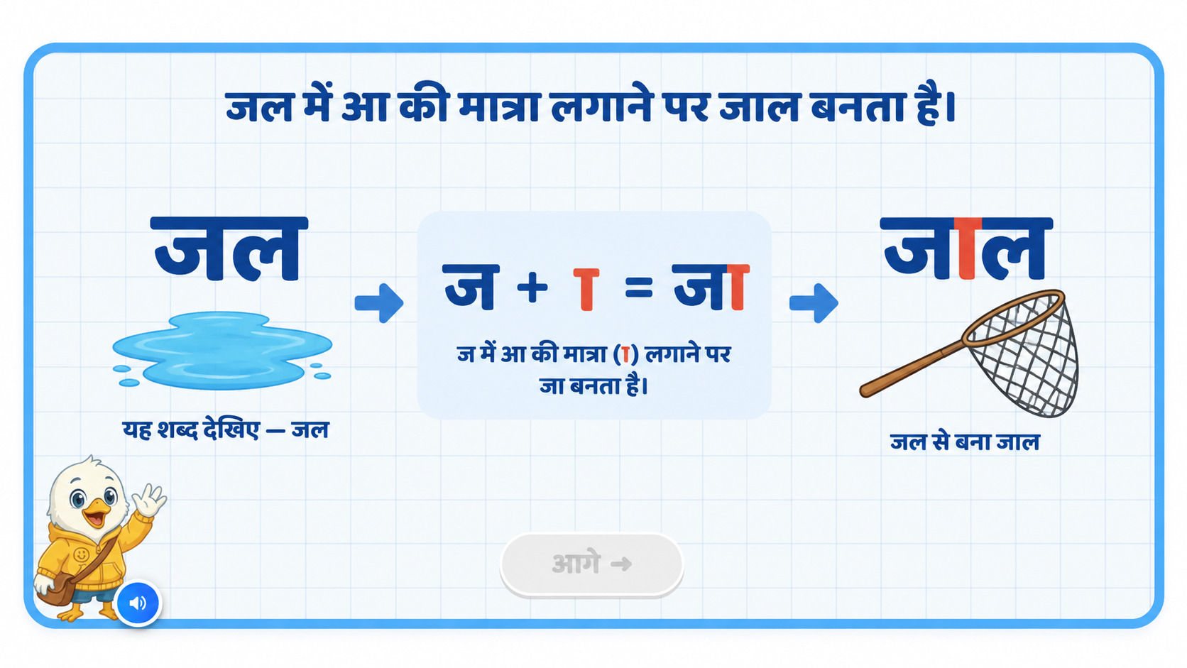
Page 3 · 03_MEET_LETTER.png
Notes:
Recommendation
VO:
“आइए, देखें कि आ की मात्रा लगने से शब्द की आवाज़ कैसे बदलती है।”
पहले:
“यह शब्द है — जल।”
फिर:
“ज में आ की मात्रा लगाने पर — जा बनता है।”
अंत में:
“अब जल में आ की मात्रा लगाने पर — जाल बनता है।”
On Screen:
Keep the screen focused on only one transformation.
First show जल clearly on the left.
Then show the transformation in the centre:
ज + ा = जा
After that, complete the word as:
जाल
Highlight only the ा matra when it is introduced.
A simple relevant image can support the final word जाल.
Sequence:
जल appears.
VO reads: “जल”.
The letter ज is highlighted.
ा appears beside ज.
Show:
ज + ा = जा
Play the sound difference clearly:
“ज” → “जा”
Then ल joins.
Final word appears:
जाल
Highlight ा inside जाल.
Final image appears.
Animation:
Use simple step-by-step animation.
जल should appear first.
Then isolate or highlight ज.
The ा matra should slide/pop into place beside ज.
As soon as it joins, ज visually transforms into जा.
Then ल joins to form जाल.
Keep the sound transformation synced with the visual:
ज → जा → जाल
Avoid showing all stages together at the start.
Sound Differentiation:
Make the difference between the sounds very clear:
ज
जा
जाल
Give a small pause between each sound so the child can hear the change.
The main learning focus should be:
आ की मात्रा जुड़ने पर ज की आवाज़ “जा” हो जाती है।
SFX:
Soft pop when ा appears.
Light chime when ज changes to जा.
Small success sound when जाल is completed.
Keep SFX subtle so the pronunciation remains clear.
Next Button:
Keep Next disabled while the transformation is playing.
Activate it only after ज → जा → जाल is fully demonstrated.
Note:
Keep the screen clean and minimal.
Do not add extra explanatory text.
Focus on the before-matra and after-matra sound difference.
The key visual learning should be:
जल → ज + ा = जा → जाल

Slide 6
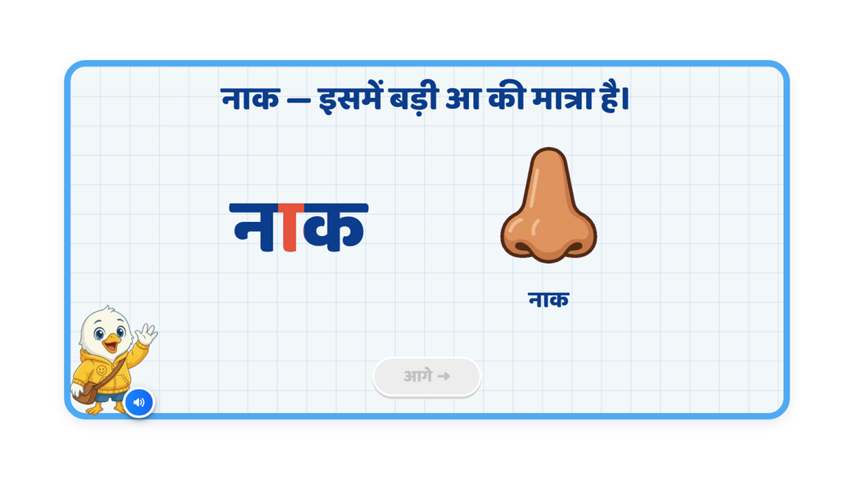
Notes:
provide recommendation Recommendation
VO:
“आइए, आ की मात्रा वाले कुछ शब्द देखें।”
पहले:
“नाक
— बोलकर
देखिए।
इसमें
न पर
बड़ी
आ की
मात्रा
लगी
है।”
फिर:
“मटका
— बोलकर
देखिए।
इसमें
क
पर
बड़ी
आ की
मात्रा
लगी
है।”
On Screen:
•Keep one example visible at a time.
•First show नाक with the nose image.
•Highlight only the ा matra in the word नाक.
•After that, show the second example मटका with a clay pot image.
•Highlight the ा matra in मटका as well.
Sequence:
1.नाक word appears
2.Nose image appears
3.The ा matra in नाक gets highlighted
4.Then move to मटका
5.मटका word appears
6.Clay pot image appears
7.The ा matra in मटका gets highlighted
Animation:
•Word should appear first, then image should appear.
•Use simple fade / pop-in animation.
•When VO says the matra part, the ा should glow/highlight.
•Keep animation one by one, not all together.
SFX:
•Soft pop sound when word/image appears
•Soft highlight chime when matra glows
•Keep SFX subtle
Next Button:
•Keep Next button disabled during the explanation
•Activate it only after both examples are shown completely
Note:
•Keep screen clean
•No extra text other than the example heading/content required for the explanation
•Focus on clearly showing that आ की मात्रा is highlighted in both words
i am attaching previous recommendation

Slide 7
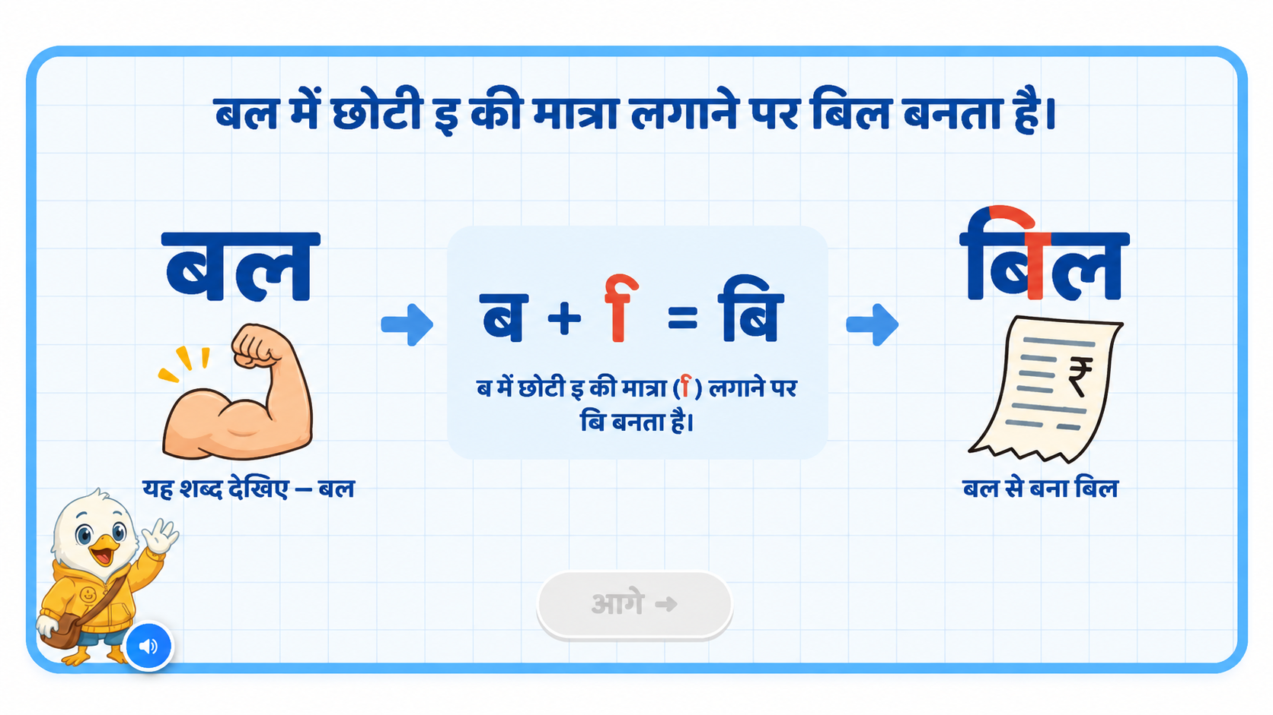
Notes:
Recommendation
VO
“आइए, देखें कि छोटी इ की मात्रा लगाने से शब्द की आवाज़ कैसे बदलती है।”
पहले:
“यह शब्द है — बल।”
फिर:
“ब में छोटी इ की मात्रा लगाने पर — बि बनता है।”
अंत में:
“अब बल में छोटी इ की मात्रा लगाने पर — बिल बनता है।”
On Screen
Keep only one transformation on the screen.
First show बल with a simple visual.
Then highlight ब.
Show the transformation in the centre:
ब + ि = बि
After that, complete the word as:
बिल
Highlight only the ि मात्रा in बिल.
Show a simple relevant image for बिल on the final side.
Sequence
बल appears.
VO reads: “बल”.
ब gets highlighted.
ि appears and moves to its correct position before ब.
Show: ब + ि = बि
Play the sound clearly: “ब” → “बि”
ल joins.
Final word appears: बिल
Highlight ि in बिल.
Final image appears.
Animation
Use simple step-by-step animation.
Do not show all stages together from the beginning.
The ि मात्रा should visibly move to the left side of ब, so the child notices its written position.
Sync the visual change with the VO:
ब → बि → बिल
Give a short pause between each sound.
Sound Differentiation
The key focus should be on the change in sound:
ब → बि → बिल
Make the pronunciation slow and clear so the child can hear how छोटी इ की मात्रा changes the sound.
SFX
Soft pop when ि appears.
Light chime when ब changes to बि.
Small success chime when बिल is completed.
Keep SFX subtle so the pronunciation remains clear.
Next Button
Keep Next disabled during the explanation.
Activate it only after the full transformation बल → बि → बिल is completed.
Note
Keep the screen clean and minimal.
Avoid extra explanatory text.
The main learning should be the before and after sound difference and the special written position of ि.

Slide 8
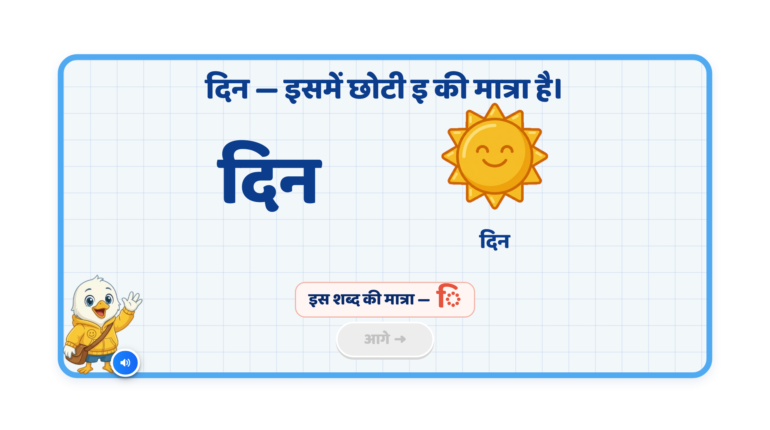
Page 4 · 04_MEET_LETTER.png
Notes:
Recommendation
VO:
“आइए, छोटी इ की मात्रा वाले कुछ शब्द देखें।”
पहले:
“दिन — बोलकर देखिए। इसमें द पर छोटी इ की मात्रा लगी है।”
फिर:
“गति — बोलकर देखिए। इसमें त पर छोटी इ की मात्रा लगी है।”
On Screen:
Keep one example visible at a time.
First show दिन with a simple day/sun image.
Highlight only the ि matra in दिन.
After that, show गति with a simple visual representing movement/motion.
Highlight the ि matra in गति as well.
Remove any extra explanatory text that is not required.
Sequence:
दिन word appears
Day/sun image appears
ि matra in दिन highlights
Then गति appears
Motion/movement visual appears
ि matra in गति highlights
Animation:
Word appears first with a soft fade/pop.
Image appears just after the word.
When the VO reaches the matra explanation, ि should glow/pulse briefly.
Keep the transition one-by-one and simple.
SFX:
Soft pop/chime when each word/image appears.
Light sparkle/chime when the matra gets highlighted.
Next Button:
Keep Next disabled while both examples are being explained.
Activate it only after both examples are completed.

Slide 9
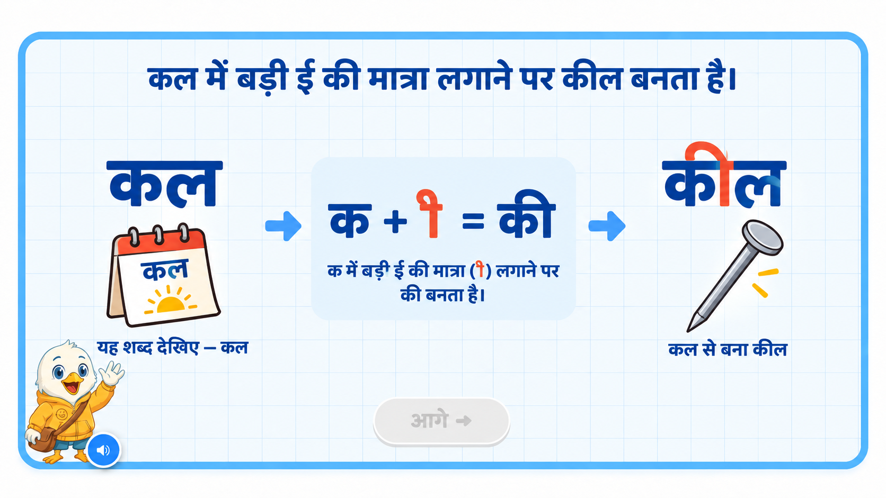
Notes:
Recommendation
VO
“आइए, देखें कि बड़ी ई की मात्रा लगाने से शब्द की आवाज़ कैसे बदलती है।”
पहले:
“यह शब्द है — कल।”
फिर:
“क में बड़ी ई की मात्रा लगाने पर — की बनता है।”
अंत में:
“अब कल में बड़ी ई की मात्रा लगाने पर — कील बनता है।”
On Screen
Keep only one transformation on the screen.
First show कल with a simple supporting visual.
Then highlight क.
Show the transformation in the centre:
क + ी = की
After that, complete the word as:
कील
Highlight only the ी मात्रा in कील.
Show a simple relevant image for कील on the final side.
Sequence
कल appears.
VO reads: “कल”.
क gets highlighted.
ी appears and joins क.
Show: क + ी = की
Play the sound clearly: “क” → “की”
ल joins.
Final word appears: कील
Highlight ी in कील.
Final image appears.
Animation
Use simple step-by-step animation.
Do not show all stages together from the beginning.
The ी मात्रा should visibly join क, so the child notices how the sound changes.
Sync the visual change with the VO:
क → की → कील
Give a short pause between each sound.
Sound Differentiation
The key focus should be on the change in sound:
क → की → कील
Make the pronunciation slow and clear so the child can hear how बड़ी ई की मात्रा changes the sound.
SFX
Soft pop when ी appears.
Light chime when क changes to की.
Small success chime when कील is completed.
Keep SFX subtle so the pronunciation remains clear.
Next Button
Keep Next disabled during the explanation.
Activate it only after the full transformation कल → की → कील is completed.
Note
Keep the screen clean and minimal.
Avoid extra explanatory text.
The main learning should be the before and after sound difference.
Focus clearly on:
कल → क + ी = की → कील

Slide 10
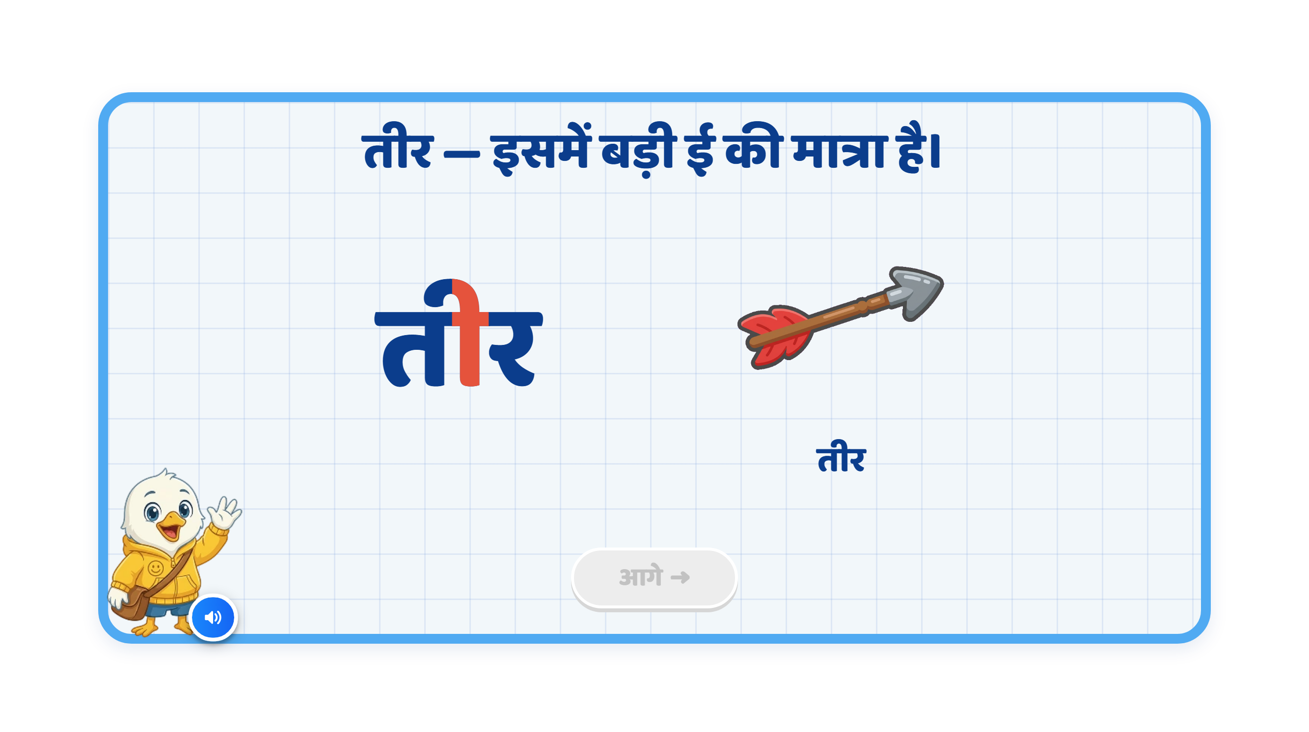
Page 5 · 05_MEET_LETTER.png
Notes:
Recommendation
VO:
“आइए, बड़ी ई की मात्रा वाले कुछ शब्द देखें।”
पहले:
“तीर — बोलकर देखिए। इसमें त पर बड़ी ई की मात्रा लगी है।”
फिर:
“लड़की — बोलकर देखिए। इसमें क पर बड़ी ई की मात्रा लगी है।”
On Screen:
Keep one example visible at a time.
First show तीर with the arrow image.
Highlight only the ी matra in तीर.
After that, show लड़की with a simple girl image.
Highlight only the ी matra in लड़की.
Remove any extra explanatory text that is not required.
Sequence:
तीर appears
Arrow image appears
ी matra in तीर highlights
Then लड़की appears
Girl image appears
ी matra in लड़की highlights
Animation:
Word appears first with a soft fade/pop animation.
Image appears just after the word.
When the VO mentions the matra, ी should glow/pulse briefly.
Show the examples one by one, not together.
SFX:
Soft pop/chime when the word or image appears.
Light sparkle/chime when the matra gets highlighted.
Next Button:
Keep Next disabled during the explanation.
Activate it only after both examples are completely shown.

Slide 11
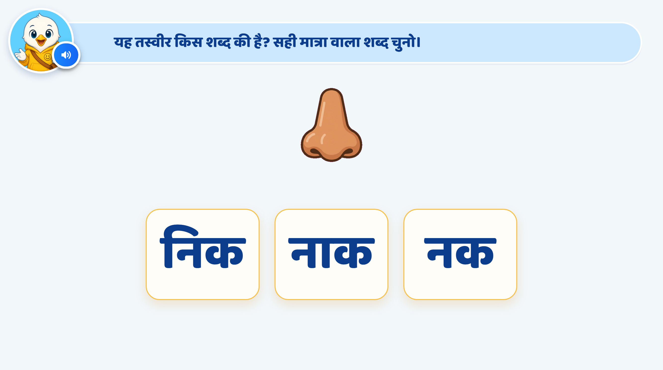
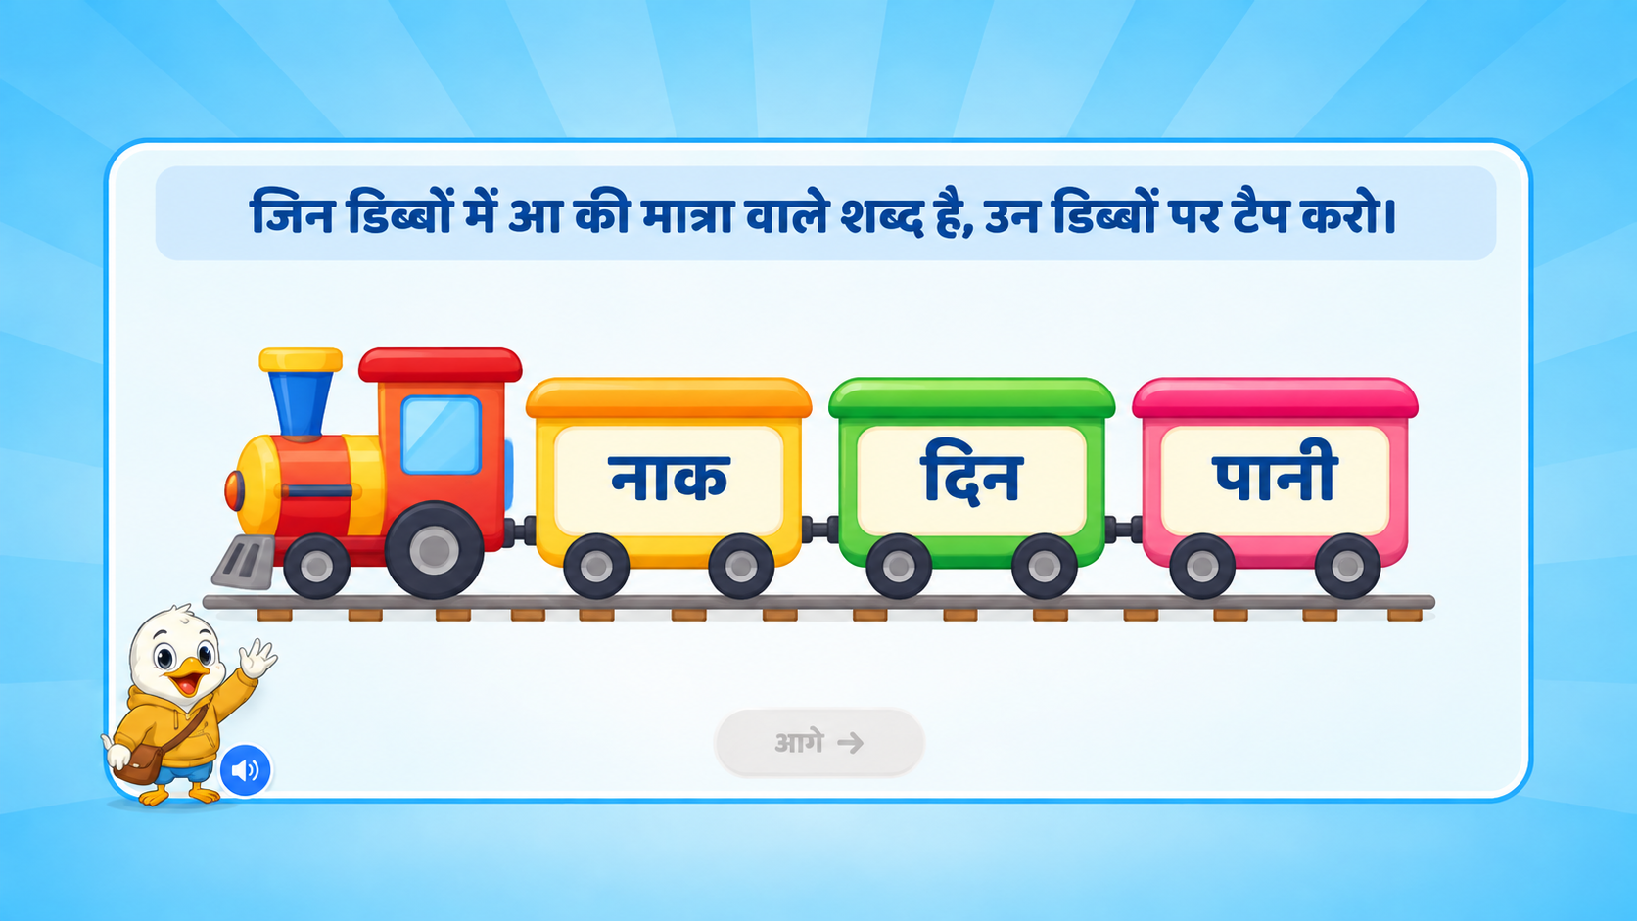
Page 6 · 06_TAP_LETTER_BY_PICTURE.png
Notes:
Recommendation
Entry Animation
Train comes through animation from right to left.
Train stops at the centre of the screen.
On Screen
No instruction text on screen
Only VO should play.
VO:
“जिस डिब्बे में आ की मात्रा वाला शब्द है, उस डिब्बे पर टैप कीजिए।”
Correct Answer
Show confetti / sparkle effect
Correct coach should glow / highlight
VO:
“शाबाश! हाथ शब्द में आ की मात्रा है।”
On 1st Wrong Attempt
Wrong coach should wiggle / shake
No hand nudge
Only hint VO should come
VO:
“फिर से सोचो। आ की मात्रा वाला शब्द कौन-सा है?”
On 2nd Wrong Attempt
Wrong coach should again wiggle / shake
Hint VO should play
Show hand nudge on the correct answer
VO:
“ध्यान से देखो और सही डिब्बे पर टैप कीजिए।”
Correct Answer on 3rd Attempt
Show confetti / sparkle
Correct coach highlights
Next button becomes active
No VO
SFX
Soft train arrival sound
Light tap sound on selection
Soft shake/error sound on wrong attempt
Light success chime on correct answer

Slide 12
Page 6 · 06_TAP_LETTER_BY_PICTURE.png
Notes:
Recommendation
Entry Animation
Train comes through animation from right to left.
Train stops at the centre of the screen.
On Screen
No instruction text on screen
Only VO should play.
VO:
“जिस डिब्बे में छोटी इ की मात्रा वाला शब्द है, उस डिब्बे पर टैप कीजिए।”
Correct Answer
Show confetti / sparkle effect
Correct coach should glow/highlight
VO:
“शाबाश! पिन शब्द में छोटी इ की मात्रा है।”
Note: Here it should be छोटी इ, not छोटी ई.
On 1st Wrong Attempt
Wrong coach should shake
No hand nudge
Only hint VO should come
VO:
“फिर से सोचो। छोटी इ की मात्रा वाला शब्द कौन-सा है?”
On 2nd Wrong Attempt
Wrong coach should again shake
Hint VO should play
Show hand nudge on the correct answer
VO:
“ध्यान से देखो और सही डिब्बे पर टैप करो।”
Correct Answer on 3rd Attempt
Show confetti / sparkle
Correct coach highlights
Next button becomes active
No VO
SFX
Soft train arrival sound
Light tap sound on selection
Soft shake/error sound on wrong attempt
Success chime on correct answer

Slide 13
Page 6 · 06_TAP_LETTER_BY_PICTURE.png
Notes:
Recommendation
Entry Animation
Train comes through animation from right to left.
Train stops at the centre of the screen.
ON SCREEN
No instruction text on screen.
Instruction should come through VO only.
VO:
“जिस डिब्बे में बड़ी ई की मात्रा वाला शब्द है, उस डिब्बे पर टैप कीजिए।”
Correct Answer
Show a small confetti / sparkle animation.
Correct coach gives a soft glow/highlight.
VO:
“शाबाश! पानी शब्द में बड़ी ई की मात्रा है।”
Next button becomes active.
1st Wrong Attempt
Wrong coach gives a short shake animation.
Only hint VO comes.
No hand nudge.
2nd Wrong Attempt
Wrong coach gives a shake animation again.
Hint VO comes.
Show a hand nudge on the correct answer.
Correct Answer on 3rd Attempt
Show confetti / sparkle.
Correct coach highlights.
Next button becomes active.
No VO.
SFX
Soft train arrival SFX.
Light tap SFX on selection.
Soft error/shake SFX on wrong attempt.
Success chime with confetti on the correct answer.

Slide 14
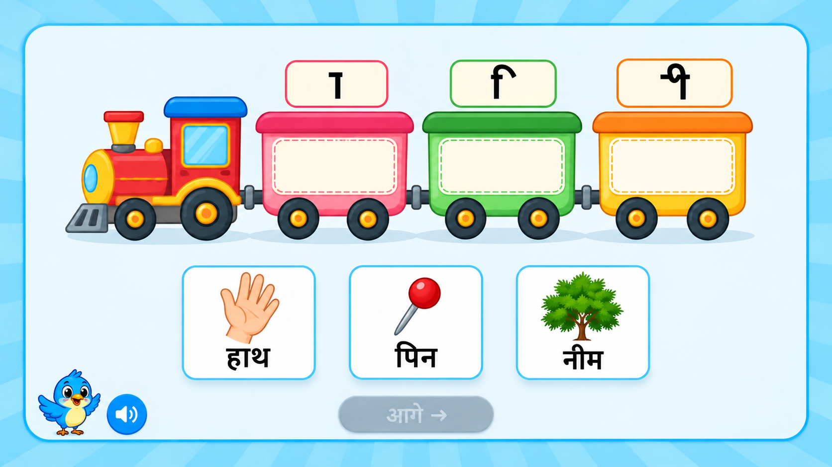
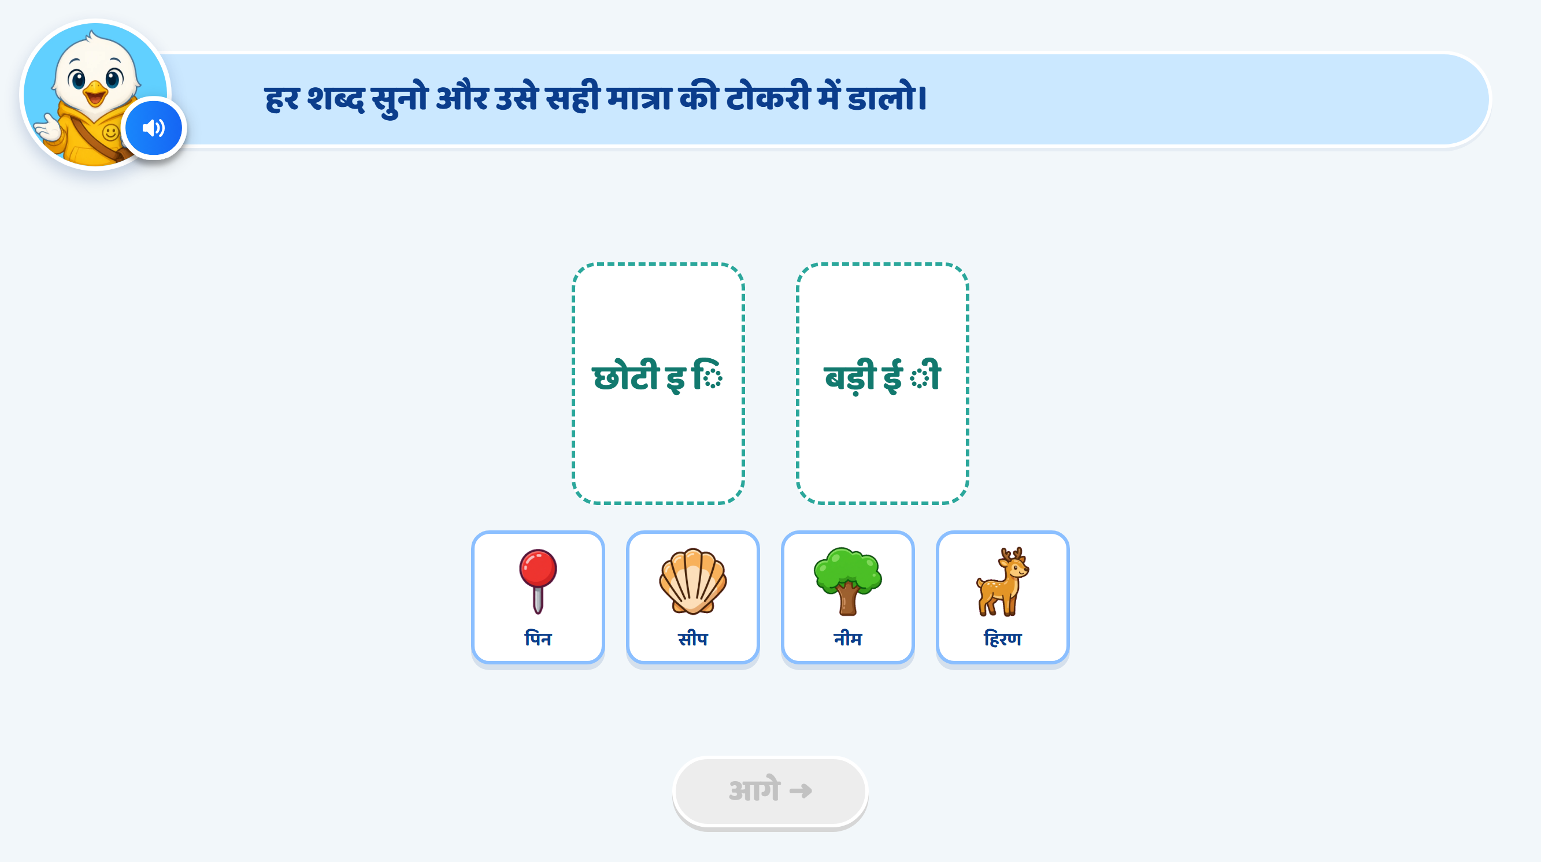
Page 9 · 09_SORT_VACHAN.png
Notes:
Train
comes through animation from right to left.
The train stops at the centre of the screen. Three coaches are visible.
Each coach has one मात्रा shown above it: आ (ा), इ (ि), ई (ी).
The inside drop area of each coach remains empty.
Three draggable word cards appear below the train:
हाथ, पिन, नीम.
ON SCREEN:
No instruction text. Only VO:
“हर शब्द को उसकी सही मात्रा वाली बोगी में डालिए।”
Each word card can also play its word VO when tapped/dragged:
“हाथ” / “पिन” / “नीम”
Drag and Drop
The child drags each word card into the correct coach.
हाथ → आ (ा)
पिन → इ (ि)
नीम → ई (ी)
Only one word can be placed inside each coach.
While dragging, the selected card slightly enlarges.
When the card reaches a coach, that coach gets a soft highlight.
Correct Answer
The word card snaps inside the correct coach.
Small confetti/sparkle animation appears around that coach.
VO example:
“शाबाश! पिन शब्द में छोटी इ की मात्रा है।”
The correctly placed card becomes locked and cannot be dragged again.
On 1st Wrong Attempt
Wrong coach gives a short shake animation.
The word card smoothly returns to its original position.
No hand nudge.
Only VO comes:
“फिर से सुनो और सही मात्रा पहचानिए।”
On 2nd Wrong Attempt
Wrong coach again gives a shake animation.
The word card returns to its original position.
VO:
“ध्यान से देखो, इस शब्द में कौन-सी मात्रा है?”
A hand nudge appears on the correct coach/drop area.
The correct coach also gives a soft pulse/glow.
Correct Answer on 3rd Attempt
The child drags the word into the correct coach.
Small confetti/sparkle animation appears.
No VO.
The word locks inside the coach.
Completion
When all three words are placed correctly:
all three coaches give a soft glow
train gives a small whistle/steam animation
Next button becomes active
no extra completion VO required

Slide 15
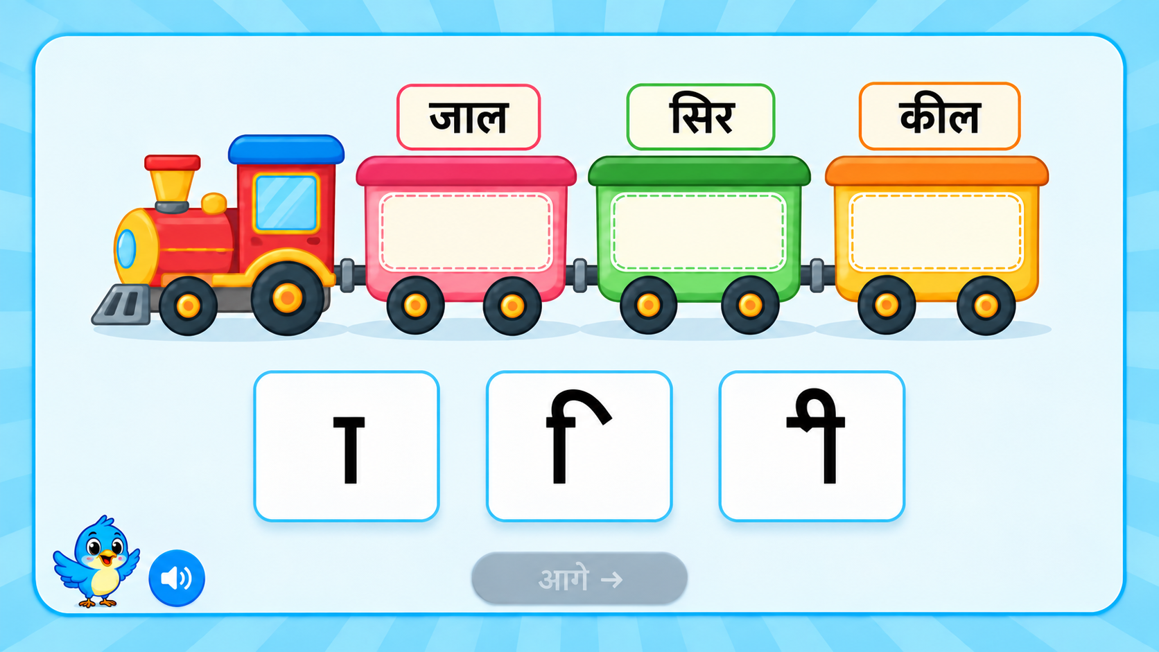
Notes:
VO only:
“सही मात्रा को सही शब्द वाली बोगी में डालिए।”
The child will drag each मात्रा and drop it into the correct coach:
जाल → आ (ा )
सिर → इ (ि)
कील → ई (ी)
Correct answer:
The मात्रा snaps and locks inside the coach. Show a small sparkle/confetti effect with VO:
“शाबाश! जाल शब्द में आ की मात्रा लगी है।”
Use the same pattern for सिर and कील.
1st wrong attempt:
The coach gives a short shake animation and the मात्रा returns to its original position.
VO: “फिर से सोचो। इस शब्द में कौन-सी मात्रा लगी है?”
2nd wrong attempt:
Shake animation + मात्रा returns back.
VO: “ध्यान से देखो और शब्द को फिर से पढ़ो।”
Show a hand nudge/pulse on the correct coach.
Correct on 3rd attempt:
The मात्रा snaps into the correct coach with a small confetti/sparkle effect. No VO required.
Completion:
Once all three मात्रा cards are placed correctly, all coaches glow briefly and the Next button becomes active.
Animation:
Train enters with a smooth right-to-left animation and stops at the centre. मात्रा cards appear from the bottom with a simple fade/slide-up animation. Keep the rest of the current UI/UX unchanged and avoid adding extra decorative elements.

Slide 16
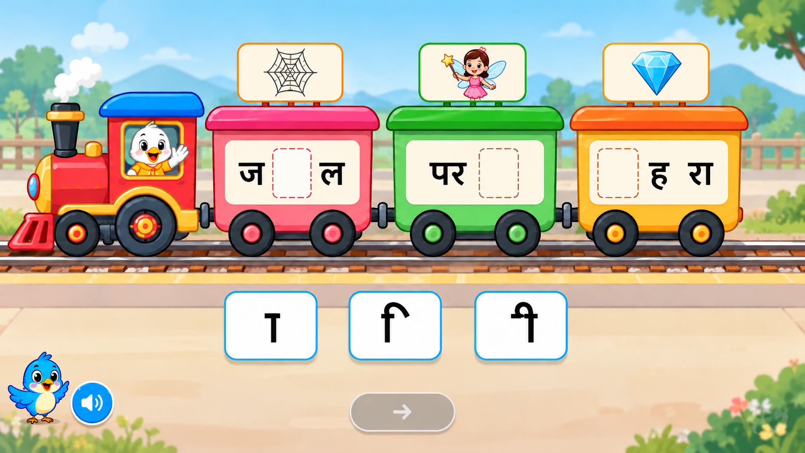
Notes:
Recommendation
This activity will be a reverse matra-building train activity.
In this screen, three train coaches will be shown.
Each coach will have an incomplete word with a blank space where the missing matra should be added.
The child will drag the correct matra from the options given below and drop it into the blank space inside the correct coach.
As soon as the child drops the correct matra, the word will be completed.
Use these words:
ज + ा + ल = जाल
पर + ी = परी
ह + ि + रण = हिरण
Important correction:
Please use “हिरण” instead of “हीरा / hira”.
On screen
Train with 3 coaches
Each coach has an incomplete word
A related picture can be shown above each coach for support
Below the train, matra options will appear:
आ (ा)
इ (ि)
ई (ी)
Next button remains disabled initially
VO only
“सही मात्रा को सही जगह पर खींचकर डालो और शब्द पूरा करिए।”
Optional word-level support VO can also be used:
“जाल”
“परी”
“हिरण”
Correct mapping
ज _ ल → ा
पर _ → ी
ह _ रण → ि
Correct answer
When the child drops the correct matra:
matra snaps into the blank
word becomes complete
small sparkle/confetti effect appears
VO:
“शाबाश! जाल बन गया।”
“शाबाश! परी बन गया।”
“शाबाश! हिरण बन गया।”
1st wrong attempt
Wrong area shakes
Matra returns to original place
Only VO:
“फिर से सोचो।”
2nd wrong attempt
Shake animation
Matra returns back
VO:
“ध्यान से देखो। कौन-सी मात्रा लगेगी?”
Hand nudge appears on the correct blank space
Correct answer on 3rd attempt
Matra snaps into place
Word completes
Small confetti/sparkle
No VO required
Completion
When all 3 words are completed:
all coaches glow softly
next button becomes active
optional small train whistle / success SFX
Developer note
Keep the same current UI/UX style.
Do not add extra text on screen.
Use VO-led interaction.
Also make sure the third word is हिरण, not हीरा.

Slide 17
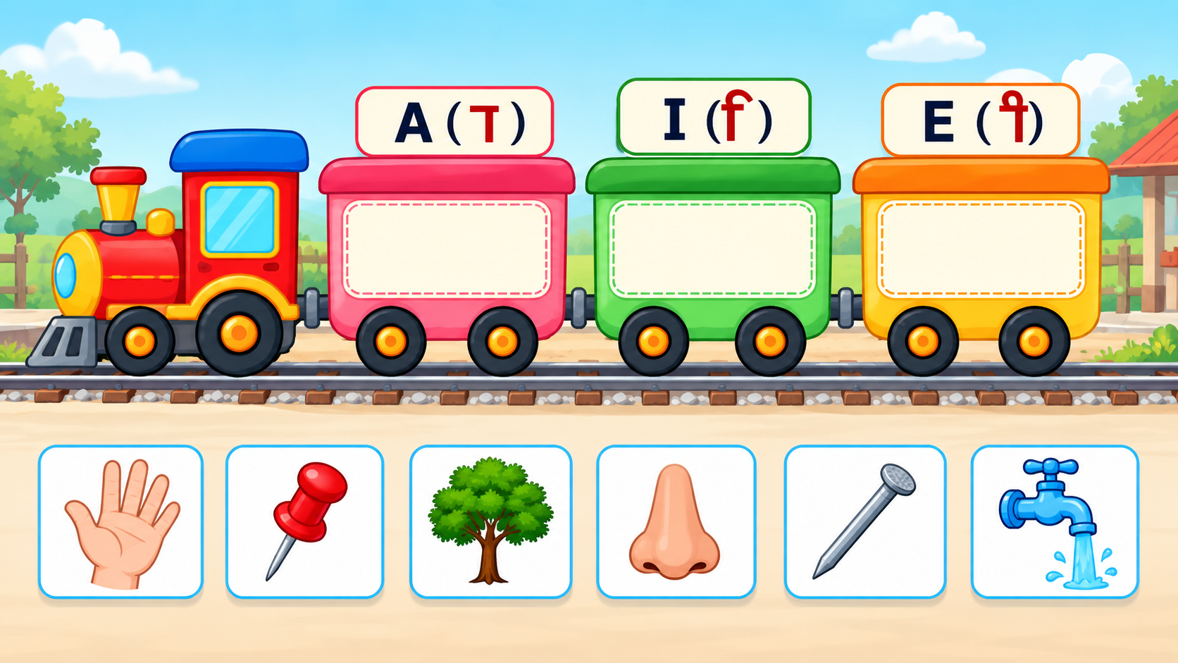
Notes:
Recommendation
Activity Concept
Show a train with three coaches.
Each coach represents one matra category:
आ (ा)
इ (ि)
ई (ी)
The inside area of each coach remains empty as the drop zone.
At the bottom, show pictures only. Do not show any word text below the pictures.
On Screen
Above the first coach: आ (ा)
Above the second coach: इ (ि)
Above the third coach: ई (ी)
Bottom section: picture cards only.
Suggested picture set:
हाथ → आ (ा)
नाक → आ (ा)
पिन → इ (ि)
हिरण → इ (ि)
नीम → ई (ी)
कील → ई (ी)
VO
Intro VO:
“चित्र को सुनो और उसे सही मात्रा वाली बोगी में डालिए।”
When the child taps or starts dragging a picture, play only that picture’s name:
“हाथ”
“नाक”
“पिन”
“हिरण”
“नीम”
“कील”
This makes the child listen to the word, identify its matra sound, and then sort it.
Drag and Drop Logic
Child drags the picture card into the correct coach.
One coach can accept multiple pictures belonging to the same matra.
The word should not be displayed at any point during the question.
While dragging, the selected picture card can slightly enlarge.
When hovering over a coach, that coach can get a soft glow.
Correct Answer
Picture snaps inside the correct coach.
Small sparkle/confetti appears around the coach.
Picture becomes locked.
VO example:
“शाबाश! हाथ में आ की मात्रा है।”
Use the same pattern for the other pictures.
1st Wrong Attempt
Wrong coach gives a short wiggle/shake animation.
Picture returns to its original position.
No hand nudge.
VO:
“फिर से सुनो और सही मात्रा पहचानो।”
2nd Wrong Attempt
Wrong coach shakes again.
Picture returns to the bottom.
VO:
“शब्द को ध्यान से सुनो।”
Show a hand nudge / soft pulse on the correct coach.
Correct Answer on 3rd Attempt
Picture snaps into the correct coach.
Small confetti/sparkle.
No VO required.
Completion
Once all pictures are correctly sorted:
all three coaches glow briefly,
train gives a small whistle/steam animation,
Next button becomes active.
Animation
Train enters right to left and stops at the centre.
Coach labels आ (ा), इ (ि), ई (ी) appear one by one.
Picture cards fade/slide up from the bottom.
Keep animation subtle and do not add extra decorative elements.

Slide 18
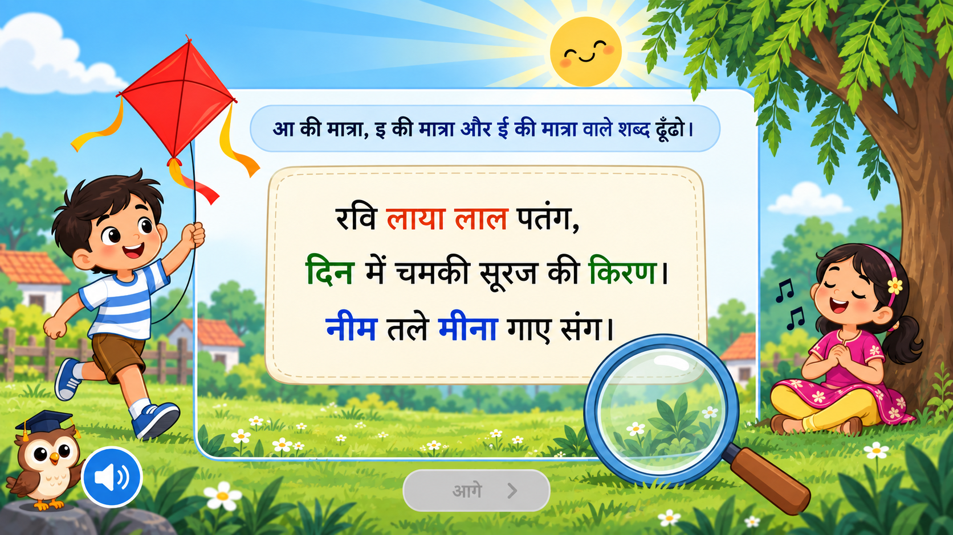
Notes:
Recommendation
Activity Concept
Use this as a final “मात्रा खोजो” challenge.
Keep the focus only on:
poem card
magnifying glass
target words
ghost animation feedback
Remove extra decorative elements like:
Ravi
kite
girl
tree
unnecessary background objects
Use a clean version of the existing UI so the child’s attention stays on the activity.
Poem on Screen
रवि लाया लाल पतंग,
दिन में चमकी सूरज की किरण।
नीम तले मीना गाए संग।
VO Flow
Round 1 VO:
“आ की मात्रा वाले शब्द ढूँढो।”
Round 2 VO:
“अब छोटी इ की मात्रा वाले शब्द ढूँढो।”
Round 3 VO:
“अब बड़ी ई की मात्रा वाले शब्द ढूँढो।”
Target Words
For आ की मात्रा (ा):
लाया
लाल
For छोटी इ की मात्रा (ि):
रवि
दिन
किरण
For बड़ी ई की मात्रा (ी):
नीम
मीना
Magnifying Glass Interaction
A large magnifying glass appears at the bottom-right.
Child drags the magnifying glass over the poem.
Any word under the glass slightly enlarges.
Child taps/selects the word through the magnifying glass.
Correct words remain highlighted.
Ghost Animation
Use a small friendly ghost character/effect as a search guide, not as decoration.
Entry animation:
When the activity begins, a small ghost floats in from one side.
It briefly circles around the magnifying glass.
Then it fades slightly or moves to a corner.
During search:
If the child is idle for a few seconds, the ghost appears near the magnifying glass and gently moves toward the poem.
This works as a visual cue: “start searching”.
On correct answer:
Ghost pops up happily near the correct word.
Small sparkle appears.
Ghost can do a short happy bounce and disappear.
VO: “शाबाश!”
On 1st wrong attempt:
Wrong word gives a small wiggle/shake.
Ghost briefly appears with a thinking expression.
No hand nudge.
VO: “फिर से देखो।”
On 2nd wrong attempt:
Wrong word shakes again.
Ghost floats toward one correct target word.
It gently points/pulses near that word.
This acts as the hint instead of adding extra text.
VO: “ध्यान से मात्रा पहचानो।”
Round Completion
When all target words for one matra are found:
Correct words glow together.
Ghost flies across the selected words with a sparkle trail.
Soft success chime plays.
Next target VO starts automatically.
Final Completion
After all three matra rounds:
All correct words stay highlighted.
Ghost appears once in the centre, celebrates with a small spin/sparkle.
Magnifying glass gives a final glow.
Next button becomes active.
Animation
Poem card fades in first.
Magnifying glass slides in from the bottom.
Ghost enters after the magnifying glass.
Keep ghost motion slow and soft, not distracting.
Do not keep ghost constantly moving on screen.
UI/UX Note
Keep the screen minimal:
plain/light background
central poem card
magnifying glass
small ghost
mascot/audio button if required
next button
Remove the large scenic illustrations. The main learning focus should be:
VO target → scan poem → find correct word → tap → highlight

Slide 19
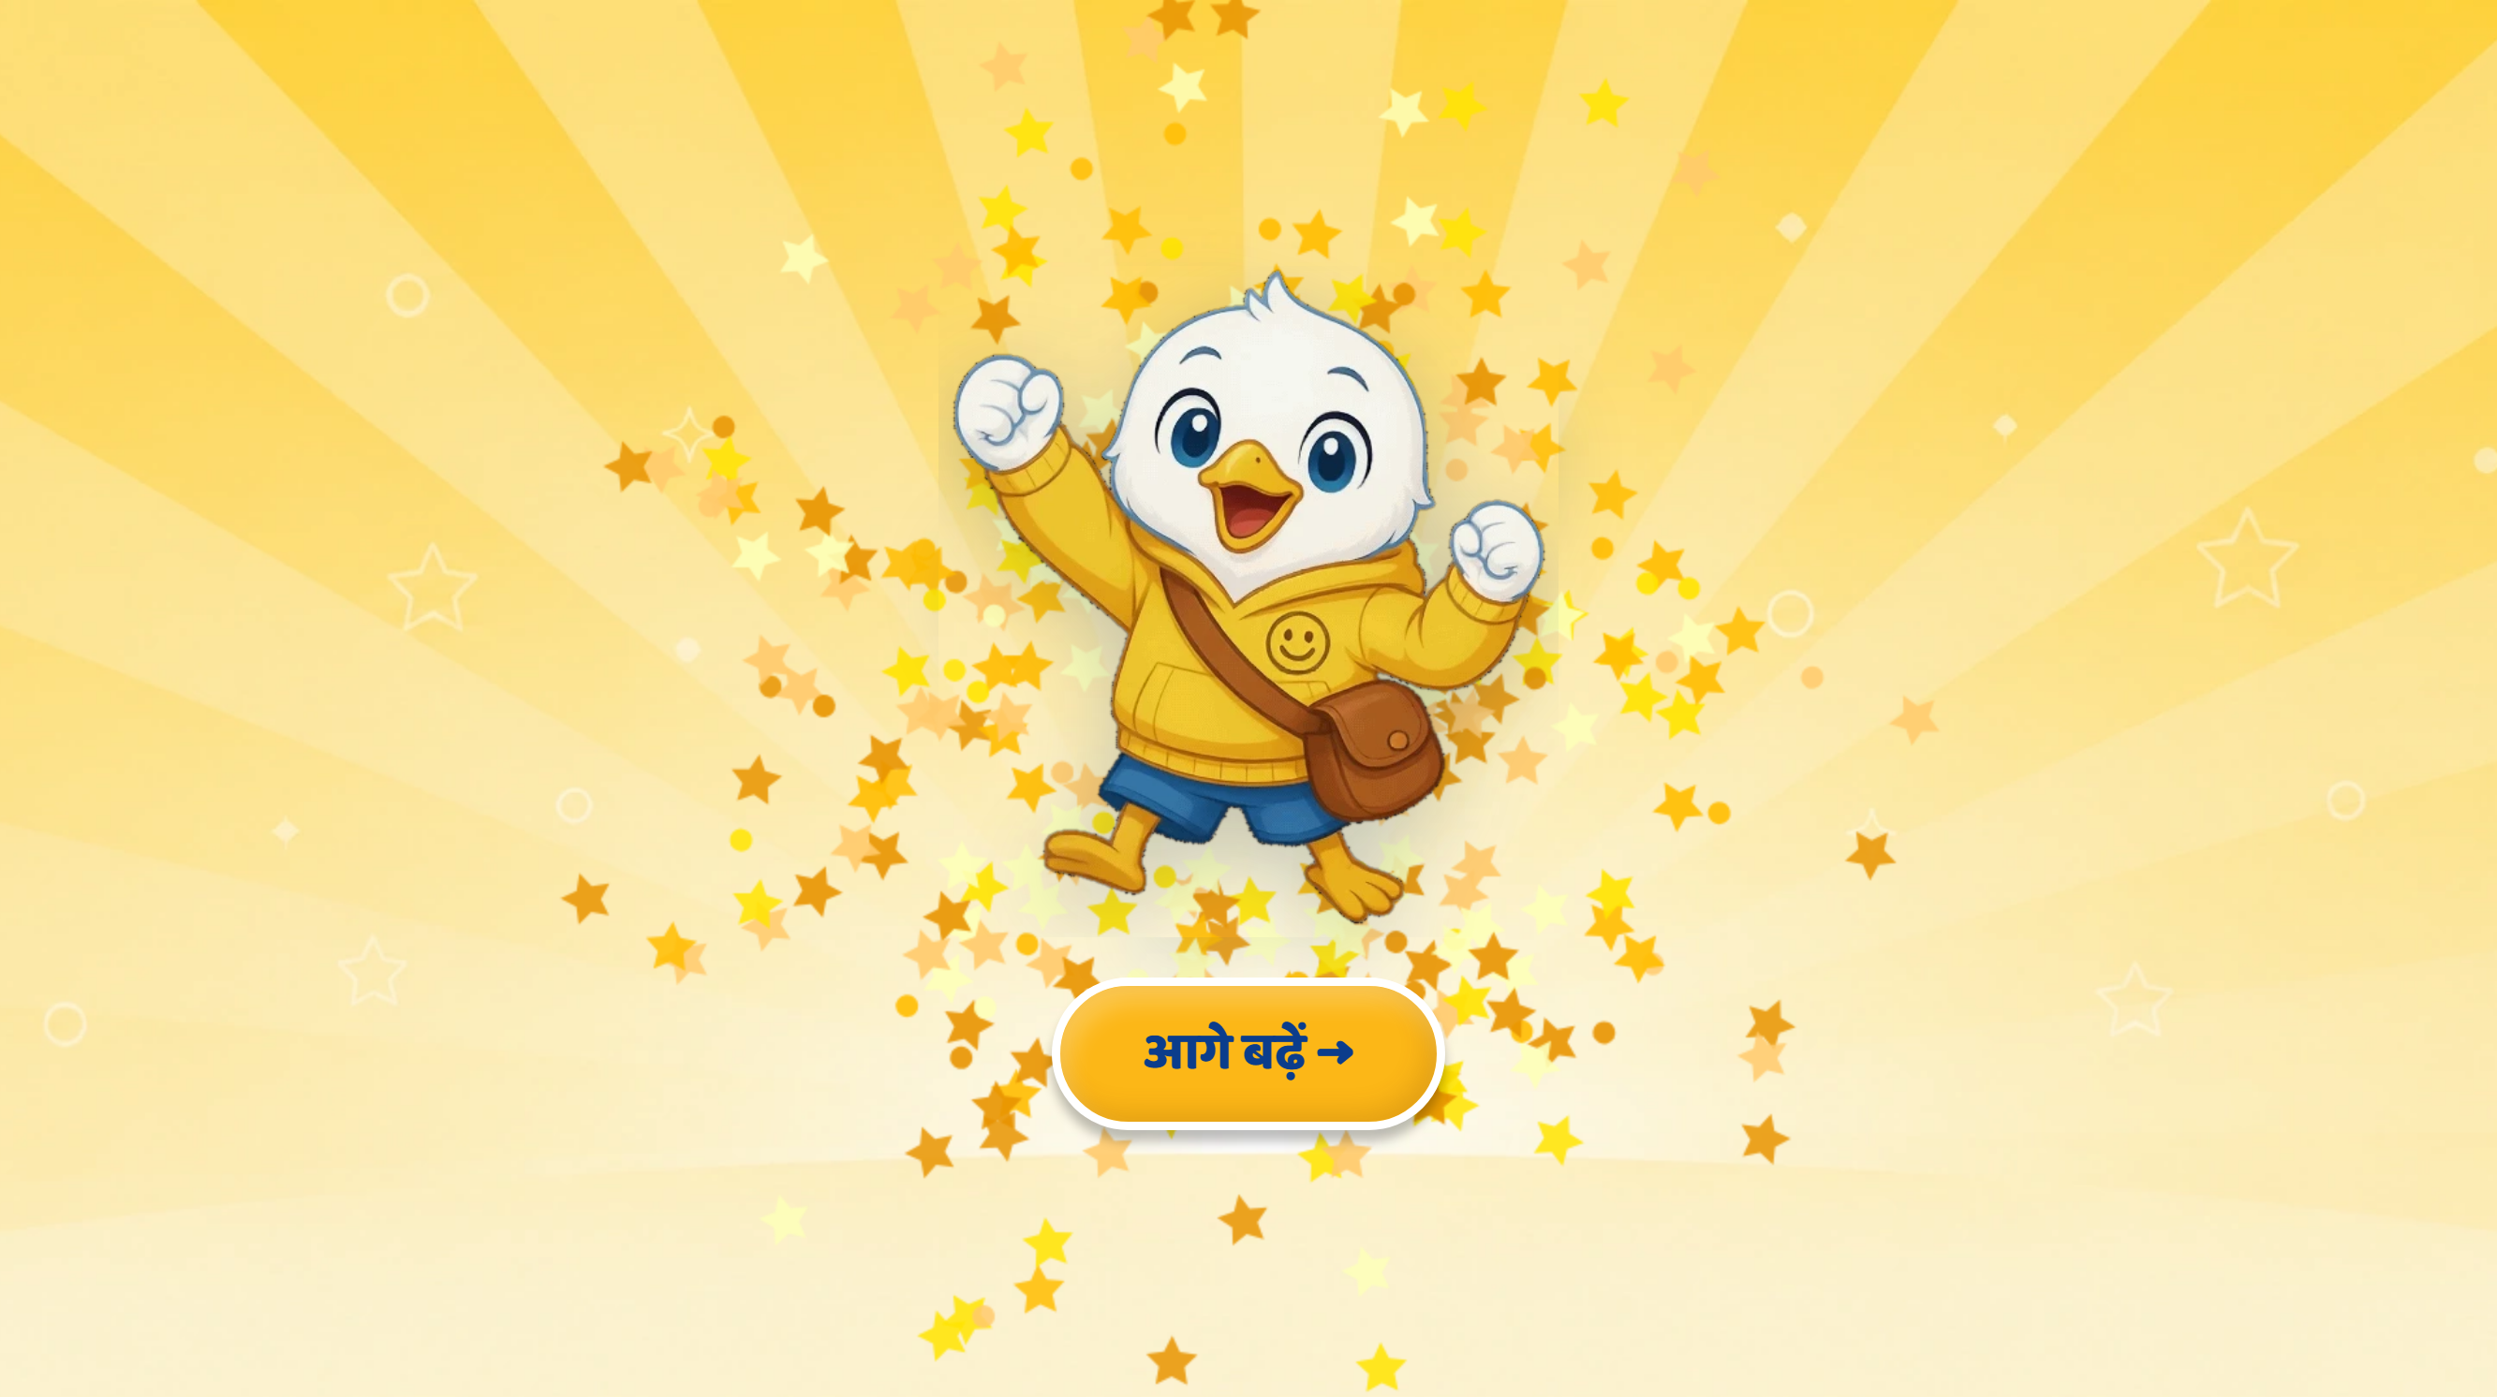
Page 20 · 20_CELEBRATION.png
Recommendations
• CELEBRATION — recaps the SKILL, not just the three matras: «आज हमने सीखा — आ, इ और ई की मात्रा पहचानना, और मात्रा वाले शब्द पढ़ना।» No score, no timer, no stars shown to the child (house rule); first-try data goes to telemetry only.

