Slide 1
HI02H11_L02_S03 · मात्राओं की रेल (ए / ऐ) — revised build
Page-by-page review · 18 pages
reviewing build da1e32bed502 (HI02H11_L02_S03.html)

Slide 2
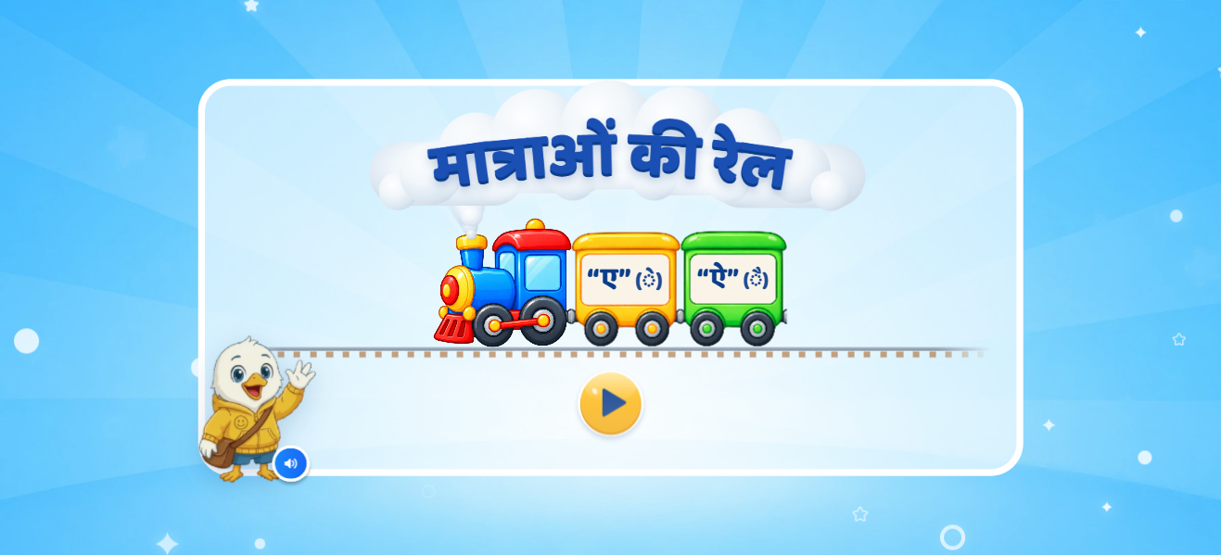
Page 1 · 01_landing.png
Recommendations
• Page 1 · Landing. Train enters right→left with whistle + smoke; title forms on the cloud; bogies «“ए” (◌े)» «“ऐ” (◌ै)» pop in after the VO «हेलो दोस्त! मैं हूँ स्विफ्टी…». (Deck note “first show ु, then ू” read as े then ै.)

Slide 3
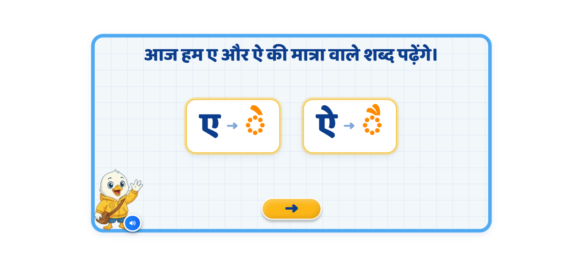
Page 2 · 02_teach.png
Recommendations
• Page 2 · Heading kept. ए → ◌े then ऐ → ◌ै, one pair active at a time; matra glows on «इसकी मात्रा देखिए». आगे unlocks after both pairs.

Slide 4
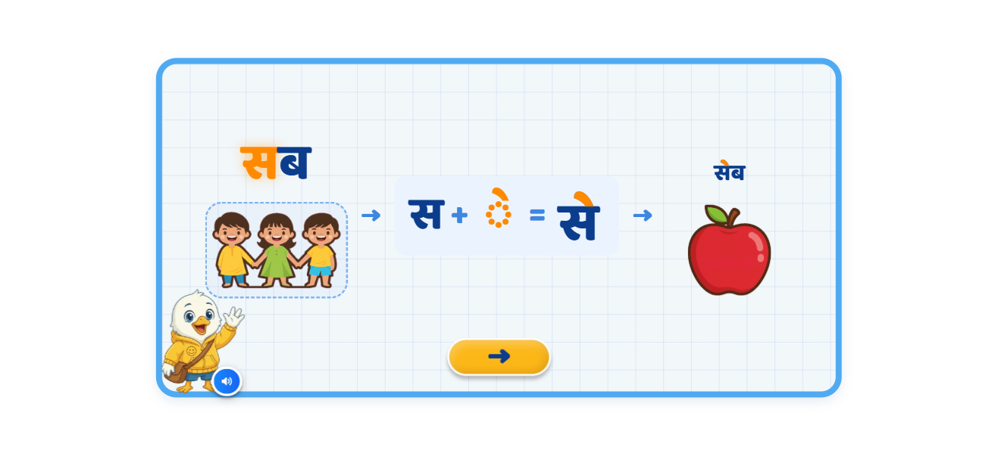
Page 3 · 03_teach.png
Recommendations
• Page 3 · सब (three children in one soft outline; group glows on «ये सब बच्चे हैं») → स + ◌े = से → सेब + apple. Only े highlighted. Sounds स, से, सेब.

Slide 5
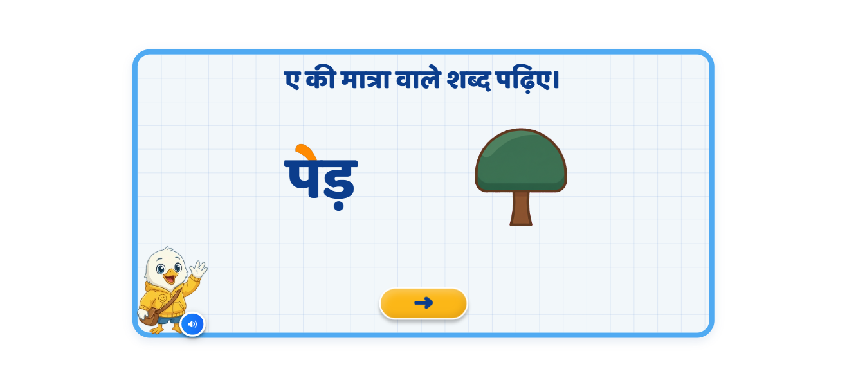
Page 4 · 04_teach.png
Recommendations
• Page 4 · Heading kept. मेज़ then पेड़, one at a time: word → picture on «बोलकर देखिए» → े lights on «इसमें…». Nukta untouched.

Slide 6
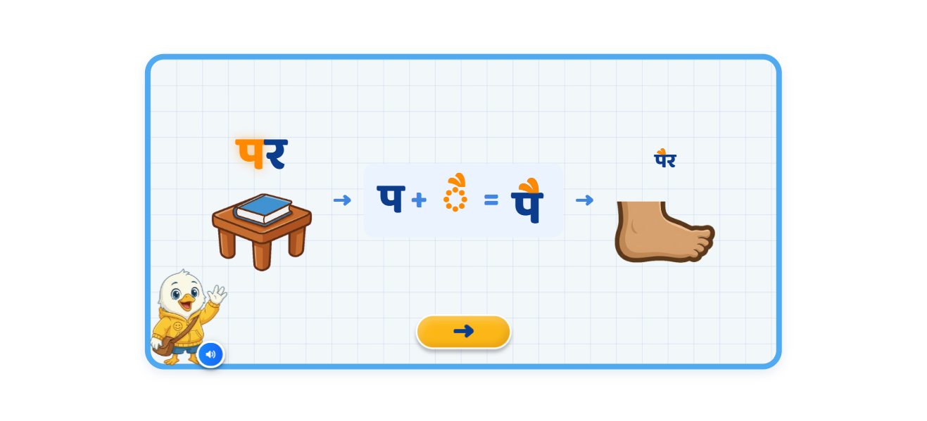
Page 5 · 05_teach.png
Recommendations
• Page 5 · पर (book on table; glows on «मेज़ पर किताब रखी है») → प + ◌ै = पै → पैर + foot (now shows toes + ankle).

Slide 7
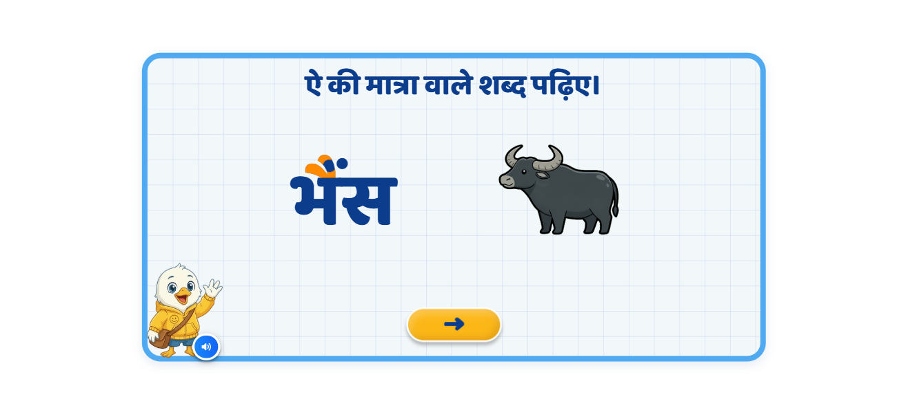
Page 6 · 06_teach.png
Recommendations
• Page 6 · बैल then भैंस. Both ै strokes highlighted; the ं in भैंस stays navy.

Slide 8
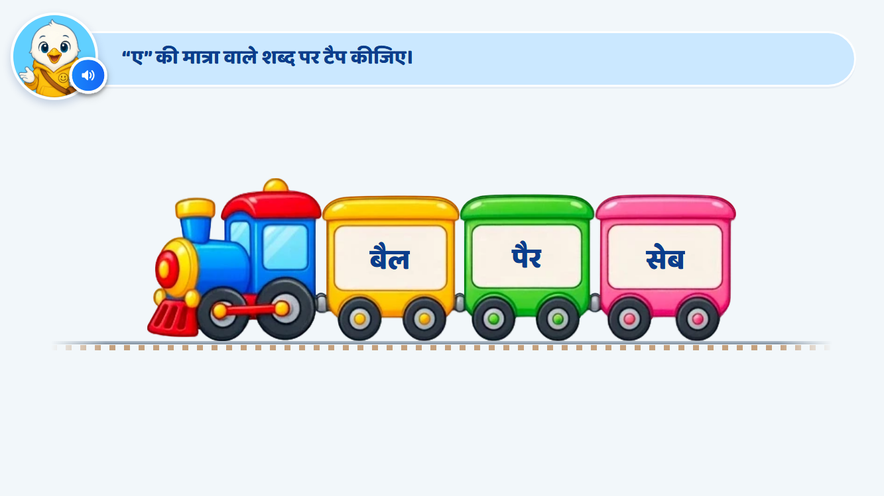
Page 7 · 07_TRAIN_TAP.png
Recommendations
• Page 7 · ए: सेब पैर बैल (shuffled each visit). H1 shake+VO · H2 reads all three, matras stay lit · H3 सेब glows, hand, others locked. Correct = confetti + े lit. ⚑ Train departs on its own (S01 flow) instead of an आगे button.

Slide 9
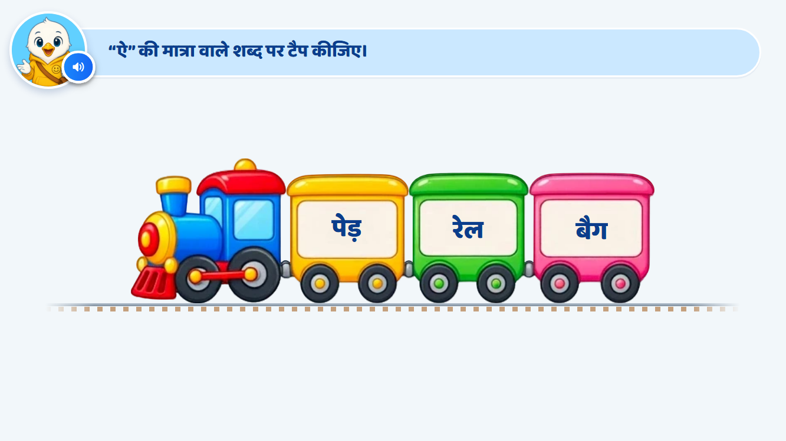
Page 8 · 08_TRAIN_TAP.png
Recommendations
• Page 8 · ऐ: पेड़ रेल बैग → बैग. Same ladder.

Slide 10

Page 9 · 09_TRAIN_TAP.png
Recommendations
• Page 9 · ऐ: मेज़ पैन सेब (रेल replaced by सेब) → पैन. Same ladder.

Slide 11
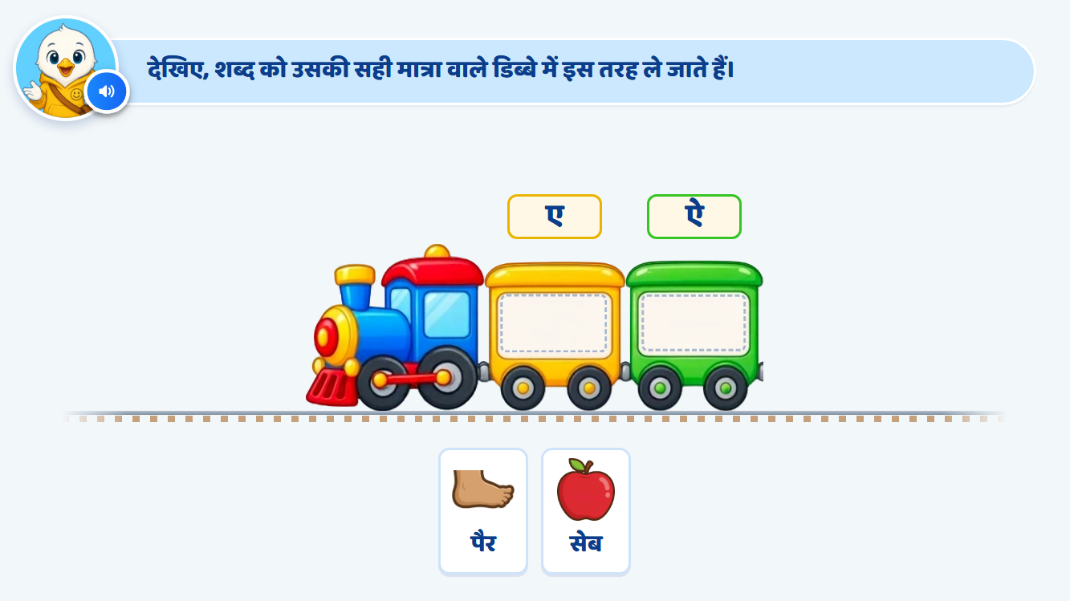
Page 10 · 10_TRAIN_SORT.png
Recommendations
• Drag demo (kept from S01's flow, not in this deck): the hand shows सेब → ए and पैर → ऐ, then the train leaves.

Slide 12
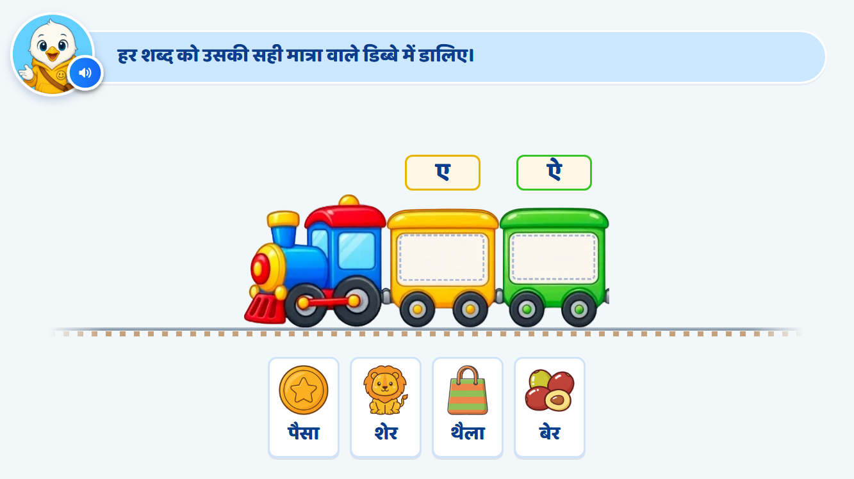
Page 11 · 11_TRAIN_SORT.png
Recommendations
• Page 10 · शेर बेर थैला पैसा into ए / ऐ, two per coach. Each word read before play. Per-card hints; H3 freezes the other cards.

Slide 13
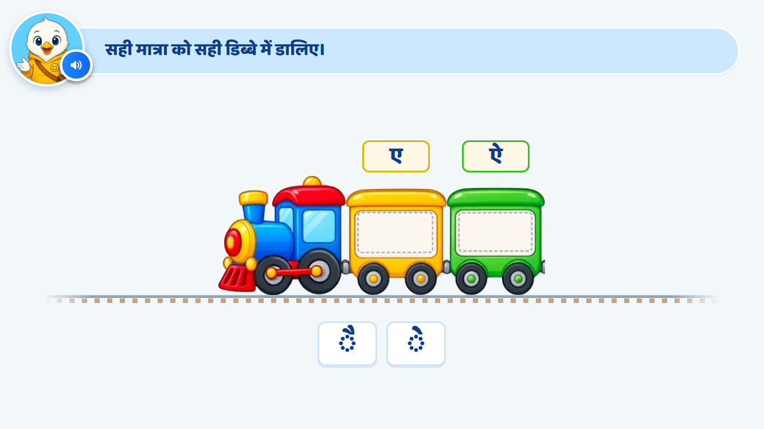
Page 12 · 12_TRAIN_SORT.png
Recommendations
• Page 11 · ◌े ◌ै into ए / ऐ. No name on pick-up; H2 enlarges the card + matra red (silent) + «मात्रा का आकार ध्यान से देखिए…».

Slide 14
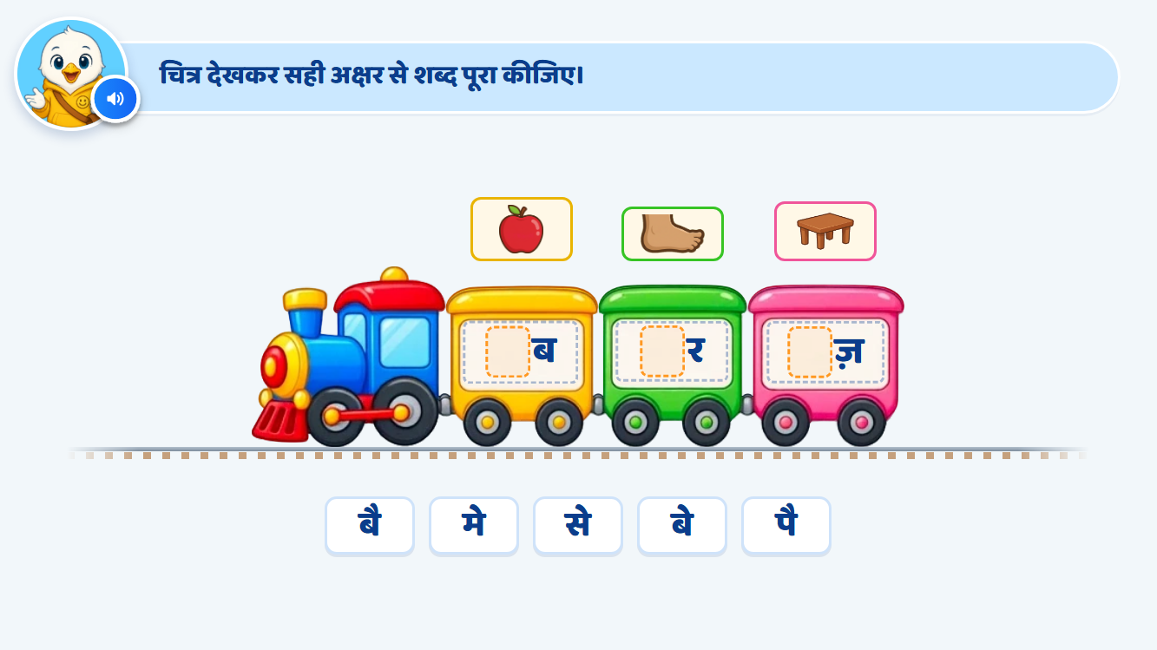
Page 13 · 13_MATRA_FILL.png
Recommendations
• Page 12 · Apple/foot/table over _ब _र _ज़; options से बै मे बे पै (रे removed). Tap = akshar sound. H2 = that akshar enlarged + read; H3 = correct akshar + blank glow, rest locked. ⚑ No hand on H3 (pending Ankita).

Slide 15
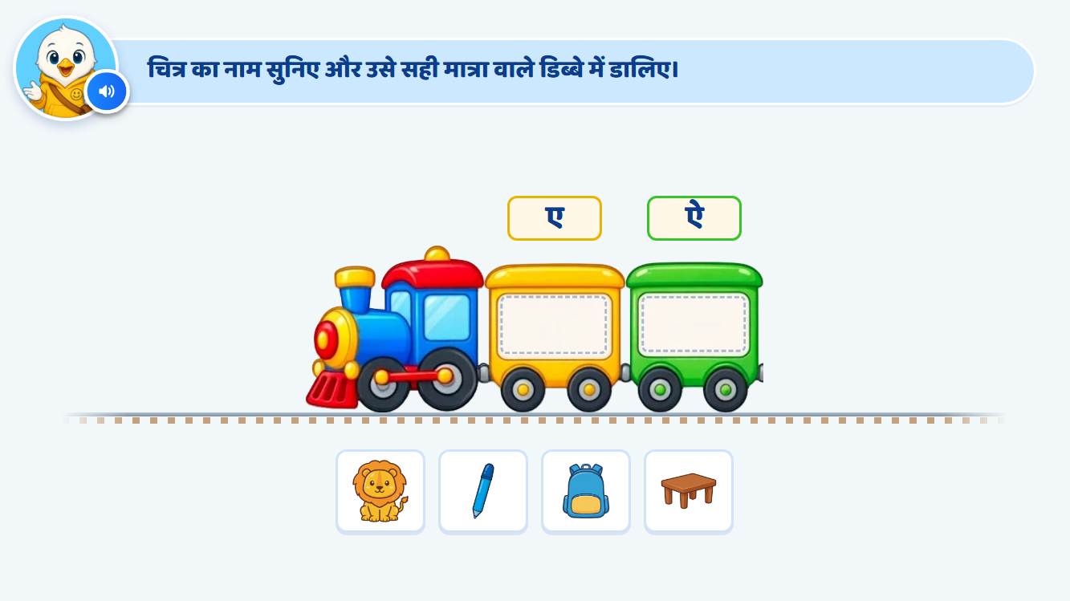
Page 14 · 14_TRAIN_SORT.png
Recommendations
• Page 13 · Pictures only: पैन मेज़ शेर बैग. H1 replays the name; H2 shows the word under the picture with its matra lit until placed; H3 glow + lock (no hand, pending).

Slide 16
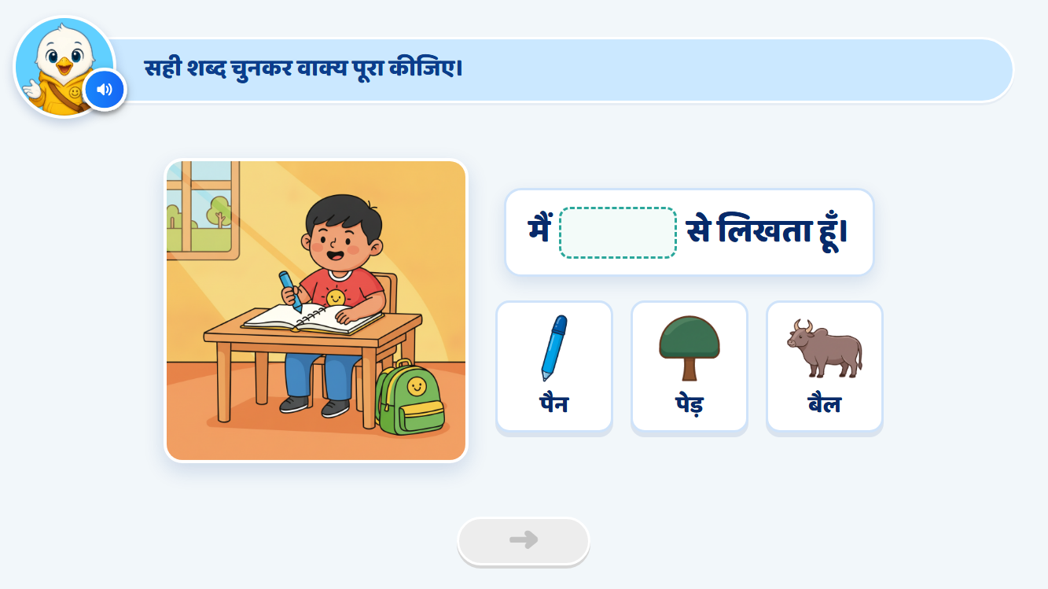
Page 15 · 15_SENTENCE_COMPLETE.png
Recommendations
• Page 17 (now first sentence) · मैं ___ से लिखता हूँ। H2 previews each option in the blank and spotlights the pen. Correct → sentence completes, आगे unlocks.

Slide 17
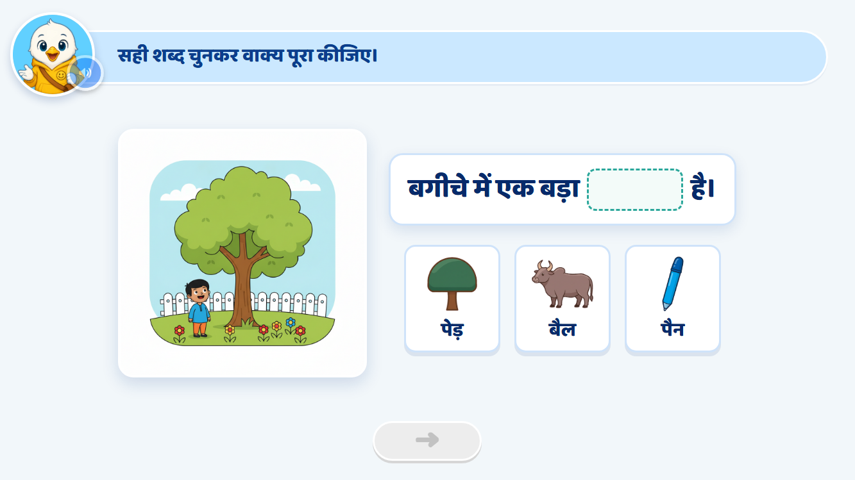
Page 16 · 16_SENTENCE_COMPLETE.png
Recommendations
• Page 14 · बगीचे में एक बड़ा ___ है। H2 spotlights the tree.

Slide 18
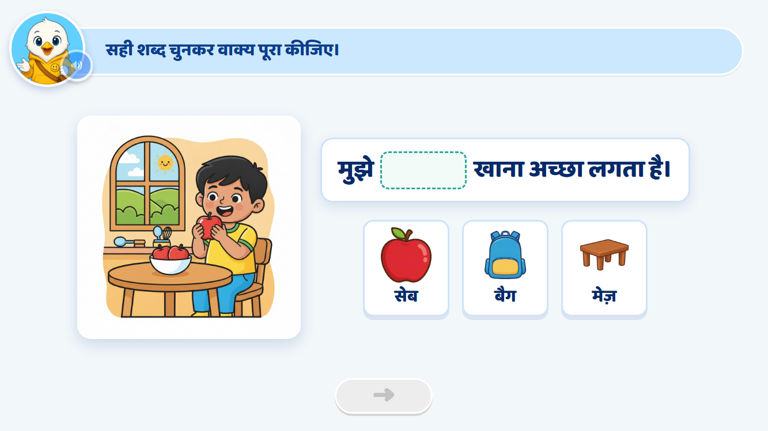
Page 17 · 17_SENTENCE_COMPLETE.png
Recommendations
• Page 16 · मुझे ___ खाना अच्छा लगता है। H2 spotlights the apple.

Slide 19
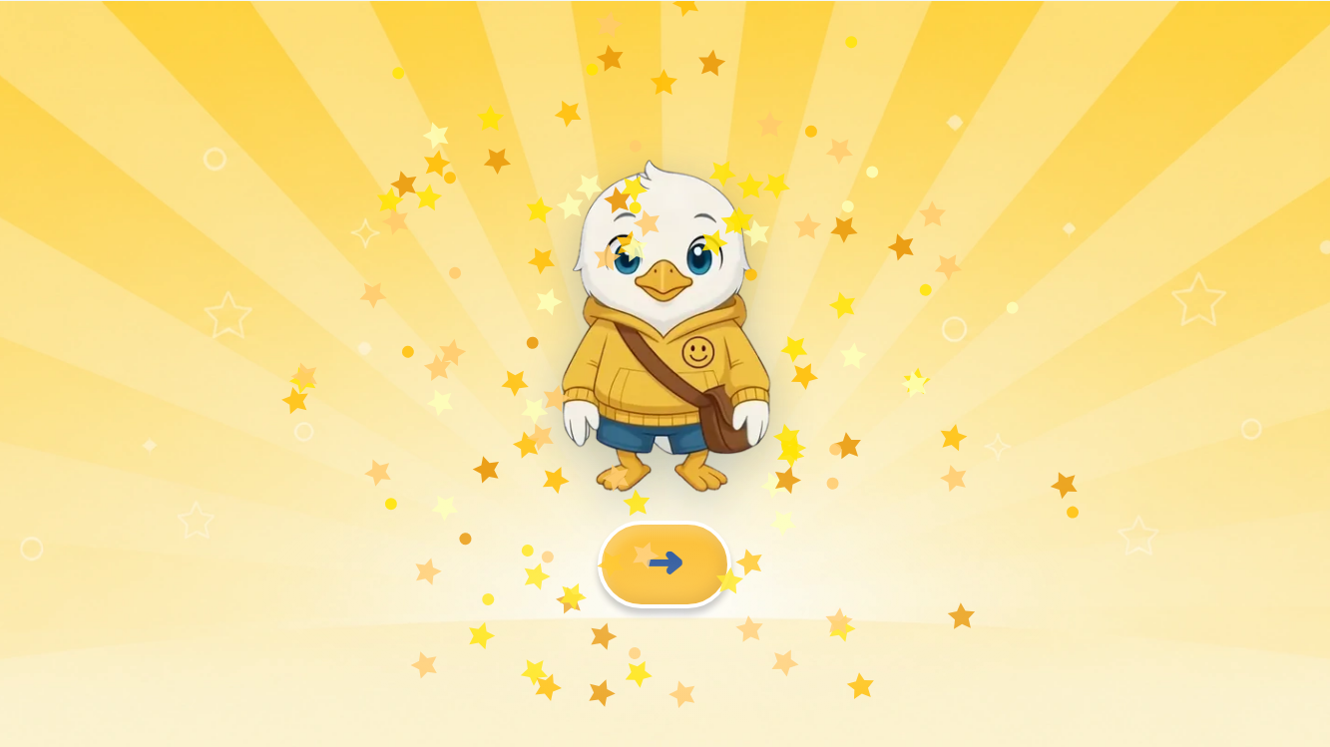
Page 18 · 18_CELEBRATION.png
Recommendations
• Page 18 · Celebration — unchanged (S01's lip-synced Swiftie).

