Slide 1
HI02H11_L02_S05 · मात्राओं की रेल · अं / अः
Page-by-page review · 17 pages

Slide 2
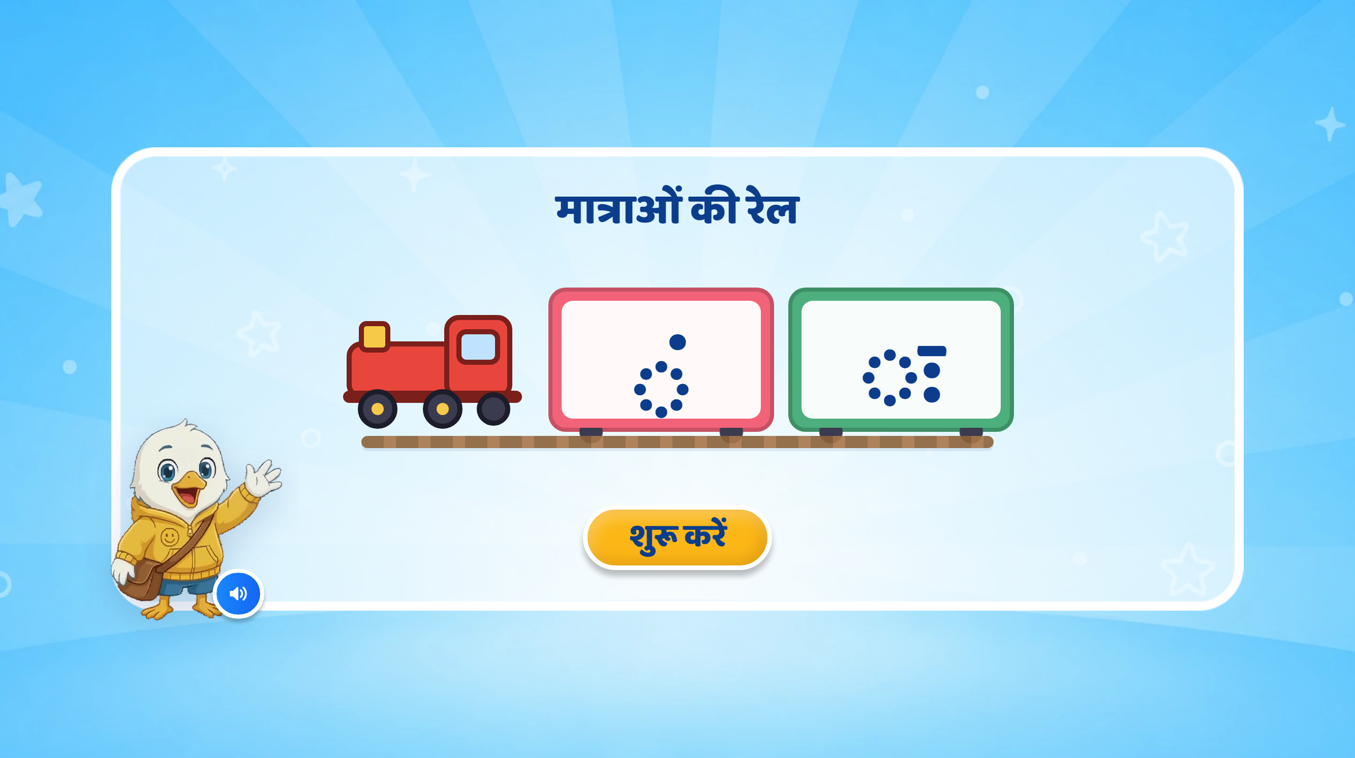
Page 1 · 01_landing.png
Notes:
Recommendations: मात्राओं की रेल
Screen Changes:
Keep the screen clean and minimal, as shown in the image.
Keep the title “मात्राओं की रेल” and the existing train with two bogies/cards:
1st pink bogie: अं (◌ं)
2nd green bogie: अः (◌ः)
Ensure the symbols are clearly displayed. Keep the dotted circles as guides to show the placement of each sign.
Keep the existing mascot, “शुरू करें” button, audio icon, and overall UI/UX style unchanged.
Animation:
If possible, bring the existing train onto the screen with a smooth right-to-left animation.
After the introductory VO, reveal ◌ं in the first bogie, followed by ◌ः in the second bogie, with a soft pop/fade animation.
Keep animations subtle and child-friendly.
SFX:
Add a soft train arrival/whistle SFX when the train enters.
Add a light pop/sparkle SFX when each symbol appears.
VO:
“हेलो दोस्त! मैं हूँ स्विफ्टी। आज हम मात्राओं के बारे में जानेंगे।
After this VO, ◌ं and ◌ः can appear one by one in their respective bogies.

Slide 3
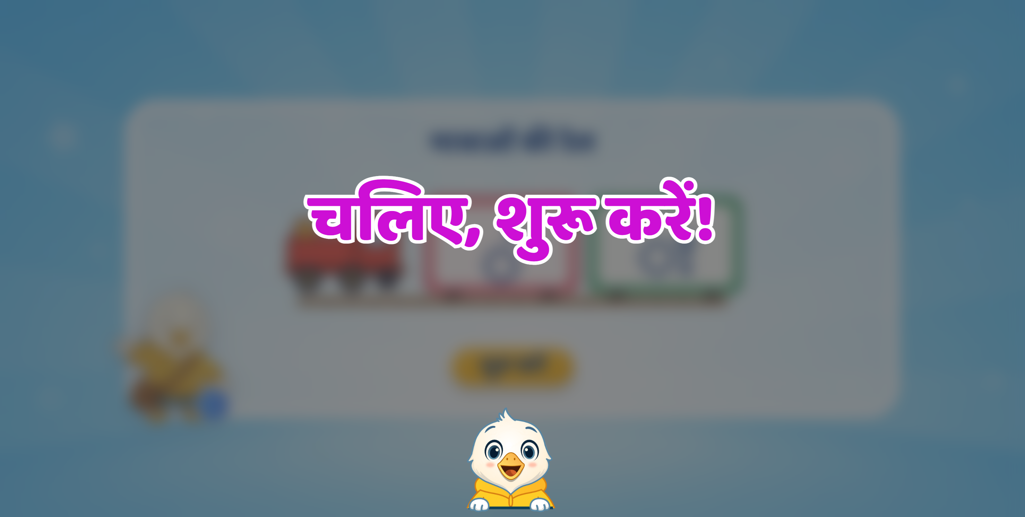
Notes:
VO and Text Synching required here

Slide 4
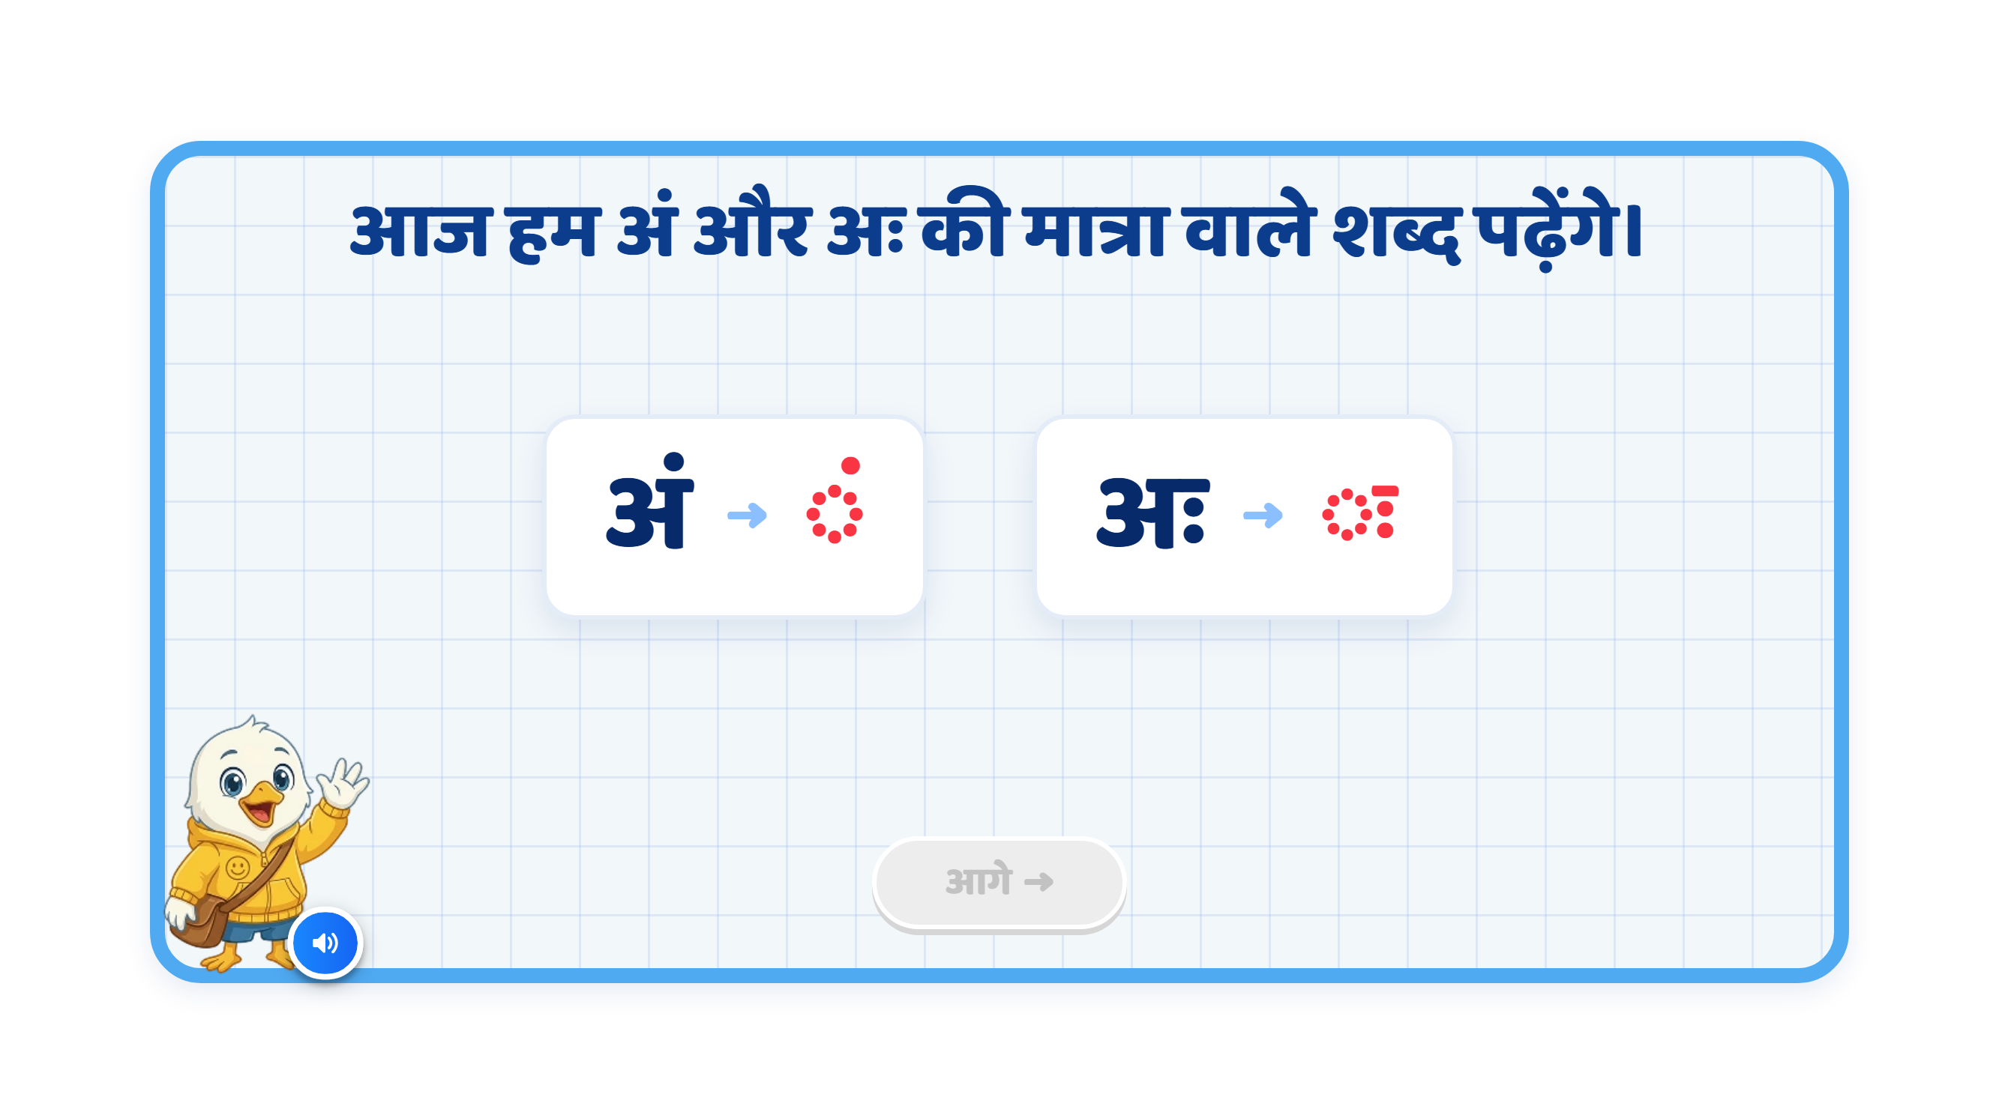
Page 2 · 02_MATRA_INTRO.png
Notes:
Recommendation
VO:
“आज हम अं और अः वाले शब्द पढ़ेंगे।”
इसके बाद pair-wise VO इस तरह चल सकती है:
“यह है अं। इसका चिह्न देखिए।”
“यह है अः। इसका चिह्न देखिए।”
On Screen:
Keep the heading: “आज हम अं और अः वाले शब्द पढ़ेंगे।”
Remove “की मात्रा” from the existing heading, as these signs are अनुस्वार and विसर्ग.
Remove any additional text so the screen stays clean and focused.
Show the letter and its corresponding symbol as a pair, one by one.
Keep only one pair active at a time.
Highlight each active pair when its VO plays.
Follow this sequence: अं → ◌ं, then अः → ◌ः.
Keep the existing two cards, mascot, audio icon, and overall UI/UX style unchanged.
Correct the second card’s symbol to ◌ः. Remove the extra horizontal stroke above the two dots.
Animation:
First अं appears, then ◌ं appears beside it with a soft glow.
After its VO finishes, dim the first pair slightly.
Then अः appears, followed by ◌ः beside it.
Highlight only the अनुस्वार dot and the two विसर्ग dots in red. Keep the dotted circles neutral.
Use simple pop/fade animations, synchronised with the VO.
Keep animations subtle and child-friendly, without extra decorative elements.
SFX:
Add a soft pop/chime when each symbol appears.
Keep SFX subtle so the VO remains clear.
Next Button:
Keep the आगे button disabled during the sequence.
Activate it only after both pairs have been shown and spoken.
Note:
This slide introduces अनुस्वार (◌ं) and विसर्ग (◌ः).
The child should clearly connect अं → ◌ं and अः → ◌ः.
Refer to the signs as अनुस्वार and विसर्ग, rather than “अं की मात्रा” and “अः की मात्रा”.
The dotted circle only helps display the sign; it is not part of the sign.
Show only these two pairs to keep the screen focused.

Slide 5
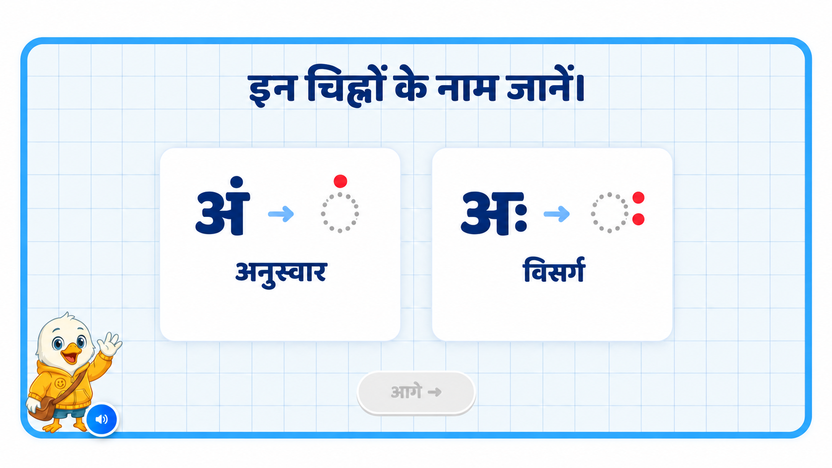
Notes:
Recommendation
VO:
“आइए, इन अक्षरों और इनके चिह्नों के नाम जानें।”
पहले:
“अं में एक बिंदी है। इस बिंदी को अनुस्वार कहते हैं।”
फिर:
“अः में दो बिंदियाँ हैं। इसे विसर्ग कहते हैं।”
On Screen:
remove heading not required: “इन चिह्नों के नाम जानें।”
Show two cards in the existing UI style.
First card: अं → ◌ं
Below it, show only “अनुस्वार”.
Second card: अः → ◌ः
Below it, show only “विसर्ग”.
Do not display “ऊपर एक बिंदी” or “दाईं ओर दो बिंदियाँ”.
Explain the number of dots only through VO.
Reveal one card at a time.
Highlight each active card when its VO plays.
Keep the dotted circles neutral grey and the actual signs red.
Keep the existing mascot, audio icon, and overall UI/UX style unchanged.
Sequence:
VO: “आइए, इन अक्षरों और इनके चिह्नों के नाम जानें।”
The first card appears with अं → ◌ं.
VO: “अं में एक बिंदी है।”
Highlight the single dot.
VO: “इस बिंदी को अनुस्वार कहते हैं।”
Reveal the label “अनुस्वार”.
Pause briefly.
The second card appears with अः → ◌ः.
VO: “अः में दो बिंदियाँ हैं।”
Highlight the two dots together.
VO: “इस चिह्न को विसर्ग कहते हैं।”
Reveal the label “विसर्ग”.
Keep both cards visible at the end for a brief comparison.
Animation:
Use simple fade/pop-in animations.
Softly highlight the single dot when अनुस्वार is introduced.
Then softly highlight the two dots when विसर्ग is introduced.
Dim the first card slightly while the second card’s VO plays.
Keep animations subtle and child-friendly.
SFX:
Add a soft pop when each card appears.
Add a light chime when each sign highlights.
Keep SFX subtle so the VO remains clear.
Next Button:
Keep the आगे button disabled during the sequence.
Activate it only after both signs and their names have been introduced.
Note:
Keep this slide focused on recognising the signs and hearing their names.
Do not require children to memorise definitions.
Avoid calling these signs “अं की मात्रा” and “अः की मात्रा”.
Show अनुस्वार as one solid dot above the dotted circle.
Show विसर्ग as two vertically aligned dots to its right, without an extra horizontal stroke.
The dotted circle is a display aid; it is not part of either sign.
Visual edited with the built-in image tool. Edit prompt: remove the two explanatory lines and preserve the symbols, names, and existing UI.

Slide 6
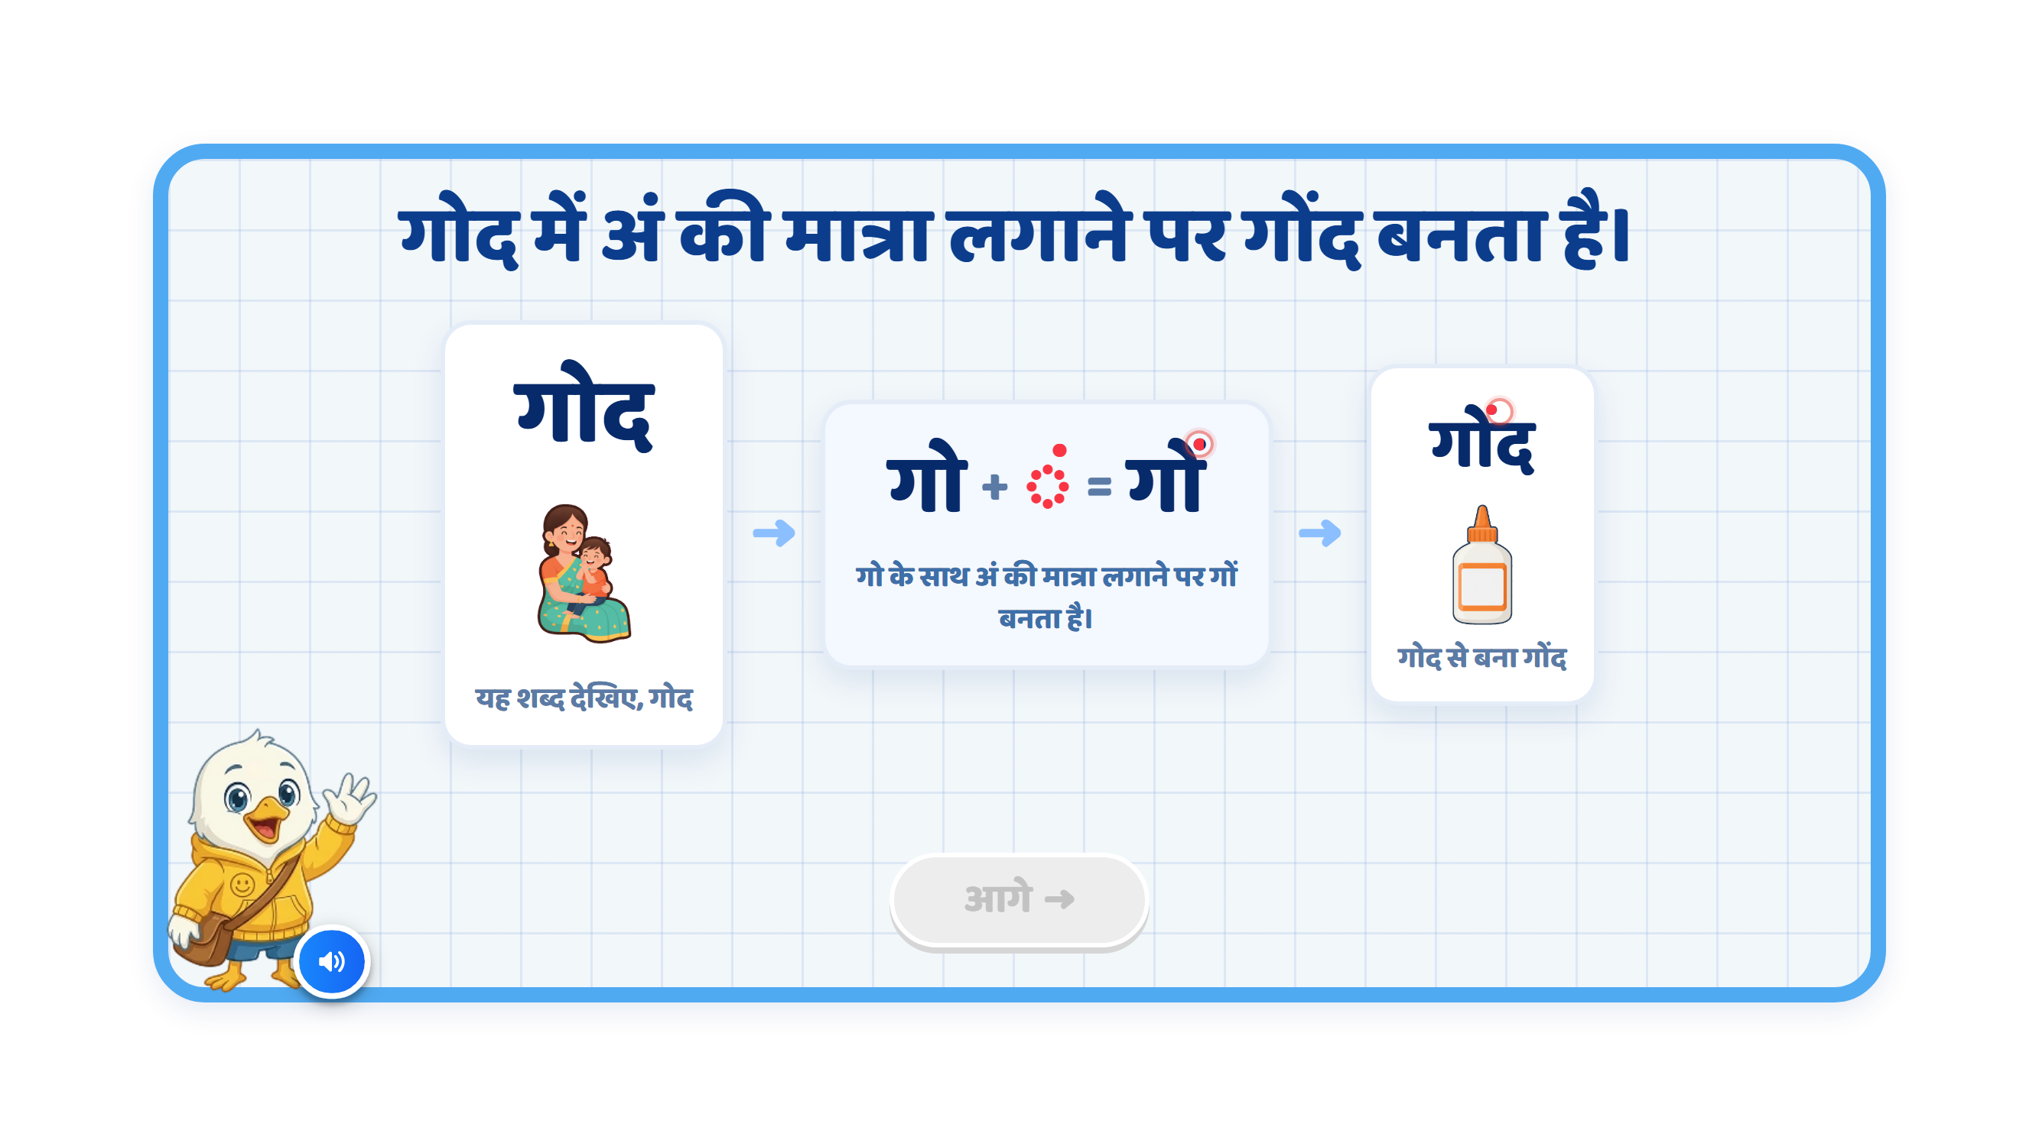
Page 3 · 03_MATRA_BUILD.png
Notes:
Recommendation
VO:
“आइए, देखें कि अं की मात्रा लगने से शब्द की आवाज़ कैसे बदलती है।”
पहले:
“यह शब्द देखिए — गोद।”
फिर:
“गो के ऊपर अनुस्वार लगाने पर ‘गों’ बनता है।”
अंत में:
“अब ‘द’ जुड़ने पर ‘गोंद’ बनता है।”
On Screen:
Keep the screen focused on one word transformation.
Update the heading to: “गोद में अनुस्वार लगाने पर गोंद बनता है।”
First show गोद clearly on the left.
Below or beside गोद, show a clear image of a child sitting in a parent’s lap.
In the centre, show: गो + ◌ं = गों
Highlight only the अनुस्वार dot in red when it is introduced.
After that, show the final word: गोंद.
In गोंद, highlight only the अनुस्वार dot in red so the child notices its position above गो.
Show a clear glue bottle image below or beside गोंद.
Keep the existing mascot and overall UI/UX style unchanged.
Remove the explanatory text beneath the cards to keep the screen clean.
Image Requirements:
गोद: A recognisable image of a child sitting in a parent’s lap.
गोंद: A recognisable glue bottle with its nozzle clearly visible.
Use a consistent, child-friendly illustration style for both images.
Keep the lap image associated with गोद and the glue bottle associated with गोंद. Do not animate one image changing into the other.
Sequence:
गोद appears on the left.
The parent-and-child image appears below or beside it.
VO: “यह शब्द देखिए — गोद।”
Highlight गो in गोद.
Show गो + ◌ं = गों in the centre.
VO: “गो के ऊपर अनुस्वार लगाने पर ‘गों’ बनता है।”
Move the अनुस्वार dot into its correct position above गो, forming गों.
Then द joins.
VO: “अब ‘द’ जुड़ने पर ‘गोंद’ बनता है।”
The final word गोंद appears.
Highlight only the अनुस्वार dot inside गोंद.
The glue bottle image appears below or beside गोंद.
Animation:
Use a simple step-by-step animation.
Do not show all stages together at the beginning.
First reveal गोद and its image with a soft fade.
Then shift attention to गो.
The अनुस्वार dot should softly slide into its correct position above गो, synchronised with the VO.
Visually transform गो → गों.
Then द slides in to form गों + द = गोंद.
Reveal the glue bottle image only after गोंद is complete.
Keep animations subtle and child-friendly.
Sound Differentiation:
Make the pronunciation difference clear:
गो → गों → गोंद
Give a short pause between each sound so the child can hear how adding अनुस्वार changes the sound.
Pronounce गोंद naturally, with a clear nasal sound.
SFX:
Add a soft pop when each image or the अनुस्वार dot appears.
Add a light chime when गो changes to गों.
Add a small success sound when गोंद is completed.
Keep SFX subtle so the pronunciation remains clear.
Next Button:
Keep the आगे button disabled during the complete sequence.
Activate it only after गोद and its image have been introduced, गो → गों → गोंद has been demonstrated, and the glue bottle image has appeared.
Note:
Use: “गो के ऊपर अनुस्वार लगाने पर ‘गों’ बनता है।”
Refer to the sign as अनुस्वार, rather than “अं की मात्रा”.
Highlight only the अनुस्वार dot in red.
Keep the consonants, headline, and existing ो मात्रा unchanged.
Use a single solid dot for अनुस्वार. Remove the red outline/glow rings visible around the dot in the current image.
The dotted circle in ◌ं is a display aid. Keep it neutral, and make it disappear when the dot joins गो.
The key visual learning should remain:
गोद (child in a parent’s lap) → गो + ◌ं = गों → गोंद (glue)

Slide 7
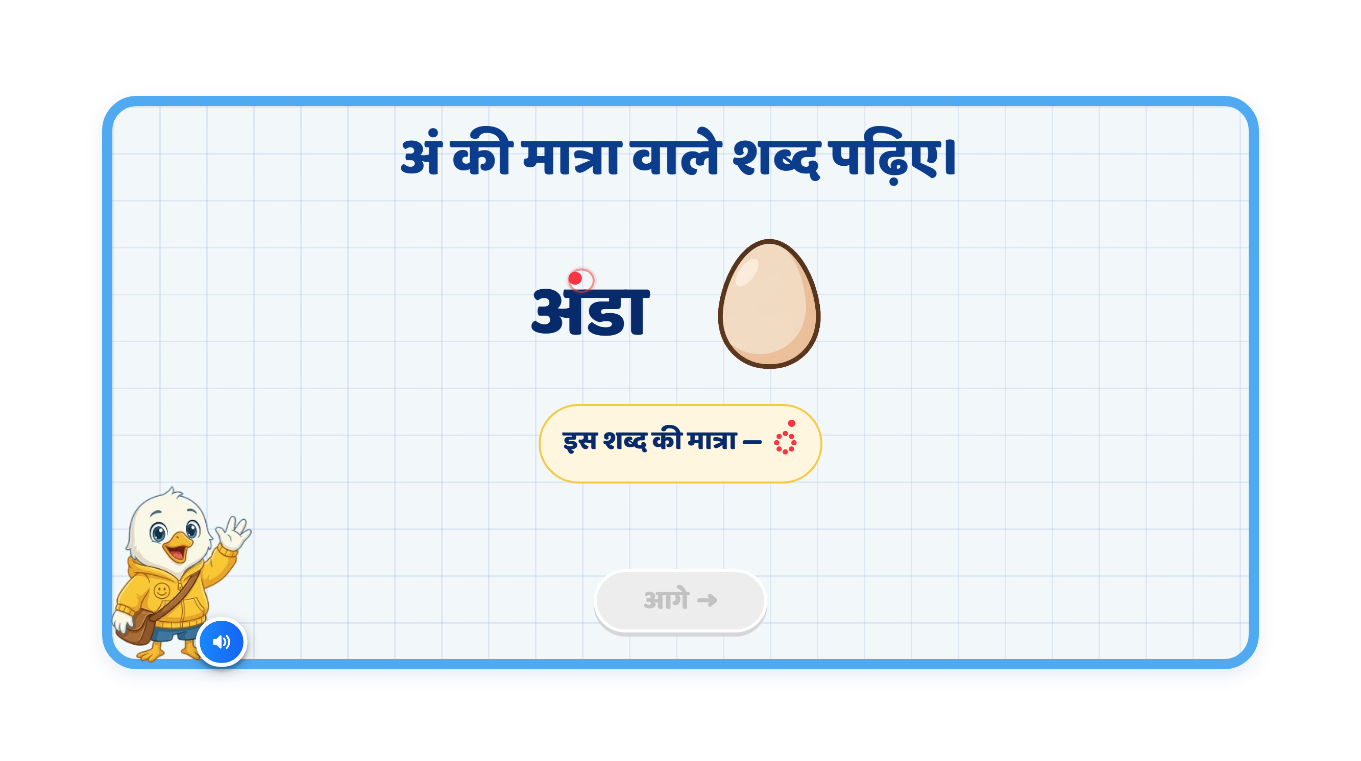
Page 4 · 04_MEET_PAIR.png
Notes:
समझ गया। Sample की wording और structure वही रखूँगा—सिर्फ image के अनुसार ज़रूरी बदलाव करूँगा।
Recommendation
VO:
“आइए, अं वाले कुछ शब्द देखें।”
पहले:
“अंडा — बोलकर देखिए। इसमें अ के ऊपर बिंदी लगी है।”
फिर:
“बंदर — बोलकर देखिए। इसमें ब के ऊपर बिंदी लगी है।”
On Screen:
Keep the heading: “अं वाले शब्द पढ़िए।”
Keep only one example visible at a time.
First show अंडा, followed by a clear egg image.
Highlight only the dot above अ in अंडा, using red.
After the first example finishes, show बंदर, followed by a clear monkey image.
Highlight only the dot above ब in बंदर, using the same red.
Keep the existing mascot and overall UI/UX style unchanged.
If retaining the “इस शब्द की मात्रा” label, change it to “इस शब्द का चिह्न” and show ◌ं for both examples.
Image Requirements:
अंडा: A recognisable oval egg with a clear outline.
बंदर: A recognisable monkey with its face, limbs and tail clearly visible.
Use a consistent, child-friendly illustration style with minimal background detail.
Sequence:
अंडा appears.
The egg image appears.
VO: “अंडा — बोलकर देखिए।”
Pause briefly so the child can repeat the word.
VO: “इसमें अ के ऊपर बिंदी लगी है।”
Highlight only the dot in अंडा, synchronised with the explanation.
Fade out the first example.
बंदर appears.
The monkey image appears.
VO: “बंदर — बोलकर देखिए।”
Pause briefly so the child can repeat the word.
VO: “इसमें ब के ऊपर बिंदी लगी है।”
Highlight only the dot in बंदर, synchronised with the explanation.
Animation:
Show the word first, followed by its image.
Use simple fade/pop-in animations.
When the VO explains the sign, softly highlight only the dot in red.
Keep the letters, headline, and existing ा मात्रा unchanged.
Remove the outline ring around the dot visible in the current image.
Complete one example before introducing the next.
SFX:
Add a soft pop when the word or image appears.
Add a soft chime when the dot highlights.
Keep SFX subtle so the VO and pronunciation remain clear.
Next Button:
Keep the आगे button disabled during the explanation.
Activate it only after both examples and their VO sequences finish.
Note:
Preserve the correct spellings: अंडा and बंदर.
Highlight only the dot, keeping the rest of each word in the regular text colour.
Keep the dotted circle in ◌ं neutral; it is only a display aid.
The learning focus is recognising the अं sign in both words: अंडा, बंदर.

Slide 8
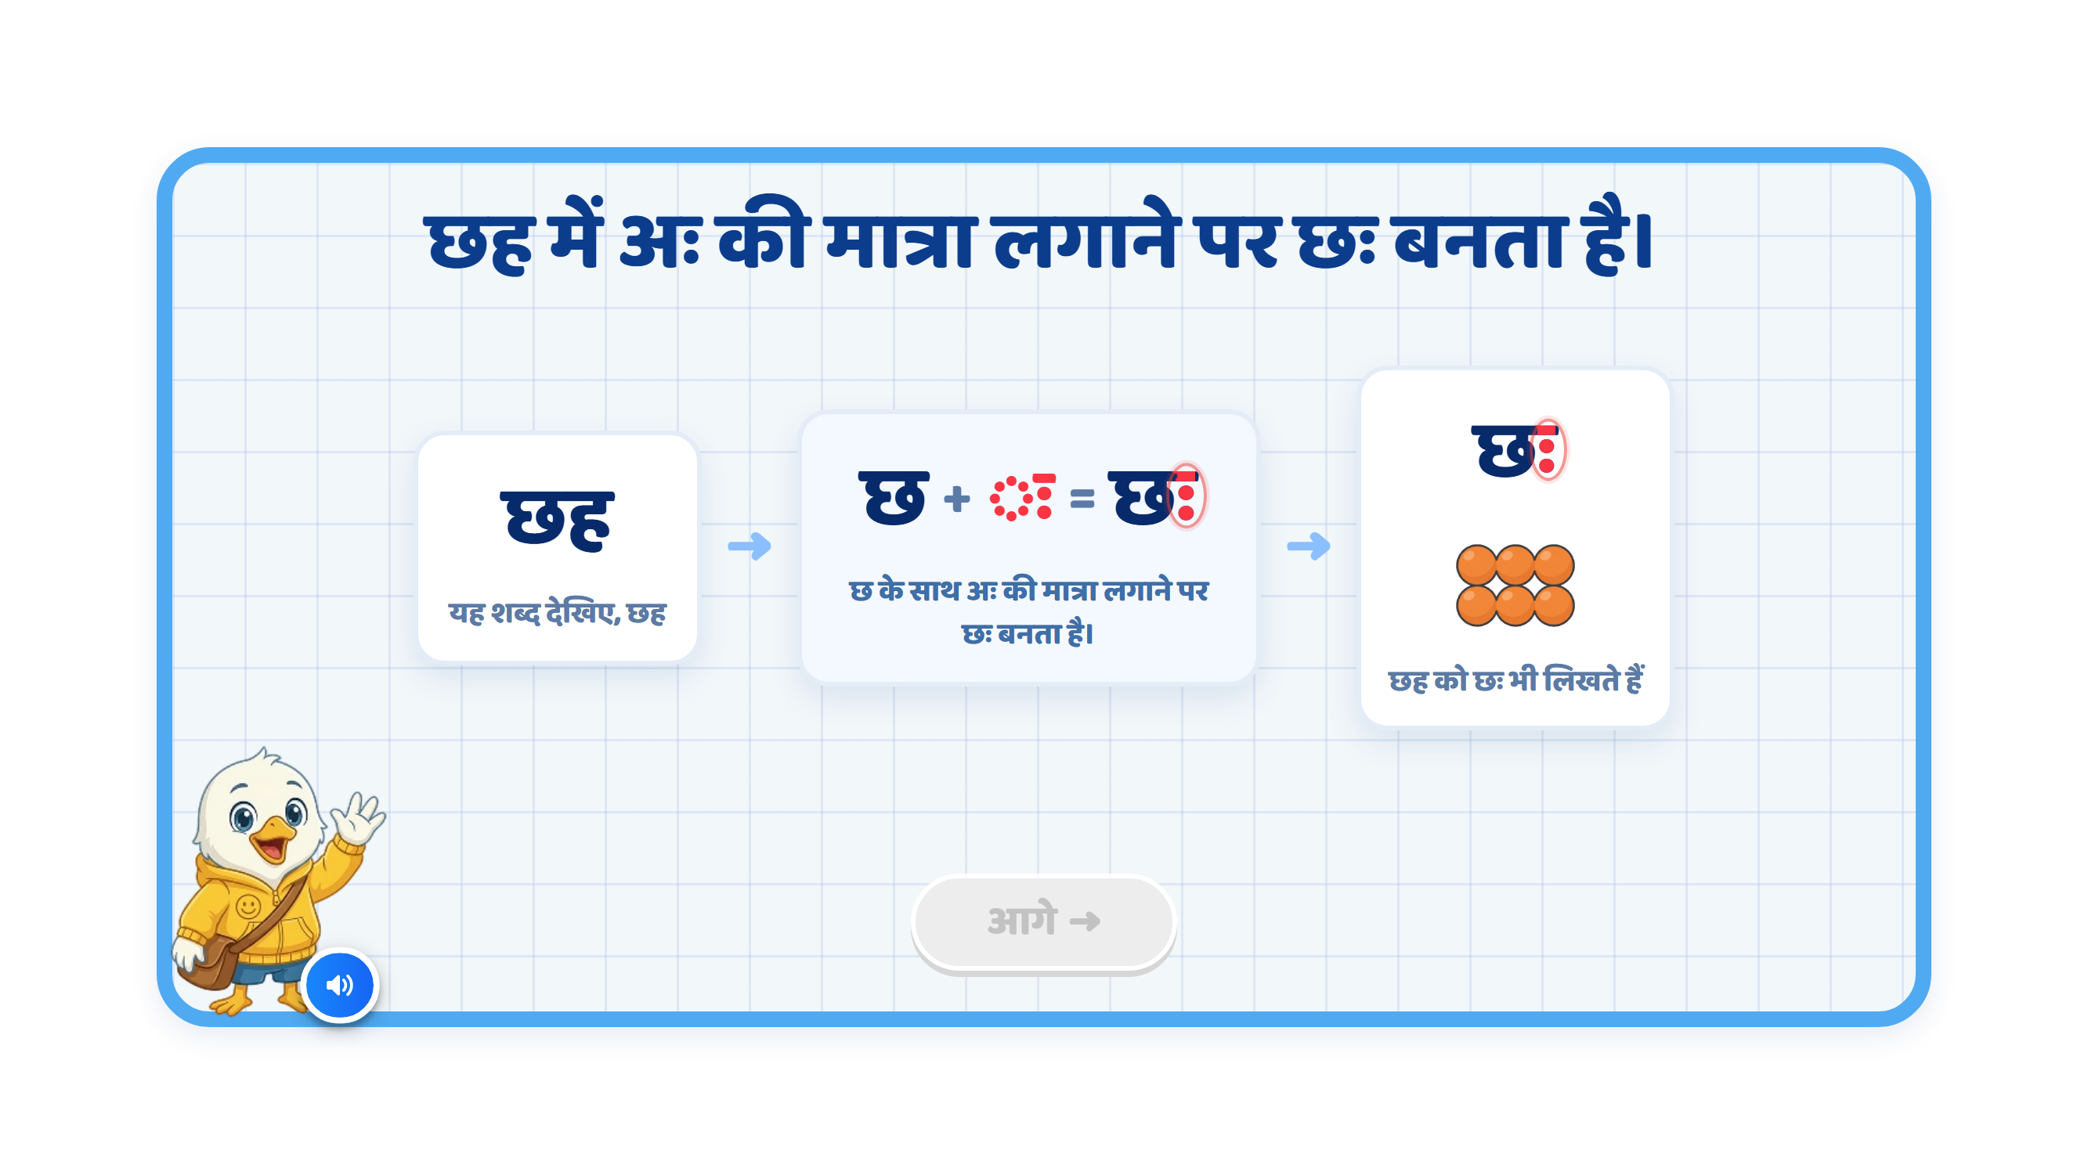
Page 5 · 05_MATRA_BUILD.png
Notes:
Recommendation
VO:
“आइए, देखें कि अः की मात्रा के शब्द को और कैसे लिख सकते हैं।”
“यह शब्द देखिए, छह।”
“छ के साथ अः की मात्रा लगाने पर, छः बनता है।”
“छह को छः भी लिखते हैं। दोनों का मतलब एक ही है।”
On Screen:
Remove the existing heading.
Keep the screen focused on one word transformation.
Follow this sequence:
छह → छ + ◌ः = छः → छः
First show छह clearly on the left.
In the centre, show: छ + ◌ः = छः
Highlight only the two dots in red when introduced.
Then show the final word छः on the right.
In छः, highlight only the two dots in red.
Remove the six-object image and unnecessary explanatory text beneath the cards.
Keep the existing mascot and overall UI/UX style unchanged.
Sequence:
VO: “आइए, देखें कि अः की मात्रा के शब्द को और कैसे लिख सकते हैं।”
छह appears on the left.
VO: “यह शब्द देखिए, छह।”
Pause briefly so the child can read the word.
Show छ + ◌ः = छः in the centre.
VO: “छ के साथ अः की मात्रा लगाने पर, छः बनता है।”
Move the two dots together to the right of छ, forming छः.
The final word छः appears on the right.
VO: “छह को छः भी लिखते हैं। दोनों का मतलब एक ही है।”
Keep छह and छः visible at the end.
Animation:
Use a simple step-by-step animation.
Do not show all stages together at the beginning.
First reveal छह with a soft fade.
Then reveal the centre formation.
The two dots should softly slide into their correct position to the right of छ, synchronised with the VO.
Reveal the final word छः with a soft fade.
Keep animations subtle and child-friendly.
SFX:
Add a soft pop when each word or sign appears.
Add a light chime when छः is formed.
Keep SFX subtle so the VO and pronunciation remain clear.
Next Button:
Keep the आगे button disabled during the complete sequence.
Activate it only after the final word छः appears and its VO finishes.
Note:
Preserve the correct spellings: छह and छः.
Highlight only the two dots, keeping छ and its headline unchanged.
Remove the extra horizontal stroke and outline rings around the dots visible in the current image.
Keep the dotted circle in ◌ः neutral. It is a display aid and should disappear when the sign joins छ.
The key visual learning should remain:
छह → छ + ◌ः = छः → छः

Slide 9
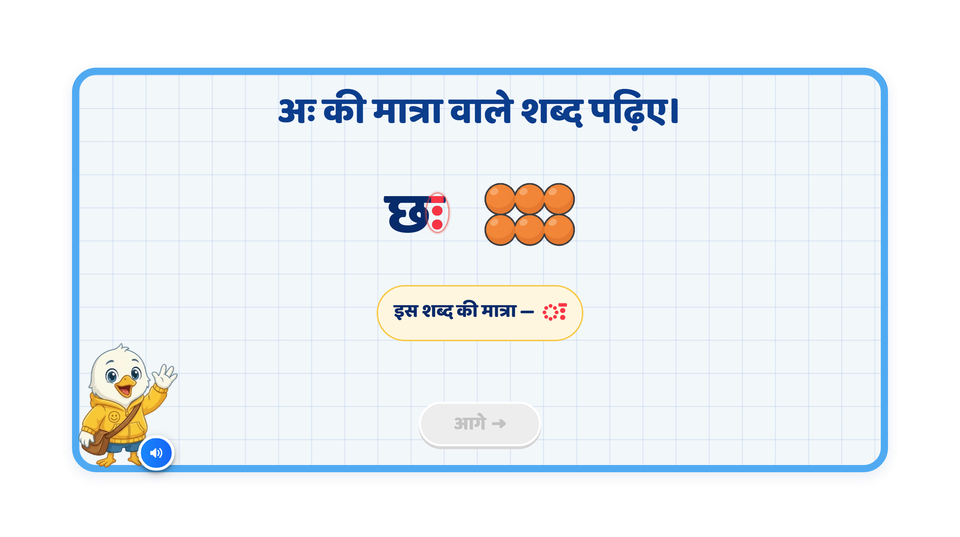
Page 6 · 06_MEET_PAIR.png
Notes:
Recommendation
VO:
“आइए, अः की मात्रा वाला एक शब्द देखें।”
“प्रातः — बोलकर देखिए। इसमें त के आगे अः की मात्रा लगी है।”
On Screen:
Remove the top heading.
Replace the existing छः example and six-object image.
Show only the example word: प्रातः.
Highlight only the two dots after त in प्रातः, using red.
Remove the “इस शब्द की मात्रा” label.
Keep the existing mascot and overall UI/UX style unchanged.
Image Requirements:
No example image is required.
Keep the screen focused on the word and the two dots.
Sequence:
प्रातः appears.
VO: “प्रातः — बोलकर देखिए।”
Pause briefly so the child can repeat the word.
VO: “इसमें त के आगे अः की मात्रा लगी है।”
Highlight only ः in प्रातः, synchronised with the explanation.
Keep the word visible at the end.
Animation:
Show the word with a simple fade/pop-in animation.
When the VO explains the sign, softly highlight the two dots in red.
Keep the letters, headline and ा in प्रातः unchanged.
SFX:
Add a soft pop when the word appears.
Add a soft chime when the two dots highlight.
Keep SFX subtle so the VO and pronunciation remain clear.
Next Button:
Keep the आगे button disabled during the explanation.
Activate it only after the example and its VO sequence finish.
Note:
Preserve the correct spelling: प्रातः.
Highlight only ः, keeping the rest of the word in the regular text colour.
Show ः as two vertically aligned dots, without an extra horizontal stroke or outline ring.
The learning focus is recognising the अः sign in प्रातः.

Slide 10
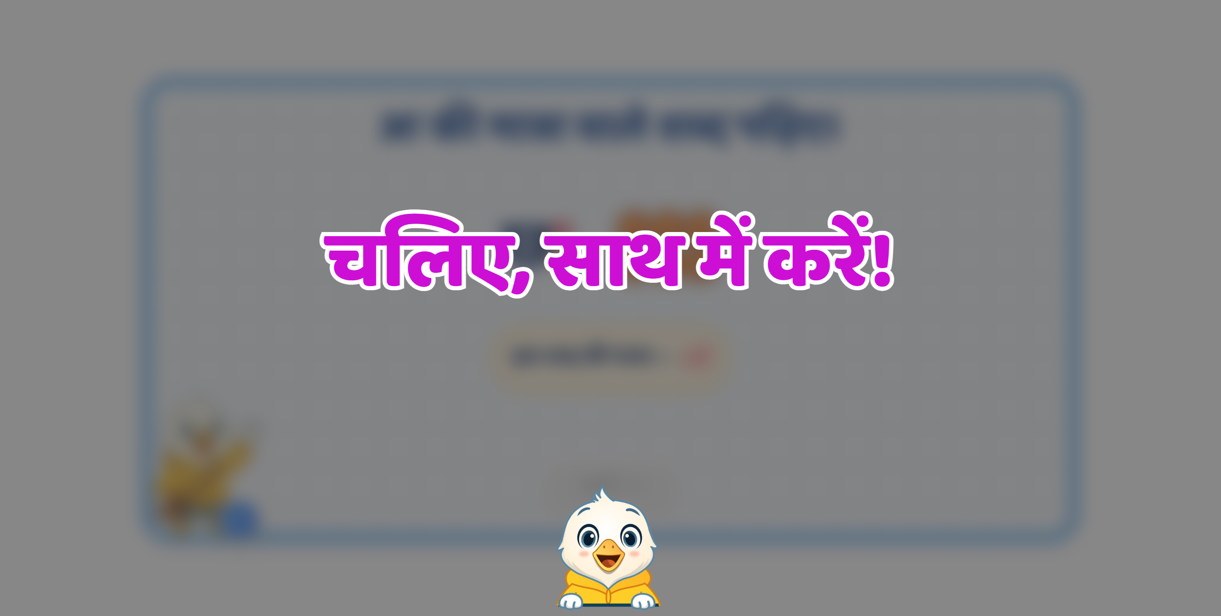

Slide 11
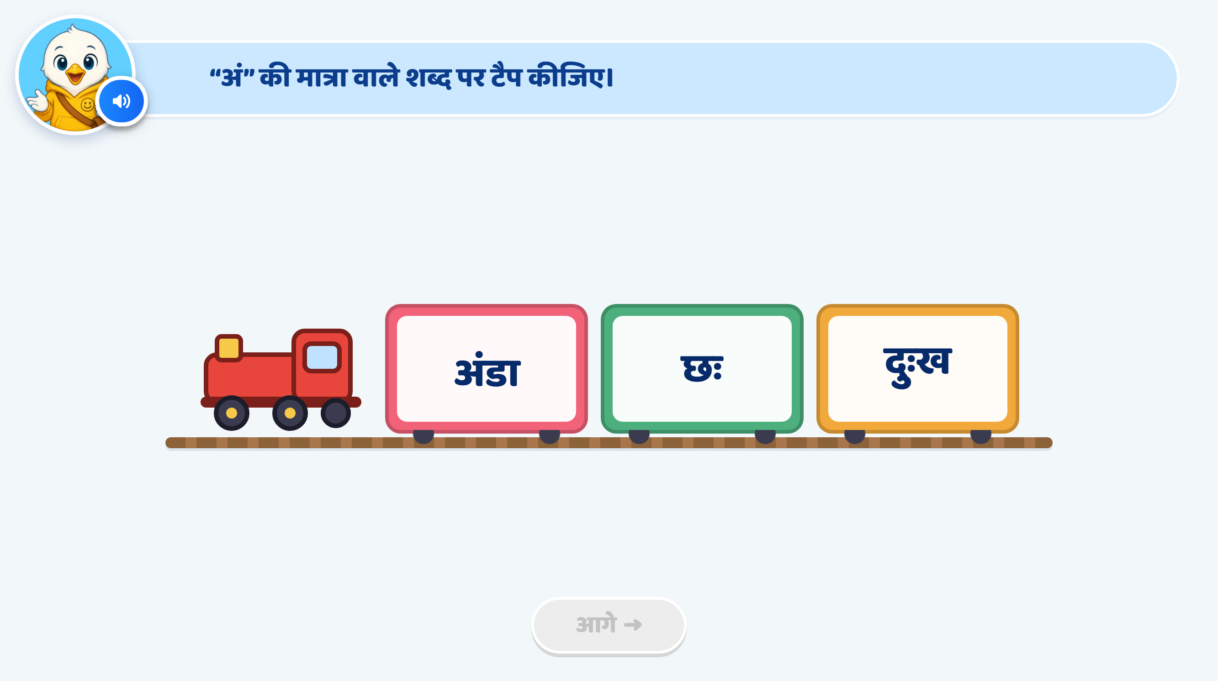
Page 7 · 07_TRAIN_TAP.png
Notes:
Recommendation
Option Change:
Replace अंडा with बंदर.
Keep छः.
Replace दुःख with प्रातः.
Updated options: बंदर, छः, प्रातः.
बंदर remains the only correct answer for अं.
Heading / Question Text:
“अं” वाले शब्द पर टैप कीजिए।
Entry Animation:
The train enters smoothly from right to left.
It stops at the centre of the screen.
The three coaches show बंदर, छः, प्रातः clearly.
Play the instruction VO after the train stops.
On Screen:
Keep the heading at the top: “अं” वाले शब्द पर टैप कीजिए।
Keep the options in this order: बंदर, छः, प्रातः.
Do not add extra instruction text in the play area.
Initially, keep all words in the regular text colour without sign highlights or answer cues.
Keep the existing mascot and overall UI/UX style unchanged.
Instruction VO:
“जिस डिब्बे में अं वाला शब्द है, उस डिब्बे पर टैप कीजिए।”
Correct Answer: बंदर
Accept a tap anywhere inside the बंदर coach.
Show a small confetti/sparkle effect.
Give the बंदर coach a soft glow.
Highlight only the dot above ब in red.
Correct Response VO:
“शाबाश! बंदर शब्द में अं की बिंदी है।”
Hint 1: Clarify — After the 1st Wrong Attempt
If the child taps छः or प्रातः, softly shake the selected coach, then return it to its original position.
Do not highlight any word or sign.
Do not show a hand nudge.
After the VO finishes, allow the child to choose from all three options again.
VO:
“फिर से पढ़िए। अं वाले शब्द पर टैप कीजिए।”
Hint 2: Strong Hint — After the 2nd Wrong Attempt
Softly shake the wrongly selected coach.
Read all three words, one by one, from left to right.
As बंदर is spoken, highlight only the dot above ब in red.
As छः is spoken, highlight only the two dots after छ in red.
As प्रातः is spoken, highlight only the two dots after त in red.
Use the same highlighting style as the teaching screens.
Keep the letters, headline and ा in प्रातः unchanged.
Retain the sign highlights in all three words so the child can compare.
Do not add a correct-answer coach glow or hand nudge.
After the VO finishes, keep all three options available.
VO, with a short pause between words:
“बंदर। छः। प्रातः।”
Then:
“अं वाले शब्द पर टैप कीजिए।”
Hint 3: Show the Answer — After the 3rd Wrong Attempt
Softly shake the wrongly selected coach.
Give the बंदर coach a soft glow.
Show a hand nudge on the बंदर coach.
Keep the dot inside बंदर highlighted in red.
Lock छः and प्रातः.
After the VO finishes, allow only बंदर to be selected.
Wait for the child to tap it. Do not select the answer or advance automatically.
VO:
“बंदर शब्द में अं की बिंदी है। बंदर पर टैप कीजिए।”
Correct Response After Hint 3:
Accept the child’s tap on बंदर.
Remove the hand nudge.
Show a small confetti/sparkle effect and play a success chime.
Keep the correct word’s dot highlighted.
Enable आगे after the feedback finishes.
No additional VO is needed because Hint 3 has already explained the answer.
SFX:
Soft train arrival/whistle sound during entry.
Light tap sound on selection.
Soft error sound on a wrong attempt.
Light success chime on the correct answer.
Keep all SFX below the VO volume.
Next Button:
Keep आगे disabled initially and throughout the hints.
Activate it only after the child selects बंदर and the feedback finishes.
Developer Notes:
Update the option text and associated word audio to बंदर, छः, प्रातः.
Preserve the correct spellings.
Show ः as two vertically aligned dots, without an extra horizontal stroke.
Disable all answer taps while any VO is playing.
Count wrong taps across both incorrect options. Switching from छः to प्रातः must not reset the counter.
Trigger Hint 1 after the first wrong tap, Hint 2 after the second, and Hint 3 after the third.
If the child answers correctly at any earlier stage, accept the answer immediately and stop the hint sequence.
The hand nudge appears only in Hint 3 for this guided activity.

Slide 12
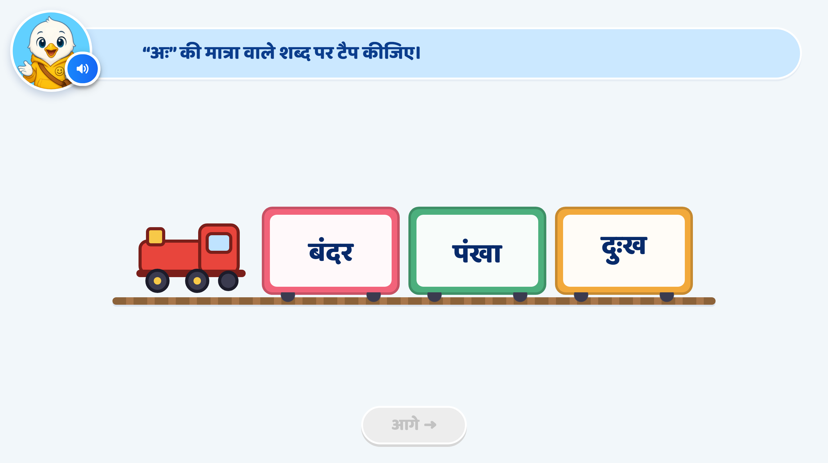
Page 8 · 08_TRAIN_TAP.png
Notes:
Recommendation
Option Change:
Replace बंदर with जंगल.
Keep पंखा.
Replace दुःख with प्रातः.
Updated options: जंगल, पंखा, प्रातः.
प्रातः remains the only correct answer for अः.
Heading / Question Text:
“अः” वाले शब्द पर टैप कीजिए।
Entry Animation:
The train enters smoothly from right to left.
It stops at the centre of the screen.
The three coaches show जंगल, पंखा, प्रातः clearly.
Play the instruction VO after the train stops.
On Screen:
Keep the heading at the top: “अः” वाले शब्द पर टैप कीजिए।
Keep the options in this order: जंगल, पंखा, प्रातः.
Do not add extra instruction text in the play area.
Initially, keep all words in the regular text colour without sign highlights or answer cues.
Keep the existing mascot and overall UI/UX style unchanged.
Instruction VO:
“जिस डिब्बे में अः वाला शब्द है, उस डिब्बे पर टैप कीजिए।”
Correct Answer: प्रातः
Accept a tap anywhere inside the प्रातः coach.
Show a small confetti/sparkle effect.
Give the प्रातः coach a soft glow.
Highlight only the two dots after त in red.
Correct Response VO:
“शाबाश! प्रातः शब्द में अः की दो बिंदियाँ हैं।”
Hint 1: Clarify — After the 1st Wrong Attempt
If the child taps जंगल or पंखा, softly shake the selected coach, then return it to its original position.
Do not highlight any word or sign.
Do not show a hand nudge.
After the VO finishes, allow the child to choose from all three options again.
VO:
“फिर से पढ़िए। अः वाले शब्द पर टैप कीजिए।”
Hint 2: Strong Hint — After the 2nd Wrong Attempt
Softly shake the wrongly selected coach.
Read all three words, one by one, from left to right.
As जंगल is spoken, highlight only the dot above ज in red.
As पंखा is spoken, highlight only the dot above प in red.
As प्रातः is spoken, highlight only the two dots after त in red.
Use the same highlighting style as the teaching screens.
Keep the letters, headline and existing ा matras unchanged.
Retain the sign highlights in all three words so the child can compare.
Do not add a correct-answer coach glow or hand nudge.
After the VO finishes, keep all three options available.
VO, with a short pause between words:
“जंगल। पंखा। प्रातः।”
Then:
“अः वाले शब्द पर टैप कीजिए।”
Hint 3: Show the Answer — After the 3rd Wrong Attempt
Softly shake the wrongly selected coach.
Give the प्रातः coach a soft glow.
Show a hand nudge on the प्रातः coach.
Keep the two dots inside प्रातः highlighted in red.
Lock जंगल and पंखा.
After the VO finishes, allow only प्रातः to be selected.
Wait for the child to tap it. Do not select the answer or advance automatically.
VO:
“प्रातः शब्द में अः की दो बिंदियाँ हैं। प्रातः पर टैप कीजिए।”
Correct Response After Hint 3:
Accept the child’s tap on प्रातः.
Remove the hand nudge.
Show a small confetti/sparkle effect and play a success chime.
Keep the correct word’s two dots highlighted.
Enable आगे after the feedback finishes.
No additional VO is needed because Hint 3 has already explained the answer.
SFX:
Soft train arrival/whistle sound during entry.
Light tap sound on selection.
Soft error sound on a wrong attempt.
Light success chime on the correct answer.
Keep all SFX below the VO volume.
Next Button:
Keep आगे disabled initially and throughout the hints.
Activate it only after the child selects प्रातः and the feedback finishes.
Developer Notes:
Update the option text and associated word audio to जंगल, पंखा, प्रातः.
Preserve the correct spellings.
Show ः as two vertically aligned dots, without an extra horizontal stroke.
Disable all answer taps while any VO is playing.
Count wrong taps across both incorrect options. Switching from जंगल to पंखा must not reset the counter.
Trigger Hint 1 after the first wrong tap, Hint 2 after the second, and Hint 3 after the third.
If the child answers correctly at any earlier stage, accept the answer immediately and stop the hint sequence.
The hand nudge appears only in Hint 3 for this guided activity.

Slide 13
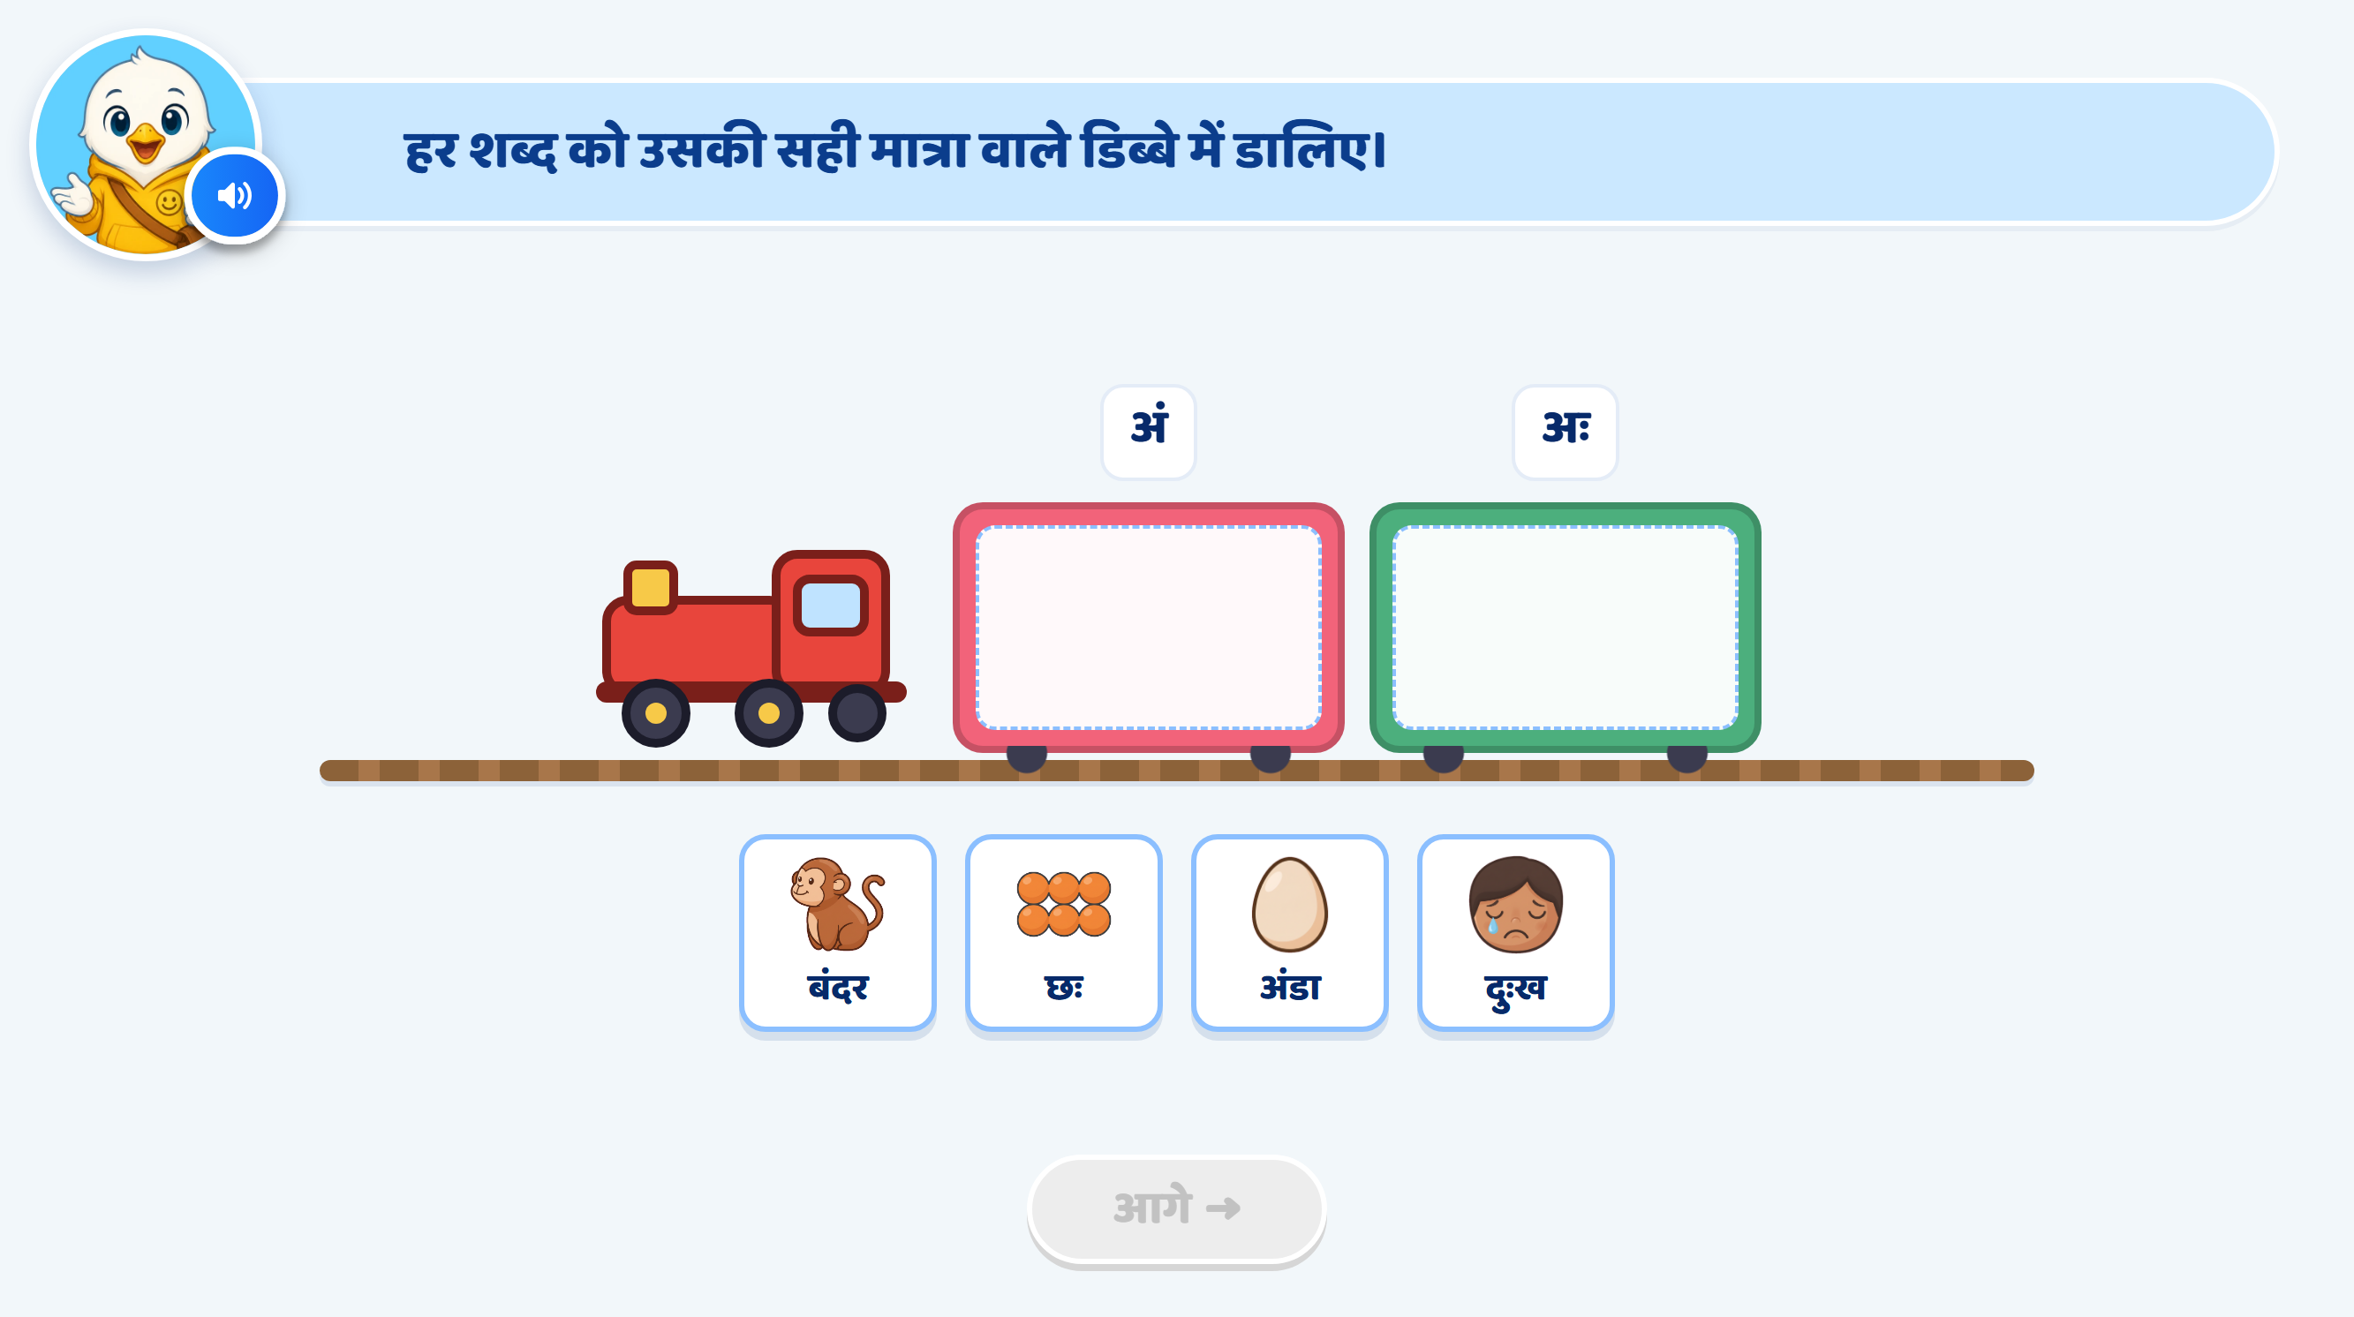
Page 10 · 10_TRAIN_SORT.png
Notes:
Recommendation
Word Changes:
Keep बंदर, छः and अंडा.
Replace दुःख with प्रातः, with clear picture support.
अं की मात्रा: बंदर, अंडा
अः की मात्रा: छः, प्रातः
Updated card order: बंदर, छः, अंडा, प्रातः.
Heading / Question Text:
“हर शब्द को उसकी सही मात्रा वाले डिब्बे में डालिए।”
Entry Animation:
The train enters smoothly from right to left.
It stops at the centre of the screen.
Show two coaches labelled अं and अः.
Keep both drop areas empty.
Four draggable picture-and-word cards appear below the train in mixed order: बंदर, छः, अंडा, प्रातः.
Play the instruction VO, then read each card’s word aloud before enabling interaction.
On Screen:
Keep the heading at the top.
Use only अं and अः as the coach labels.
Each card should show a clear picture with its word underneath.
Initially, keep all words in the regular text colour without matra highlights.
Do not add extra instruction text in the play area.
Keep the existing mascot and overall UI/UX style unchanged.
Image Requirements:
बंदर: A recognisable monkey with its face, limbs and tail clearly visible.
छः: Six clearly separated objects arranged in two rows of three, matching the current image.
अंडा: A recognisable oval egg with a clear outline.
प्रातः: A clear sunrise scene representing morning.
Use consistent, child-friendly artwork with minimal background detail.
Pair every picture with its written word and spoken name.
Instruction VO:
“हर शब्द को उसकी सही मात्रा वाले डिब्बे में डालिए।”
Card-name VO:
“बंदर।” / “छः।” / “अंडा।” / “प्रातः।”
A tap on a card plays its name without counting as an answer attempt. Disable dragging while the word VO plays.
Drag and Drop:
The child drags each card into the correct coach.
Correct mapping:
बंदर → अं
छः → अः
अंडा → अं
प्रातः → अः
Allow two cards inside each coach without overlap.
Slightly enlarge the selected card while dragging.
Give either coach the same neutral hover highlight when a card moves over it. This should not indicate whether the answer is correct.
Correct Placement:
Snap the card inside the correct coach.
Show a small sparkle and play a success chime.
Highlight the target matra inside the word in red.
Lock the correctly placed card so it cannot be dragged again.
Correct Response VO — Play Only the Matching Line:
“शाबाश! बंदर शब्द में अं की मात्रा है।”
“शाबाश! छः शब्द में अः की मात्रा है।”
“शाबाश! अंडा शब्द में अं की मात्रा है।”
“शाबाश! प्रातः शब्द में अः की मात्रा है।”
Hint 1: Clarify — After the 1st Wrong Drop for That Card
Softly shake the wrongly dropped card.
Return it to its original position.
Do not highlight a matra or the correct coach.
Do not show a hand nudge.
After the VO finishes, allow another attempt.
VO:
“फिर से पढ़िए। इस शब्द को उसकी सही मात्रा वाले डिब्बे में डालिए।”
Hint 2: Strong Hint — After the 2nd Wrong Drop for That Card
Softly shake the card and return it to its original position.
Read only the wrongly dropped word.
Highlight its target matra in red using the teaching-screen style:
बंदर: Highlight only the dot above ब.
छः: Highlight only the two dots after छ.
अंडा: Highlight only the dot above अ.
प्रातः: Highlight only the two dots after त.
Keep ा in अंडा and प्रातः in the regular text colour.
Keep the consonants and headline unchanged.
Do not highlight the correct coach or show a hand.
After the VO finishes, allow the child to try either coach.
Word VO — Play Only the Current Word:
“बंदर।” / “छः।” / “अंडा।” / “प्रातः।”
Then:
“इस शब्द को उसकी सही मात्रा वाले डिब्बे में डालिए।”
Hint 3: Show the Answer — After the 3rd Wrong Drop for That Card
Softly shake the card and return it to its original position.
Give the current card and its correct coach a soft glow.
Show a hand drag nudge from the card to the correct coach.
Lock the wrong coach as a destination for this card.
Temporarily disable other unfinished cards until this guided placement is complete.
After the VO finishes, allow the child to drag the current card only into its correct coach.
Do not place the card automatically.
VO — Play Only the Matching Line:
“बंदर शब्द में अं की मात्रा है। इसे अं वाले डिब्बे में डालिए।”
“छः शब्द में अः की मात्रा है। इसे अः वाले डिब्बे में डालिए।”
“अंडा शब्द में अं की मात्रा है। इसे अं वाले डिब्बे में डालिए।”
“प्रातः शब्द में अः की मात्रा है। इसे अः वाले डिब्बे में डालिए।”
Correct Placement After Hint 3:
Snap the card into the correct coach.
Remove the hand nudge.
Show a small sparkle and play a success chime.
Keep the target matra highlighted and lock the placed card.
No additional VO is needed because Hint 3 has already explained the answer.
Re-enable the remaining unfinished cards.
Completion:
When all four cards are correctly placed, give both coaches a soft glow.
Play a brief train whistle with a subtle steam animation.
Enable आगे after the feedback finishes.
No extra completion VO is required.
SFX:
Soft train arrival/whistle sound.
Light pick-up sound when dragging begins.
Soft error sound on a wrong drop.
Light drop/success sound on correct placement.
Keep SFX below the VO volume.
Next Button:
Keep आगे disabled initially and throughout the activity.
Activate it only after all four cards are correctly placed and feedback finishes.
Developer Notes:
Update the card images, written words, word audio and answer mappings to the new set.
Preserve the correct spellings: बंदर, छः, अंडा, प्रातः.
Show ः as two vertically aligned dots, without an extra horizontal stroke or outline ring.
Disable all answer taps and drags while any VO is playing.
Maintain a separate wrong-attempt counter for each card. Each new card starts at zero.
If the child switches cards, preserve each unfinished card’s counter.
Count a drop into the wrong coach as one wrong attempt. A name-only tap or release outside both coaches does not count.
Trigger Hint 1 after the first wrong drop, Hint 2 after the second, and Hint 3 after the third for that card.
Keep correctly placed cards locked throughout later hints.
If the child places a card correctly earlier, stop its hint sequence immediately.
Show the hand drag nudge only in Hint 3 for this guided activity.

Slide 14
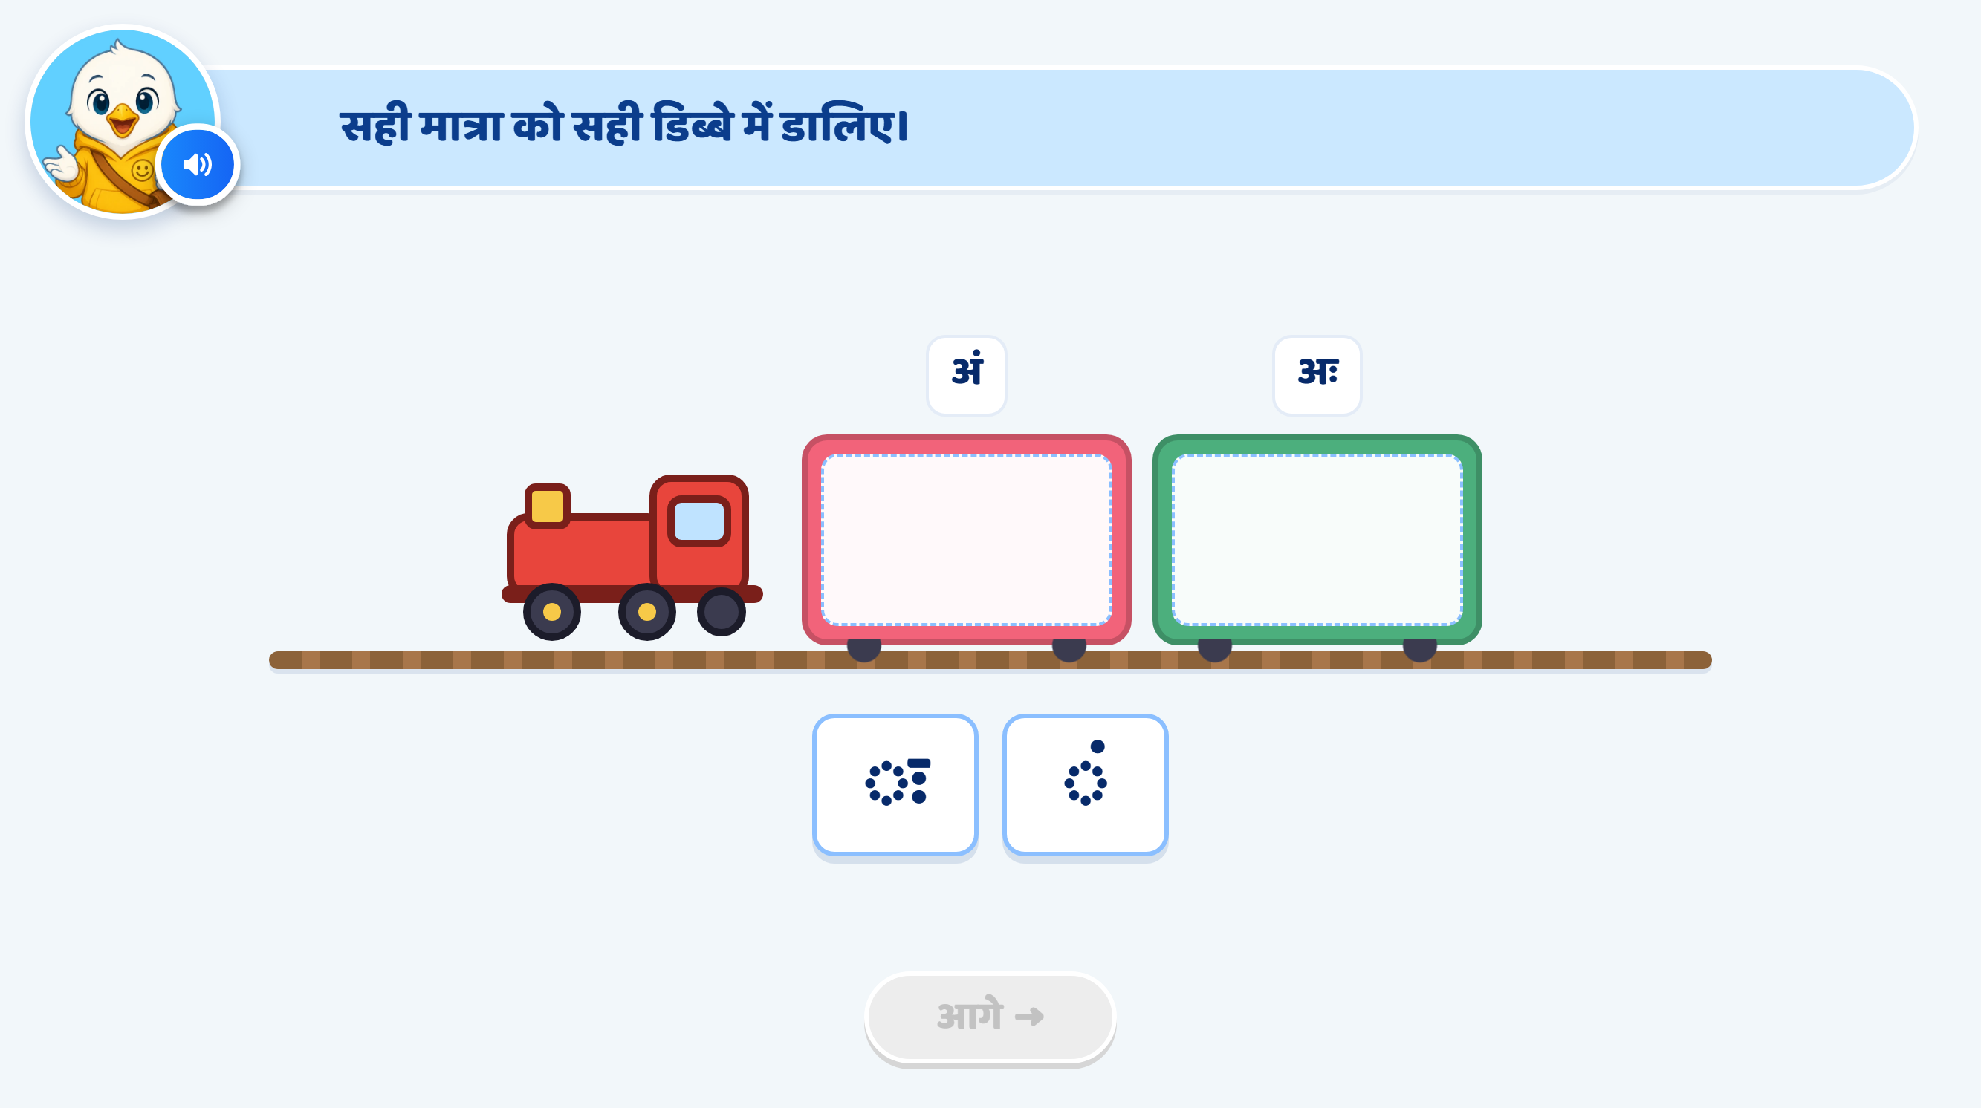
Page 11 · 11_TRAIN_SORT.png
Notes:
Recommendation
Heading / Question Text:
“सही चिह्न को सही डिब्बे में डालिए।”
Entry Animation:
The train enters smoothly from right to left.
It stops at the centre of the screen.
Show two coaches labelled अं and अः.
Keep both drop areas empty.
Show two draggable sign cards below the train: ◌ः and ◌ं, in the order shown in the attached screen.
Play the instruction VO before enabling interaction.
On Screen:
Update the heading to: “सही चिह्न को सही डिब्बे में डालिए।”
Keep only अं and अः above the coaches.
Do not add separate sign symbols to the coach labels.
Keep both sign cards in the regular text colour initially.
Use a neutral dotted circle to display each sign clearly.
Correct ◌ः to show only two vertically aligned dots to the right of the dotted circle. Remove the extra horizontal stroke visible in the current image.
Keep the existing mascot and overall UI/UX style unchanged.
Instruction VO:
“सही चिह्न को सही डिब्बे में डालिए।”
Drag and Drop:
The child drags each sign card into its matching coach.
Correct mapping:
◌ं → अं
◌ः → अः
Allow only one sign card inside each coach.
Slightly enlarge the selected card while dragging.
Use the same neutral hover highlight for either coach. It should not reveal whether the destination is correct.
Do not announce the sign’s name on initial pick-up, as this would identify its matching coach.
Correct Placement:
Snap the sign card inside the correct coach.
Show a small sparkle and play a success chime.
Highlight only the actual sign in red.
Keep the dotted circle neutral.
Lock the correctly placed card.
Correct Response VO — Play Only the Matching Line:
For ◌ं:
“शाबाश! यह अं का चिह्न है।”
For ◌ः:
“शाबाश! यह अः का चिह्न है।”
Hint 1: Clarify — After the 1st Wrong Drop for That Card
Softly shake the wrongly dropped card.
Return it to its original position.
Do not highlight the sign or either coach.
Do not show a hand nudge.
After the VO finishes, allow another attempt.
VO:
“फिर से देखिए। सही चिह्न को सही डिब्बे में डालिए।”
Hint 2: Strong Hint — After the 2nd Wrong Drop for That Card
Softly shake the card and return it.
Slightly enlarge only the wrongly dropped sign card.
Highlight its actual sign in red using the teaching-screen style.
For ◌ं, highlight the single dot above the dotted circle.
For ◌ः, highlight the two dots to the right of the dotted circle.
Keep the dotted circle neutral.
Keep both coach labels visible without highlighting the correct one.
Do not announce the sign’s name or show a hand nudge.
After the VO finishes, return the card to its normal size and allow another attempt.
VO:
“चिह्न का आकार ध्यान से देखिए। इसे सही डिब्बे में डालिए।”
Hint 3: Show the Answer — After the 3rd Wrong Drop for That Card
Softly shake the card and return it.
Give the current sign card and its correct coach a soft glow.
Show a hand drag nudge from the card to the correct coach.
Lock the wrong coach as a destination for this card.
Temporarily disable the other unfinished card.
After the VO finishes, allow only the correct placement.
Wait for the child to complete the drag. Do not place the card automatically.
VO for ◌ं:
“यह अं का चिह्न है। इसे अं वाले डिब्बे में डालिए।”
VO for ◌ः:
“यह अः का चिह्न है। इसे अः वाले डिब्बे में डालिए।”
Correct Placement After Hint 3:
Snap the card inside the correct coach.
Remove the hand nudge.
Show a small sparkle and play a success chime.
Keep the sign highlighted in red and the dotted circle neutral.
Lock the placed card.
No additional VO is needed because Hint 3 has already explained the answer.
Re-enable the remaining card, if any.
Completion:
When both signs are placed correctly, give both coaches a soft glow.
Play a brief train whistle with a subtle steam animation.
Enable आगे after the feedback finishes.
No extra completion VO is required.
SFX:
Soft train arrival/whistle sound.
Light pick-up sound when dragging begins.
Soft error sound on a wrong drop.
Light success chime on correct placement.
Keep SFX below the VO volume.
Next Button:
Keep आगे disabled initially and throughout the hints.
Activate it only after both signs are correctly placed and feedback finishes.
Developer Notes:
Disable all answer taps and drags while any VO is playing.
Maintain a separate wrong-attempt counter for each card.
Each card starts at zero. Switching cards must not reset an existing counter.
Count a drop into the wrong coach as one wrong attempt. Releasing outside both coaches simply returns the card without adding an attempt.
Keep correctly placed cards locked. A drop onto an occupied coach should return the dragged card without disturbing the placed card.
If the child answers correctly earlier, stop that card’s hint sequence.
Show the hand drag nudge only in Hint 3 for this guided activity.
With only two cards, the second placement may be completed by elimination. Treat this screen as supported matching practice.

Slide 15
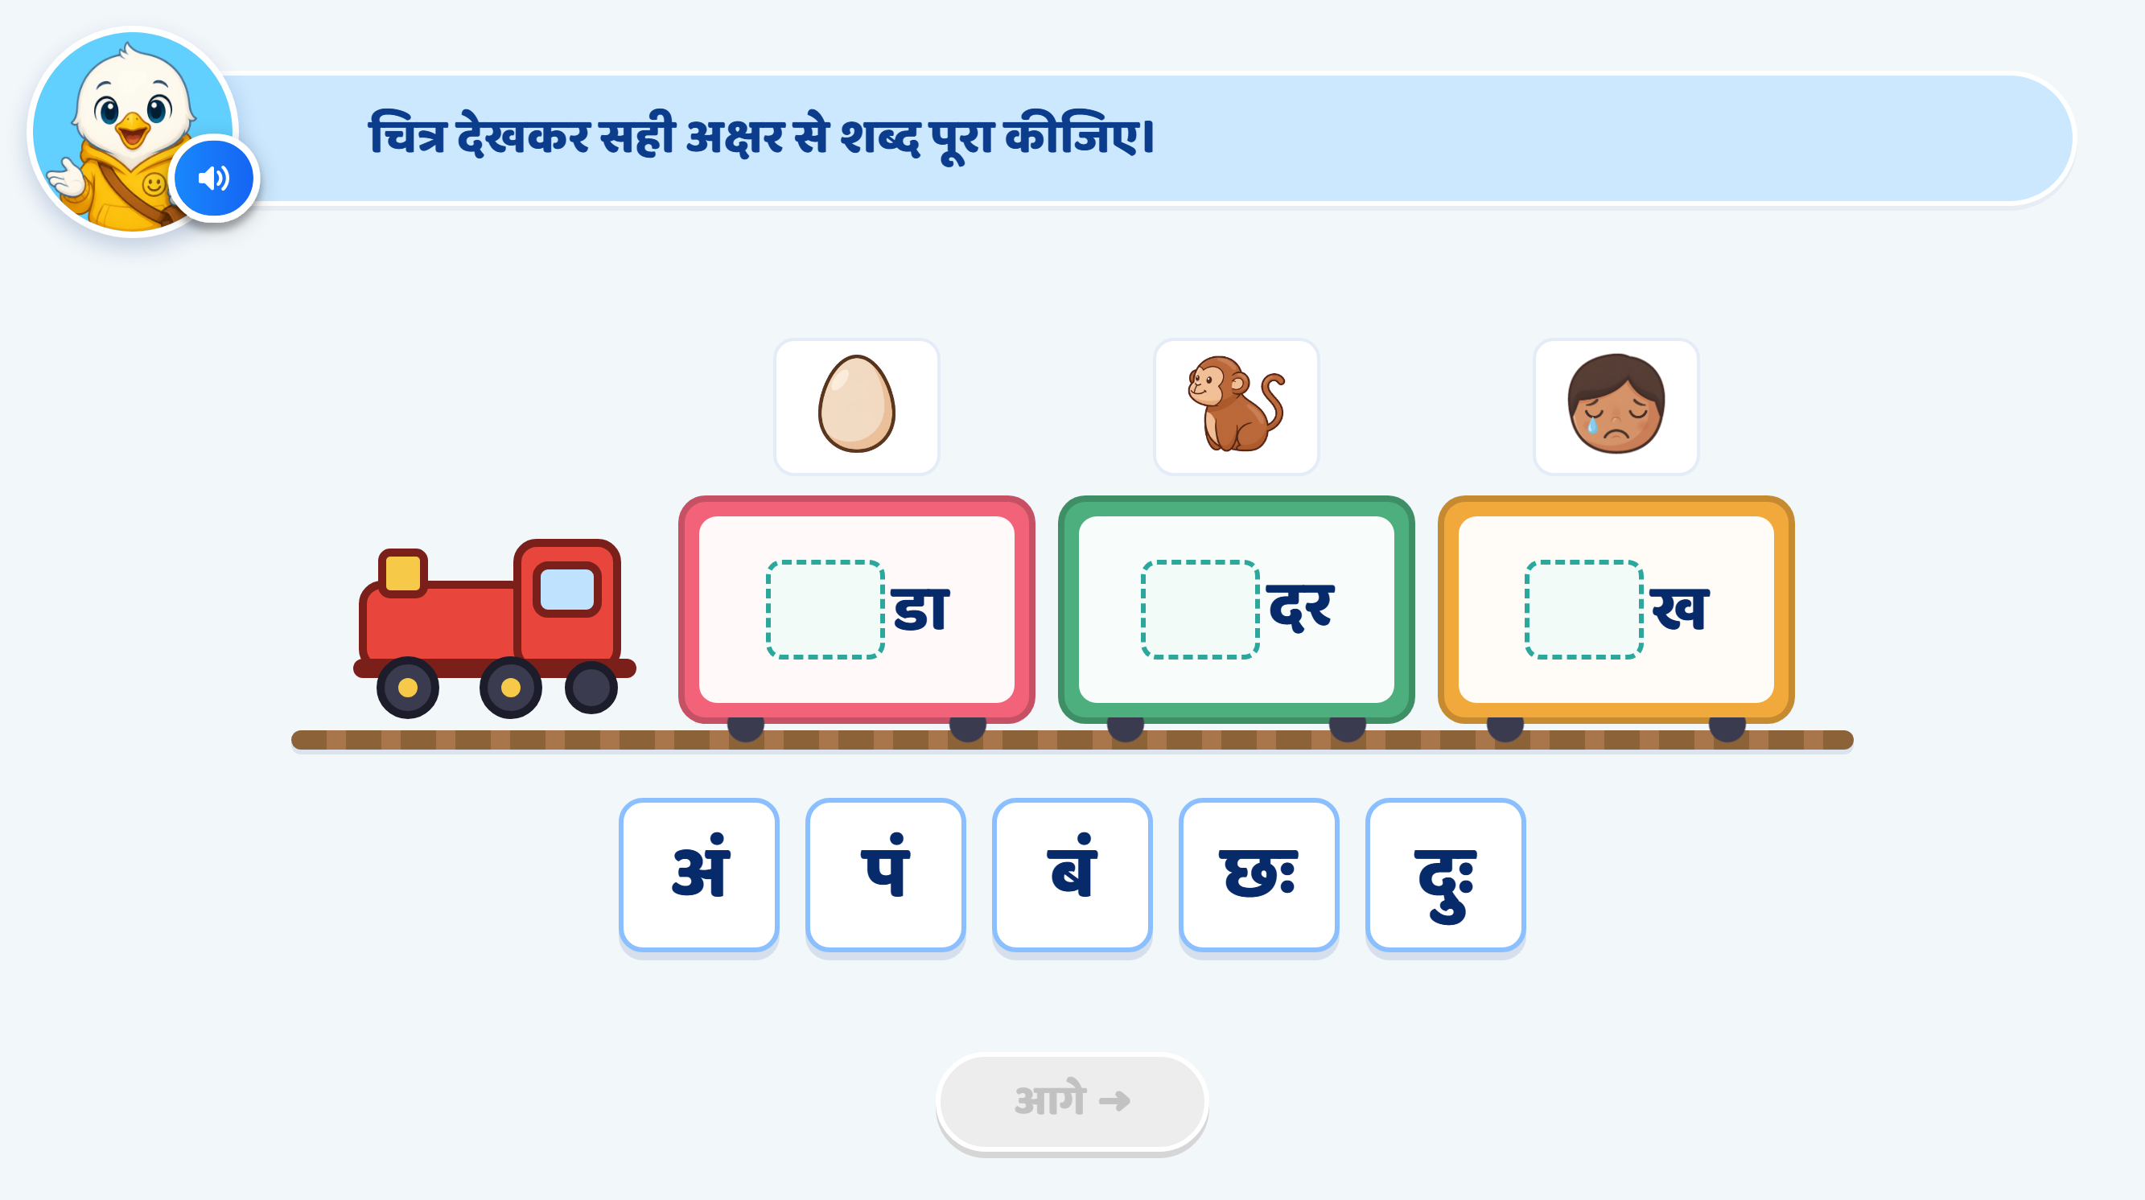
Page 12 · 12_WORD_BUILD.png
Notes:
Recommendation
Word Changes:
Use बंदर, पंखा, झंडा. All three are familiar words that can be represented with clear pictures.
Replace अंडा with बंदर.
Replace बंदर in the second coach with पंखा.
Replace दुःख with झंडा.
Use बं, पं, झं as the correct अक्षर options.
Keep छः, दुः as अः distractors.
The activity targets only अं वाले शब्द.
Activity Concept:
Keep the train with three coaches.
Each coach contains a blank for the first अक्षर, followed by the remaining part of the word.
The child looks at the picture and drags the correct अक्षर into the blank.
Use whole अक्षर options rather than separate matra symbols.
Heading / Question Text:
“चित्र देखकर सही अक्षर से शब्द पूरा कीजिए।”
On Screen:
Show these pictures and incomplete words:
PictureIncomplete WordCorrect OptionCompleted WordMonkey_दरबंबंदरFan_खापंपंखाFlag_डाझंझंडा
Show five draggable options in this mixed order: बं, छः, पं, दुः, झं.
छः and दुः do not correctly complete any pictured word.
Do not show complete words or highlight matras initially.
Keep the existing mascot and train UI/UX style unchanged.
Image Requirements:
बंदर: A recognisable monkey with its face, limbs and tail clearly visible.
पंखा: A recognisable table fan with visible blades, protective grill and stand.
झंडा: A recognisable Indian flag on a pole.
Keep all pictures large enough to recognise.
Use a consistent, child-friendly illustration style with minimal background detail.
Entry Animation:
The train enters smoothly from right to left and stops at the centre.
Picture cards appear above the coaches.
Incomplete words appear inside the coaches.
अक्षर options slide up from the bottom.
Play the instruction VO before enabling interaction.
Instruction VO:
“चित्र देखकर सही अक्षर से शब्द पूरा कीजिए।”
Option VO:
Tapping an अक्षर card plays only its sound:
“बं।” / “छः।” / “पं।” / “दुः।” / “झं।”
A sound-only tap does not count as an answer attempt.
Disable dragging while the VO plays.
Drag and Drop:
The child drags an अक्षर into a word’s blank.
Correct combinations:
बं + दर = बंदर
पं + खा = पंखा
झं + डा = झंडा
Slightly enlarge the selected card while dragging.
Give each blank the same neutral hover highlight, without indicating whether the option is correct.
Accept a placement only when the completed word matches the picture.
Correct Placement:
Snap the अक्षर into the blank.
Show the completed word.
Highlight only its target matra in red:
बंदर: Highlight the dot above ब.
पंखा: Highlight the dot above प.
झंडा: Highlight the dot above झ.
Keep ा in खा and डा in the regular text colour.
Show a small sparkle and play a success chime.
Lock the completed word and its used अक्षर card.
Correct Response VO — Play Only the Matching Line:
“शाबाश! बंदर बन गया।”
“शाबाश! पंखा बन गया।”
“शाबाश! झंडा बन गया।”
Hint 1: Clarify — After the 1st Wrong Drop
Softly shake the wrongly dropped अक्षर card.
Return it to its original position.
Do not highlight the correct अक्षर or blank.
Do not show a hand nudge.
After the VO finishes, allow another attempt.
VO:
“फिर से देखिए। चित्र देखकर सही अक्षर से शब्द पूरा कीजिए।”
Hint 2: Strong Hint — After the 2nd Wrong Drop
Softly shake the card and return it.
Read only the wrongly dropped अक्षर.
Slightly enlarge that card and highlight its matra in red:
बं, पं, झं: Highlight only the dot above the letter.
छः, दुः: Highlight only the two dots to the right.
Keep the consonants, headline and ु in दुः unchanged.
Keep the relevant picture and incomplete word clearly visible so the child can compare.
Do not highlight the correct option or show a hand nudge.
After the VO finishes, return the card to its normal size and allow another attempt.
Option VO — Play Only the Wrongly Dropped अक्षर:
“बं।” / “छः।” / “पं।” / “दुः।” / “झं।”
Then:
“चित्र देखकर सही अक्षर से शब्द पूरा कीजिए।”
Hint 3: Show the Answer — After the 3rd Wrong Drop
Return the wrong card to its original position.
Give the correct अक्षर and its matching blank a soft glow.
Temporarily lock all other options and destinations.
After the VO finishes, allow only the correct placement.
Wait for the child to drag the अक्षर into the blank. Do not complete the word automatically.
VO for बंदर:
“बं लगाने से बंदर बनता है। बं को खाली जगह में डालिए।”
VO for पंखा:
“पं लगाने से पंखा बनता है। पं को खाली जगह में डालिए।”
VO for झंडा:
“झं लगाने से झंडा बनता है। झं को खाली जगह में डालिए।”
Practice-Round Hand Nudge:
Use glow and lock without a hand, following the sample’s default practice behaviour.
Distractor Handling and Attempt Counts:
Keep a separate wrong-attempt counter for each correct अक्षर card: बं, पं, झं.
Preserve its counter if the child switches cards. Each new card starts at zero.
At Hint 3, guide that अक्षर to its matching word.
A wrong drop of छः or दुः also counts as an attempt. Track these errors against the unfinished blank where the distractor was dropped.
Switching between छः and दुः must not reset that blank’s distractor counter.
After the third distractor error for a blank, reveal the correct अक्षर for that blank.
A release outside all blanks simply returns the card and does not count as an answer attempt.
Correct Placement After Hint 3:
Snap the correct अक्षर into place.
Show the completed word and highlight its target matra.
Show a small sparkle and play a success chime.
No additional VO is needed because Hint 3 has already explained the answer.
Lock the completed word and re-enable the remaining unfinished items.
Completion:
Finish when बंदर, पंखा and झंडा are complete.
Leave the unused distractors in the tray and disable them.
Give all three coaches a soft glow.
Play a brief train whistle with a subtle steam animation.
Enable आगे after feedback finishes.
No extra completion VO is required.
SFX:
Soft train arrival/whistle sound.
Light pick-up sound.
Soft error sound on a wrong drop.
Light success chime on correct completion.
Keep all SFX below the VO volume.
Next Button:
Keep आगे disabled initially and throughout the activity.
Activate it only after all three words are complete and feedback finishes.
Developer Notes:
Update the pictures, incomplete words, option audio and answer mappings to the new set.
Preserve the correct spellings: बंदर, पंखा, झंडा.
Disable all answer taps and drags while any VO is playing.
Keep completed words locked throughout later hints.
Stop an item’s hint sequence immediately if the child answers correctly earlier.
Keep खा and डा together in their respective coaches.
Highlight only the target dot, keeping consonants, headline and existing ा matras unchanged.
Show ः in the distractors as two vertically aligned dots, without an extra horizontal stroke or outline ring.

Slide 16
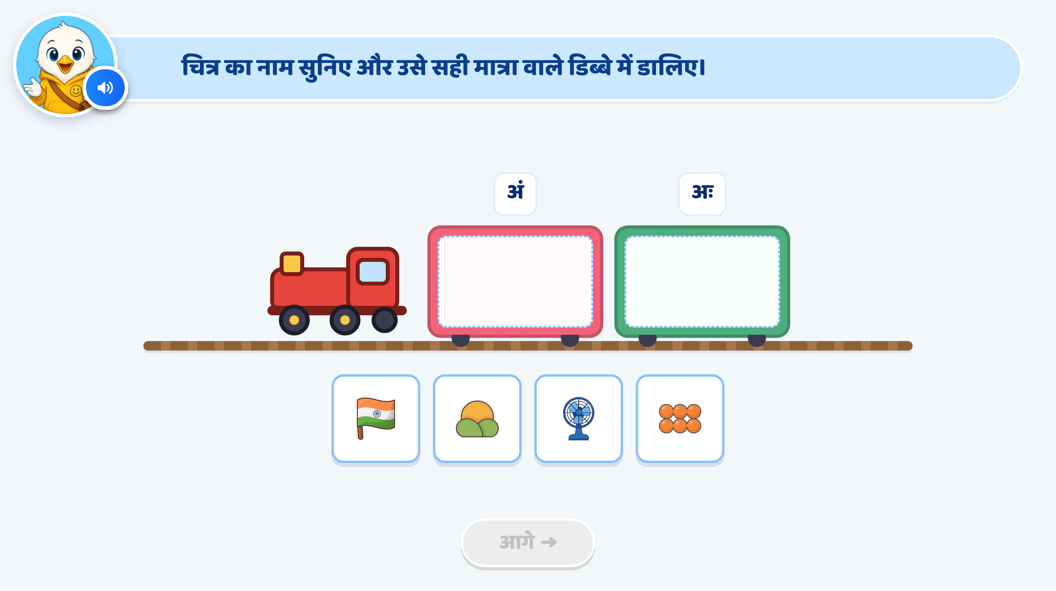
Page 13 · 13_TRAIN_SORT.png
Notes:
Recommendation
Picture Change:
Use only these three picture options in this order: झंडा, प्रातः, पंखा.
Remove the छः picture.
अं की मात्रा: झंडा, पंखा
अः की मात्रा: प्रातः
Activity Concept:
Show a train with two coaches, labelled अं and अः.
Keep the inside of each coach empty as a drop zone.
Show picture cards only below the train.
The child listens to each picture’s name and drags it into the correct डिब्बा.
Keep the initial question free of written picture names.
During Hint 2, temporarily show the wrongly dropped picture’s word and highlight its target matra.
Heading / Question Text:
“चित्र का नाम सुनिए और उसे सही मात्रा वाले डिब्बे में डालिए।”
Entry Animation:
The train enters smoothly from right to left.
It stops at the centre.
Coach labels अं and अः appear.
Picture cards झंडा, प्रातः, पंखा appear below the train.
Play the instruction VO before enabling interaction.
On Screen:
First coach label: अं
Second coach label: अः
Do not add separate matra symbols to the coach labels.
Keep the three pictures clear and equally prominent.
Do not show picture names or correct-answer cues initially.
Keep the existing mascot and train UI/UX style unchanged.
Image Requirements:
झंडा: A recognisable Indian flag on a pole, matching the current image.
प्रातः: A clear sunrise scene representing morning, matching the current image.
पंखा: A recognisable table fan with visible blades, protective grill and stand.
Use consistent, child-friendly artwork.
For प्रातः, use the exact spoken word “प्रातः” so the child connects the sunrise picture with the intended word.
Instruction VO:
“चित्र का नाम सुनिए और उसे सही मात्रा वाले डिब्बे में डालिए।”
Picture-name VO:
When the child taps a picture, play only its name:
“झंडा।” / “प्रातः।” / “पंखा।”
A name-only tap does not count as an answer attempt.
If a drag begins before the name has been heard, play the name first and enable dragging after the VO finishes.
Drag and Drop:
The child drags each picture into its correct coach.
The अं coach accepts two pictures.
The अः coach accepts one picture.
Slightly enlarge the selected picture while dragging.
Use the same neutral hover highlight for either coach, without indicating correctness.
Correct Mapping:
झंडा → अं
प्रातः → अः
पंखा → अं
Correct Placement:
Snap the picture inside the correct coach.
Show a small sparkle and play a success chime.
Lock the placed picture.
Keep placed pictures clearly visible without overlap.
Correct Response VO — Play Only the Matching Line:
“शाबाश! झंडा में अं की मात्रा है।”
“शाबाश! प्रातः में अः की मात्रा है।”
“शाबाश! पंखा में अं की मात्रा है।”
Hint 1: Clarify — After the 1st Wrong Drop for That Picture
Softly shake the wrongly dropped picture card.
Return it to its original position.
Replay only that picture’s name.
Do not show its written name, highlight a coach or add a hand nudge.
After the VO finishes, allow another attempt.
VO:
“फिर से सुनिए।”
Play the current picture’s name, then:
“चित्र को सही मात्रा वाले डिब्बे में डालिए।”
Hint 2: Strong Hint — After the 2nd Wrong Drop for That Picture
Softly shake the picture card and return it.
Replay only the wrongly dropped picture’s name.
Temporarily display its word underneath the picture.
Highlight its target matra in red using the teaching-screen style:
झंडा: Highlight only the dot above झ.
प्रातः: Highlight only the two dots after त.
पंखा: Highlight only the dot above प.
Keep the letters, headline and existing ा matras in the regular text colour.
Keep this word support visible for the next attempt.
Do not highlight the correct coach or show a hand nudge.
After the VO finishes, allow either destination.
Word VO — Play Only the Current Word:
“झंडा।” / “प्रातः।” / “पंखा।”
Then:
“मात्रा देखिए। चित्र को सही मात्रा वाले डिब्बे में डालिए।”
Hint 3: Show the Answer — After the 3rd Wrong Drop for That Picture
Return the wrongly dropped picture to its original position.
Give the picture and its correct coach a soft glow.
Lock the wrong coach as a destination for that picture.
Temporarily disable other unfinished pictures.
After the VO finishes, allow only the correct placement.
Wait for the child to drag the picture. Do not place it automatically.
VO — Play Only the Matching Line:
“झंडा में अं की मात्रा है। इसे अं वाले डिब्बे में डालिए।”
“प्रातः में अः की मात्रा है। इसे अः वाले डिब्बे में डालिए।”
“पंखा में अं की मात्रा है। इसे अं वाले डिब्बे में डालिए।”
Practice-Round Hand Nudge:
Use glow and lock without a hand, following the sample’s default practice behaviour.
Correct Placement After Hint 3:
Snap the picture into the correct coach.
Remove the temporary word support.
Show a small sparkle and play a success chime.
Lock the placed picture.
No additional VO is needed because Hint 3 has already explained the answer.
Re-enable the remaining unfinished pictures.
Completion:
When all three pictures are correctly sorted, give both coaches a soft glow.
Play a brief train whistle with a subtle steam animation.
Enable आगे after feedback finishes.
No extra completion VO is required.
SFX:
Soft train arrival/whistle sound.
Light tap or pick-up sound.
Soft error sound on a wrong drop.
Light success chime on correct placement.
Keep SFX below the VO volume.
Next Button:
Keep आगे disabled initially and throughout the hints.
Activate it only after all three pictures are correctly placed and feedback finishes.
Developer Notes:
Update the picture assets, associated word audio and answer mappings to झंडा, प्रातः, पंखा.
Keep only three draggable picture cards.
Disable all answer taps and drags while any VO is playing.
Maintain a separate wrong-attempt counter for each picture.
Each new picture starts at zero. Switching pictures must not reset an existing counter.
Count a drop into the wrong coach as one wrong attempt. Name-only taps and releases outside both coaches do not count.
Keep correctly placed pictures locked during later hints.
Remove temporary word support whenever its picture is correctly placed.
If the child answers correctly earlier, stop that picture’s hint sequence immediately.
Preserve the correct spellings.
Show ः in प्रातः as two vertically aligned dots, without an extra horizontal stroke or outline ring.

Slide 17
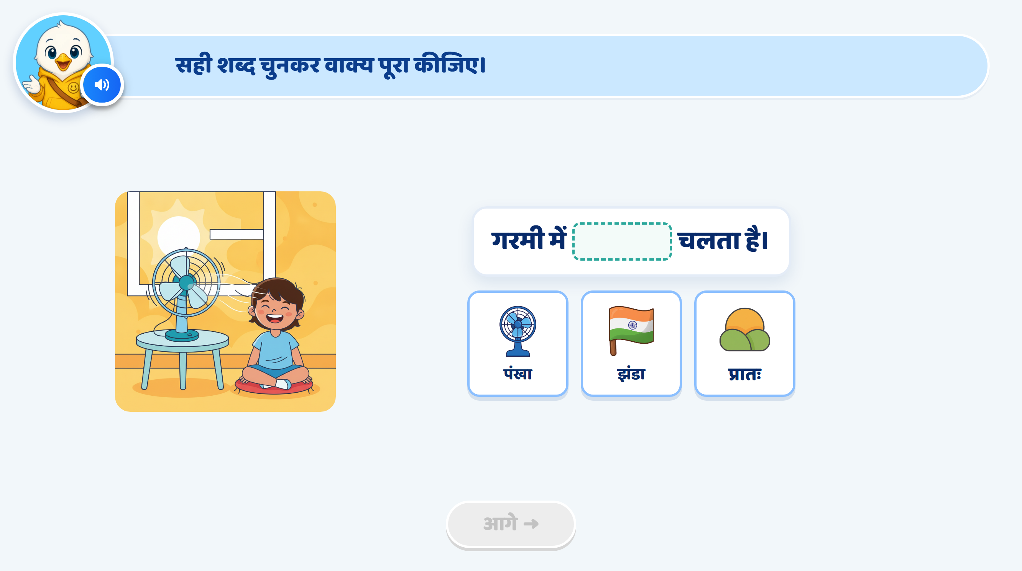
Page 15 · 15_SENTENCE_COMPLETE.png
Notes:
Recommendation
Activity Concept:
This is a picture-based sentence completion activity.
The child looks at the scene, listens to the sentence and drags the correct word card into the blank.
The focus is on using अं वाले शब्द in a meaningful sentence.
Sentence and Options:
Use the sentence: “गरमी में ___ चलता है।”
Show these options in order: पंखा, झंडा, प्रातः.
Correct completed sentence: “गरमी में पंखा चलता है।”
Heading / Question Text:
“सही शब्द चुनकर वाक्य पूरा कीजिए।”
On Screen:
Keep the main scene on the left and the sentence on the right.
Show “गरमी में ___ चलता है।” with an empty blank.
Show three picture-and-word options below the sentence:
पंखा
झंडा
प्रातः
Make the fan in the main scene clearly visible.
Do not highlight the fan or the correct option initially.
Keep the existing mascot and overall UI/UX style unchanged.
Image Requirements:
Main scene: Keep the child sitting beside a table fan on a hot day, as shown in the image. Show the fan clearly, with subtle airflow lines.
पंखा option: A recognisable table fan matching the one in the main scene.
झंडा option: A recognisable Indian flag on a pole, as shown in the image.
प्रातः option: A clear sunrise scene representing morning.
Use consistent, child-friendly artwork with minimal background detail.
Keep the fan large enough to identify in both the main scene and the option card.
Entry Animation:
The main picture appears first.
The sentence appears with an empty blank.
The three option cards fade in one by one.
Play the instruction and sentence VO before enabling interaction.
Instruction VO:
“चित्र देखकर सही शब्द चुनकर वाक्य पूरा कीजिए। शब्द को खाली जगह में डालिए।”
Sentence VO:
Read “गरमी में…”, pause at the blank, then say “चलता है।”
Do not say the missing word.
Option VO:
When an option is tapped, play only its name:
“पंखा।” / “झंडा।” / “प्रातः।”
A tap plays the word’s name.
A drag into the blank submits the answer.
Disable dragging while any VO plays.
Correct Answer: पंखा
Snap the पंखा card into the blank.
Display the completed sentence:
“गरमी में पंखा चलता है।”
Give the correct answer a soft glow.
Show a small sparkle/confetti effect.
Lock the completed sentence.
Correct Response VO:
“शाबाश! गरमी में पंखा चलता है।”
Hint 1: Clarify — After the 1st Wrong Drop
If the child drops झंडा or प्रातः into the blank, softly shake the wrong card.
Return it to its original position.
Do not highlight the fan, any option or a sign.
Do not show a hand nudge.
After the VO finishes, allow another attempt.
VO:
“फिर से देखिए। चित्र देखकर सही शब्द चुनकर वाक्य पूरा कीजिए।”
Hint 2: Strong Hint — After the 2nd Wrong Drop
Softly shake the wrong card and return it.
Read the full sentence with each option, one at a time, from left to right.
Briefly preview each word in the blank while its sentence is spoken.
Use the same neutral preview style for all three words. Do not show success feedback.
Highlight the fan in the main scene using a soft outline or glow.
After all three readings, restore the empty blank.
Do not glow the correct option or show a hand nudge.
After the VO finishes, keep all three options available.
VO — Separate Clips with a Short Pause Between Them:
“गरमी में पंखा चलता है।”
“गरमी में झंडा चलता है।”
“गरमी में प्रातः चलता है।”
Then:
“चित्र देखकर सही शब्द चुनकर वाक्य पूरा कीजिए।”
Hint 3: Show the Answer — After the 3rd Wrong Drop
Softly shake the wrong card and return it.
Give the पंखा option and the sentence blank a soft glow.
Lock झंडा and प्रातः.
After the VO finishes, allow only पंखा to be dragged into the blank.
Wait for the child to complete the action. Do not fill the blank automatically.
VO:
“चित्र में पंखा चल रहा है। ‘पंखा’ शब्द को खाली जगह में डालिए।”
Practice-Round Hand Nudge:
Use glow and lock without a hand, following the sample’s default practice behaviour.
Correct Response After Hint 3:
Snap पंखा into the blank.
Show the completed sentence.
Show a small sparkle and play a success chime.
Lock the answer.
No additional VO is needed because Hint 3 has already explained it.
Enable आगे after the feedback finishes.
SFX:
Soft pop when the picture, sentence or options appear.
Light tap/pick-up sound.
Soft error sound on a wrong drop.
Light success chime on the correct answer.
Keep SFX below the VO volume.
Next Button:
Keep आगे disabled initially and throughout the hints.
Activate it only after पंखा is correctly placed and feedback finishes.
Developer Notes:
Use the sentence “गरमी में ___ चलता है।” and option text पंखा, झंडा, प्रातः consistently.
Size the blank and option card so पंखा fits clearly without reducing readability.
Preserve the correct spellings and signs in all three words.
Disable option taps and drags while any VO is playing.
Use one wrong-attempt counter for this sentence blank.
Switching between झंडा and प्रातः must not reset the counter.
A name-only tap or release outside the blank does not count as a wrong answer.
Trigger Hint 1 after the first wrong drop, Hint 2 after the second, and Hint 3 after the third.
If the child answers correctly earlier, accept the answer and stop the hint sequence.
Hint 2 previews are temporary comparisons, not accepted answers.
Highlight the fan in Hint 2 because the task tests picture understanding and sentence meaning.

Slide 18
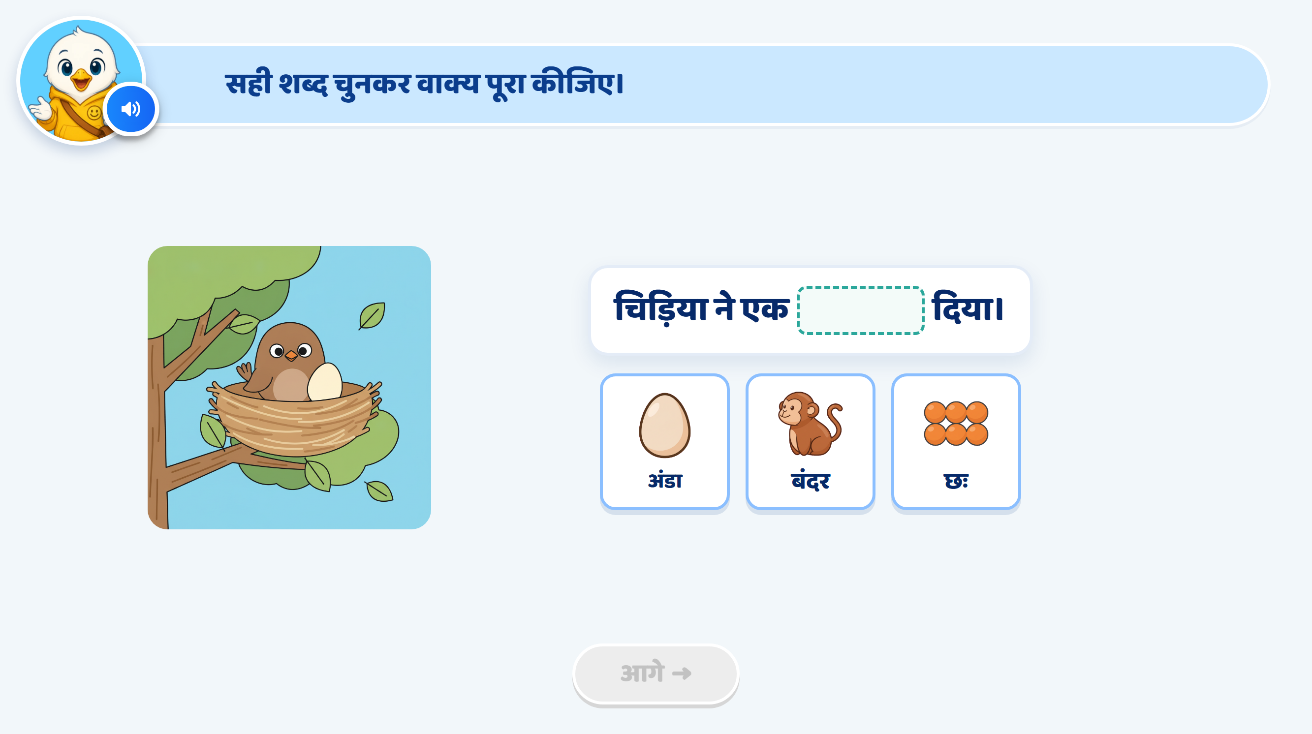
Page 14 · 14_SENTENCE_COMPLETE.png
Notes:
Recommendation
Activity Concept:
This is a picture-based sentence completion activity.
The child looks at the scene, listens to the sentence and drags the correct word card into the blank.
The focus is on using अं वाले शब्द in a meaningful sentence.
Heading / Question Text:
“सही शब्द चुनकर वाक्य पूरा कीजिए।”
On Screen:
Keep the bird-and-nest scene on the left and the sentence on the right.
Sentence: “चिड़िया ने एक ___ दिया।”
Show three picture-and-word options below the sentence:
अंडा
बंदर
छः
Make the egg in the nest clearly visible.
Do not highlight the egg or the correct option initially.
Keep the existing mascot and overall UI/UX style unchanged.
Image Requirements:
Main scene: A bird sitting in a nest on a tree branch with one clearly visible egg, matching the current image.
अंडा option: A recognisable oval egg matching the egg in the nest.
बंदर option: A recognisable monkey with its face, limbs and tail clearly visible.
छः option: Six clearly separated objects arranged in two rows of three, matching the current image.
Use consistent, child-friendly artwork with minimal background detail.
Entry Animation:
The main picture appears first.
The sentence appears with an empty blank.
The three option cards fade in one by one.
Play the instruction and sentence VO before enabling interaction.
Instruction VO:
“चित्र देखकर सही शब्द चुनकर वाक्य पूरा कीजिए। शब्द को खाली जगह में डालिए।”
Sentence VO:
Read “चिड़िया ने एक…”, pause at the blank, then say “दिया।”
Do not say the missing word.
Option VO:
When an option is tapped, play only its name:
“अंडा।” / “बंदर।” / “छः।”
A tap plays the word’s name.
A drag into the blank submits the answer.
Disable dragging while any VO plays.
Correct Answer: अंडा
Snap the अंडा card into the blank.
Display the completed sentence:
“चिड़िया ने एक अंडा दिया।”
Give the correct answer a soft glow.
Show a small sparkle/confetti effect.
Lock the completed sentence.
Correct Response VO:
“शाबाश! चिड़िया ने एक अंडा दिया।”
Hint 1: Clarify — After the 1st Wrong Drop
If the child drops बंदर or छः into the blank, softly shake the wrong card.
Return it to its original position.
Do not highlight the egg, any option or a sign.
Do not show a hand nudge.
After the VO finishes, allow another attempt.
VO:
“फिर से देखिए। चित्र देखकर सही शब्द चुनकर वाक्य पूरा कीजिए।”
Hint 2: Strong Hint — After the 2nd Wrong Drop
Softly shake the wrong card and return it.
Read the full sentence with each option, one at a time, from left to right.
Briefly preview each word in the blank while its sentence is spoken.
Use the same neutral preview style for all three words. Do not show success feedback.
Highlight the egg in the nest using a soft outline or glow.
After all three readings, restore the empty blank.
Do not glow the correct option or show a hand nudge.
After the VO finishes, keep all three options available.
VO — Separate Clips with a Short Pause Between Them:
“चिड़िया ने एक अंडा दिया।”
“चिड़िया ने एक बंदर दिया।”
“चिड़िया ने एक छः दिया।”
Then:
“चित्र देखकर सही शब्द चुनकर वाक्य पूरा कीजिए।”
Hint 3: Show the Answer — After the 3rd Wrong Drop
Softly shake the wrong card and return it.
Give the अंडा option and the sentence blank a soft glow.
Lock बंदर and छः.
After the VO finishes, allow only अंडा to be dragged into the blank.
Wait for the child to complete the action. Do not fill the blank automatically.
VO:
“चित्र में चिड़िया ने एक अंडा दिया है। ‘अंडा’ शब्द को खाली जगह में डालिए।”
Practice-Round Hand Nudge:
Use glow and lock without a hand, following the sample’s default practice behaviour.
Correct Response After Hint 3:
Snap अंडा into the blank.
Show the completed sentence.
Show a small sparkle and play a success chime.
Lock the answer.
No additional VO is needed because Hint 3 has already explained it.
Enable आगे after the feedback finishes.
SFX:
Soft pop when the picture, sentence or options appear.
Light tap/pick-up sound.
Soft error sound on a wrong drop.
Light success chime on the correct answer.
Keep SFX below the VO volume.
Next Button:
Keep आगे disabled initially and throughout the hints.
Activate it only after अंडा is correctly placed and feedback finishes.
Developer Notes:
Use the option text and associated word audio अंडा, बंदर, छः.
Size the blank and option card so अंडा fits clearly without reducing readability.
Preserve the correct spellings and signs in all three words.
Disable all option taps and drags while any VO is playing.
Use one wrong-attempt counter for this sentence blank.
Switching between बंदर and छः must not reset the counter.
A name-only tap or release outside the blank does not count as a wrong answer.
Trigger Hint 1 after the first wrong drop, Hint 2 after the second, and Hint 3 after the third.
If the child answers correctly earlier, accept the answer and stop the hint sequence.
Hint 2 previews are temporary comparisons, not accepted answers.
Highlight the egg in Hint 2 because the task tests picture understanding and sentence meaning.

Slide 19


Slide 20
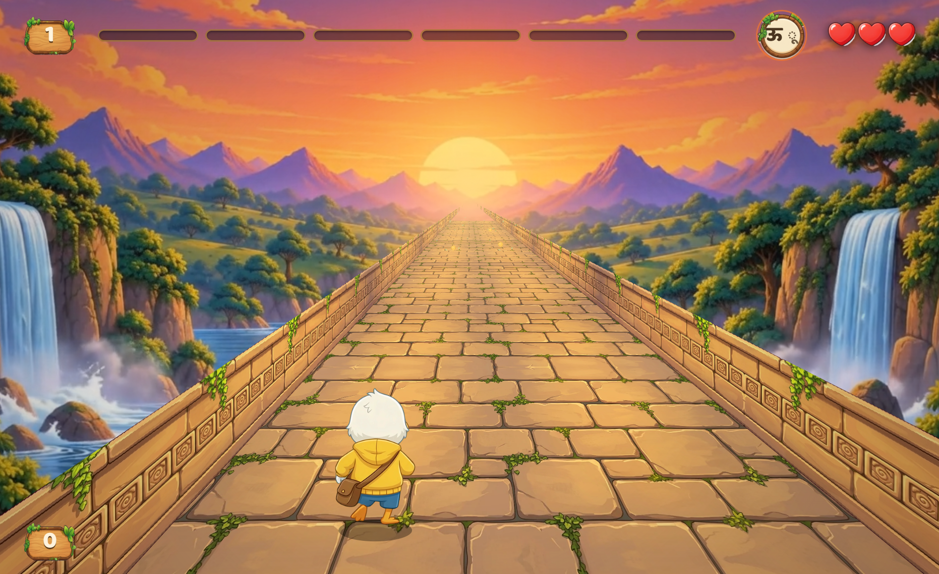
Notes:
अं (ं) वाले शब्द
अंग
रंग
संग
बंदर
जंगल
पतंग
संतरा
चंदा
घंटा
लंबा
अः (ः) वाले सरल शब्द
प्रातः
पुनः
अतः
4. छः
In this game we will ask child to fine अं Matra only not अः
1 level game only

Slide 21
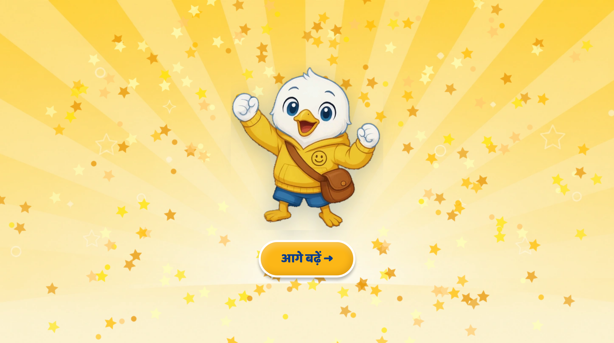
Page 17 · 17_CELEBRATION.png
Notes:
[DRAFT — generated from the card, in the format ratified in the S03 review (2026-09-30). Not yet reviewed by the SME.]
CELEBRATION — no text on the page. VO:
बहुत बढ़िया, दोस्त! तुमने कमाल कर दिया!

