Slide 1
MTG2A01_L02_S01 — टप्पू मेंढक की कूद (r3b, file4 shell + cover)
Page-by-page review · 17 pages
reviewing build 828c3b518edd (MTG2A01_L02_S01.html)

Slide 2
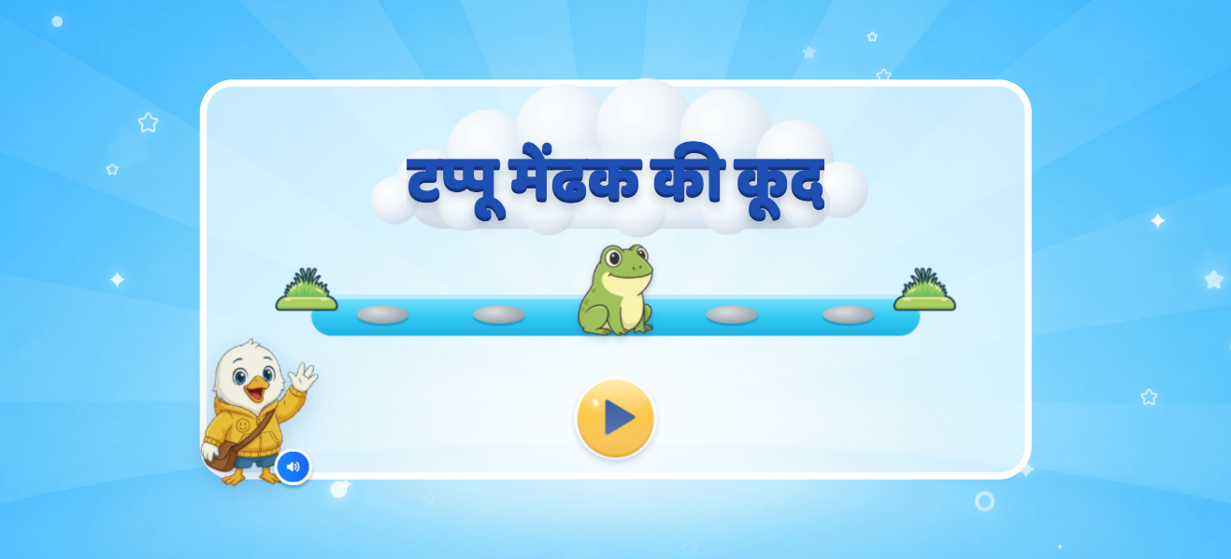
Page 1 · 01_landing.png
Recommendations
• Landing (deck s.3): title «टप्पू मेंढक की कूद», pond scene with the frog jumping over stones, «शुरू करें».

Slide 3
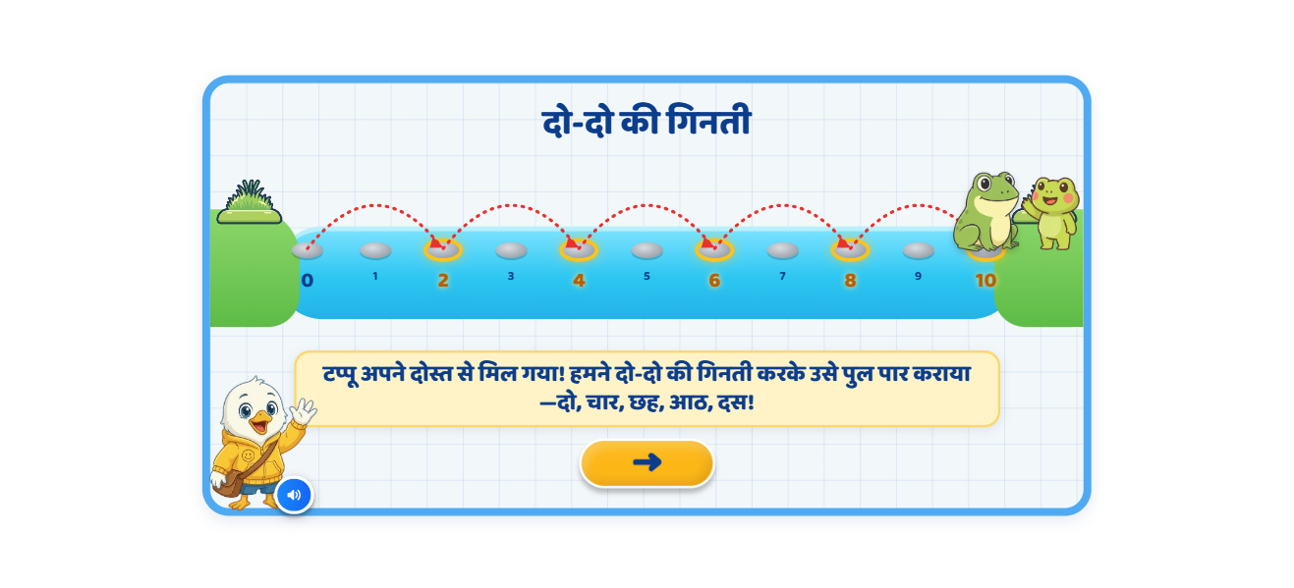
Page 2 · 02_T1_BRIDGE_2s.png
Recommendations
• Teach 2s (deck s.4): bridge 0–10, friend near 10; glow 0, light 1-2 / 3-4, jumps with red arcs, yellow marks; recap 2,4,6,8,10. ⚑ 4→6 jump added (deck skipped it).

Slide 4
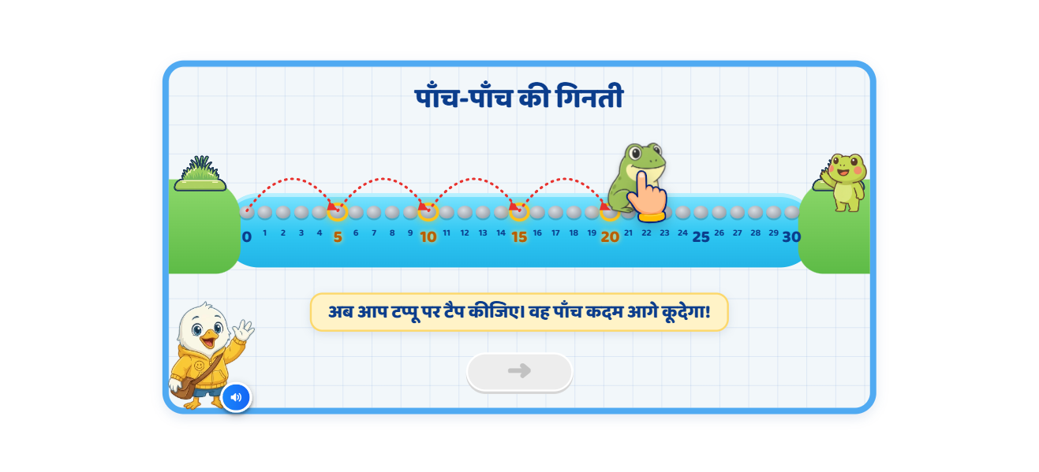
Page 3 · 03_T2_BRIDGE_5s.png
Recommendations
• Teach 5s (deck s.5): 0–30; light dot 1–5, jumps to 20, then the child taps टप्पू twice (20→25, 25→30); recap 5…30 with all six arcs.

Slide 5
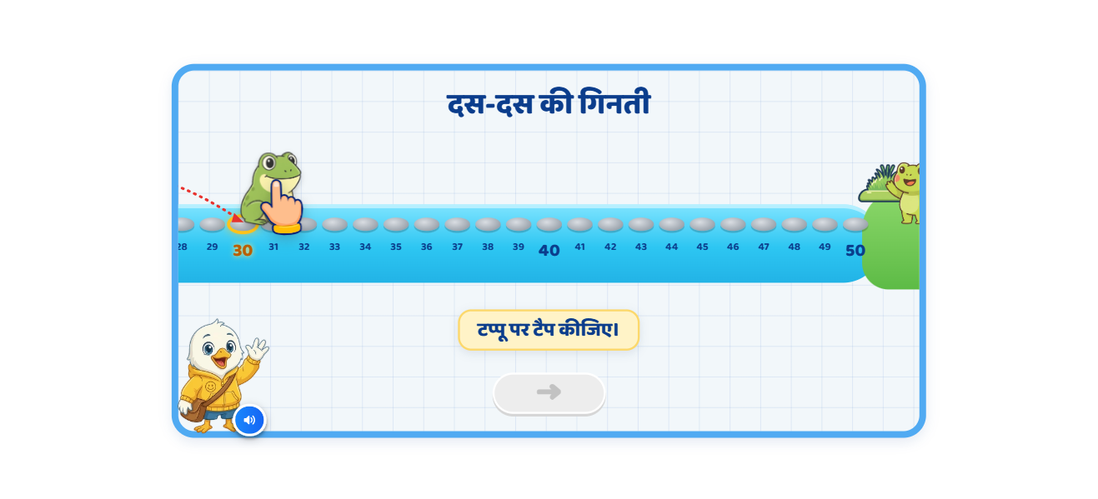
Page 4 · 04_T3_BRIDGE_10s.png
Recommendations
• Teach 10s (deck s.6): 0–50 with camera — zoomed out at the start, follows टप्पू, settles on 30–50 for the two taps, zooms out for the 10…50 recap.

Slide 6
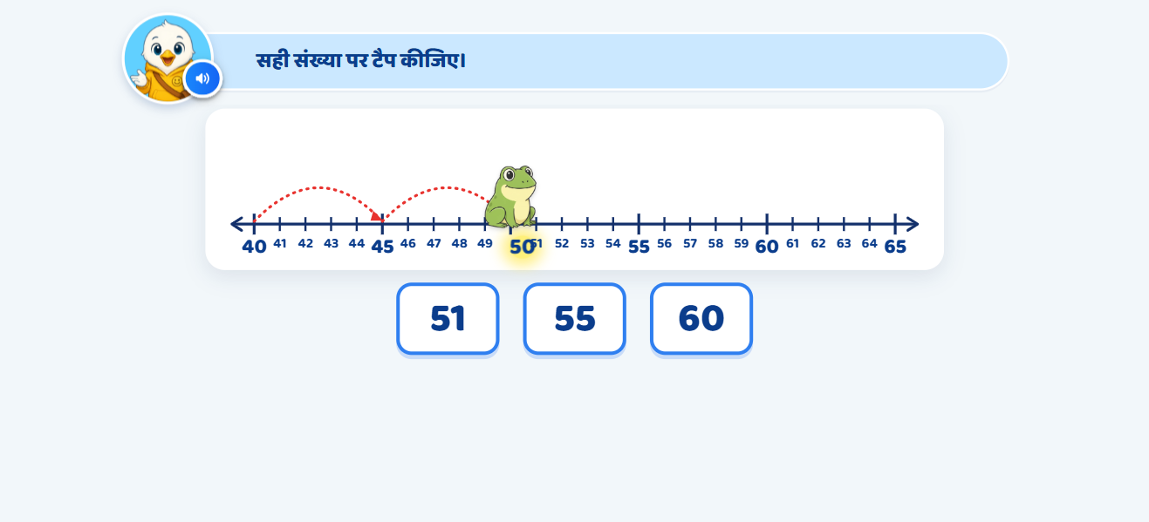
Page 5 · 05_G1_JUMP_PICK.png
Recommendations
• Guided Q1 (deck s.7): frog at 50, options 51 · 55 · 60. WA1 repeat, WA2 glow the 5 spaces, WA3 fade + pulse 55 + hand. Correct: frog jumps to 55.

Slide 7
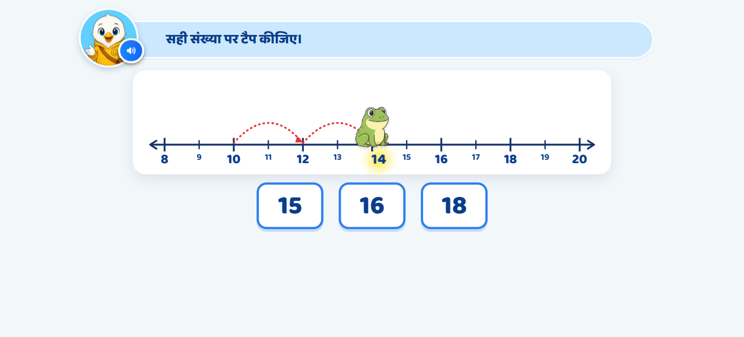
Page 6 · 06_G2_JUMP_PICK.png
Recommendations
• Guided Q2 (deck s.7 notes): frog at 14, options 15 · 16 · 18 → 16.

Slide 8
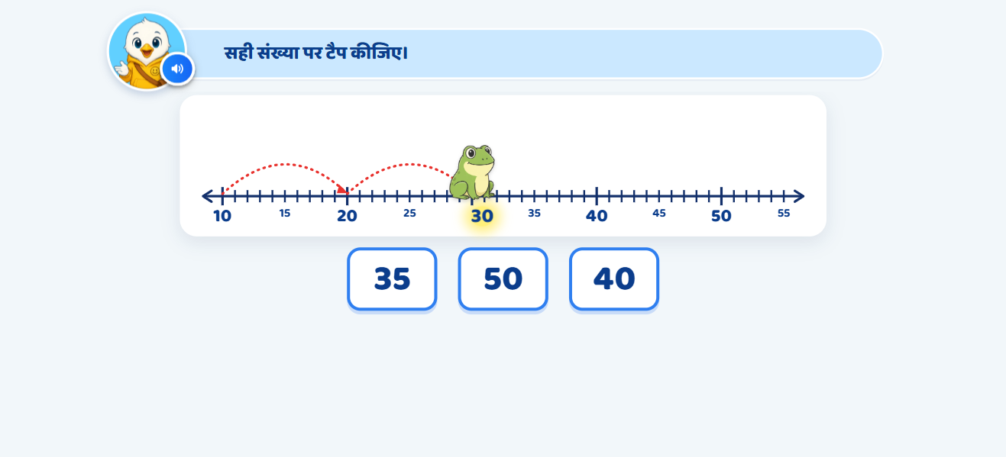
Page 7 · 07_G3_JUMP_PICK.png
Recommendations
• Guided Q3 (deck s.7 notes): frog at 30, options 35 · 50 · 40 → 40.

Slide 9
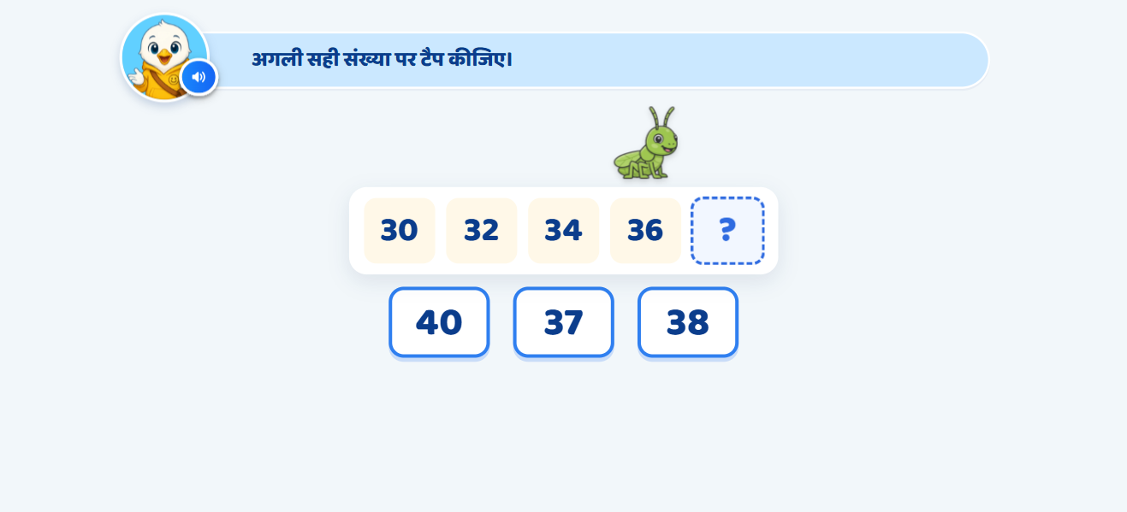
Page 8 · 08_G4_SEQ_FILL.png
Recommendations
• Q4 (deck s.8): grasshopper hops 30→32→34→36 with the VO, then «?»; options 40 · 37 · 38. WA2 = «संकेत» popup 34–40, +2, auto-closes after ~5 s.

Slide 10
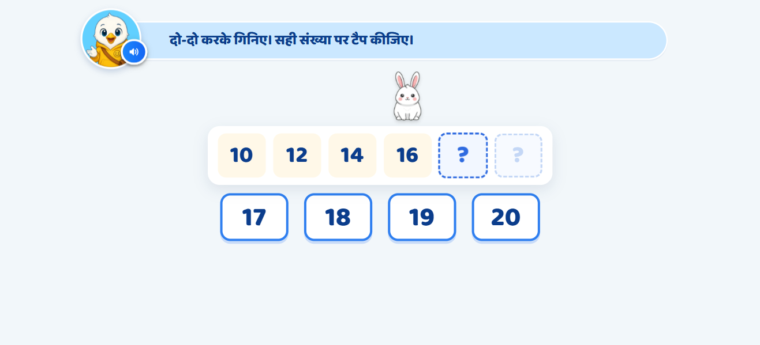
Page 9 · 09_G5_SEQ_FILL.png
Recommendations
• Q5 (deck s.9): rabbit, 10,12,14,16,?,? options 17–20; one blank at a time, used options fade; number-line hint popup per blank.

Slide 11
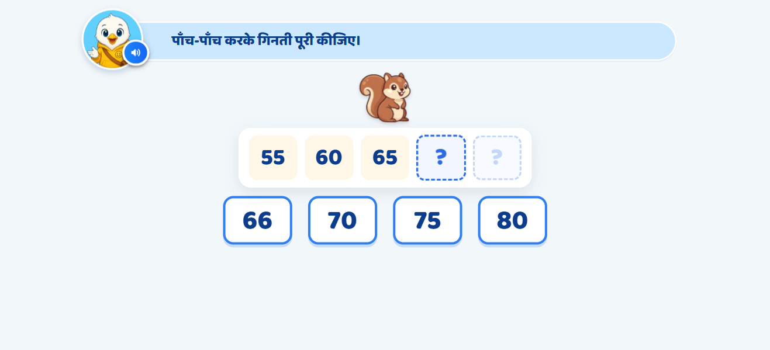
Page 10 · 10_G6_SEQ_FILL.png
Recommendations
• Q6 (deck s.10): squirrel (VO says गिलहरी), 55,60,65,?,? options 66 · 70 · 75 · 80; hint popups 64–70 / 69–75.

Slide 12
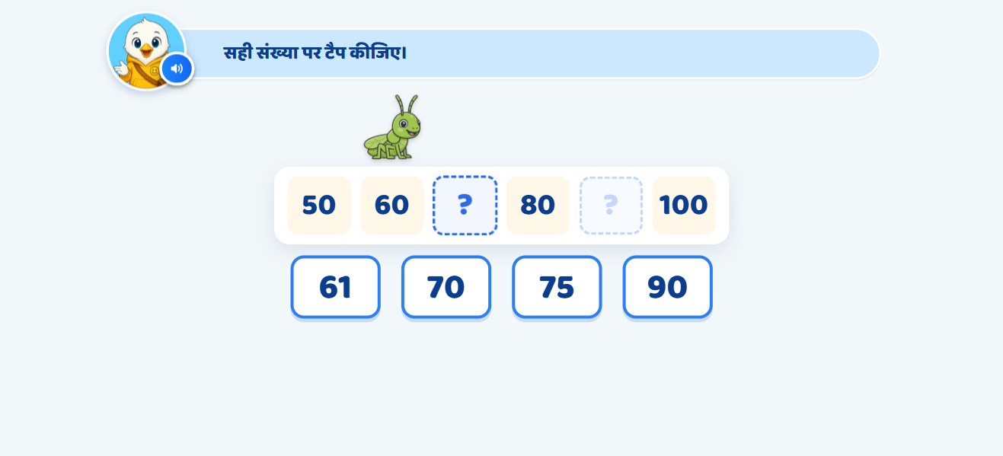
Page 11 · 11_G7_SEQ_FILL.png
Recommendations
• Q7 (deck s.11): grasshopper, 50,60,?,80,?,100 options 61 · 70 · 75 · 90; WA2 says «साठ से दस आगे गिनिए।» then the +10 popup.

Slide 13
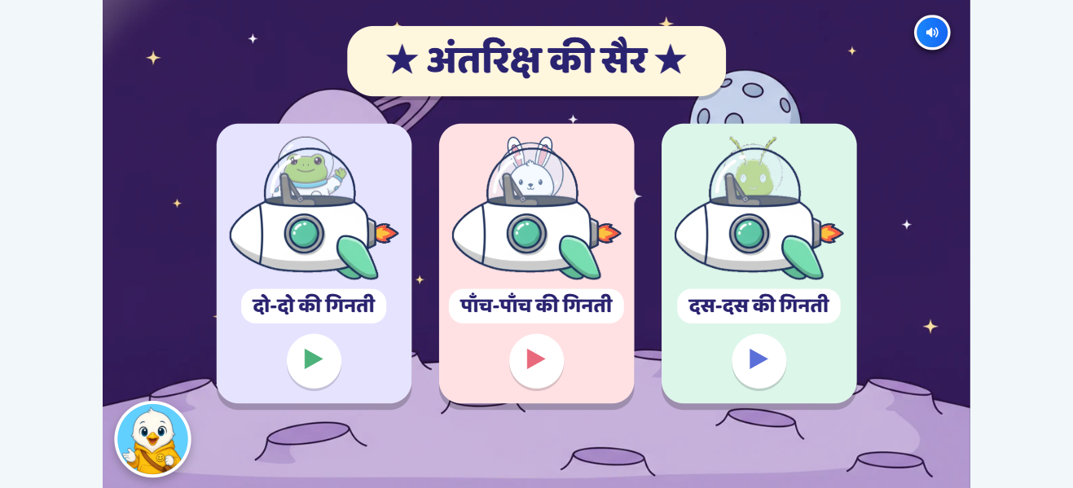
Page 12 · 12_GAME_menu.png
Recommendations
• Game «अंतरिक्ष की सैर» (deck s.12–16): menu 2s/5s/10s; 3 rounds each with the deck's number sets; drag astronauts into pods; wrong = wiggle + smoke; pods fly off; badge on the menu.

Slide 14

Page 13 · 13_CELEBRATION.png
Recommendations
• Celebration (deck s.17): unchanged.

Slide 15
Page 14 · SHELL_cover_idle.png
Recommendations
• —

Slide 16
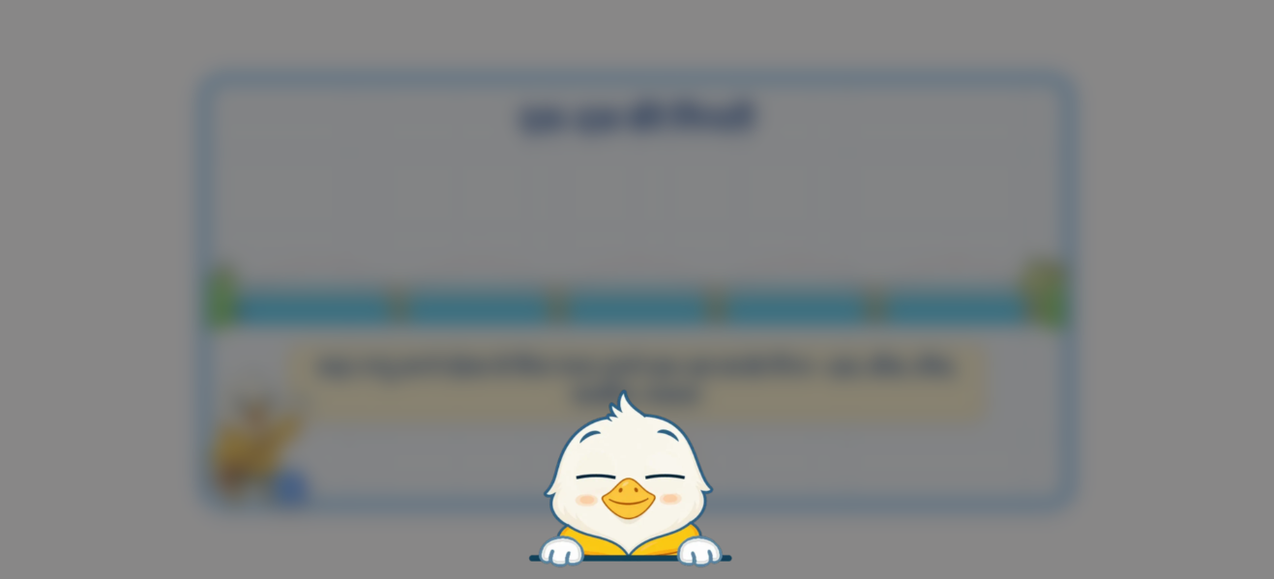
Page 15 · SHELL_gate_guided.png
Recommendations
• —

Slide 17

Page 16 · SHELL_gate_practice.png
Recommendations
• —

Slide 18

Page 17 · SHELL_gate_tutorial.png
Recommendations
• —

