Slide 1
Final Project Presentation
Zhangda Xu 2088192
Supervisor: Mohan Sridharan

Slide 2
Contents
Introduction
Task & Goal
Theory
Methods
Model selection
Implementation
Experiment

Slide 3
Introduction
Goal: agent completes a tabletop task
Method: Reinforcement learning
Project rationale:
  define a problem
  formulate it
  solve it

Slide 4
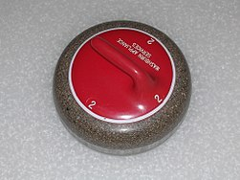
Task of curling
Curling:
  Players slide stones on a sheet of ice toward a target area which is segmented into four concentric circles.
Gameplay and RL
  simulated environment
  dedicated return signal
Simplified task for agent:
  Icy plane
  one throw without sweeping the rock
  Single round play
  Arbitrary location of target stones
  Best score for all scenarios
Fig 1. Curling stone

Slide 5
Goal
Build tabletop environment and agent.
Develop control methods of agent.
Train agent in the face of uncertainty.
Find policy for highest score in curling.

Slide 6
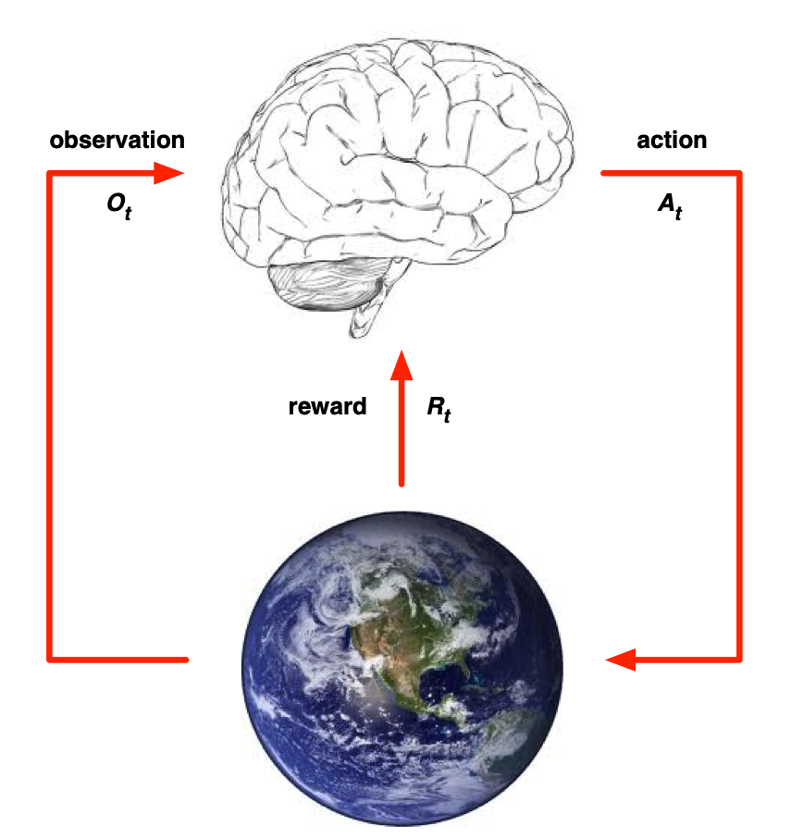
Reinforcement Learning
Reward: a scalar feedback R_{t}
At each step t the agent:
  Executes action A_{t}
  Observes environment O_{t}
  Receives reward R_{t}
Advantages:
RL can deal with sequential data (non i.i.d.).
RL has no supervisor but a returned reward.
RL incorporates Interactions between agent and environment.
Fig 2. Environment and agent

Slide 7



Markov Decision Process
MDPs formally describe an environment for RL.
A state S_{t} is Markov if and only if:
A MDP is an environment in which all states are Markov.
  A: a finite action space to choose from.
  P: a state transition probability matrix:
  R: a reward function for each state-action pair:

Slide 8




Tabular Representation
Policy: maps states to a probability distribution over actions.
For an episodic MDP, the state value function is the expected return starting from state s, following policy π:
where return G_{t} is the total discounted reward from step t:
The action-value function is the expected return starting from state s, taking action a, following policy π:

Slide 9

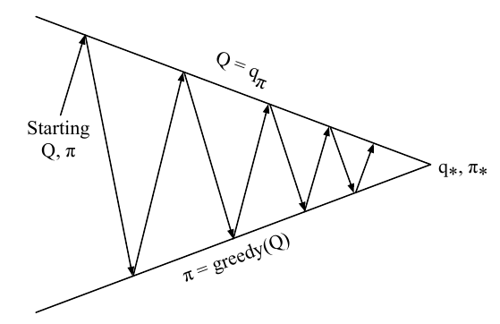
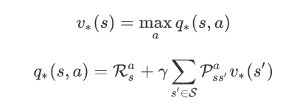
Generalised Policy Iteration
Bellman expectation equation with one-step lookahead DP:
Bellman optimality equation:
Finding the best action-value
and the best policy.
Fig 3. GPI

Slide 10
Task & Goal II
Given the environment and agent:
Accumulate reward in sequential states.
Find the maximum total return G_{t}.

Slide 11
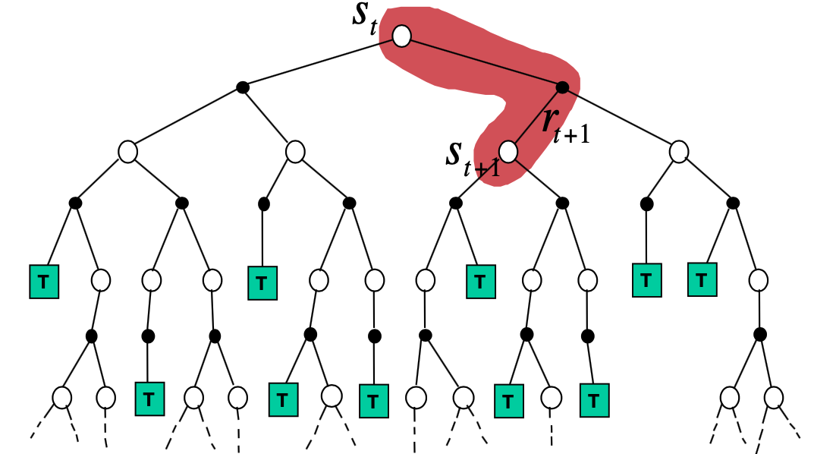
Temporal-difference Learning
Goal: learn policy value function from experience under policy π.
Update the state value online towards estimated return:
Bootstrapping: learn from incomplete episodes.
Sampling: update with only one sample.
TD(0) converges to MLE solution.
Fig 4. TD backup

Slide 12

Policy Gradient Methods
Approximation: use parameters θ to generalise state-action pairs.
Policy gradient algorithms search for a local maximum in any policy objective function by ascending the gradient of the policy w.r.t. parameters.
For any differentiable policy, any of the policy objective functions, the policy gradient to full MDP is given as:
Update parameters online using SGD.

Slide 13



Actor-critic
Learning off-policy
Critic: Updates action-value function parameters w.
Actor: Updates policy parameters , in direction suggested by critic.
We need a policy gradient method with lower variance.
  Using estimation instead of returned action value:
  Using advantage function instead of action-value:

Slide 14
Task & Goal III
Given the states and actions:
Approximate the reward for each action.
Optimise the policy on curling gameplay.

Slide 15

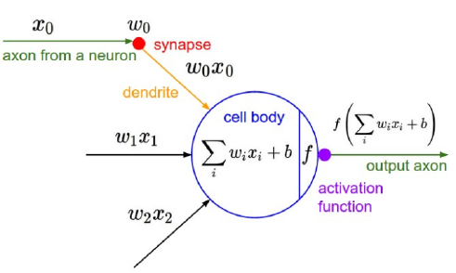
Multi-layer Perceptron
Feedforward neural network as universal approximator (Cybenko, 1989)
Multi-layer perceptron (MLP) with at least one hidden layers:
Deep learning applications:
Computer vision
Natural language processing
Prediction
Synthetic generator
Fig 5. Multi-layer Perceptron

Slide 16
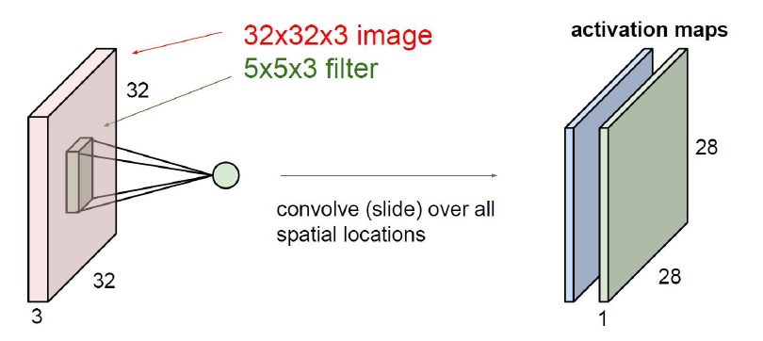
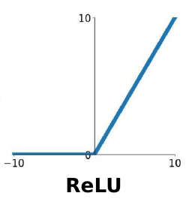
Convolutional Filter
ConvNet architecture:
  Convolutional 2D
  ReLU activation
  Fully-connected
Frame differences:
  Episodic control task
  Inference for velocity
End-to-end RL:
  Pixel input → ConvNet → Learning output
Fig 6. Conv layer
Fig 7. ReLU activation

Slide 17
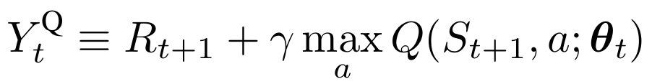
Deep Reinforcement learning
Standard policy update step in Q-learning:
Q-learning (Watkins, 1990) uses the target:
TD-Gammon (Tesauro 1995)
Deep Q Network (Mnih 2015):
  Atari environment
  For a given state s
  Outputs a vector of action values Q(s,·; θ).
  Read input directly from the screen frames.
  Minimising the loss between action-value and target.

Slide 18
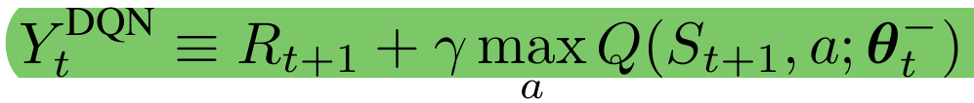
Deep Q-learning
Target network: parameterised by θ⁻
  parameters copied every τ steps from the online network
  kept fixed for other steps
  update target:
Memory buffer:
  store samples of experiences
  use random mini batch of experiences for update
  break correlation between sequential data
    better convergence

Slide 19
Task & Goal IV
Observe the state from pixel input.
Save memory after each throw.
Update target and policy after several throws.

Slide 20
Deep Deterministic Policy Gradient
Deterministic action function
  unstable stochastic policy decision
  slow optimisation for a_{t}
Randomised exploration noise
  continuous exploration
Batch normalisation
  minimise covariance shift
  whitening features
Action repeat
  3x simulated timesteps to infer velocity
Soft update
  slowly update the target parameters online

Slide 21
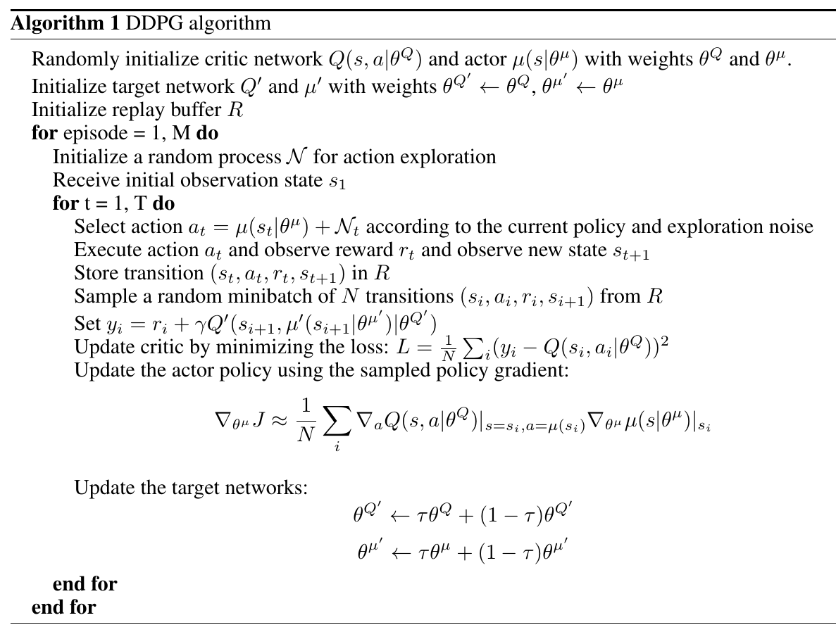
DDPG

Slide 22
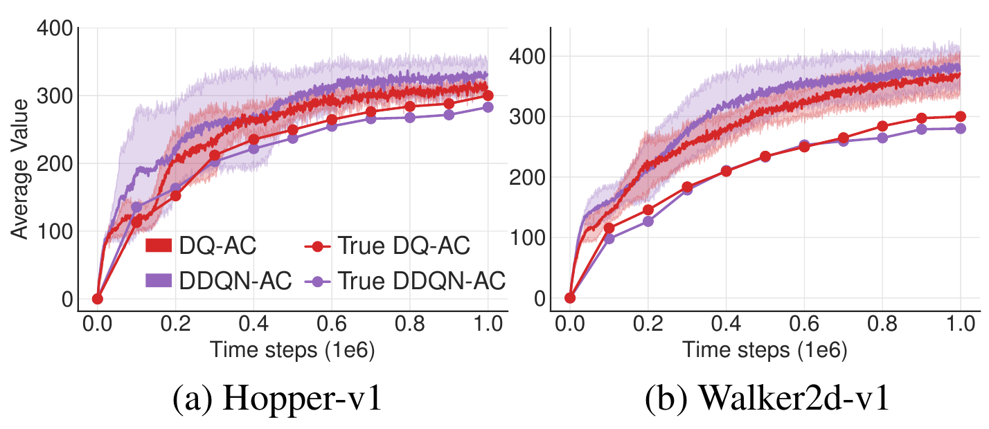
Twin-delayed DDPG
Overestimate bias in actor-critic
Fig 8. TD3 vs DDPG

Slide 23

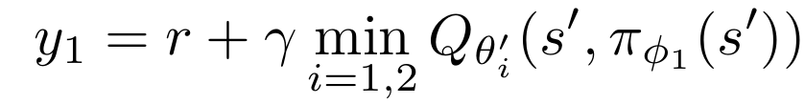
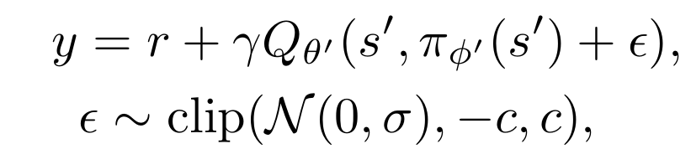
TD3
Fight against high variance value estimate:
  Double Q-learning: value estimation disentanglement
  Clipped Double Q-learning:
  Delayed policy update:
    Policy network should be updated at a lower frequency than the value network, to first minimise error before introducing a policy update.
  Target Policy Smoothing Regularization:

Slide 24
Implementation
|— Pybullet Client (no GUI)
  |— puck.urdf - self-control
  |— table.urdf - surface
  |— stone.urdf - inertia
|— gym-curling
  |— curling_env.py
  |— __init__()
  |— step()
  |— reset()
  |— render()
|— Algorithm
|— FIFO buffer
|— ddpg.py
|— td3.py
|— PyTorch
  |— Critic
  |— Actor
  |— Target critic
  |— Target actor

Slide 25
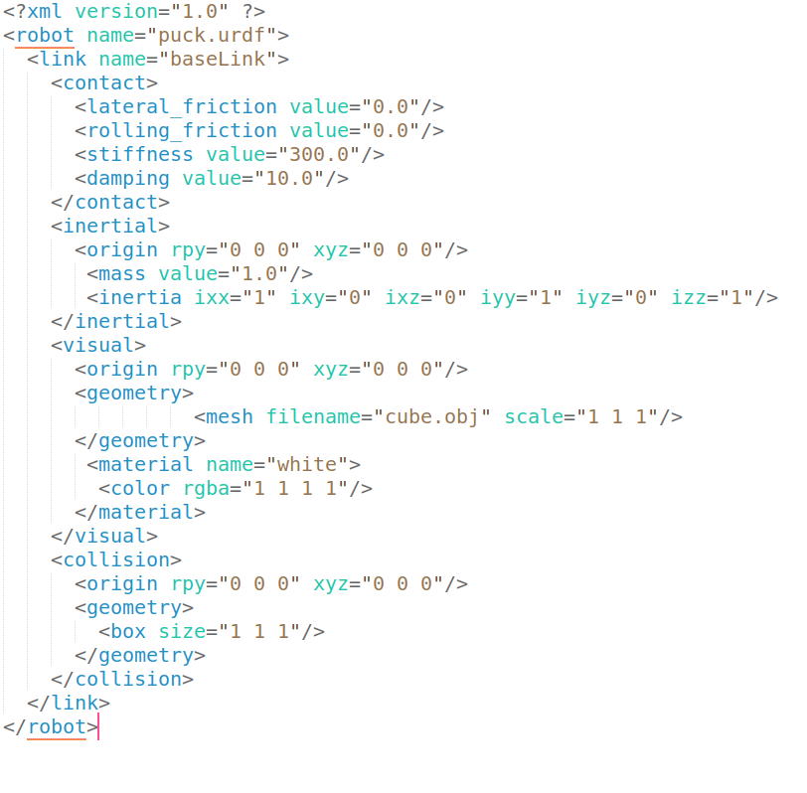
PyBullet Gym Environment
urdf models
Fig 9. Stone/ Puck
Fig 10. Tabletop

Slide 26
Hyperparameters
Action space | (-1,1) * 5
Observation space | (-1,1)^3
Reward definition | R = [0, 1, 2, 3, 4]
Viewpoint | 0.7m upon centre
Action noise span | 0.1
Memory buffer size | 10^6
Epochs | 100
Episode | 1000

Slide 27
Training
Randomly initiate environment and target stones.
Place the ‘puck’ on the line.
Impose random starting velocity.
Render final environment state after collison stopped.
Store the state in memory buffer.
Update internal policy.

Slide 28
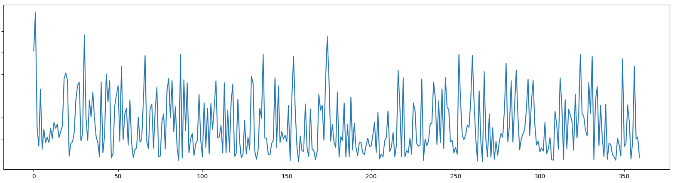
Fig 11. Training episode reward

Slide 29
Preliminary testing
Environment | TD3 | DDPG | SAC | DQN (disc)
HalfCheetah | 9636.95 ± 859.065 | 3305.60 | 2347.19 | -15.57
Walker2d | 4682.82 ± 539.64 | 1843.85 | 1283.67 | 2321.47
curling | 9.2144 ± 0.5132 | 8.7313 | 6.5535 | N/A

Slide 30
Future Experiment
LSTM variant comparison
Complete performance evaluation
Refined gym environment GUI
Other modifications:
  intrisic exploration
  prioritised experience replay
  evolution strategies

