Slide 1
Workflow for remote repos: GitHub
Various
ICT40120 Certificate IV in Information Technology
Applied Programming in Python
ICTICT449 | Use version control systems in development environments
ICTPRG430 | Introductory object-oriented techniques

Slide 2
Session Contents
Forking
Pull request
Working with remote branches
Fundamental branch lifecycles

Slide 3

Forking
GitHub (not git) feature
Fork -> clones a repo to somewhere else on GitHub
GitHub maintains a link back to the forked repo and a count of forks

Slide 4
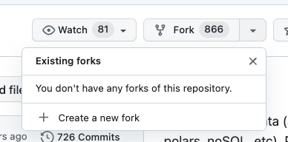
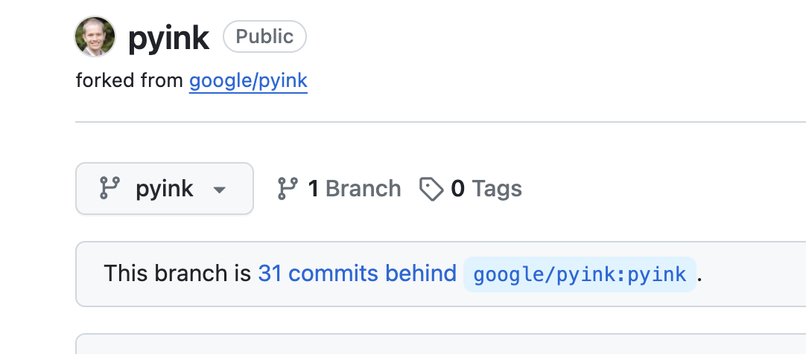
Fork: How to
select to fork
GitHub maintains a link to the origin of the fork

Slide 5


Why fork?
Go your own way: Take a repo in a direction of your choosing, experiment, learn, grow and don’t ever look back!
Branch (from the outside looking in): You can use a fork almost like a branch. But you only need read permissions to the repo to start working.
Notes:
Another song alternative: https://www.youtube.com/watch?v=_AU1yyy_At4

Slide 6
Forking in enterprise
Recall that forking is a GitHub feature, though other Git hosting solutions have similar features
Common practice in open source development
Less common in enterprise where branching provides centralized management and permissioned

Slide 7
Fork vs. Branch: Summary
 | Fork | Branch
Purpose | Create a separate copy of a repository for significant changes or different directions | Develop new features or fix bugs without disrupting the main codebase
Relationship to the original codebase | Soft or no links to originating repository | Direct part of the repository
Ownership | Owned and managed by the user who created the fork | Owned and managed by the repository owner
Scope of changes | Typically involve significant changes | Typically involve smaller changes
Collaboration | Used to develop ideas in isolation from the main team | Used to develop ideas that the main team is working on
based on: https://www.ssw.com.au/rules/fork-vs-branch/

Slide 8
Pull request
Imagine you created a fork or branch or both
You think your changes are good enough for the main branch/repo
What should happen next?
Options:
Merge and see
Propose, discuss/review, then merge

Slide 9
Merge and see
In “merge and see” your merge your changes and hope for the best
It’s not as crazy as it sounds since Git is meant to provide us with fail safes: such as?
But:
You must have permissions to merge into the repo/branch
May not meet quality standards and organizational requirements
“silent but deadly”

Slide 10
Review before merge
Many people and organizations want to review proposed changes prior to merging
Enhances quality: ensuring code that gets “mainlined” has been proofed
Encourages collaboration: multiple people have a stake in a change
Improves security: we can have more authors than committers since you can have a ‘gatekeepers’ who are the only ones allowed to merge a proposed set of a changes to given repos and branches

Slide 11
Pull Request
GitHub feature (with similar features in other git hosting)
Rather than push to a target repo (“production”) or merge to a production branch, propose the target repo pulls from a secondary repo or branch
Hence “pull request”: request a pull from your branch instead of pushing to the target repo/branch

Slide 12
Pull requests in enterprise
Common though not ubiquitous
Other code review strategies may be used
Popular for its governance and visibility
Highly suitable for remote work

Slide 13

Anatomy of pull request
Has a target repo/branch <=> source repo/branch
Has a state: Open, Closed, Merged, Draft
Presents a moving Δ between the target and source
Contains an area to review and discuss, including in line comments
Can be a trigger for automated checks and workflows

Slide 14
In conjunction with protected branches
GitHub allows you to specify that branches with a given name pattern are protected
Require pull request before merge
Require X number of reviewers or particular reviewers before merge

Slide 15
Remote branch
When you create a branch, even on a repo with a remote, it is only created locally and it is not, by default, tracked by any remote branches
You must –set-upstream to create (if it doesn’t exist) and use a remote branch
The next activity will help you with this

Slide 16
Activity
Use the markdown activity associated with this lesson and complete a pull request

Slide 17
Development workflows
Each organization will have its own way of working with Git
All approaches are designed to optimize for:
collaboration
quality
security
stability
auditability
Different priorities within these metrics shape different flows
No two organizations are the same
But a common git workflow, is GitHub flow

Slide 18

GitHub Flow: Typical Workflow

