Slide 1
Exoplanet Detection

Slide 2
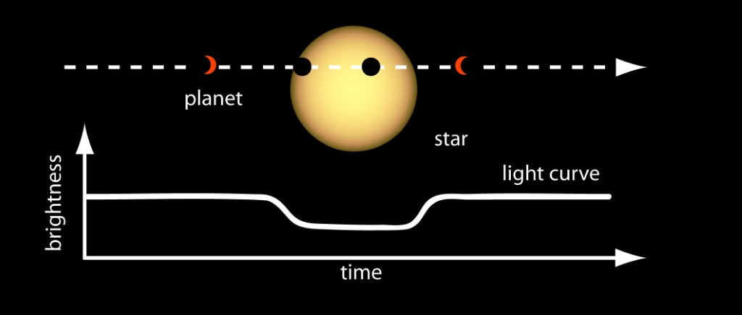
Problem Statement
3960 light curves
Column 1 is the label vector. Columns 2 to 3198 are the flux values over time.
33 confirmed exoplanet-stars and 3928 non-exoplanet-stars.

Slide 3
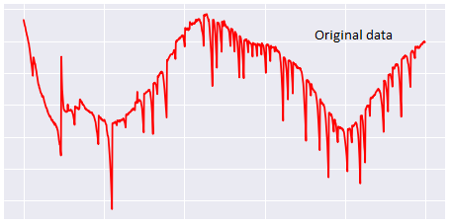
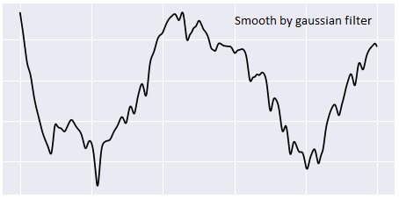
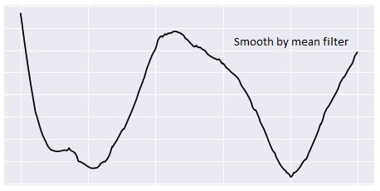
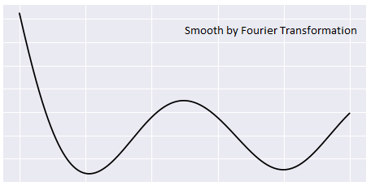
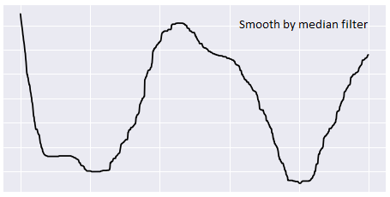
Preprocessing
Standardise the Data
Mean = 0; Variance = 1

Slide 4
Why did Machine Learning Algorithm failed?
Method | F1 score (macro)
Xgboost + original data | 0.709
Xgboost + gaussian filter data | 0.649
Xgboost + uniform filter data | 0.483
Xgboost + Fourier filter data | 0.491
Logistic Regression (all type data) | 0.498
SVM (RBF Kernel) | 0.498
Construct Features from the data and use them for classification

Slide 5
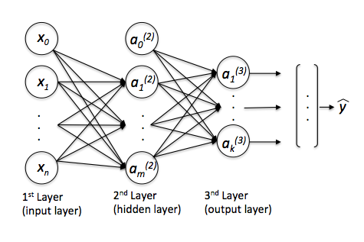

Deep Representation Learning
Multi Layer Perceptron
Score - .69

Slide 6
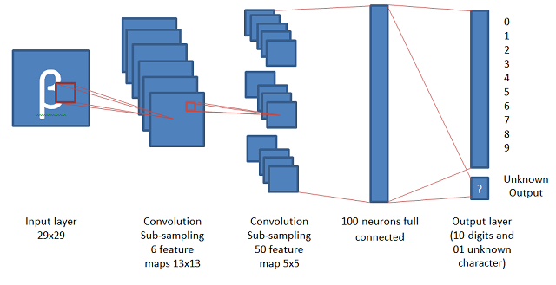
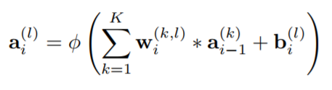
Convolution Neural Network
Score - .92

Slide 7
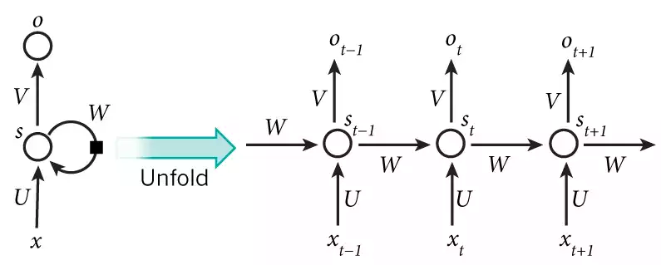

LSTM
Score -.75

Slide 8
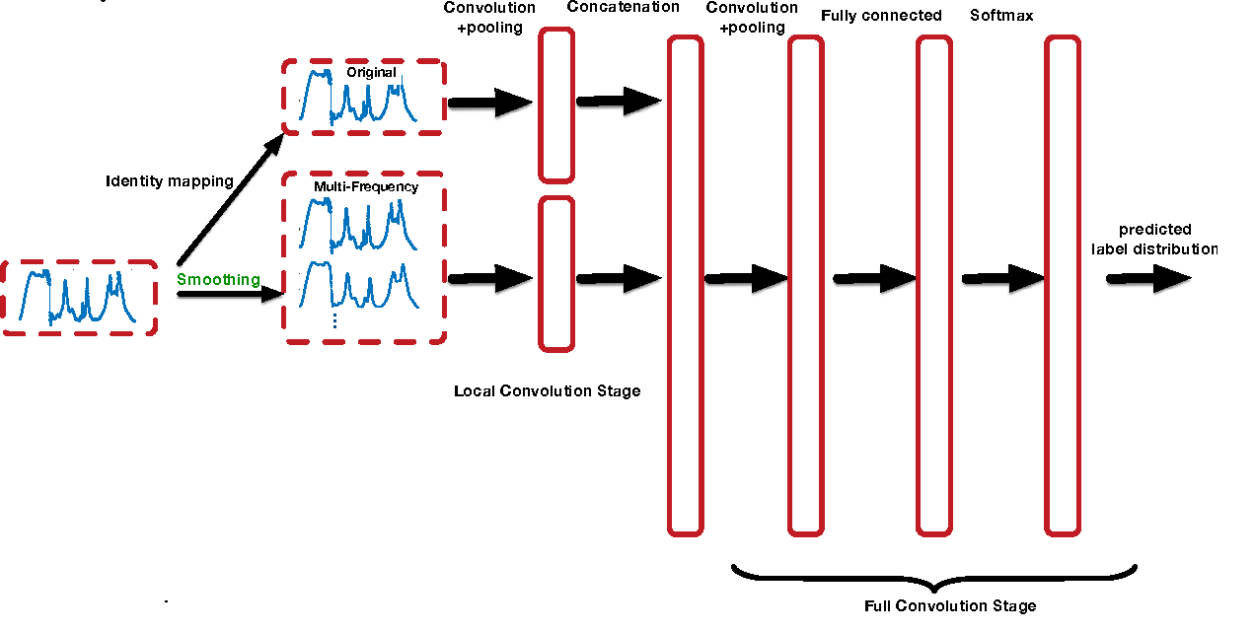

Slide 9
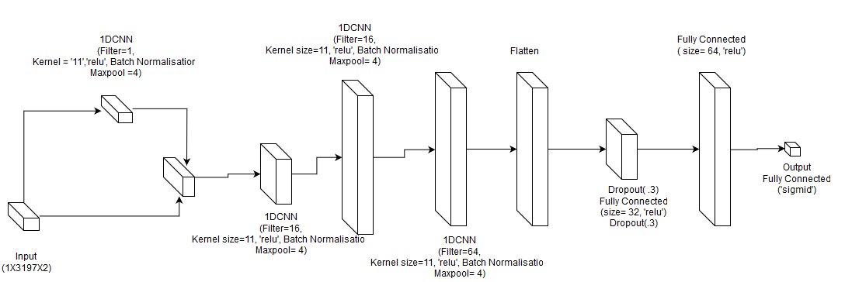
Skip Connection

Slide 10
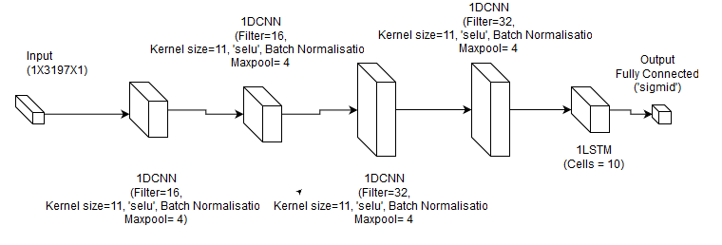
Final Architecture- CNN+LSTM- Model 3

Slide 11
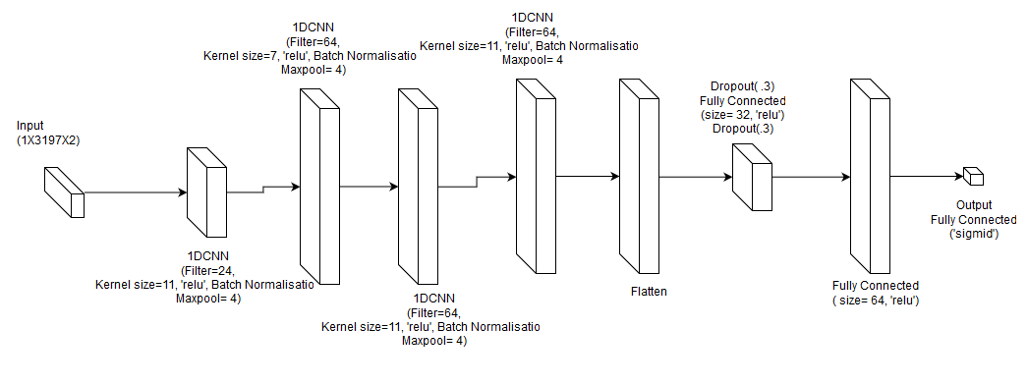
Final Architecture- CNN2- Model 2

Slide 12
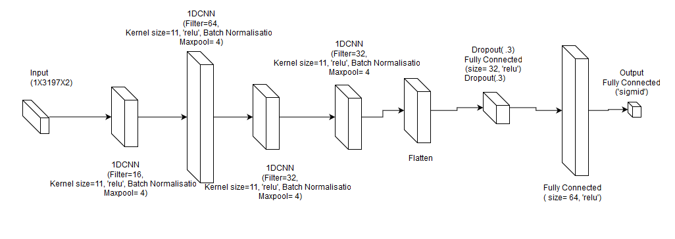
Final Architecture- CNN1 - Model1

Slide 13

Training
Batch Generator - Returned 48 examples (16 exoplanet , 32 non-exoplanet)
Binary Cross Entropy
Adam Optimiser - 35 epochs , Learning Rate= .001
Next 10 epochs, Learning Rate= .0001
Next 10 epochs, Learning Rate= .00001

Slide 14
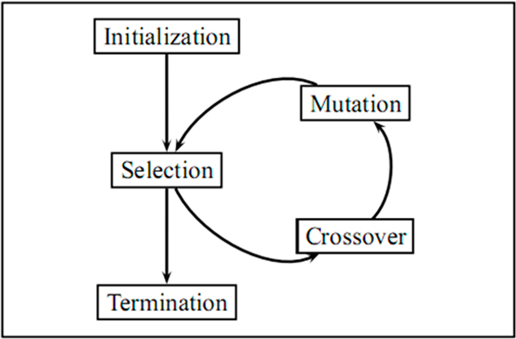
Genetic Algorithm
Hyperparameter tuned-
Activation, Dropout, No of Filter,
Kernel Size, No of Layers.
Total Permutations - ~45k
Generations = 30
Population = 30
Retain percentage = 40%

Slide 15
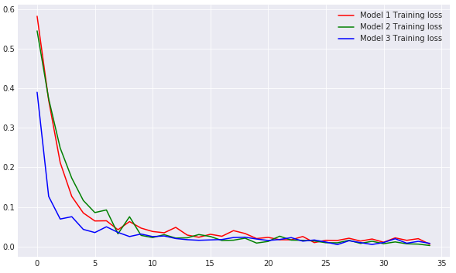
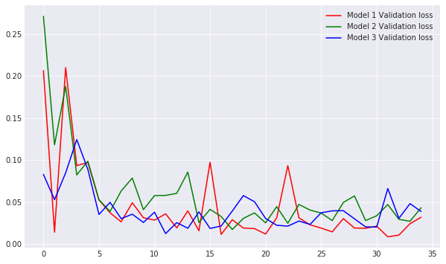

Slide 16
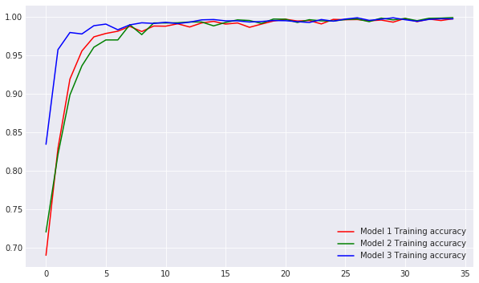
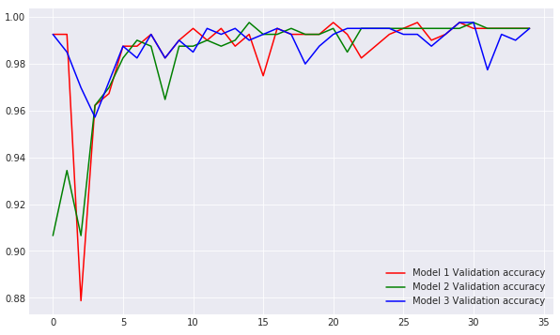

Slide 17
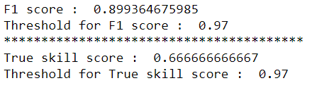
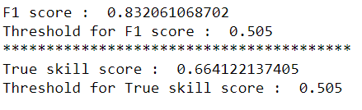
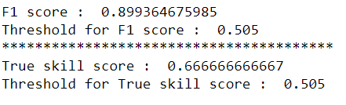
Final Result
Model 1
Model 2
Model 3

Slide 18
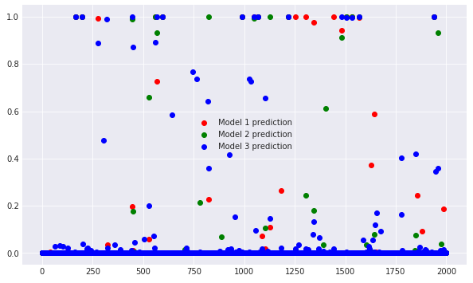
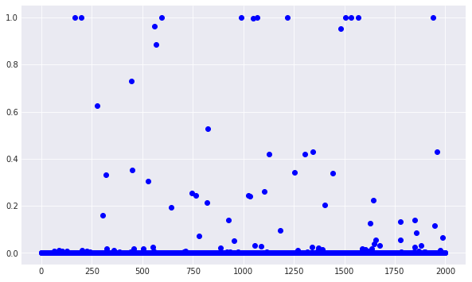
Ensemble
Prediction using individual model
Prediction using ensemble of models

Slide 19
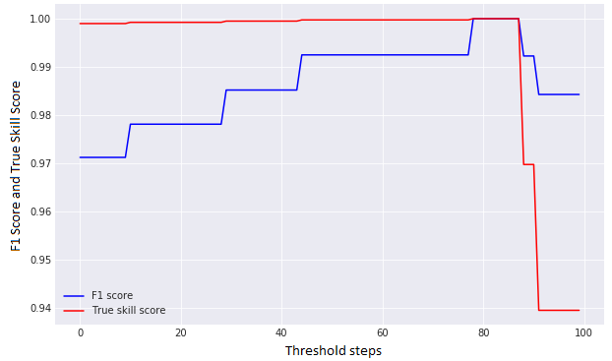
Setting the Threshold for the Best F1 and True Skill score

Slide 20
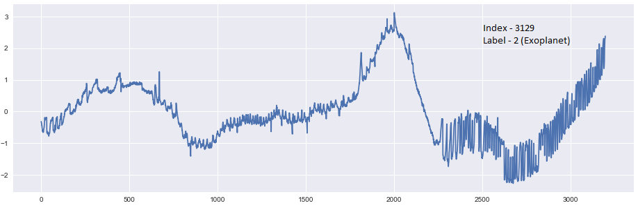
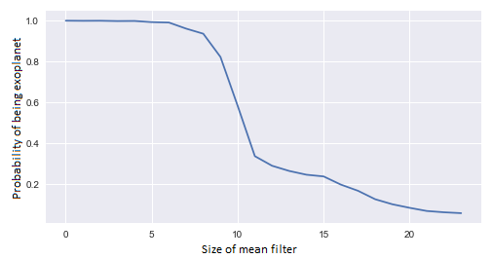
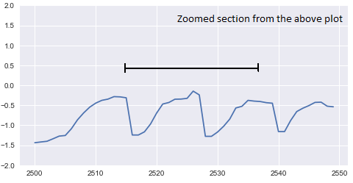
Sanity Check

Slide 21
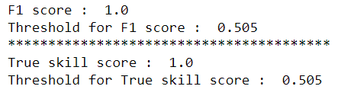
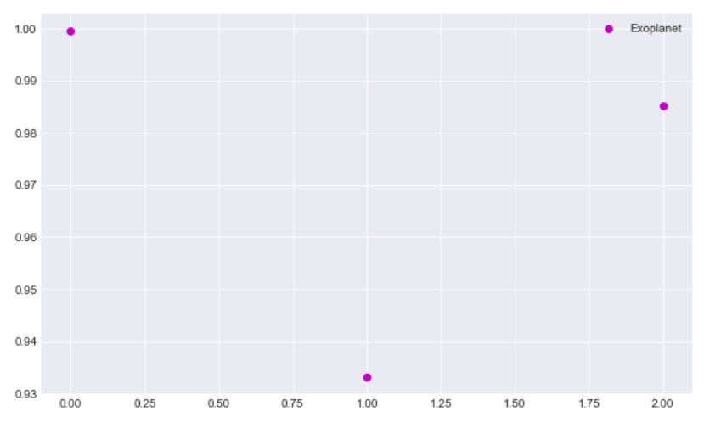
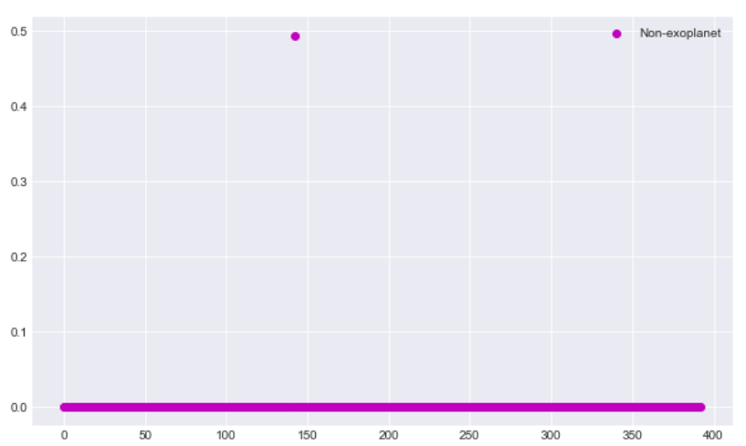
Skip Connection

Slide 22
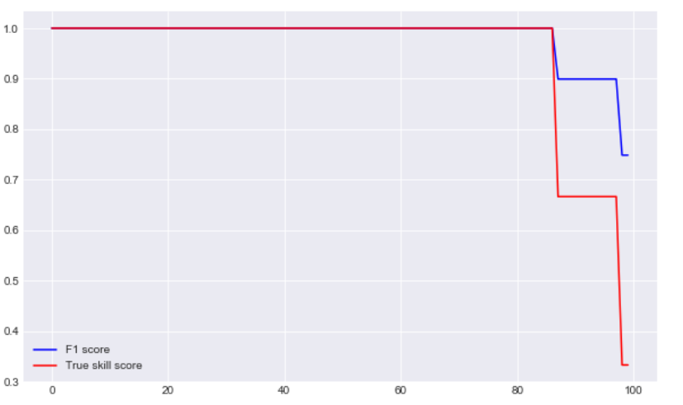

Slide 23
Thank You

